Slide 1
CONNECTICUT STATE DEPARTMENT OF EDUCATION
CSDE Data & Performance Summit
2018

Slide 2
CONNECTICUT STATE DEPARTMENT OF EDUCATION
ED162 Non-Certified Staff File
https://www.csde.state.ct.us/public/help/Ed162/default.asp
2018

Slide 3
What is it ?
The Non-Certified Staff file is a data collection of paraprofessional staff as of October 1 every school year.
CONNECTICUT STATE DEPARTMENT OF EDUCATION

Slide 4
ED162: Non-Certified Staff Data
Collect para-professional staff in nine instructional and eleven non-instructional categories.
Used for federal and state grants under the Connecticut General Statues Section 10-20 and 10-220. Statutory Reference C.G.S. Section 10-4.
Have no changes in the 2018-19 school year.
Include regular non-certified, contracted food service, and transportation staff (e.g., employees of Laidlaw, Dattco, Marriott, etc.).
Report full-time equivalent (FTE) for a full-time position as 1.0 and a part-time position as a percentage of 1.0 (e.g., 0.4, 0.6, etc.).
CONNECTICUT STATE DEPARTMENT OF EDUCATION

Slide 5
Instructional Staff:
Pre-Kindergarten,
Kindergarten,
Regular Program,
Special Education: age 3-5, and age 6-21,
ESL/Bilingual,
Other Program,
Reading Instructional Assistant,
Library/Media Support Staff
CONNECTICUT STATE DEPARTMENT OF EDUCATION

Slide 6
Non-Instructional Staff:
Technical Staff,
School Nurse,
Other Student Support Services,
Professional Administrative Support Staff,
Auxiliary Support Staff, Maintenance,
Custodial,
Food Service,
Transportation,
Security,
Other
CONNECTICUT STATE DEPARTMENT OF EDUCATION

Slide 7
What are the ED162 data used for?
the District Profile and Performance Report (PPR replacing SSP): the October 1st snapshot;
the Connecticut Data Warehouse and other education-related websites;
research; and
federal reporting.
CONNECTICUT STATE DEPARTMENT OF EDUCATION

Slide 8
Common Problems
1. Computer got stuck in the ED162 application
An incompatibility issue between the ED162 and Internet Explorer. You're using a newer version of IE which blocks the old scripting in the page by default. You need to go into the Tools menu in IE and click View Compatibility Settings, then add "state.ct.us" to the list of sites, then refresh the page.
2. Can’t enter 0 FTE value while in ED162.
Please enter 0.001 FTE in order to continue.
CONNECTICUT STATE DEPARTMENT OF EDUCATION

Slide 9
Data Deadlines
Due Date Submission: (TIMELY):
October 31, 2018 Final Revision Date: (ACCURATE):
Freeze Date January 2, 2019
CONNECTICUT STATE DEPARTMENT OF EDUCATION

Slide 11
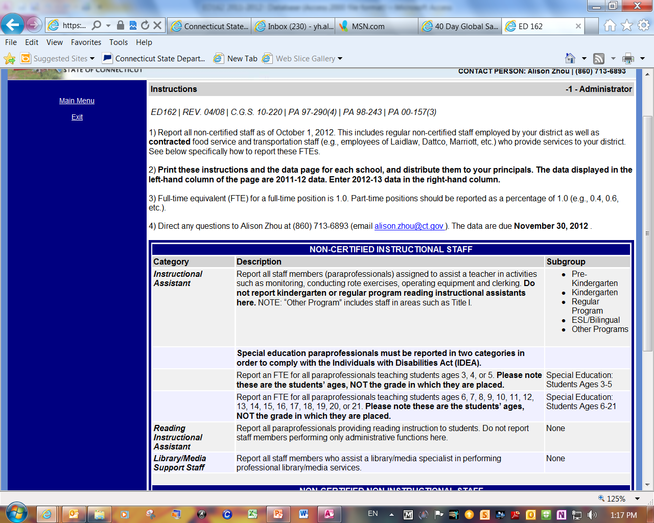

Slide 12
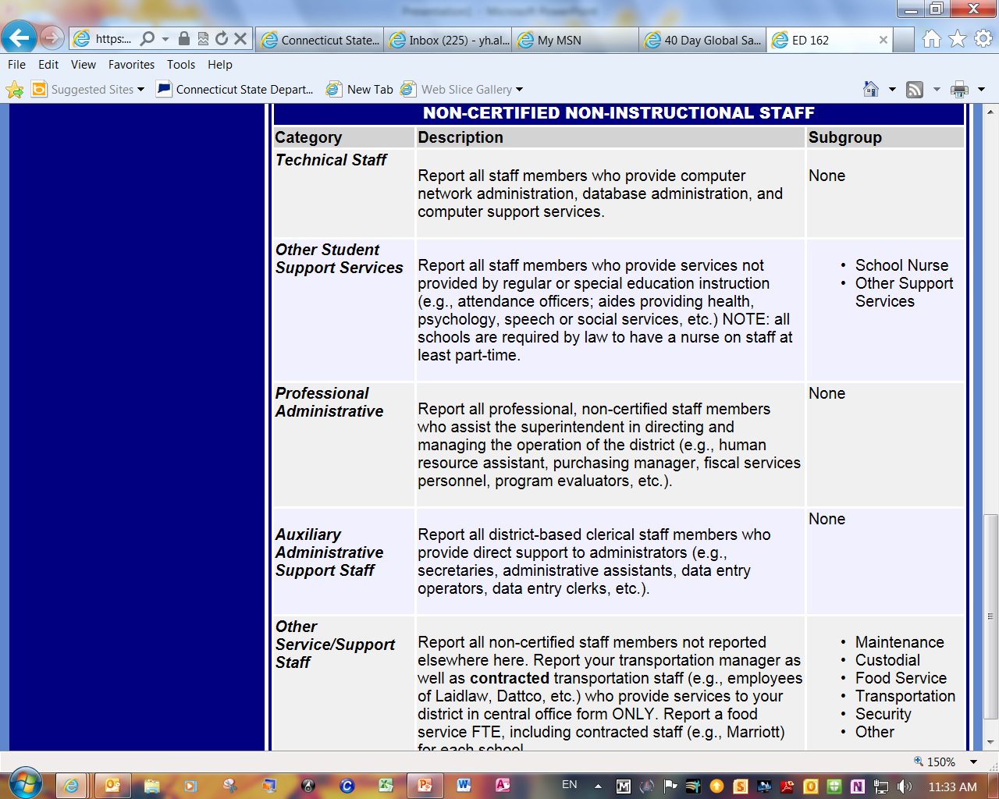

Slide 13
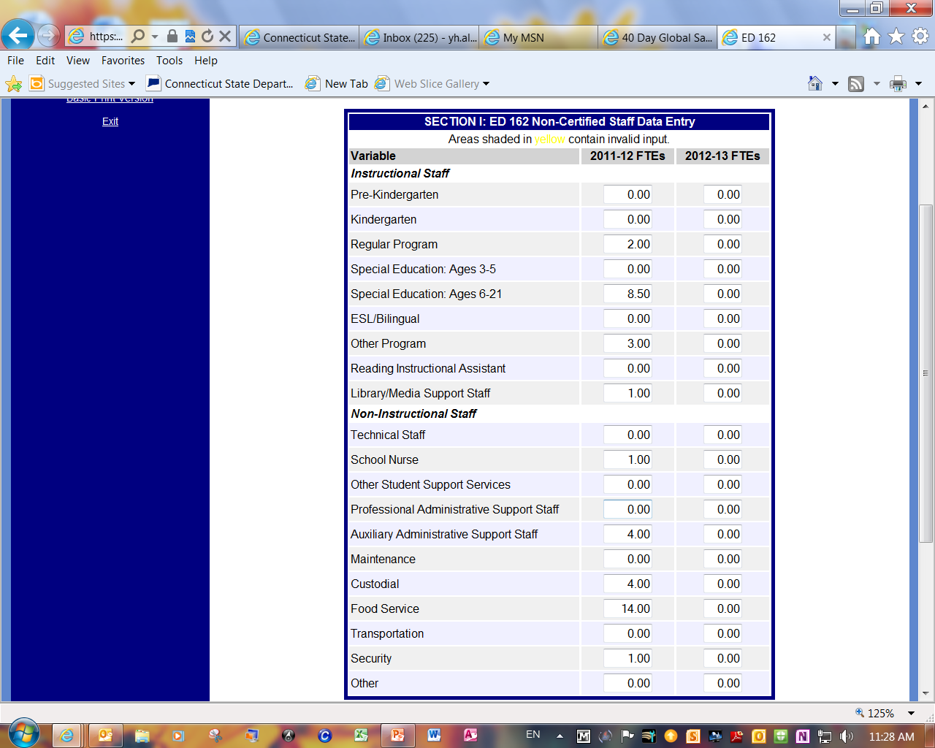

Slide 14
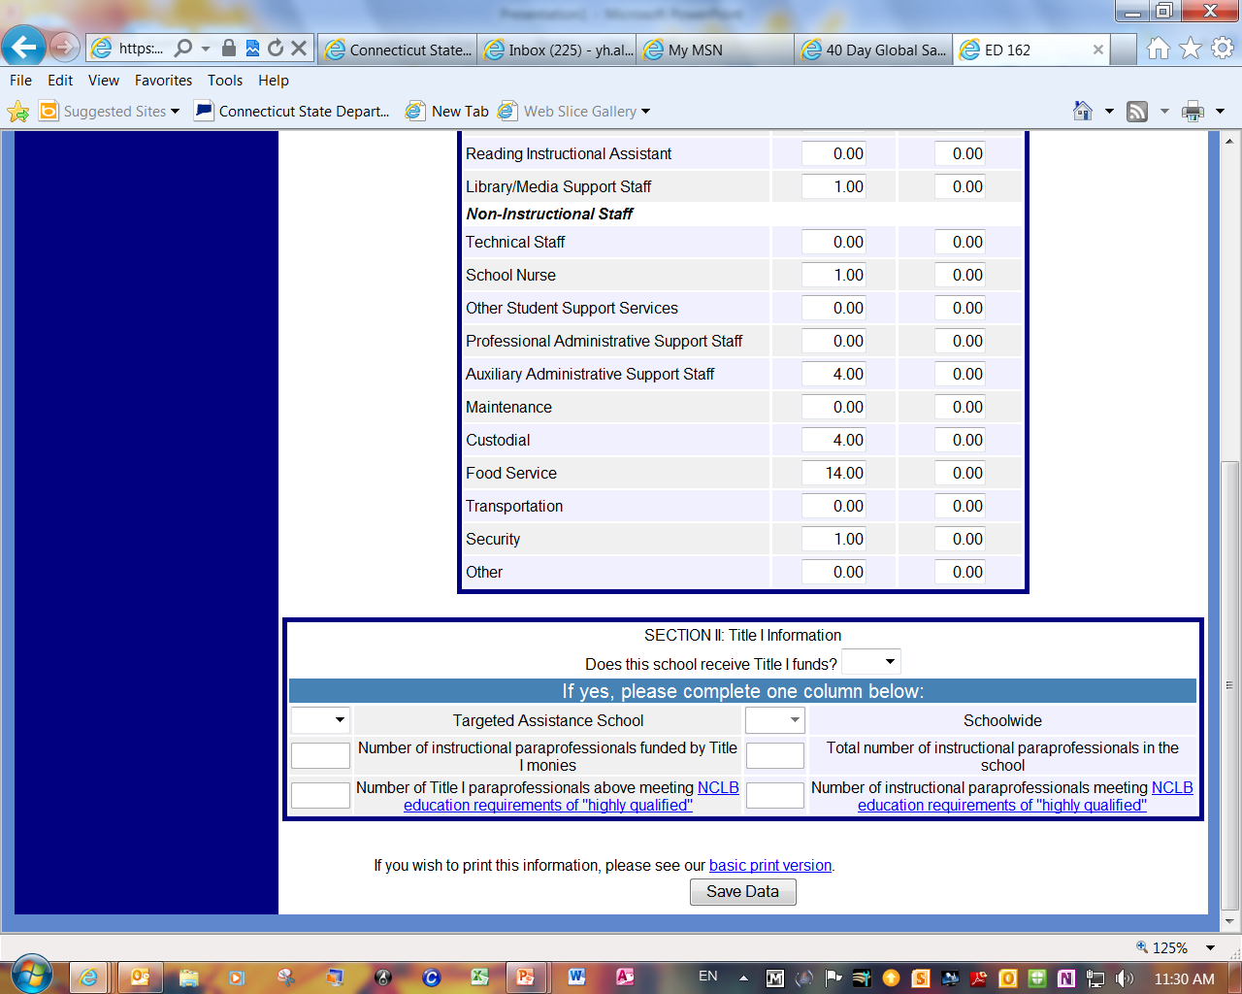

Slide 15
Final Steps
Run the reports to identify outdated or erroneous data elements.
Send the reports along with a copy of the instructions to each principal.
Ask them to provide current data.
Enter and edit records to reflect all FTE changes.
Complete by October 31st
CONNECTICUT STATE DEPARTMENT OF EDUCATION

Slide 16
Need help?
For Help, please contact:
SDE Data Manager/Analyst | Y.H. Alison Zhou | Alison.Zhou@ct.gov | 860-713-6893
CONNECTICUT STATE DEPARTMENT OF EDUCATION

