Slide 1
Staffing &
Reporting
CSDE Data & Performance Summit 2014
August 19, 2014

Slide 2
Educator Data System
(EDS)

Slide 3
About the EDS
The Educator Data System is a collection of information about people occupying roles which require certification, not just staff holding certification.
When a district hires a person at any time during the school year, a record must be created for that person as soon as possible even if the person does not hold an active certificate at the time of hire.
When a person leaves a district, the EDS file record must be updated with the leave information as soon as possible. Having duplicate records in the staff file (i.e., having it appear that a person is working full-time in two different districts) negatively impacts other data systems.

Slide 4
How will EDS Data be Used?
EDS data will be used for:
Federal and state reporting;
District/School Profiles and Performance Reports;
Public reporting on the web;
Research;
The teacher quality analysis (HQT);
Certification and Teachers’ Retirement (TRB);
Validation of the Teacher-Course-Student (TCS) data your district submits;
Registration of beginning teachers in the Teacher Education and Mentoring (TEAM) Program, and
Confirming service for individual teachers certification and retirement benefits.

Slide 5
The Old System
ED163
Teacher-Course-Student (TCS) Collection
Certification
Limited and Intermittent connections.

Slide 6
Vision
EDS
Teacher-Course-Student (TCS) Collection
Certification
Active and continuous connections.

Slide 7
Approach
Phasing it in
During the 2014-15 School Year:
  Base functionality at Opening
  Additional reports will be added throughout the fall
  Additional data checks will be added
  Connecting to the Teacher-Course-Student (TCS) data collection
For Next Year:
  SCED Codes replace assignment codes for classroom teachers
  Paraprofessionals

Slide 8
Big Changes
Method of Entry
Data Element Changes
Other Changes

Slide 9
Big Changes
Method of Entry
  New website (http://csde.ct.gov) works with Internet Explorer, FireFox, Chrome.
  Data Upload files (Comma Separated Value [CSV])
    Core Data
    Assignment Data
  Manual Entry Still Available

Slide 10
Big Changes
Data Element Changes
Educator Identification Number (EIN) replaces SSN as the unique identifier. All records must have valid EIN.
Assignment based grade served and bilingual certificate data
Birth Year becomes Date of Birth (MM/DD/YYYY)
Treatment of temporary leaves
Assignment codes transition to Course/Role Descriptors and expand from 3 digits to 5 digits (for 2014-15 add “90” to the beginning of the old assignment codes).

Slide 11
Big Changes
Data Element Changes (continued)
New Course/Role Descriptors
Two assignment codes removed (old assignments 910 and 989)
Salary become Annualized Salary (for part year employees report what they would receive if employed the entire year)
No longer collected:
Additional Credits | Short Term subs
Educator Name | CT Education Experience

Slide 12
Big Changes
New Data Elements
Employment start and end date (Dates started and stopped working in your district)
Total FTE (was auto calculated before)
TRB Eligible
Assignment type – recommended element
Funded by Title 1 Funds (yes/no) - optional element
Local educator ID – optional element

Slide 13
Big Changes
Other Notable Changes
  Data Certification
    October 1 certification
    End of year certification
  Connection to Teacher Certification (for information purposes only)
  Additional data reports
  Enhanced data verification
  Transition to the full seven digit organization codes and the Directory Manger organization list
  In system communication
  New help site (http://www.csde.state.ct.us/public/eds/)

Slide 14
How it Works
While the EDS will have direct entry functionality, it is designed for most districts to use data uploads. The system will accept two different comma separated value (CSV) files. They are:
Core File – The information about the educator themselves (gender, date of birth, etc.). One record for each educator per district.
Assignment File – This is about the different roles that the educators fill. In this file, an educator can have multiple records.
CORE
ASSIGN.
Step 1
Step 2
EDS

Slide 15
How it Works
In year 1 (2014-15), districts will need to load a Core file for all active staff in their district. Only staff that are active at the beginning of your school year should be included (so leave out those staff that left over summer). After that initial load, you’ll only upload files to submit changes (new staff, changes to existing staff, staff leaving).
The assignment file will need to be uploaded annually. Assignment data will NOT be rolled over from one year to the next. As staff change positions, you will need to exit them from one role and enter them into their new role. Only educators in the CORE file will be accepted.
As always, it is CRITICAL you keep these data up-to-date.

Slide 16
How it Works
The table below outlines how things will be reported in EDS for year 1 and after.
 |  | CORE | ASSIGNMENT
Year 1 | Initial | All Staff | All Staff
 | Ongoing | Changes Only | Changes Only
Year 2 & beyond | Initial | Changes Only | All Staff
 | Ongoing | Changes Only | Changes Only

Slide 17
Core File
The educator focused file. One record per educator per district.
Element # | Field Name | Element # | Field Name
1 | Record Type | 13 | Highest Degree Code
2 | Educator Identification Number | 14 | Experience outside of CT Public Schools
3 | Reporting Organization Code | 15 | Position Type (in Year 1, enter 1 only)
4 | Date of Birth | 16 | TRB Eligible
5 | District Educator ID | 17 | Annual Salary
6 | Gender Code | 18 | Reason For Leave Code
7 | Hispanic or Latino | 19 | Date In District
8 | American Indian or Alaska Native | 20 | Date Out of District
9 | Asian | 21 | Long Term Sub
10 | Black or African American | 22 | Expected Long Term Sub Duration
11 | Native Hawaiian or Other Pacific Islander | 23 | Total FTE
12 | White | 24 | End of Record Marker

Slide 18
Assignment File
The “what are they doing?” file. One record per assignment per educator per district.
Element # | Field Name
1 | Record Type
2 | Educator Identification Number
3 | Reporting District
4 | Date of Birth
5 | Assigned Facility Code
6 | Assignment Start Date
7 | Assignment End Date
8 | Assignment Type
9 | Course/Role Descriptor
10 | Assignment FTE
11 | Taught under Bilingual Certificate
12 | Special Education Teacher Type
13 | Role Funded by Title I funds
14 | Grade Served – System-wide Through 12
30 | End of Record Marker
Notice element # jump. Each grade is separate element.

Slide 19
Organization Information
The Core and Assignment files have a number of organization codes. They are all the full seven digit codes (district code + school code + institution code) and are text variables. The will be compared against the Directory Manager System (DM) for open organizations.
The different organization variables include:
Reporting Organization – This is the employing organization who is reporting the educator. For public school districts, the school code for this indicator will be “00”.
Assigned Facility Code – This indicted where the educator is actually working. It can be a school in your district, a private school they are assigned to or your district central office (school “00” in those cases).
Note: The transition to DM means that the historical ED163 APSEP org codes will not work nor will the generic homebound, other or private school facility codes districts have used in the past.

Slide 20
Data Verification
How will the data be checked? What will be checked?
Data uploads will be checked for completeness and format compliance.
Reasonability Checks: For example, a staff person who is making more than $1,000,000 would be flagged.
Certification compliance: These warnings will be for information only and WILL NOT constitute the formal certification compliance process.
Organizational Data Checks: These organization level checks will ensure that all organizations reported in your district have staff and that all schools have principals.
Assignment/Grade Level Checks: For example, making sure a Biology course does not have a grade of Kindergarten.

Slide 21
Changes to Staff on Leave
In the EDS, staff on leave are treated differently than the ED163. Staff on temporary leave are now reported the same way as assignments. Permanent leaves are reported the same as in the past.
 | ED163 | EDS
Permanent leave | Reported the same, with only the leave types different. Both used Dates In and Out of Classroom. | Reported in Core file with reason for leave code and a Date out of District
Temporary Leave |  | Reported in Assignment file as if the temporary leave was an assignment. Assignment Start Date and Assignment End Date define the dates of the leave. Please do not enter the End Date until the person actually returns.

Slide 22
Certification
One of the notable changes from the ED163 is that the EDS has a required data certification process. While the ED163 had no formal data signoff process, the EDS will need to be signed off by a certified administrator and will only be allowed if there are no outstanding errors or missing data. This data certification process will be required twice a year. Once in the fall (for October 1 data) and once at the end of the school year.
The process of certification is rather simple. A user with the proper role will log into the system, go to the certification section and click the certification button and acknowledge that the data are final.
There will be more on this process later in the presentation.

Slide 23
Accessing the EDS
The website that the EDS is on is actually a web portal (https://CSDE.CT.GOV) that contains a number of CSDE applications. It uses individualized credentials, so you’ll enter and act on the site as yourself (not using the district level credentials you’ve used in the past).
If you do not have an account in the portal, speak to your district’s LEA Security Manager. They can create you an account. When they do, you’ll receive two emails from the system. One with your username (some version of your last name and then first initial) and a second with a temporary password (you’ll choose a permanent one when you log in. If you need to find out who your LEA Security Manager is, please visit this site: http://www.csde.state.ct.us/public/directorymanager/docs/DirectoryManagerRoles.pdf
For APSEPS only, please contact me directly if you do not currently have access (for Restraint and Seclusion) to be assigned the EDS Certifier Role.

Slide 24
Accessing the EDS
Hints about using the csde.ct.gov website:
Do not set up a favorite based on the site. Favorites are usually set up on the redirected site and that will cause problems.
The website does have a time out function and it will kick you out if you go a while without an action. It is set a little over 15 minutes.
The site customizes what a user can see and do based upon the roles that they have, so your colleagues may be able to see and do other things than you can do based upon their role(s).
Some more up to date web browsers can have issues with the site. If yours does, try going into compatibility mode.
Under no circumstances should you share your credentials. This is a significant security breach. The CSDE reserves the right to deactivate rights of users who have shared their account information.
If you have a problem or an unexpected error, take a screen capture of the message you are receiving (use the print screen or snipping tool in windows) and include it in the email asking for help. And be detailed in your email. An email of “It won’t work!” may be accurate, but it doesn’t help us fix the problem.

Slide 25
Application Roles
The web portal that will contain the EDS utilizes individualized security (the system that manages this security is called Directory Manager [DM]). The EDS will have two district roles.
EDS LEA Writer – Users with the EDS LEA Writer role can upload files, enter data, run reports, and search for staff. This is essentially a data entry role.
EDS LEA Certifier – Users with the EDS LEA Certifier role can take all of the actions that the EDS LEA Writer as well as certify the data. Since July 1, 2014, the CSDE has required that all final data submissions be reviewed and certified by certified administrators only.

Slide 26
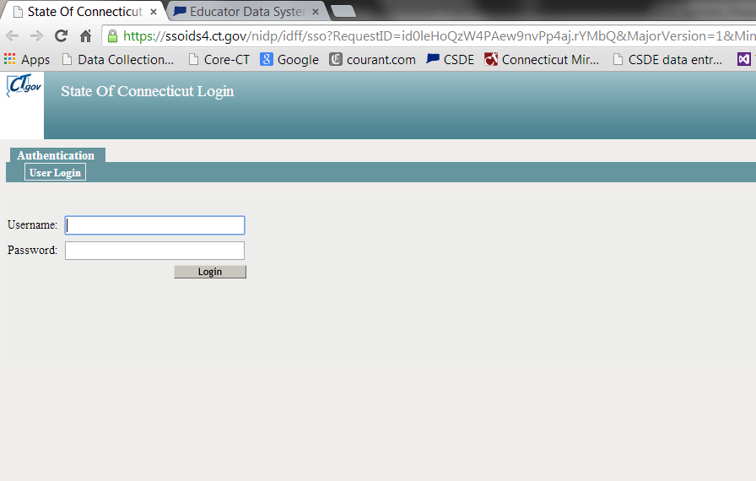
Logging into the EDS
As we mentioned before, EDS is located at a different website than ED163. The URL is https://CSDE.CT.gov. When you enter in the web address you’ll be automatically redirected to the page below, where you will enter your user name and password.

Slide 27
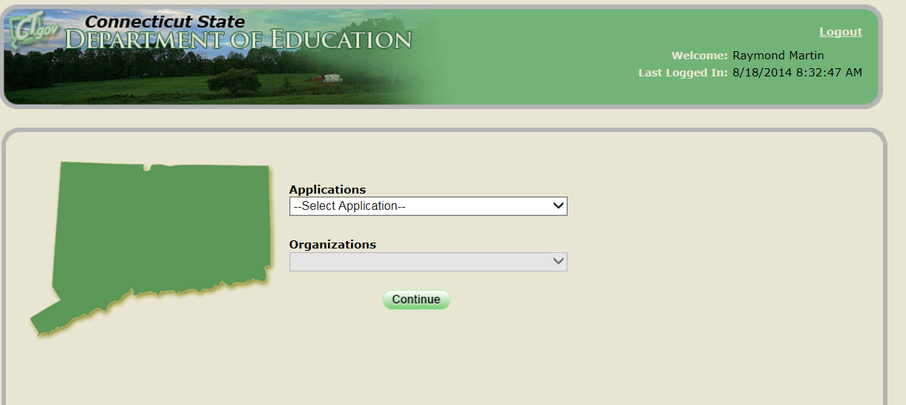
Logging into the EDS
If you have access to more than one application in the portal, you will see the page below when you log in. From here you will be able to choose the EDS application.
If you do not have other portal applications assigned to you, you will be sent directly to the EDS.

Slide 28

Expectations
The EDS is a work in progress. The pages you will see today may change over the coming weeks and months and new reports are added and new features are released. Even from today and the release date, some of the page text will change, but the basic functionality and concepts will stay the same.

Slide 29
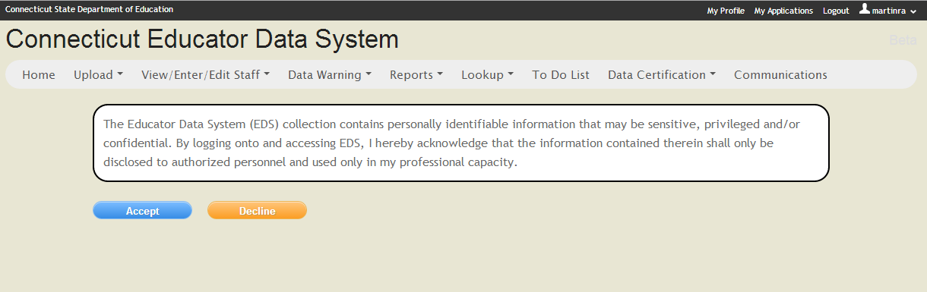
Acknowledgement
As you enter EDS, you will be asked to acknowledge that you understand data in the system may be confidential and privileged and that you will only use them in your official capacity.

Slide 30
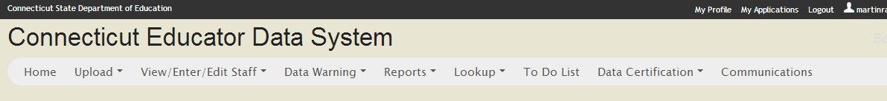
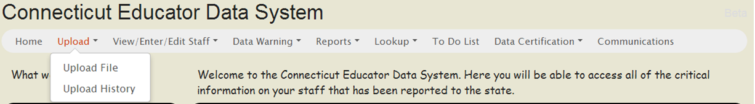
Navigating the EDS
On the top of each page you will see the navigation bar. This will allow you to move through out the application. The same options will be on the left hand side of the home page.
When you hover over one of the six navigation items that have multiple items, the different items will appear.

Slide 31
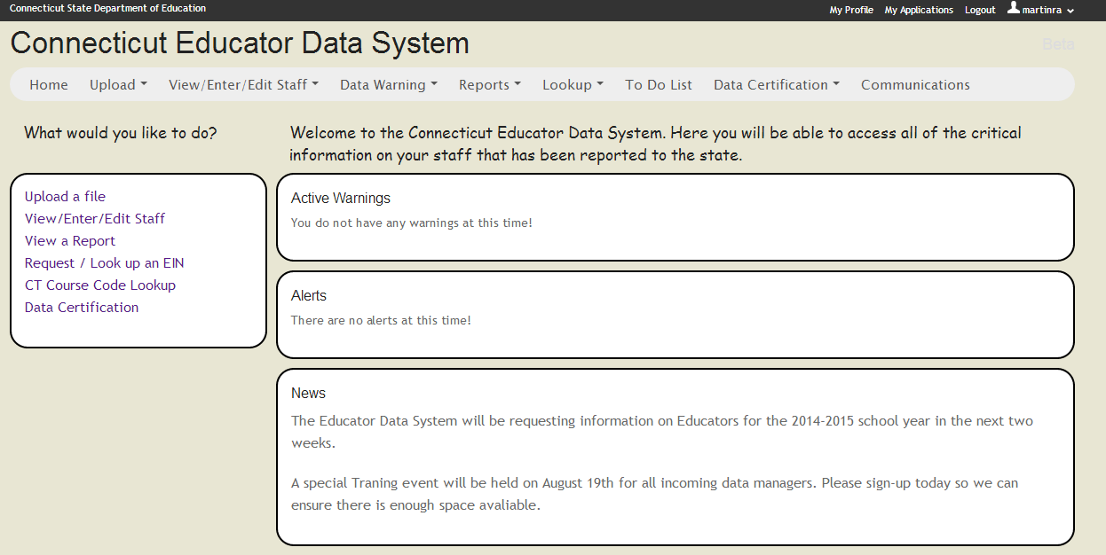
Home Page
Below is a shot of the home page, which is also the page you’ll be brought to when you enter the application. Here you’ll be warned of potential problems with your data and any system announcements.

Slide 32
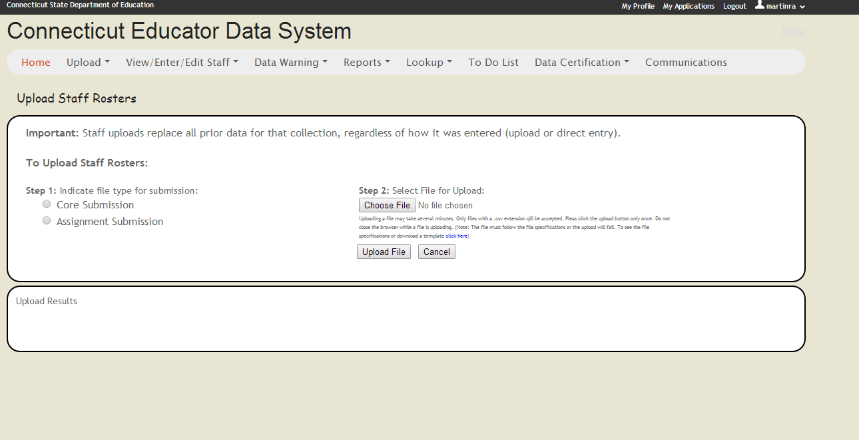
Upload Staff Rosters Page
When you select the Upload File under the Upload navigation option, you will come to this page, where you can indicate the type of file you wish to submit and Upload it.

Slide 33
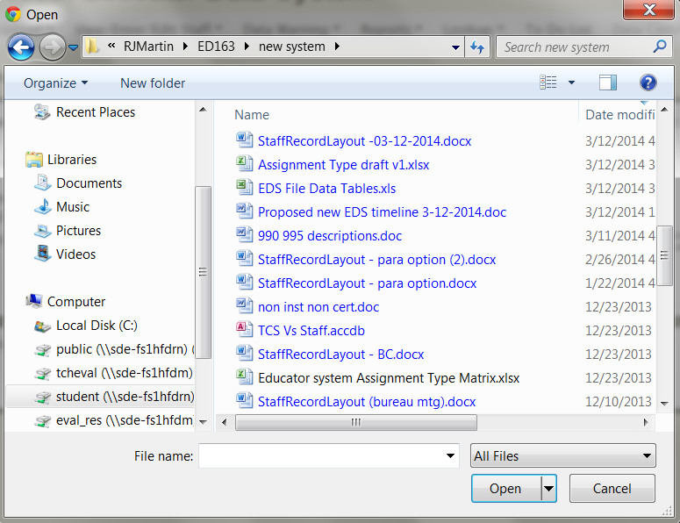
Upload Staff Rosters Page
When you click choose file, it will open a window to allow you find the file you wish to upload. When you’ve selected it, click open.

Slide 34
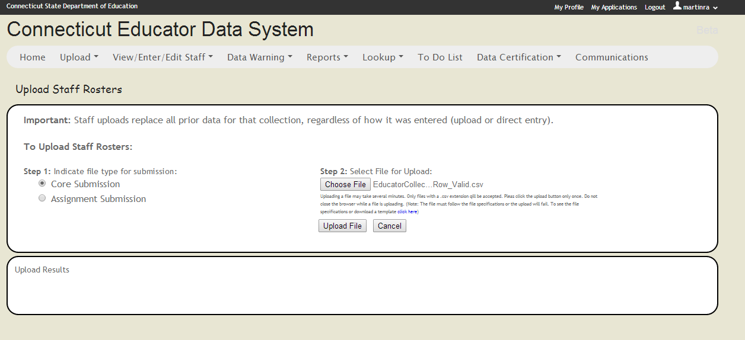
Upload Staff Rosters Page
The system will show the file you’ve selected and if it is correct, click the Upload button. If it is incorrect, click the Cancel button.

Slide 35
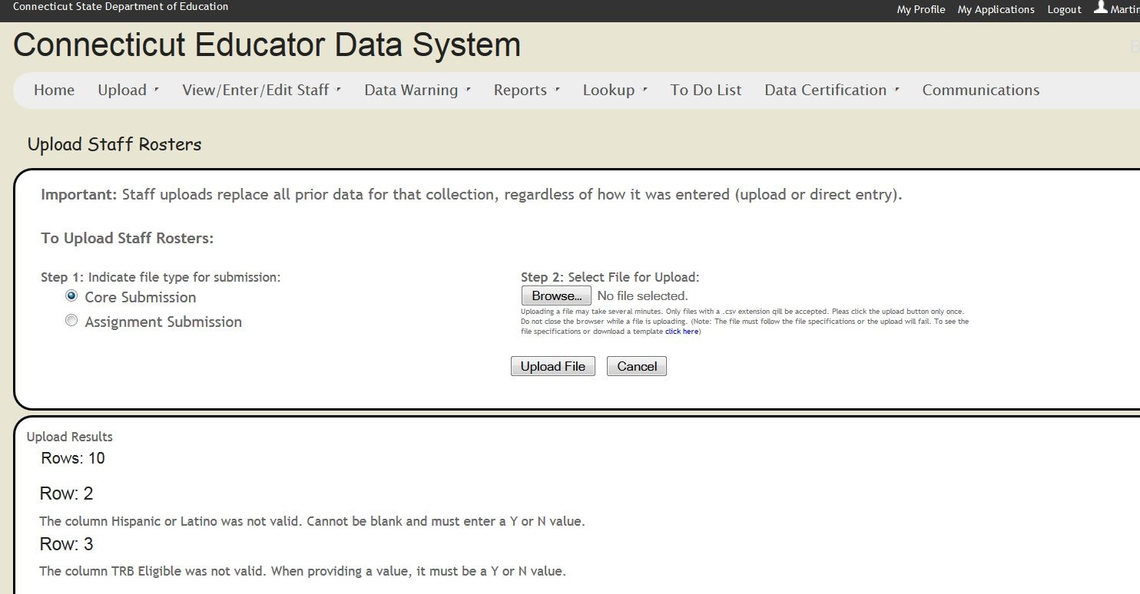
Upload Staff Rosters Page
When you load a file, the system will load the records that pass the basic file specifications validations and let you know the rows of the records that do not pass the data checks. It will also tell you the number of records (rows) in the uploaded file, so you can verify all of your data was uploaded.

Slide 36
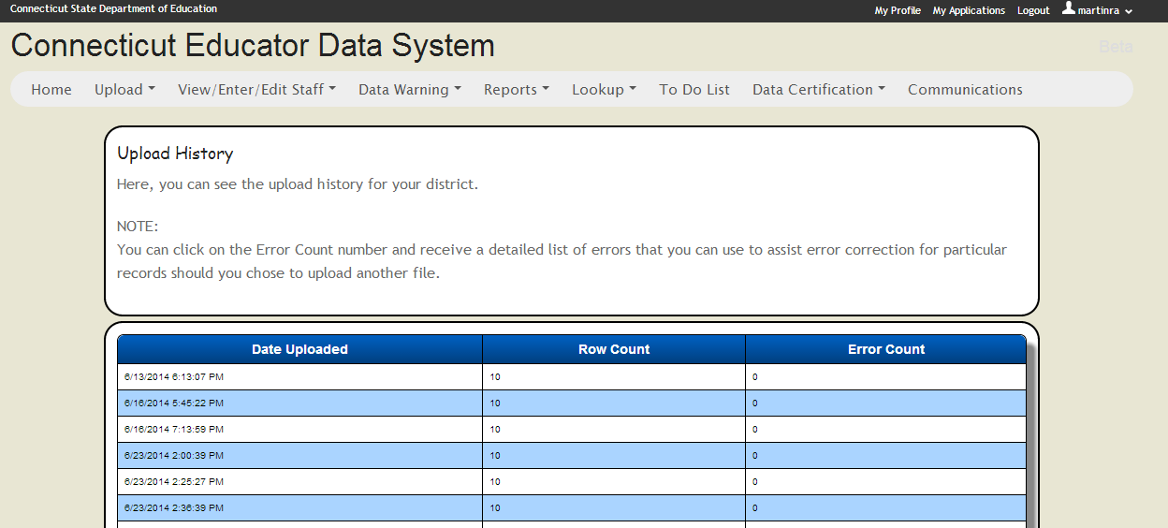
Upload History Page
The other option under the Upload navigation tab is upload history.
When you upload files, the record of those upload will be on the upload history page.

Slide 37
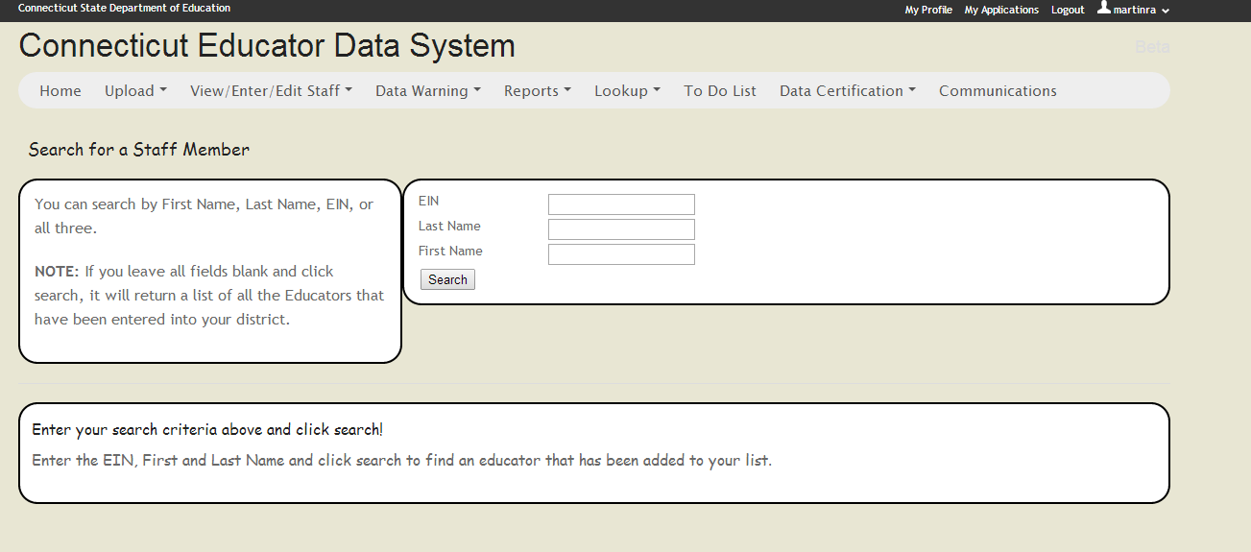
Search for an Educator Page
Under the View/Enter/Edit Staff tab, you can search your staff for an individual educator and view their record. When in their record, you can enter edit mode and make changes to their record. If you want all your of your staff to show, simply click search and all will show.

Slide 38
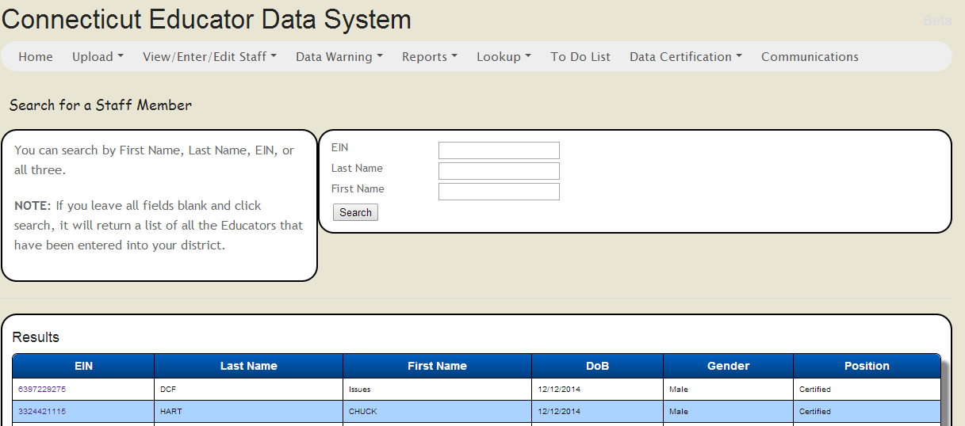
Search for an Educator Page
The results show beneath the search area. The educator’s EINs are links to their record.

Slide 39
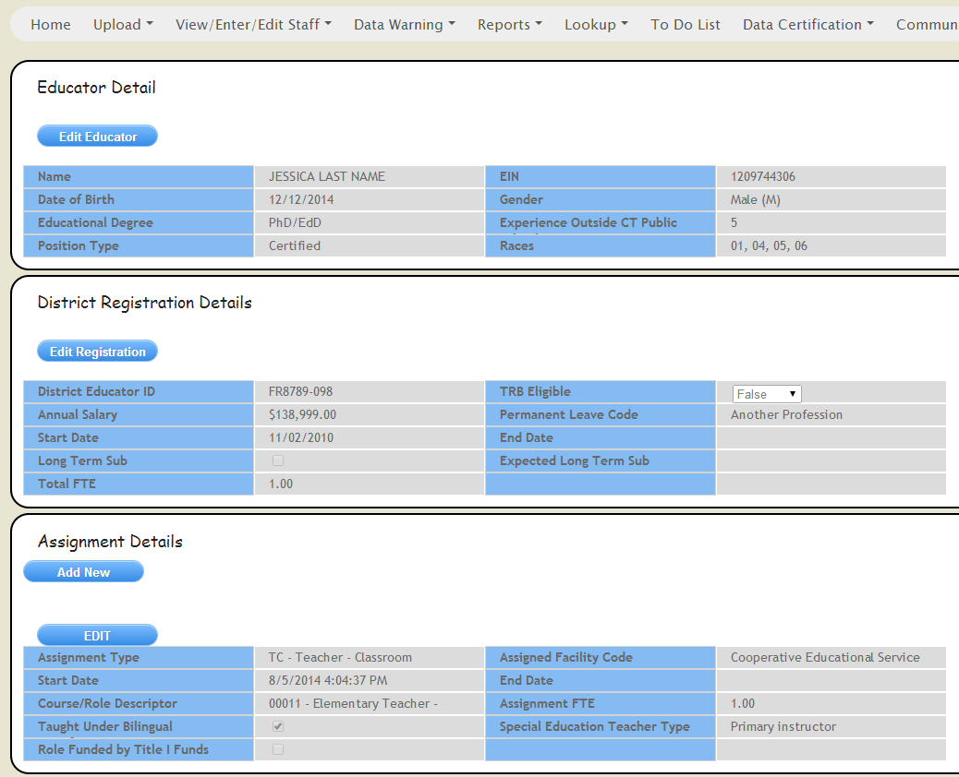
View an Educator Page
The View Page has three sections. One for basic demographic information about the educator, one for district information and one for assignment information

Slide 40
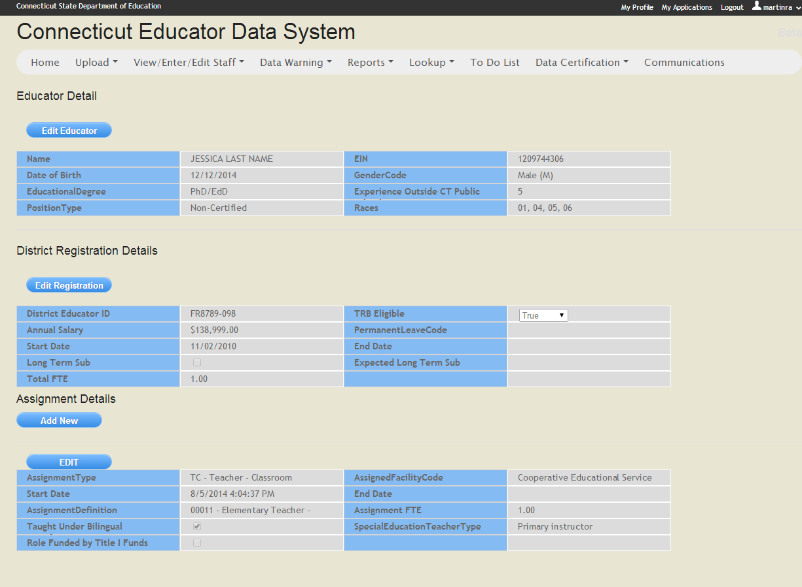
View Educator Page
To enter edit mode for one of the areas, you click the edit button. For example if we wanted to exit a staff member who left the district, we’d click the Edit Registration button.

Slide 41
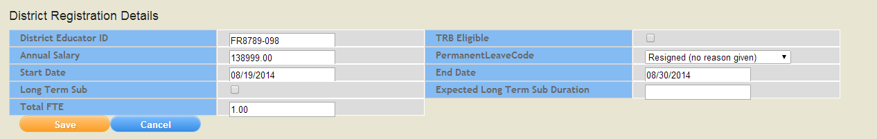
Editing an Educator Record
To exit the staff person, you enter the district end date in the End Date field, give the reason for the permanent leave and click the Save button. You do not need to exit a person who is leaving your district from their assignments. The system will automatically exit them from their active assignments with their final last day.

Slide 42
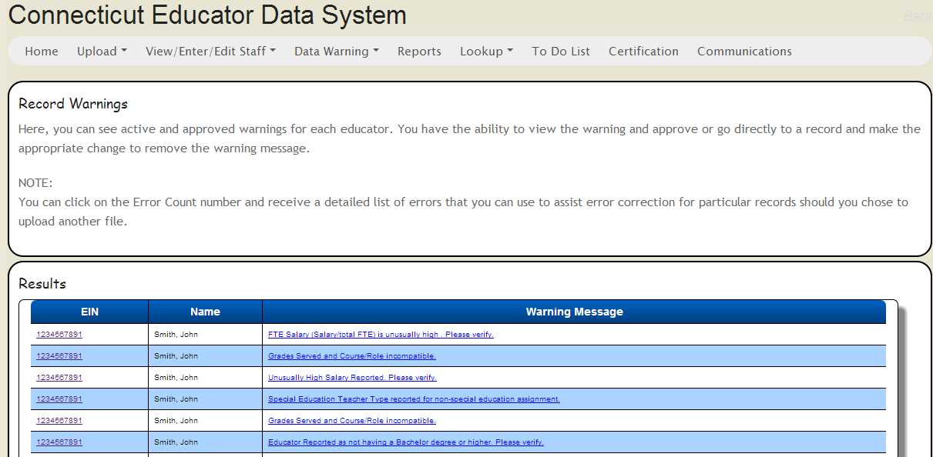
Warnings and Errors
The Data Warnings tab will bring you to a page where your data warnings and errors are displayed. Each educator’s EIN is a link to their record so you can attempt to fix the data. If you believe that your data is in fact accurate, you can either give an explanation of why the data are accurate or (in some cases) leave the data as is without explanation

Slide 43
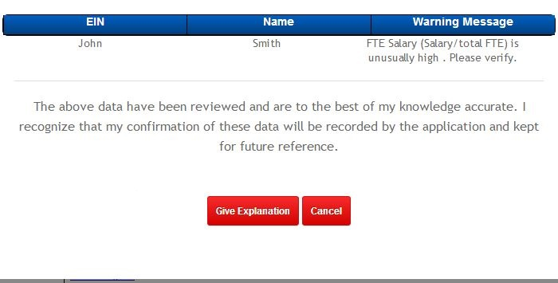
Warnings and Errors
There will be warnings and errors where you will need to explain why your data is unusual, but true. For example, a teacher’s FTE salary being over $1,000,000. in those cases, you’ll be given the opportunity to explain the unusual data. Some errors, like not reporting a principal in a school, will require an explanation and CSDE override of the error for you to certify your data.

Slide 44
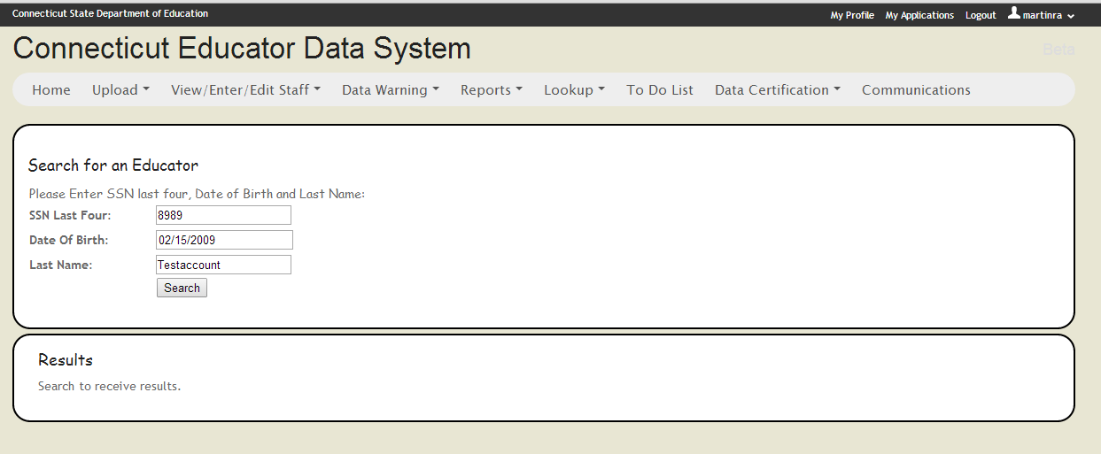
Searching for an EIN
If you need to find out the EIN of an employee, the system has a lookup function. Simply enter the last four digits of the person’s social security number, their date of birth and last name.

Slide 45
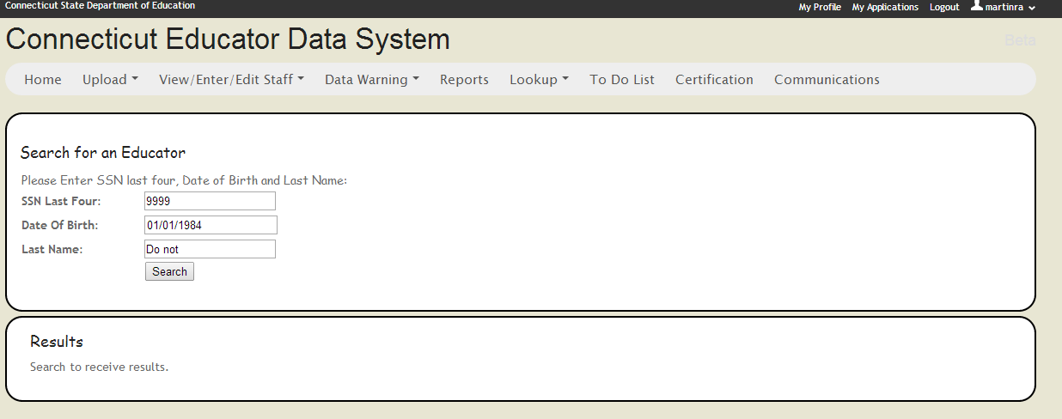
Searching for an EIN
If you need to find out the EIN of an employee, the system has a lookup unction. Simply enter the last four digits of the person’s social security number, their date of birth and last name.

Slide 46
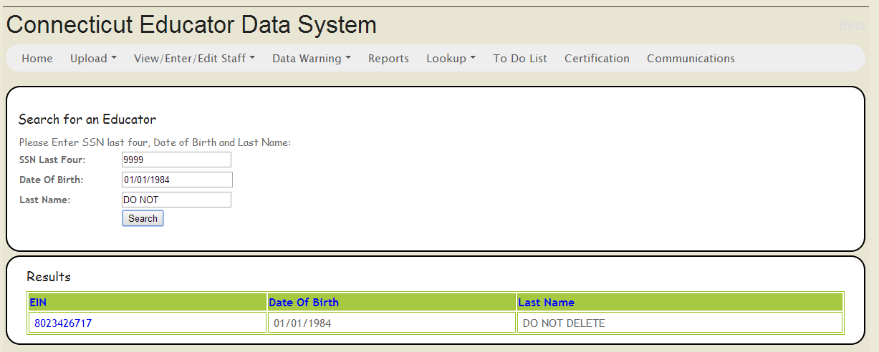
Searching for an EIN
The EIN Search Results will give you the person’s EIN as well give you’re the name so you can confirm you have the correct educator.

Slide 47
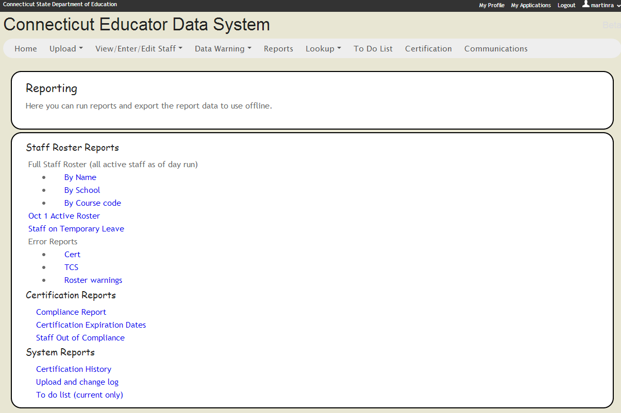
Reports
The EDS contains a number of reports that will allow you to print and export your data. While not all of the reports below will be available on Day 1, we believe that the reports that are available will be a distinct improvement form the ED163.

Slide 48
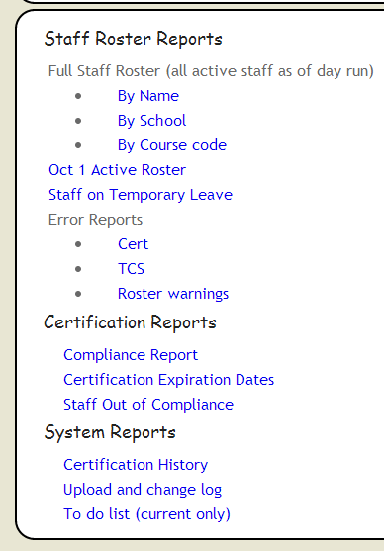
Reports
The image at the left is an up close view of the reports we are working on for the EDS.
The Certification reports will likely be coming on line later in the fall. These reports are for information purposes only and will not constitute the Department’s official compliance process.

Slide 49
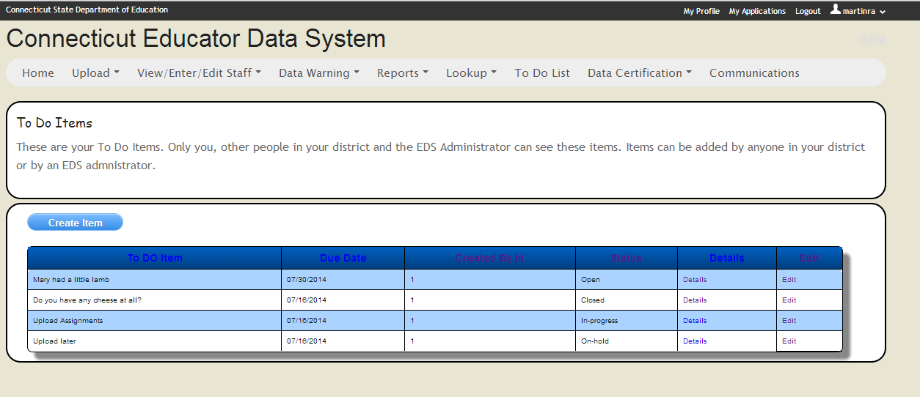
To Do
The system also includes a “To Do” list where you can track your tasks. Items can be added and edited by both district staff and the CSDE administrator.

Slide 50
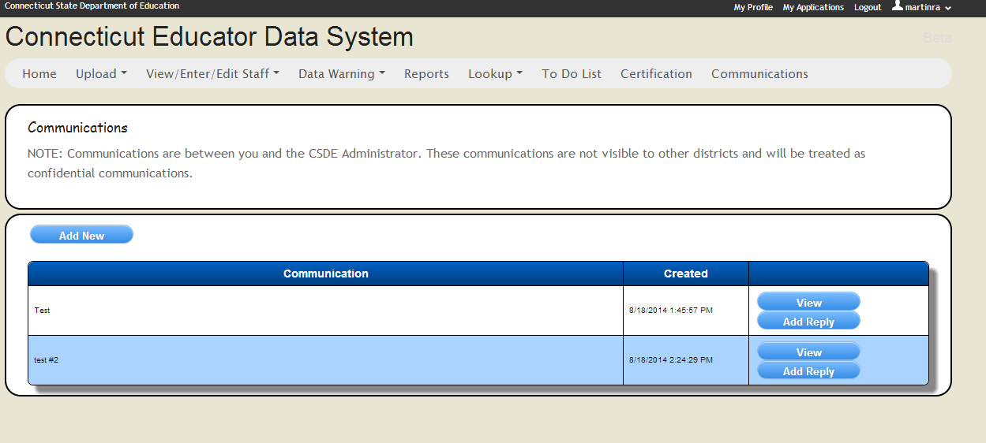
Communication
The EDS system has been built with a new way to send and receive message from the CSDE administrator. The Communication tab will allow you to ask questions, get clarifications and get updates from the Department.

Slide 51
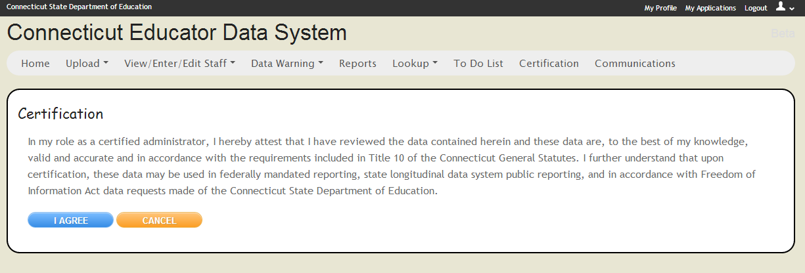
Certification Page
As mentioned before the new EDS will require that the data be certified twice a year. Once for the October 1 reporting data and once at the end of the school year indicating the data are up-to-date and final. The year end certification will also auto exit all assignments for the schools year, so you will not need to submit an assignment file closing out all of your educators’ assignments. Only users with the EDS LEA Certifier role will be able to certify data.
Note: Districts with outstanding errors and/or incomplete data will not be able to certify their data.
Department policy requires that only certified administrators certify data.

Slide 52

Coming Attractions
Missing staff
Certification compliance warnings
Staff in two districts
Window into CECS

Slide 53
FAQ
Where can I get more information?
The EDS help site: http://www.csde.state.ct.us/public/eds . It has file specifications, definitions, code sets, and (eventually) this presentation.
The EDS is just a once a year collection, right?
No, the EDS is a year round collection that must be kept up-to-date. While we use the October 1 snapshot for reporting purposes, the year round data are used for several purposes.
If the Assignment Type element is not required, why should I care?
The Assignment Type element is important to keep your district and the Department on the same page on how the different assignment will be counted. This common understanding is important to limit confusion and surprises when data are publicly reported.

Slide 54
FAQ
How will I know the EIN for all my staff?
Districts were instructed years ago to add EINs to their HR systems and have been reporting them to the CSDE as part of the TCS collection. You should have them. If you do not have them, the system has an EIN look up feature that will allow you to look them up. Furthermore, the CSDE will make reports of the staff you had at the end of 2013-14 available. They will include EINs.
What about the staff that left over the summer?
Since we are starting from scratch, you do not need to report staff who left your district over the summer or who retired in June. If you have staff who are starting the year on leave, however, you should report their leave.
After I’ve entered all of my data and passed all edit checks, I’m set, right?
No. Not only do you need to keep up on changes, but during the year data that passed edit checks initially may fail subsequent checks. Why? In year one, we’ll be adding data checks throughout the year and your data may fail one of those checks. Furthermore, when certification compliance check are live, you may have staff that let their certifications lapse and that will result in warnings.

Slide 55
FAQ
What if I don’t know the actual date a person started in my district?
In most cases, you’ll know the year they started or the number of years that they worked in your district and you can use that to determine the year and use September 1 of that year.
We have a teacher who is awaiting their certification. Should I report them?
If they are working in a role that requires certification, you need to report them, even if they are not yet certified. There are no exceptions to this rule.
What if a person is not a certified administrator, can they certify data?
As of July 1, 2014, CSDE is policy requires that all final data submissions be reviewed and certified by certified administrators only.

Slide 56
Expectations
While we are working diligently and trying our hardest, there will be bumps in the road. There will be problems and things will take longer than anyone hopes.
No one wants this system working smoothly more than we do!
So please:
Be patient.
Be descriptive as possible when reporting a problem.
Visit our Help Site.
If you are having problems getting onto the site, visit our DM help site (http://www.csde.state.ct.us/public/directorymanager/default.asp) before throwing the computer out the window (or at us).

Slide 57

So When????????
We recognize that everyone is incredibly eager to get started. We also know that you want a system that works properly and doesn’t waste your time and efforts.
Our current targeting a go live the week of September 2nd, but please do not wait until then. Start working on getting your files ready now.

Slide 58
Questions?

Slide 59
Frustrated? Need help?
For Help, please contact:
Ray Martin: 860-713-6876
or raymond.martin@ct.gov

