Slide 1
ED166 Student Disciplinary Offense Collection Training
Part 1: General, Mid-Year and Phase 1 Information
2024-25 School Year
Updated 2/20/2025
Notes:
This information covers the ED166 Student Disciplinary Offense Collection. The focus is General, Mid-Year and Phase 1 information. This information is intended for those who have direct contact with the ED166 application and are responsible for reporting data to the CT State Department of Education.

Slide 2
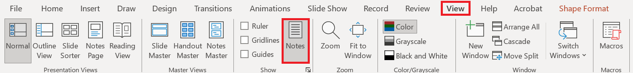
Slide Deck Information
If you are viewing this in PowerPoint, be sure the notes are visible beneath the slides. To enable notes, go to View and select Notes:
If you are viewing this as a PDF, and the links within the slide do not work, use the links provided in the notes below the slide.
Notes:
If you are viewing this in PowerPoint, and you can see this message, your notes are visible.

Slide 3
CSDE Resources
Keryn G. Felder
Education Consultant
Keryn.Felder@ct.gov
ED166 Help Site
Search ED166 from the CSDE home page
Notes:
Welcome Message:
Welcome to the ED166 Student Disciplinary Offense collection. This information includes the same content presented at both live and virtual training sessions but allows you to step through the information at your own pace. I encourage you to reference this document when you are completing your collection. Note that if I get questions during the school year or at training sessions this PDF version of this document (posted online) may contain additional clarifying information in the accompanying text so be sure you have the latest edition.
I encourage you to bookmark the ED166 Help Site as it’s a great resource and many questions can be answered from information on the Documentation page. I recommend beginning your collection early, as it will allow ample time to work through any issues that may occur (missing data, records that require further research, etc.).
If you have any questions, I’m happy to help. The best way to reach me with questions is via email.
Keryn Felder
Slide Links
Email: Keryn.Felder@ct.gov
ED166 Help Site: https://portal.ct.gov/SDE/Performance/Data-Collection-Help-Sites/ED166-Help-Site
CSDE Home Page: https://portal.ct.gov/sde

Slide 4
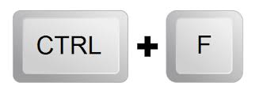
Contents
General collection information
Record Layout/User Guide
A closer look at reporting:
  Multiple Incident/Sanction Types
  School Based Arrests
Laws
Help Site
Application Walkthrough
  A video demonstrating the application is available on the Help Site
Press CTRL + F to search
Notes:
This topics covered include the basics of the collection including the Record Layout/User Guide document (these names are used interchangeably), applicable laws, exploring the Help Site and an application walkthrough.
There are several pieces of reference material available on the Documentation page of the Help Site that accompany this presentation, which you may wish to download or print:
2024-25 Record Layout
Multiple Incident Types/Sanctions Guide
Reporting Arrests Flow Chart
If you are looking for a specific item in this document, click on CTRL + F keys to open a search window. TIP: This command will work in other file types as well, such as Word and Excel.
Slide Links
ED166 Help Site: https://portal.ct.gov/SDE/Performance/Data-Collection-Help-Sites/ED166-Help-Site

Slide 5
2024–25 ED166 Application Deadlines
Collection Opens – Fall (email and web site notification)
Charter School Submission: December 4, 2024 (required)
Mid-Year: March 5, 2025
Phase 1: July 9, 2025
Phase 2: August 20, 2025
Freeze Date: September 3, 2025
Incident Date Range: July 1 – June 30 → Does not change
Varies yearly, but within the same general time frame
START YOUR COLLECTION EARLY
Notes:
The ED166 collection opens in the Fall each school year, and your Reporting District can begin uploading/data entry at any time. When the collection opens, an email will be sent to everyone in the ED166 District Profile alerting you of the opening. The collection will also be posted as “open” on the Home Page of the Help Site.
NOTE: The ED166 District Profile is a screen within the ED166 application. Be sure this information is up to date as the individuals listed are the only ones authorized to receive password information from the CSDE. These individuals are also automatically on the ED166 mailing list.
The deadlines on this screen pertain to the ED166 Application, not your Reporting District policy. Most LEAs enter incidents into their local Student Information System daily.
These deadlines do adjust within the same general time frame each year. These dates are posted on the Home Page of the Help Site, as well as on the left side of every email sent about the collection. Note the Charter Schools have an additional submission date this year.
The ED166 incident date range is July 1 – June 30 every year. It’s important to note that the data can be entered at any time, you do not need to wait for the mid-year collection deadline to approach to begin. You can report data at any interval you wish, such as monthly or weekly. You can also group your batches in any way you wish such as by school or grade level.
A best practice is to start your collection early, especially in Phase 2 as it is generally more difficult to connect with colleagues during the summer months if you need to learn more about an incident to clean up errors, etc. New users are encouraged to start each portion early so there is ample time for assistance.

Slide 6
Acronyms
FERPA: Family Educational Rights and Privacy Act
FOI: Freedom of Information
ISS: In-School Suspension
LEA: Local Education Agency (your district)
OSS: Out-of-School Suspension
PII: Personally Identifiable Information
PSIS: Public School Information System – many of you may also work on this application. If you are not familiar this is the online application where all public-school students are registered.
CSDE: Connecticut State Department of Education
SASID: State Assigned Student Identifier
SIF: School Interoperability Framework
SIS: This is your student information system such as Administrator Plus, Infinite Campus, PowerSchool, etc.
The terms District and LEA used interchangeably in this document
Notes:
This slide lists the acronyms referenced in this document.
The most used ones are:
ISS: In-School Suspension
OSS: Out-of-School Suspension
LEA: Local Education Agency or your district. The terms LEA and District are used interchangeably in this presentation.
PSIS: Public School Information System – many of you may also work on this application. If you are not familiar this is the online application where all public-school students are registered and receive their SASID.
SASID: State Assigned Student Identifier – this number is generated by the PSIS Register Module, is unique to each student, and stays with them throughout their public-school career even if they change districts.
SIS: Your LEA’s student information system such as Administrator Plus, Infinite Campus, PowerSchool, etc.

Slide 7
Overall Process
Input Data
(Mid-Year & Phase 1)
Data Cleaning
(Phase 2)
Administrator Review & Certification
Notes:
A high-level view of this collection is inputting the required data, cleaning the data, and then an Administrator should complete a final review of the data before Certifying. This PowerPoint details the first step of the process.

Slide 8

Your Team
IT Specialists
Administrators/Directors
Guidance Counselors
Data Entry Personnel
School Resource Officers
Administrative Assistants
Notes:
Each Reporting District is different and involves different parties. Be sure that all the involved parties in your district have an adequate understanding of the collection. You are encouraged to communicate regularly with all who are involved to ensure records are reported in a correct and consistent manner.

Slide 9

Records Required to be Reported
All offenses that result in:
In-school suspension
Out-of-school suspension
Bus suspension
Expulsion
In addition, all "serious" offenses and incidents involving Alcohol, Drugs or Weapons must be reported regardless of the type of sanction (consequence) imposed. This means that if anything is listed in the Weapon Involvement or Substance Involvement field (including vaping) the incident must be reported. All Bullying Incidents must be reported.
A list of offenses categorized as “serious” is available on the Documentation page of the Help Site
Notes:
This collection is sometimes referred to as the “suspension and expulsion collection.” While this is partially true, it is not a complete description of the collection.
LEA’s are required to report incidents to the CSDE that result in in-school-suspension, out-of-school suspension, bus suspension and expulsion. In addition to that, all offenses categorized as “serious” must be reported regardless of the sanction (consequence) imposed. Note that all incidents involving a Weapon or Substance must be reported as well as all Bullying incidents.
A list of offenses categorized as “serious” is available on the Documentation page of the Help Site.
If your Reporting District reports an incident to CSDE that is not required to be reported, it will not be saved on the CSDE end and not used in any CSDE analysis. Upon data transmission to the CSDE non-required records will result in a warning from the ED166 Application; however, no action is needed on the Reporting District end.
As a reminder, the requirements above pertain to the ED166 application; follow your local district policy when recording incidents in your Student Information System (SIS).

Slide 10
What is the Data Used for?
Federal Data Collections
State Data Collections
  Board Report
EdSight
  Data Suppression Guidelines
FOI Requests
  Media
  Research
  Other
Notes:
The data collected is used to satisfy federal data collections, state data collections including our annual Board Report, and Freedom of Information (FOI) requests. Discipline data is also publicly posted on EdSight, the SDE’s public longitudinal data portal. Any publicly posted or released data follows all Family Educational Rights and Privacy Act (FERPA) data suppression guidelines and no Personally Identifiable Information (PII) is included. This generally means that counts of 5 or less are suppressed. More information on the data suppression guidelines is available on EdSight.
Slide Links:
EdSight: http://edsight.ct.gov
Data Suppression Guidelines: https://edsight.ct.gov/relatedreports/BDCRE%20Data%20Suppression%20Rules.pdf

Slide 11

Legal Requirements
Education of Individuals with Disabilities
20 U.S.C. 1418(a)
Safe & Drug Free Schools and Communities
20 U.S.C. 7101- 7165
Strengthening & Improvement of Elementary & Secondary Schools: Gun Possession
20 U.S.C. 8921
Notes:
There are several laws requiring CSDE to collect this information. This is an example of some of them. Links to these laws are available on the Statutory References section of the ED166 Help Site.
Slide Links:
Documentation Page of Help Site: https://portal.ct.gov/sde/performance/data-collection-help-sites/ed166-help-site/laws

Slide 12
Phase Requirements
Mid-Year Collection
March 5, 2025
Report all required incidents that occurred between 7/1 and 1/31*
Ensure uploads are error free
Recommendation: Clear Data Cleaning Reports
Complete mid-year certification
  This is a checkbox, no password is needed
  Does not have to be completed by an Administrator
* NOTE: Your Reporting District may go beyond this date if you wish; 1/31 is not a hard cut-off date. After your Reporting District has completed the mid-year collection you can continue to add, edit, or delete records as needed. You do not need to clear your certification.
Phase 1
July 9, 2025
Report all required incidents that occurred between 2/1 and 6/30 as well as any other incidents your Reporting District may have missed
Ensure uploads are error free
Recommendation: Clear Data Cleaning Reports
Complete Phase 1 Certification
  This is a checkbox, no password is needed
  Does not have to be completed by an Administrator
Notes:
For the Mid-Year Collection your Reporting District should report all incidents that took place from July 1 – January 31 of the current school year. If there was a summer school incident that took place on July 15, 2024 for example, it should be included in the current 2024-25 collection, not the collection pertaining to the prior school year. Note that the mid-year dates are not hard dates, you can certainly go beyond January 31. The purpose of the Mid-Year Collection is for CSDE to obtain approximately half of your school year’s incidents. All uploads must be error free. When your Reporting District has finished reporting you must check the Mid-Year Certification checkbox. Your Reporting District can continue to add, edit or delete records, you do not need to clear the checkbox. It is also recommended that you begin clearing your Data Cleaning Reports.
Phase 1 follows the same process as the Mid-Year Collection, except your Reporting District is now reporting incidents that occurred from February 1 – June 30 as well as any other incidents that may have been missed during the Mid-Year Collection.

Slide 13
Phase Requirements (continued)
These items are covered in detail in Part 2 (Spring) training
Phase 2
August 20, 2025
Input any additional records
Respond to Data Exceptions
Clear Data Cleaning Reports
Review other reports to ensure data accuracy
Administrator Review & Certification
  The Superintendents Certification code is required (this is a 5-6 digit password)
  Must be completed by an Administrator
All items above are listed on the Certification Checklist that is emailed and posted on the Help Site at the beginning of Phase 2.
Freeze
September 3, 2025
Respond ASAP to any CSDE questions
Input any final changes and recertify immediately
No changes can be made once the file is frozen
Notes:
Phase 2 is the Data Cleaning and Certification stage. During this phase, your Reporting District will input any final records. Your Reporting District will then review the Data Exceptions which are variances in the data from the prior year.
All Data Cleaning Reports must be cleared. Your Reporting District should review the other reports available within the application, and then a Certified Administrator must input their Certification Code to indicate their electronic signoff of the data. More details on each of these items will be emailed to you during Phase 2. A Phase 2 video and PowerPoint will be available. Once your Administrator has completed Certification CSDE will review your data to see if there are any final items that need attention.
During the finalization period please respond to any CSDE questions and re-certify as soon as possible. Note that no changes can be made after the Freeze so please be sure that all final changes have been made by this date.

Slide 14
PSIS Connection
PSIS Registration Module
PSIS
Collections
TCS
CT-SEDS
ED166
Register before reporting
Check your dates
Notes:
Many ED166 Application Managers also are responsible for the Public School Information System (PSIS). If you are unfamiliar with the PSIS Registration Module, this is the state application that assigns each student a unique 10-digit SASID (or State Assigned ID).
PSIS Registration has several “hang-off” applications including the PSIS Collections, TCS, CT-SEDS and the ED166. The data in a “hang-off” application relies on the data in PSIS Registration to exist and be accurate. You will be unable to successfully report a record in the ED166 unless a student has been registered in the PSIS Registration Module.

Slide 15
Data Transmission Options
Batch Upload
SIF
Manual Entry
Notes:
All records must be electronically reported. There are three ways to do this: Batch Entry, SIF, or Manual Entry.
SIF - School Interoperability Framework

Slide 16
Batch Upload
Export data from local SIS (built in feature), requires Reporting District knowledge
Multiple file types accepted: CSV or Fixed Width
Open to ALL LEAs
Can upload all records or by school
GIGO – Garbage In Garbage Out
Notes:
The most common type of data transmission is Batch Upload. This is when your data is extracted from your local Student Information System and organized into a format readable by the ED166 application (CSV or Fixed Width). Most SIS’s have a “state reporting” feature that will automatically arrange your data according to the Record Layout. Your Reporting District can also manually build a file following the Record Layout – a template is available on the Help Site. All LEA’s can use this method of transmittal, regardless of SIS. Each batch added via upload is appended to any data already reported – unless the Incident Tracking Number is included (see page 24 for more details on the ITN).
Two things to remember with this method is Garbage In Garbage Out – if there are mistakes in your Student Information System there will be mistakes in the ED166. The other item is that while CSDE can assist with the upload process and error correction, we do not have knowledge of all the SIS’s and the processes to extract data from your system. If you are unsure how to do that contact your SIS vendor.

Slide 17
School Interoperability Framework (SIF)
Transmit data to ED166 directly
Available to PowerSchool LEAs only
Reporting District must be SIF enabled
Test the process early
GIGO
SIF Contact Information:
Srinivasa (Reddy) Erigela
Srinivasa.Erigela@ct.gov
Set up SIF
Set date range
Troubleshooting
Help Site
Notes:
The second type of transmittal is SIF – the School Interoperability Framework. SIF works as a link between your local Student Information System and the ED166. Note that this method does not bypass error checks, and like Batch Upload, Garbage In, Garbage Out applies. If there are mistakes on the Reporting District end, they will be imported into the ED166.
Currently SIF is only available to LEA’s using PowerSchool, and your district must be “SIF enabled” to use this mechanism. Many LEA’s who use SIF absolutely love it, however there are some who have run into issues. If your Reporting District decides to use SIF be sure to test the process early and complete the collection well before the deadline so if you do run into SIF related issues you still have time to upload directly to the system to make the deadline.

Slide 18
Manual Entry
Hand type each record
Open to ALL LEA’s
Can combine with other types
GIGO and human error
Notes:
The final type of data transmission is manual entry, where each record is hand typed. This method is open to all LEA’s regardless of size, however it is not recommended to complete your entire collection this way unless you only have a handful of records to report.
Like the other methods the data entered will only be as good as the data in your local student information system, so once again GIGO applies. In addition, your Reporting District is open to human data entry error. While this method is not the most efficient, it can be combined with the other data entry methods. Therefore, if you notice one record is missing you do not have to create and submit a batch to add the data you can simply add it manually.

Slide 19
Collection Steps
KEY: LEA Process Application Process CSDE Process
LEA Extracts Data from local SIS
Transmit Data
(Mid-Year, Phase 1)
Review Error Report
Complete
Pre-Certification
IF ERRORS EXIST
CSDE Opens Phase 2
Data Cleaning & Finalization
Administrator Review & Certification
CSDE FREEZE
Notes:
This slide illustrates the steps of the collection process using a batch transmission, the most common method of reporting. Note the item in green is a district-only process, the items in gray are CSDE processes, and the remaining boxes in blue are application-based processes.
The first step is for your district to extract the data from the student information system. Most SIS have a “State Reporting” feature which automatically pulls the required records in the correct format. Note that CSDE cannot assist with the data extraction, we advise reaching out to someone in your district or the SIS vendor if you need help with this step.
Next, your district will upload the file into the ED166 application. Next, review the error report that automatically opens after your upload. If errors exist, the best practice is to go back to your Student Information System, resolve the errors, extract an updated file, and repeat the process.
If you do not have errors, the next step it to complete the appropriate precertification checkbox. After that, you can begin reviewing your Data Cleaning Reports, or wait until Phase 2 begins.
Once we open Phase 2, you will complete the data cleaning and finalization stage. Then, to complete the report, your administrator should review the data for accuracy and then electronically sign off. Separate training materials will be available for Phase 2.

Slide 20

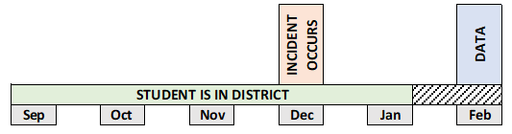
PSIS Registration Accuracy
September - Student enters LEA
December - Incident occurs
January - Student exits LEA
February - ED166 data is uploaded
Report Incident
Notes:
If you had a student who began the school year with your district, committed an incident in December, and then left in January, the discipline record should be reported in the ED166, and it will be accepted by the system if PSIS registration accurately reflects the students Entry and Exit Dates AND the Incident Date took place during the time the student was registered to your LEA.

Slide 21
Record Layout/User Guide
Fields Collected
Definitions
Code Lists
Additional Information (reporting rules, etc.)
The Record Layout is available on the ED166 Help Site
Notes:
The next section of this presentation is a review of the Record Layout document. The Record Layout lists all fields collected, as well as definitions, code lists and reporting rules.
The Record Layout is available on the Help Site.
Slide Links:
ED166 Help Site: https://portal.ct.gov/SDE/Performance/Data-Collection-Help-Sites/ED166-Help-Site

Slide 22
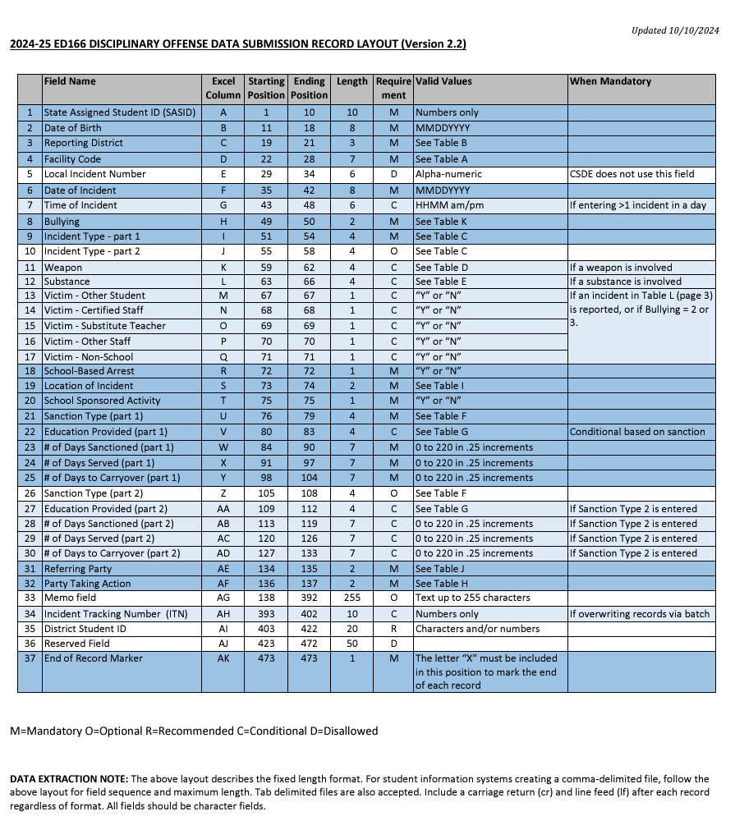
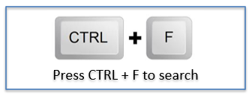
Notes:
Record Layout Page 1: It’s recommended to have a copy of the Record Layout (either physical or digital) open while you read through these slides. Note that if you keep a digital copy open now or while completing your collection you can press CTRL + F to open a search box to quickly find what you need within the document.
Before the content of the Record Layout is described, there are a few items to make note of. First is the updated date in the upper right corner. An “updated date” is included on all documentation so you can always be sure you are using the most recent copy. Since this document is quite lengthy, items updated from the prior year are highlighted in yellow. Changes to the file structure itself (number of fields, length, etc.) are rare; however, new codes and definition updates do occur more regularly. There is a change log listed on the Help Site, however there are generally no significant changes made once a collection is open for a school year.
At the bottom of the page is a key: M–Mandatory, O–Optional, R-Recommended, C-Conditional and D-Disallowed. The various shades of blue and white rows also coincide with this key.
Note each of the column headers. After the field name there is the Excel column. When reviewing errors, some LEA’s like to look directly in the batch, so the Excel column is useful. The starting and ending column, as well as the maximum field length is only needed when manually creating a file - the state reporting feature in your SIS has already been set up to follow these rules.
Next is the Requirement column which is where the key referenced earlier is used. After that is the Valid Values column so you can determine if a field is alpha-numeric, yes/no, or uses a code table. Finally, there is a column to indicate the parameters for a conditional field, such as requiring a Victim Type when a specific Incident Type is reported.

Slide 23
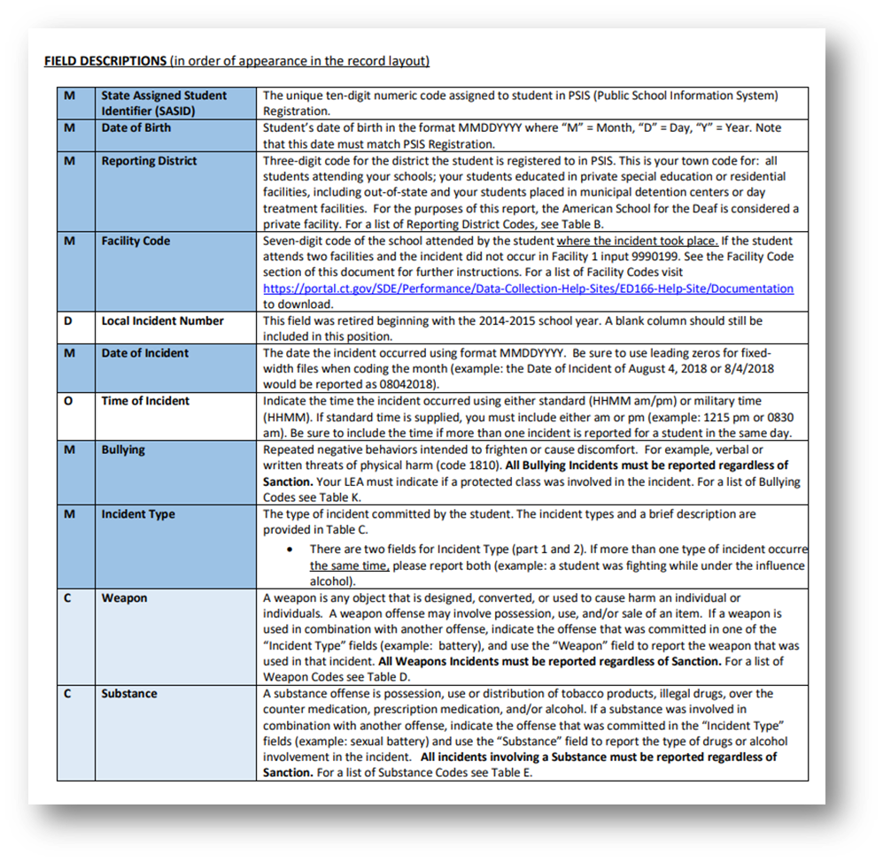
Notes:
Some of the following definitions are brief, but there are additional slides with more details on select fields.
Record Layout Page 2: The definition of each field begins on page 2 of the Record Layout. You will notice that the first column again indicates if the field is mandatory, optional, etc. and the same color-code is followed from the first page. The Code Tables are at the end of this document.
The SASID is the student’s 10-digit identifier which you may recall comes from PSIS Registration. Next is the student’s DOB. These two fields must match PSIS Registration exactly for the record to be accepted by the system. A common upload error is that the SASID or DOB does not match PSIS Registration. These two fields must be consistent so if there is a mistake in PSIS you (or your PSIS Manager) may have to update PSIS Registration to resolve the error in the ED166.
Next is your three-digit Reporting District. You can only report records for students who are registered (or were registered) to your Reporting District on the date of incident. If a student joined your district mid-year but they committed an incident in their previous district that incident should not be reported by your district.
After that is the seven-digit Facility Code for the facility where the incident took place. In 99% of the cases this will be the student’s Facility Code 1 in PSIS. If the student did commit an incident while attending their Facility Code 2 instructions for reporting are available on the Documentation page of the Help Site and linked above.
The Local Incident Number is no longer used; however, a column needs to be left in the record layout to maintain the file structure.
The Date of Incident is when the incident took place – remember this date must be within the timeframe that a student was registered to your district.
Time of Incident is Optional but must be included if a student had two or more incidents on the same day.
Bullying is a separate field (not an Incident Type) that must be completed for every record to indicate if it was a Bullying incident.
Next is Incident Type. There are two Incident Type fields that can be used to describe each incident. More information on using both fields is on slide 34.
After that are the Substance and Weapons fields. Remember that all incidents involving a Substance (including vaping) or Weapons must be reported regardless of sanction (consequence).

Slide 24
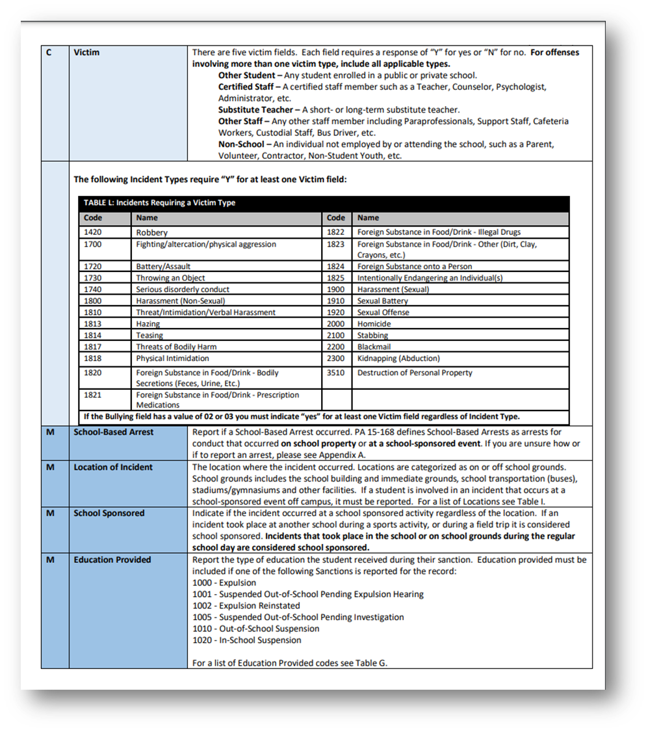
Notes:
Record Layout Page 3:
Next are the Victim Type fields. Some Incident Types require at least one Victim Type to be reported. CSDE does not require specific information on the victim, or how many victims there are, but we do require the category of the victim. The categories are Other Student, Certified Staff, Substitute Teacher, Other Staff and Non-School individual (such as a parent, etc.).
Here you can see a list of Incident Types that require a Victim Type.
If an Incident results in a School-Based Arrest it must be reported. Note that a School-Based Arrest is an arrest that took place due to an incident that took place on school grounds during the school day or at a school-sponsored event. More information on School-Based Arrests is on slide 36.
Location of Incident is where the incident took place. There is a code for online (22) as well as a location code for an accumulation of incidents (50) since those are not specific locations.
School Sponsored is used to indicate if the incident took place during the school day or at a school-sponsored event (such as an evening concert or sporting event).
Education Provided is the type of education a student receives during their sanction. This field is especially important for expelled students.

Slide 25
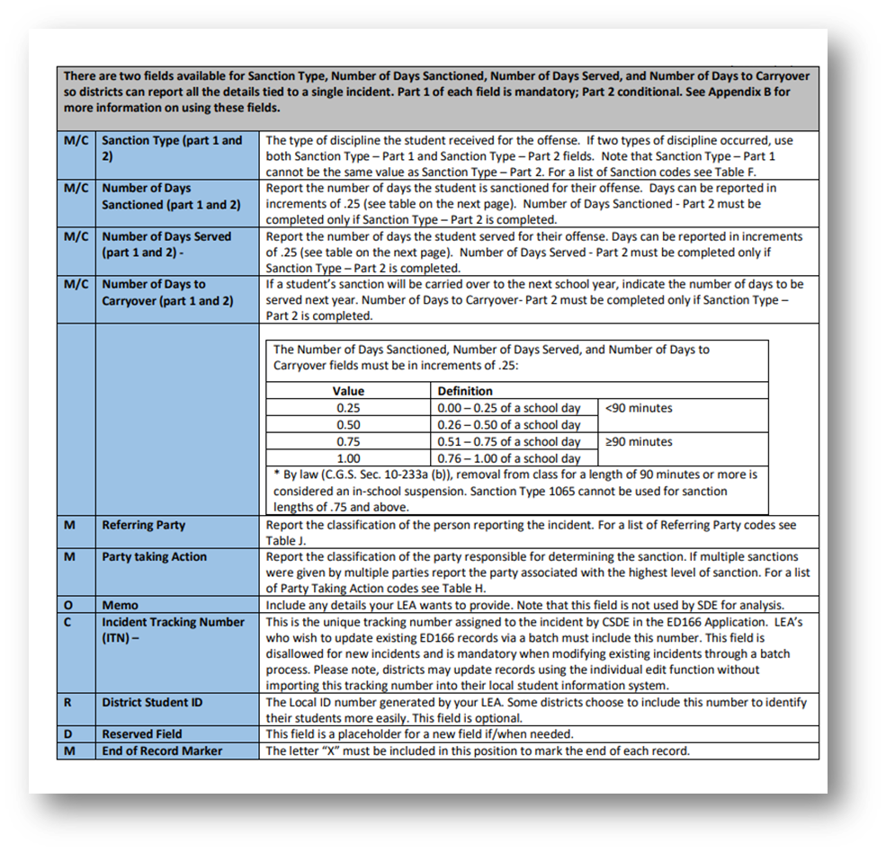
90 Minute Rule
Notes:
Record Layout Page 4: On page 4 you will see there are two fields available for the Sanction. There are three additional fields associated with the Sanction (consequence) fields: Days Sanctioned, Days Served, and Days to Carryover. The number of Days Sanctioned is the total number of days the student is supposed to be sanctioned, the Number of Days Served is the actual number of days the student completed the sanction (example: student transferred to another Reporting District mid-suspension), and the Carryover Days are the number of days that the student will be sanctioned the next school year (example: an incident took place at the end of the school year in June and the sanction could not be completed that school year).
All three of the “Days” fields must be reported in increments of .25 or one quarter of a school day. Note that any amount over .5 is considered over 90 minutes. 90 minutes is an important parameter because once a student is removed from class for 90 minutes or more that is legally considered an ISS. If a student is sitting outside of the principal’s office for 91 minutes, by law, that is considered an ISS. See slide 39 for statute information.
Referring Party is the person who reported the student while Party Taking Action is the person who sanctioned the student.
Memo is an optional field where your Reporting District can include a few sentences about the incident. This field is not used for analysis.
The ITN or Incident Tracking Number is a unique number assigned by the ED166 once an incident is successfully reported. The ITN number is used if you are trying to batch update records that have already been reported in the ED166. To update a record this number must be included in the batch, otherwise the system will recognize the record as a new record.
The District ID is the local ID number used by your Reporting District which is often shorter and therefore easier to work with than the SASID.
The Reserved Field is a placeholder field that will be used for any future updates needed.
Finally, the End of Record Marker is simply the letter X. This marker signifies to our database to move onto the next line to read the next record. Your state reporting feature will automatically populate this field.

Slide 26
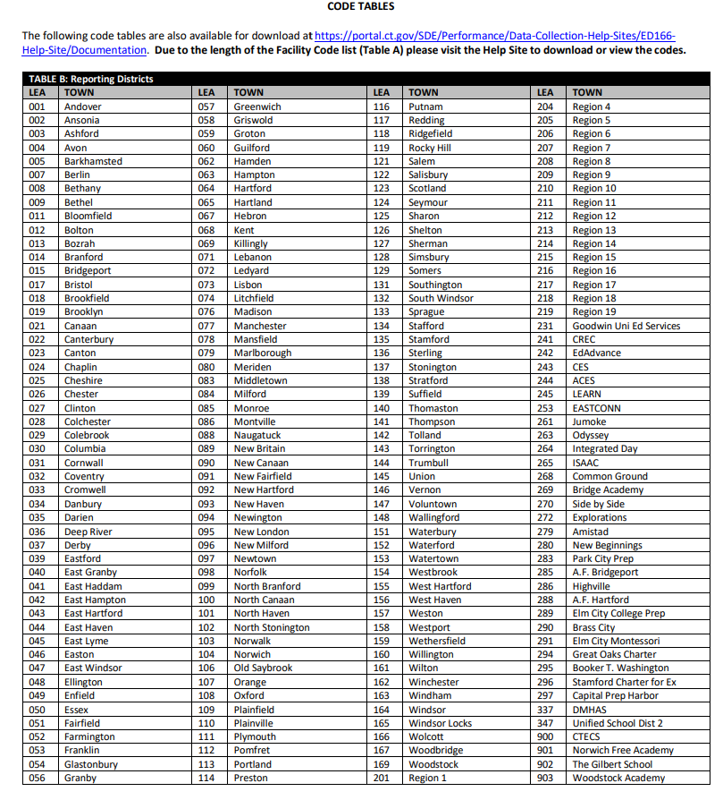
Notes:
Record Layout Page 5: The code tables begin on page 5 of the Record Layout. First is Reporting District. Remember that this can only be your Reporting District.

Slide 27
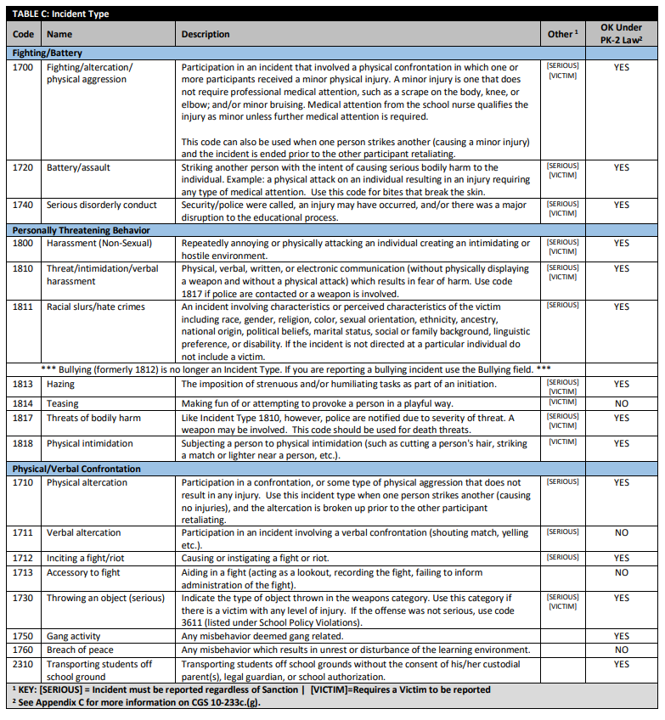
Code
The first column contains the Incident Type Code, followed by the name of the code and then a description
The Incident Types are
listed by category, which are separated by the blue rows. The ten categories are consistent
with the way
data is publicly reported on EdSight.
There are two important indicators for each code:
Other, which indicates if the code is Serious or requires a Victim. All Serious incidents must be reported regardless of Sanction.
The second is “OK Under PK-2 Law”. This indicator is explained in more detail in the Laws section.
Category
Notes:
Record Layout Pages 6-10: These pages contain the Incident Types. The Incident Types are listed by category. Note that the first column contains the Incident Type Code, followed by the name of the code and then a description. There are two important columns at the end. The first is Other, which indicates if the code is Serious or requires a Victim. Remember all Serious incidents must be reported regardless of Sanction. The last column is “OK Under PK-2 Law”. This law is explained in more detail on slide 37.
The Incident Type categories are:
Fighting/battery
Personally threatening behavior
Physical/Verbal confrontation
Property Damage
School Policy Violations. Notice that this category has the most Incident Types. This category also does not contain any “Serious” incidents so these Incident Types should only be reported if only ending in an ISS, OSS, Expulsion or Bus Suspension.
Theft/Theft Related Behaviors
Sexually Related behavior
Violent Crimes Against Persons
Weapons
Drugs
These categories are consistent with how the data is publicly reported on EdSight.

Slide 28
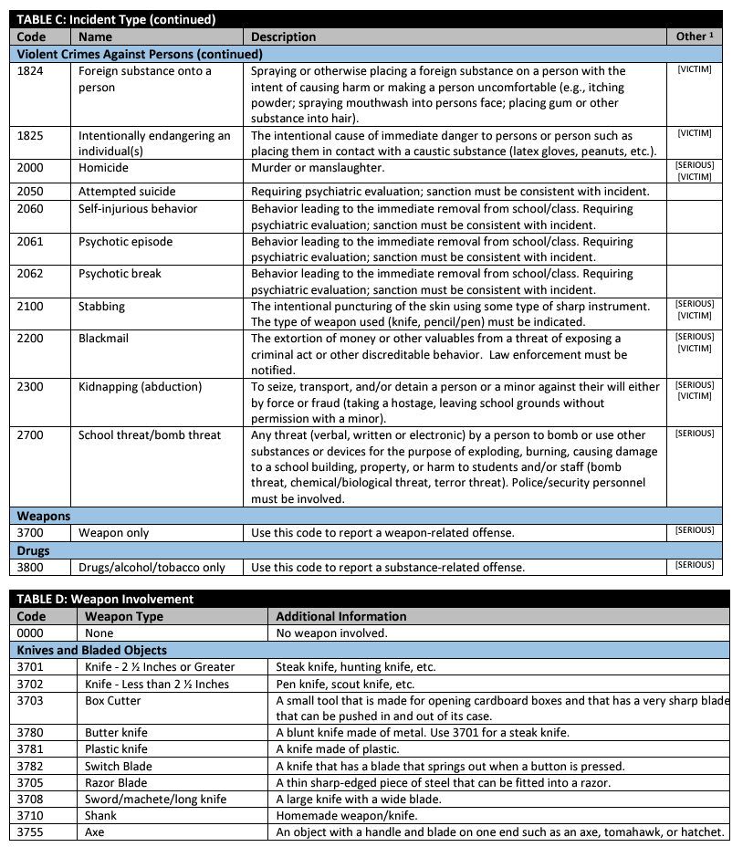
Notes:
Record Layout Page 10: Notice that there is only one code for both Weapons and Drugs (3700 and 3800) in the Incident Type table. This is because there are separate fields with additional code lists. For example, if a student was in a fight and has a substance on them you may choose to use a fight code as the Incident Type and then use the Substance Involvement field to provide that additional piece of information.
The Weapons categories are:
Knives and Bladed Objects
Guns of Any Type and Related Items
Explosives/Incendiary Devices
Projectiles and Related Items
Other Weapons
Everyday Objects
Other Weapon Related Offenses

Slide 29
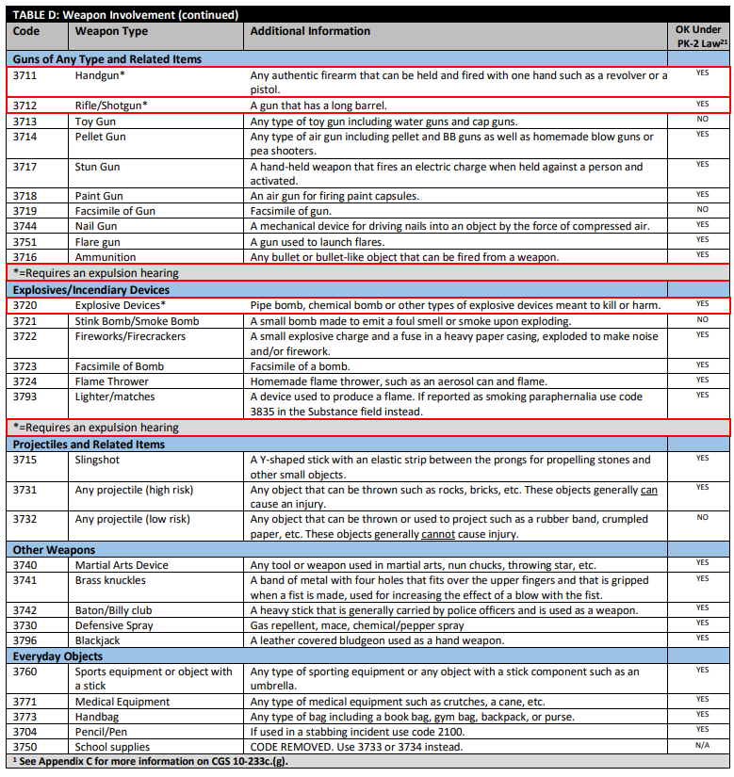
Notes:
Record Layout Page 11: Page 11 begins with the Guns of Any Type and Related Items and Explosives/Incendiary Devices categories.
Note there are red boxes around the following codes:
3711 - Handgun
3712 - Rifle/Shotgun
3720 - Explosive Device
If you report a record with one of these weapons the Gun-Free Schools Act of 1994 indicates that states receiving federal funds require a law where an Reporting District must expel a student who was determined to have brought a weapon to school. If your district does not code a record in this way, we will reach out to you to verify your coding prior to freezing the file.

Slide 30
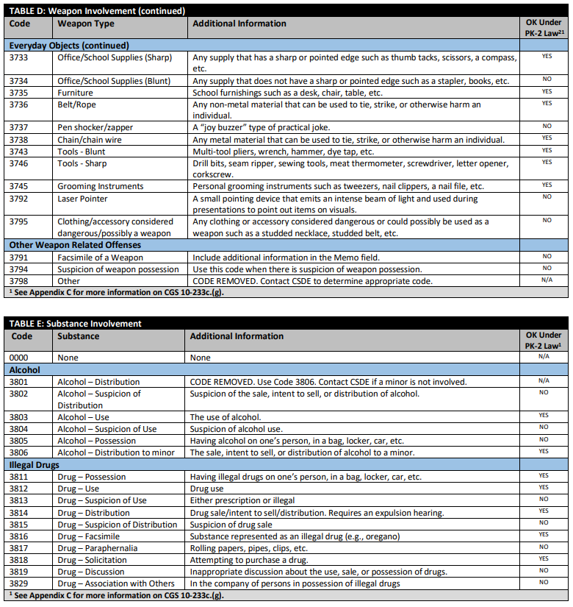
Notes:
Record Layout Page 12: Remember that all substances must be reported regardless of Sanction. Like the previous tables they are categorized:
Alcohol
Illegal Drugs
Prescription Drugs
Over the Counter Drugs
Tobacco and ENDS - Electronic Nicotine Delivery Systems, better known as vaping or e-cigarettes. Both Tobacco and e-cigarettes are highly underreported. Note that the ENDS codes only pertain to tobacco based vaping device. Be sure to use the marijuana codes if applicable.

Slide 31
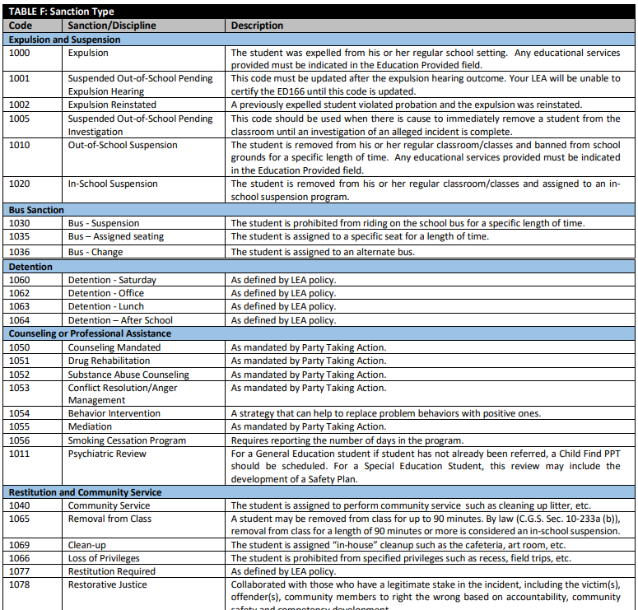
1000 Expulsion
1010 OSS
1020 ISS
1001 Suspended Pending Expulsion
1002 Expulsion Reinstated
1090 No Sanction
Notes:
Record Layout Pages 13-14: Next is the Sanction Codes table. The most common ones are:
1000 Expulsion
1010 OSS
1020 ISS
In addition to these it’s important to be aware of:
1001 Suspended Pending Expulsion
1002 Expulsion Reinstated
These two are important to note because the code Suspended Pending Expulsion will need to be updated prior to Certification unless the expulsion hearing is continued into the next school year. Expulsion reinstated is used if your Reporting District has a student who was expelled and then was allowed back in school as part of an agreement plan, and then that student then violates agreement.
One other Sanction Code to note is 1090 No Sanction. This code is used if your district is reporting a serious incident that did not end in a sanction.

Slide 32
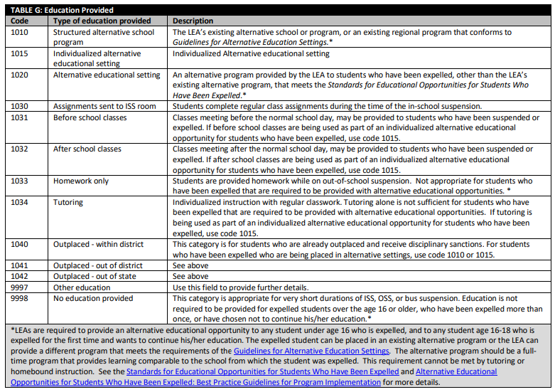
Notes:
Record Layout Page 15: On page 15 are the Education Provided codes. These codes are especially important when reporting Expulsions. At the bottom of this table are footnotes pertaining to Expulsions. By law, LEA’s are required to provide an appropriate alternative education to any student who is under the age of 16 and expelled or and any student 16-18 who is expelled for the first time and wants to continue their education. There are links to documentation detailing appropriate alternative education both at the bottom of this table and on the Help Site. The codes that fulfill the appropriate alternative education definition are identified in the definitions.
See slides 38-39 for statute information.

Slide 33
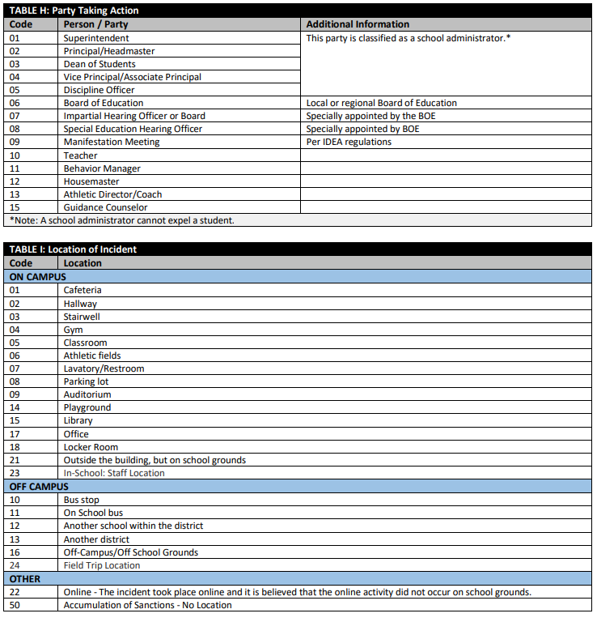
Notes:
Record Layout Page 16: On page 16 is the Party Taking Action code list – this is the individual that sanctioned the student. If a student is expelled a hearing must take place and an administrator cannot expel a student.
The next table is the Location of Incident. These codes are categorized by On-Campus, Off-Campus, and then Other. Other includes online as well as if a reportable incident took place because of an accumulation of incidents.
EXAMPLE: a student was suspended after numerous detentions not served.

Slide 34
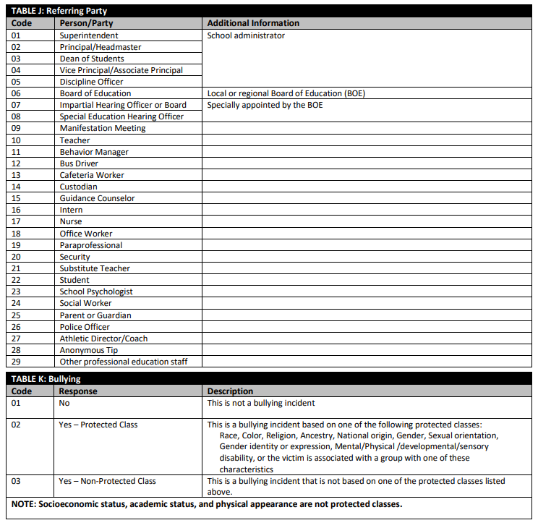
Notes:
Record Layout Page 17: The Referring Party is the individual who reported the student. Note that there is a code for an anonymous tip as well as a parent.
The final table is the Bullying codes. Remember that all incidents must have the Bullying field completed so you must indicate if each incident was a bullying incident. If a Bullying incident did take place your Reporting District must select if the incident was Bullying of a Protected Class or Bullying Non-Protected Class. Protected classes include incidents based on Race, Color, Religion, Ancestry, National origin, Gender, Sexual orientation, Gender identity or expression, Mental/Physical /developmental/sensory disability, or the victim is associated with a group with one of these characteristics.
EXAMPLE: If there is a student who does not have a physical disability, but they are friends with a group of students who do have physical disabilities and are subsequently bullied because of that relationship the incident would fall under Bullying of a Protected Class (since the student was associated with a protected class).
An Incident Type code is required in addition to saying yes in the Bullying field. Common Incident Type codes for Bullying incidents are:
• 1800 – Harassment (non-sexual)
• 1810 – Threat/Intimidation/Verbal Harassment
• 1814 – Teasing

Slide 35
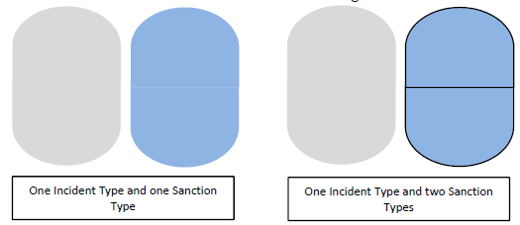
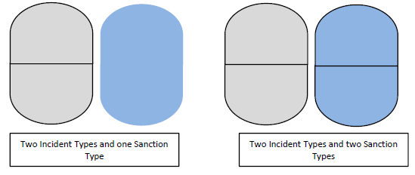
Possible Incident/Sanction
Field Combinations
Notes:
Recall that there are two Incident Type fields and two Sanction Type fields in the Record Layout. Think of each set of ovals as one all-encompassing event. The gray portion is the Incident description, and the blue portion is the Sanction description.
A record can consist of:
one incident type and one sanction type or
one incident type and two sanction types or
two incident types and one sanction type or
two incident types and two sanction types
This can get confusing, so it is useful to follow the description on the next page while viewing a full page printed or downloaded copy of the Multiple Incident Types/Sanctions Guide.

Slide 36
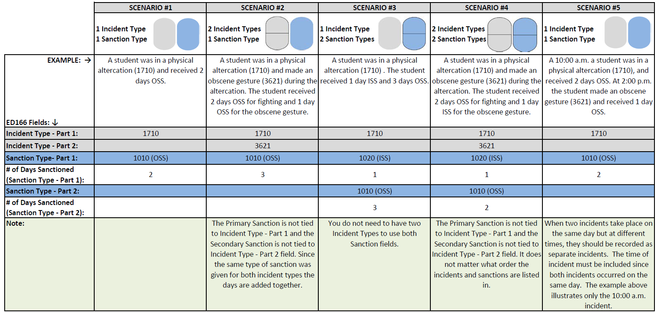
Using Multiple Incident Type and Sanction Type Fields
 TIP: Download the Multiple Incident Types/Sanctions Guide PDF from the Help Site
Notes:
This document covers 5 scenarios. Each includes an example situation and then the appropriate Incident and Sanction fields to use.
Scenario #1 – 1 Incident Type, 1 Sanction Type - A student was in a physical altercation (1710) and received 2 days OSS (1010).
Incident Type – Input 1710 in the first Incident Type field and leave the second Incident Type field blank.
Sanction Type – Input 1010 in the first Sanction Type field and leave the second Sanction Type field blank.
Scenario #2 - 2 Incident Types, 1 Sanction Type - A student was in a physical altercation (1710) and made an obscene gesture (3621) during the altercation. The student received 2 days OSS (1010) for fighting and 1 day OSS (1010) for the obscene gesture.
For the Incident Type use both fields – but then only one sanction field. The second sanction field must remain blank, even though the student received 2 days of OSS for part of the incident and an additional day of OSS for the other part of the incident. Since it was the same sanction, the days are combined.
Incident Type – Input 1710 in the first Incident Type field and 3621 in the second Incident Type field
Sanction Type – Input 1010 in the first Sanction Type field and leave the second Sanction Type field blank.
Scenario #3 - 1 Incident Type, 2 Sanction Types - A student was in a physical altercation (1710) . The student received 1 day ISS (1020) and 3 days OSS (1010). In this instance use one Incident Type field and both Sanction Type fields. The other incident field remains blank. You do not need to have two Incident Types to use both Sanction fields.
Scenario #4 - 2 Incident Types, 2 Sanction Types - A student was in a physical altercation (1710) and made an obscene gesture (3621) during the altercation. The student received 2 days OSS for fighting and 1 day ISS for the obscene gesture. In this case all four fields are used. The Primary Sanction is not tied to Incident Type ‐ Part 1 and the Secondary Sanction is not tied to Incident Type ‐ Part 2 field. It does not matter what order the incidents and sanctions are listed in.
Scenario #5 is a little different - At 10:00 a.m. a student was in a physical altercation (1710) and received 2 days OSS. At 2:00 p.m. the student made an obscene gesture (3621) and received 1 day OSS. When two incidents take place on the same day but at different times, they should be recorded as separate incidents. The time of incident must be included since both incidents occurred on the same day. The example on this handout illustrates only the 10:00 a.m. incident.
A few rules to remember are at the bottom of this sheet:
Incident Type ‐ Part 1 and Incident Type ‐ Part 2 should be viewed as one all‐encompassing description of an incident regardless of if one or two Sanction Types are imposed.
Sanction Type ‐ Part 1 and Sanction Type ‐ Part 2 should be viewed as one all‐encompassing sanction for an incident regardless of if the incident is described in one or two Incident Types.
Incident Type ‐ Part 1 CANNOT equal Incident Type ‐ Part 2.
Sanction Type ‐ Part 1 CANNOT equal Sanction Type ‐ Part 2.
As mentioned earlier this section this can get confusing! Please reach out to CSDE if you are unsure how to code a multi-part incident.
There is a data cleaning report built into the ED166 that will help you identify records that have been potentially miscoded. More information on this report will be available in Phase 2 Training.

Slide 37
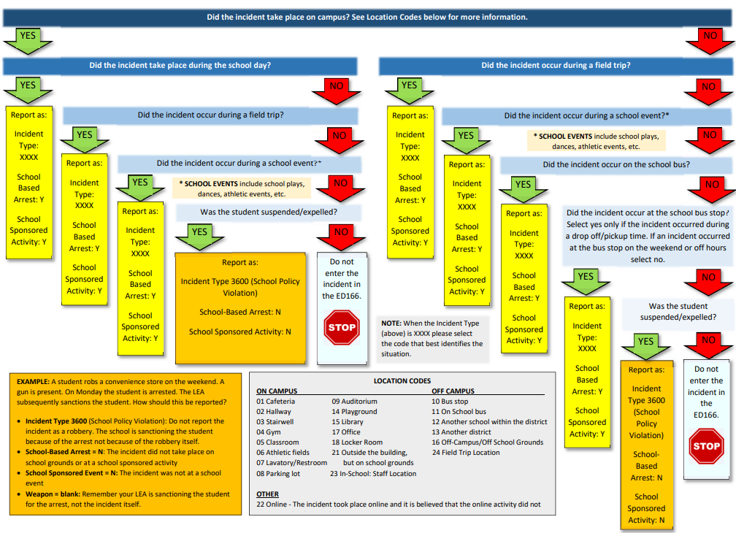
School Based Arrest Flow Chart
 TIP: Download the Reporting Arrests PDF from the Help Site
Notes:
This slide details when your Reporting District should report a student arrest in the ED166. As with the last slide it is recommended to follow this description with a printed or downloaded copy of the Reporting Arrests document as it will likely be easier to see.
Recall that only School-Based Arrests (SBA) should be reported in the ED166. This only includes incidents that took place on school grounds or at a school-sponsored event.
Note the series of questions in blue and the green “yes” arrows and red “no” arrows. All the situations that end in yellow will instruct you to report the arrest as School-Based, while the orange boxes will not be reported as a SBA, and the light blue boxes result in the incident not being reported in the ED166 at all. At the bottom of the page are several pertinent definition as well as the location codes.
EXAMPLE #1: A student robbed a convenience store on the weekend with a weapon. The student was arrested on school grounds on Monday and subsequently suspended from the school district due to the severity of the arrest. How and should that be reported?
Start at the top of the chart…Did the incident take place on campus? No, it did not, move to the right and down to the next question.
Did the incident occur on a field trip? No, again move right and down to the next question.
Did the incident occur on a school bus, No, again move right and down to the next question.
Did the incident occur at the school bus stop? Note that a bus stop is only considered a bus stop during drop-off/pickup times. In this case no, again move right and down to the next question.
Was the student suspended/expelled? Yes. Following the guidance in the orange box, note that the incident should be reported, but not as a SBA. Use incident type 3600 – which is a school policy violation where a “sanctionable” arrest took place. The incident is not coded as a robbery and the weapon is not reported. The school-sponsored activity field is coded as no.
EXAMPLE #2: A student shoplifted merchandise from a convenience store on a weekend. The student was arrested on school grounds on Monday, but no sanction is given by the LEA. Stepping through the chart all the answers are the same as the previous example except for the last one. The student was not suspended/expelled. This is an example of when a non-SBA took place, and nothing needs to be reported in the ED166.
Many other situations are more straight forward – arrests that occurred due to fights during the school day or at school football game etc. In each of those cases the SBA field should be marked “yes” as well as School Sponsored Activity field. The Incident Type would be coded as the actual incident that took place, and include any weapon or substance involved.
See slide 40 for statute information.

Slide 38
Laws
CT General Statutes Sec. 10-233d. Expulsion of pupils
  LEAs are required to offer an alternative educational opportunity to (1) any student under 16 years old who has been expelled (regardless of the reason); and (2) any student between 16-18 years old who has been expelled for the first time and wishes to continue his or her education shall be offered such an alternative educational opportunity if he or she complies with conditions established by his or her local or regional board of education
  Reporting District Review:
    ED166 Report
    Alternative Education information linked from the Help Site
More information on Reporting District Review items is available in the Phase 2 Training
Notes:
The next set of slides pertain to the discipline laws related to this collection.
10-233 (d) covers alternative education for expelled students. Recall that additional information is also linked at the bottom of the Alternative Education Provided table in the Record Layout and in the Links section of the Help Site.

Slide 39
Laws
CT General Statutes Sec. 10-233 (a-n) - Suspension of Pupils
  Defines Removal (90-minute rule), In-School Suspension, Suspension (Out of School), Expulsion and School-Sponsored Activities
  Resources: ED166 Data Exceptions
Notes:
10-233 (a-n) defines several of the terms used in reference to discipline including the “90 Minute Rule” referenced earlier.

Slide 40
Laws
Public Act No. 15-168 - An Act Concerning Collaboration Between Boards of Education and School Resource Officers and the Collection and Reporting of Data on School-Based Arrests
  "School-based arrest" means an arrest of a student for conduct of such student on school property or at a school-sponsored event.
  Resources: Reporting Arrests flow chart, Data Exceptions, Report
Notes:
PA 15-168 defines School-Based Arrests, which was discussed on slide 36.

Slide 41
Laws
Public Act 24-45 Sec. 14 revises the standard for determining when a school may issue an out-of-school suspension for Kindergarten through Grade Two students. An out-of-school suspension is permissible only if it is determined that it is necessary based on evidence that the student’s conduct (on school grounds) constitutes behavior that causes physical harm. School suspensions for such students cannot exceed five consecutive school days.
Notes:
This is an update to a law that has been in place since July 1, 2015. The law prohibits exclusionary discipline for students in grades PK-2 unless the behavior causes physical harm. Refer to the last column in Table C (Incident Type codes) to determine if a code falls within the law.
A report housed within the ED166 identifies records that may not follow the law. If the records below do not accurately describe the incident that occurred, your district should recode them before the data is frozen. This report is live, so it will be updated as you make changes to the data.

Slide 42
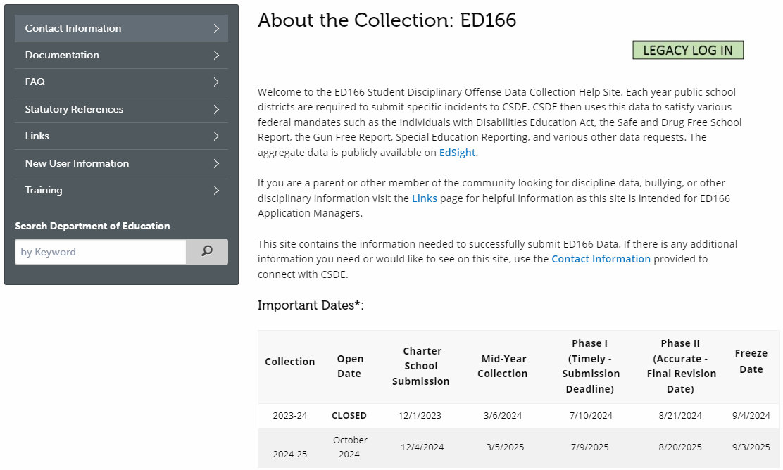
Help Site - Home
url: https://portal.ct.gov/SDE/Performance/Data-Collection-Help-Sites/ED166-Help-Site
or go to https://portal.ct.gov/SDE and search for ED166
Notes:
This is the ED166 Help Site Home Page. Note that there is a link to the application login page in the upper right. In the bottom center of the page the deadlines are listed.
There are several links on the left side menu. The next few slides will highlight the most referenced pages.
Slide Links:
ED166 Help Site: https://portal.ct.gov/SDE/Performance/Data-Collection-Help-Sites/ED166-Help-Site
CSDE Home Page: https://portal.ct.gov/SDE

Slide 43
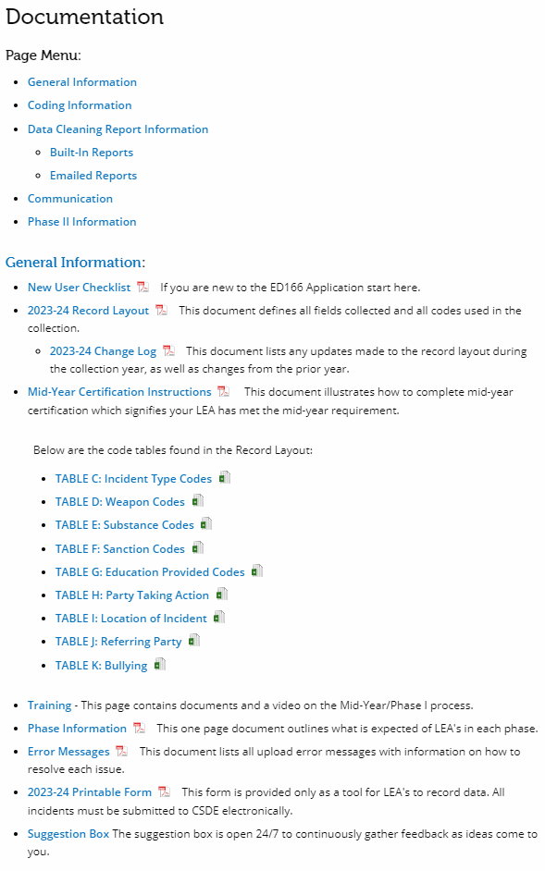
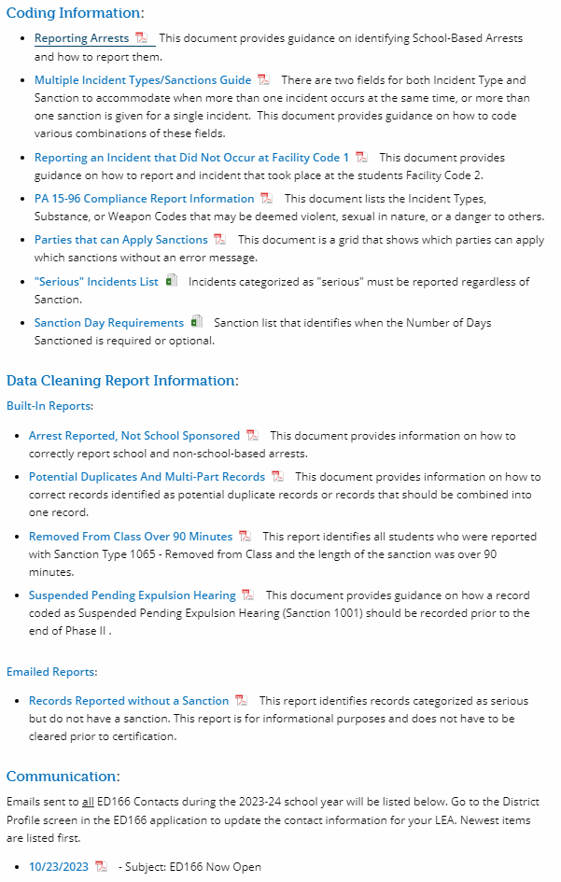
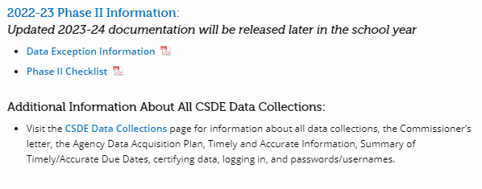
Help Site - Documentation
Notes:
The Documentation page is the most important pages as everything needed for reference is here. The page starts with General Information such as the record layout as well as the change log – recall that this is where any updates are listed. There is information on the phases and error messages. Next there is Coding Information. This is where the documents covered in this PowerPoint are all posted. After that is the Data Cleaning Report Information. Those reports will be covered in the Phase 2 PowerPoint, but you are encouraged to begin reviewing them early. Next is the Communication section. Since you are reviewing these instructions you may be new, so if you just joined the mailing list or haven’t yet been added to the profile, here is where you can catch up on the emails that have been sent this collection year.
When Phase 2 opens additional information will be posted in the Phase 2 Information section. If you need prior year documentation you can check the archive page (linked at the top left side of the screen but not visible on this screen shot).

Slide 44
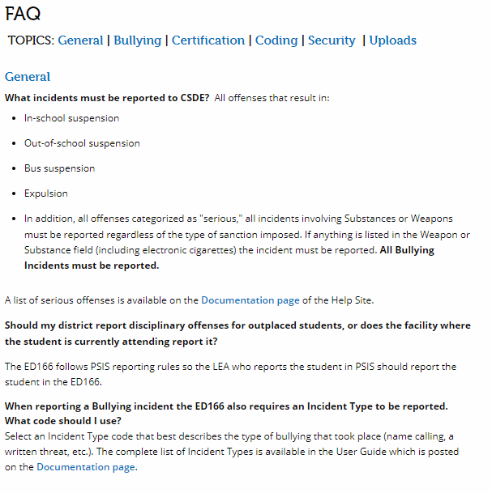
Help Site - Frequently Asked Questions
Notes:
The Frequently Asked Questions page lists the most common questions and is updated as additional reoccurring questions emerge.

Slide 45
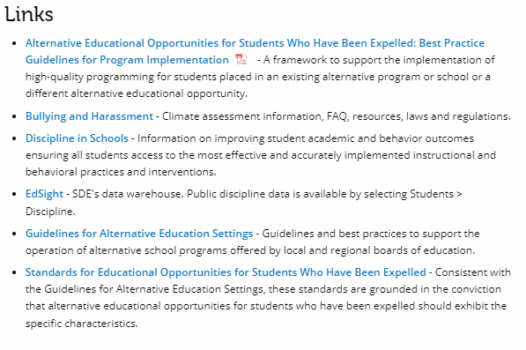
Help Site - Links
Notes:
The Links page brings you to documentation on alternative education for expelled students, information on bullying and harassment, as well as a link to EdSight, our public data warehouse.

Slide 46
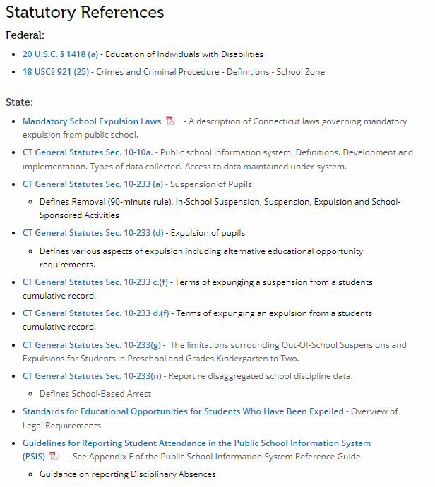
Help Site - Statutory References
Notes:
The Statutory References page links to the laws pertaining to the ED166 including those covered on the slides.

Slide 47
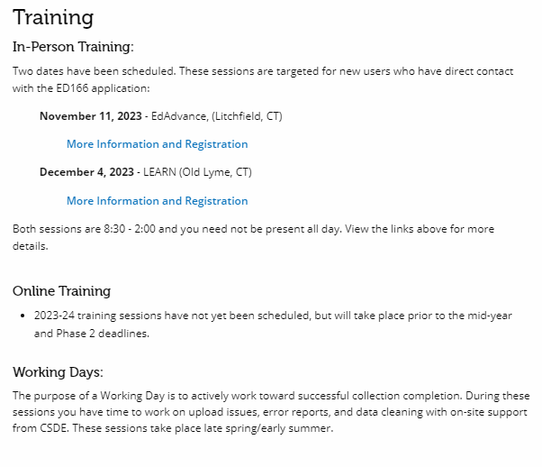
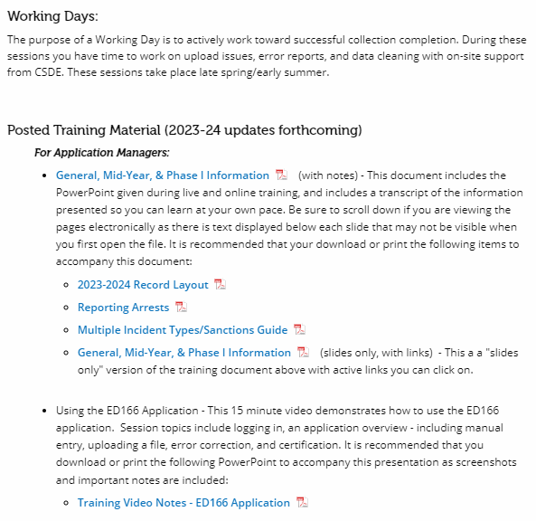
Help Site - Training
Notes:
The Training page lists any upcoming live sessions as well as prerecorded videos and PowerPoint training such as this one. When live sessions are scheduled, you will be notified via email if you are listed as an ED166 Contact.
In addition to training, we have Working Days in the spring/early summer. It is highly encouraged for new users to attend these. These sessions give districts a chance to work on their collection and receive live help as needed. The goal of these sessions is to complete your collection or to understand what else is needed to successfully complete your collection.

Slide 48
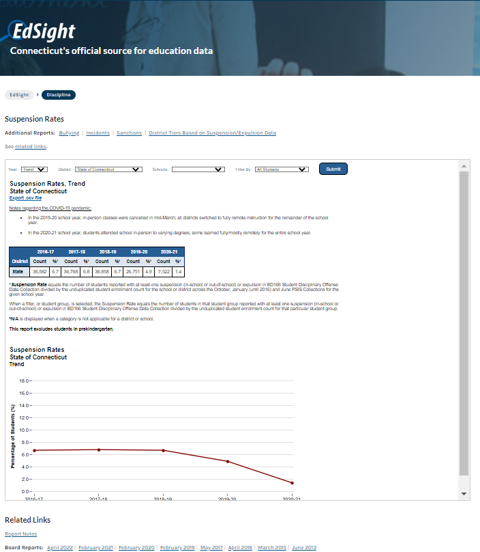
EdSight
url: http://edsight.ct.gov/
Go to Students → Discipline
Notes:
EdSight, CSDE’s public information portal, has been mentioned on a few slides. The website is linked from the Help Site, or you can go directly to http://edsight.ct.gov/. To view the discipline data, go to Students → Discipline
There are four sections of discipline data: Bullying, Incidents (where the data counts by category are displayed), Sanctions, and Suspension Rates.
You can view trend data, which shows a five-year range, or select a specific year. You can view district wide data or view a specific school. On the Suspension Rates Page, you can also drill down by subcategory (gender, grade, etc.).
Note that no Personally Identifying Information (PII) is posted on EdSight. You may notice some tables contain an asterisk instead of a number following our Data Suppression Guidelines (https://edsight.ct.gov/relatedreports/BDCRE%20Data%20Suppression%20Rules.pdf). Calculation information on each of these reports are available in the Report Notes section.
EdSight also contains links to our Annual Board Report on Discipline.

Slide 49
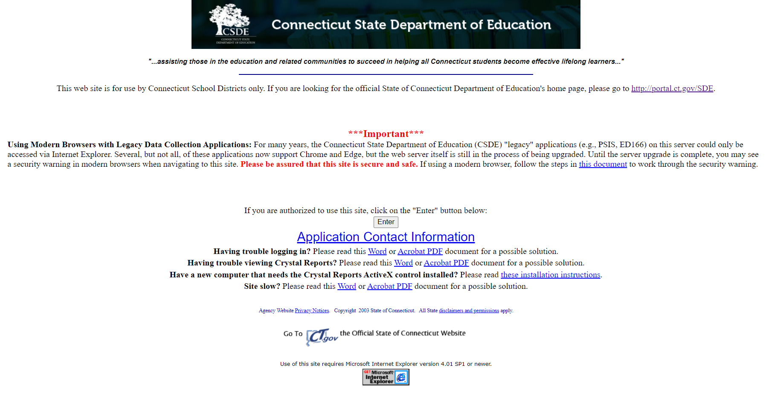
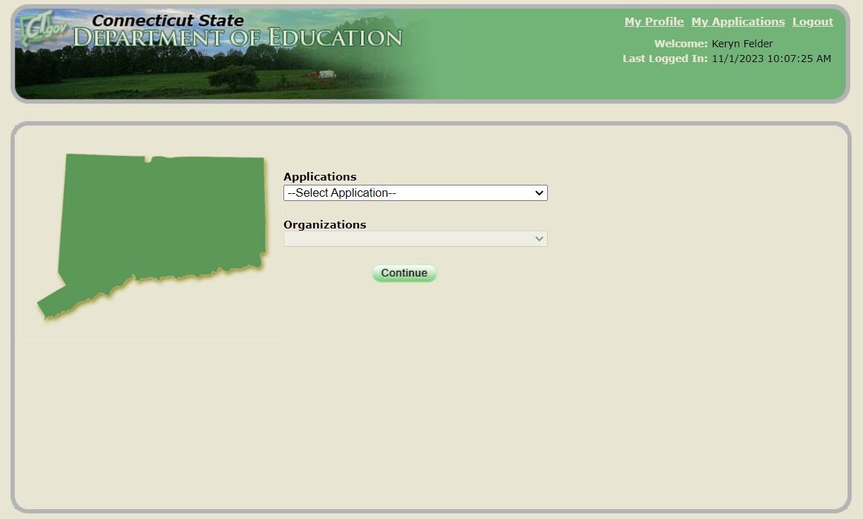
Application Types
Legacy | Portal
One password per Reporting District – may be shared as they see fit | One password per person. Do not share passwords, create a new account for every user.
One role per Reporting District – anyone with the password can add, delete, etc. | Multiple roles available. Functions are based on roles (access to editing data, certification, etc.)
Contact CSDE to reset your password | Password can be reset online
Visit the Data Collection Applications page for a list of each Performance Office application with its type.
Notes:
CSDE has two types of applications, legacy and portal. The ED166 is a legacy application, so there is only one username and password per district – and districts may share this with whoever they feel is appropriate on their end.
Slide Links:
Data Collection Applications: https://portal.ct.gov/SDE/Performance/Data-Collections-Guide/Data-Collection-Applications

Slide 50
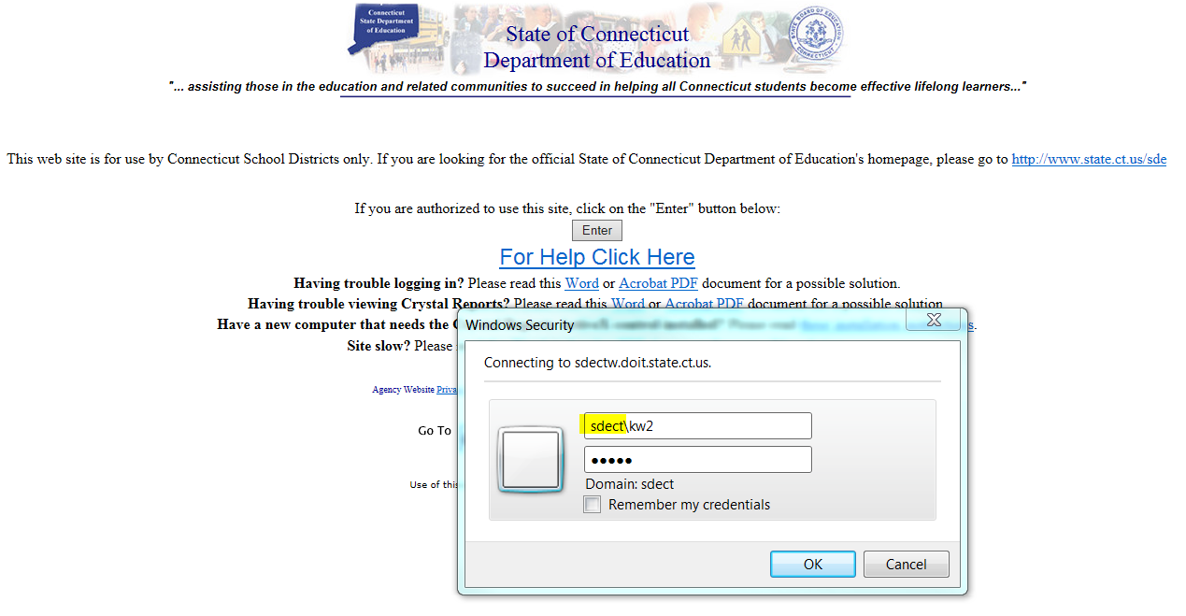
Accessing the Application
TIPS & REMINDERS:
• Add sdect\ before your username
Use the same username/password used to access other collections such as PSIS
If you are unsure of the username/password please contact our IT office at (860) 713-6681. Ask for the “enter button” password.
Notes:
The next set of slides are screen shots from the application and include tips in the blue boxes on the slides. This is a quick overview of each page, not comprehensive instructions. Visit the Training section of the Help Site to view a video demonstrating how to upload or manually enter data in to the ED166 Application. The next set of slides has been included so you can take additional notes on each screen as needed when you watch the video or when you upload.
To log onto the ED166 go to http://www.csde.state.ct.us/

Slide 51
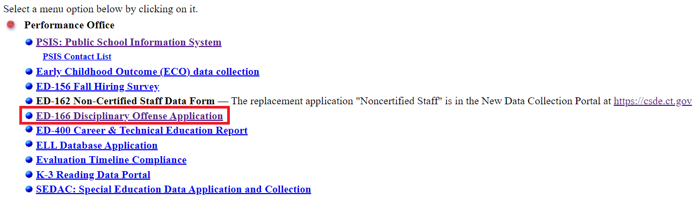
Accessing the Application
Notes:
After entering the first password select ED166 Disciplinary Offense Application.

Slide 52
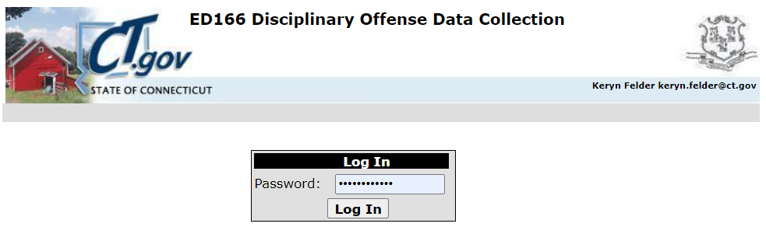
Accessing the Application
TIPS & REMINDERS:
There is one shared password per LEA
The password will only be released to those listed on the District Profile
The password provides users with full access
Notes:
Enter the ED166 specific password. If you need password assistance, contact CSDE.

Slide 53
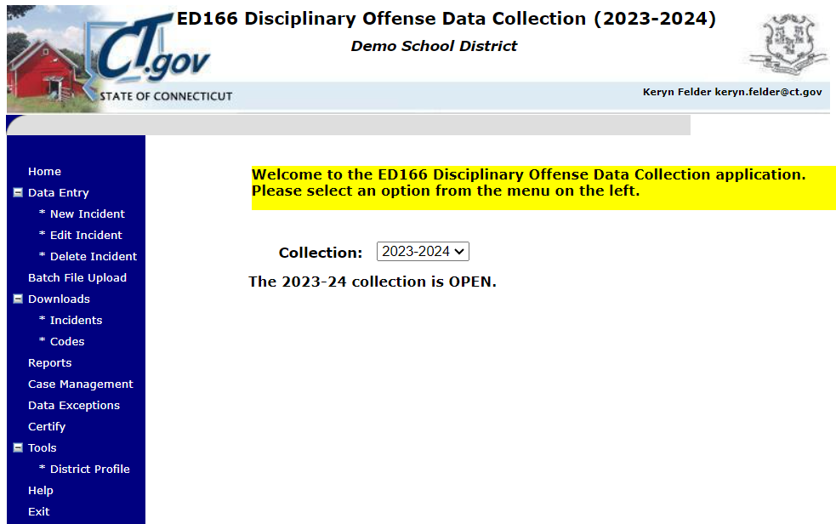
ED166 - Home Screen
TIPS & REMINDERS:
You can select a prior year on the Home screen. This can be useful to review data by comparing it to previous year data.
Notes:
On the ED166 Home Screen you can select a prior year in the drop-down menu to review reports or download data from a different collection year.
The next slides will step through each of the menu item on the left side of the screen.

Slide 54
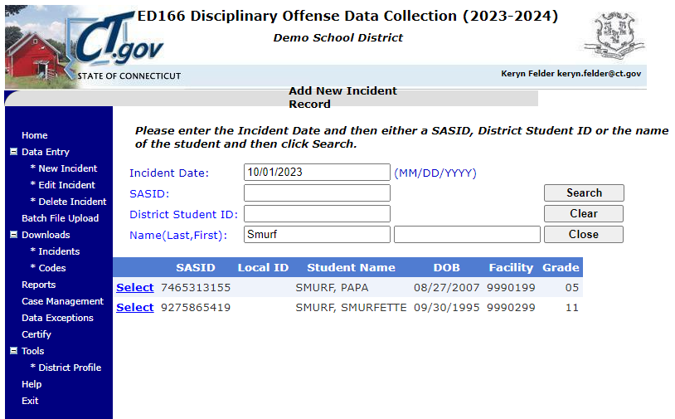
ED166 – Manual Entry Step 1
TIPS & REMINDERS:
When manually entering a record, you must include the Incident Date and then SASID or Name
Notes:
To manually enter a record, select New Incident. Next enter the date of the incident and the students SASID, District Student ID, or Name. A list of potential matches will appear. Select the appropriate student and the Individual Entry screen will open.

Slide 55
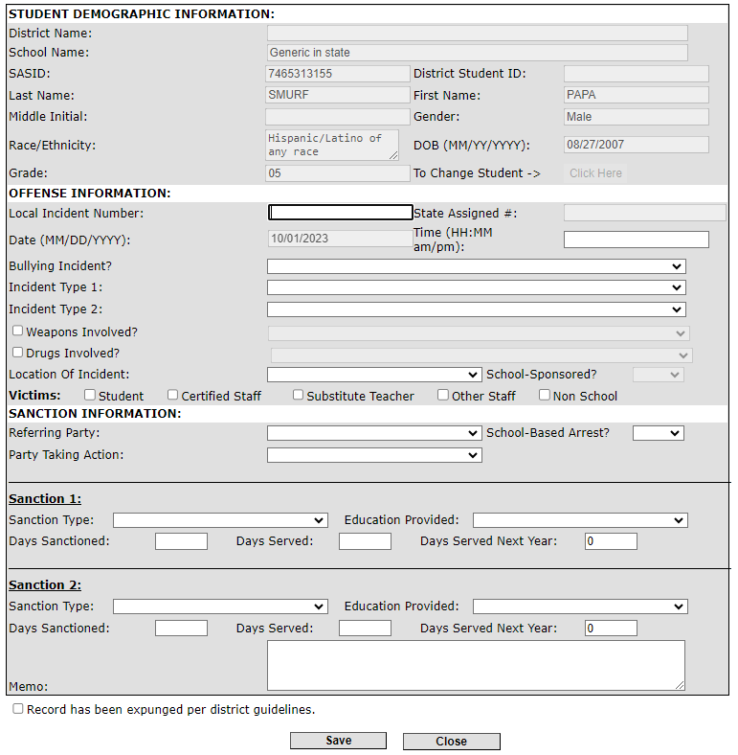
ED166 – Manual Entry Step 2
TIPS & REMINDERS:
Demographic information is populated from PSIS registration.
Notes:
The top of this screen contains locked (“grayed out”) fields with demographic information for the selected student. If the data in any of these fields is incorrect, it must be edited in the Public School Information System (PSIS) Registration Module.
Complete the form and select Save. An error message will occur at the top of the screen if there is any missing or inconsistent information. You will not get an error report for manually entered records as the error check occurs upon saving.

Slide 56
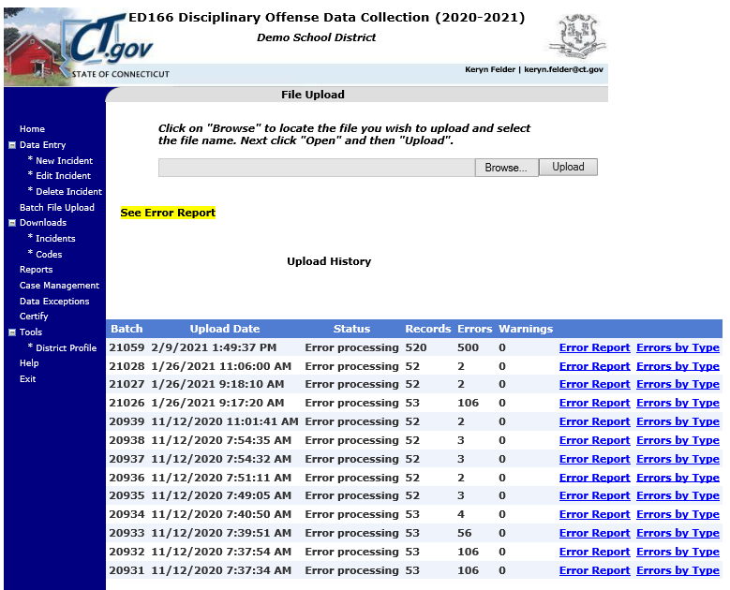
ED166 – Batch Upload Screen
TIPS & REMINDERS:
Your prior uploads will be listed here.
This is where you access your error report.
Max errors = 500
Notes:
All uploads for the school year are listed as well as corresponding error reports. There is also a report that indicates the number of errors by type, which can be useful to identify systematic issues. If you enter records manually, they will not be reflected on this page.

Slide 57
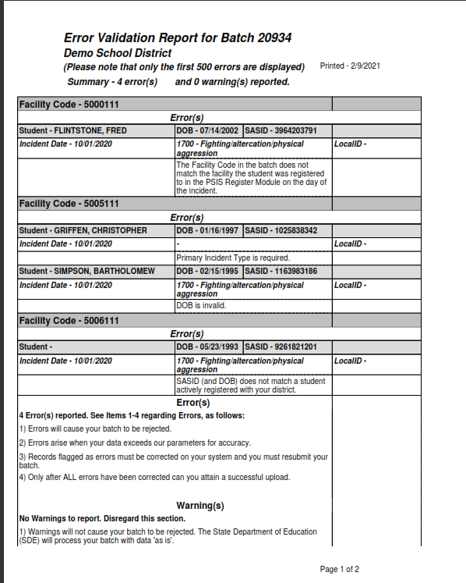
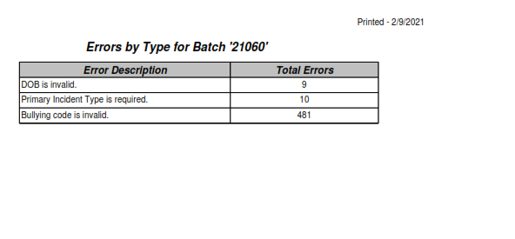
Error Report
TIPS & REMINDERS:
A list of Error Messages & correction information is on the Help Site
500+ errors are generally same error on every record
Notes:
The Error Report identifies records that did not pass the ED166 validation checks. The best practice is to correct errors in your LEA’s Student Information System (SIS), create a new extract, and upload again.
These errors cannot be corrected manually within the ED166 application.

Slide 58
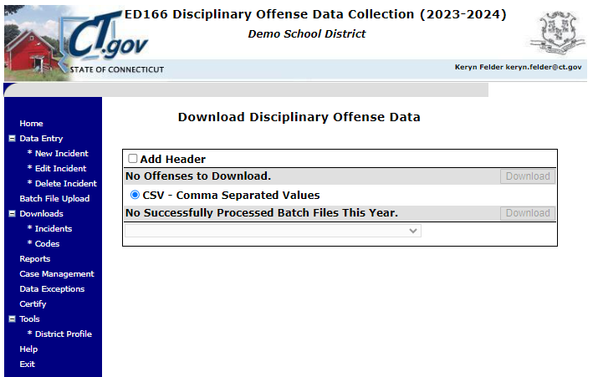
ED166 – Download Incidents Screen
TIPS & REMINDERS:
It can be useful to retain a copy of your complete batch
Prior year data is also available
Notes:
The downloads section of the application provides extracts of your data and system codes, both of which can be helpful with internal analysis or recordkeeping.
Incidents – records reported can be downloaded by batch, or combined. There is an option to include the field names in the download (select “Add Header”).

Slide 59
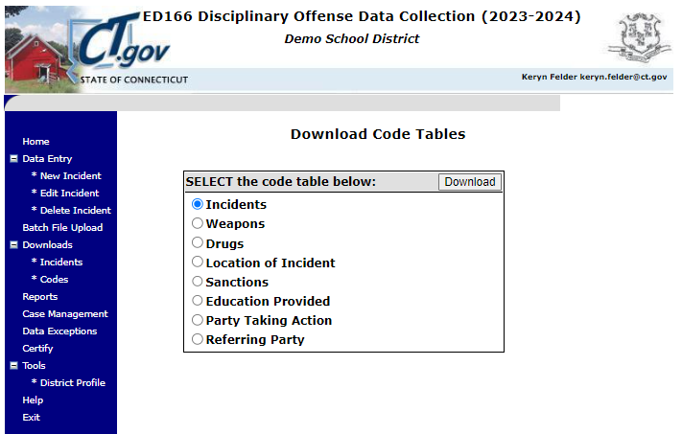
ED166 – Download Codes Screen
TIPS & REMINDERS:
Code lists can be helpful for internal analysis
Notes:
Codes – Each of the code tables is available for individual download.

Slide 60
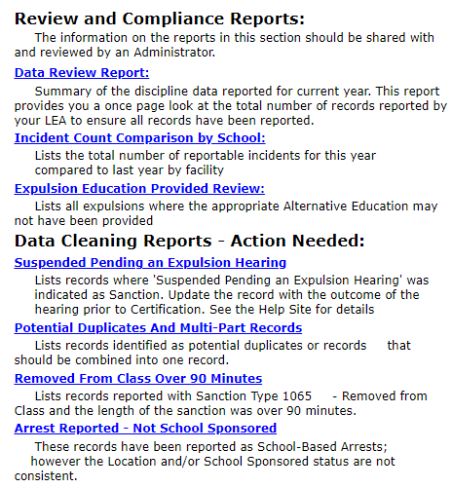
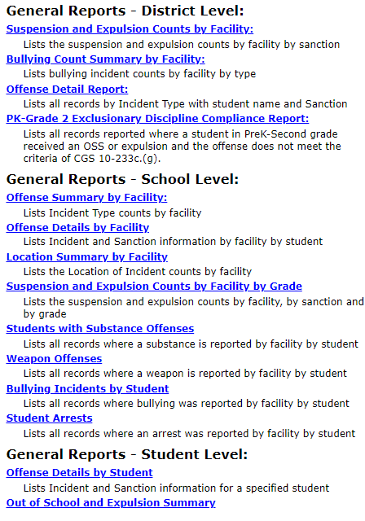
ED166 – Reports Screen
TIPS & REMINDERS:
Data Cleaning Reports must be cleared prior to final Certification
Notes:
There are many reports available within the ED166. These reports are live, and therefore immediately updated upon data charges.
Review and Compliance Reports
These reports are encouraged to be shared with administrators as they provide a high-level record review, as well as student level records that may be out of compliance with CT disciplinary laws or have been reported incorrectly.
Data Cleaning Reports
The Data Cleaning Reports identify records that must be updated prior to Phase 2 Certification.
General Reports
Several general reports are available to help your Reporting District review the data submitted.

Slide 61
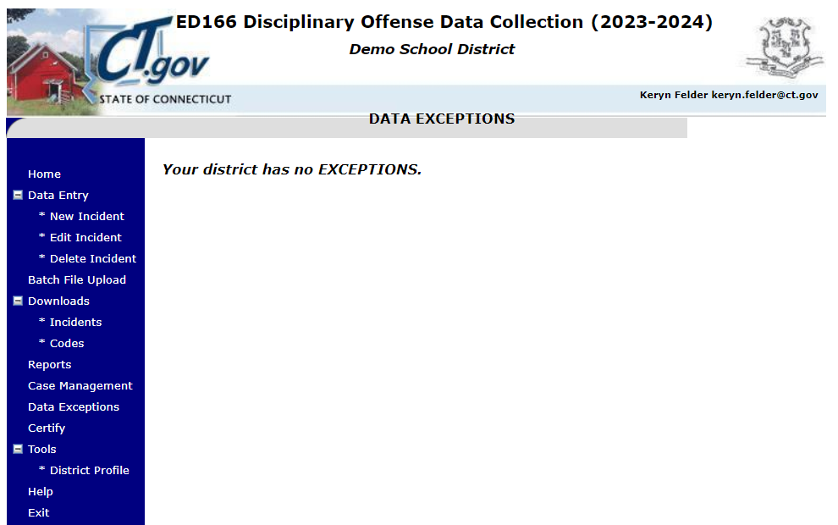
ED166 – Data Exceptions Screen
TIPS & REMINDERS:
Data Exception information will be covered in Phase 2 training.
Data Exceptions are not generated until Phase 2.
Notes:
Variances in counts will generate a data exception that must be addressed by your LEA. Fluctuation in counts can naturally occur due to redistricting, changes in enrollment/administration, etc. or can be indicative of errors in data reporting.
An explanation of the logic used to identify Data Exception Types is available on the Help Site. Data Exceptions are not generated until Phase 2 begins and detailed information will be available in Phase 2 training.

Slide 62
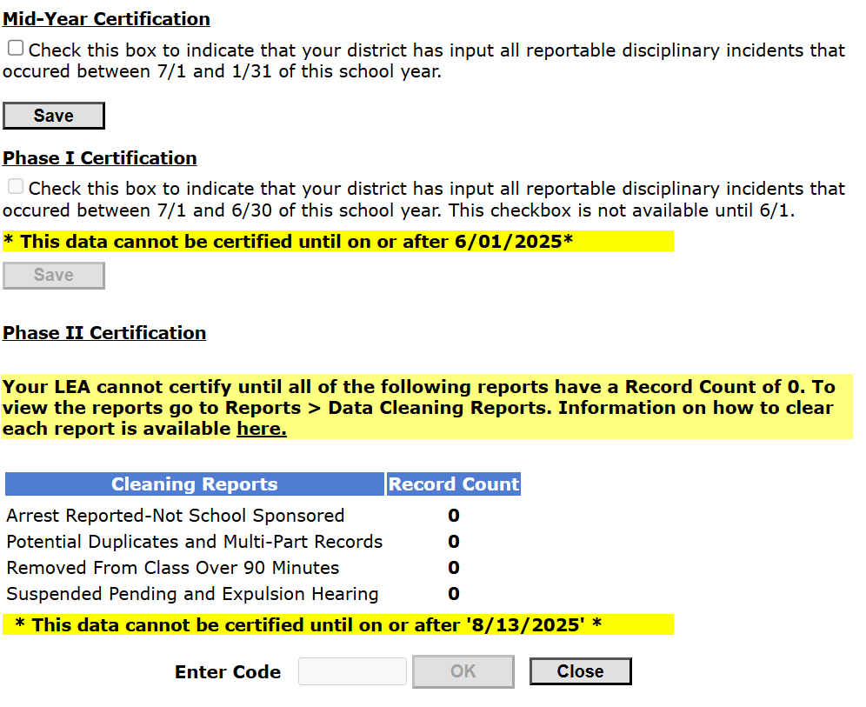
ED166 – Certification Screen
TIPS & REMINDERS:
Check this box to complete the Mid-Year Collection
An Administrator is not required to complete this step
You do not need to uncheck the box to add/edit/delete data
Notes:
Mid-Year Certification – consists of a checkbox indicating that incidents which occurred between 7/1 and 1/31 of the school year have been reported. This box does not need to be unchecked to make any additional edits and does not need to be completed by an Administrator.
Phase 1 Certification – as with Mid-Year Certification this consists of a checkbox indicating that incidents which occurred between 2/1 and 6/30 of the school year have been reported. This box does not need to be unchecked to make any additional edits and does not need to be completed by an Administrator.

Slide 63
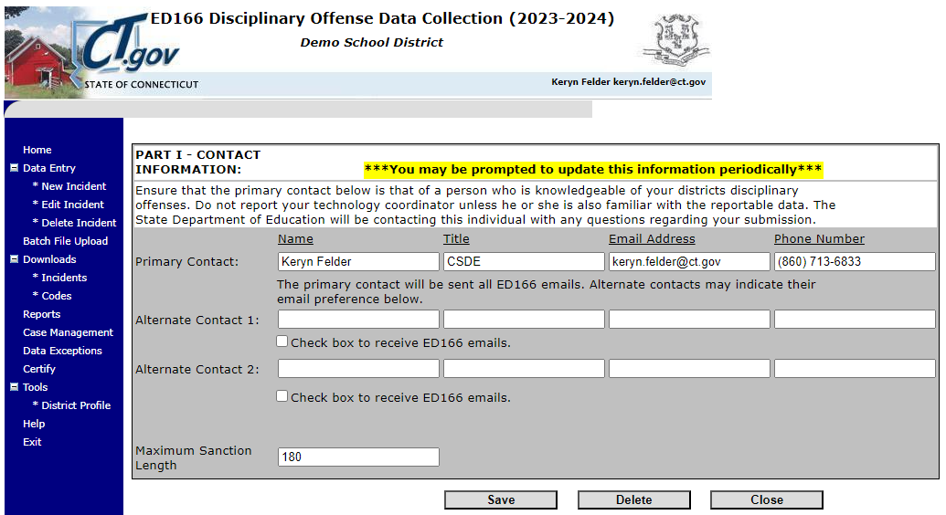
ED166 – District Profile Screen
TIPS & REMINDERS:
Passwords are only released to those on the profile
Once you are added to the profile you are automatically on the email list
Notes:
Passwords are only released to those on the profile. Once a user is added to the profile, they are automatically on the email list and will receive training invitations, collection reminders, and other pertinent information.
The Maximum Sanction Length is also stored on this page. This number is used to validate the length of expulsions reported by your LEA.

Slide 64
What Can I Do Now?
Step through the Record Layout to familiarize yourself with the codes
Review last years data – in the ED166 as well as on EdSight
Query your SIS (check for missing data, etc.)
Upload a file (can upload at any interval) or enter data

Slide 65
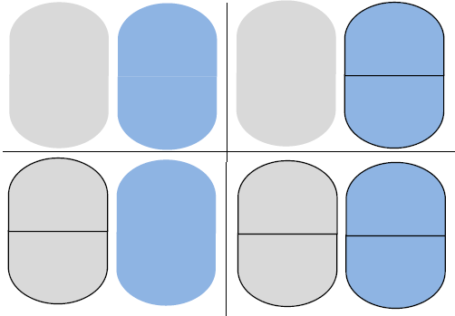
THE MOST IMPORTANT SLIDE
Bookmark the Help Site (Record Layout, FAQs, Instructions): https://portal.ct.gov/SDE → Search “ED166”
What incidents are required to be reported to CSDE?
All offenses that result in:
In-school suspension
Out-of-school suspension
Bus suspension
Expulsion
In addition, all "serious" offenses and incidents involving Alcohol, Drugs or Weapons must be reported regardless of the type of sanction imposed. This means that if anything is listed in the Weapon Involvement or Substance Involvement field the incident must be reported. All Bullying Incidents must be reported.
Deadlines
Mid-Year: March 5, 2025
- partial data
- checkbox to certify (no Admin needed)
Phase 1: July 9, 2025
- all remaining data
- checkbox to certify (no Admin needed)
Phase 2: August 20, 2025
- resolve Data Exceptions
- clear Cleaning Reports
- review Certification checklist
- Administrator Certification
Reminders:
A student must be registered to your district in the PSIS Registration Module on the Incident Date to report them.
Review the Reporting Arrests flowchart to determine if a School-Based Arrest should be reported
Be sure to update incidents with an expulsion hearing pending (do not add a new record)
Update your District Profile as needed
A single record in the ED166 can “look”
any of the following ways:
1 Incident Type, 1 Sanction Type
1 Incident Type, 2 Sanction Types
2 Incident Types, 1 Sanction Type
2 Incident Types, 2 Sanction Types
Details available on the Help Site
Questions: Keryn.Felder@ct.gov
 START YOUR  COLLECTION EARLY
FREEZE DATE: SEPTEMBER 3, 2025
ABSOLUTELY NO CHANGES CAN BE MADE AFTER THIS DATE
Notes:
This slide highlights the biggest takeaways:
What is, and what is not, a reportable incident
A reminder about the link between the ED166 and PSIS
The four ways a record can “look” using 1-2 Incident Type fields and 1-2 Sanction Type fields
The link to the Help Site
The deadlines
A reminder to start your collection early

Slide 66
Questions? Suggestions?
Keryn G. Felder Keryn.Felder@ct.gov Additional training opportunities for the 2024-25 collection: January/February – New User Phase 2 Training – online May/June – New User Phase 2 Training – online July – Working Day Sessions – in person
Notes:
Closing Remarks:
I hope the printed version of this information was helpful to you. Be sure you are viewing the most recent version of this document as the training sessions above will be updated as they are scheduled.
Once again, I recommend beginning your collection early, as it will allow ample time to work together through any issues that may occur (missing data, records that require further research, etc.). If you have any additional questions, I’m happy to help, and if you have any recommendations on the collection itself (new reports, etc.) let me know. As always feel free to email me with questions.
- Keryn Felder

