Slide 1
ED166 Student Disciplinary Offense Collection Training Administrator Overview
2024-25 School Year
Updated 10/21/2024
Notes:
This PowerPoint is on the ED166 Student Disciplinary Offense Collection. The focus is general information, an overview of discipline laws related to this collection, and best practices for reviewing your District’s data. This PowerPoint is intended for Administrators or other District individuals who would like general overview of the collection.
The term “Application Manager” applies to the individual(s) in your District who are directly responsible for uploading data into the ED166 application.

Slide 2
Slide Deck Information
If you are viewing this in PowerPoint, be sure the notes are visible beneath the slides. To enable notes, go to View and select Notes:
If you are viewing this as a PDF, and the links within the slide do not work, use the links provided in the notes below the slide.
Notes:
If you are viewing this in PowerPoint, and you can see this message, your notes are visible.

Slide 3
CSDE Resources
Keryn G. Felder
Education Consultant
Keryn.Felder@ct.gov
ED166 Help Site
Search ED166 from the CSDE home page
Notes:
Welcome Message:
Welcome to the ED166 Student Disciplinary Offense collection. This information includes the same content presented at both live and virtual training sessions but allows you to step through the information at your own pace. I encourage you to reference this document when you are completing your collection. Note that if I get questions during the school year or at training sessions this PDF version of this document (posted online) may contain additional clarifying information in the accompanying text so be sure you have the latest edition.
I encourage you to bookmark the ED166 Help Site as it’s a great resource and many questions can be answered from information on the Documentation page. I recommend beginning your collection early, as it will allow ample time to work through any issues that may occur (missing data, records that require further research, etc.).
If you have any questions, I’m happy to help. The best way to reach me with questions is via email.
Keryn Felder
Slide Links
Email: Keryn.Felder@ct.gov
ED166 Help Site: https://portal.ct.gov/SDE/Performance/Data-Collection-Help-Sites/ED166-Help-Site
CSDE Home Page: https://portal.ct.gov/sde

Slide 4
Contents
General information and timeline
Review of discipline laws
Data review recommendations
Notes:
The goals of this PowerPoint are to provide a better understanding of what the State Department of Education (SDE) is required to collect, a brief overview of ED166 related discipline laws, and suggest strategies to identify if there are incorrectly reported records or incorrectly sanctioned incidents.

Slide 5
ED166 Student Disciplinary Offense Application
Reportable offenses include all offenses that result in:
In-school suspension
Out-of-school suspension
Bus suspension
Expulsion
In addition, all "serious" offenses, all incidents involving Alcohol, Drugs or Weapons must be reported regardless of the type of sanction imposed.
This means that if anything is listed in the Weapon Involvement or Substance Involvement field (including electronic cigarettes) the incident must be reported.
All Bullying incidents must be reported.
All other incidents are removed if reported.
A list of serious offenses is available on the Documentation page of the Help Site.
Notes:
The ED166 collection is sometimes incorrectly referred to as the “suspension and expulsion collection” as many who are not directly involved with reporting are not familiar with the with the full requirements. The slide above outlines which incidents are required to be reported.
While other incidents do occur, they are not required to be reported to the SDE. There are over 100 Incident Type codes broken into 10 categories. This material focuses on reportable incidents.
The complete Record Layout is available on the Help Site. It includes Incident Type codes, Sanction Type codes and all other ED166 fields and definitions.
Slide Links:
Help Site: https://portal.ct.gov/SDE/Performance/Data-Collection-Help-Sites/ED166-Help-Site
Record Layout: https://portal.ct.gov/-/media/SDE/Performance/Data-Collection/Help-Sites/ED166/2022-2023_ED166_RecordLayout.pdf

Slide 6
What is the Data Used for?
Federal Data Collections
State Data Collections
Board Report
EdSight
Data Suppression Guidelines
FOI Requests
Media
Research
Other
Notes:
The data collected is used to satisfy federal data collections, state data collections including our annual Board Report, and Freedom of Information (FOI) requests. Discipline data is also publicly posted on EdSight, the SDE’s public longitudinal data portal. Any publicly posted or released data follows all Family Educational Rights and Privacy Act (FERPA) data suppression guidelines and no Personally Identifiable Information (PII) is included. This generally means that counts of 5 or less are suppressed. More information on the data suppression guidelines is available on EdSight.
Slide Links:
EdSight: http://edsight.ct.gov
Data Suppression Guidelines: https://edsight.ct.gov/relatedreports/BDCRE%20Data%20Suppression%20Rules.pdf

Slide 7
2024–25 ED166 Application Deadlines
Collection Opens – Fall (email and web site notification)
Charter School Submission: December 4, 2024 (required)
Mid-Year: March 5, 2025
Phase 1: July 9, 2025
Phase 2: August 20, 2025
Freeze Date: September 3, 2025
Incident Date Range: July 1 – June 30 → Does not change
Varies yearly, but within the same general time frame
START YOUR COLLECTION EARLY
Notes:
The ED166 collection opens in the Fall each school year, and your Reporting District can begin uploading/data entry at any time. When the collection opens, an email will be sent to everyone in the ED166 District Profile alerting them of the opening. The collection will also be posted as “open” on the Home Page of the Help Site.
NOTE: The ED166 District Profile is a screen within the ED166 application. Be sure this information is up to date as the individuals listed are the only ones authorized to receive password information from the CSDE. These individuals are also automatically on the ED166 mailing list.
The deadlines on this screen pertain to the ED166 Application, not your Reporting District policy. Most Reporting Districts enter incidents into their local Student Information System daily.
These deadlines do adjust within the same general time frame each year. These dates are posted on the Home Page of the Help Site, as well as on the left side of every email sent about the collection. Note the Charter Schools have an additional submission, which began in the 2023-24 school year.
The ED166 incident date range is July 1 – June 30 every year. It’s important to note that the data can be entered at any time, you do not need to wait for the mid-year collection deadline to approach to begin. You can report data at any interval you wish, such as monthly or weekly. You can also group your batches in any way you wish such as by school or grade level.
A best practice is to start your collection early, especially in Phase 2 as it is generally more difficult to connect with colleagues during the summer months if you need to learn more about an incident to clean up errors, etc. New users are encouraged to start each portion early so there is ample time for assistance.
Reminder emails are sent at the following intervals: 1 month, 2 weeks, and then to applicable Reporting District’s 1 week, 2 days, 1 day, and the day of.
Slide Links:
Timely and Accurate Calendar: https://portal.ct.gov/-/media/SDE/Performance/Data-Collection/Timely_Accurate_Calendar_Current.pdf
Data Acquisition Plan: https://portal.ct.gov/-/media/SDE/Performance/Data-Collection/DAP_Current_Excel.xlsx

Slide 8
Accessing the Application
The ED166 is a Legacy Application
Logon Page
One username and two passwords are needed:
Password #1
The same username/password used to access other collections such as PSIS
Call (860) 713-6681 for assistance
Password #2
The password will only be released to those listed on the District Profile
The password provides users with full access
Notes:
The ED166 is a Legacy Application meaning a shared username and passwords are used to access the application.
The first password is the same username/password used to access other collections such as PSIS.
If your Reporting District is unsure of the first username/password please contact our IT office at (860) 713-6681. Ask for the “enter button” password.
The second password applies to the ED166 application only. Again, this username can be shared amongst your Reporting District as you see fit.
Contact Keryn Felder (Keryn.Felder@ct.gov) if your Reporting District needs your password reset.
The password will only be released to those listed on the District Profile screen in the ED166.
For security purposes the District Profile can only be updated on the Reporting District end.
The password provides users with full access so be sure those with access understand their role.
Slide Links:
Login Page: https://www.csde.state.ct.us/

Slide 9
Phase Descriptions Application Manger Responsibilities
Mid-Year (May) and Phase 1 (July):
Input all incidents. If uploading data must be error free
Complete mid-year or Phase 1 certification (checkbox)
Phase 2(August):
Respond to any data exceptions
Clear Data Cleaning Reports
Review all other reports
Request a Certified Administrator to complete certification (5-6 digit password)
Notes:
Each Reporting District may handle data entry differently throughout the year. Some Reporting District’s have guidance counselors input discipline logs, others have a dedicated data entry person.
While the first deadline is March 1, your Reporting District may upload data at any interval (monthly, quarterly, etc.) to meet the deadline. Your ED166 Application Manager will extract the data from your student information system (SIS) and upload it into the ED166. Any errors detected by the ED166 should be corrected in your SIS, and then a new file should be exported and uploaded.
During Phase 1 I, your ED166 Application Manager will be prompted to review several reports, update items that appear to be errors, and respond to any large variations in your numbers (excluding of the “COVID years”).
It is highly recommended that new Application Managers try uploading data well before the deadlines so there is ample time to work through any issues that may occur.

Slide 10
Administrator Timeline and Responsibilities
August 20, 2025 - Certification – the electronic signoff signifying the accuracy and completeness of the data reported. This must only be completed by an administrator.
September 3, 2025 - Freeze – no changes can be made after this date. The frozen data is used for all reporting purposes.
Notes:
There are two important dates that those at the Administrator level should be aware of (see above).
Once the data is certified, certification can only be removed by SDE if further changes are needed. Once updated, the file must be recertified. Certification cannot be removed after the data is frozen.

Slide 11
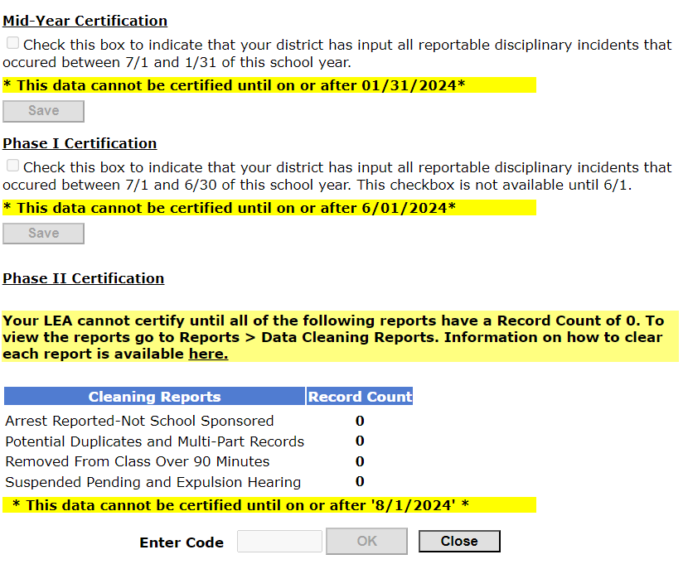
Phase 2 - Final Certification
TIPS & REMINDERS:
An Administrator must complete this step.
The 5-digit Superintendent certification code is needed here.
Once certified, your Reporting District must request that certification be cleared if any additional edits are needed (before the freeze date).
Notes:
To access the Certification page, log onto the ED166 Application and go to the Certify page. While there is a Mid-Year and Phase 1 checkbox that can be completed by any Application Manager, an administrator must complete Phase 2 Certification since it is the final signoff affirming completeness and accuracy.
Note the following:
Phase 2 Certification is not available until the Data Exceptions are generated and Reporting District’s are notified that Phase 2 has begun.
The Phase 2 Certification section lists all Cleaning Reports that must be cleared prior to Certification. Your Application Manager will receive more information on these reports.
Enter your 5-6 digit numeric code and click OK.

Slide 12
School-Based Arrests
PA 15-168 - An Act Concerning Collaboration Between Boards of Education and School Resource Officers and the Collection and Reporting of Data on School-Based Arrests
"School-based arrest“ refers to an arrest of a student for conduct of such student on school property or at a school-sponsored event.
ED166 Resources: Reporting Arrests flow chart, Data Exceptions
Notes:
CSDE only collects School-Based Arrests. “School-sponsored event” is defined any school activity such as a football game, dance, play, etc.
A data exception will be generated in Phase 2 to identify records that may have been reported incorrectly in the ED166.
Slide Links:
Reporting Arrests flow chart: https://portal.ct.gov/-/media/SDE/Performance/Data-Collection/Help-Sites/ED166/ED166_SchoolBasedArrestsFlowChart.pdf
PA 15-168: https://www.cga.ct.gov/2015/act/pa/pdf/2015PA-00168-R00HB-06834-PA.pdf

Slide 13
“90 Minute Rule”
CT General Statutes Sec. 10-233 (a) - Definitions
Defines “removal” as exclusion from a classroom for all or part of a single class period, provided such exclusion shall not extend beyond ninety minutes.
ED166 Resources: Data Exceptions
Notes:
Once a removal is over 90 minutes the “Removal from Class” sanction can no longer be used as more than 90 minutes is legally considered an In-School Suspension (ISS).
A data exception will be generated in Phase 2 to identify records that may have been reported incorrectly in the ED166.
Slide Links:
Sec. 10-233 (a) – Definitions: https://www.cga.ct.gov/current/pub/chap_170.htm#sec_10-233

Slide 14
Expelled Students & Alternative Education
CT General Statutes Sec. 10-233d. Expulsion of pupils
Reporting Districts are required to offer an alternative educational opportunity to (1) any student under 16 years old who has been expelled (regardless of the reason); and (2) any student between 16-18 years old who has been expelled for the first time and wishes to continue his or her education
ED166 Resources: Data Exceptions and Application Report
Additional Resources are available on the Links section of the Help Site.
Notes:
A live report is available within the ED166 application to review records where students may not have received the appropriate Alternative Education or where data reporting may be incorrect.
Slide Links:
Links page: https://portal.ct.gov/SDE/Performance/Data-Collection-Help-Sites/ED166-Help-Site/Links

Slide 15
ED166 Application Reports
Incident Count Comparison by School
Suspension and Expulsion Counts by Facility
Bullying Count Summary by Facility
Substance Offenses by Facility
Weapon Offenses by Facility
Student Arrests by Facility
Notes:
There are several reports in the ED166 application that are useful to review prior to Certification.
These reports are broken out by facility and those with access to the ED166 can obtain them. The reports should be compared to your SIS data. Spot checks and aggregate counts are recommended. It is also helpful to ensure that reports that “should be” blank are blank (for example if you know if a particular school has no School Based Arrests).

Slide 16
Additional Data Review Recommendations
Incident count by student
Identification of students with multiple incidents in a day
Compliance with discipline laws
Notes:
These recommendations apply to data reporting only; additional reviews should take place to further identify students who may need support/intervention.
These checks are not built into the ED166 application, they are recommended to be completed by someone in your Reporting District familiar with your SIS.
Incident count by student: Once your Reporting District identifies students with the highest incident counts you can determine if an error in reporting has occurred, or if the student needs support/intervention.
Students with multiple incidents in one day may be indicative of duplicate records or could be correctly reported with two or more incidents in one day. Again, this may signify data correction or support/intervention is needed.
It is recommended to review compliance with the four laws on the previous slides by comparing the application reports to your SIS. If there are records that do not follow the law, such as a School Based Arrest with a location off campus, it could signify data cleanup is needed while in the case of the PreK -2 law it can identify an opportunity to review discipline practices in your Reporting District.

Slide 17
Advanced Data Review Recommendations
Are sanctions consistent by incident type?
What proportion of students are being reported with School Policy Violations?
Are the differences in rate by subgroup?
Notes:
Your Reporting District may choose to take a deeper look at the data reported to the SDE.
The items on this slide are ongoing areas of concern across the state. Each year a large section of the annual Report on Student Discipline in CT Public Schools is devoted to these topics.
It is suggested to review if similar incidents end with similar sanctions or if some students are treated more severely. If there is inconsistency, it’s helpful to look at student subgroups as well as the number of previous incidents a student has had to determine if the appropriate sanction was given.
On an earlier slide it was noted that the incidents are broken into ten categories and some incidents are classified as serious, while others are not. One of the categories is School Policy Violations. None of the incidents in this category are considered “serious” so they only become reportable if they end in OSS, ISS…etc. In the Board Report there is a case study where select School Policy Violations are examined and the sanction is analyzed by subgroup to identify disparities.
These examples may provide your Reporting District with inspiration on additional ways to examine your data.

Slide 18
Useful Resources
Help Site:
Deadlines
Record Layout
FAQ
Training Dates and/or Documents
Statutory References
Links (alternative education, parent information, etc.)
EdSight Public:
Students → Discipline
Board Reports
District Tiers
Notes:
The Help Site contains everything your Application Manager needs for a successful collection, as well as content that may be useful to Administrators. If you have a new Application Manger join your Reporting District during the school year they should review the Training page for any upcoming sessions or posted material. Links to the ED166 related laws are posted on the Statutory References page. The Links page contains additional information on education for expelled students, as well as links that may be useful to parents, such as information on Bullying.
The Discipline section of EdSight can be accessed by visiting EdSight → Students → Discipline. Board Reports and Discipline Tiers are available in this section.
Slide Links:
Help Site (contains Deadlines, Record Layout, FAQ, Training Information, Statutory References, and Links): https://portal.ct.gov/SDE/Performance/Data-Collection-Help-Sites/ED166-Help-Site
EdSight: http://edsight.ct.gov/

