Slide 1
Civil Rights
Your Responsibilities in the
School Nutrition Programs
School Year 2025-26

Slide 2
Disclaimer
The language in this PowerPoint addresses compliance with the U.S. Department of Agriculture (USDA) civil rights requirements and should not be modified

Slide 3
Topics
Civil Rights Overview
Assurances
Public Notification
Data Collection
Complaint Procedure
Language Assistance
Accommodations
Customer Service
Conflict Resolution
Compliance Reviews/Resolution
Required Training

Slide 4
Civil Rights Overview

Slide 5
Civil Rights Legislation
Law | Addresses
Title VI – Civil Rights Act of 1964 | Race, color and national origin
Civil Rights Restoration Act of 1987 | Clarifies scope of Civil Rights Act of 1964
Section 504 of the Rehabilitation Act of 1973, Americans with Disabilities Act (ADA) of 1990, and ADA Amendments Act of 2008 | Disability
Title IX of the Education Amendments of 1972 | Sex (including gender identity and sexual orientation)
Age Discrimination Act of 1975 | Age

Slide 6
Civil Rights Program Authorities
28 CFR Part 42: Nondiscrimination in Federally Assisted Programs
U.S. Department of Agriculture (USDA)
Food and Nutrition Service (FNS) Instruction 113-1 Appendix B
Executive Order 13166: Addresses/improves access requirements for persons with Limited English Proficiency (LEP)

Slide 7
Civil Rights Program Authorities, continued
USDA LEP Policy Guidance
(79 Federal Register No. 229. Friday, November 28, 2014)
7 CFR Part 16: “Equal Opportunity for Religious Organizations”
USDA Regulation 4330-2: Prohibits discrimination in programs and activities receiving Federal financial assistance from USDA
Bostock v. Clayton County, 140 S. Ct. 1731, 590 U.S.___(2020)

Slide 8
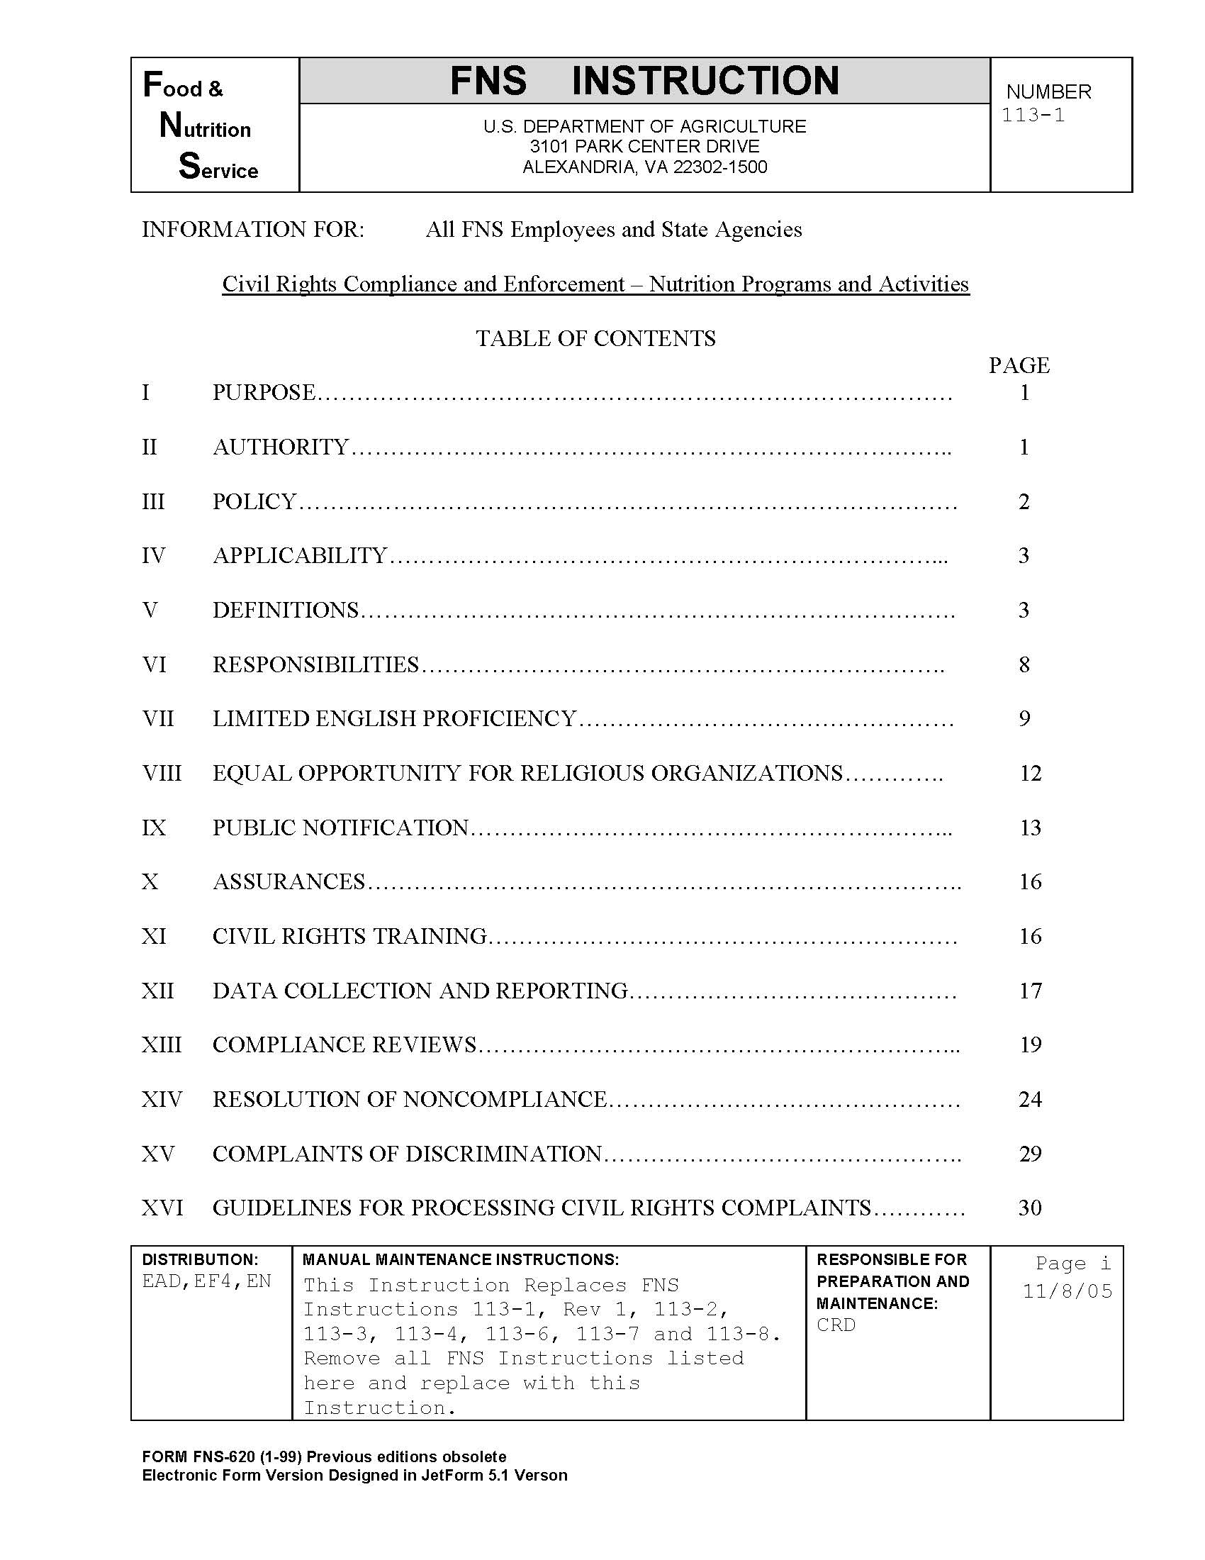
USDA Civil Rights Policy
Food and Nutrition Service (FNS)
Instruction 113-1
To establish and convey policy and provide guidance and direction to the USDA FNS and its recipients and customers and ensure compliance with and enforcement of the prohibition against discrimination in all FNS programs and activities whether federally funded or not
https://www.fns.usda.gov/cr/fns-instruction-113-1

Slide 9
FNS Instruction 113-1 Applies To
National School Lunch Program (NSLP)
School Breakfast Program (SBP)
Special Milk Program (SMP)
Fresh Fruit and Vegetable Program (FFVP)
Afterschool Snack Program (ASP)
Seamless Summer Option (SSO) of the NSLP
https://portal.ct.gov/sde/nutrition/school-nutrition-programs

Slide 10
Purpose of Civil Rights
Equal opportunity to participate in and access benefits and services

Slide 11
Civil Rights Goals
Eliminate barriers that prevent or deter people from receiving benefits of a government sponsored/funded program
Provide equal treatment in the delivery of programs and services to all applicants, participants and beneficiaries of a federal program

Slide 12
Protected Classes

Slide 13
USDA Protected Classes
Race
Color
National origin
Sex (including gender identity and sexual orientation)
Disability
Age
Reprisal or retaliation for
prior civil rights activity

Slide 14
CSDE Protected Classes Include All Federal Plus
Religious creed
Pregnancy
Workplace hazards to
reproductive systems
Ancestry
Marital status
Gender expression
Genetic information
Retaliation for previously opposed discrimination or coercion
Intellectual disability
Learning disability
Physical disability
Mental disability
Military or Veteran status
Status as a victim of domestic violence
Criminal record in state employment

Slide 15
Definition of Discrimination
The act of distinguishing one person or group of persons from others based on the protected bases
Intentional, e.g., not accommodating a disabled child with a dietary need is verified by a recognized medical authority
Neglect or omission
Effect of actions or lack of actions, e.g., intentionally delaying approval of an eligibility application

Slide 16
Assurances

Slide 17
Written Assurance Required
To qualify for federal financial assistance, all programs need
a written assurance that the program or facility will be operated in compliance with the civil rights laws and implementing nondiscrimination regulations

Slide 18
Agreements Between Local and State Agencies
A civil rights assurance must be incorporated in all agreements between state and local agencies
  Included in CSDE’s Permanent Agreement for Child Nutrition Programs (CNPs)
FNS Instruction 113-1 Appendix B contains required language for NSLP, SMP, SBP, FFVP,
and ASP
https://portal.ct.gov/sde/nutrition/school-nutrition-programs

Slide 19
Retailer/Vendor Agreements and Contracts
Retailer and vendor agreements and contracts must also include an assurance of nondiscrimination
Example
If school food authority (SFA) contracts with food service management company (FSMC) to provide food service to students, SFA is responsible for ensuring that FSMC complies with civil rights requirements

Slide 20
Contacts, MOU, and MOA
Prescribed language must be included in all
  Contracts
  Memoranda of Understanding (MOU)
  Memoranda of Agreement (MOA)

Slide 21
Contacts, MOU, and MOA, continued
Assurance is binding on program application and its successors, transferees, and assignees as long as they receive assistance or retain possession of any assistance from USDA

Slide 22
Civil Rights Assurance Statement
“The program applicant hereby agrees that it will comply with Title VI of the Civil Rights Act of 1964 (42 U.S.C. § 2000d et seq.), Title IX of the Education Amendments of 1972 (20 U.S.C. § 1681 et seq.), Section 504 of the Rehabilitation Act of 1973 (29 U.S.C. § 794), the Age Discrimination Act of 1975 (42 U.S.C. § 6101 et seq.); all provisions required by the implementing regulations of the Department of Agriculture; Department of Justice Enforcement Guidelines, 28 CFR Part SO.3 and 42; and FNS directives and guidelines, to the effect that, no person shall, on the grounds of race, color, national origin, sex (including gender identity and sexual orientation), disability, age, or reprisal or retaliation for prior civil rights activity be excluded from participation in, be denied benefits of, or otherwise be subject to discrimination under any program or activity for which the program applicant receives Federal financial assistance from FNS; and hereby gives assurance that it will immediately take measures necessary to effectuate this agreement.”
“By accepting this assurance, the Program applicant agrees to compile data, maintain records, and submit reports as required, to permit effective enforcement of nondiscrimination laws and permit authorized USDA personnel during hours of program operation to review such records, books, and accounts as needed to ascertain compliance with the nondiscrimination laws. If there are any violations of this assurance, the Department of Agriculture, FNS, shall have the right to seek judicial enforcement of this assurance. This assurance is binding on the Program applicant, its successors, transferees, and assignees as long as it receives assistance or retains possession of any assistance from USDA. The person or persons whose signatures appear below are authorized to sign this assurance on the behalf of the Program applicant.”

Slide 23
Public Notification

Slide 24
Public Notification Requirement
Sponsors must notify the
public of their participation
in the USDA school nutrition programs
  Program availability
  Program rights and responsibilities
  Policy of nondiscrimination
  Procedure for filing a complaint
Inform community of
program and details
  Eligibility
  Benefits
  Services
  Facility location
  Hours
  Delivery points

Slide 25
Examples of Public Notification Methods
Internet
Newspaper articles
Radio and TV announcements
Letters
Bulletins

Slide 26
Public Notification for Disabilities and LEP
Provide appropriate information in alternative formats for persons with disabilities
Provide appropriate information in appropriate languages for LEP persons

Slide 27

Equal Opportunity in Photos and Graphics
Convey equal opportunity in photos and other graphics in program-related information

Slide 28
Include Required Nondiscrimination Statement
Must be on all appropriate
  publications
  websites
  posters
  informational materials

Slide 29
And Justice for All” (AJFA) Poster

Slide 30
AJFA Poster Form AD-475-A
All entities participating in CNPs must prominently display USDA’s “And Justice for All” (AJFA) poster where participants and potential participants have access
Updated USDA AJFA posters are in production and will be distributed
to all SFAs when available
https://www.usda.gov/sites/default/files/documents/ad-475a.pdf

Slide 31
AJFA Poster for Classroom Meals
Schools serving all meals in classroom can display posters in prominent locations throughout the school
  bulletin board in building entrance
  school office
  another area frequently visited by parents/guardians and children
Schools may copy posters and put one in each classroom

Slide 32
AJFA Poster for School Year 2024-25
Must prominently display in all facilities and locations that distribute CNP benefits or administer services
May display AJFA posters dated September 2019 until new posters are received
If the 2019 AJFA posters are not available for display, paper copies may be substituted as necessary if SFA has not received new posters (issued 2019)

Slide 33
USDA Nondiscrimination Statement

Slide 34
USDA Nondiscrimination Statement (NDS)
In accordance with federal civil rights law and U.S. Department of Agriculture (USDA) civil rights regulations and policies, this institution is prohibited from discriminating on the basis of race, color, national origin, sex (including gender identity and sexual orientation), disability, age, or reprisal or retaliation for prior civil rights activity.
Program information may be made available in languages other than English. Persons with disabilities who require alternative means of communication to obtain program information (e.g., Braille, large print, audiotape, American Sign Language), should contact the responsible state or local agency that administers the program or USDA’s TARGET Center at (202) 720-2600 (voice and TTY) or contact USDA through the Federal Relay Service at (800) 877-8339
To file a program discrimination complaint, a Complainant should complete a Form AD-3027, USDA Program Discrimination Complaint Form which can be obtained online at: https://www.usda.gov/sites/default/files/documents/ad-3027.pdf, from any USDA office, by calling (866) 632-9992, or by writing a letter addressed to USDA. The letter must contain the complainant’s name, address, telephone number, and a written description of the alleged discriminatory action in sufficient detail to inform the Assistant Secretary for Civil Rights (ASCR) about the nature and date of an alleged civil rights violation. The completed AD-3027 form or letter must be submitted to USDA by:
1. mail: U.S. Department of Agriculture
Office of the Assistant Secretary for Civil Rights
1400 Independence Avenue, SW
Washington, D.C. 20250-9410;
2. fax: (833) 256-1665 or (202) 690-7442; or
3. email: program.intake@usda.gov.
This institution is an equal opportunity provider.

Slide 35
Where USDA NDS Statement is Required
The most current nondiscrimination statement must be on
  application forms
  notification letters
  state agency and SFA’s CNP webpages (English and Spanish)
  information developed for public information

Slide 36
When Short USDA NDS is Allowed
Short statement can be used only in special circumstances (e.g., menu, one-page flier)
  “This institution is an equal opportunity provider.”

Slide 37
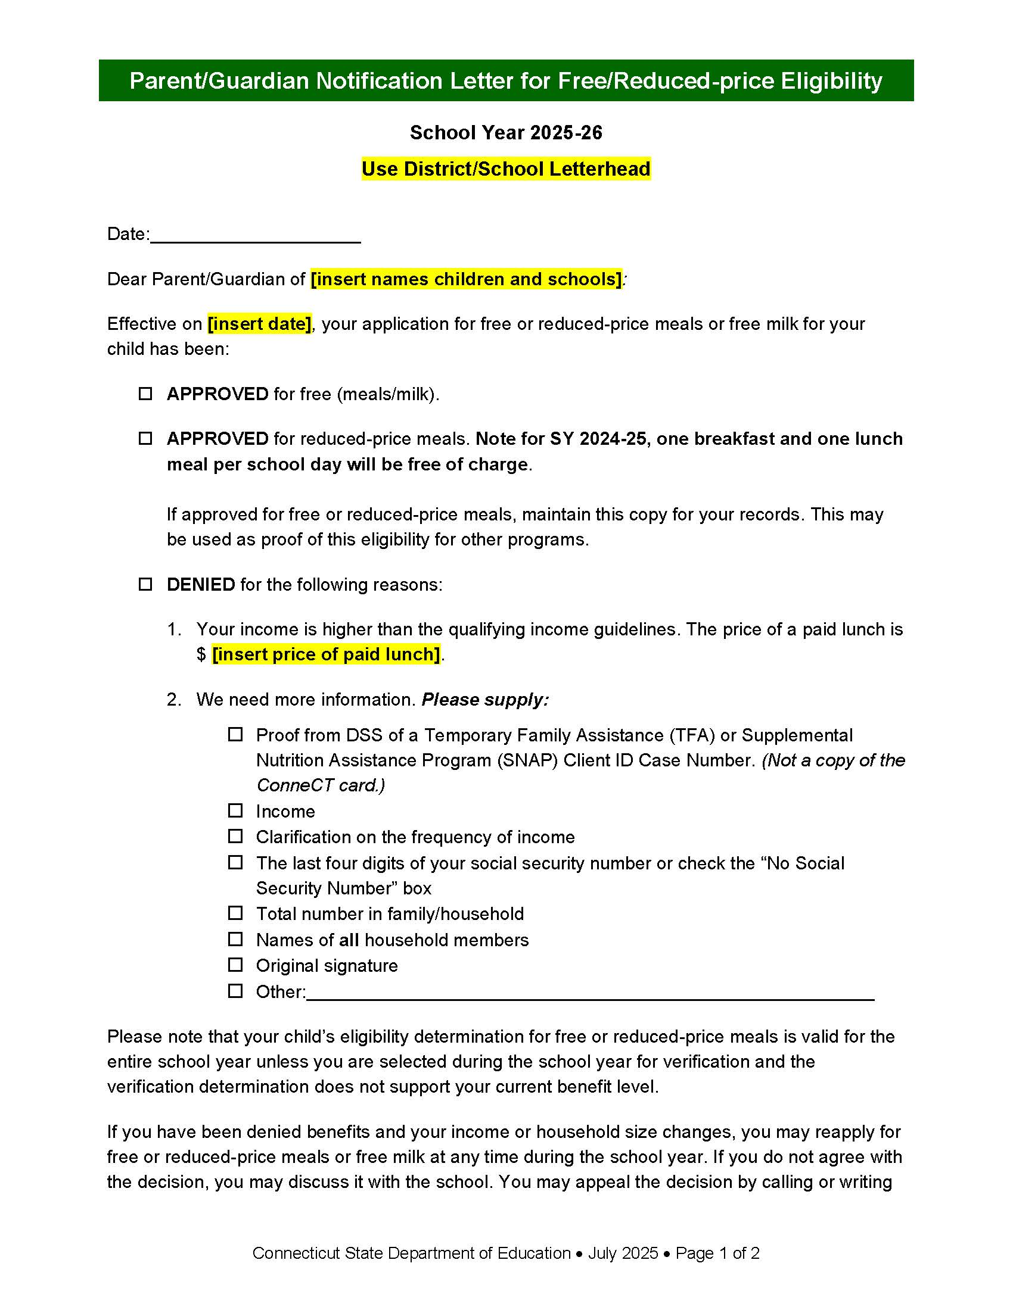
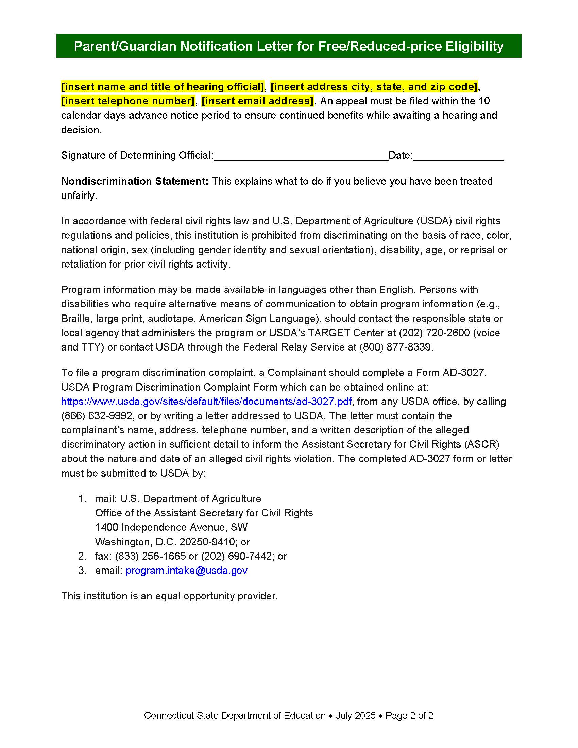
USDA NDS is Required for Vital Documents
Vital documents about sensitive topics require full NDS, even if one page
Example: CSDE’s sample parent/guardian notification letter for free and reduced-price meals has full USDA NDS on page 2
https://portal.ct.gov/sde/nutrition/eligibility-for-free-and-reduced-price-meals-
and-free-milk-in-school-nutrition-programs/parent-and-guardian-notification-letters

Slide 38
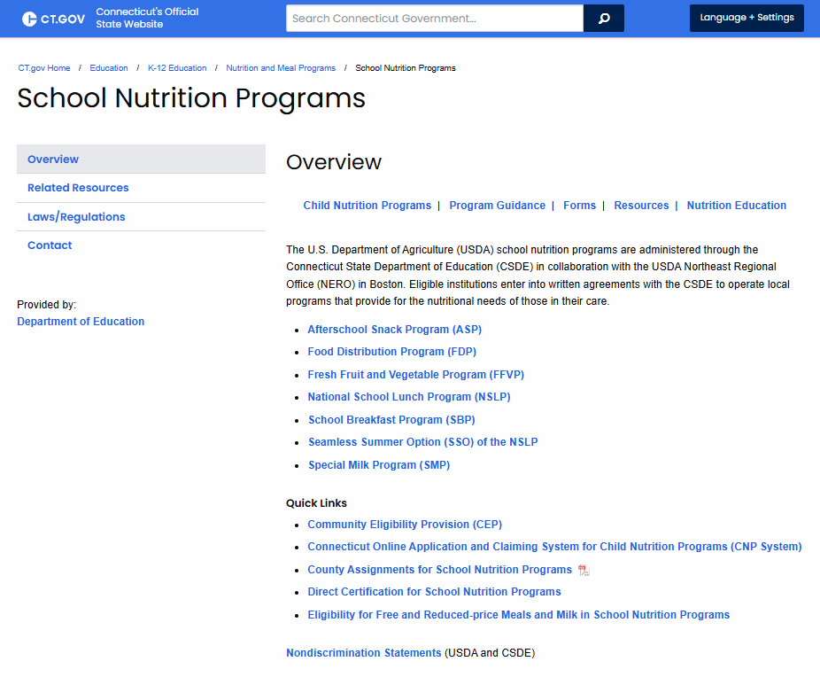
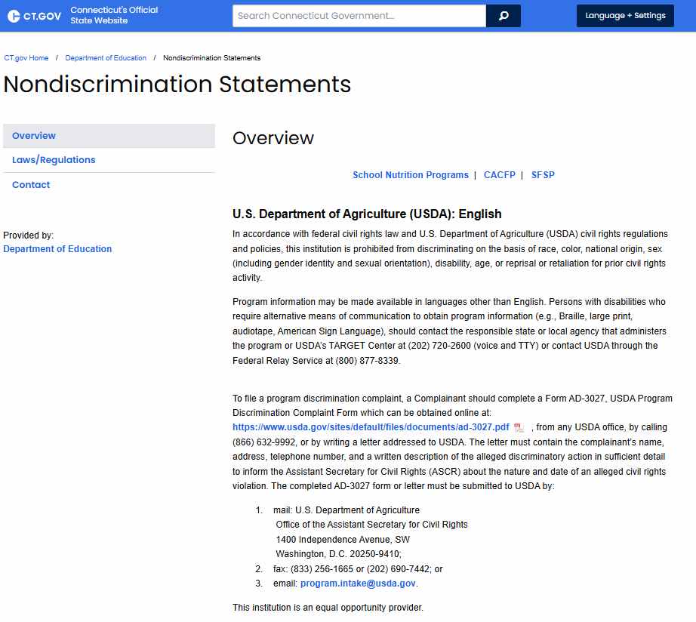
Webpages with Information About CNPs
Must include full statement or direct link to full statement

Slide 39
Data Collection

Slide 40
Data Collection Requirements
Develop method for data collection on racial/ethnic breakdown of potential participants (free and reduced applications or data collected by school officials)
Sources include census or public school enrollment

Slide 41
Maintaining Data
Any data collected about beneficiaries must be kept secure and confidential
Maintain all records
  Current to 3 years prior

Slide 42
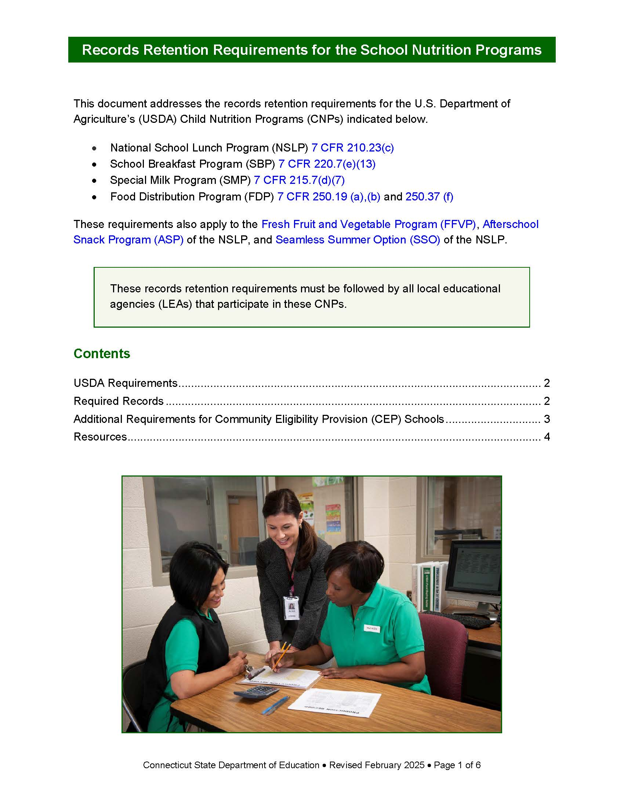
Records Retention Requirements for the School Nutrition Programs
https://portal.ct.gov/-/media/sde/nutrition/nslp/adminrev/records_retention_snp.pdf

Slide 43
Data Use
To determine how effectively CNPs are reaching potentially eligible persons and beneficiaries
Outreach efforts can be targeted
Information is used for statistical purposes only and has no effect on eligibility criteria
Verification of citizenship or immigration status should never give rise to discrimination

Slide 44
Complaint Procedures

Slide 45
Right to File a Complaint
Any person alleging discrimination based on race, color, sex, age, national origin or disability has a right to file a complaint within 180 days of the alleged discriminatory action

Slide 46
Written Complaint Procedure Required
Outlined in FNS Instruction 113-1
SFA must have a written formal procedure for receiving and processing complaints alleging discrimination within FNS programs (NSLP, SBP, SMP, FFVP, ASP)
SFAs must use CSDE-issued Civil Rights Complaint Procedures for School Nutrition Programs,
dated July 2025
The procedure as written cannot be edited

Slide 47
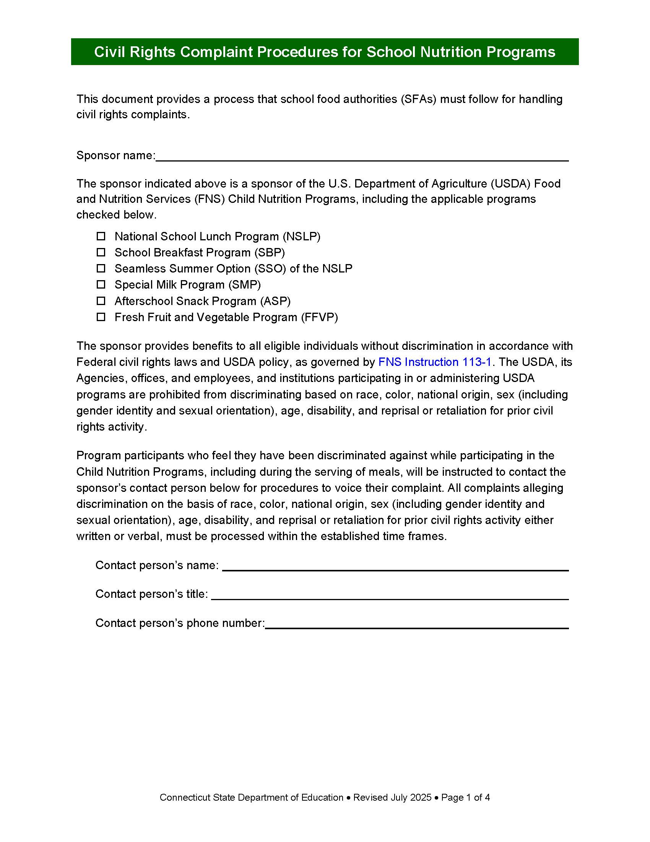
Civil Rights Complaint Procedures for School Nutrition Programs
https://portal.ct.gov/-/media/sde/nutrition/civilrights/civil_rights_snp_complaint_procedures.pdf

Slide 48
Providing Procedures to Complainant
SFA will provide complainant with information pertaining to filing a program discrimination complaint as a USDA customer
Nondiscrimination statement provides instructions (English and Spanish)
SFA will refer complainant to FNS Civil Rights website

Slide 49
Where to Submit Complaints
All civil rights complaints shall be accepted and forwarded to USDA Office of the Assistant Secretary for Civil Rights (OASCR)
  mail: U.S. Department of Agriculture Office
  of the Assistant Secretary for Civil Rights
  1400 Independence Avenue, SW
  Washington, D.C. 20250-9410; or
  fax: (833) 256-1665 or (202) 690-7442; or
  email: program.intake@usda.gov

Slide 50
Filing Complaints
Individuals must file a complaint within 180
days from the act of discrimination
Complaints may be
written or verbal
Never discourage groups or individuals from filing complaints or from voicing allegations of discrimination
Notify CSDE that a complaint has been or
may be filed

Slide 51
Filing Complaints, continued
Maintain tracking log of complaints received and forwarded to OSCAR
Procedures for receiving a complaint should not prevent a complaint from being accepted
SFA must not attempt to resolve the complaint themselves

Slide 52
Verbal Complaints
If complainant will not put the complaint in writing, SFA must do so
Use USDA Discrimination Complaint Form to ensure all required information is captured

Slide 53
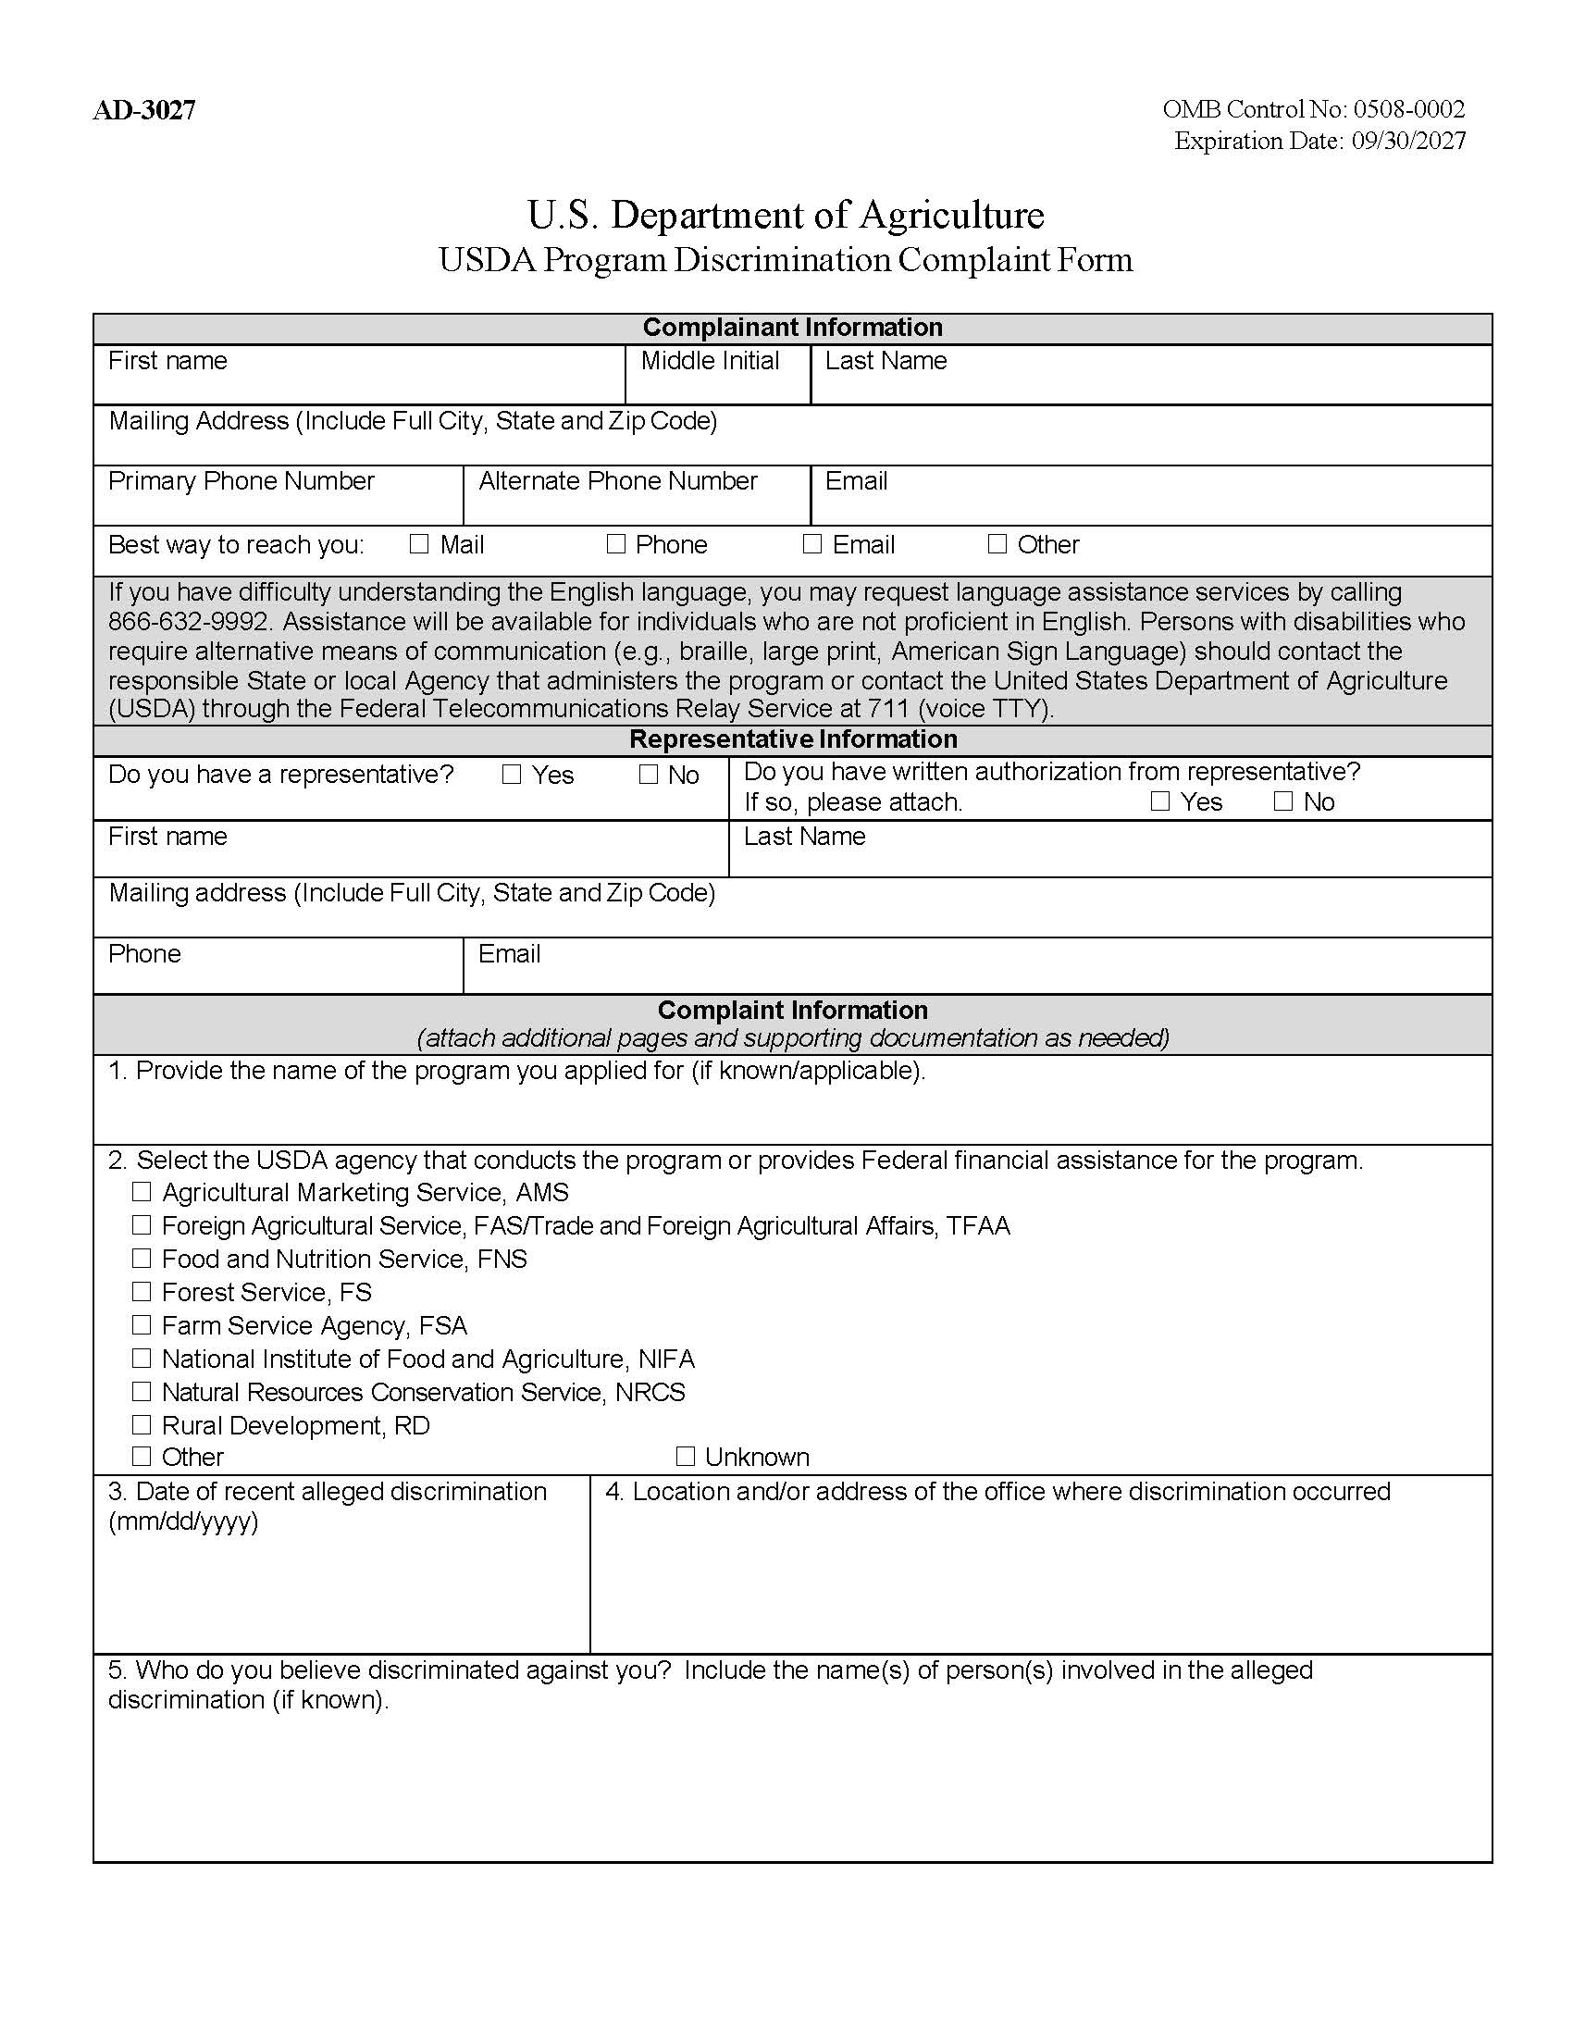
USDA Discrimination Complaint Form: English
Form AD-3027
U.S. Department of Agriculture USDA Program Discrimination Complaint Form
https://www.usda.gov/sites/default/files/documents/ad-3027.pdf

Slide 54
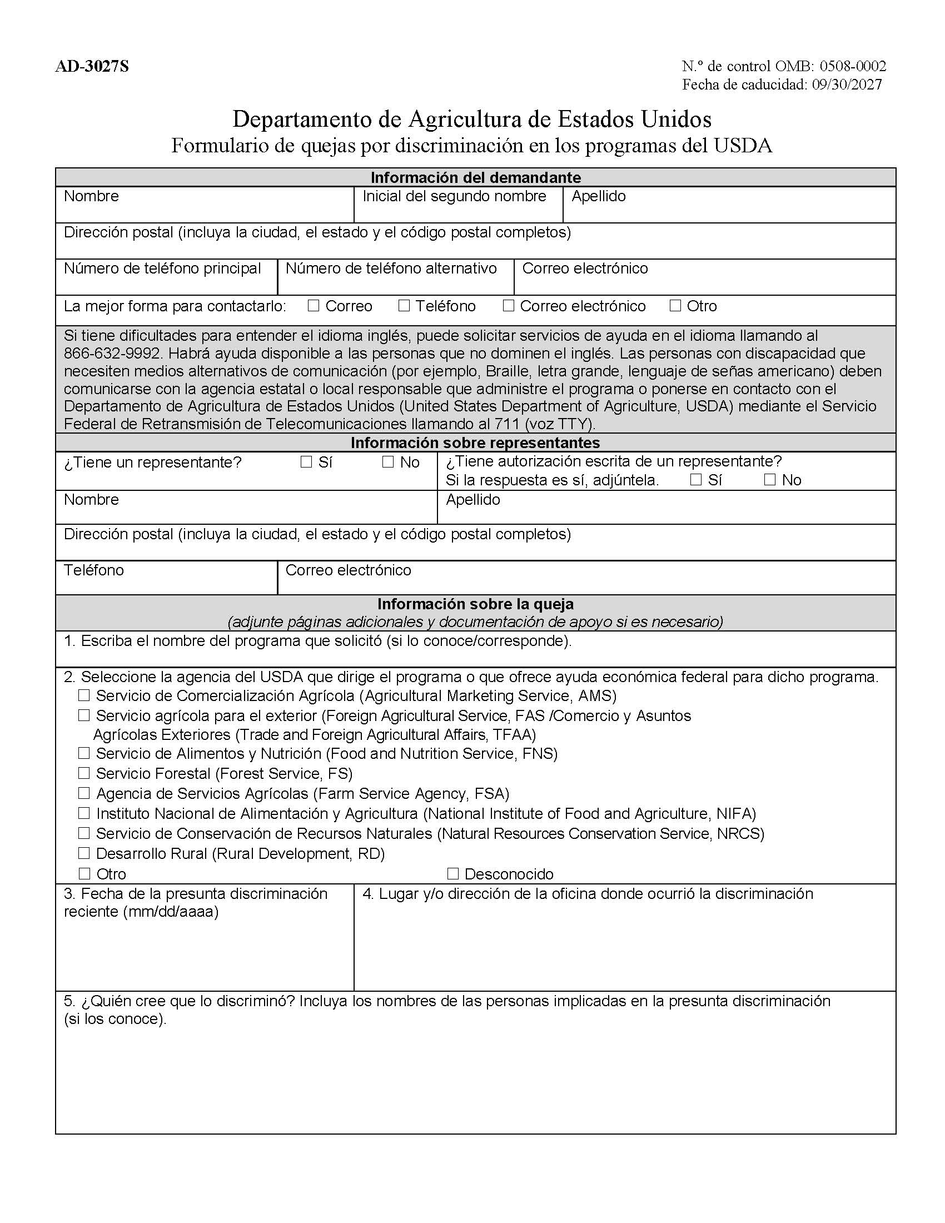
USDA Discrimination Complaint Form: Spanish
Form AD-3027S
Departamento de Agricultura de Estados Unidos Formulario de quejas por discriminación en los programas del USDA
https://www.usda.gov/sites/default/files/documents/ad-3027s.pdf

Slide 55
Language Assistance

Slide 56
Limited English Proficiency (LEP)
LEP individuals
  Do not speak English as their primary language
  Have limited ability to read, speak, write, or understand English
SFAs must take “reasonable steps” to ensure meaningful access to their programs and activities by a LEP person

Slide 57
Reasonable Steps to Ensure Meaningful Access
Providing documents in a variety of languages (translation)
Providing interpretation services to those that need help in completing applications
Providing verbal information for individuals who are unable to read the written information provided

Slide 58
Factors Determining What Constitutes “Reasonable Steps”
Number or proportion of LEP persons eligible to be served or likely to be encountered within the area serviced by the recipient
Frequency with which LEP individuals come in contact with the program
Nature and importance of the program, activity, or service provided by the program
Resources available and
their costs

Slide 59
Meaningful Access
Accomplished by
providing reasonable, competent/qualified, accurate, and effective language services to individuals with LEP
when accessing recipient programs and activities

Slide 60
Providing Language Assistance
USDA provides application forms in many foreign languages (refer to link below)
Foreign language teachers and community organizations may have resources to help with translations (written and verbal)
May use volunteers but make sure they are competent/qualified, understand interpreter ethics, and maintain participant confidentiality
Cannot use children as interpreters
https://www.fns.usda.gov/schoolmeals/model-application/translations

Slide 61
Provide Documents/Services in Predominant Languages
SFAs must identify their district’s predominant languages and provide documents or services to participants and their families in those languages
Documents or Services
Free and reduced-price applications
Notification letters
Interpretive services for
parent questions

Slide 62
LEP Taglines
A phrase in different languages that guides a person to where they can obtain language assistance services

Slide 63
Top Six Languages Spoken in Connecticut Schools
Spanish
Portuguese
Arabic
Chinese Mandarin
Polish
Haitian-Creole
October 2023 Public School Information System (PSIS) Data Collection

Slide 64
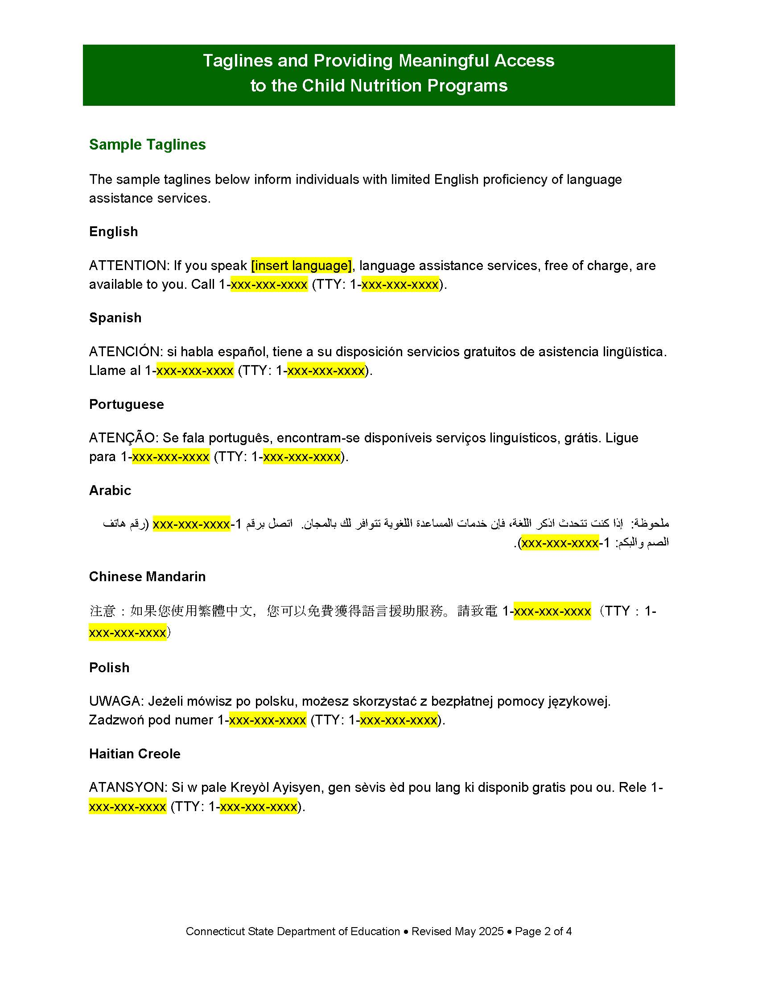
Taglines and Providing Meaningful Access to the Child Nutrition Programs
Sample taglines
https://portal.ct.gov/-/media/sde/nutrition/nslp/forms/freered/taglines_providing_meaningful_access_cnps.pdf

Slide 65
LEP Accessibility for District Websites
Does the website have the ability to provide information in another language?
Would an LEP individual be able to find out how to access the webpage in another language?
Work with your IT department to make the district website more accessible to LEP persons

Slide 66

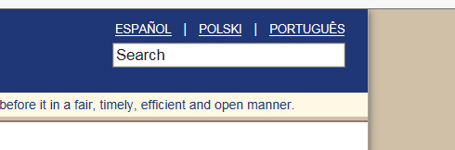
Website LEP Examples
If Spanish was your native language and you could not read English, which format would be the most helpful to indicate the website was available in other languages?
Example 1
Example 2

Slide 67
Website LEP Examples: Answer
If Spanish was your native language and you could not read English, which format would be the most helpful to indicate the website was available in other languages?
Example 2
Shows language options recognizable to LEP individual
Work with district/school website designer to see if website has capability to offer language assistance in this way

Slide 68
English Learner/ Multilingual Learner (EL/ML)
English Learners and Bilingual Education Statues
Connecticut English Language Proficiency (CELP) Standards
English Learners Data Bulletin
https://portal.ct.gov/sde/english-learners/english-learner-multilingual-learner

Slide 69
Federal LEP Website
More information
and resources
https://www.lep.gov/

Slide 70
Accommodations

Slide 71
Laws Prohibit Disability Discrimination
Sections 504 and 508 of the Rehabilitation Act of 1973 and 7CFR Part 15b, prohibit discrimination based on disability in programs or activities receiving Federal financial assistance
The ADA, 28 CFR Part 35, Title II, Subtitle A, prohibits discrimination on the basis of disability in all services, programs and activities provided to the public by State and local government
These civil rights laws protect persons with disabilities if they are potential applicants or participants in any FNS funded programs

Slide 72
Definition of Person with a Disability
Has a physical or mental impairment which substantially limits one or more major life activity, has a record of such an impairment, or is regarded as having and impairment
  Source: Section 504 of the Rehabilitation Act of 1973 and the American with Disabilities Act (ADA) of 1900, and the ADA Amendments Act of 2008 (P.L. 110-325)

Slide 73
SFAs Must Ensure Accessibility
Imperative that SFA websites and online application systems are readily accessible to and useable by persons with visual impairments and other disabilities
Programs must ensure physical accessibility for buildings and facilities, particularly to persons in wheelchairs and with mobility disabilities
In some cases, different or special treatment may be necessary to ensure effective aids, benefits and services are reasonable

Slide 74
Examples of Accommodations
Access for persons in wheelchairs and other mobility limitations
Access for those with limited vision
Using American Sign Language (ASL) and interpreters
Substitutions for participants whose disability restricts their diet (meal modifications)

Slide 75
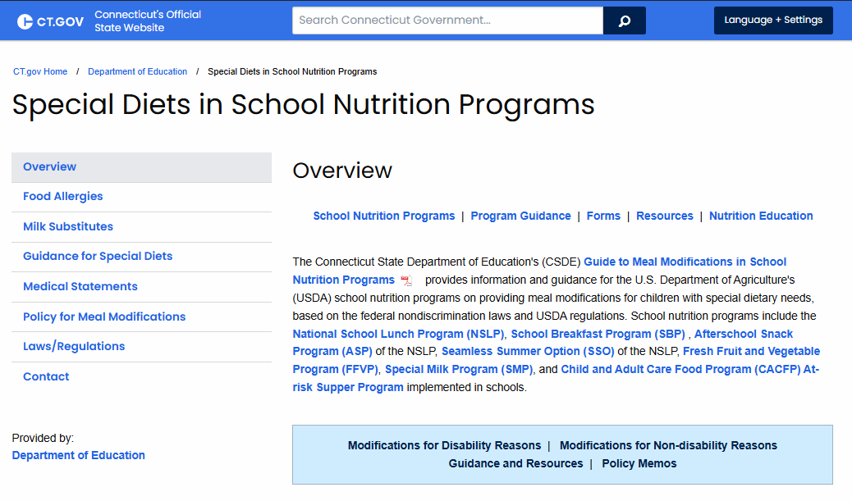
Special Diets in School Nutrition Programs
Guide to Meal Modifications
in School Nutrition Programs
Summary Chart: Overview of
USDA Requirements
Medical Statement
Guidance and Instructions for Medical Statement
Allowable Milk Substitutes
Training links
Additional Resources
https://portal.ct.gov/sde/nutrition/special-diets-in-school-nutrition-programs

Slide 76
Customer Service

Slide 77
Importance of Customer Service
Good customer service reduces chances of discrimination complaints

Slide 78
Tips for Customer Service
Be courteous and thoughtful
Be patient and listen carefully
Treat all students equally
  No seating arrangements, serving lines, services and facilities, or eating periods separated by protected class

Slide 79
Conflict Resolution

Slide 80
Conflict Resolution Requirements
Must be covered in SFA’s Civil Rights procedures
Include how SFA will process a complaint with the goal of providing a solution with assistance of state agency and USDA, as needed

Slide 81
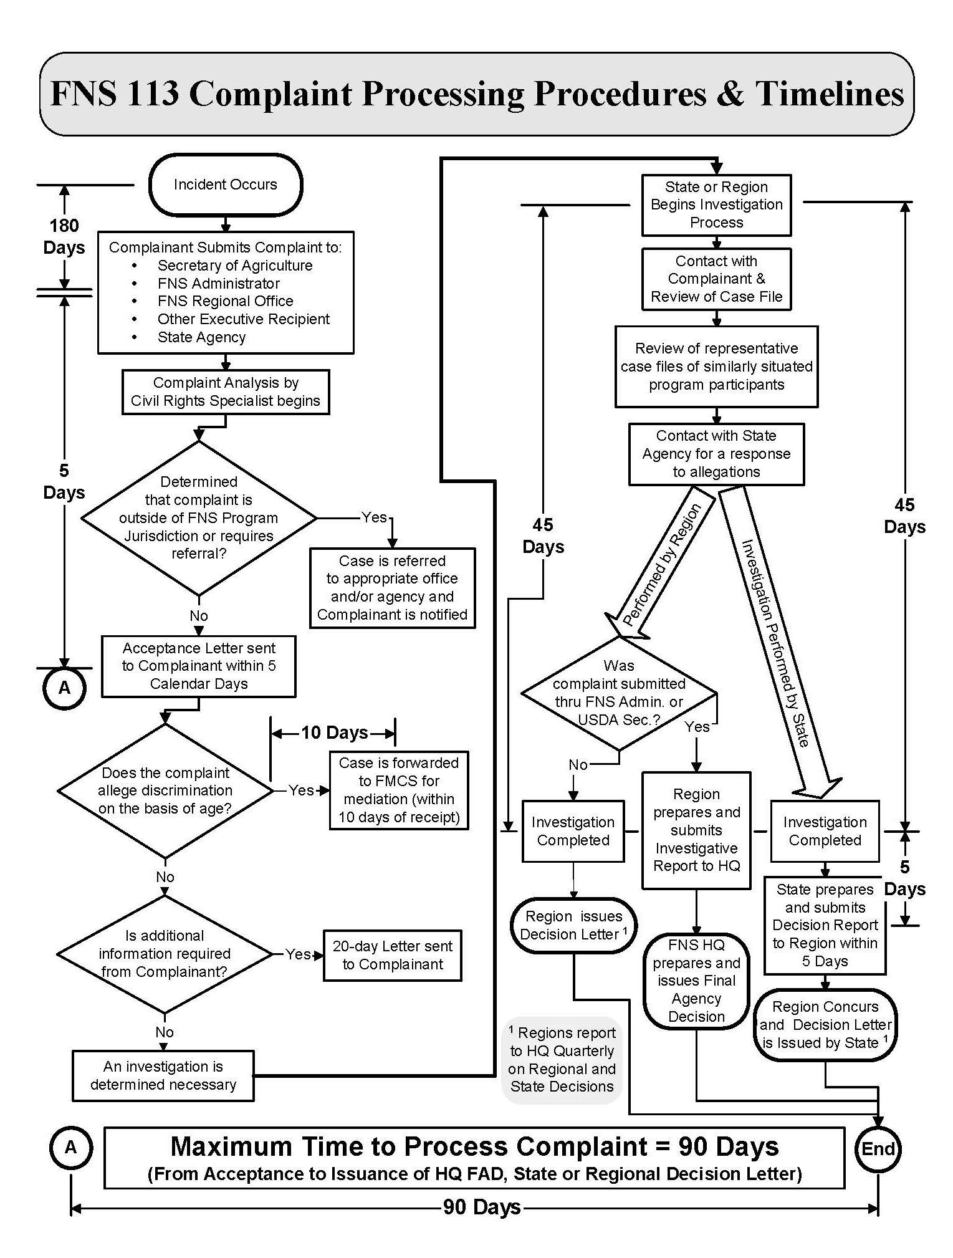
Complaint Processing Procedures and Timelines
Diagram that summarizes how to handle Civil Rights complaints and required timeframes
Last page of FNS-113
https://www.fns.usda.gov/fns-instruction-113-1

Slide 82
Required Training

Slide 83
USDA Requires Annual Civil Rights Training
For all staff who work with program applicants or participants
  Food service staff
  Front line staff
  Supervisors
  Determining officials, verifying officials, and hearing officials

Slide 84
Required Training Topics
Data collection and use
Effective public notification
Complaint procedure
Compliance review techniques
Resolution of noncompliance
Reasonable accommodations for disabilities
Language assistance
Conflict resolution
Customer service

Slide 85
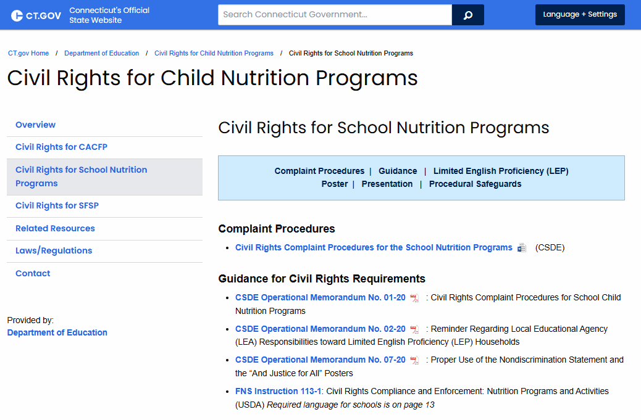
CSDE Training Resource
This PowerPoint presentation is available for SFAs to provide staff training
  “Presentation” section of CSDE’s Civil Rights for School Nutrition Programs webpage
https://portal.ct.gov/sde/nutrition/civil-rights-for-child-nutrition-programs/civil-rights-for-school-nutrition-programs#Presentation

Slide 86
Document Staff Training
Document training for each staff member as part of USDA’s Professional Standards training requirements
https://portal.ct.gov/sde/nutrition/professional-standards-for-school-nutrition-professionals

Slide 87
Resources

Slide 88
Civil Rights for Child Nutrition Programs
  Civil Rights for School Nutrition Programs section
https://portal.ct.gov/sde/nutrition/civil-rights-for-child-nutrition-programs/civil-rights-for-school-nutrition-programs

Slide 89
CSDE School Nutrition Programs Staff

Slide 90
Contact Information for CSDE Staff
County | CSDE Staff
Middlesex County (includes Regions 4, 13, and 17 Tolland County (includes Regions 8 and 19) RCCIs: Adelbrook, Inc. – The Children’s Home | Jennifer Bove jennifer.bove@ct.gov 860-807-2044
Fairfield County (includes Region 9) Litchfield County (includes Regions 1, 7, 12, 14, and 20) | Fionnuala Brown fionnuala.brown@ct.gov 860-807-2129
Hartford County (includes Region 10 and the Connecticut Technical Education & Career System [CTECS]) | Teri Dandeneau teri.dandeneau@ct.gov 860-807-2079
New Haven County (includes Regions 5, 15, and 16) RCCIs: Children’s Center, Boys & Girls Village, Inc. | Greg King greg.king@ct.gov 860-713-6804
New London County Windham County (includes Region 11) RCCIs: Waterford Country School | Susan Alston susan.alston@ct.gov 860-807-2081
https://portal.ct.gov/-/media/sde/nutrition/cnstaff/countyassign.pdf

Slide 91
Questions

Slide 92
USDA NDS
In accordance with federal civil rights law and U.S. Department of Agriculture (USDA) civil rights regulations and policies, this institution is prohibited from discriminating on the basis of race, color, national origin, sex (including gender identity and sexual orientation), disability, age, or reprisal or retaliation for prior civil rights activity.
Program information may be made available in languages other than English. Persons with disabilities who require alternative means of communication to obtain program information (e.g., Braille, large print, audiotape, American Sign Language), should contact the responsible state or local agency that administers the program or USDA’s TARGET Center at (202) 720-2600 (voice and TTY) or contact USDA through the Federal Relay Service at (800) 877-8339
To file a program discrimination complaint, a Complainant should complete a Form AD-3027, USDA Program Discrimination Complaint Form which can be obtained online at: https://www.usda.gov/sites/default/files/documents/ad-3027.pdf, from any USDA office, by calling (866) 632-9992, or by writing a letter addressed to USDA. The letter must contain the complainant’s name, address, telephone number, and a written description of the alleged discriminatory action in sufficient detail to inform the Assistant Secretary for Civil Rights (ASCR) about the nature and date of an alleged civil rights violation. The completed AD-3027 form or letter must be submitted to USDA by:
1. mail: U.S. Department of Agriculture
Office of the Assistant Secretary for Civil Rights
1400 Independence Avenue, SW
Washington, D.C. 20250-9410;
2. fax: (833) 256-1665 or (202) 690-7442; or
3. email: program.intake@usda.gov.
This institution is an equal opportunity provider.

Slide 93
CSDE NDS
The Connecticut State Department of Education is committed to a policy of equal opportunity/affirmative action for all qualified persons. The Connecticut Department of Education does not discriminate in any employment practice, education program, or educational activity on the basis of race; color; religious creed; age; sex; pregnancy; sexual orientation; workplace hazards to reproductive systems, gender identity or expression; marital status; national origin; ancestry; retaliation for previously opposed discrimination or coercion, intellectual disability; genetic information; learning disability; physical disability (including, but not limited to, blindness); mental disability (past/present history thereof); military or veteran status; status as a victim of domestic violence; or criminal record in state employment, unless there is a bona fide occupational qualification excluding persons in any of the aforementioned protected classes. Inquiries regarding the Connecticut State Department of Education’s nondiscrimination policies should be directed to: Attorney Louis Todisco, Connecticut State Department of Education, by mail 450 Columbus Boulevard, Hartford, CT 06103-1841; or by telephone 860-713-6594; or by email louis.todisco@ct.gov.

