Slide 1
Civil Rights
Your Responsibilities in the
Child and Adult Care Food Program (CACFP)
Connecticut State Department of Education
Bureau of Child Nutrition Programs

Slide 2
Disclaimer
The language in this PowerPoint addresses compliance with the U.S. Department of Agriculture (USDA) civil rights requirements and should not be modified

Slide 3
Topics
Civil Rights Overview
Assurances
Public Notification
Data Collection
Complaint Procedure
Language Assistance
Accommodations
Customer Service
Conflict Resolution
Compliance Reviews/Resolution
Required Training
https://portal.ct.gov/sde/nutrition/civil-rights-for-child-nutrition-programs/civil-rights-for-cacfp

Slide 4
Civil Rights Overview

Slide 5
Civil Rights Legislation
Law | Addresses
Title VI – Civil Rights Act of 1964 | Race, color and national origin
Civil Rights Restoration Act of 1987 | Clarifies scope of Civil Rights Act of 1964
Section 504 of the Rehabilitation Act of 1973, Americans with Disabilities Act (ADA) of 1990, and ADA Amendments Act of 2008 | Disability
Title IX of the Education Amendments of 1972 | Sex (including gender identity and sexual orientation)
Age Discrimination Act of 1975 | Age

Slide 6
Civil Rights Program Requirements
28 CFR Part 42: Nondiscrimination in Federally Assisted Programs
U.S. Department of Agriculture (USDA)
Executive Order 13166: Addresses/improves access requirements for persons with Limited English Proficiency (LEP)

Slide 7
Civil Rights Program Requirements, continued
USDA LEP Policy Guidance
(79 Federal Register No. 229. Friday, November 28, 2014)
7 CFR Part 16: “Equal Opportunity for Religious Organizations”
USDA Regulation 4330-2: Prohibits discrimination in programs and activities receiving Federal financial assistance from USDA
Bostock v. Clayton County, 140 S. Ct. 1731, 590 U.S.___(2020)

Slide 8
Civil Rights Program Requirements Apply To
Adult Day Care Centers
At-Risk afterschool Care
Child Care Centers
Emergency Shelters
Family Day Care Homes
https://portal.ct.gov/sde/nutrition/child-and-adult-care-food-program

Slide 9
Purpose of Civil Rights
Equal opportunity to participate in and access benefits and services

Slide 10
Civil Rights Goals
Eliminate barriers that prevent or deter people from receiving benefits of a government sponsored/funded program
Provide equal treatment in the delivery of programs and services to all applicants, participants and beneficiaries of a federal program

Slide 11
Protected Classes

Slide 12
Different Federal and State Protected Classes
USDA classes
CSDE classes

Slide 13
CSDE Protected Classes Include All Federal Plus
Race
Color
Religious creed
Age
Sex
Pregnancy
Sexual orientation
Workplace hazards to reproductive systems, gender identity or expression
Marital status
National origin
Ancestry
Retaliation for previously opposed discrimination or coercion
Intellectual disability
Genetic information
Learning disability
Physical disability (including, but not limited to, blindness)
Mental disability (past/present history thereof)
Military or veteran status
Status as a victim of domestic violence
Criminal record in state employment

Slide 14
Definition of Discrimination
The act of distinguishing one person or group of persons from others based on the protected bases
Intentional, e.g., not accommodating a disabled child with a dietary need is verified by a recognized medical authority
Neglect or omission
Effect of actions or lack of actions, e.g., intentionally delaying approval of an eligibility application

Slide 15
Assurances

Slide 16
Written Assurance Required
To qualify for federal financial assistance, all programs need
a written assurance that the program or facility will be operated in compliance with the civil rights laws and implementing nondiscrimination regulations

Slide 17
Agreements Between Local and State Agencies
A civil rights assurance must be incorporated in all agreements between state and local agencies
  Included in CSDE’s Permanent Agreement for Child Nutrition Programs (CNPs)

Slide 18
Retailer/Vendor Agreements and Contracts
Retailer and vendor agreements and contracts must also include an assurance of nondiscrimination
Example
If a CACFP sponsor contracts with a vendor to provide meals, CACFP sponsor is responsible for ensuring that vendor complies with civil rights requirements

Slide 19
Contacts, MOU, and MOA
Prescribed language must be included in all
  Contracts
  Memoranda of Understanding (MOU)
  Memoranda of Agreement (MOA)

Slide 20
Contacts, MOU, and MOA, continued
Assurance is binding on program application and its successors, transferees, and assignees as long as they receive assistance or retain possession of any assistance from USDA

Slide 21
Public Notification

Slide 22
Public Notification Requirement
Sponsors must notify the
public of their participation
in the CACFP
  Program availability
  Program rights and responsibilities
  Policy of nondiscrimination
  Procedure for filing a complaint
Inform community of
program and details
  Eligibility
  Benefits
  Services
  Facility location
  Hours
  Delivery points

Slide 23
Examples of Public Notification Methods
Internet
Newspaper articles
Radio and TV announcements
Letters
Bulletins

Slide 24
Public Notification for Disabilities and LEP
Provide appropriate information in alternative formats for persons with disabilities
Provide appropriate information in appropriate languages for LEP persons

Slide 25
Equal Opportunity in Photos and Graphics
Convey equal opportunity in photos and other graphics in program-related information

Slide 26
Include Required Nondiscrimination Statement
Must be on all appropriate
  publications
  websites
  posters
  informational materials

Slide 27
And Justice for All” (AJFA) Poster

Slide 28
AJFA Poster
All entities participating in the CACFP must prominently display the USDA’s “And Justice for All” (AJFA) poster where participants and potential participants have access
Must be 11 x 17 inches
CSDE issues an annual statewide public release on behalf of all participating CACFP institutions
https://fns-prod.azureedge.us/sites/default/files/resource-files/ajfa-green-030223.pdf

Slide 29
USDA Nondiscrimination Statement (NDS)

Slide 30
Current USDA Nondiscrimination Statement (NDS)
Visit CSDE’s Nondiscrimination Statements webpage
https://portal.ct.gov/sde/nutrition/nondiscrimination-statements

Slide 31
Where USDA NDS Statement is Required
The most current nondiscrimination statement must be on
  parent/household letters
  sponsor’s CACFP webpages
  (English and Spanish)
  information developed for public information

Slide 32
USDA NDS is Required for Vital documents
Vital documents about sensitive topics require full NDS, even if one page

Slide 33
When Short USDA NDS is Allowed
Short NDS statement can be used only in special circumstances, e.g., menu, one-page flier
  “This institution is an equal opportunity provider.”

Slide 34
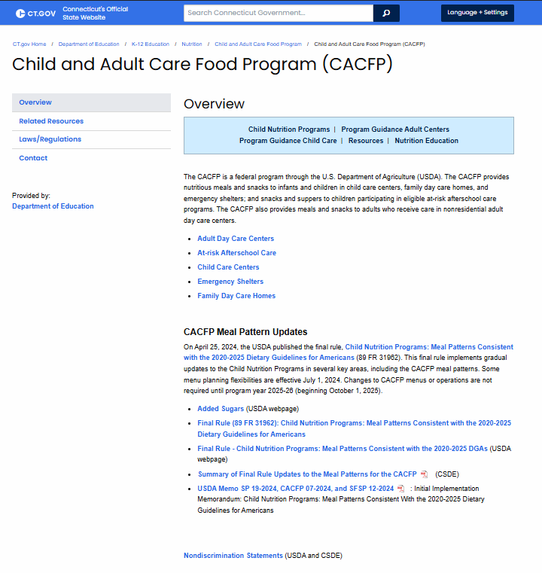
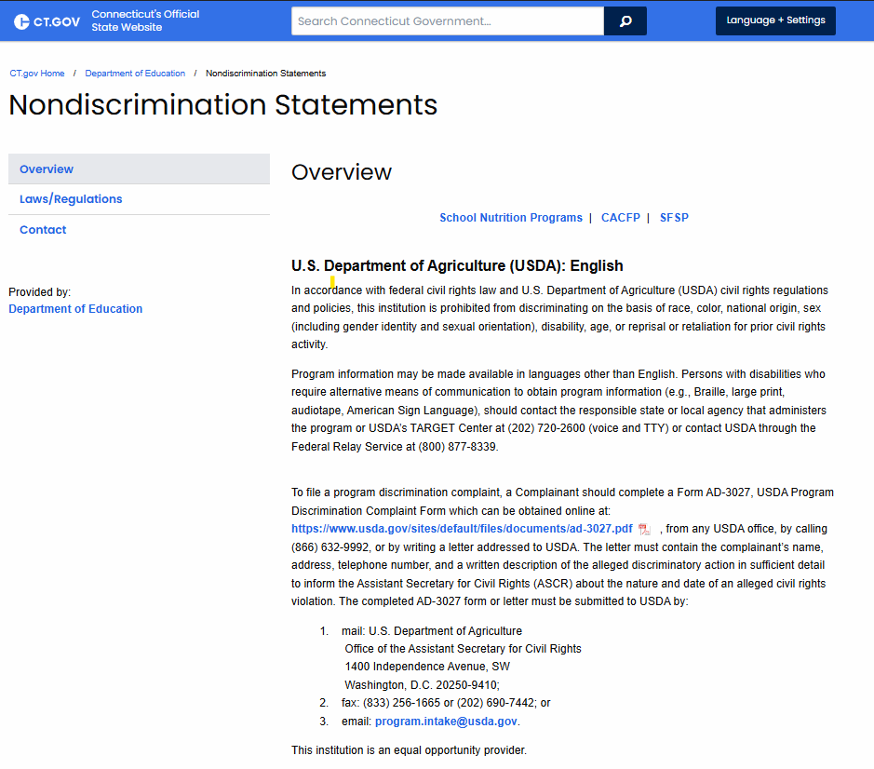
Sponsor Webpages with Information About CNPs
Must include full statement or direct link to full statement

Slide 35
Data Collection

Slide 36
Data Collection Requirements
Develop method for data collection on racial/ethnic breakdown of potential participants
Any data collected about beneficiaries must be kept secure and confidential

Slide 37
Maintaining Data
Three years after submission of final claim for reimbursement for fiscal year
If audit findings have not been resolved, retain records beyond three-year period, for as long as required to resolve issues raised by audit

Slide 38
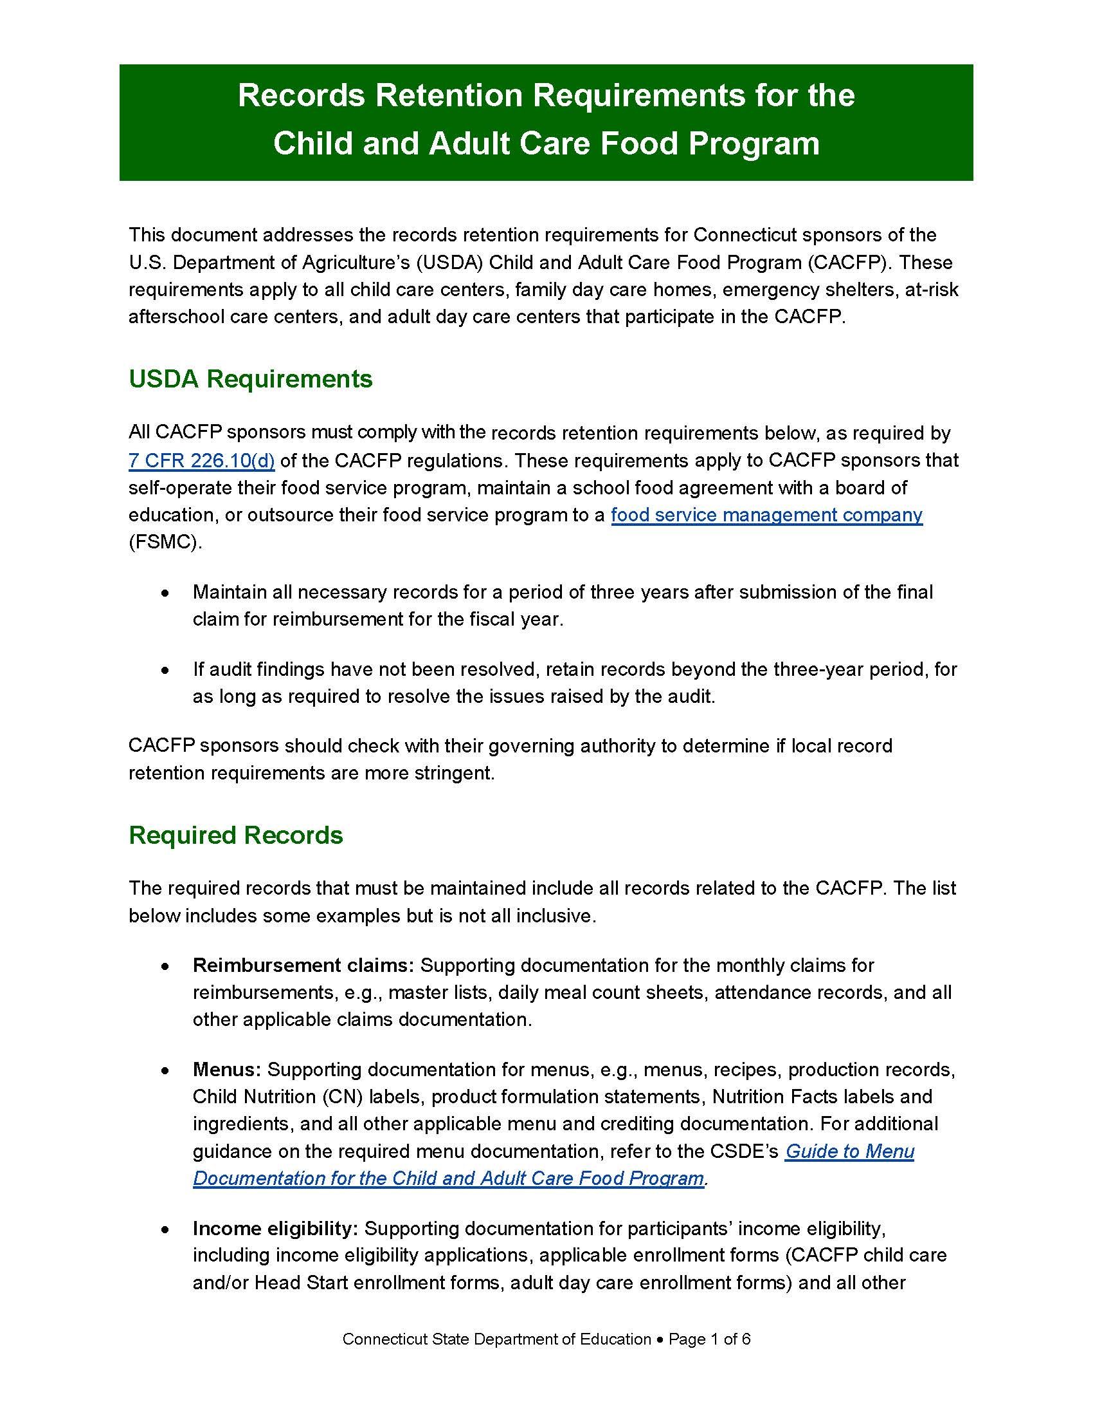
More Information About Records Retention
Records Retention Requirements for the Child and Adult Care Food Program
https://portal.ct.gov/-/media/sde/nutrition/cacfp/forms/records_retention_cacfp.pdf

Slide 39
Two Required Data Collection Forms
Civil Rights Potential Beneficiary Data Determination Form for the CACFP
CACFP Civil Rights Beneficiary Data Collection Form

Slide 40
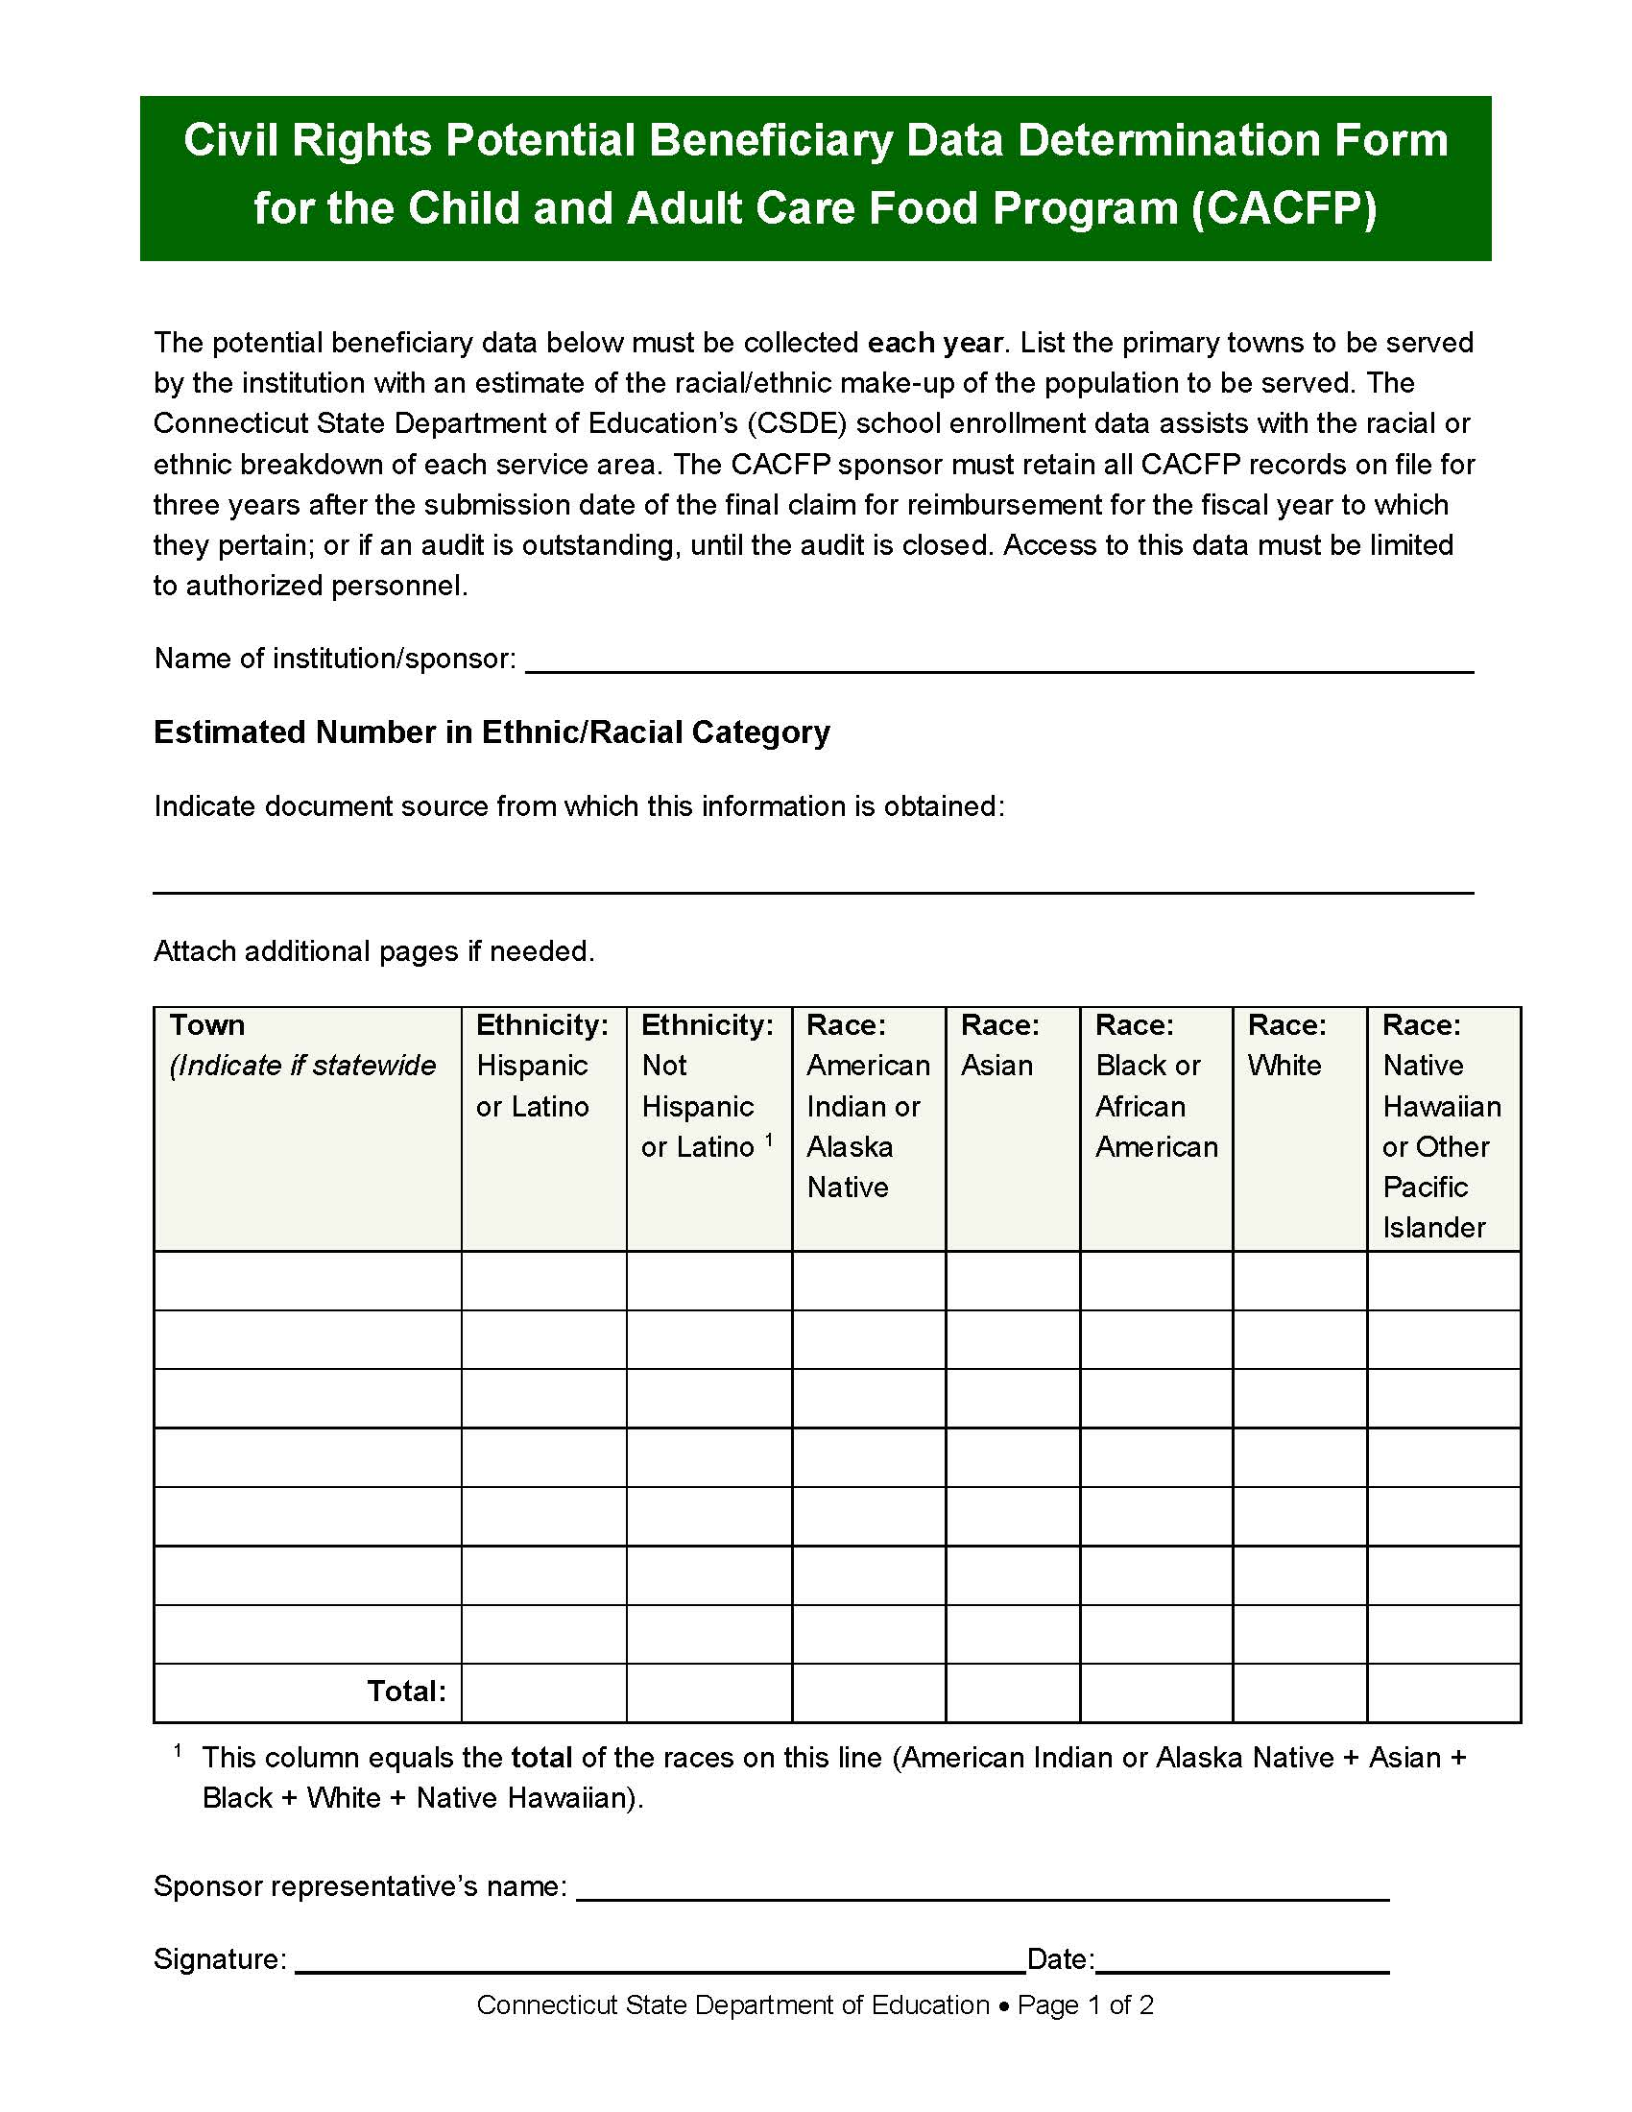
Form 1: Civil Rights Potential Beneficiary Data Determination Form for the Child and Adult Care Food Program
All towns in service area
of institution
Record racial/ethnic school data for each town
One form per institution
https://portal.ct.gov/-/media/sde/nutrition/civilrights/civil_rights_cacfp_potential_beneficiary_data_determination_form.pdf

Slide 41
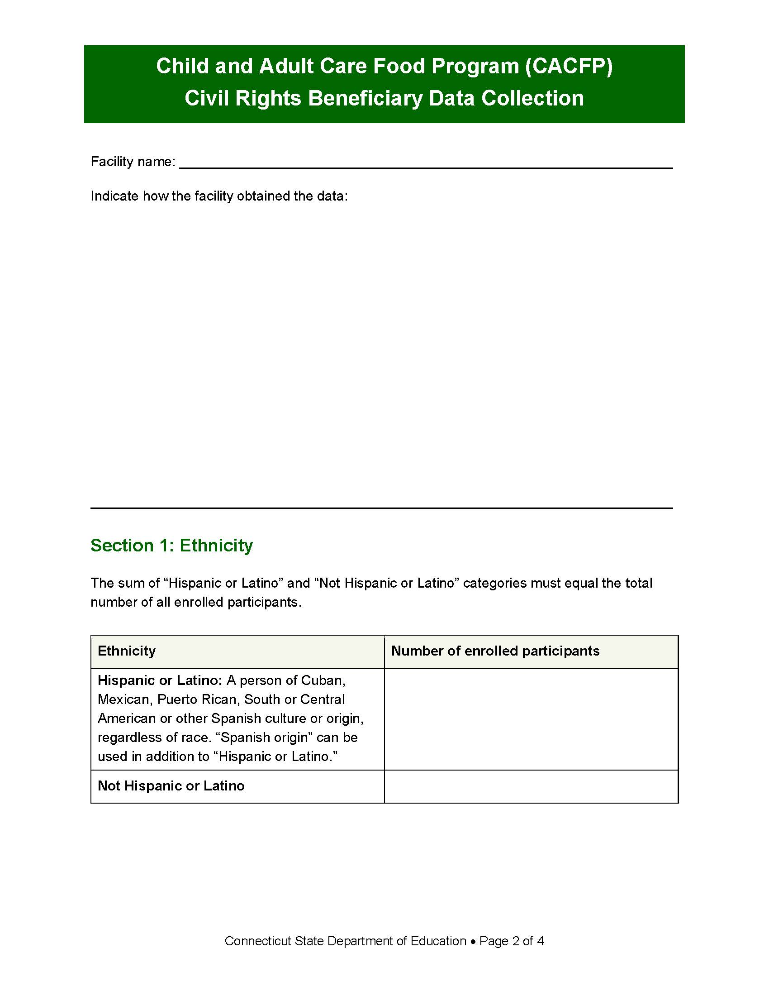
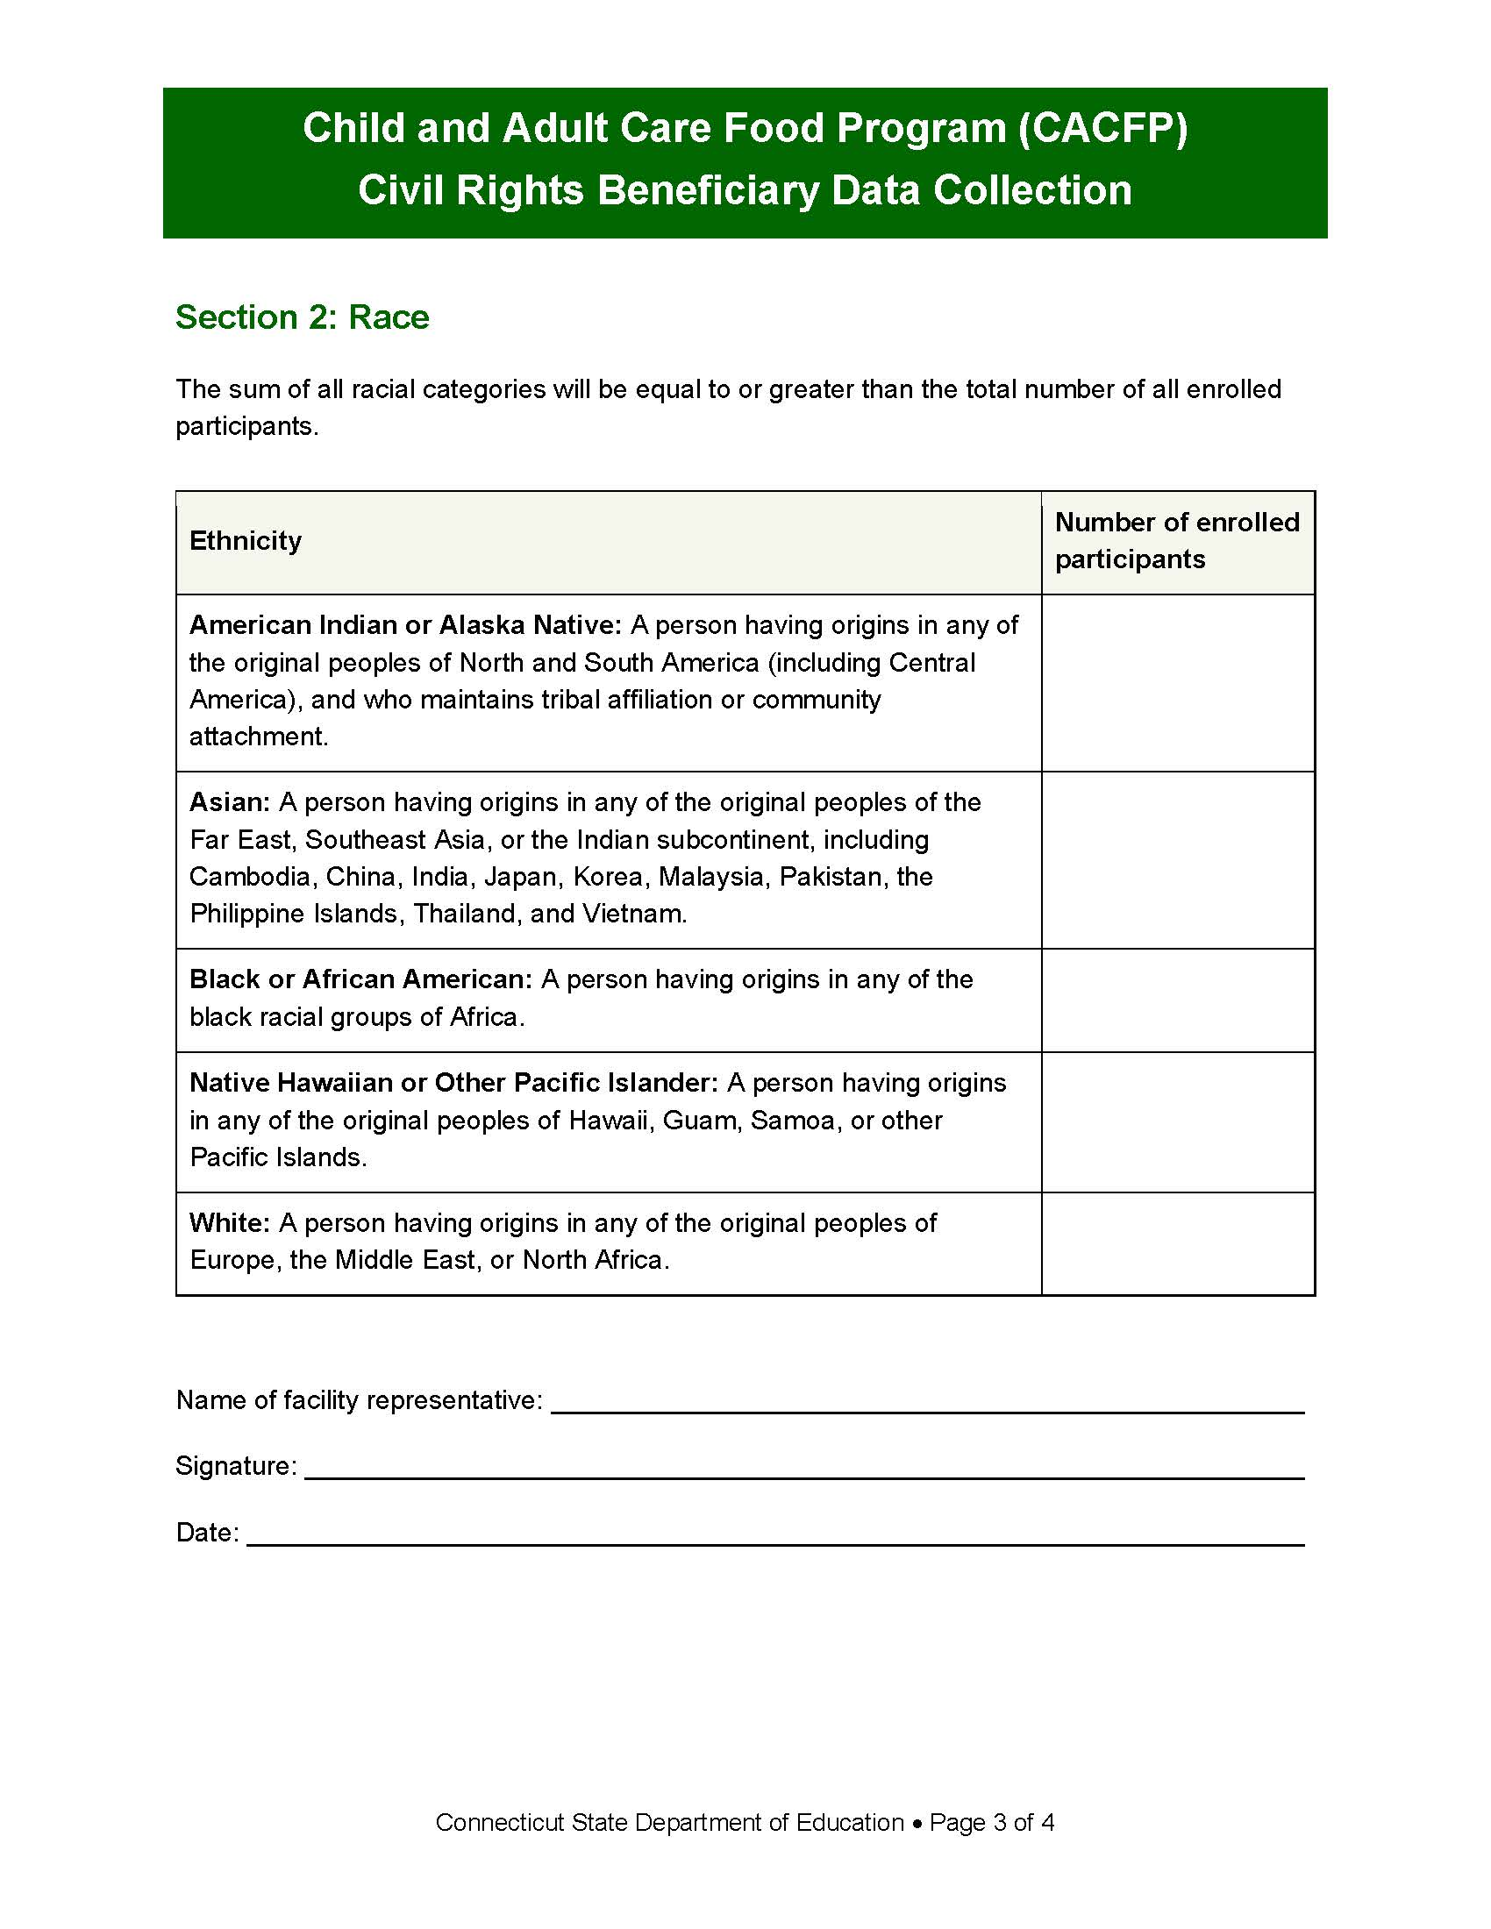
Form 2: Child and Adult Care Food Program (CACFP) Civil Rights Beneficiary Data Collection
Number of participants who are “Hispanic or Latino” and “Not Hispanic or Latino”
Number of participants in each racial category
https://portal.ct.gov/-/media/sde/nutrition/civilrights/civil_rights_cacfp_data_form.pdf

Slide 42
Race and Ethnic Categories
Ethnicity
Hispanic or Latino:
A person of Cuban, Mexican, Puerto Rican, South or Central American, or other Spanish culture or origin, regardless of race
Not Hispanic or Latino
Race
American Indian or
Alaska Native
Asian
Black or African American
Native Hawaiian or Other Pacific Islander
White

Slide 43
Requirements for Data Collection Forms
Complete annually, sign, date, and maintain on file with CACFP records
For sponsors with multiple sites, each site must complete and maintain each form

Slide 44
Visual Identification is Not Allowed
CACFP facilities cannot use visual observation and identification to collect race or ethnicity data
Preferred data collection method is self-identification and self-reporting from other sources in which respondent has self-identified race or ethnicity
  CACFP income eligibility applications
  Data for other funding sources,
  e.g., Head Start
https://www.fns.usda.gov/cn/Race-and-Ethnicity-Data-Policy-Rescission

Slide 45
Visual Identification is Not Allowed, continued
CACFP facilities should
explain importance of data to participants
encourage participants to
self-identify and
self-report
CACFP facilities must
make applicants and participants aware that failure to provide racial or ethnic identity information will not impact CACFP eligibility

Slide 46
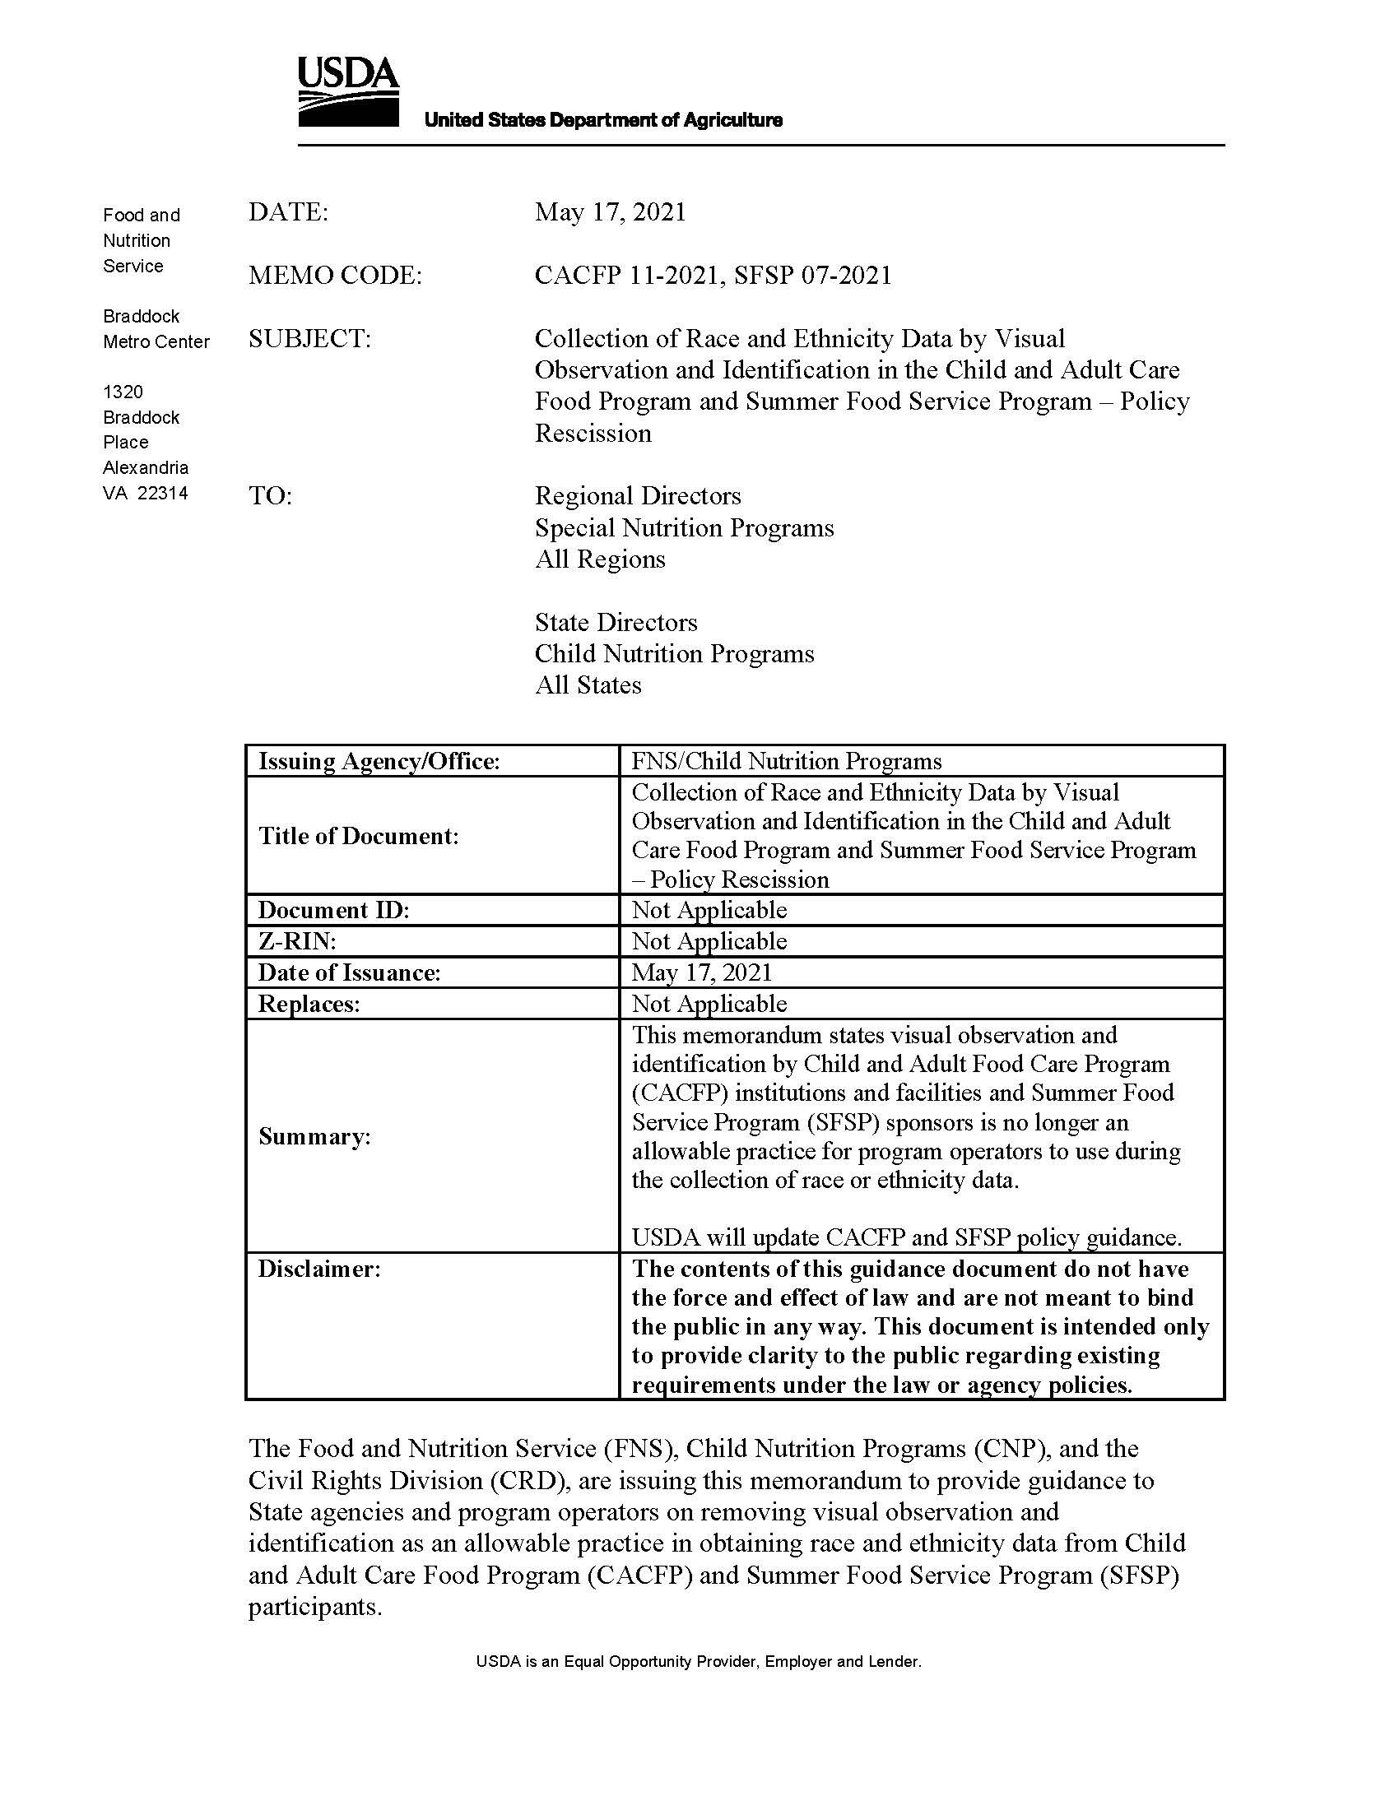
USDA Memo Prohibiting Visual Identification
USDA Memo CACFP 11-2021 and SFSP 07-2021: Collection of Race and Ethnicity Data by Visual Observation and Identification in the Child and Adult Care Food Program and Summer Food Service Program – Policy Rescission
https://www.fns.usda.gov/cn/Race-and-Ethnicity-Data-Policy-Rescission

Slide 47
USDA Questions and Answers for Visual Observation
USDA Memo CACFP 09-2022 and SFSP 05-2022: Questions and Answers Related to Collection of Race and Ethnicity Data by Visual Observation and Identification in CACFP and SFSP – Policy Rescission
USDA Memo CACFP 12-2024 and SFSP 16-2024: Questions and Answers Related to CACFP 11-2021, SFSP 07-2021 Collection of Race and Ethnicity Data by Visual Observation and Identification in the CACFP and SFSP – Policy Rescission – Set 2
https://www.fns.usda.gov/cn/qas-related-collection-race-and-ethnicity
https://www.fns.usda.gov/cn/qas-collection-race-ethnicity-data-policy-rescission2

Slide 48
Data Use
To determine how effectively CNPs are reaching potentially eligible persons and beneficiaries
Outreach efforts can be targeted
Information is used for statistical purposes only and has no effect on eligibility criteria
Verification of citizenship or immigration status should never give rise to discrimination

Slide 49
Complaint Procedures

Slide 50
Right to File a Complaint
Any person alleging discrimination based on race, color, sex, age, national origin or disability has a right to file a complaint within 180 days of the alleged discriminatory action

Slide 51
Written Complaint Procedure Required
CACFP sponsors must have a written formal procedure for receiving and processing complaints alleging discrimination within the CACFP
CACFP sponsors must
use CSDE-issued complaint procedure dated April 2026
The procedure as written cannot be edited

Slide 52
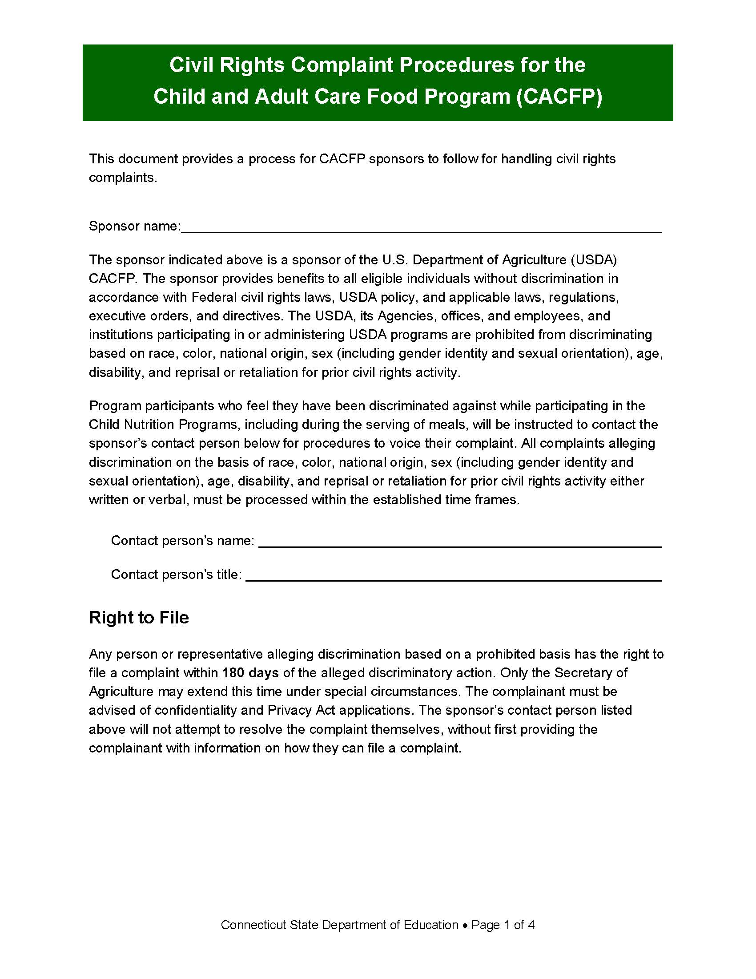
Civil Rights Complaint Procedures for the Child and Adult Care Food Program (CACFP)
https://portal.ct.gov/-/media/sde/nutrition/civilrights/civil_rights_cacfp_complaint_procedures.pdf

Slide 53
Providing Procedures to Complainant
CACFP sponsor will provide complainant with information pertaining to filing a program discrimination complaint as a USDA customer
Nondiscrimination statement provides instructions (English and Spanish)
CACFP sponsor will refer complainant to FNS Civil Rights website

Slide 54
Where to Submit Complaints
All civil rights complaints shall be accepted and forwarded to USDA Office of the Assistant Secretary for Civil Rights (OASCR)
  mail: U.S. Department of Agriculture
    Office of the Assistant Secretary for Civil Rights
    1400 Independence Avenue, SW
    Washington, D.C. 20250-9410; or
  email: program.intake@usda.gov

Slide 55
Filing Complaints
Individuals must file a complaint within 180 days from the act of discrimination
Complaints may be written or verbal
Never discourage groups or individuals from filing complaints or from voicing allegations of discrimination
Notify CSDE that a complaint has been or may be filed

Slide 56
Filing Complaints, continued
Maintain tracking log of complaints received and forwarded to OSCAR
The procedures for receiving a complaint should not prevent a complaint from being accepted
CACFP sponsor must not attempt to resolve the complaint themselves

Slide 57
Verbal Complaints
If complainant will not put the complaint in writing, the CACFP sponsor must do so
Use USDA Discrimination Complaint Form to ensure all required information is captured

Slide 58
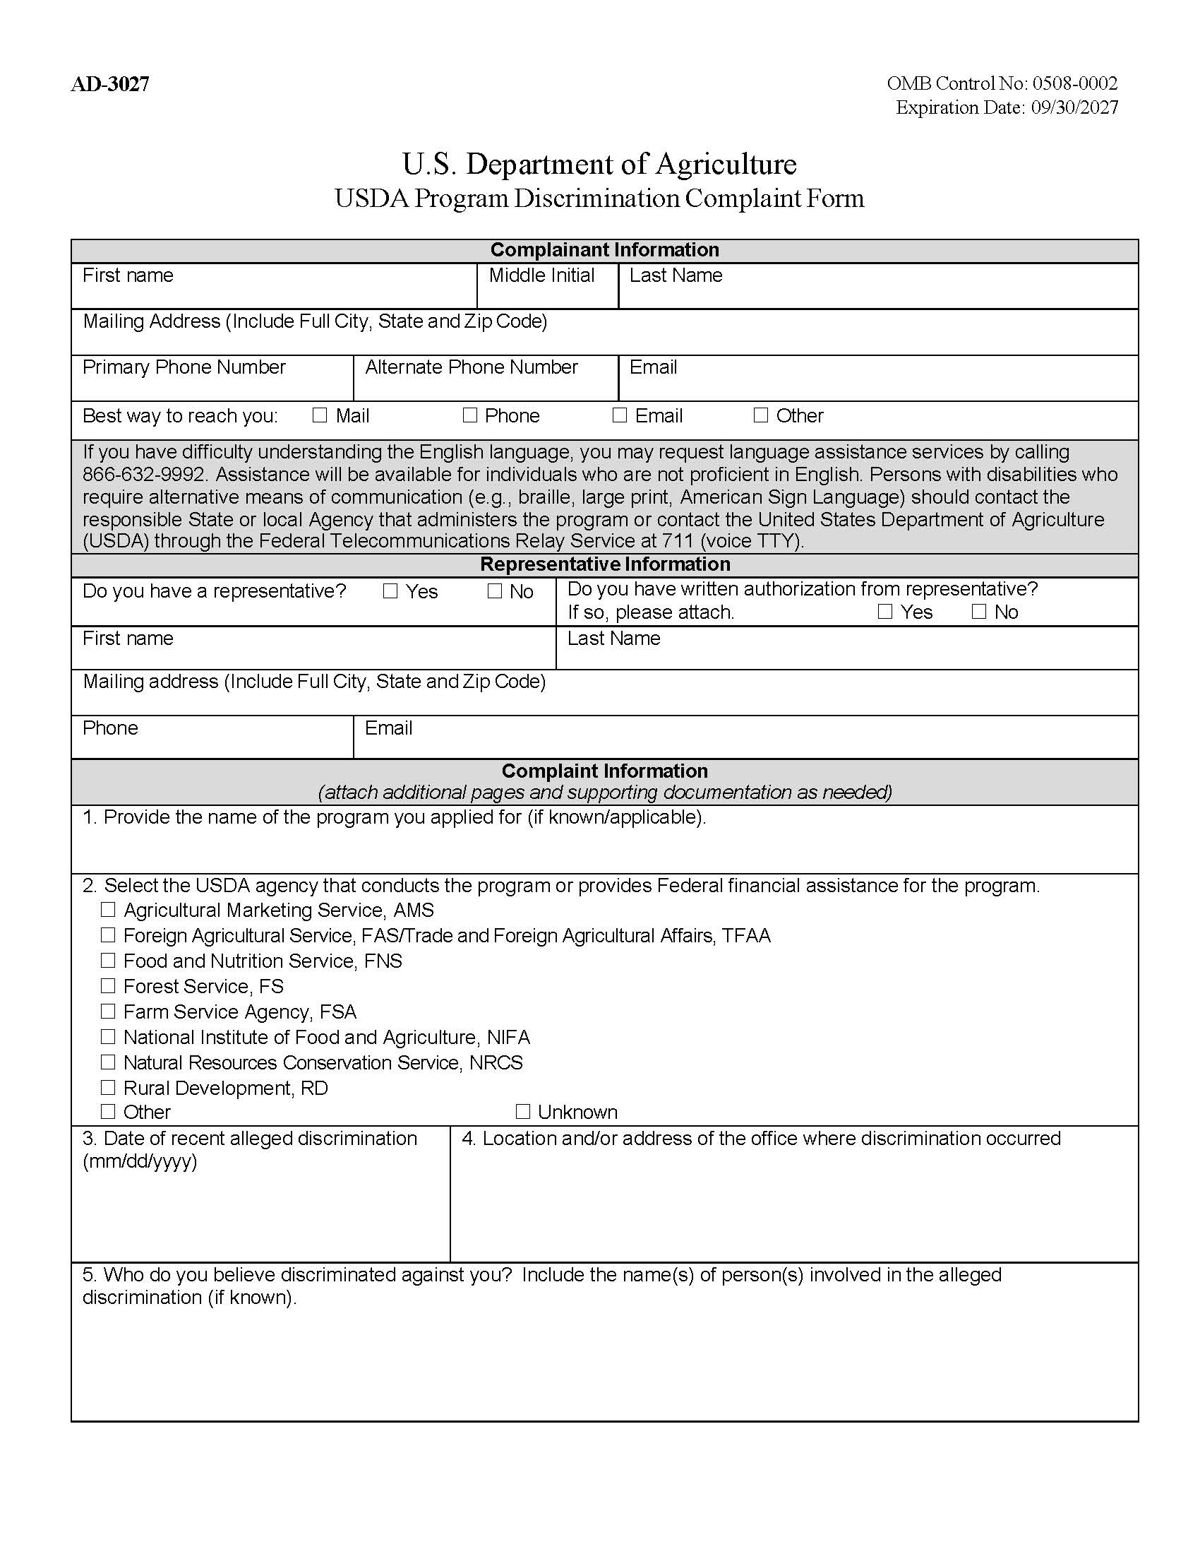
USDA Discrimination Complaint Form: English
Form AD-3027
U.S. Department of Agriculture USDA Program Discrimination Complaint Form
https://www.usda.gov/sites/default/files/documents/ad-3027.pdf

Slide 59
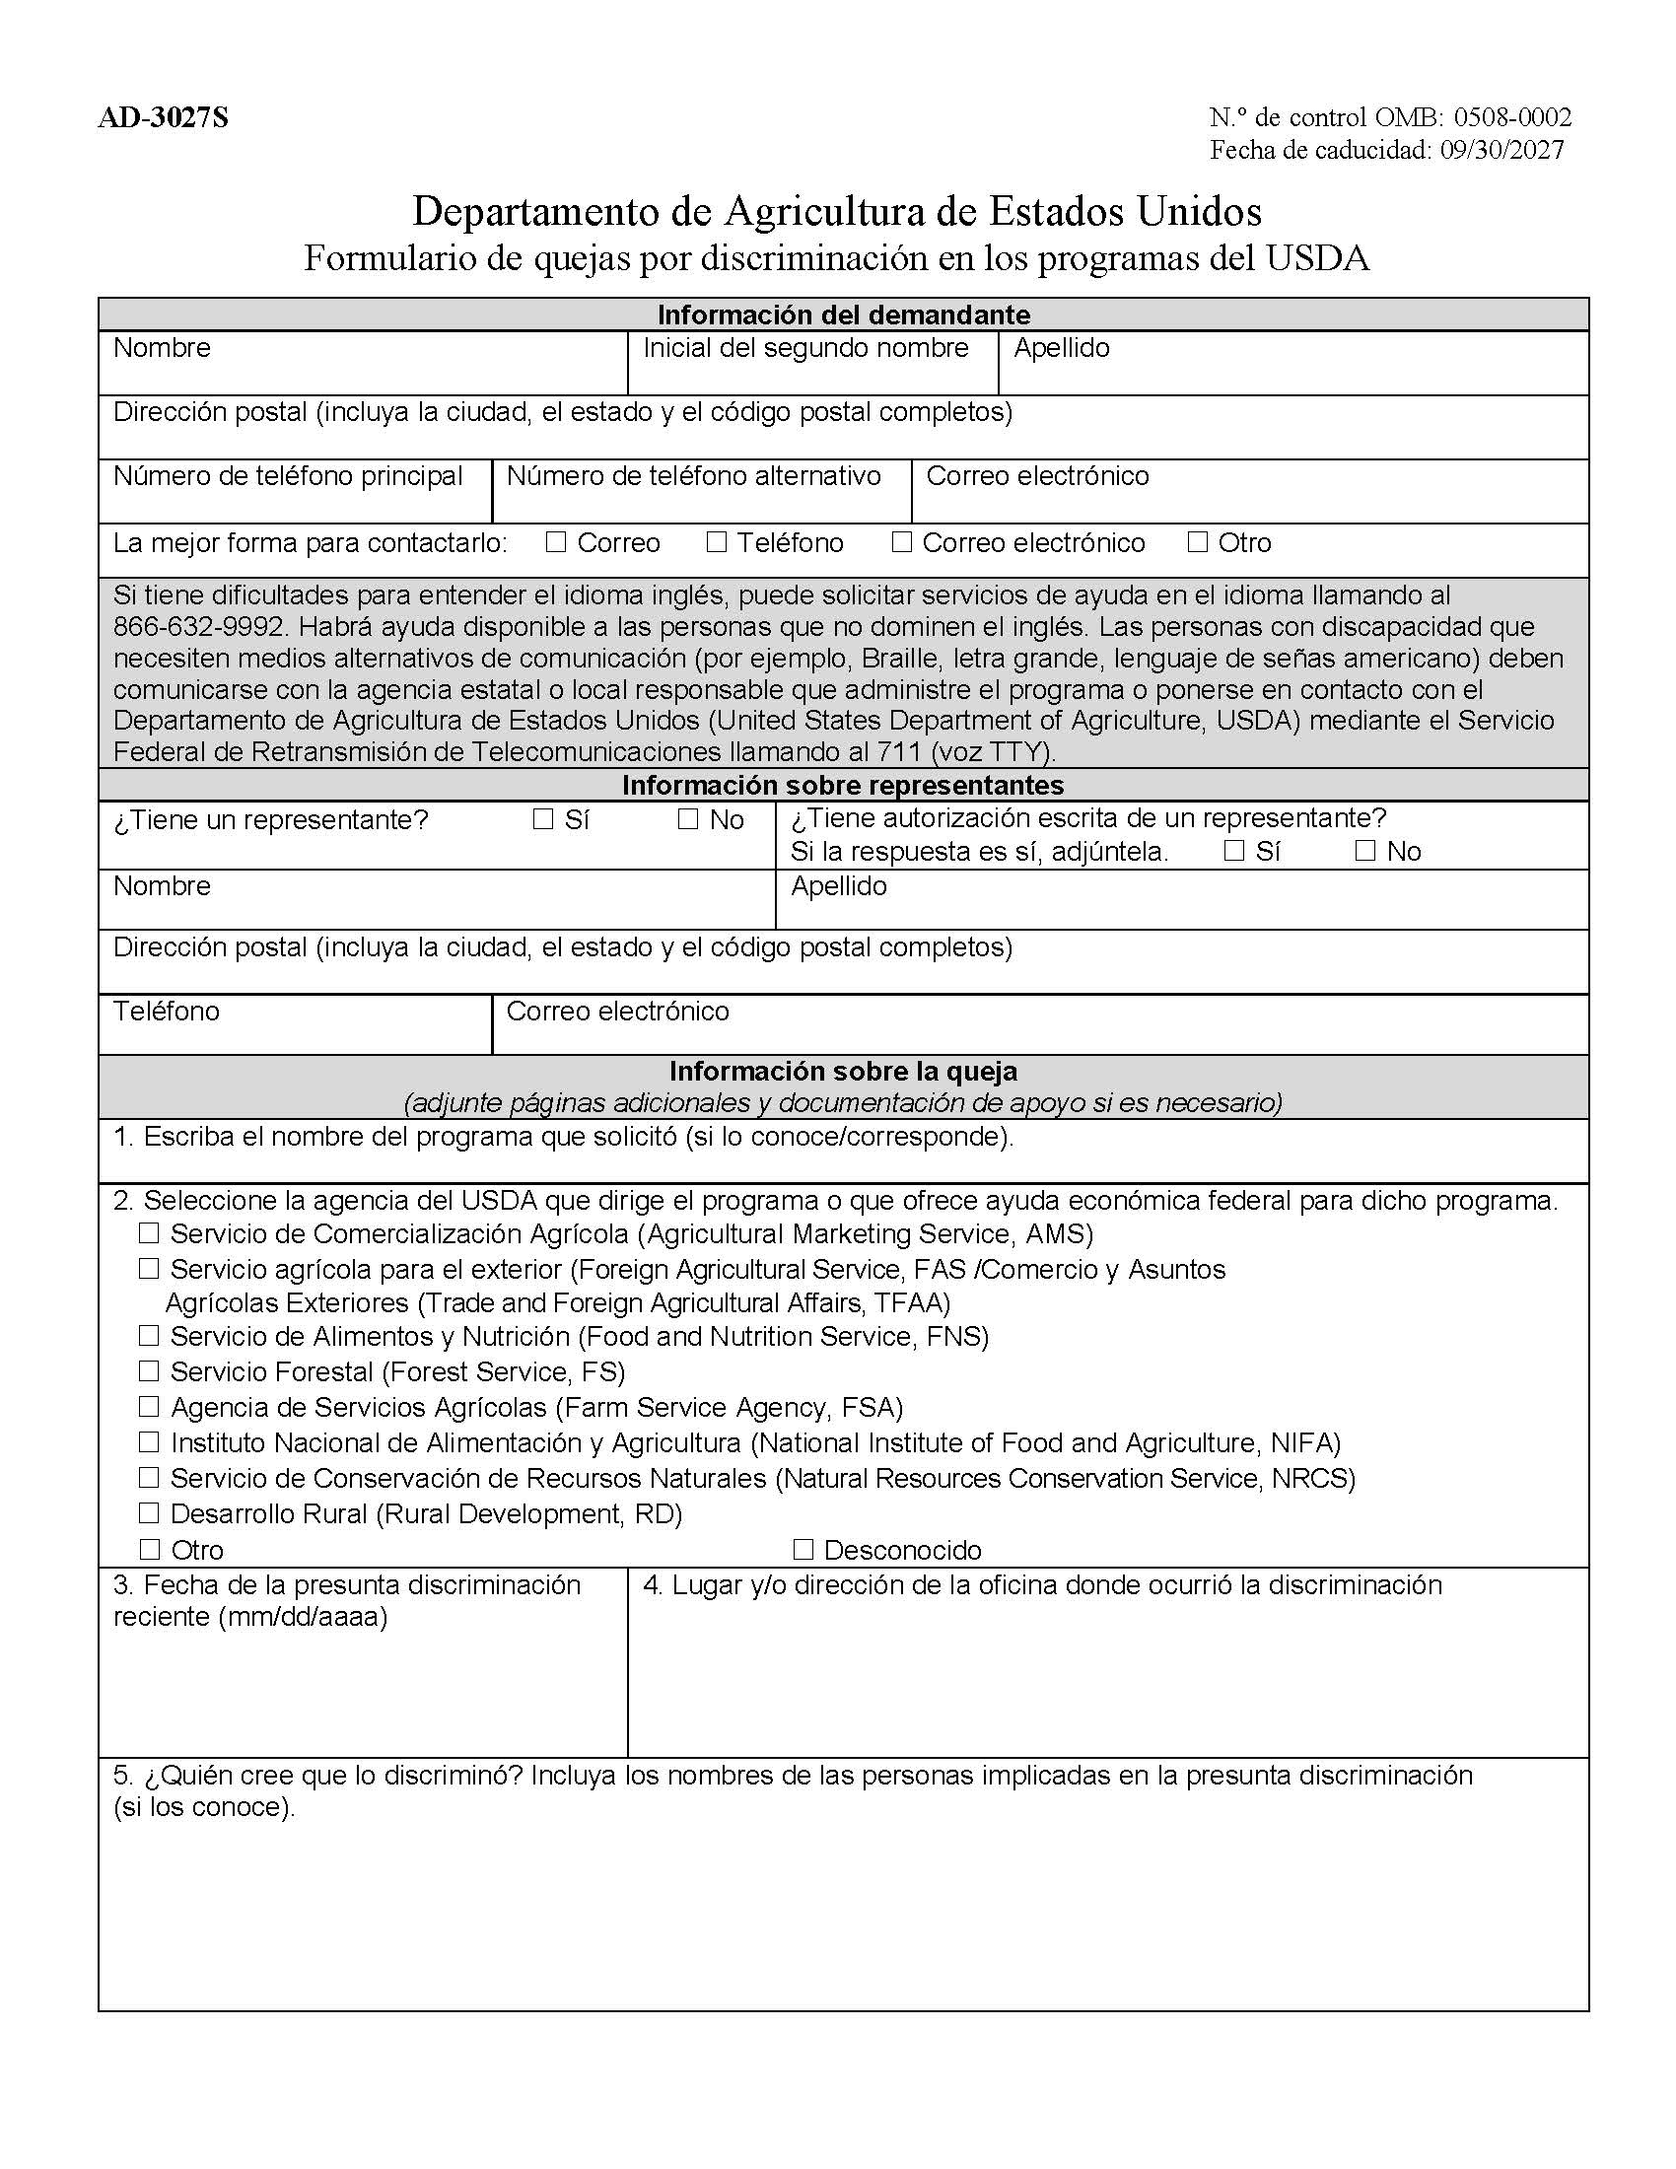
USDA Discrimination Complaint Form: Spanish
Form AD-3027S
Departamento de Agricultura de Estados Unidos Formulario de quejas por discriminación en los programas del USDA
https://www.usda.gov/sites/default/files/documents/ad-3027s.pdf

Slide 60
Language Assistance

Slide 61
Limited English Proficiency (LEP)
LEP individuals
  Do not speak English as their primary language
  Have limited ability to read, speak, write, or understand English
CACFP sponsors must take “reasonable steps” to ensure meaningful access to their programs and activities by a LEP person

Slide 62
Reasonable Steps to Ensure Meaningful Access
Providing documents in a variety of languages (translation)
Providing interpretation services to those that need help in completing applications
Providing verbal information for individuals who are unable to read the written information provided

Slide 63
What Constitutes “Reasonable Steps” Depends On
Number or proportion of LEP persons eligible to be served or likely to be encountered within the area serviced by the recipient
Frequency with which LEP individuals come in contact with the program
Nature and importance of the program, activity, or service provided by the program
Resources available and their costs

Slide 64
Meaningful Access
Accomplished by providing reasonable, competent/ qualified, accurate, and effective language services to individuals with LEP when accessing recipient programs and activities

Slide 65
Providing Language Assistance
Foreign language teachers and community organizations may have resources to help with translations (written and verbal)
May use volunteers but make sure they are competent/ qualified, understand interpreter ethics, and maintain participant confidentiality
Cannot use participants as interpreters

Slide 66
Providing Language Assistance, continued
CACFP sponsors must
identify their community’s predominant languages and provide documents or services to participants and their families in those languages
Documents or Services
CACFP income eligibility applications
Parent letters
Interpretive services for
parent questions

Slide 67
LEP Taglines
A phrase in different languages that guides a person to where they can obtain language assistance services

Slide 68
Top Six Languages Spoken in Connecticut Schools
Spanish
Portuguese
Arabic
Chinese Mandarin
Polish
Haitian-Creole
October 2023 Public School Information System (PSIS) Data Collection

Slide 69
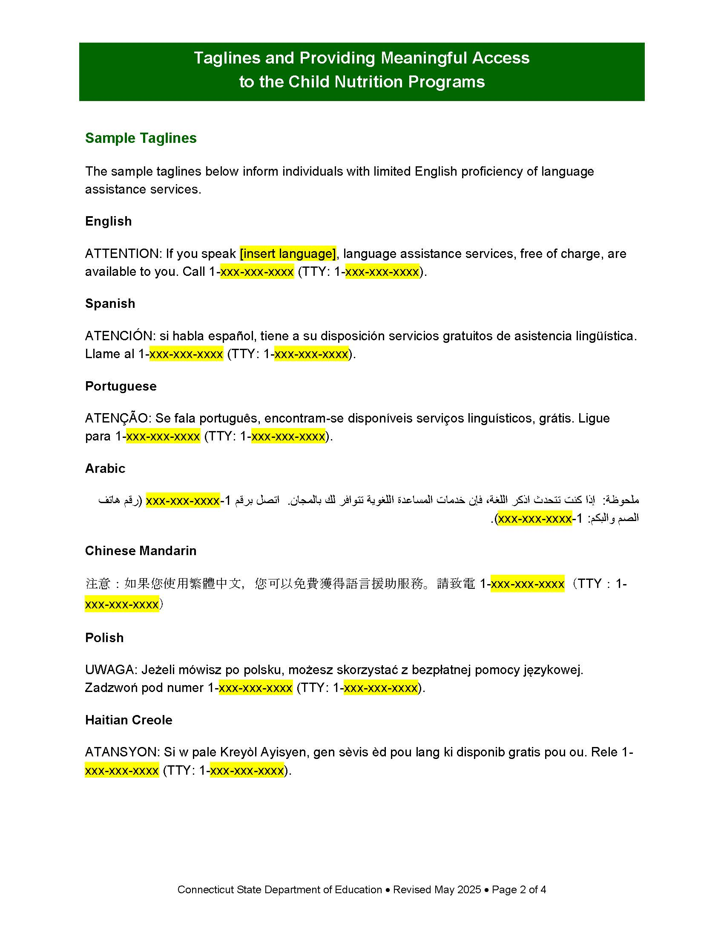
Taglines and Providing Meaningful Access to the Child Nutrition Programs
Sample taglines
https://portal.ct.gov/-/media/sde/nutrition/nslp/forms/freered/taglines_providing_meaningful_access_cnps.pdf

Slide 70
LEP Accessibility for Sponsor Websites
Does the website have
the ability to provide information in another language?
Would an LEP individual be able to find out how to access the webpage in another language?
Work with your IT department to make the CACFP webpage more accessible to LEP persons

Slide 71

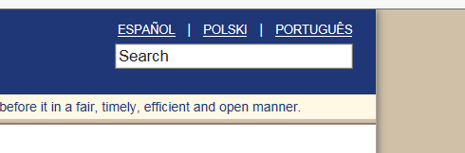
Website LEP Examples
If Spanish was your native language and you could not read English, which format would be the most helpful to indicate the website was available in other languages?
Example 1
Example 2

Slide 72
Website LEP Examples
If Spanish was your native language and you could not read English, which format would be the most helpful to indicate the website was available in other languages?
Example 1
Shows language options recognizable to LEP individual
Work with website designer to see if website has capability to offer language assistance in this way

Slide 73
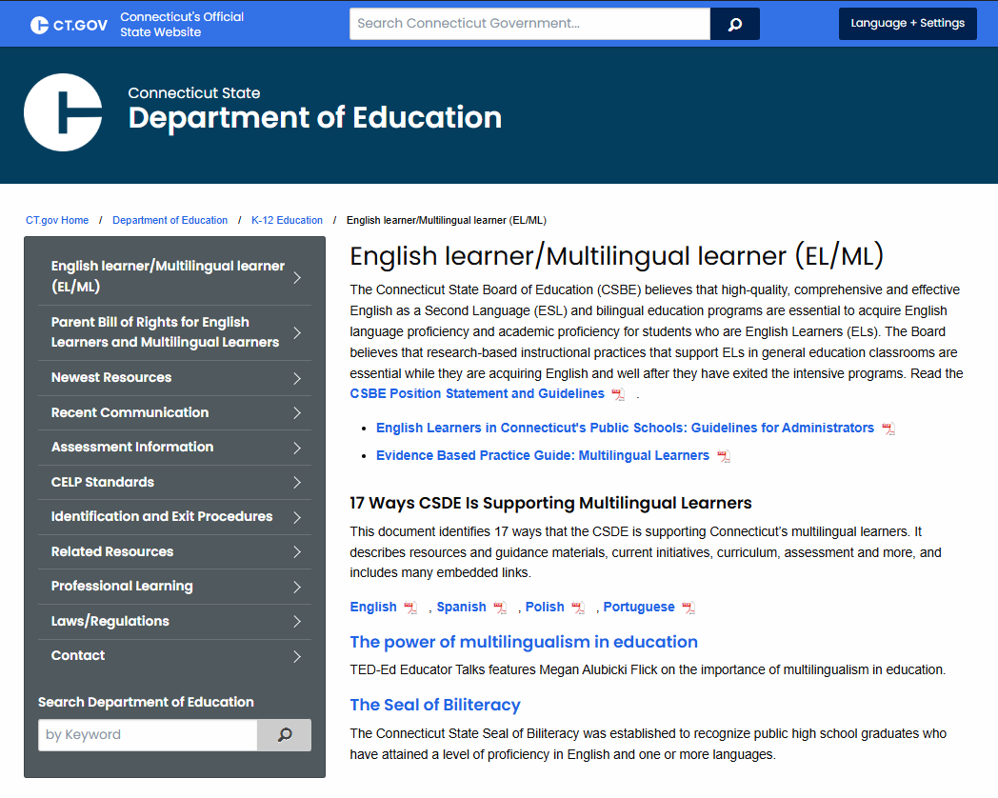
English Learner/Multilingual Learner (EL/ML)
English Learners and Bilingual Education Statues
Connecticut English Language Proficiency (CELP) Standards
English Learners Data Bulletin
https://portal.ct.gov/sde/english-learners/english-learner-multilingual-learner

Slide 74
Accommodations

Slide 75
Laws Prohibit Disability Discrimination
Sections 504 and 508 of the Rehabilitation Act of 1973 and 7CFR Part 15b, prohibit discrimination based on disability in programs or activities receiving Federal financial assistance
The ADA, 28 CFR Part 35, Title II, Subtitle A, prohibits discrimination on the basis of disability in all services, programs and activities provided to the public by state and local government
These civil rights laws protect persons with disabilities if they are potential applicants or participants in any FNS funded programs

Slide 76
Person with a Disability
Has a physical or mental impairment which substantially limits one or more major life activity, has a record of such an impairment, or is regarded as having and impairment
  Source: Section 504 of the Rehabilitation Act of 1973 and the American with Disabilities Act (ADA) of 1900, and the ADA Amendments Act of 2008 (P.L. 110-325)

Slide 77
CACFP Sponsors Must Ensure Accessibility
Imperative that CACFP sponsor websites and online application systems are readily accessible to and useable by persons with visual impairments and other disabilities
Programs must ensure physical accessibility for buildings and facilities, particularly to persons in wheelchairs and with mobility disabilities
In some cases, different or special treatment may be necessary to ensure effective aids, benefits and services are reasonable

Slide 78
Examples of Accommodations
Access for persons in wheelchairs and other mobility limitations
Access for those with limited vision
Using American Sign Language (ASL) and interpreters
Substitutions for participants whose disability restricts their diet (meal modifications)

Slide 79
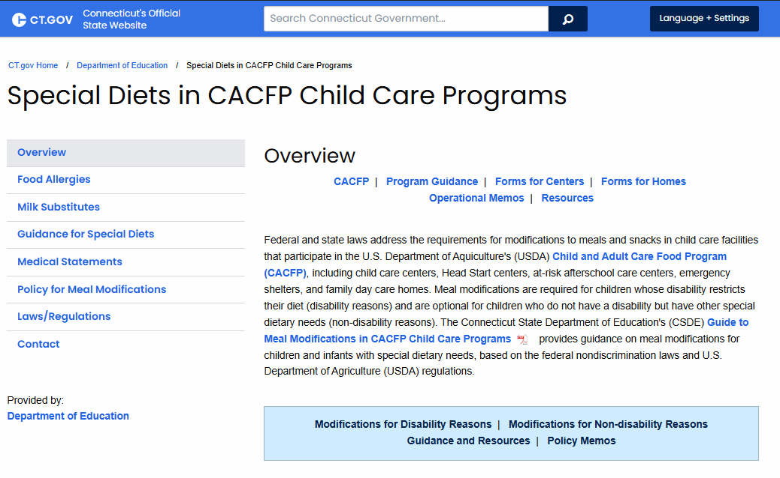
Special Diets in CACFP Child Care Programs
Guide to Meal Modifications in CACFP Child Care Programs
Summary Chart: Overview of USDA Requirements
Medical Statement
Guidance and Instructions for Medical Statement
Allowable Milk Substitutes
Training links
Additional Resources
https://portal.ct.gov/sde/nutrition/special-diets-in-cacfp-child-care-programs

Slide 80
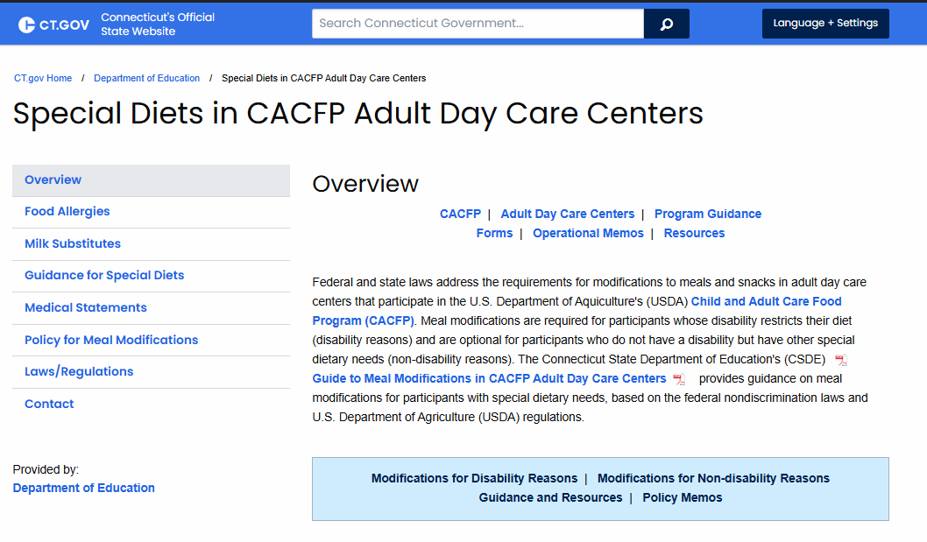
Special Diets in CACFP Adult Day Care Centers
Guide to Meal Modifications in CACFP Adult Day Care Centers
Summary Chart: Overview of USDA Requirements
Medical Statement
Guidance and Instructions for Medical Statement
Allowable Milk Substitutes
Training links
Additional Resources
https://portal.ct.gov/sde/nutrition/special-diets-in-cacfp-adult-day-care-centers

Slide 81
Customer Service

Slide 82
Importance of Customer Service
Good customer service reduces chances of discrimination complaints

Slide 83
Tips for Customer Service
Be courteous and thoughtful
Be patient and listen carefully
Treat all students equally
  No seating arrangements, serving lines, services and facilities, or eating periods separated by protected class

Slide 84
Conflict Resolution

Slide 85
Conflict Resolution Requirements
Must be covered in CACFP sponsor’s Civil Rights procedures
Include how sponsor will process a complaint with the goal of providing a solution with assistance of state agency and USDA, as needed

Slide 86
Evaluation of Civil Rights Compliance

Slide 87
Sponsor and State Agency Must Evaluate
Civil Rights Compliance During
Pre-approval Reviews
  Question on pre-approval form
  Observation of practices
Post-award or routine reviews
  CSDE administrative reviews
  Sponsor and CSDE monitoring visits

Slide 88
Civil Rights Noncompliance
A factual finding that any civil rights requirement, as provided by law, regulation, policy, instruction or guidelines, is not being adhered to

Slide 89
Noncompliance May Result From
Routine review
Special review
Investigation

Slide 90
Resolving Noncompliance
Once civil rights noncompliance is determined, must take steps to immediately obtain voluntary compliance
Continued noncompliance may lead to suspension or termination

Slide 91
Resolving Noncompliance, continued
CSDE reports significant findings to USDA
All findings require corrective action
Follow-up visit may be needed to assure compliance

Slide 92
Required Training

Slide 93
USDA Requires Annual Civil Rights Training
For all staff who work with program applicants or participants
  Food service staff
  Front line staff
  Supervisors
  Determining officials, verifying officials, and hearing officials

Slide 94
Required Training Topics
Data collection and use
Effective public notification
Complaint procedure
Compliance review techniques
Resolution of noncompliance
Reasonable accommodations for disabilities
Language assistance
Conflict resolution
Customer service

Slide 95
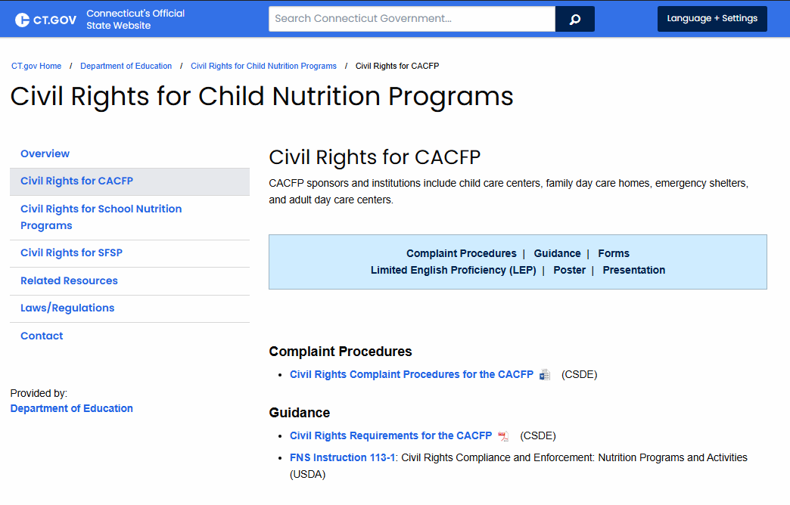
CSDE Training Resource
This PowerPoint presentation is available for CACFP sponsors to provide staff training
  “Presentation” section of CSDE’s Civil Rights for CACFP webpage
https://portal.ct.gov/sde/nutrition/civil-rights-for-child-nutrition-programs/civil-rights-for-cacfp#Presentation

Slide 96
Document Staff Training
For each staff member

Slide 97
CSDE CACFP Staff

Slide 98
Contact Information for Community Nutrition Staff
Bernice Amponsah
bernice.amponsah@ct.gov
860-807-2117
Caroline Cooke
caroline.cooke@ct.gov
860-807-2144
Terese Maineri
terese.maineri@ct.gov
860-807-2145
Benedict Onye
benedict.onye@ct.gov
860-807-2080
Flor Sprouse
flor.sprouse@ct.gov
860-713-6849

Slide 99
Questions

Slide 100
USDA NDS
In accordance with federal civil rights law and U.S. Department of Agriculture (USDA) civil rights regulations and policies, this institution is prohibited from discriminating on the basis of race, color, national origin, sex (including gender identity and sexual orientation), disability, age, or reprisal or retaliation for prior civil rights activity.
Program information may be made available in languages other than English. Persons with disabilities who require alternative means of communication to obtain program information (e.g., Braille, large print, audiotape, American Sign Language), should contact the responsible state or local agency that administers the program or USDA’s TARGET Center at (202) 720-2600 (voice and TTY) or contact USDA through the Federal Relay Service at (800) 877-8339
To file a program discrimination complaint, a Complainant should complete a Form AD-3027, USDA Program Discrimination Complaint Form which can be obtained online at: https://www.usda.gov/sites/default/files/documents/ad-3027.pdf, from any USDA office, by calling (866) 632-9992, or by writing a letter addressed to USDA. The letter must contain the complainant’s name, address, telephone number, and a written description of the alleged discriminatory action in sufficient detail to inform the Assistant Secretary for Civil Rights (ASCR) about the nature and date of an alleged civil rights violation. The completed AD-3027 form or letter must be submitted to USDA by:
1. mail: U.S. Department of Agriculture
Office of the Assistant Secretary for Civil Rights
1400 Independence Avenue, SW
Washington, D.C. 20250-9410;
2. fax: (833) 256-1665 or (202) 690-7442; or
3. email: program.intake@usda.gov.
This institution is an equal opportunity provider.

Slide 101
CSDE NDS
The Connecticut State Department of Education is committed to a policy of equal opportunity/affirmative action for all qualified persons. The Connecticut Department of Education does not discriminate in any employment practice, education program, or educational activity on the basis of race; color; religious creed; age; sex; pregnancy; sexual orientation; workplace hazards to reproductive systems, gender identity or expression; marital status; national origin; ancestry; retaliation for previously opposed discrimination or coercion, intellectual disability; genetic information; learning disability; physical disability (including, but not limited to, blindness); mental disability (past/present history thereof); military or veteran status; status as a victim of domestic violence; or criminal record in state employment, unless there is a bona fide occupational qualification excluding persons in any of the aforementioned protected classes. Inquiries regarding the Connecticut State Department of Education’s nondiscrimination policies should be directed to: Attorney Louis Todisco, Connecticut State Department of Education, by mail 450 Columbus Boulevard, Hartford, CT 06103-1841; or by telephone 860-713-6594; or by email louis.todisco@ct.gov.

