Slide 1
The Promise of High Dosage Tutoring Performance Matters Forum October 10, 2024
Patricia Chenail, Thompson School District
Javier Perez, Regional School District 15
Josh Steffenson, Manchester School District
John Scianimanico, CSDE

Slide 2
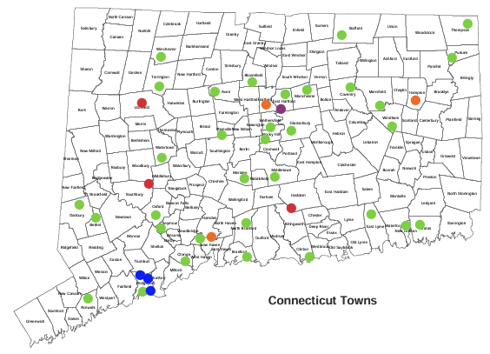
CT HDT Grantees
43 public school districts
33 local school districts, 3 regional school districts, 3 charter school districts, 3 RESCs, 1 college-affiliated school district
25 of the 43 are high need districts (i.e., FRL >= 43% between 2014 and 2022)
14 of 43 are Alliance Districts
43 districts offering tutoring during school hours
40 districts offering in-person tutoring exclusively
Local District
Charter School
RESC
Regional District
College-affiliated District

Slide 3
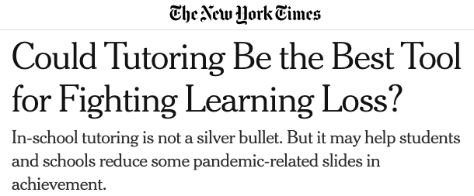
Why HDT?

Slide 4
What HDT Is vs Is Not
What High-Dosage Tutoring Is | What It is Not
Intensive and Frequent Small tutor-student ratios (1:4) Offered 3x a week over a school year during school day Minimum of 30-minute sessions Provided by a Qualified Tutor Has content experience Regularly works with the same students Individualized and Supplemental Driven by assessment data Aligned to core instruction | Low-Dosage or Irregular Occurs weekly or as needed/on demand Treated as optional for student Large or 1:1 tutor-student ratios Provided by an Unqualified Tutor Lack of student-tutor relationship A volunteer with no formal commitment to program Decontextualized and Impersonal Sitting in front of a computer screen

Slide 5
CSDE Model: What Does HDT Look Like in Schools?
LEA Champion
An LEA-appointed individual with time and administrative power to coordinate efforts across school(s)
High Quality Tutors
CSDE vetted and identified 16 vendors
LEAs also used their own tutors/educators
Targeted Academics
Math (Grades 6-9)
District Program and Curriculum
District selected, aligned to CT Core Math Standards and builds foundational skills
District may opt for programs provided by selected tutoring organization
Tutor-Student Ratio
1:4 (maximum)
Frequent Tutoring Sessions
3x week, 30-minute sessions (minimum)
Timing and Delivery*
*Regardless of timing and delivery, what's most important is having a structured, recurring time for students to meet with tutors.
 | During School Day | Before/After School Day
In-Person Tutoring | Strongly Encouraged | Acceptable
Virtual Tutoring | Acceptable | Strongly Discouraged

Slide 6
Thompson School District
Students Receiving HDT in 2023-24 School Year
Grade 6: 52
Grade 7: 40 Grades 6 to 8 – Thompson Middle School
Grade 8: 42 Grade 9 – Tourtellotte Memorial High School
Grade 9: 25
Number of Tutors: Jan to June 2024 = 7 tutors / Sept to December 2024 = 6 tutors*
Tutor Provider/Source: Catapult Learning
Biggest Challenge(s) of HDT Program: For the first half of the program starting mid-year was very challenging. Another challenge is recruiting qualified tutors. Finally, knowing that we were continuing for 24/25 we planned program in May 2024. Planned as a UA class so as not to disrupt any other instruction. HS students are a challenge.
Biggest Success(es) of HDT
Top to Down initiative | My role (implementation & maintaining)
Relationship with tutor source | Teacher/tutor collaboration
Tutor source training (initial / ongoing) | Lead teacher*
SBAC Result Spring 2024

Slide 7
Regional School District 15
Students Receiving HDT in 2023-24 School Year
Grade 6: 62
Grade 7: 91
Grade 8: 71
HDT Schools: Rochambeau Middle School / Memorial Middle School
Number of Tutors: 9
Tutor Provider/Source: SmartStart Education
Biggest Successes of HDT Program:
1) 33% of students reached level 3 or higher on SBAC
2) Qualitative Data from Student Survey about tutoring and tutoring program
Biggest Challenges of HDT Program:
1) Obtaining qualified tutors to teach the math content
2) Tutor Management and Scheduling
3) Managing Dual Responsibilities

Slide 8
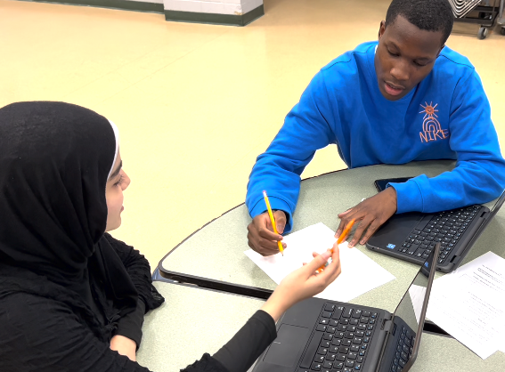
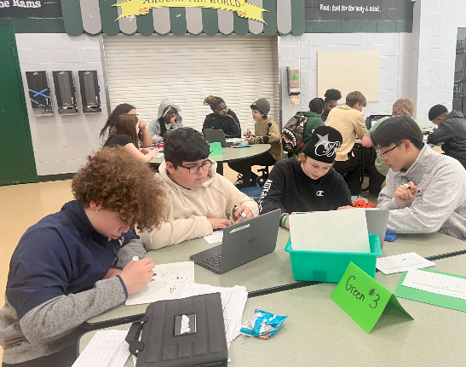
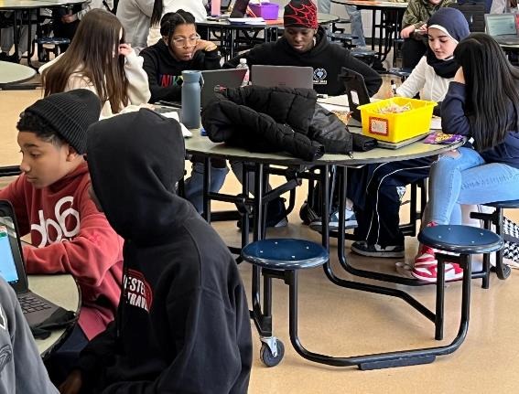
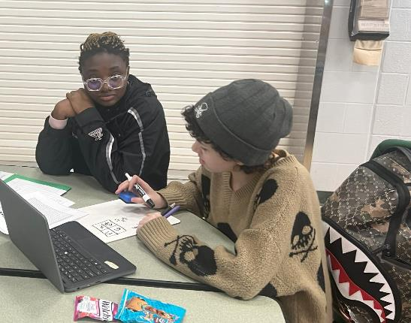
Manchester School District
Students Receiving HDT in 2023-24 School Year
Grade 7: 40
Grade 8: 40
HDT Schools: Illing Middle School
Number of Tutors: 30
Tutor Provider/Source: Manchester High Students!
Biggest Successes of HDT Program: ‘Personal’ + ‘Interpersonal’
Biggest Challenges of HDT Program: ‘Operational’

Slide 9
CSDE Supports: Vetted Tutor Organizations
In-Person and Virtual Organizations
Catapult, LLC
Creativista Charm, LLC
Great Oaks Foundation
HeyTutor, Inc
Kelly Education, Tutoring Solutions for Excellence
SmartStart Education, LLC
Virtual Organizations Only
Air Tutors
Carnegie Learning, LLC
FEV Tutor, Inc
Fullmind (formerly iTutor)
Intervene K-12
Simplify Math Engagement Center, LLC (DBA Eurekii)
Teach for America, Connecticut
Tutored by Teachers, Inc
Tutor.com and The Princeton Review
Varsity Tutors for Schools, LLC
***Districts may also use their own staff. Detailed information on each of these organizations can be found on the CSDE High-Dosage Tutoring webpage.

