Slide 1


CONNECTICUT STATE DEPARTMENT OF EDUCATION
Rethinking Educator Evaluation and Support
Summary of Proposed CT Guidelines for Educator Evaluation and Support 2023
Proposed Recommendations from the Educator Evaluation and Support (EES) Council*
for Adoption by the CT State Board of Education
*codified in Conn. Gen. Stat. 10-151b as the Performance Evaluation and Advisory Council

Slide 2









Educator Evaluation and
Support (EES) Council
Including liaisons from the CSDE and CSBE, and
facilitated by EdAdvance and EASTCONN
MTR Policy Oversight Council

Slide 3
EES Council
Vision
All Connecticut educators have the opportunity for continuous learning and feedback, to develop and grow, both individually and collectively, through the educator evaluation and support system so that all Connecticut students experience growth and success.

Slide 4
EES Council
The primary goal of the educator evaluation and support system is to strengthen individual and collective practices so as to increase student learning, growth and achievement.
To achieve this goal, the CSDE convened the Educator Evaluation and Support (EES) Council in April 2021 to reimagine
CT’s educator evaluation and support system. The proposed new system will engage educators and leaders in professional learning, growth and continuous improvement to positively impact student learning, growth and achievement.

Slide 5
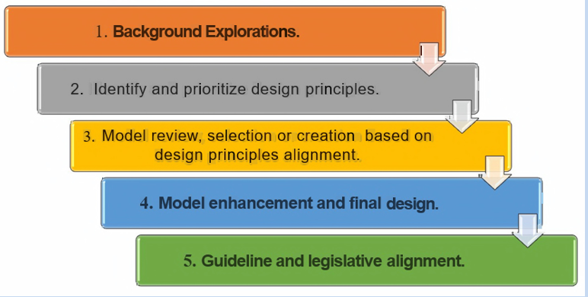
EES Council
EES Council Design Process Steps

Slide 6
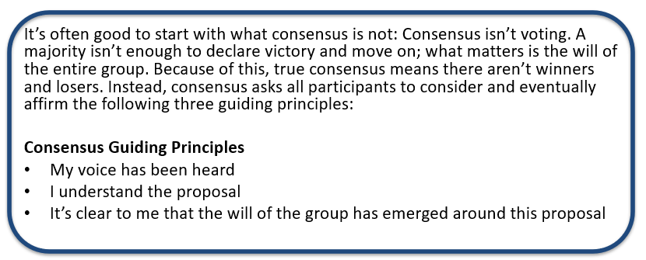
EES Council
Consensus Protocol
This process was used with the Gradients of Agreement on the following slide to discuss and reach consensus as the EES Council engaged in the process of developing the proposed reimagined CT Guidelines for Educator Evaluation and Support (2023).

Slide 7
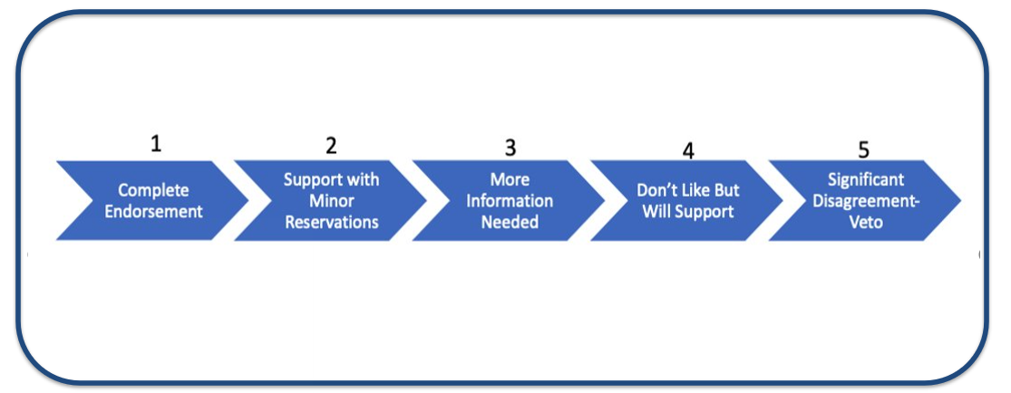
EES Council
Gradients of Agreement
Using the Gradients of Agreement process fostered productive discussion that contributed to reaching consensus about the design, structure and components of the proposed reimagined CT Guidelines for Educator Evaluation and Support. (2023).

Slide 8
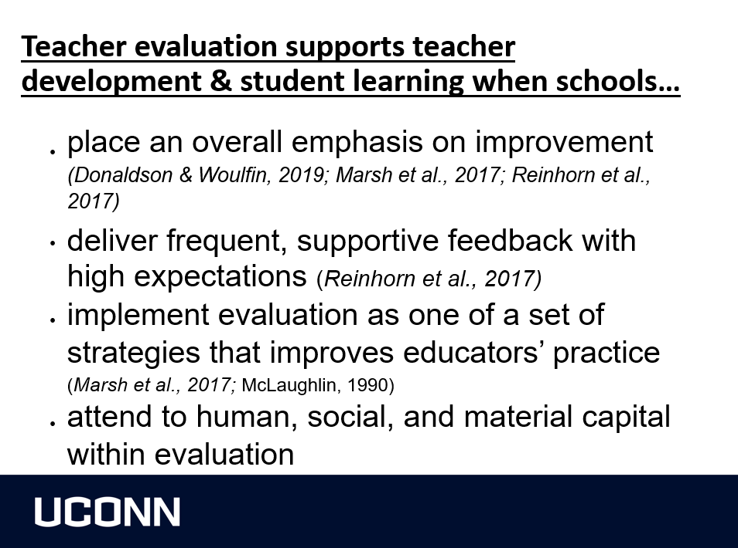

Morgaen L. Donaldson (2020)
Associate Dean for Research, UConn
Neag School of Education

Slide 9

Douglas Fisher, Nancy Frey &
John Hattie (2016)

Slide 10
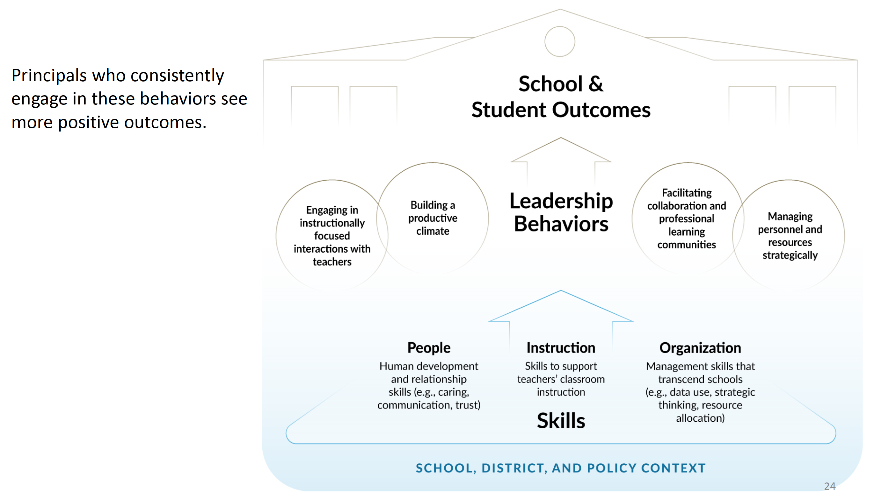
Grissom, Jason A., Anna J. Egalite, and Constance A. Lindsey (2021)
The average student gains an additional three months of learning in math and reading with an effective principal.

Slide 11
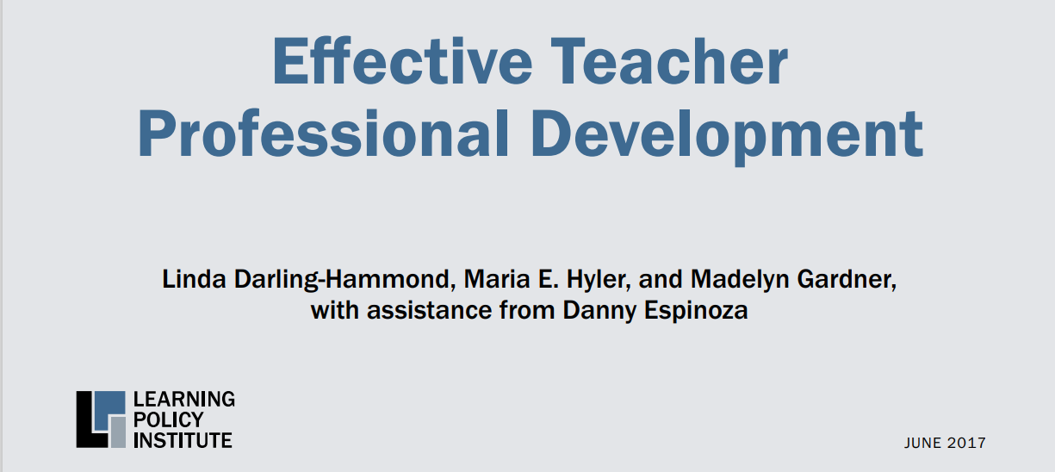
Linda Darling-Hammond, Maria E. Hyler, and Madelyn Gardner – (2017)
Effective Professional Development
“Teacher professional learning is of increasing interest as one way to support the increasingly complex skills students need to learn in preparation for further and work in the 21st century. Sophisticated forms of teaching are needed to develop student competencies such as deep mastery of challenging content, critical thinking, complex problem-solving, effective communication and collaboration, and self-direction. In turn, effective professional development (PD) is needed to help teachers learn and refine the pedagogies required to teach these skills.”
Features of Effective Professional Development
Is of sustained duration
Incorporates active learning
Supports collaboration
Uses models of effective practice
Is of sustained duration
Provides coaching and expert support
Offers feedback
and reflection

Slide 12
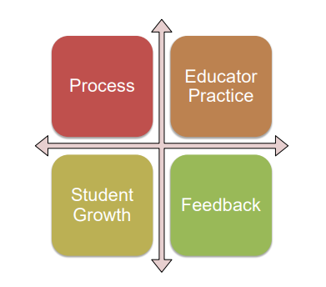

EES Council
The EES Council considered improvements and changes in the following areas:

Slide 13
EES Council
Educator Evaluation Design Principles
    Support educator growth and agency
      Engage professionals by focusing on growth and practice in partnership with others aligned to a strategic focus
    Allow for differentiation of roles
      Teachers, counselors, support staff, leaders – principal, assistant principal, Central office administrators
    Simplify and reduce burden
      Eliminate the technical challenge, reduce the number of steps & paperwork
    Focus on things that matter
      Identify high leverage, mainstream goal focus areas
    Continued on next slide.

Slide 14
EES Council
Educator Evaluation Design Principles
(continued)
    Implement continuous improvement cycles that include specific, timely, actionable and reciprocal feedback
      Quality feedback leads to opportunities for meaningful professional learning
    Meaningful connections to professional learning
      There are pathways for educators and leaders to improve their own practice in a way that is meaningful and impactful
    Focus on standards connected to best practices in the delivery of content and the development of the whole child
      Academic, social, emotional, and physical

Slide 15
Next Steps
SBE Approval and Adoption
Process to Adopt Proposed New CT Guidelines for Educator Evaluation and Support (2023)
(CT Guidelines 2023)
Internal review by CSDE Office of Legal and Governmental Affairs
Present proposed new CT Guidelines (2023) to the State Board of Education (SBE) Legislation and Policy Development Committee (May 2023)
Reconvene with the Legislation and Policy Development Committee following outcomes of current legislative session.
Pending approval of Committee, recommend that the SBE adopts the proposed new CT Guidelines 2023
Communication to districts following June SBE meeting
Required implementation beginning in the 2024-25 school year

Slide 16
Next Steps for Successful Implementation
Training and Guidance
The EES Council identified key elements to be included in training and guidance that is being developed for:
Evaluators of administrators/leaders
Evaluators of educators
Professional Development and Evaluation Committees (PDECs)
Training
These trainings will be offered by the RESCs and CAS, tentatively to begin late summer 2023. Dates and times will be posted on the EES Council webpage.
Districts will have the 2023-24 school year to train staff on the com[ponents and processes of the new proposed CT Guidelines 2023.
Information will also be available specific to:
Local/Regional Boards of Education
Educator Preparation Programs
CSDE-Approved Private Special Education Programs (APSEPs)

Slide 17
Next Steps for Districts in 2024-25
Suggestions for District Planning
Suggestions to begin the transformation to the new proposed CT Guidelines 2023:
Guidance for PDECs is being developed to ensure that PDECs have the information and resources needed to ensure successful implementation of the new, proposed CT Guidelines (2023), and including design elements for professional learning. More information will be provided regarding content, dates and times (tentative date: July 2023).
Celebrate goals that have been accomplished and look forward to a reimagined system that is focused on:
  Emerging research and best practices in the field of education
  Professional learning to develop systems of continuous improvement for educator/leader practice and student outcomes
  Provides opportunities to address the continued impact of the COVID-19 pandemic on students, teachers, administrators, families, and school communities.
  Continued on next slide

Slide 18
Next Steps for Implementation in 2024-25
Suggestions for District Planning (continued)
Suggestions to begin the transformation to the new proposed CT Guidelines 2023 (continued):
Become familiar with Learning Forward’s Standards for Professional Learning (April 2022).
  CSDE Standards for Professional Learning are still valid. These were developed based on the previous version of the Learning Forward Standards for Professional Learning.
Consider a process to determine mutual agreement among PDEC members.
  The Consensus Protocol and Gradients of Agreement process (slides #6 and #7 were successful as the EES Council engaged in this process of reimagining educator evaluation and support).
Begin to plan a 2023-24 timeline that includes ongoing PDEC meetings throughout the year:
  To develop a revised educator evaluation and support plan aligned to the CT Guidelines 2023, pending adoption by the SBE in June 2023, and
  To provide training for staff on the com[ponents and processes of the new proposed CT Guidelines 2023.

Slide 19
Thank You for your Collaboration, Insight, and Innovation!
AACTE-CT: Dr. Paula Talty, Dr. Laura Whitacre
AFT-CT: Steve McKeever, Mary Yordon, Jennifer Benevento
CSBE: Vice-Chair Erin Benham
CSDE: Dr. Shuana Tucker, Sharon Fuller
CABE: Elizabeth Brown, Leonard Lockhart
CAPSS: Frances Rabinowitz, Teresa Carroll, Kathleen Greider
CAS: Glenn Lungarini, Dr. Alicia Bowman
CEA: Joslyn Delaney, Kate Field
CASA: Anthony Ditrio, Sanjeeta Bella
CFSA: Fran DiFiore
MTR Policy Oversight Council: Dr. Samuel Galloway, Dr. Rebecca Good
RESC Alliance: Dr. Charles Dumais, Dr. Katherine Ericson
RESC Alliance Facilitators: Jonathan Costa, Diane Dugas

Slide 20
Contact Information
CSDE Talent Office
Dr. Shuana K. Tucker, Chief Talent Officer
Shuana.Tucker@ct.gov
860.713.6848
Sharon M. S. Fuller, Education Consultant
  Sharon.Fuller@ct.gov
  860.713.6814

