Slide 1


CONNECTICUT STATE DEPARTMENT OF EDUCATION
Educator Evaluation & Support 2022
Updates

Slide 2
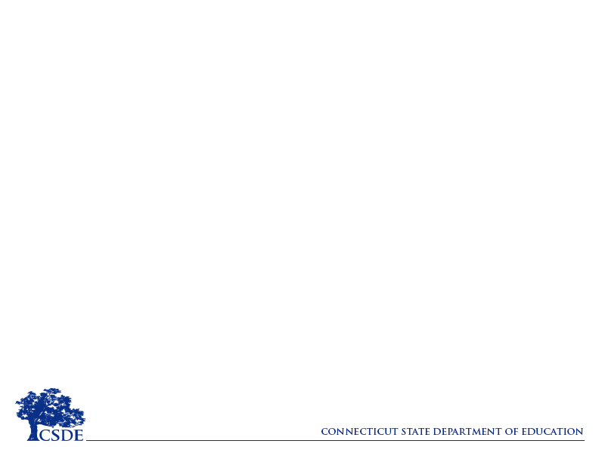
Highlights of Flexibilities for 2021-2022
Student Learning Indicators Component
Expanded guidance around Indicators and Measures of Accomplishment (pp. 1-2)
Inclusion of Key Definitions (p. 2)
Teachers - One SLO with a minimum of two indicators or measures of accomplishment (p. 2)*
Administrators – Two student learning indicators (SLIs) or measures of accomplishment (p. 3)**
*Additional SLOs/SLIs are not allowed as additional requirements under the Flexibilities 2021-22.
Notes:
Key Definitions include Holistic Indicators of Student Growth, Measures of Accomplishment, Mutual Agreement. These definitions provide additional guidance related to Student Learning Indicators.
Teachers will develop one student learning goal with a minimum of two indicators or measures of accomplishments.
Administrators will develop two student learning indicators or measures of accomplishment.

Slide 3
Highlights of Flexibilities for 2021-2022
Observation of Performance and Practice Component
Observation Protocols
Alignment w/ current practices highlighted within existing CSDE-approved Rubrics (At-a-Glance Crosswalk)
Inclusion of Key Definitions including informal observations & non-classroom based educators (pp. 3-4)
Support and feedback from observations should align with support needed for the teacher/administrator to achieve SLO/SLIs
Notes:
The At-a-Glance Crosswalks includes alignment of the five social and emotional core competencies from CASEL, SEL teaching practices from GTL and the CCT Rubric for Effective Teaching 2017.
Key Definitions include Informal Observation, Formal Observation, In-class Observation, Review of Practice, Non-Classroom Based Educators
Teachers
Minimum of two informal observations and a minimum of one review of practice for teachers with more than two years of experience and who were rated Proficient or Exemplary during the 2018-19 school year and/or maintained Proficient or Exemplary practice during 2020-2021.
Minimum of three informal observations and a minimum of one review of practice for first and second year teachers and teachers who demonstrated Developing or Below Standard practice during 2020-2021.
Administrators
Minimum of two site visits and one artifact review for administrators with two or more years of experience and who were rated Proficient or Exemplary during the 2018-19 school year and/or maintained Proficient or Exemplary practice during 2020-21.
Minimum of three site visits and two artifact reviews, with additional site visits/artifact reviews, as needed, for administrators who are new to the profession or the district, or who demonstrated Developing or Below Standard practice during 2020-21.

Slide 4
Highlights of Flexibilities 2021-2022
Whole-School Student Learning Indicators/
Teacher Effectiveness Outcomes Component
Additional focus on educators' professional practice allows for better alignment of professional learning to support school-wide areas of focus (p. 5):
  Social and emotional learning,
  Providing equitable learning opportunities for all students,
  Professional learning to improve practice,
  Professional learning communities, or
  Best practices for hybrid or remote learning.
Notes:
Follow most recently approved CSDE-EESP or focus on one of the following areas to support professional practice and/or to support school-wide area of focus:
Social and emotional learning,
Providing equitable learning opportunities for all students,
Professional learning to improve practice,
Professional learning communities, or
Best practices for hybrid or remote learning.
*This is an opportunity to align to current/existing work/school priorities versus creating new areas of focus.

Slide 5
Highlights of Flexibilities 2021-2022
Stakeholder Feedback Component
Engaging with families continues to be essential in supporting the social and emotional well-being of students, student engagement, and academic learning. It is recommended that educators prioritize the focus on implementing strategies for ongoing communication and engagement with families.
Notes:
This is continuing from the Flexibilities from 2020-21 (https://portal.ct.gov/-/media/SDE/Digest/2020-21/Educator-Guidelines-Flexibilities-Memo081120.pdf).

Slide 6
Highlights of Flexibilities 2021-2022
4-Level Matrix Rating System
Holistic review of evidence across each component (pp. 5-6)
Sample Summative Form Templates included to highlight user-friendly approaches to determining summative ratings
District PDECs are encouraged to discuss/agree upon how the holistic review of evidence will be determined for each component.
Summative ratings are required in alignment with C.G.S. Section 10-151b and in considering Governor Lamont’s Executive Order 7C will have expired for the 2021-22 school year.
Notes:
District PDECs are encouraged to discuss/agree upon how the holistic review of evidence will be determined for each component.
The Educator Evaluation and Support 2022 Council (EES 2022) has begun the process to ‘reimagine’ Connecticut’s educator evaluation in its entirety for the academic year 2021-22 and beyond. The first step in the process of ‘reimagining’ educator evaluation was to update and revise the current Flexibilities for Implementing the CT Guidelines for Educator Evaluation 2017 (Guidelines) in 2020-21 to what is allowable within the current Guidelines and in alignment with C.G.S. Section 10-151b considering that Governor Lamont’s Executive Order 7C will have expired for the 2021-22 school year.

Slide 7
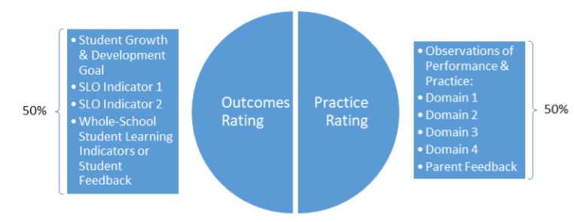
Highlights of Flexibilities 2021-2022
Sample Teacher Holistic Rating
*District PDECs are encouraged to discuss/agree upon how the holistic review of evidence will be determined for each component.*
Notes:
District PDECs are encouraged to discuss/agree upon how the holistic review of evidence will be determined for each component.

Slide 8
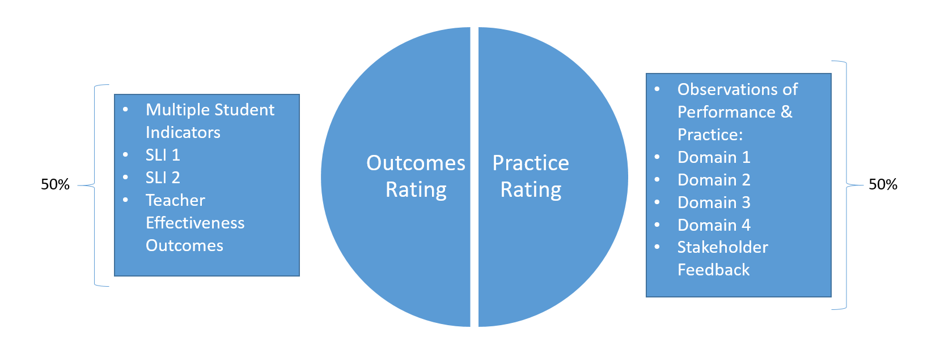
Highlights of Flexibilities 2021-2022
Sample Administrator Holistic Rating
*District PDECs are encouraged to discuss/agree upon how the holistic review of evidence will be determined for each component.*
Notes:
District PDECs are encouraged to discuss/agree upon how the holistic review of evidence will be determined for each component.

Slide 9
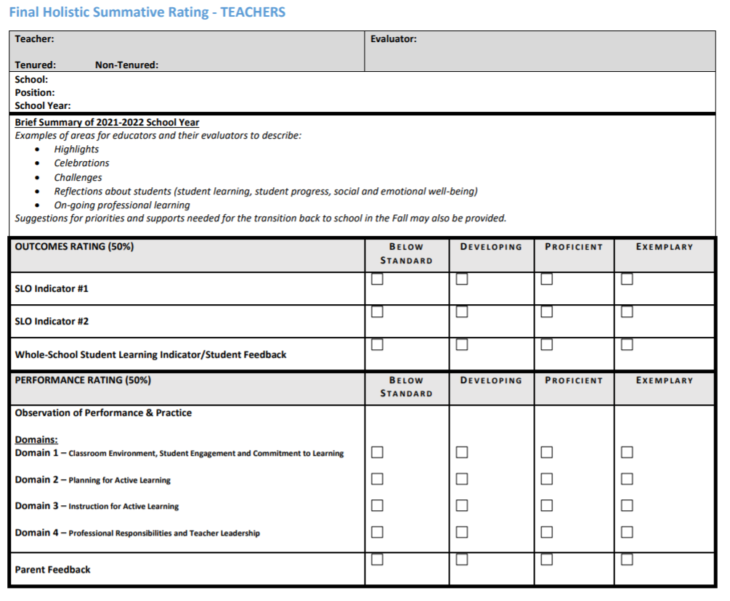
Highlights of Flexibilities 2021-2022
Sample Final Holistic Summative Rating Form
The sample holistic rating form
can be found on the
CSDE EES 2022 website.
Notes:
District PDECs are encouraged to discuss/agree upon how the holistic review of evidence will be determined for each component.
EES 2022 Website - https://portal.ct.gov/SDE/Evaluation-and-Support/Educator-Evaluation-and-Support-Council
CSDE Educator Evaluation Flexibilities can be found at https://portal.ct.gov/SDE/Talent_Office/Talent-Office-home-page/Educator-Evaluation

Slide 10
Frequently Asked Questions
Goals and Indicators/Measures of Accomplishment
Q: The Flexibilities require teachers to have one goal* with a minimum of two indicators or measures of accomplishment. Can teachers focus on any two of the focus areas listed in the Flexibilities for 2021-22?
A: Yes. Teachers can have two different focus areas that include SEL for students, student engagement, engaging families, cultural responsiveness, or academic achievement. A list of examples of demonstrating measures of accomplishment are included on page 2 of the Flexibilities 2021-22. This list does not preclude other methods that are mutually agreed upon.
*Additional SLOs for teachers are not allowed as additional requirements under the Flexibilities.
Notes:
The Flexibilities require administrators to have two student learning indicators (SLIs), or measures of accomplishment. Additional SLIs for administrators are not allowed.

Slide 11
Frequently Asked Questions
Minimum Requirements
Q: Can the PDEC add requirements to their plan if the district adopts the Flexibilities 2021-22?
A: The Flexibilities 2021-22 are the minimum requirements and must be adopted in its entirety. A district PDEC may determine if additional requirements are needed in their local educator evaluation plan. For example, the observation process in the Flexibilities 2021-22 is the minimum requirement. A PDEC may determine, through mutual agreement, if additional observations or pre/post conferences are needed.

Slide 12
Frequently Asked Questions
Observations
Q: How long should an informal observation be?
A: In the Flexibilities 2021-22, an informal observation is less than 20 minutes. While the Flexibilities 2021-22 do not require formal observations, the key definition for formal observations is at least 20 minutes. Refer to the Flexibilities 2021-22 for more key definitions.

Slide 13
Frequently Asked Questions
Sample SLOs
Q: Where can I find sample SLOs?
A: It is recommended that districts create their own samples that reflect the individual teacher goals and areas of focus, school and district goals and strategies, and school and district context. Resources can be found on the Educator Evaluation page of the CSDE Talent Office website. It is recommended that you reach out to your local RESC for additional support.
Notes:
https://portal.ct.gov/SDE/Talent_Office/Talent-Office-home-page/Educator-Evaluation

Slide 14
Overview of EES 2022
Phase II (Fall/Winter 2021): Updated Guidelines Recommendations for 2022-23
Phase II: Fall/Winter 2021
- Seek statewide stakeholder input & feedback through RESC-facilitated focus groups - Begin discussions with EES 2022 (PEAC) regarding 2022-23 Guidelines changes
- Present changes to the State Board of Education (SBE) for approval (Winter)
- Begin conversations regarding potential legislative proposals
Phase III: Legislative Proposals
Phase III: Fall/Winter 2021
- Continue discussions with EES 2022 (PEAC) regarding substantive changes to guidelines that would require legislative proposals
- Convene stakeholders for comments & feedback
- Proposals prepared for Winter 2021
On-going conversations w/EES 2022 Council regarding stakeholder group input process, survey and regional forum mechanisms and potential need for training updates
Notes:
The process of ‘Reimagining’ Educator Evaluation and Support will take place in three Phases:
Phase I: Updating and revising the current Flexibilities for Implementing the CT Guidelines for Educator Evaluation 2017 – allowable within the current CT Guidelines and in alignment with C.G.S. 10-151 (b)
The 2020-21 Flexibilities included some options that were made possible by the Governor’s Executive Order authority, which will have expired for 2021-22. There are requirements in the Guidelines that are required per CT General Statutes.
Phase II: Consider more broadly where changes could be made within the CT Guidelines for 2022-23.
The CSDE is working with the RESCs to develop a process to seek stakeholder feedback state-wide.
In Phase II, the EES Council will also begin discussions about what proposed changes to the CT Guidelines would need changes in legislation.
Phase III: Determine substantive changes to the CT Guidelines that would require legislative proposals.

Slide 15
Adopting the Flexibilities 2021-22
An LEA/APSEP/Charter School intending to adopt the Flexibilities for the 2021-22 school year or submit a request for an amendment to their most recent CSDE-approved EESP should complete the EESP checklist prior to October 1, 2021.
After an LEA/APSEP/Charter School receives confirmation/approval of their request to adopt Flexibilities for 2021-22 or amendment request that their Board of Education needs to adopt the Flexibilities for 2021-22 or the amended plan.
Contact the CSDE consultant assigned to your region to discuss questions from the PDEC.
  Sharon Fuller – sharon.fuller@ct.gov (CES, EDADVANCE, LEARN)
  Kimberly Audet – kimberly.audet@ct.gov (ACES, CREC, EASTCONN)
Notes:
If an LEA adopted the Flexibilities for 2020-21 school year, the PDEC must determine, through mutual agreement with the local board of education, whether to adopt the Flexibilities for the 2021-22 school year or continue with their most recent CSDE-approved EESP. The Flexibilities for the 2021-22 school year or submit a request for an amendment to their CSDE-approved EESP should complete the EESP checklist prior to October 1, 2021. EESP Checklist - https://sdect.co1.qualtrics.com/jfe/form/SV_9GMaBTd7AZe8yZU.

