Slide 1
CONNECTICUT STATE DEPARTMENT OF EDUCATION
Educator Evaluation & Support 2022
April 8, 2022
9:30 – 11:00 am

Slide 2
Today’s Agenda & Objectives
Welcome
Presentation from Mansfield Public Schools
Kelly Lyman, Superintendent
Presentation from Farmington Public Schools
Kimberly Wynne, Asst. Superintendent for Curriculum and Instruction
Veronica Ruzek, Director of Curriculum and Instruction
Summary of Subcommittee Meeting
Next Steps
Today’s Primary Objectives:
Learn from two districts about an innovative component of their Educator Evaluation and Support Plan
Provide opportunities for Q & A
Introduce the materials that informed the Student Growth and Development Subcommittee meeting
To be discussed at a future Council meeting
Next steps for future meetings

Slide 3
Webinar Housekeeping
Share video and please turn off the camera if you need to attend to a personal matter.
Make sure you are in a quiet area. Limit the background noise.
Mute your phone/device when you are not speaking.
Utilize the chat box. Comments can be shared via chat as well as verbally.
Meetings and chat box comments will be recorded and sent to all Council members after each session as well as posted to the CSDE EES 2022 Webpage.

Slide 4
Council Member Norms
Be present and focused (avoid incoming distractions like incoming emails, text messages, phone calls, etc.).
Position yourself as a learner and a collaborator.
Be open to multiple perspectives.
Monitor your airtime and encourage others so that all voices are heard.
Use the chat box for comments/additional input as we meet.

Slide 5
Mansfield Educator Evaluation System
Presentation to Educator Evaluation
and Support Council 2022
Kelly Lyman, Superintendent, Mansfield Public Schools
April 8, 2022
Mansfield Public Schools, Mansfield CT

Slide 6
Systems that result in improvement are those that:
Invest in capacity building of the professionals
Increase transparency of results
Maintain a relentless focus on progress
Develop cultures that build in learning every day
Promote collaboration with explicit links to student learning
Michael Fullan, 2014
Presentation to EES 2022 Council, April 8, 2022

Slide 7
Why Equity has Become a Conservative Force in American Education and How that Could Change
Education should liberate - create ways for students to take agency to transform their lives and the world around them
Tap into “centers of knowledge” available when teachers work together leading to mutual learning for all
Rather than acting on teachers and students act with them
Create symmetry between student learning and teacher learning – allow all to be meaning makers
Jal Mehta, 2019
Presentation to EES 2022 Council, April 8, 2022
Presentation to EES 2022 Council, April 8, 2022

Slide 8
Mansfield Professional Learning and Evaluation Plan Core Beliefs
Educators and students grow when professional learning and evaluation are aligned.
Educators are capable meaning makers and facilitators of their own learning.
A culture of risk-taking and collaboration fuels continuous learning for all.
Effective professional learning and evaluation keeps the focus on student learning.
When educators succeed, students succeed.
Presentation to EES 2022 Council, April 8, 2022

Slide 9
Evaluation Informed Professional Learning
Student success depends on effective teaching, learning, and leadership. Mansfield Public School’s vision for professional learning is that educators engage in continuous learning every day to increase professional effectiveness, resulting in positive outcomes for all student.
Presentation to EES 2022 Council, April 8, 2022

Slide 10
What Changed
Student Learning Goal with measures
Student Outcomes and Achievement section was revised and integrates teacher-led professional learning.
Parent/Family Engagement Goal based on survey results
Whole-School connected to Administrators Goal/School Development Plan
3 Informal Observations/Review of Practice or Formal Observation
Presentation to EES 2022 Council, April 8, 2022
Notes:
Two text boxes are animated
Eval plan is guided by state legislation (that we cannot change) and SDE guidelines and requirements. Much of our plan did not change because it has to meet the basic requirements which include:
4 Components (Student Outcome 45%, Whole School 5%, Teacher Performance 40%, and Parent Feedback 10%)
First animation text box: emphasize focus of revision was on student outcomes section/component
Second Animation text box: We cannot change the use of a 4 pt rubric (Exemplary, effective, developing, below standard) and the weighted components that are scored.
HOWEVER…what we did change was to shift the emphasis of student learning goal from data to research, implementing new strategies, and working collaboratively with colleagues. This was a big change that the SDE was excited about and aligned to our district’s vision for professional learning.

Slide 11
Supporting Teacher Effectiveness Project - STEP
Presentation to EES 2022 Council, April 8, 2022

Slide 12
Supporting Teacher Effectiveness Project - STEP
Developed by Insight Education Group in partnership with the Bill and Melinda Gates Foundation
Brings teachers together to address practical, shared challenges and find solutions from within their own school and district communities
An action research approach grounded in the theory of Positive Deviance
Presentation to EES 2022 Council, April 8, 2022
Presentation to EES 2022 Council, April 8, 2022

Slide 13
Seek
Form a collaborative team
Analyze student data and evidence to identify a broad focus for improvement
Create a student growth goal with two indicators
Hold initial conference with administrator
Presentation to EES 2022 Council, April 8, 2022

Slide 14
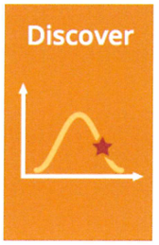
Discover
Teachers work together to continue to gather student performance information and conduct research
Research includes learning from others within or outside the school/district, education literature reviews, professional learning experiences
Summarize findings and identify promising practices/action steps
Hold mid-year conference with administrator
Presentation to EES 2022 Council, April 8, 2022

Slide 15
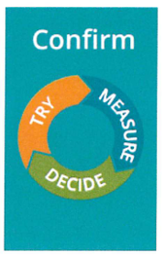
Confirm
Implement promising practices/action steps
Engage in cyclical process to plan, implement, reflect, and consider next steps
Create summary of data for analysis
Each teacher creates a summary of result for their students and completes a self-assessment of professional learning
End of year conference held with administrator
Presentation to EES 2022 Council, April 8, 2022

Slide 16
Share
Share both results and learnings with larger audience
Promotes teacher reflection, distributes learning, and inspires others to replicate practices
Sharing can be at the school or district level either at the end of the year or the start of the next year
Presentation to EES 2022 Council, April 8, 2022

Slide 17
Share
STEP Goal Focus | Description/Outcomes
Building norms/skills needed for math workshop | Continuation of work from last year to increase norms and student behaviors needed in math workshop so that students do a better job in communicating understandings, showing work, and working in various independent models
Using the Comprehensible input strategy in World Language Class | This team researched and implemented a CI strategy called Star of the Week which positively affected engagement and performance in Spanish class.
Increasing student ownership and improving work ethic | Focus on engaging students in their learning. An engagement survey was delivered to students early in the year. We adjusted our method of delivery for classes and topics based on survey feedback. The team researched practices to build organization and coping skills necessary to be successful in grade 5.
Kindergarten Playshop | This project focuses in on creativity and writing. They use play boxes designed by 8th graders to begin to tell stories. We are creating a unit on play and writing to implement next year.
Giving and Receiving Feedback in Practice | This is the third year of the continuation of this project. Team members are utilizing the work that has been done during the past two years to create lessons plans that incorporate giving and receiving feedback strategies throughout all related arts classes.
Presentation to EES 2022 Council, April 8, 2022

Slide 19
Farmington
Public Schools
Educator Evaluation and Professional Development Plan

Slide 20
TARG-IT GOAL
Team Action Research Goal - Innovative Teaching

Slide 21
Goal Focus
TARG-IT Goals focus on Farmington’s Vision of the Global Citizen and develop creative and novel ways to support students in exhibiting the defined attributes.

Slide 22
Goal Development
Who will you work with?
Determine a team of educators with whom you will conduct this action-research project.
How will you plan your research?
Select one of the attributes of the Global Citizen that you want to focus on.
Consider what success will look like - include models and exemplars, self-assessment, and reflective critique protocols.

Slide 23
Action-Research Process
Document cycles of collaborative inquiry during which the team observes each other’s practice and co-plans innovative instruction and assessment.
Use observational data and student work to develop new insights through reflection and dialogue
Engage in new learning through professional reading, colleague visits, consultation with experts
At the end of the year, TARG-IT Teams submit one report highlighting the team’s process, learning, and student outcomes (videos, work samples, or other artifacts / exhibits)

Slide 24
TARG-IT GOAL
Exceptional | Effective | Needs Improvement | Ineffective | Score
4 - A substantial and innovative action research process resulted in all or most students meeting performance expectations including any / all subgroups | 3 - The action research process resulted in most students meeting performance expectations including any / all subgroups | 2 - The action research process resulted in some students demonstrating growth toward performance expectations. Still a notable % of students did not meet and some subgroups made little or no gains | 1 - A limited action research process resulting in inconclusive data or very little growth toward performance expectations | ______ @ 30%

Slide 25
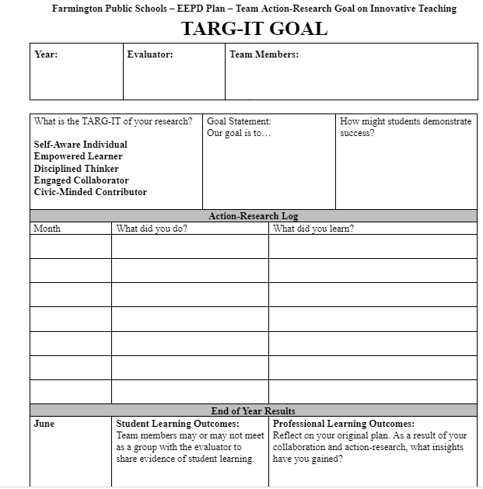

Slide 27
Subcommittee Summary
Excerpts from Three States

Slide 28
SWOT Analysis

Slide 29
Some Key Takeaways
Massachusetts:
Iowa:
Holistic multiple-measures approach:
“Evidence of student learning is just one of several types of evidence that inform an educator’s evaluation. The MA framework for educator evaluation promotes a holistic, multi-dimensional view of educator performance based on multiple sources of evidence. No single type of individual piece of evidence can be the sole factor when determining a rating.”
5-step evaluation cycle that starts w/self-assessments (what happened last year, what do I think this year)
Clear guidance around designing learning opportunities in the context of informing a professional learning plan;
Ability to center the evaluation experience around the needs of specific educators role; instructional coaching, content-specific, etc.
Clear cycle starting w/self-assessment

Slide 30
Consensus Protocol
Thank you for submitting ratings for the following components:
Holistic Summative Rating
Three Categories
Educator Professional Practice
Student Growth & Development
Stakeholder engagement
No Categorical Ratings
Consensus Guiding Principles
My voice has been heard
I understand the proposal
It’s clear to me that the will of the group has emerged around this proposal
The following slides represent a summary of the ratings submitted and will be further discussed in a future meeting.

Slide 31
Holistic Summative Rating
X XX X X X X X

Slide 32
Three Categories Educator Professional Practice Student Growth & Development Stakeholder Engagement
X X X X X X X X

Slide 33
No Categorical Ratings
X X X X X X X X

Slide 34
Next Steps
Slowing Down to Get It Right
CSDE leadership has authorized the allocation of additional resources to support EES 2022 efforts
CSDE Talent Office will be working with the RESC Alliance to facilitate further work of the Council members to:
Build on current foundation of consensus regarding direction & future
Create opportunities to further explore promising practices for incorporation into CT’s Educator Evaluation and Support Plan
Intentionally focused work groups for educator plan and administrator plan
In-Person & Virtual structure through the spring, summer & fall

Slide 35
Thank You!!
Thank you for your collaboration as we reimagine educator evaluation to best support students to:
Be engaged in learning.
Grow and develop.
Be healthy and well.
Be motivated and curious.
Be problem solvers & solution seekers.

