Slide 1
Educator Evaluation Reimagined:
The CT Growth Model
Helping Students & Educators Thrive
Notes:
Joslyn

Slide 2
Notes:
Joslyn

Slide 3
Key EES Council Take-Aways So Far
Evaluation works best as a tool for continuous learning when it aligns to what we know about adult learning:
From Diane Dugan’s presentation 7/21/22

Slide 4
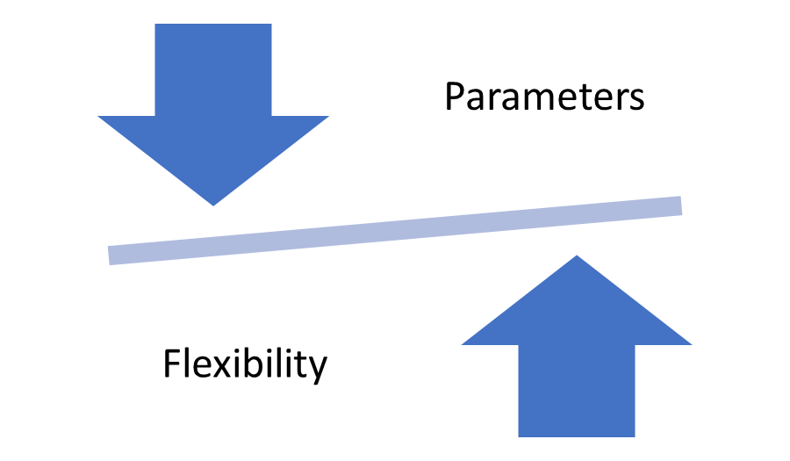
Notes:
Kate
In the last year and half, we have heard the voices, needs and concerns of all the different stakeholder groups on the EES committee. The committee is united in our calls for a bold and innovative educator growth system that provides districts and PDECs with the ideal balance of guidance and guardrails paired with flexibility and autonomy.

Slide 5
Educator Evaluation in Five Simple Steps
Helping Educators & Students Thrive
Simplify
Focus on Feedback
Reduce paperwork
Reduce # of observations
Eliminate surveys
Reduce # of goals
Eliminate ratings
Quality feedback provided regularly
Ongoing PD for evaluators
Build Trust
Differentiate
Emphasize Growth
Functional PDECs
Accountability process for PDECs
Mutual Agreement
Annual calibration of evaluators
Different process for support specialists
Keep discipline & compliance separate from TEVAL
Focus on the process of learning, not outcomes
Align PD with educator needs
Separate process for struggling educators.
www.free-powerpoint-templates-design.com
Notes:
Kate

Slide 6
Step 1: Build a Solid Foundation
Notes:
Kate
To attract and retain teachers not only in our districts but also into the profession as well.

Slide 7
Components of Trust
Notes:
Kate

Slide 8
Trust: The Cornerstones
Strengthen PDECs
Ensure equal representation of administrators and teachers (commitment)
Regular training for PDEC members (competency)
Accountability process for PDECs to ensure functionality (honesty)
Mutual agreement clarified and emphasized (sincerity)
Annual training for evaluators and ongoing calibration requirements (competency and reliability)
Transparent dispute resolution process involving mutually agreeable third party (honesty and consistency)
Ensure the purpose (promoting educator growth) remains clear (consistency) and guidelines are not used for punitive purpose (integrity).
Notes:
Kate
In relation to architecture, a cornerstone is traditionally the first stone laid for a structure, with all other stones laid in reference. A cornerstone marks the geographical location by orienting a building in a specific direction.

Slide 9
Step #2: Simplify the Process
Reduce paperwork
Eliminate surveys
Reduce # of goals
Focus on what’s most essential: growth
Notes:
Kate
By streamlining and simplifying the growth process, we can create more time and space for organic relationship building, genuine conversation and individualized coaching opportunities between educators and administrators.

Slide 10
Step 3: Differentiate
Differentiate the evaluation process for educators who do not primarily provide direct classroom instruction like school psychologists, counselors, media specialists, etc…
Differentiate the process for beginning teachers that aligns with TEAM.
Use a different process for disciplinary/non-compliance issues.
Differentiate the process for struggling teachers in need of additional support
Notes:
Kate
Example of flexibility: tenured teachers in good standing could elect not to set learning goals but instead indicate an area of professional growth, submit a midyear reflection, as well as a summative reflection on a PDEC approved template that encourages the teacher to reflect on their progress and the impact of their learning on student academic and/or social-emotional wellbeing.
Allowing beginning teachers to focus on TEAM as their growth process rather than trying to navigate two segregated systems of learning in their introductory years will provide a less stressful induction into the profession hopefully leading to greater retention of new educators.

Slide 11
Step 4: Focus on Feedback & Professional Learning
Evaluation is at least three scheduled professional discussions focused on growth between evaluator and teacher.
Educator and evaluator collaboratively identify and mutually agree to
one specific individualized goal
an individualized timeline
Multiple measures of evidence
portfolios, student data, scheduled or non-scheduled classroom/worksite visits
Evaluators
Provide ongoing, formative feedback
Must be trained in constructive feedback and other coaching strategies.
Must be trained and calibrated to ensure consistency and reliability.
Discussions
grounded in rubrics approved by the PDEC. Discussions
focus on action steps for educator growth & student learning.
Notes:
Mary
Here is the heart, and the roles in this model. We have heard it said in this committee, supported by the research presented, and it resonates with me and my experience, the leverage point of actual growth is in discussions between the evaluator and evaluee, grounded in observations of practice, and rubric that defines effective practice. We focus on feedback and PL, with more focus on these discussions and individualization than previously. We envision this to be the heart of this system, with the timeline, goals and major sources of evidence identified in advance, a series of scheduled discussions for each cycle of improvement focused on the identified goal. The discussions may be informed by classroom observations, portfolios, service logs, data about students or other elements. It is a flexible system of guidelines designed to be individualized for the needs of the educator. Established and effective teachers can be given more independence and longer cycles. Evaluators must be well trained in providing feedback, and the PDEC must be effective in order to make sure a meaningful achievable process is supported. We are saying today, trust the evaluator and evaluee to work together to focus on growth, trust the evaluator to work towards educator effectiveness, trust the educator to care about his or her individual professional growth and take it seriously.

Slide 12
Step 5: Keep the Focus on Educator Growth
No ratings
Align professional development to teachers’ needs
Emphasize learning and growth
Keep the evaluation process and discipline process separate to ensure teacher evaluation is not used punitively.
Notes:
Kate

Slide 13
Growth vs. Punitive Evaluation
Addressing Issues of Discipline, Non-Compliance & Remediation
Notes:
Mary

Slide 14
Address Disciplinary or Non-Compliance Issues Separately
Disciplinary action is available for issues that are contractually regulated, such as abuse of sick time:
From Norwalk Public Schools CBA: “In addition, the Superintendent or the Director of Human Resources may require a signed statement from a licensed physician to verify the nature of absences when he/she has reasonable suspicion of a pattern of abuse of sick leave. In all such cases, the Federation shall be notified of such verification requirement.”
Disciplinary action is available for issues related to professional lapses such as those codified in the CT Code of Professional Responsibility for Teachers, which includes Responsibility to the Student, to the Community, and to the Profession.
Disciplinary action is also available for issues related to Board Policies, such as handling of money, interactions with staff, or harassment.
Notes:
Mary
For example, “RESPONSIBILITY TO THE PROFESSION (1) The professional teacher, in full recognition of his or her obligation to the profession of teaching, shall: A) Conduct himself or herself as a professional realizing that his or her action reflects directly upon the status and substance of the profession;”

Slide 15
Teachers with Performance Issues
All teachers can improve
Small numbers need more intensive support.
Focused assistance plans for performance issues
A tiered support system separate from the evaluation system
Established through PDEC
Involve the teacher and collective bargaining rep in creation of the focus plan.
Focus plans should be growth-oriented, not punitive
Maintain the statutory requirements regarding:
Specific time frame for the plan
Identifying the extra supports provided
With specified measures of success
Collective bargaining involvement
Notes:
Kate
All teachers have areas where they need to improve, which is why feedback and support are critical.
A small minority of teachers may require more intensive support than is provided under the regular evaluation guidelines.
A separate, tiered support process to assist struggling teachers should be collaboratively developed and mutually agreed to by members of the PDEC.
The process to identify and provide support to struggling teachers must include multiple levels of support similar to the SRBI process. Statutory requirements regarding collective bargaining involvement in this process should remain in place.
The support process must include the teacher and their collective bargaining representative at every stage.
Plans should be growth-oriented rather than punitive in nature and provide scaffolded supports and resources tailored to support the individual.

Slide 16
Notes:
Joslyn, Fran

Slide 17
The CT Growth Model
Next Steps…
Notes:
Mary

