Slide 1


CONNECTICUT STATE DEPARTMENT OF EDUCATION
Professional Development and Evaluation Committee (PDEC) Survey Results
January 2022

Slide 2

PDEC Survey: December 2021
A PDEC is a local educational agency (LEA) committee composed of certified teachers, administrators and other appropriate school personnel including representatives of the respective bargaining units. The PDEC is responsible for the development of the LEA educator evaluation and support program, as well as the development, evaluation, and annual updating of a local comprehensive professional learning/development plan.
CONNECTICUT STATE DEPARTMENT OF EDUCATION

Slide 3
PDEC Survey: Nov. – Dec. 2021
The following slides contain a preliminary summary of the 896 survey responses.
A graph of responses from multiple responses in a section is provided, followed by a breakdown of the raw data.
The complete data will be posted on: Educator Evaluation and Support 2022 Council webpage.
CONNECTICUT STATE DEPARTMENT OF EDUCATION

Slide 4
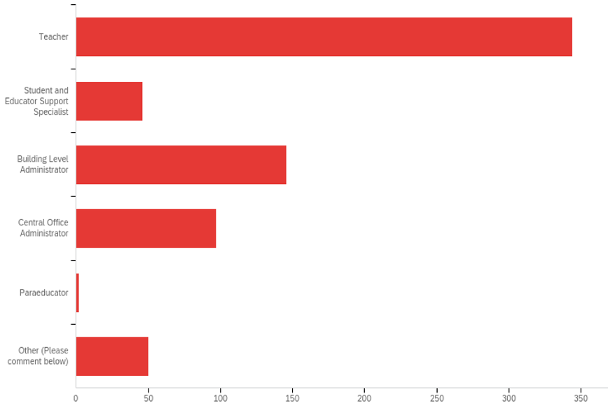
Survey Participants
CONNECTICUT STATE DEPARTMENT OF EDUCATION

Slide 5
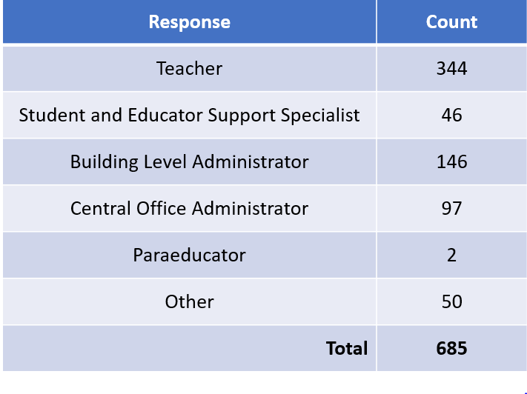
Survey Participants
CONNECTICUT STATE DEPARTMENT OF EDUCATION

Slide 6
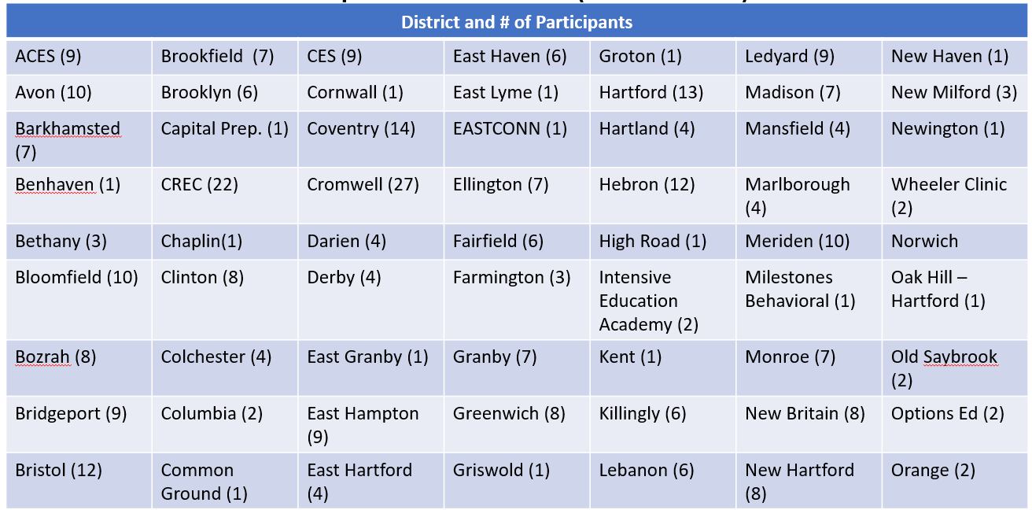
Districts Represented (n= 665) – (Part 1 of 2)
CONNECTICUT STATE DEPARTMENT OF EDUCATION

Slide 7
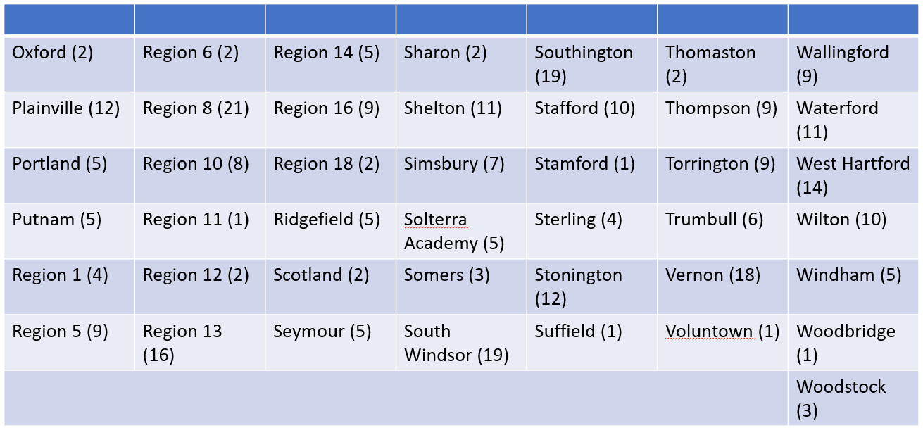
Districts Represented (n= 665) – (Part 2 of 2)
CONNECTICUT STATE DEPARTMENT OF EDUCATION

Slide 8
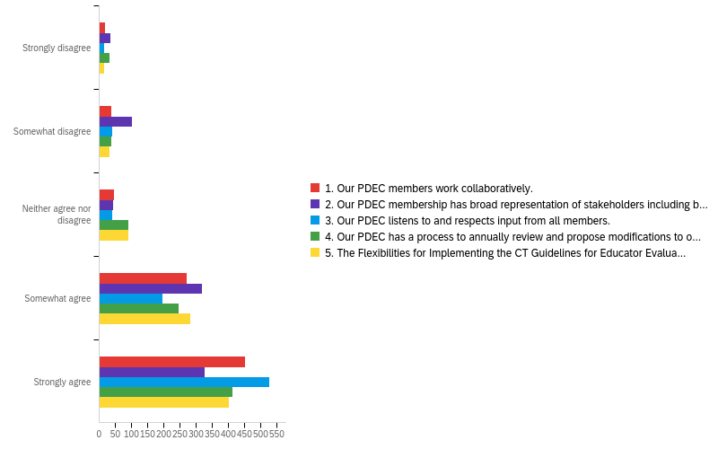
Functionality of PDECs
CONNECTICUT STATE DEPARTMENT OF EDUCATION

Slide 9
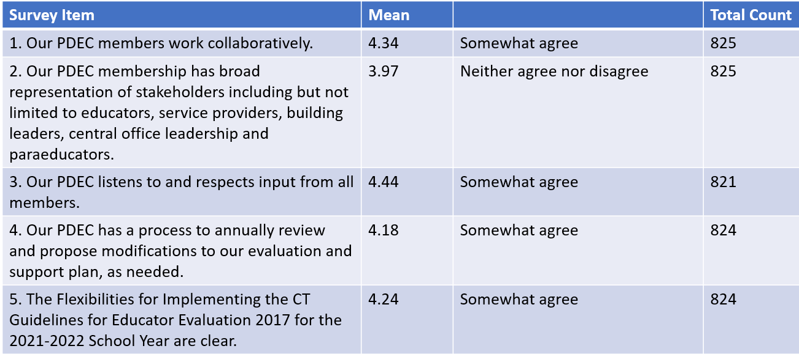
Functionality of PDECs
CONNECTICUT STATE DEPARTMENT OF EDUCATION

Slide 10
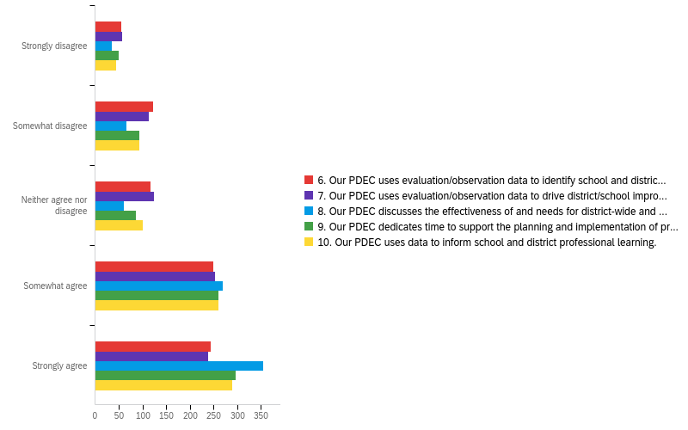
Sources of Information to Inform PDECs
CONNECTICUT STATE DEPARTMENT OF EDUCATION

Slide 11
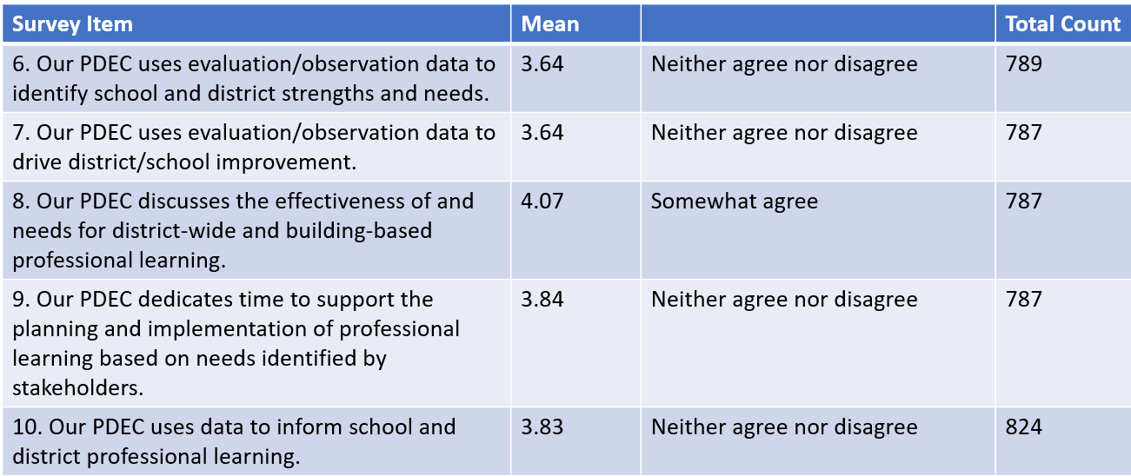
Sources of Information to Inform PDECs
CONNECTICUT STATE DEPARTMENT OF EDUCATION

Slide 12
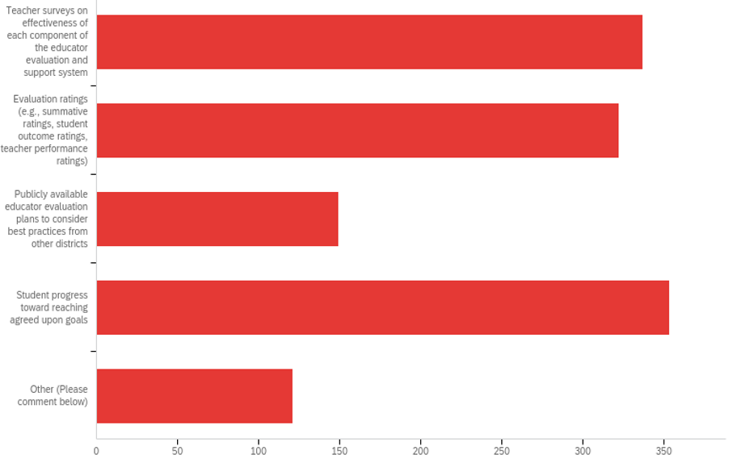
Data PDECs Review to Determine Impact of Educator Evaluation and Support Systems
CONNECTICUT STATE DEPARTMENT OF EDUCATION

Slide 13
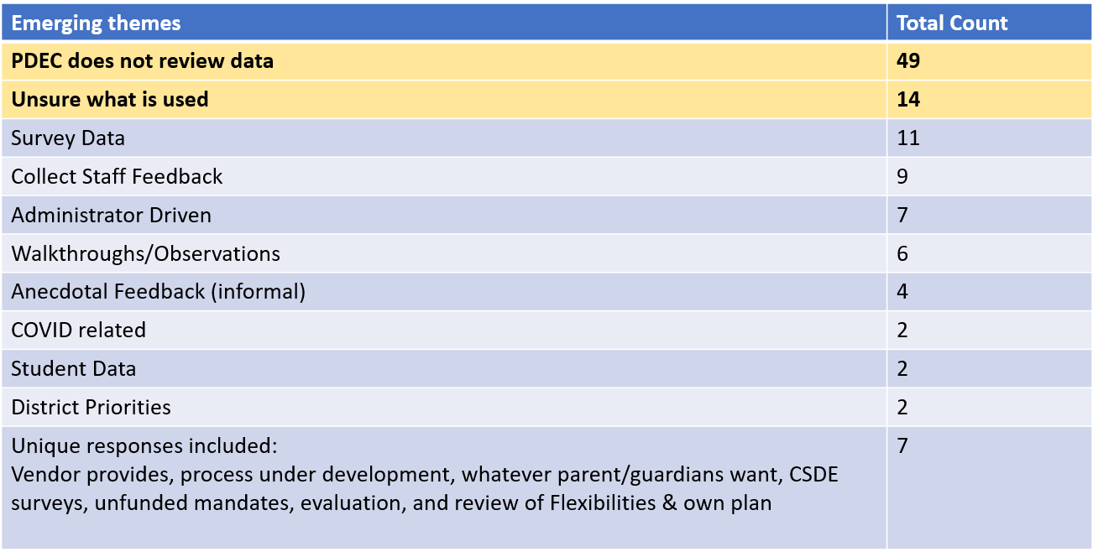
Emerging Themes
CONNECTICUT STATE DEPARTMENT OF EDUCATION

Slide 14
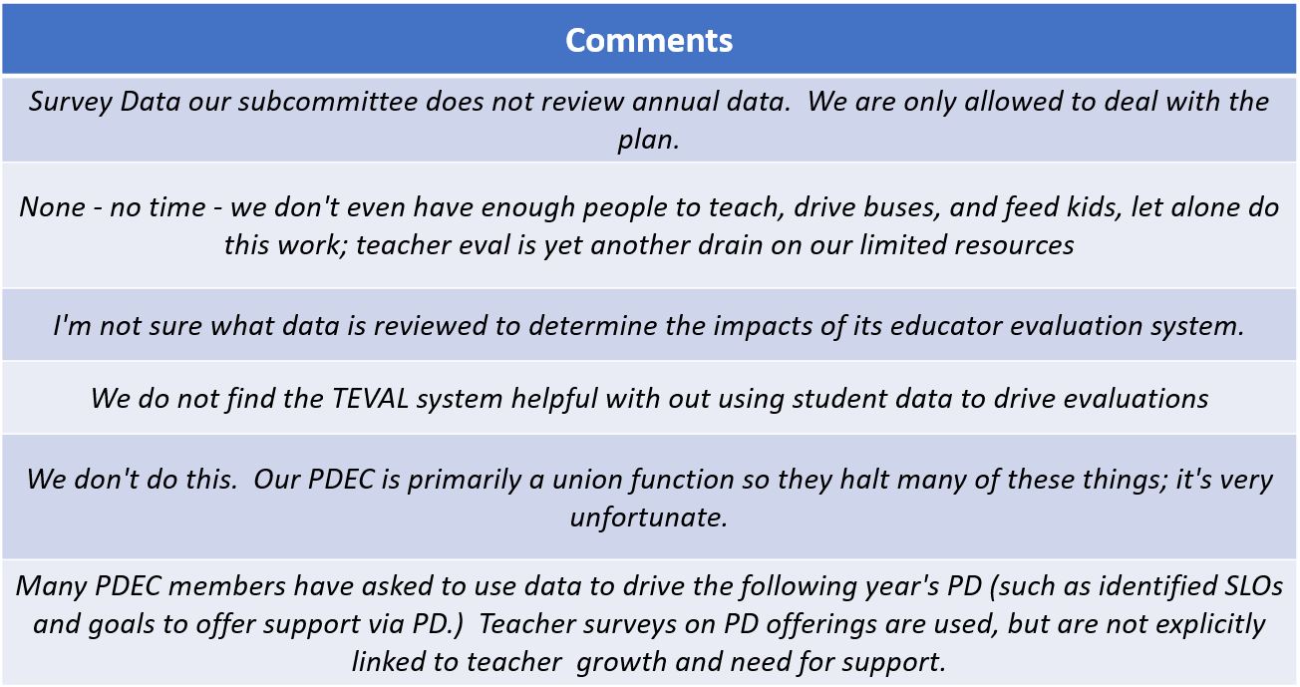
Sample Comments
CONNECTICUT STATE DEPARTMENT OF EDUCATION

Slide 15
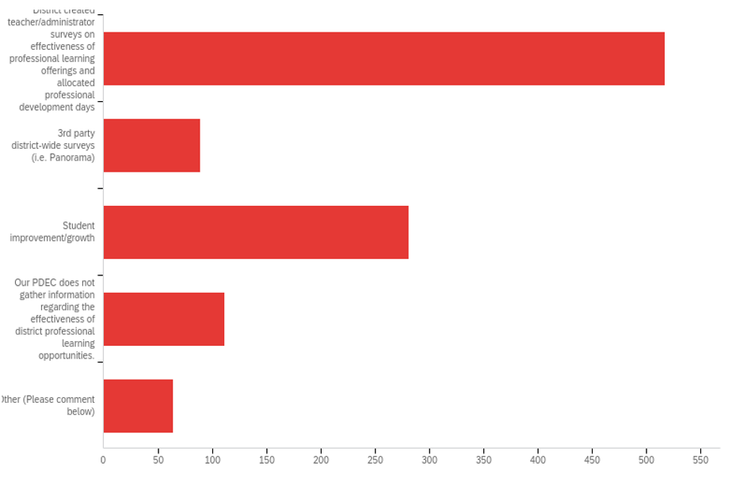
Data PDECs Review to Determine Impact of Professional Learning Opportunities
CONNECTICUT STATE DEPARTMENT OF EDUCATION

Slide 16
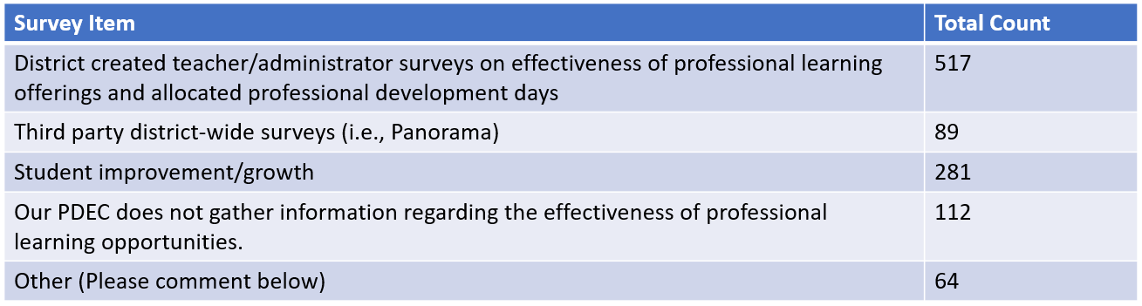
Data PDECs Review to Determine Impact of Professional Learning Opportunities
CONNECTICUT STATE DEPARTMENT OF EDUCATION

Slide 17
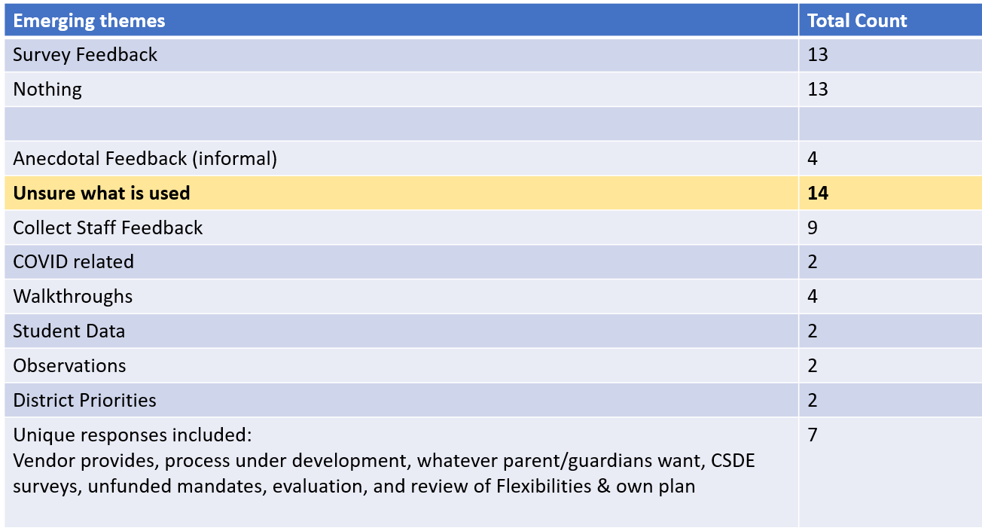
Emerging Themes
CONNECTICUT STATE DEPARTMENT OF EDUCATION

Slide 18
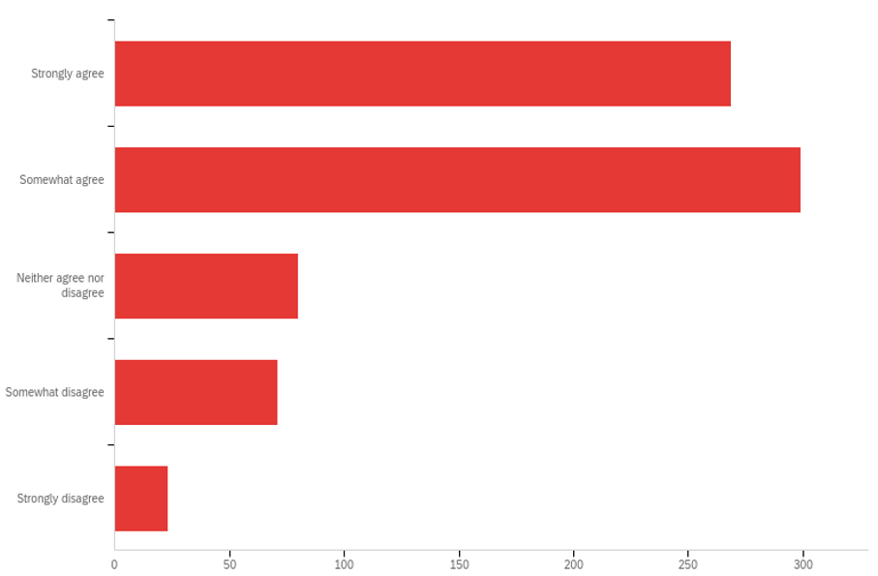
PDECs Operate Effectively
CONNECTICUT STATE DEPARTMENT OF EDUCATION

Slide 19
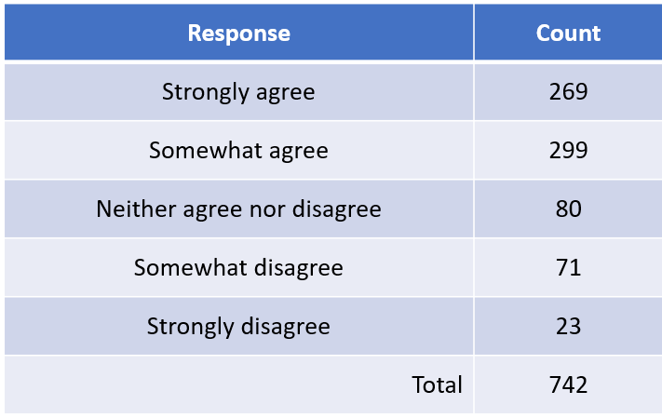
PDECs Operate Effectively
CONNECTICUT STATE DEPARTMENT OF EDUCATION

Slide 20
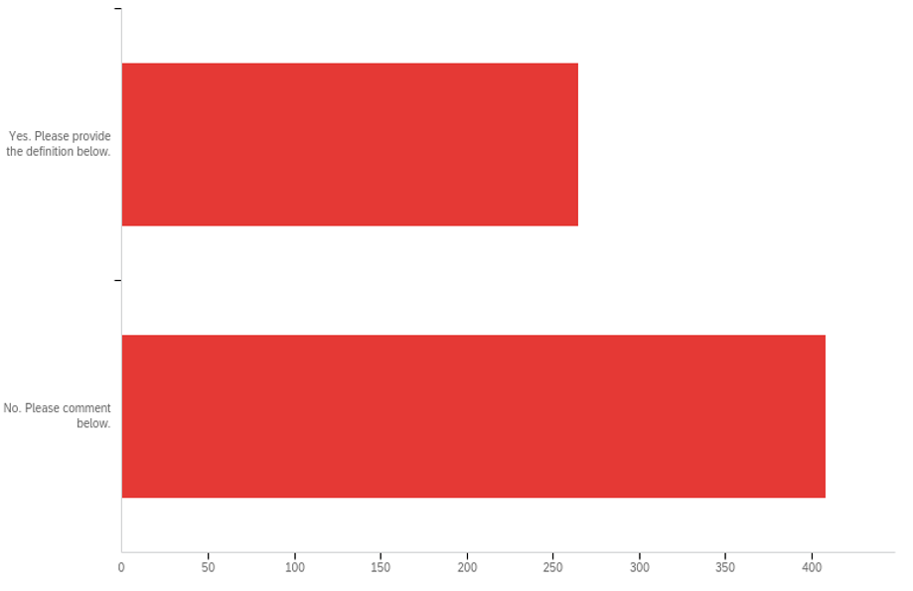
PDECs Define Mutual Agreement
CONNECTICUT STATE DEPARTMENT OF EDUCATION

Slide 21
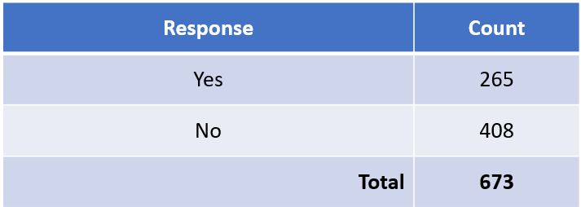
PDECs Define Mutual Agreement
CONNECTICUT STATE DEPARTMENT OF EDUCATION

Slide 22
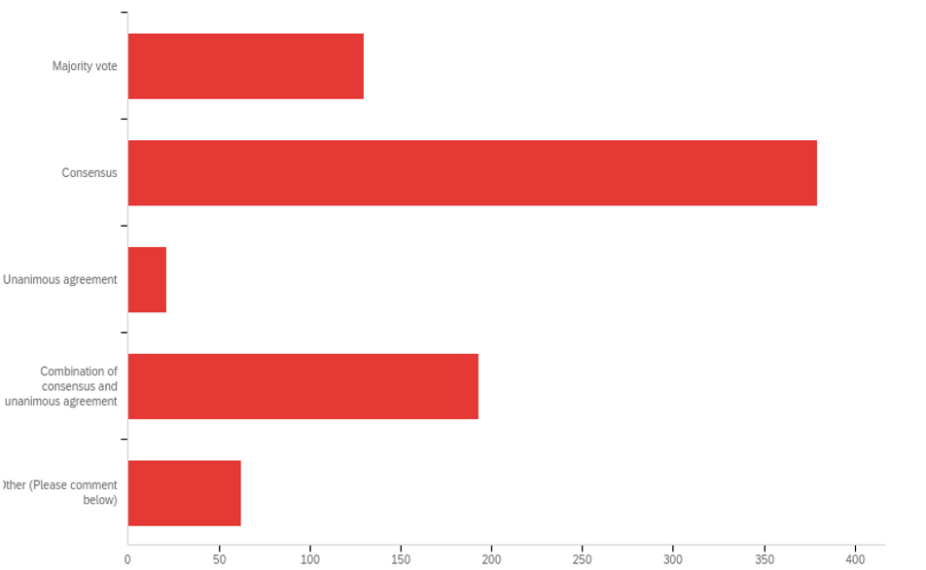
Making PDEC Decisions
CONNECTICUT STATE DEPARTMENT OF EDUCATION

Slide 23
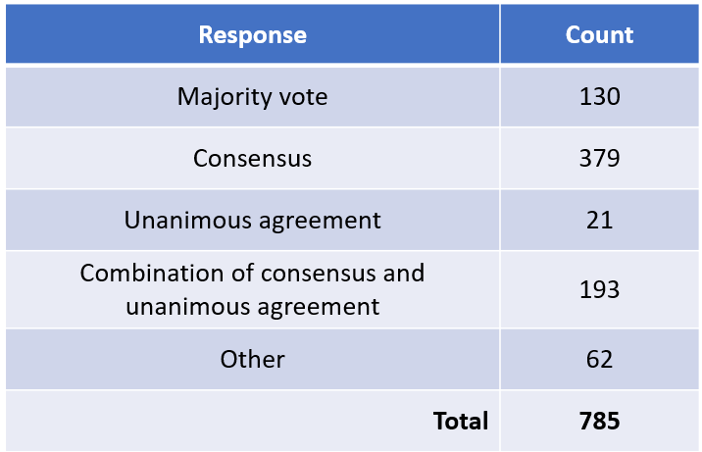
Making PDEC Decisions
CONNECTICUT STATE DEPARTMENT OF EDUCATION

Slide 24
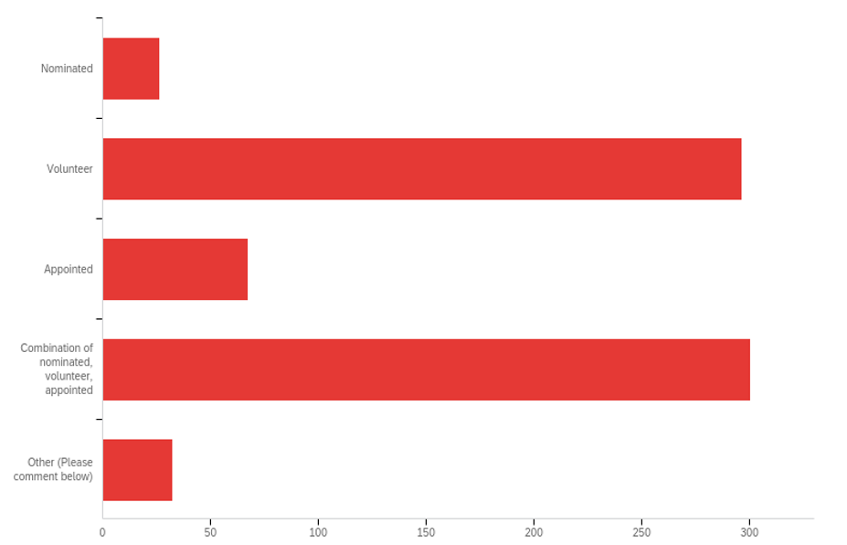
Selection of PDEC Members
CONNECTICUT STATE DEPARTMENT OF EDUCATION

Slide 25
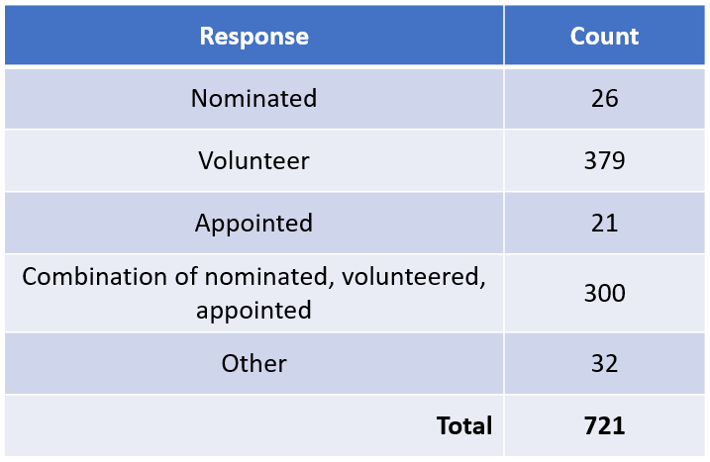
Selection of PDEC Members
CONNECTICUT STATE DEPARTMENT OF EDUCATION

Slide 26
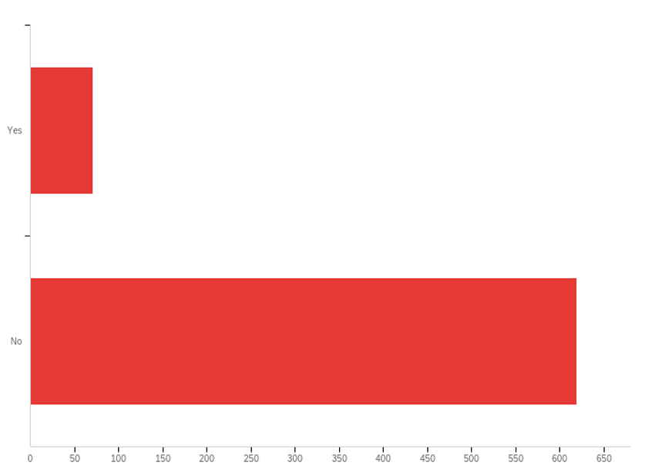
PDEC Member Term Limit
CONNECTICUT STATE DEPARTMENT OF EDUCATION

Slide 27
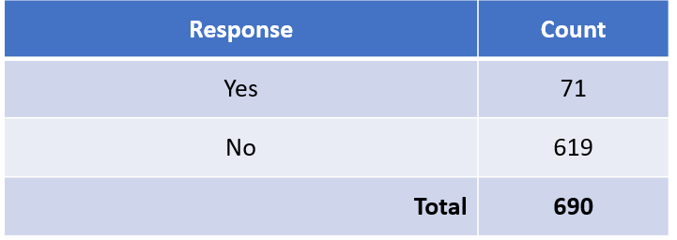
PDEC Member Term Limit
CONNECTICUT STATE DEPARTMENT OF EDUCATION

Slide 28
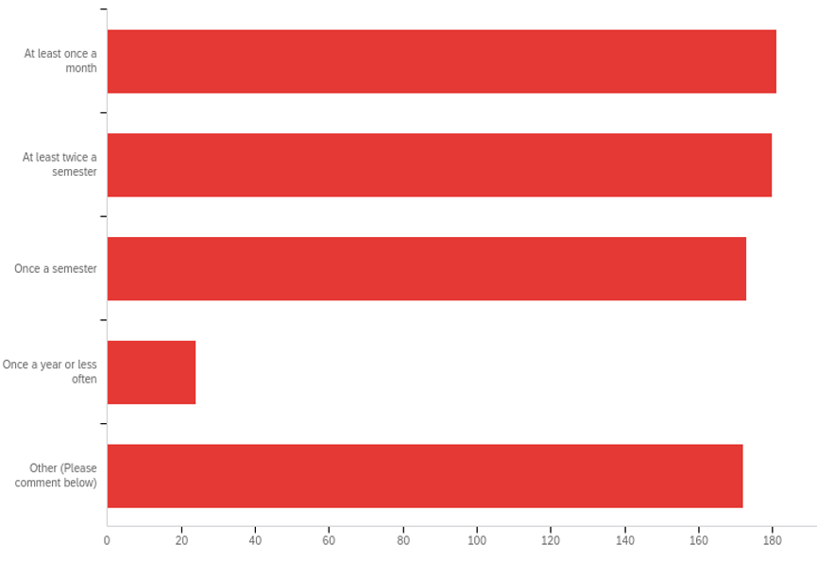
Frequency of PDEC Meetings
CONNECTICUT STATE DEPARTMENT OF EDUCATION

Slide 29
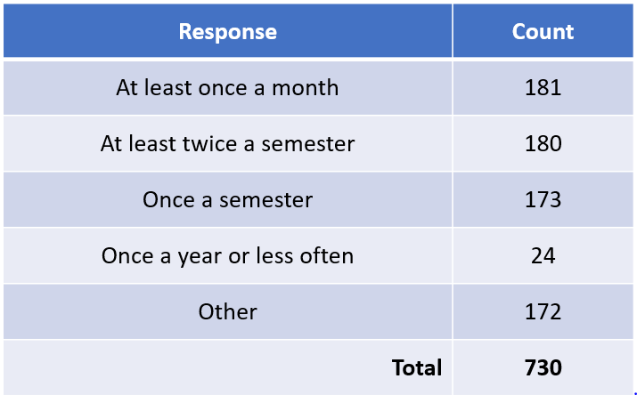
Frequency of PDEC Meetings
CONNECTICUT STATE DEPARTMENT OF EDUCATION

Slide 30
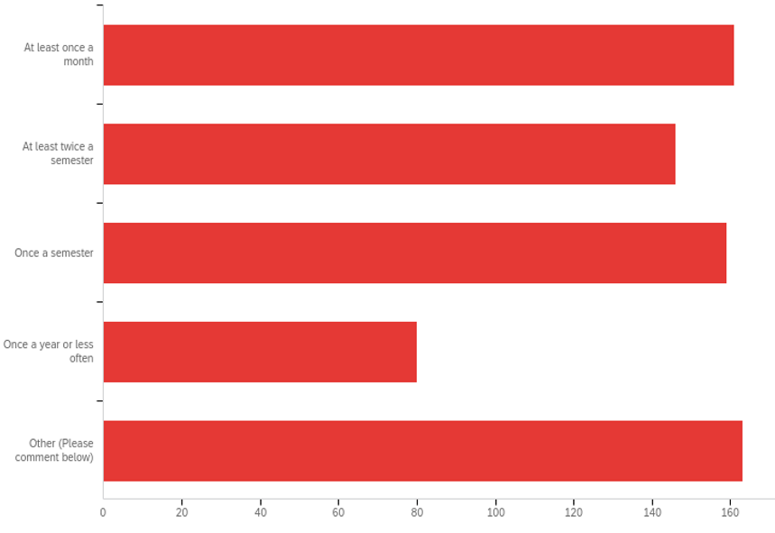
Frequency of PDEC Communications with School/District Colleagues
CONNECTICUT STATE DEPARTMENT OF EDUCATION

Slide 31
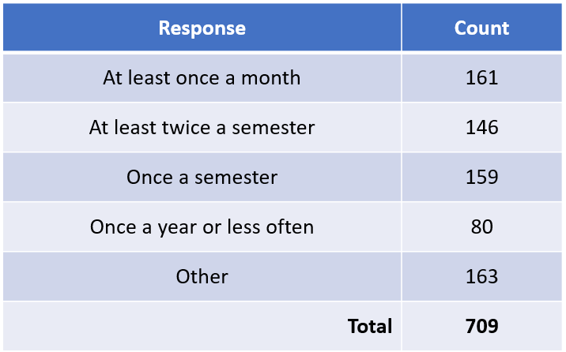
Frequency of PDEC Communications with School/District Colleagues
CONNECTICUT STATE DEPARTMENT OF EDUCATION

Slide 32
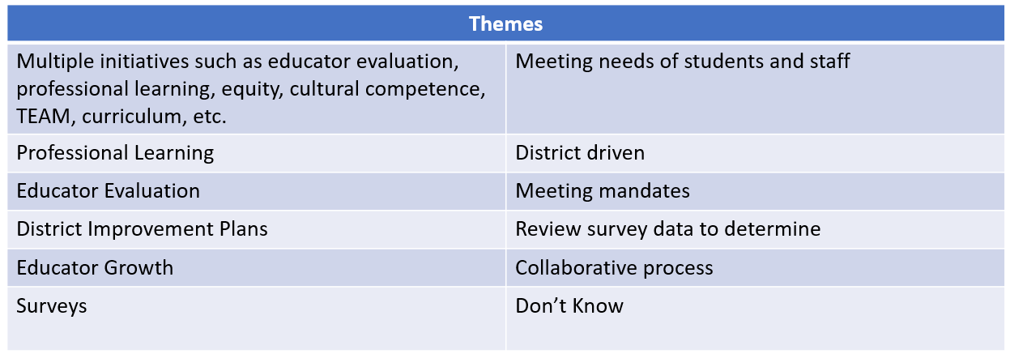
Priorities of District PDECs
CONNECTICUT STATE DEPARTMENT OF EDUCATION

Slide 33
In Conclusion
This data will be reviewed & discussed by the EES 2022 Council at the January 24, 2022 Council meeting.
A Forum Feedback Report, with data gathered by the RESC Alliance via seven (7) regional Forums will also be presented to the EES 2022 Council.
Updates on the EES 2022 Council in developing proposed revisions to the CT Guidelines for Educator Evaluation 2017 can be found on the EES 2022 Council webpage.
CONNECTICUT STATE DEPARTMENT OF EDUCATION

Slide 34
CSDE Contact Information
Sharon Fuller, Talent Office Consultant: sharon.fuller@ct.gov
Christopher Todd, Talent Office Bureau Chief: christopher.todd@ct.gov
Dr. Shuana Tucker, Chief Talent Officer: shuana.tucker@ct.gov
CONNECTICUT STATE DEPARTMENT OF EDUCATION

