Slide 1
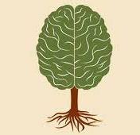
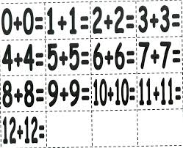
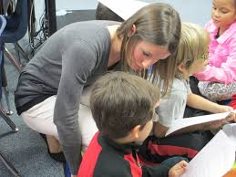
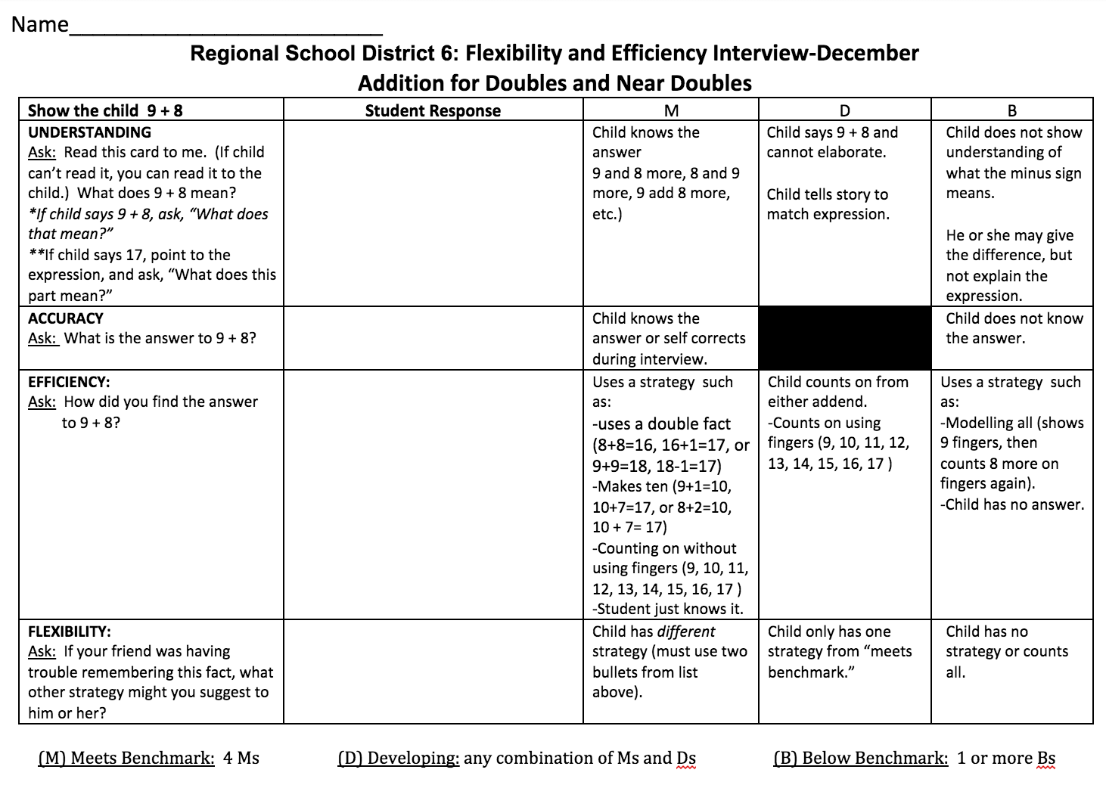
Making Fact Fluency
Assessment Meaningful
http://bit.ly/2hgu9NR
Robin Moore
PreK-8 Math Coordinator
Regional School District 6: Warren, Morris, Goshen, CT
SAP Connecticut Core Advocate
rmoore@rsd6.org
Twitter: @mooreintomath

Slide 2
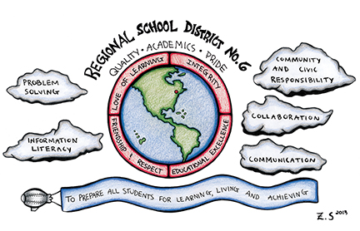
Regional School
District #6
Warren | Morris | Goshen
K-6 Enrollment: 57 Pre-K: 10 Multiage Classrooms (PreK/K, ½, ¾, ⅚) | K-6 Enrollment: 110 Pre-K: 24 Single Grade Classrooms (one of each grade level) | K-6 Enrollment: 160 Pre-K: 40 Single Grade Classrooms (two of grade K, 3, 5; one of grade 1, 2, 4, 6)
Notes:
Region 6 is made up of three rural towns, Warren, Morris, and Goshen. Each town has its own PreK-6 elementary school. Overall the district’s enrollment has been declining.

Slide 3
Goals
To improve student mastery of fact fluency
To create a meaningful district-wide approach to assessing fact fluency that would drive instruction

Slide 4
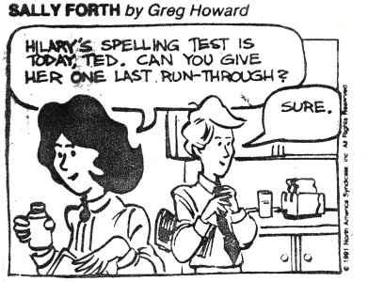
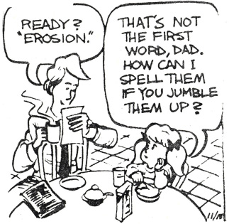
FACT FLUENCY
8 x 4
FACT
SOLVE
Notes:
Revised a cartoon that was about a spelling test. Sadly, it can apply to how some students learn math facts too.

Slide 5
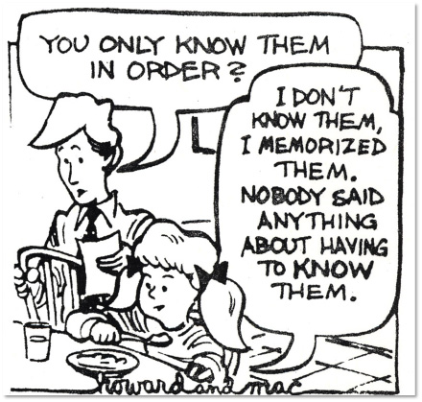

Slide 6
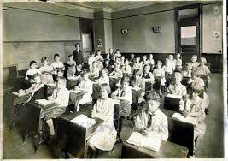
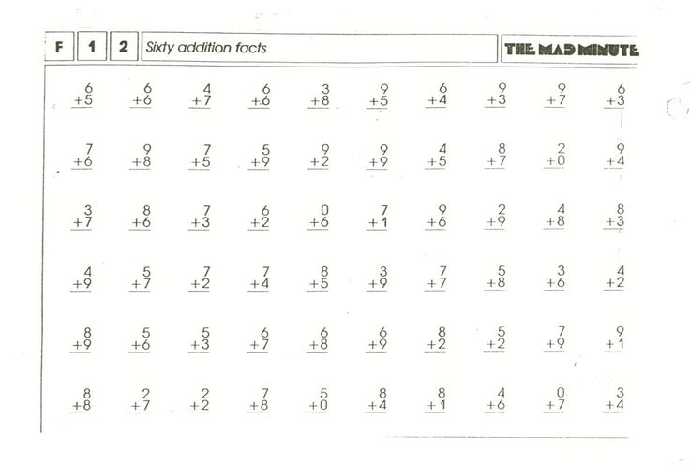
The Way it Was...
Notes:
Region 6 math fact fluency practices often involved:
-whole class instruction
-answer getting as the focus with “kill and drill” methods
-assessments focused on accuracy and speed
-many students were unsuccessful, anxious, and frustrated as a result

Slide 7
We asked ourselves...
What do we learn about our students from our current assessment practices?
How does the data drive our instruction?
If you’ve memorized basic facts, have you learned them? Why or why not?
Do we all agree on what fact fluency is?
Notes:
The math specialist team reflected on what we could do to improve fact fluency in our district.

Slide 8
Creating the Vision
Create a sense of urgency
Develop a fluency team
Research, research, research
Dialogue>agree to disagree
Meet on common ground>create a district-wide fluency mission statement
Create common assessments
Notes:
The math specialist team decided to create a vision around math fact fluency.

Slide 9
First Steps in Number, 2006
Notes:
This video was a game changer for many who believed that memorization and instructional strategies such as “kill and drill” was the only way for students to develop fact fluency.

Slide 10
Fluency of Basic Facts
Efficient, appropriate, and flexible application of calculation skills and is an essential aspect of mathematical proficiency (Baroody, 2006).
Fluently means noticing relationships and using strategies.
Fluency is “skill in carrying out procedures flexibly, accurately, efficiently, and appropriately” (CCSSI 2010, p.6).
From memory does not mean “memorized”.
Notes:
Our teachers learned what fact fluency truly is.

Slide 11
Fletcher, 2014
Notes:
This is a video of Graham Fletcher going into greater depth on the difference between the meaning of memorization and from memory.

Slide 12
What is Flexibility, Efficiency, & Accuracy?
Flexibility means the ability to use number relationships with ease in computation.
Efficiency refers to the ability to choose an appropriate, expedient strategy for a specific computation problem.
Accuracy denotes the ability to produce a correct answer.
(Parish, 2010)
Notes:
Ideas on:
Flexibility-having different strategies to solve a computation
Efficiency-finding an expedient strategy for the problem at hand
were new philosophies for many teachers.

Slide 13
Components of Fact Fluency
Computational Fluency
Flexibility
Efficiency
Accuracy
Notes:
When thinking of computational fluency, an image of a 3-legged stool comes to mind. In order for a student to truly be computational fluent, they need to be able to be flexible, efficient, and accurate.

Slide 14
Computational Fluency
Speed
Flexibility
Efficiency
Accuracy
Notes:
When flexibility and efficiency are taken away and substituted for speed, there is no longer a solid foundation for computational fluency.

Slide 15
Computational Fluency
Accuracy
Speed
Notes:
Our stool falls over--Computational fluency cannot be strong.

Slide 16
Fluency Mission Statement
The teachers of Region 6 believe that all students can develop single and multi-digit computational fluency (+, -, x, ÷ of whole number, fractions and decimals) through mathematics instruction that balances and connects conceptual understanding and procedural fluency .
To achieve computational fluency, students must integrate:
The meaning of operations and their relationships to each other;
Number relationships; and
The Base-Ten Number system. (Russell, 2000, p. 154-155)
Computational fluency demands more of students than memorizing a single procedure or basic facts. It is the ability to solve single-digit and multidigit computation with flexibility, efficiency and accuracy.
Flexibility means the ability to use number relationships with ease in computation.
Efficiency refers to the ability to choose an appropriate, expedient strategy for a specific computation problem.
Accuracy denotes the ability to produce a correct answer. (Parish, 2010, p. 5)
Computationally fluent students can compute using a variety of tools including manipulatives, representations, mental math, paper and pencil, calculators or other technology, and can wisely and comfortably choose which strategy is appropriate for a given situation. Regardless of the particular method used, students should be able to explain their method.
Notes:
The Fact Fluency Team created a fluency mission statement for our district, so that administrators, teachers, students, and parents would all have a common understanding of our philosophy and expectations around this concept.

Slide 17
Fluency Mission Statement cont.
Instant Recall of Basic Facts
The teachers of Region 6 believes that instant recall of basic facts, as a component of computational fluency, can be helpful as this allows students to solve complex mathematical tasks more efficiently in later grades.
Committing facts to memory is a process where students begin by refining and extending their natural strategies for solving simpler problems. Embracing multiple strategies promotes deep understanding, which then connects to fact knowledge. This helps students develop methods for mental and multi-digit computation. Gradually students master more and more efficient strategies and commit more facts to memory. (Isaacs & Carroll, 1999, p 509 )
By developing students’ deep conceptual understanding through flexible strategies (procedural fluency) for addition, subtraction, multiplication and division, they will be able to figure out a solution If a student rotely memorizes his or her facts without these opportunities, he or she will have no way of figuring out a solution if the fact is forgotten or unknown. In essence, the students will spend more time trying to retrieve the fact, rather than applying a known strategy to solve the fact.
Research shows that when properly instructed, the basic facts offer excellent opportunities for students to reason mathematically. (Isaacs & Carroll, 1999, p 509)
Notes:
Teachers agreed, but still wanted the old way.

Slide 18
What changed? Not much!
Sample Common Math Fact Fluency Scoring Rubric
(based on 45 facts in 4 minutes/5 seconds per fact)
Expectation | Number Correct
 | Addition | Subtraction
Exceeds | 49-54 | 49-56
Meets | 45-48 | 45-48
Near | 40-44 | 40-44
Below | 0-39 | 0-39
Notes:
Although our teachers had a better understanding of what fact fluency entails, they were unsure of how to assess it. They decided to create common fact fluency assessments that were scored with a rubric for the number of facts a student could answer within 4 minutes. The increased the time allowing 5 seconds per fact. We were still assessing for speed and accuracy.

Slide 19
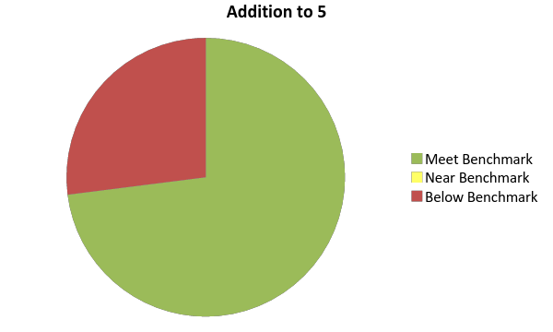
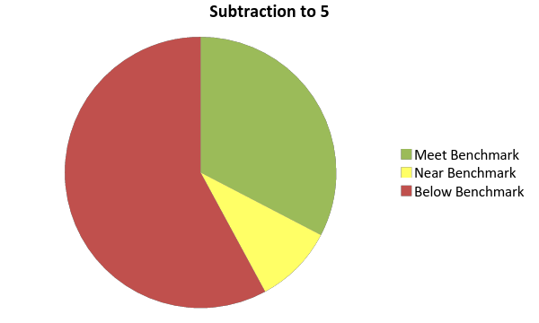
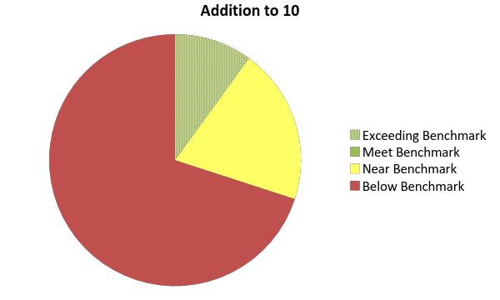
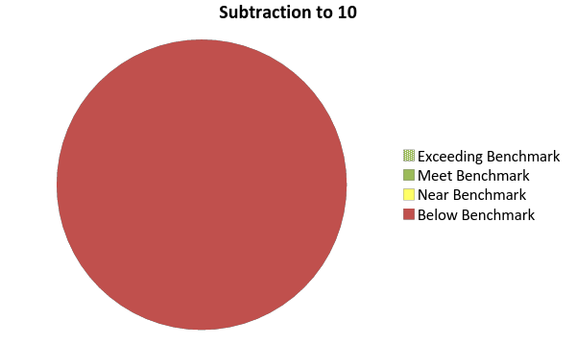
The Data-Grade 1 Results
Notes:
This is data from the common assessments the teachers created. The “Addition to 5” and “Subtraction to 5” was given in September as a transition assessment. The expectation was that students should have these skill mastered at the end of Kindergarten. The “Addition to 10” and “Subtraction to 10” was given at the end of the school year. The results were alarming; none of our grade one students were fluent within 10.

Slide 20
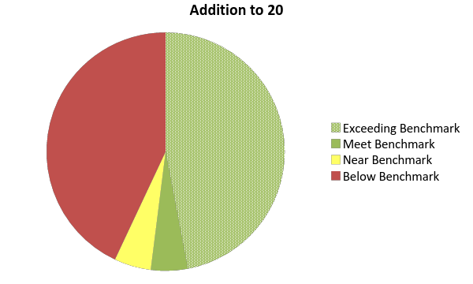
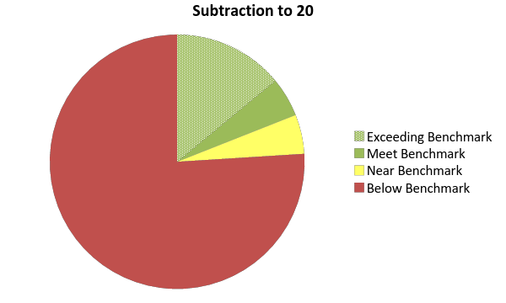
The Data-3 Grade Results
Notes:
Here is data of grade 3 taking a transition assessment in September on “Addition to 20” and “Subtraction to 20”. These were skills that should have been mastered at the end of grade 2. We see very low retention and mastery.

Slide 21
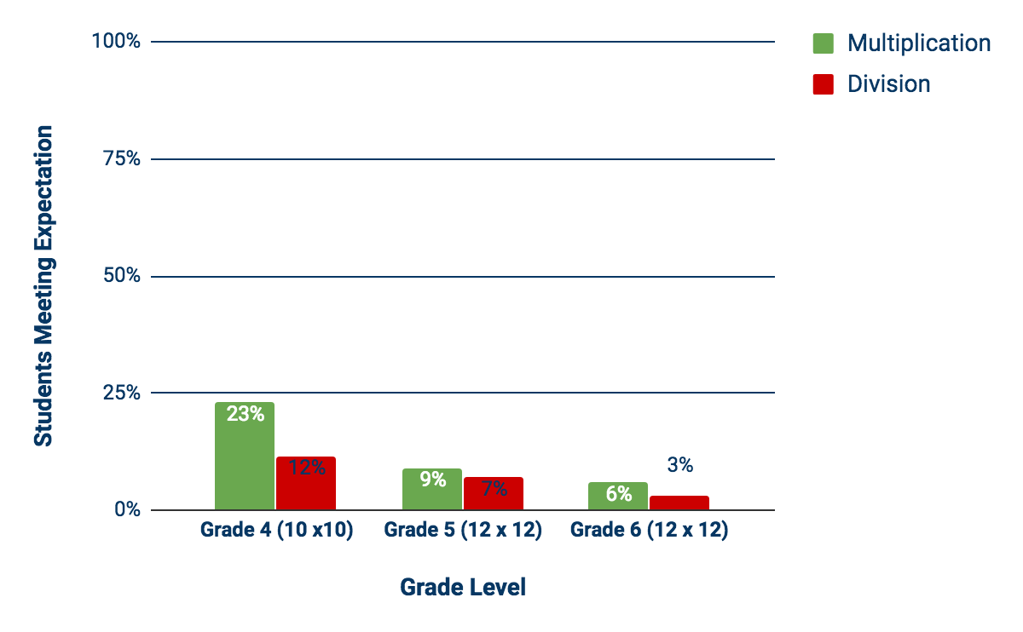
Grades 4-6 Data
Notes:
The trends continue. Our data from grades 4 through 6 are showing that kids are not fluent. Truth of the matter was, we weren’t assessing fluency. Still assessing accuracy and speed. We thought we were assessing flexibility by extending the time, but obviously the kids weren’t flexible.

Slide 22
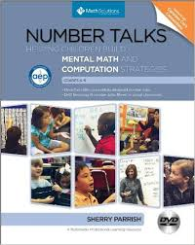
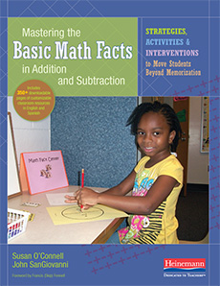
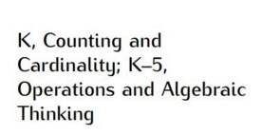
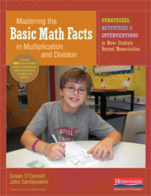
Back to the Drawing Board...
Notes:
The math specialists decided that we needed to create fact fluency assessments that truly assessed the fact fluency that we defined in our mission statement. We needed to get at how kids were making sense of facts, using strategies to be efficient and flexible, and of course accuracy still mattered. We also knew that automaticity had its place too. We continued to do more research.

Slide 23
Phases of Basic Fact Mastery
Traditional approaches to learning facts (flashcards, drill, and timed testing) attempt to move students from counting all directly to mastery.
This approach is ineffective—many students do not retain what they memorized in the long term, moving to grade 4 and beyond still not knowing their facts.
Even if students remember facts, they are unlikely to be fluent as defined above, as they will not have learned to flexibly apply strategies to find the answer to a addition and subtraction facts or more complex computation. (Baroody 2006)

Slide 24
Methods for Solving Single-digit Addition and Subtraction Problems
Level 1
Direct Modeling by Counting All or Taking Away - Represent situational or numerical
problem with groups of objects, a drawing, or fingers. Model the situation by
composing two addend groups or decomposing a total group. Count the total or
addend.
Level 2
Counting on-Embed an addend within the total (the addend is perceived simultaneously as
an addend and as part of the total). Count this total but abbreviate the counting by
omitting the count of this addend; instead begin with the number word of this
addend. Some method of keeping track (fingers, objects, mentally imaged objects,
body motions, other count words) is used to monitor the count.
Level 3
Dorec
Convert to an easier problem -Decompose an addend to compose a part with another
addend.
Progressions for the Common Core State Standards in Mathematics (Draft). 2011.

Slide 25
Level 1
Direct Modeling by Counting All or Taking From - Represent situational or numerical
problem with groups of objects, a drawing, or fingers. Model the situation by
composing two addend groups or decomposing a total group. Count the total or
addend.
Progressions for the Common Core State Standards in Mathematics (Draft). 2011.

Slide 26
Level 2
Counting on-Embed an addend within the total (the addend is perceived simultaneously as
an addend and as part of the total). Count this total but abbreviate the counting by
omitting the count of this addend; instead, begin with the number word of this
addend. Some method of keeping track (fingers, objects, mentally imaged objects,
body motions, other count words) is used to monitor the count.
Progressions for the Common Core State Standards in Mathematics (Draft). 2011.

Slide 27
Methods for solving single-digit addition and subtraction problems
Level 3
Dorec
Convert to an easier problem -Decompose an addend to compose a part with another
addend.
Progressions for the Common Core State Standards in Mathematics (Draft). 211.

Slide 28
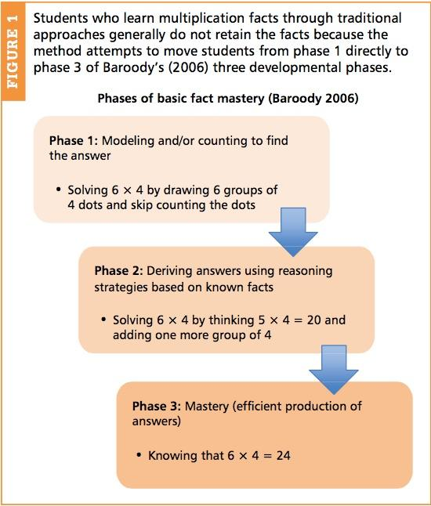
Methods for Solving Single-digit Multiplication and Division Problems
Traditional approaches to learning multiplication facts (flashcards, drill, and timed testing) attempt to move students from phase 1 directly to phase 3.
This approach is ineffective—many students do not retain what they memorized in the long term, moving to grade 4 and beyond still not knowing their facts.
Even if students remember facts, they are unlikely to be fluent as defined above, as they will not have learned to flexibly apply strategies to find the answer to a multiplication fact.
Baroody 2006, Kling and Williams 2015
Notes:
The phases for multiplication and division are similar to the levels of addition and subtraction.

Slide 29
Explicitly Teaching Strategies….
DOES NOT MEAN...
teaching a specific strategy and then asking students to use it. This approach removes the reasoning component and adds to what the student is being asked to memorize.
MEANS...
supporting thinking, including asking students which strategies they might use in a given situation helping students see the possibilities and letting them choose strategies that help them arrive at a solution.
It can take 2-4 lessons before students will internalize the reasoning strategies discussed in class (Steinbery, 1985).
Notes:
Strategies must be explicitly taught to students at their individualized entry point.
The Common Core Progressions for Operations and Algebraic Thinking state that fluency in each grade involves a mixture of just knowing some answers, knowing some answers from patterns (e.g., “adding 0 yields the same number”), and knowing some answers from the use of strategies.
Students should be allowed to fall back on earlier strategies when needed.
In order for kids to be able to know facts from memory or be able to recall them, facts should not be taught divorced from their meanings, but as a result of heavy interplay of practice and reasoning.

Slide 30
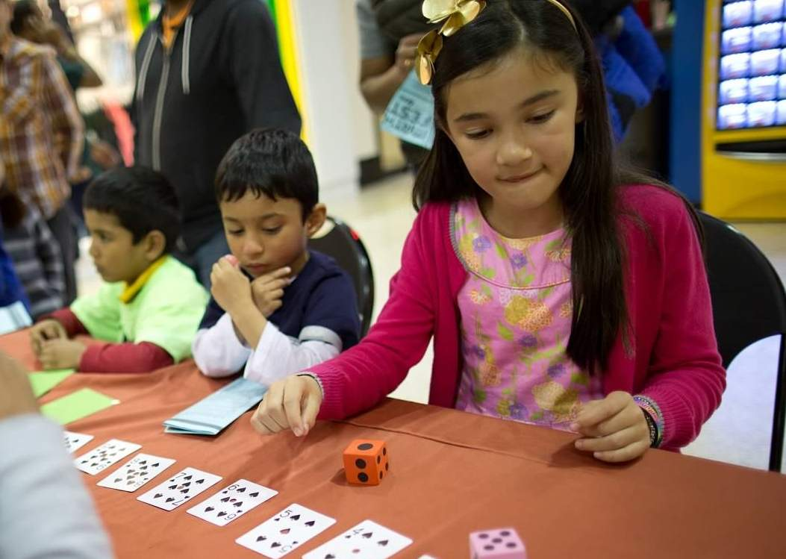
Developing Number Sense
Teachers should help students develop math facts, not by emphasizing facts for the sake of facts or using ‘timed tests’ but by encouraging students to use, work with, and explore numbers.
As students work on meaningful number activities they will commit math facts “to heart” at the same time as understanding numbers and math.
They will enjoy and learn important mathematics rather than memorize, dread, and fear mathematics.

Slide 31
Number Sense not Math Anxiety
Number sense, critically important
to students’ mathematical
development, is inhibited by over-
emphasis on the memorization of math
facts in classrooms and homes. The
more we emphasize memorization to
students, the less willing they become to think about numbers and their relations and to use and develop number sense. (Boaler, 2009)
Boaler, Jo. Fluency Without Fear: Research Evidence on the Best Ways to Learn Math Facts (2014)
http://tinyurl.com/pjqwnjp
Notes:
It is useful to hold some facts in memory, but focus should be on learning them through different mathematical situations and applications.
All mathematics should be build on the foundation of number sense.
When students work on rich mathematics problems they develop number sense and they also learn and can remember math facts.
Students often memorize times tables without number sense - means they are very limited in what they can do and are prone to making errors.
Mathematical thinking is about depth not speed.
https://www.youcubed.org/category/teaching-ideas/depth-not-speed/

Slide 32
Games = Formative Assessment
NCTM Assessment Principle states “Assessment should support the learning of important mathematics and furnish useful information”(NCTM, 2000)
Monitor progress through:
observations
interviews
math journals (Kling and Bay-Williams, 2014)
Data is more useful, as “efficiency and accuracy can be negatively influenced by timed testing” (Henry and Brown 2012), and timed testing has a negative impact on students (Boaler 2012).
Notes:
Henry and Brown (2008)-A study of nearly 300 first graders found a negative correlation between timed testing and fact retrieval and number sense. Some of our best mathematical thinkers are often those who are most negatively influenced by timed testing.

Slide 33
& - Fluency Progression
Grade Level | Skill | How It is Assessed
Kindergarten | Within 5: Conceptual understanding and accuracy | Interviews with problems in context
Grade 1 | Within 10: Understanding, efficiency, flexibility, accuracy | Strategy Checklists Interviews End of Year Assessments (untimed)
Grade 2 | Within 20: Understanding, efficiency, flexibility, accuracy | Strategy Checklists Interviews End of Year Assessments (untimed)
Grade 3 | Within 20: Automaticity and accuracy | End of Year Assessments (timed)
Notes:
The math specialists used this information to create a comprehensive fluency assessment progression across the grades that was aligned to the CCSS.
Addition and subtraction is an area of focus within grades K-3.

Slide 34
x & ÷ Fluency Progression
Grade Level | Skill | How It is Assessed
Grade 3 | Within 100: Understanding, efficiency, flexibility, accuracy | Strategy Checklists Interviews End of Year Assessments (untimed)
Grade 4 | Within 100: Automaticity and accuracy | End of Year Assessments (timed)
Notes:
Multiplication and division is an area of focus in grades 3 and 4.

Slide 35
Kindergarten Interview
“Students act out addition and subtraction situations by representing quantities in the situation with objects, their fingers, and math drawings (MP 5, K.OA.1). To do this, students must mathematize a real world situations (MP 4) focusing on their quantities and their relationships rather than non-mathematical aspects of the situation.”
“Students solve addition and subtraction equations for numbers within 5 (2+1 = __ or 3-1 = ___) while still connecting these equations to situations verbally or with drawings. Experience with decompositions of numbers and with Add To or Take From situations enables students to begin to fluently add and subtract within 5.”
From the Progressions for the Common Core State Standards (2011)
Notes:
Fluency work in kindergarten should be connected to situational contexts rather than in isolation as with “naked numbers”.

Slide 36
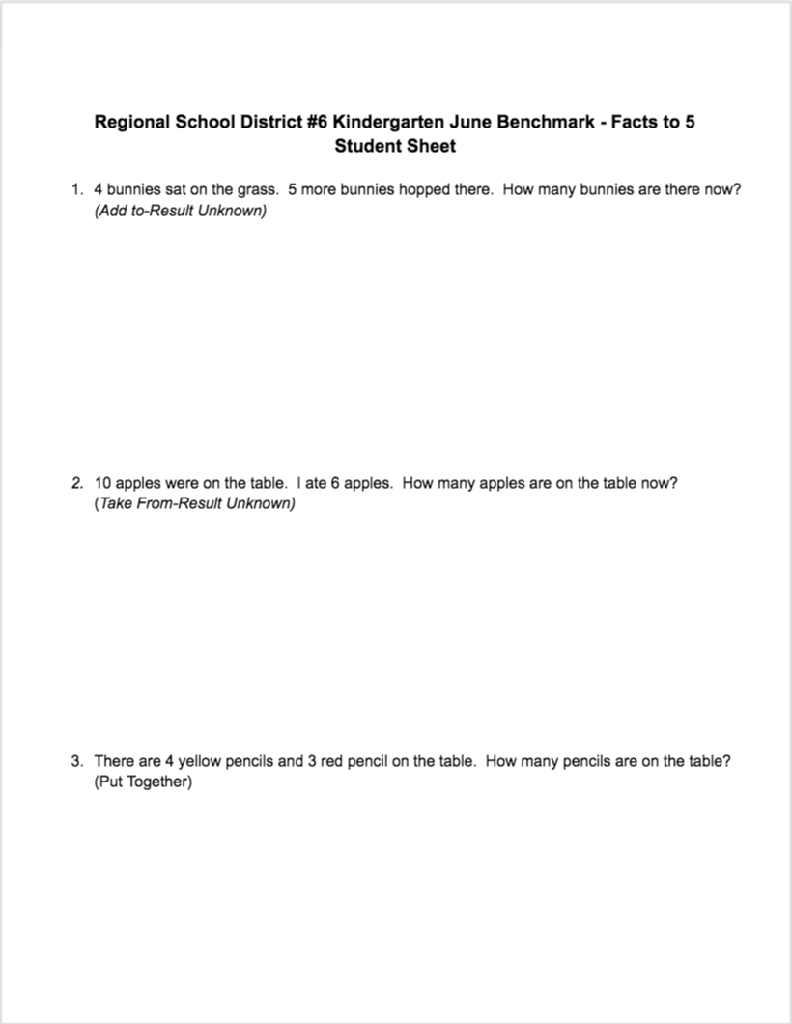
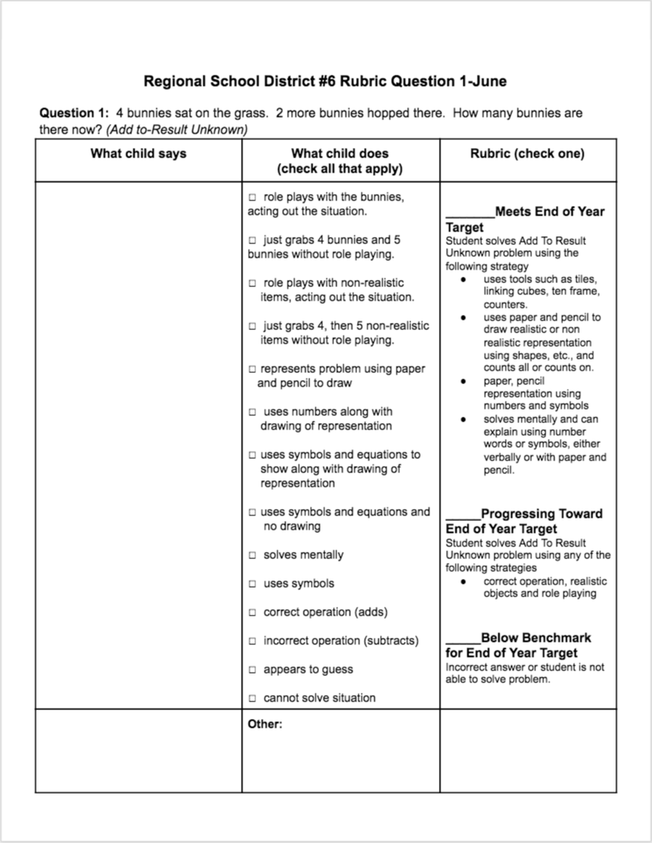
Kindergarten Interview
Notes:
Here is a sample of a Kindergarten Interview for the month of June.

Slide 37
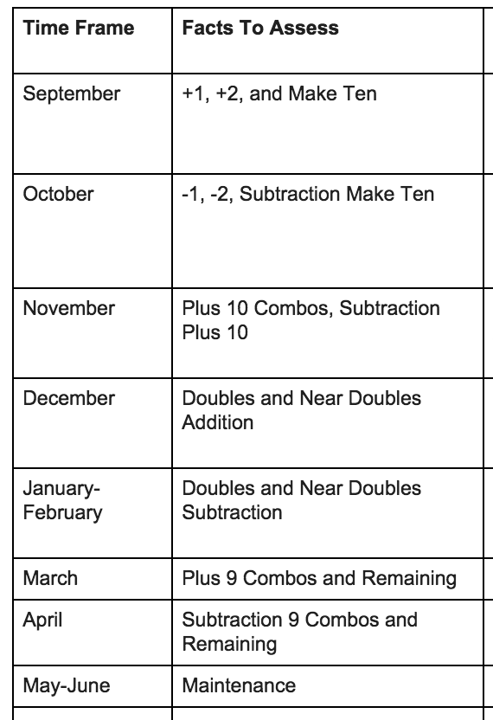
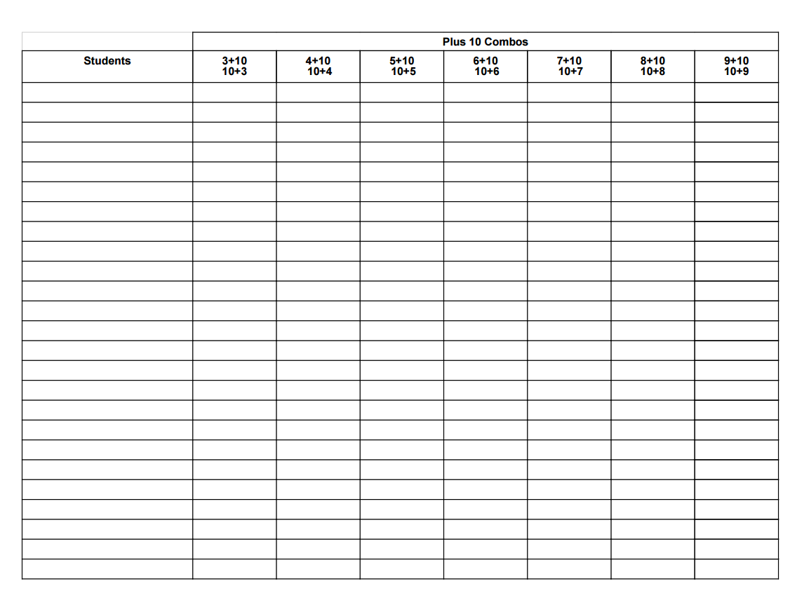
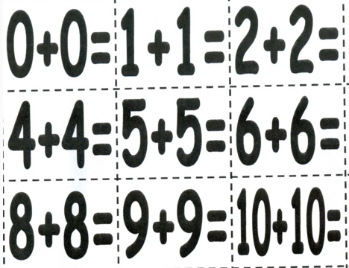
Grade 2 Checklists
Notes:
This slide shows the grade 2 progression of facts throughout the school year. Notice that the facts are grouped by strategy. Checklists are used to assess student progress within the progression of facts. The months are targets for when the strategies should be mastered within the grade. Students who are ready can be accelerated through the suggested pacing. Students who have not mastered a month’s designated strategies should not move on because each month is a prerequisite for the next. The checklists help the teacher determine which facts a student knows and does not know. This supports the accuracy component of fluency.

Slide 38
Flexibility and Efficiency Interview
Notes:
Here is a sample of an interview used in grade 2. The interview complements the strategy checklists in the progression of the strategies. Students are given an interview for 2 facts for each strategy group. The interview helps the teacher determine if the student has all components of fluency by assessing understanding, accuracy, efficiency, and flexibility.

Slide 39
Teachers can use the data collected to create an instructional fact fluency plan that will meet each of their student’s individual needs.
Notes:
Teachers will know what facts their students know and do not know which will allow them to group students based on their fluency progression. Teachers can ensure that students are truly fluent rather than just relying on surface level memorization.

Slide 40
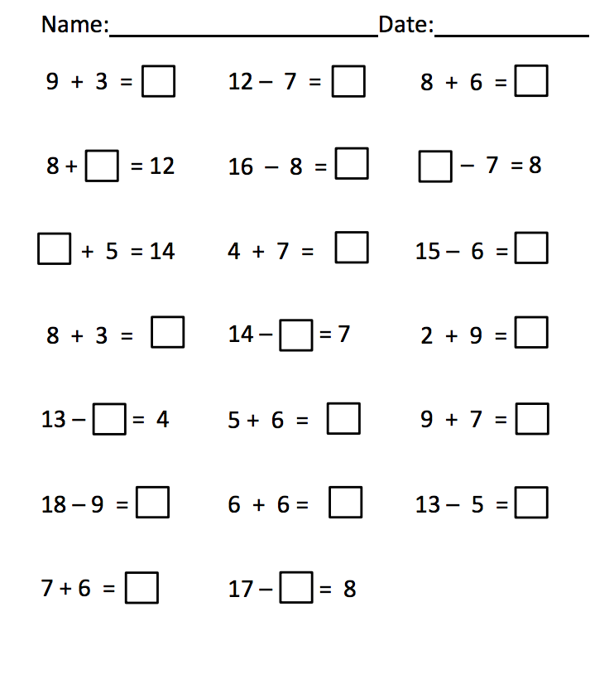
End of Year Assessment
Administered 3-5x per year (dependent on grade level).
Growth Mindset – students in grade three and four are timed up rather than back using their foundation of strategies to improve upon their automaticity.
Application of facts, built on conceptual to procedural foundation – RIGOR
Focuses on the relationship between the operations and their properties.
Notes:
This assessment has been taken from Achieve the Core’s mini-assessments. Students begin to apply their knowledge of facts and the relationships among numbers. This work lays the foundation for computational fluency with bigger numbers.

Slide 41
Remember The Way It Was-
Grade 1 Results, 2014
Notes:
Remember our data when our assessments only focused on speed and accuracy...

Slide 42
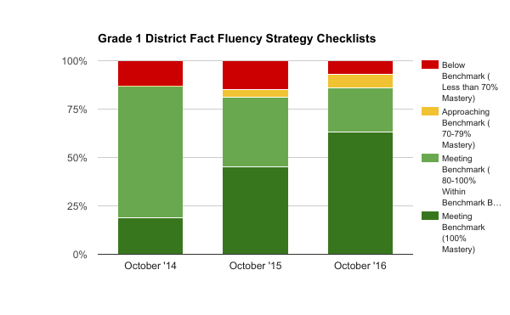
The Way It Is-Grade 1 Results
The number of students reaching 100% mastery has greatly improved since implementation
Notes:
Here is a sample of our data since implementation of our new assessment process. This graph shows grade one student mastery of facts from our strategy checklists.

Slide 43
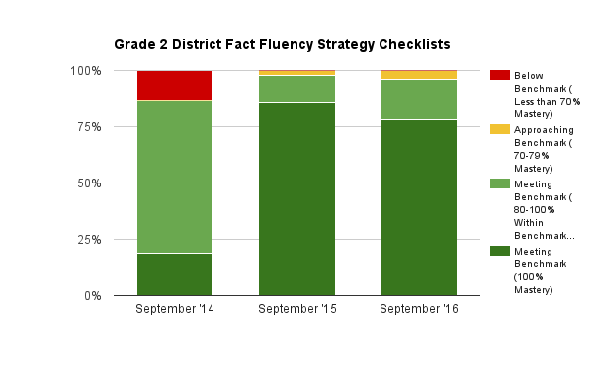
The Way It Is-Grade 2 Results
The number of students meeting benchmark and reaching 100% mastery has greatly improved since implementation

Slide 44
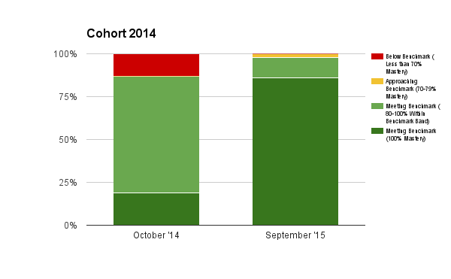
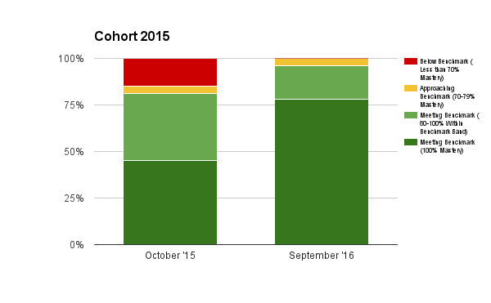
The Way It Is-Year to Year Growth
Grade 1 > Grade 2
More students met benchmark in 2nd year
No students were in need of support in 2nd year
More students had 100% mastery in 2nd year
Notes:
Here we look at two different cohorts of students in during their years in first and second grade. We see that these students are not only retaining what was learned, but they are also building upon their fluency abilities.

Slide 45
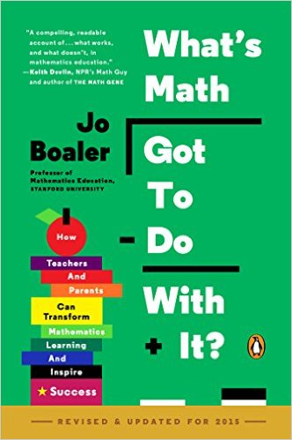
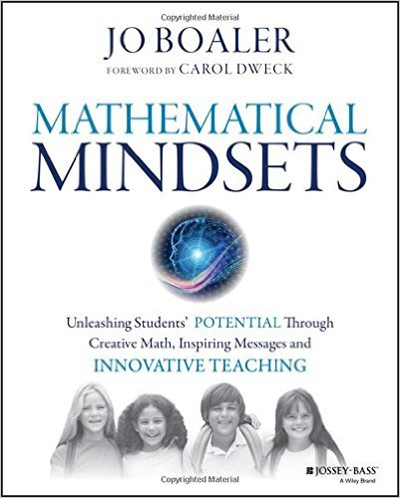
To Sum it all up…..
Fluency comes about when students develop number sense, when they are mathematically confident because they understand numbers. (Boaler, 2015)
Notes:
If you are looking for more information on the development of number sense as the foundation to fluency, Jo Boaler is an excellent resource. She also has lots of research on the positive correlations of timed testing and math anxiety as well as the action steps that one can take to develop healthy growth mindsets in mathematics.

Slide 46
Jo-Boaler’s Youcubed Links
Youcubed.org
Aligning Assessment to Brain Science
Depth, not Speed
Fluency Without Fear: Research Evidence on the Best Ways to Learn Math Facts
Speed and Time Pressure Blocks Working Memory
Think It Up! Mistakes Grow Your Brain
Notes:
Sara

Slide 47
A Call to Action…
What is one component of this assessment practice you will take back to your classroom or school?
Notes:
Robin work on peardeck

Slide 48
Resources
"Addition and Subtraction within 20 Mini-Assessment." Achieve the Core. Student Achievement Partners, 13 Oct. 2013. Web.
Baroody, Arthur J. 2006. “Why children have difficulty mastering the basic number combinations and how to help them.” Teaching Children Mathematics 13 (August): 22-31.
Boaler, Jo. 2012. “Timed tests and the development of math anxiety.” Education Week. Online July 3, 2012
Boaler, Jo. “Fluency Without Fear: Research Evidence on the Best Ways to Learn Math Facts. https://youcubed.org. Online January 28, 2015.
First Steps in Mathematics: Number
Fletcher, Graham. "From Memory and Memorization: There Is a Difference." G Fletchy. N.p., 1 Dec. 2014. Web.
Henry, Valerie J., and Richard S. Brown. 2008. “First-Grade basic facts: An investigation into teaching and learning of an accelerated, high-demand memorization standard.” Journal for Research in Mathematics Education 39 (March):153-83
Notes:
Add Achieve the Core

Slide 49
Resources
Kling, Gina and Jennifer M. Bay-Williams. 2014. “Assessing Basic Fact Fluency.”
Teaching Children Mathematics 20 (April): 490-96.
Kling, Gina and Jennifer M. Bay-Williams. 2014. “Enriching addition and subtraction fact mastery through games” Teaching Children Mathematics 21 (November: 238-47).
National Council of Teachers of Mathematics (NCTM). 2000. Principles and Standards for School Mathematics. Reston, VA: NCTM.
Parrish, Sherry (2010). Number Talks: Helping Children Build Mental Math and Computation Strategies K-5. Math Solutions.
Progressions for the Common Core State Standards in Mathematics (Draft). 2011. K, Counting and Cardinality; K–5, Operations and Algebraic Thinking. The Common Core Standards Writing Team.
Russell, Susan Jo, Karen Economopoulos, Lucy Wittenberg, et al. 2012. Investigations in Number, Data and Space series. Common Core Edition. Glenview, IL: Scott Foresman.

Slide 50
Making Fact Fluency
Assessment Meaningful
http://bit.ly/2hgu9NR
Robin Moore
PreK-8 Math Coordinator
Regional School District 6: Warren, Morris, Goshen, CT
SAP Connecticut Core Advocate
rmoore@rsd6.org
Twitter: @mooreintomath

