Slide 1
MSP SHOWCASE:
Intel® Math
September 27, 2017
Mathematics Education Specialist:
Dr. Robin S. Kalder, kalderr@ccsu.edu
Central Connecticut State University
Mathematician:
Dr. Becky Hall, hallb@wcsu.edu
Western Connecticut State University

Slide 2
Course Basics
For K-8 school teachers in K-8 mathematics content
80 hour professional development course
Emphasis on deepening the conceptual understanding of mathematics through exploration, inquiry activities, solution sharing, and homework
90% mathematics content & 10% mathematics pedagogy

Slide 3
Course Themes
Mathematics is problem solving
Arithmetic, geometry, & algebra are interconnected
There are many ways to solve a problem
Mathematics is not a spectator sport!

Slide 4
Intel Math is NOT…
Intel Math is…
remediation
make and take activities
only focused on the math a particular teacher teaches
deeply conceptual
for building the foundational knowledge of teachers
about the coherent whole of K-8 mathematics

Slide 5
In the beginning…
The Intel Foundation wanted to find a math content PD program that they could get behind
Spent a full year doing research on existing PD programs, and was dissatisfied with what they found
Vermont Math Initiative (3 yr master’s program) was impressive, but not scalable
Intel contracted Dr. Ken Gross to “distill” his Phase 1 and “Greatest Hits” into an 80 hour PD program

Slide 6
From 2010 – 2017
  Implemented nationally across 17 states:
  AZ, CA, CT, FL, GA, IL, MA, MI, MS, NH, NJ, NM, OR, PA, UT, VA, WI
  272 cohorts
  ~7254 teachers
  reaching 1.7M students

Slide 7
Course Content
Unit 1: Problem Solving
Unit 2: Addition and Subtraction
Unit 3: Multiplication
Unit 4: Division
Unit 5: Fractions
Unit 6: Rational Numbers
Unit 7: Linear Relations
Unit 8: Functions

Slide 8
Course Pedagogy
Content Sessions
Pedagogy Sessions
Modeling by Instructors
Reflecting on Pedagogical Moves

Slide 9
Summer 2017
Session 1: July 10 – July 21
Twenty nine K-8 teachers from
Hamden, New Haven and Vernon
Constance Leidy, Wesleyan University,
Lindsay Keazer, CCSU
Session 2: July 24 – August 4
Twenty eight K-8 teachers from
Hamden, New Haven and Vernon
Becky Hall WCSU, Robin Kalder, CCSU

Slide 10


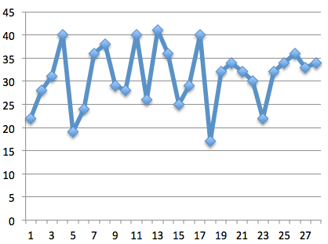
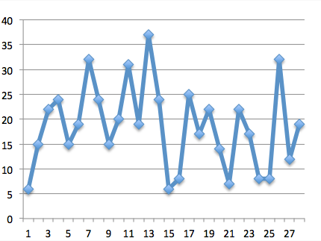
Results from Session 2
Pretest Average Posttest Average

Slide 11
Results from Session 2
Rate the impact the Intel Math Summer Institute had on your understanding of math content and concepts by comparing your understanding before your involvement in the Institute with your current understanding. (Scale 1 – 10)
  Level of previous math content and concept understanding (5.86)
  Level of current math content and concept understanding (8.50)

Slide 12
Participant Comments
I understand why the math works for a lot of the content I already knew and was refreshed on math I hadn’t done in years
I have been able to hone in on areas of relative weakness in my content
I felt pretty confident in my math content ability leading into this, but the institute pushed me to become confident beyond my grade level

Slide 13
Rate the impact the Intel Math Summer Institute had on your confidence in effectively teaching mathematics at a deeper level by comparing your confidence before your involvement in the Institute to your current confidence level. (Scale 1 – 10)
  Previous level of confidence (6.29)
  Current level of confidence (8.32)

Slide 14
Participants Comments
Understanding the conceptual meanings behind math concepts, thus increasing my confidence
I was so unsure of myself. I feel so much more confident. I feel like I can get through some tough problems & it’s so rewarding
I think I will be able to better explain to students why the math works and make deeper connections across content

Slide 15
Rate the potential impact the Intel Math Summer Institute may have on your math instruction by comparing instructional strategies and/or methods you used before your involvement in the Institute with the strategies and/or methods you may adopt as a result of your participation in the Institute. (Scale 1 – 10)
  Previous level of confidence (6.50)
  Current level of confidence (8.86)

Slide 16
Participants Comments
I have so many more ideas & strategies to give my students more of the how and why behind their math concepts
I had such a mental block before I feel / I know I can do more
I was really lacking in explaining the why to my students. I will certainly add more critical thinking to my math lessons & not just “teach a rule”

Slide 17
What has been the most beneficial aspect of this Institute for you as a professional educator?
  Opening my eyes to math connections between lower and upper grades
  To deepen the level of my math instruction – give my students more excitement for math & to think critically
  Networking with others, really understanding why we do certain things and connecting it all together
  Reworking problems outside of “comfort base” with colleagues and teachers outside of my discipline
  Truly gaining an understanding of mathematical learning K-middle school

Slide 18
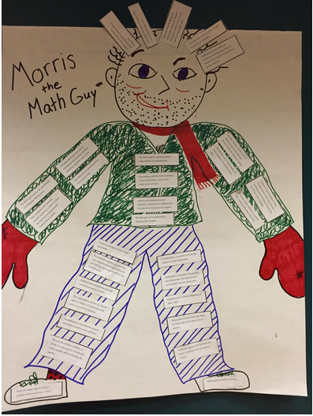

Slide 19
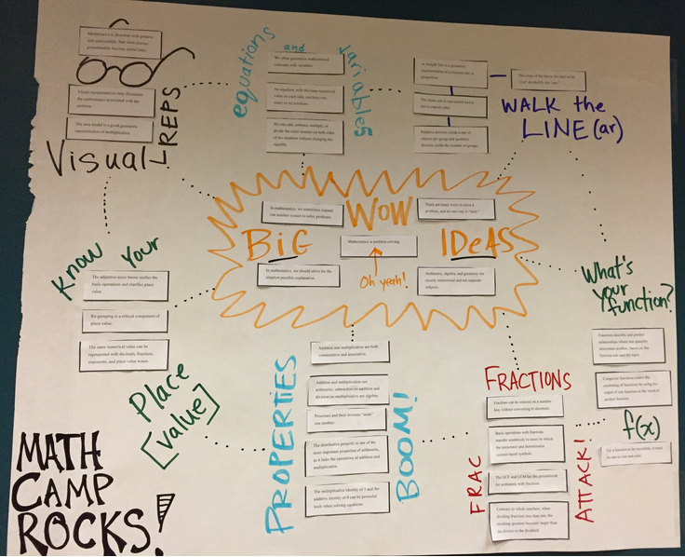

Slide 20
Write one statement that should be shared with future Intel Math Summer Institute participants.
  Being a student again helps you be a better teacher
  The how & why behind math procedure is so key to teaching the concepts
  Try your best, you most likely will have a math breakthrough in the end
  You will be a better teacher for taking Intel math

Slide 21
For information about a future Intel training please contact:
  Robin S. Kalder
  Central Connecticut State University
  kalderr@ccsu.edu
  860-832-2842
Any questions?

