Slide 1


CSDE Webinar Series
Systems of Professional Learning
Connecticut Core Standards
Session:
CELP and CT State Core Standards: Meeting the Needs of English Learners
Thursday, February 4th
3:30 – 4:30 p.m. EST

Slide 2
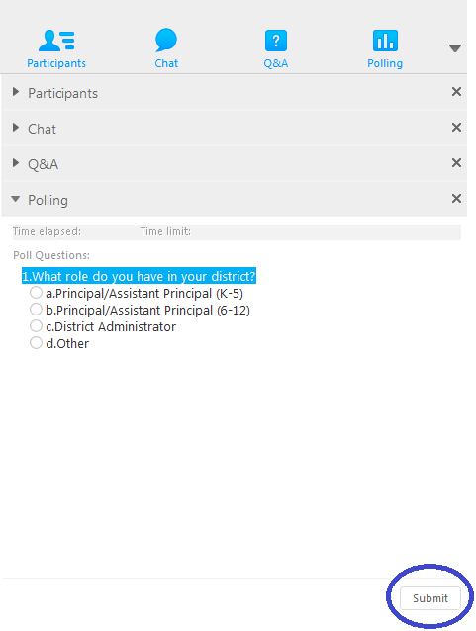
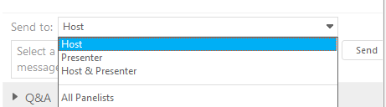

Logistics…Things to Know
How to communicate via WebEx
Using the Polling Tool

Slide 3


PCG Facilitator
Gloria Rodriguez

Slide 4
Poll Question
What role do you have in your district?
ESL Teacher
Classroom Teacher
ESL Administrator
Principal/Assistant Principal
District Administrator
Other

Slide 5

CELP and CT Core Standards: Meeting the Needs of English Learners
Review the demographics and profiles of ELs in CT
Become familiar with the components of the new Connecticut English Language Proficiency (CELP) Standards Document
Examine the purpose of CELP Standards
Review the CELP Standards

Slide 6

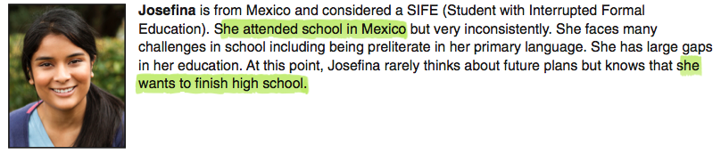
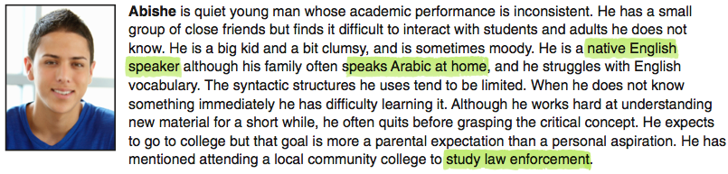
Who are the English Learners in CT?

Slide 7

The Connecticut EL Landscape
Number of ELs in Connecticut
Top 6 Languages
Graduation Rates
English Language Attainment
Academic Success

Slide 8
Connecticut’s English Learners (ELs) Grades K-12, 2014-15
Lack sufficient mastery of English to “assure equal educational opportunity in the regular school program”
There are 34, 833 ELs in 173 public LEAs
6.6 % of all public school students in K-12
Over 60% of ELs were in K-5
76.8 percent of ELs were eligible for either free or reduced-price meals

Slide 9
Geography of ELs
10 Education Alliance Districts- 51%
20 Non-Education Alliance Districts-26%
RESCs, Public Charter Schools; State and Other LEAs-22.8%
The majority of ELs are concentrated in the large urban districts with growth in the number of ELs in smaller suburban and rural districts.

Slide 10
Poll Question
Which school reform District are you representing?
A. Education Alliance Districts
B. Non-Education Alliance Districts
C. RESCs, Public Charter Schools; State and Other
LEAs

Slide 11
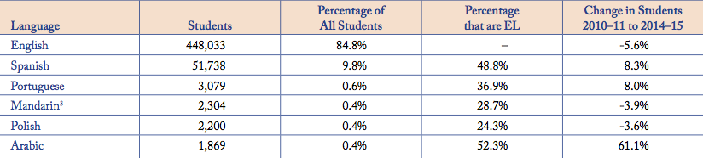
Top 6 Dominant Languages (Grades K-12), 2014-15

Slide 12
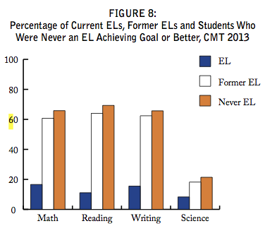

Slide 13
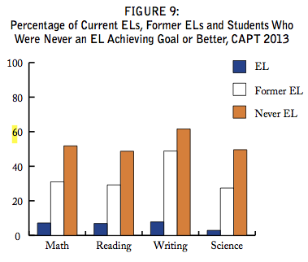

Slide 14
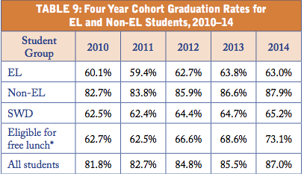

Slide 15
Poll: Your EL Population
A. Under 10%
B. Between 10% and 15%
C. Between 16% and 20%
D. Over 20%

Slide 16
Standards
Raise Expectations for Student Achievement
Level the Playing Field
Improve Teaching Practices
All Students are Taught to the Same Standards and Held to the Same Rigorous Expectations

Slide 17

Content Standards and English Language Proficiency Standards
Content Standards
Define what students should know and be able to do to be successful to be college and career ready.
English Language Proficiency Standards
Describe the language necessary for success in content area courses.

Slide 18
What must students be able to do with language?
comprehend and evaluate complex texts across a range of types and disciplines
construct effective arguments and convey intricate or multifaceted information
discern a speaker’s key points
request clarification and ask relevant questions
build on others’ ideas
articulate their own ideas, and confirm they have been understood”

Slide 19
Why New CELP Standards for Connecticut?
The former Connecticut English Language Learner Framework (2005) is based on old TESOL standards (1999). Therefore, federal agencies have asked Connecticut for updated English Language Proficiency Standards (ELPS)
In order for ELs to be college and career-ready, they need to participate more fully in the curriculum and develop language and content at the same time.

Slide 20
What is your familiarity with CELP standards?
Poll Question
A. I know about them but I’ve never used them.
B. Our school has a plan for using them school wide.
C. I use them to plan my lessons and instruction.
D. I’m new to ELs and trying to learn more about how to use the CELP standards.

Slide 21
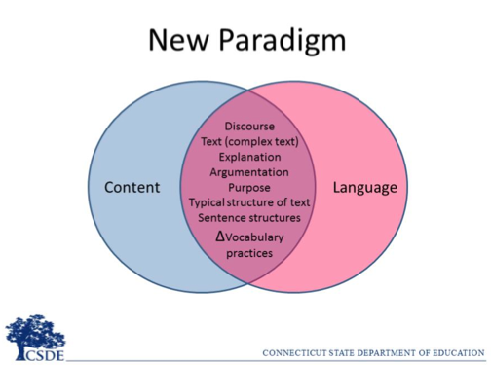

Slide 22
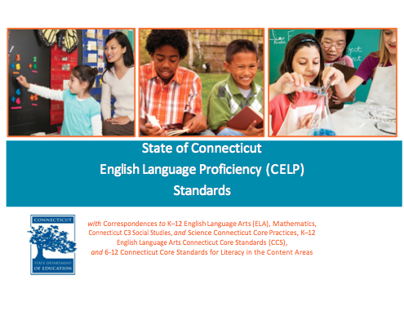
Sections in the CELP Publication
Guiding Principles
The 10 CELP Standards
CELP Standards with Proficiency Descriptors by Grade Level
CELP Standards K-12 Progressions With Proficiency Descriptors by Standard
K-12 Practice Matrix
CELP Standards with Correspondences to Content Practices and Connecticut Core Standards
CELP Glossary
Linguistic Supports
Acronym Key
http://www.sde.ct.gov/sde/lib/sde/pdf/curriculum/bilingual/celp_standards.pdf

Slide 23
Guiding Principles
Potential
Funds of Knowledge
Diversity in EL Progress in Acquiring English Language Proficiency
Scaffolding
Students with Limited or Interrupted Formal Education
Long Term English Learners (LTELs)
Special Needs
Designated Supports and Accommodations
Multimedia, Technology and New Literacies
(page 2-3 of the CT CELP Standards Document)

Slide 24
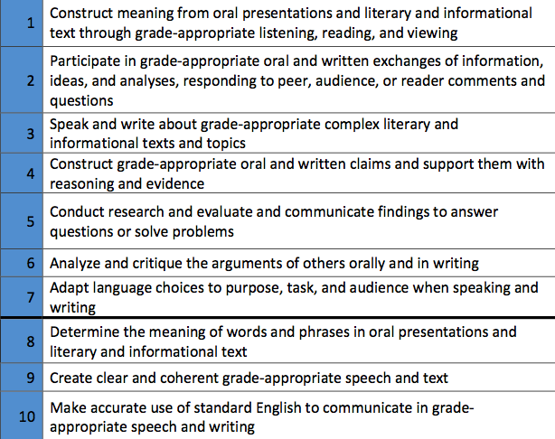
The 10 CELP Standards

Slide 25
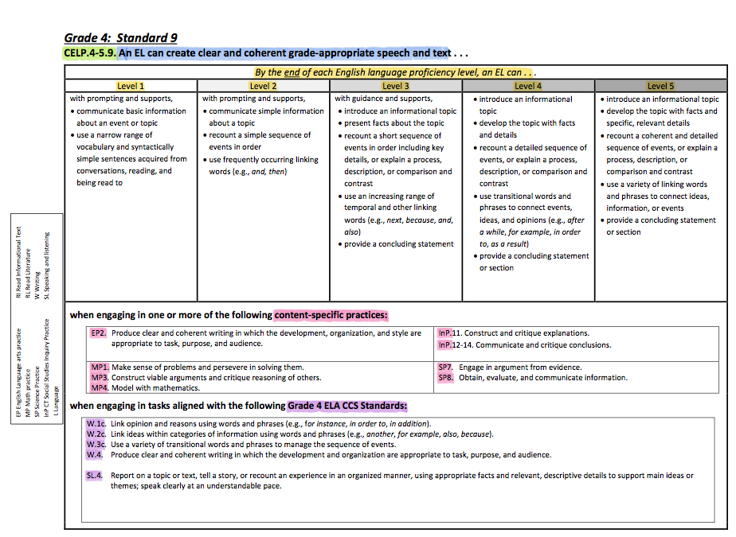

Slide 26
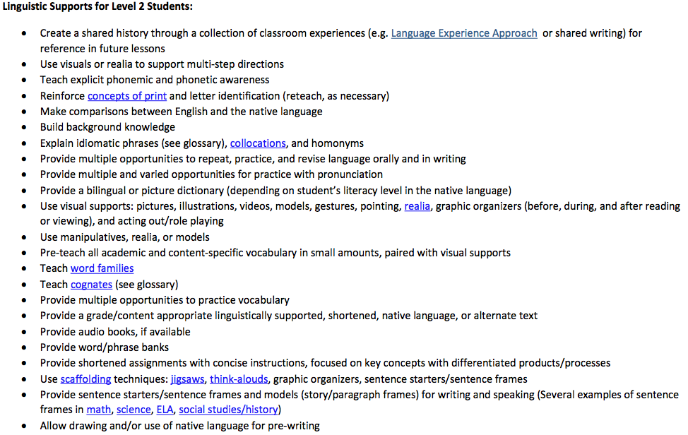
Linguistic Supports

Slide 27
What do new CELP standards potentially mean…
For Students:
CELP standards will provide the type of scaffolds students need to participate in a rigorous curriculum that is cognitively challenging. As a result, students will be ready for college and career ready opportunities.
For Teachers:
CELP Standards will inform general education teachers and TESOL/Bilingual teachers how to plan for rigorous instruction that addresses the language and academic needs of students.
For School Leaders:
CELP standards will provide school leaders with an opportunity to bring a school wide approach and commitment to planning and increasing for the academic success rate of a growing student population.

Slide 28
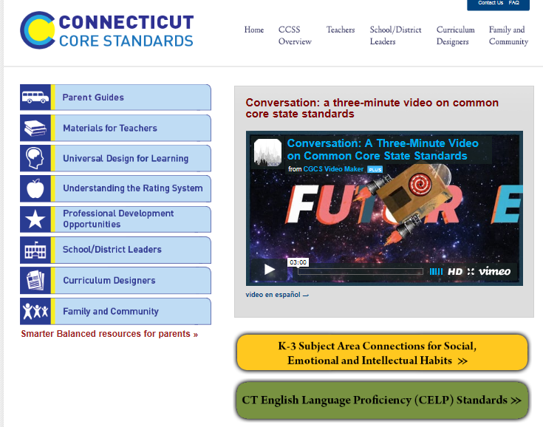
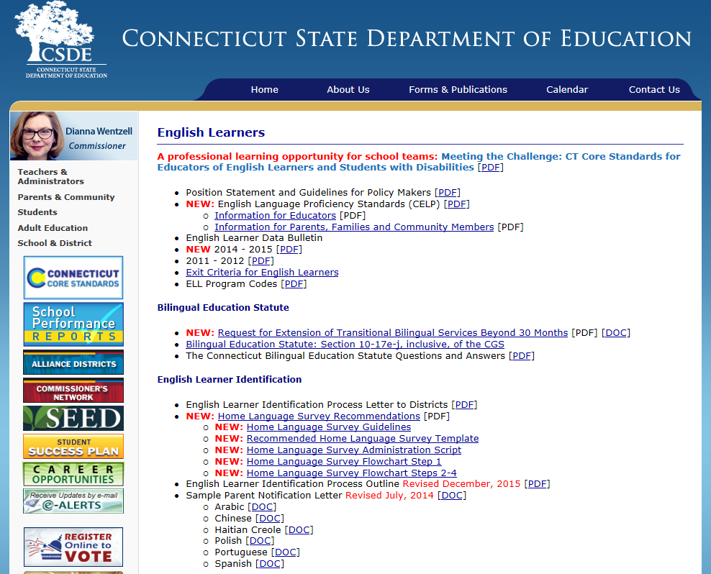
Where to Find More Information
http://ctcorestandards.org
www.ct.gov/sde/Englishlearners

Slide 29
English Learners
“There is no equality of treatment merely by providing students with the same facilities, textbooks, teachers and curriculum…for students who do not understand English are effectively foreclosed from any meaningful education….”
Lau v. Nichols, U. S. Supreme Court

Slide 30
Questions, Concerns, Thoughts…

Slide 31

Thank you for participating in today’s Webinar!
1) If you have additional questions please contact:
Gloria Rodriguez, EL Subject Matter Expert, grodriguez@pcgus.com
Megan Alubicki Flick, ESL Bilingual Consultant CSDE, megan.alubicki@ct.gov
Robb Geier, Project Director, rgeier@pcgus.com
2) Visit our PD page at CTCoreStandards.org

