Slide 1

New Fairfield Middle School
Leading the Journey to Personalized Learning
CCSS Community of Practice, CAS, March 31, 2016

Slide 2

Today’s Learning Targets
I can identify instructional changes that can be made in classrooms and faculty meetings.
I can identify resources for implementation of Project Based Learning and the CT Core Standards.
I can identify how technology can help teachers differentiate and personalize instruction.

Slide 3
Presentation
http://tinyurl.com/CASpresentation

Slide 4
Do Now:
Log in to http://tinyurl.com/DoNowCAS
There are two images...think about how they connect to your classroom or school.
Spend 5 minutes at your table to discuss thoughts
This is also a place to leave questions during the presentation.

Slide 5


One to the World

Slide 6







District Goal
To use the 5 C’s- critical thinking, communication, collaboration, creativity, and connections- to drive instruction and improve each student’s achievement in alignment with the State Standards.

Slide 7






NFMS Vision
New Fairfield Middle School is committed to challenging all learners to be self-directed, empowered citizens through personalized learning experiences.

Slide 8
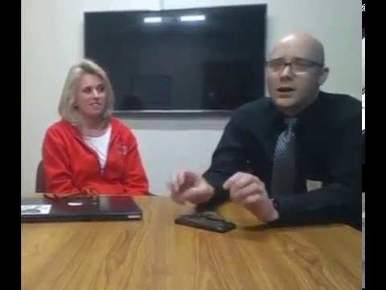
NFMS Focus
2013-2014:
AUDEAMUS: To DARE, To RISK, To VENTURE
2014-2015:
This will be the most creative year ever!
2015-2016:
Striving for excellence will cause
success with anything you do.

Slide 9

Personalizing for the Faculty
Genius Hour Projects
Blended Learning Professional Development
EdCamp
Flipped Faculty Meeting
Learning Menus
Choice Board
Cruise Ship PD
Faculty Book Clubs

Slide 10
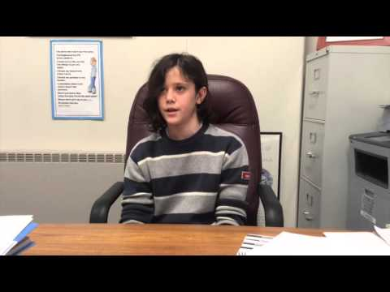
Student Perspective

Slide 11
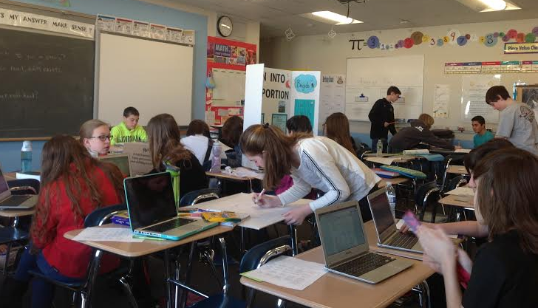

Mathematics
Planning- Unit based rather than day to day
Instruction & Remediation- Using data from sites such as IXL to help with remediation
Practice- Learning Activities (Blended Learning Variations)
Rational Numbers - Fractions - differentiated
Rational Numbers - Adding Integers- differentiated
Inequalities - Work at your own pace (take the quiz when ready)
Assessment-
Using data to drive instruction & remediate (IXL)
Refresh & Review- Excel & PLC (topics learned & not yet covered)
Rubric Shifts- Beginnings of SBG Inequality Project
Project Options- choice, presenting skills
Ownership-
Self assessment & self-monitoring
Student Led Conferences: Exemplar

Slide 12


World Language
In an inclusive MS classroom how do we move language students of differing abilities across ACTFL proficiency levels within the same classroom?
Planning based on skills and vocabulary themes
  Daily agendas 3/31, 3/31A and Learning menus Level 1, Level 2 : differentiated by skill, ability, task
Instruction/remediation
  Whole class, small group
  Blended learning (EDPuzzle/educanon)
  Language PLC
Assessment differentiated by skill/ability
  Traditional quizzes, ACTFL based rubrics
  Oral interviews, Tell me something about...
  Reading comprehension
  Writing journals scored on ACTFL based rubrics

Slide 13
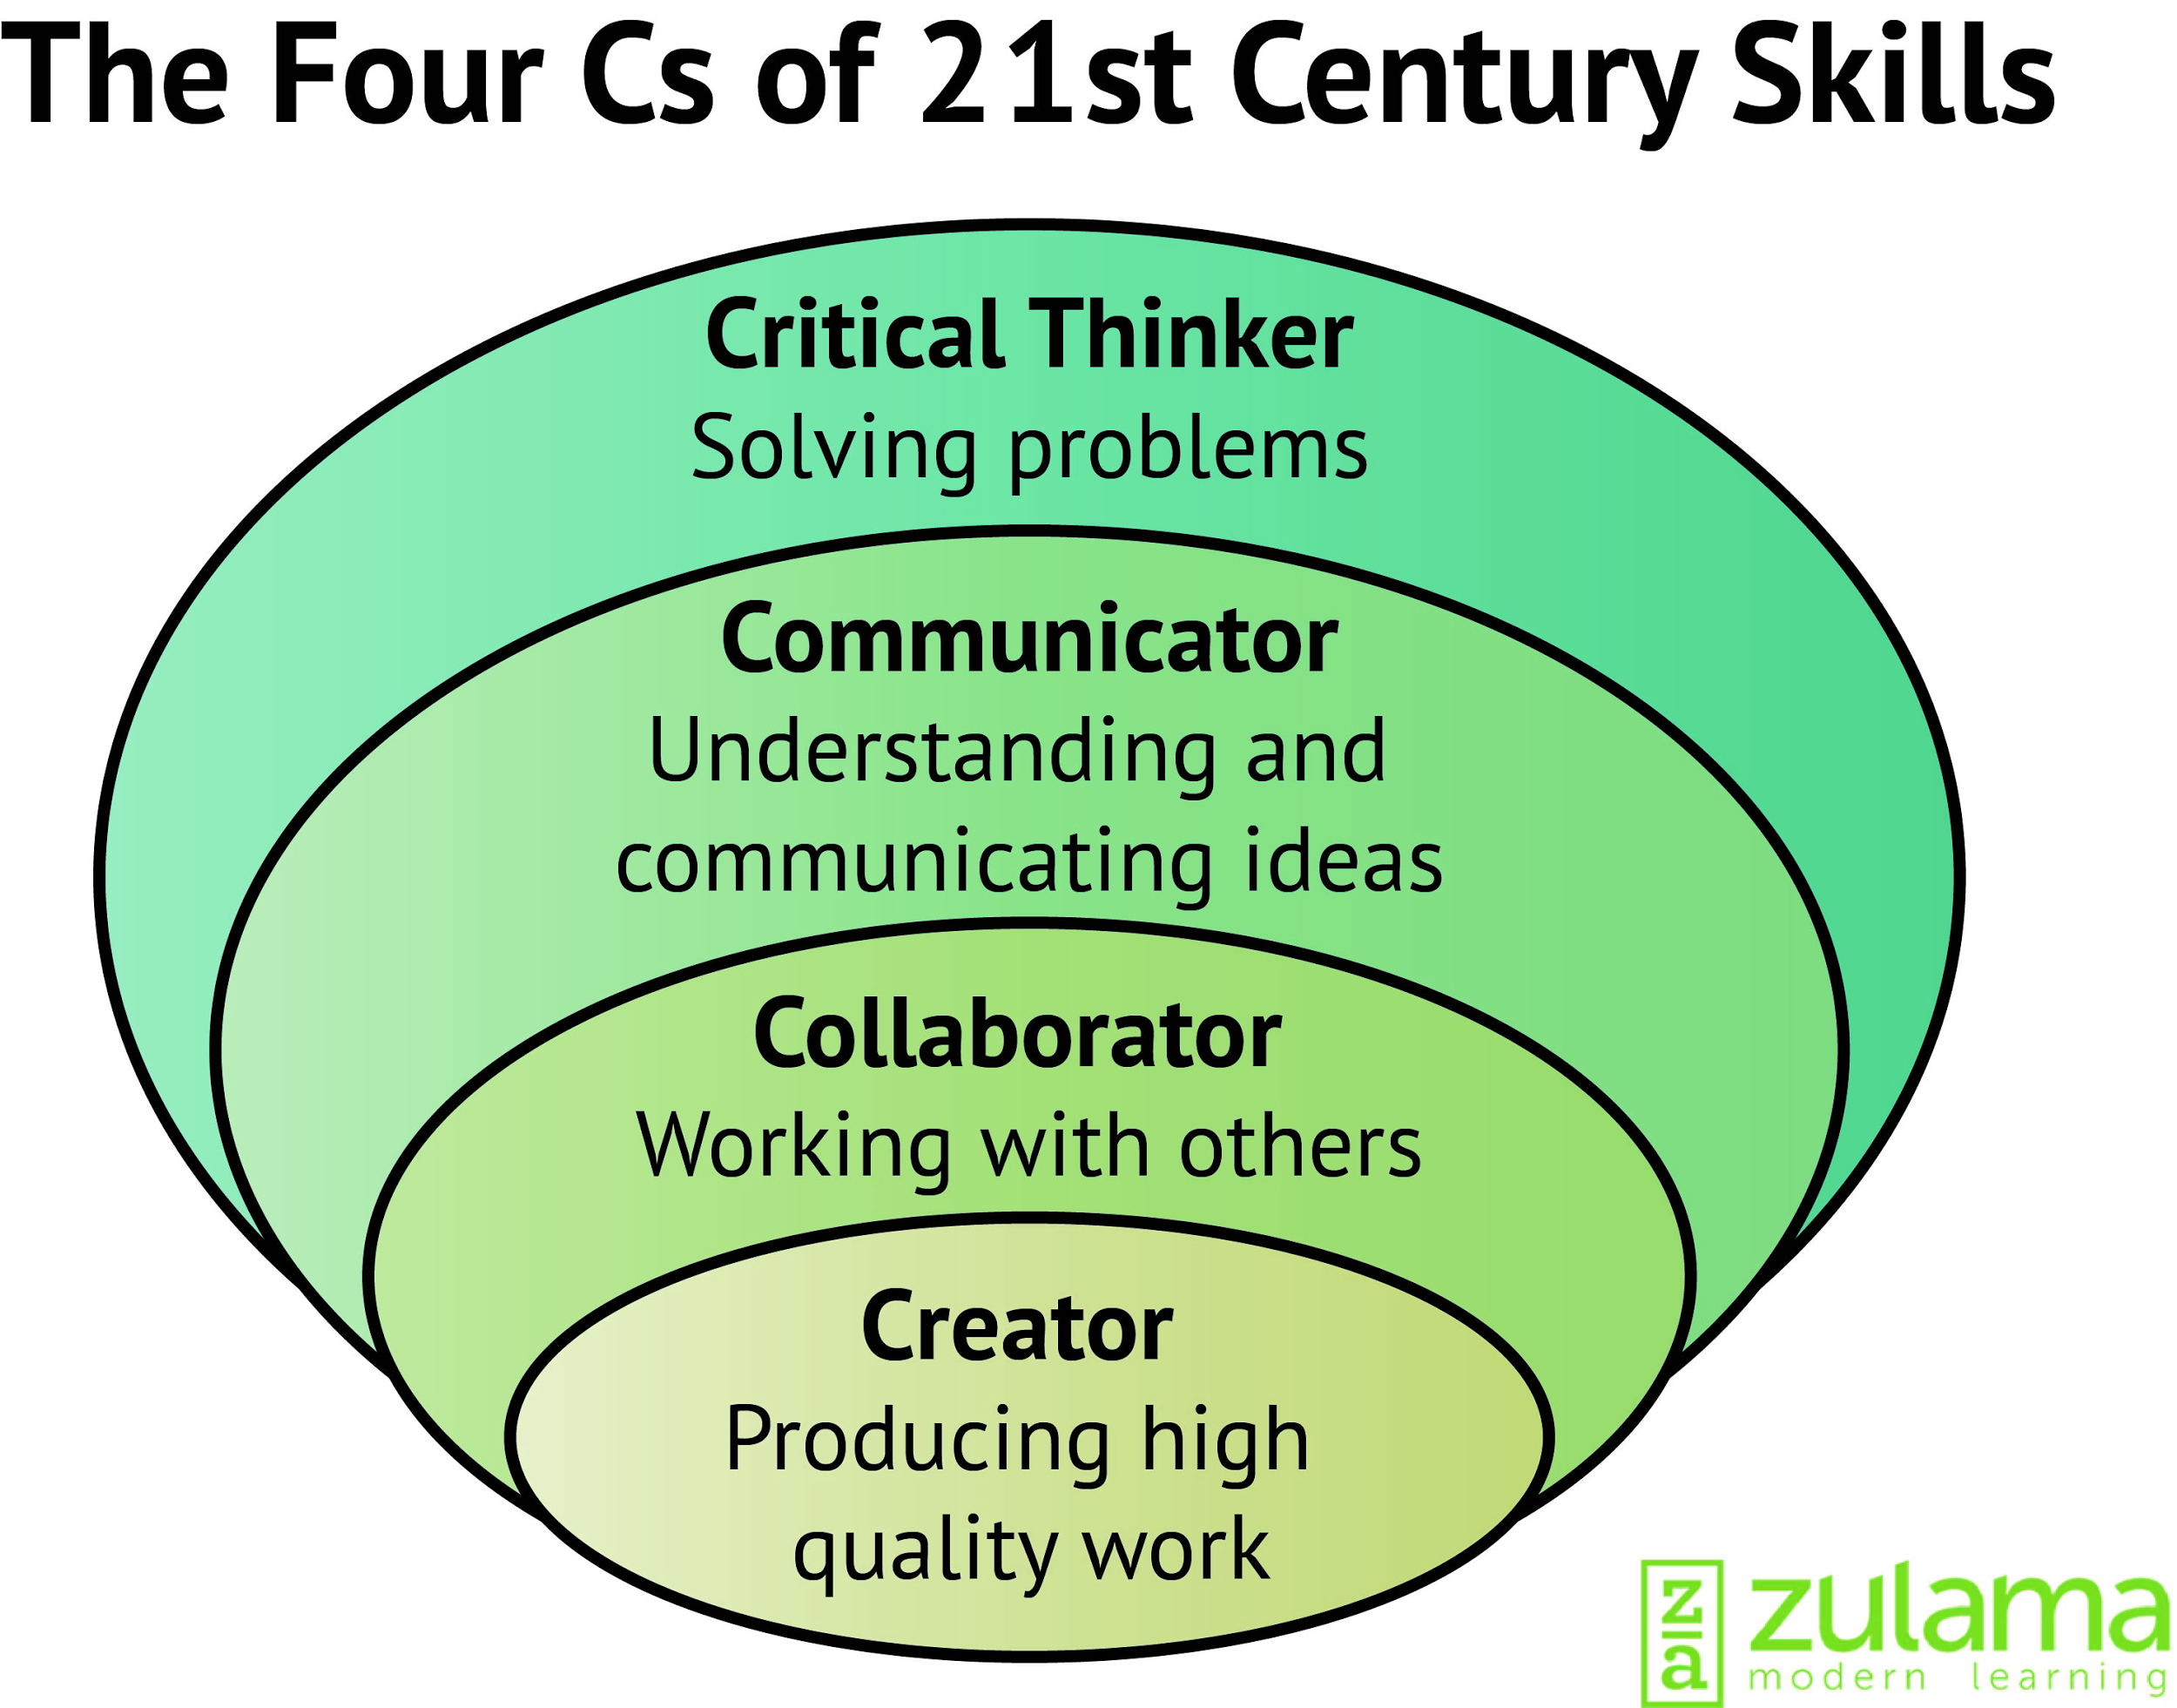
Core 21
Students learn 21st Century skills by practicing them during a variety of projects which offer varying levels of choice and voice.
Year begins with a Skills University focuses on
Attitudes
Habitudes and Mindset
Skills:
Website and source evaluation
Paraphrasing
Question Creation (QFT)
Creating Essential Questions
Modeling/Don’t be afraid to take time.

Slide 14

Core 21-Personalizing Learning
Skills Continued:
KWLHQ
Research Log
Project Examples:Variety of Personalization
Genius Hour Intro: question,product,topics
Digital Storytelling: topic/focus
Unesco Project: topic/focus/product
Science Project: topic/product
Pace/Constant Feedback Loop
Reflections
Chaos
Joy Kirr Livebinder

Slide 15

English Language Arts
When Literacy and Technology meet
  Students as creators
    Rubrics
    Creations
  Changes the audience
    Blog Post
Importance of Questioning
  Shared Inquiry Model
  QFT
Feedback, reflection, and revision

Slide 16
Where are we heading?
1:1 is only a tool
Move towards 1:World...how do we have students use the technology to publish out to a public space?
Providing students more choice and voice as well as leadership (Subject Councils)
Curriculum Mapping and alignment with Cross Curricular Graduation Standards and Scoring Criteria
Mastery Based Learning and Grading

Slide 17


Questions and Thoughts
Jeff Alterman alterman.jeff@newfairfieldschools.org Grade 7 Math
Mary Fuller fuller.mary@newfairfieldschools.org Grades 6-8 Spanish
Cheryl Milo milo.cheryl@newfairfieldschools.org Assistant Principal
Link to all resources mentioned in the presentation.
Follow us @NFMiddleSchool
Final Thought

Slide 18
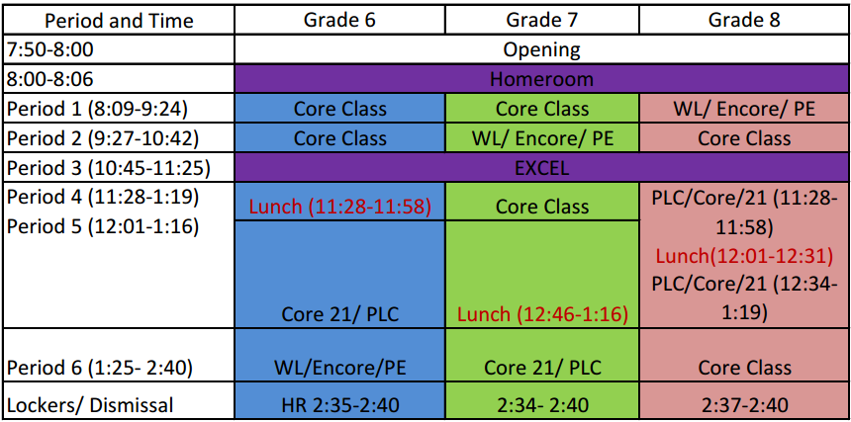
Schedule

