Slide 1
Connecticut Core ELA: Waterbury’s Perspective
On Implementation Successes and Modifications
Dena Mortensen
Waterbury Public Schools
K-5 ELA Supervisor
dmoura@Waterbury.k12.ct.us

Slide 2

Our Journey
Professional Learning

Slide 3
July 2010-Present
July 2010
CCSS Adopted by CSDE
August 2012
Shifts
Deconstructed Standards
DOK
January 2013
Concept-Based Curriculum Written
August 2013
Concept-Based Curriculum Implemented
September 2013-June 2014
CT Systems of Professional Learning
EQuIP
Text Complexity
Text Dependent Questions
Close Reading
Smarter Balanced
September 2014
August 2015-
Present

Slide 4
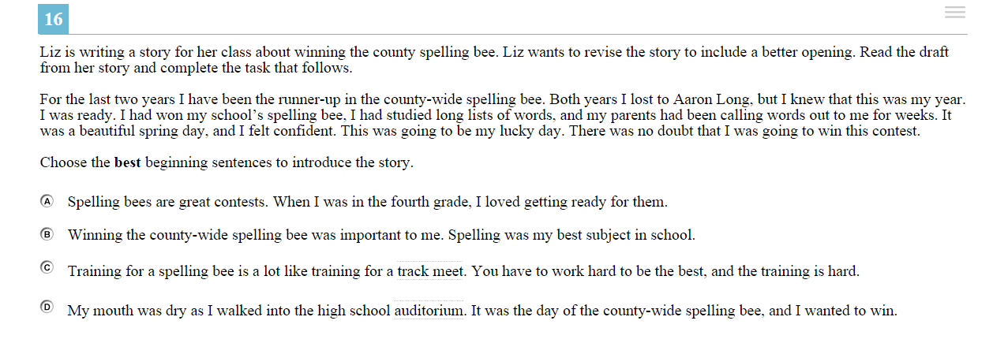
Grade 4 Practice Test Item

Slide 5
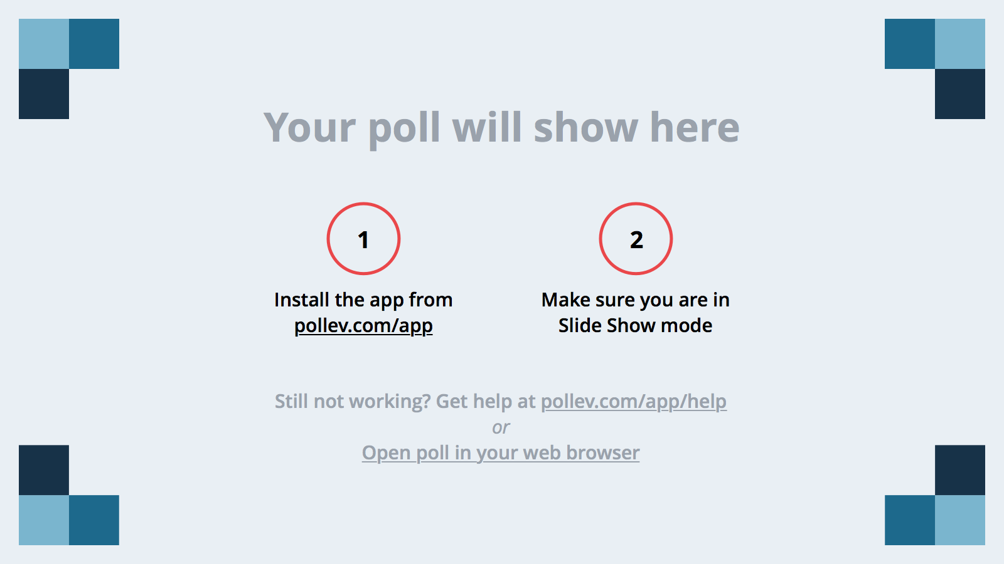
Notes:
Poll Title: Choose the best beginning sentences to introduce the story.
https://www.polleverywhere.com/multiple_choice_polls/1uGUlh3OQRwutT0

Slide 6
Notes:
Poll Title: What Claim is being assessed?
https://www.polleverywhere.com/multiple_choice_polls/qmOQEyk0cYC7Q4j

Slide 7
Notes:
Poll Title: What is the DOK?
https://www.polleverywhere.com/multiple_choice_polls/vOIWvoAiT9BxHeZ

Slide 8
Notes:
Poll Title: What is one CCS assessed in this item?
https://www.polleverywhere.com/multiple_choice_polls/Bf9nc3VYkh2CraM

Slide 9
What is the criteria on which to base curricula review?
Waterbury Unit Development Criteria
(Based on Educators Evaluating Quality Instructional Products (EQuIP) rubric)

Slide 10
Waterbury Unit Development Criteria
A rubric (originally designed by the tri-state area) provided to districts by the CT State Department of Education to develop, improve, and/or evaluate CT Core Standards-aligned units.
The rubric includes 4 dimensions:
Dimension 1: Clarity and Specificity of Learning Targets
Dimension 1 is non-negotiable. A score of 3 or 4 is required to move forward.
Dimension 2: Key Shifts in CT Core Standards (CCS)
Dimension 3: Instructional Supports
Dimension 4: Assessment/Monitoring Student Progress

Slide 11
Unit Development Criteria Rating Scale
Rating/Category | Descriptor/Next Step
4: Exemplifies Quality | Meets all of the criteria in the dimension.
3: Approaching Standard Level of Expectation | Meets most of the criteria in the dimension, but will benefit from revision in others
2: Progressing | Meets some of the criteria in the dimension; needs significant revision
1: Emerging | Does not meet the criteria in the dimension.
* A score of 3 or 4 is required to move to additional Dimensions. Otherwise, significant revision is necessary before proceeding.

Slide 12
July 2010-Present
July 2010
CCSS Adopted by CSDE
August 2012
Shifts
Deconstructed Standards
DOK
January 2013
Concept-Based Curriculum Written
August 2013
Concept-Based Curriculum Implemented
September 2013-June 2014
CT Systems of Professional Learning
EQuIP
Text Complexity
Text Dependent Questions
Close Reading
September 2014
Implemented Equip
Curriculum Management Cycle
Revised Templates
New standards (multidisciplinary)
August 2015-
Present

Slide 13
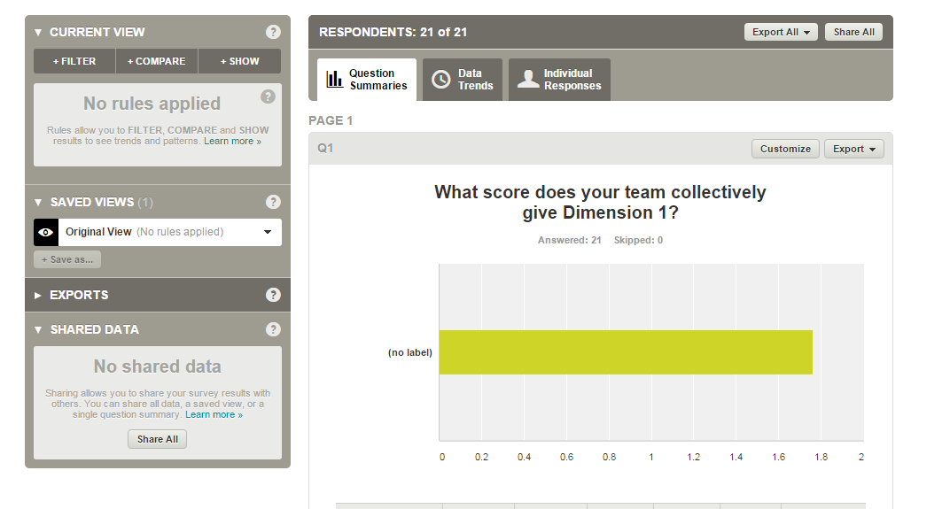
K-9 Criteria Rating for Dimension 1
ALL TEAMS (all grades/all schools)
Average Score: 1.67
Rating/Category | Descriptor/Next Step
4: Exemplifies Quality | Meets all of the criteria in the dimension.
3: Approaching Standard Level of Expectation | Meets most of the criteria in the dimension, but will benefit from revision in others
2: Progressing | Meets some of the criteria in the dimension; needs significant revision
1: Emerging | Does not meet the criteria in the dimension.
* A score of 3 or 4 is required to move to additional Dimensions. Otherwise, significant revision is necessary before proceeding.

Slide 14
K-5 Summary of Evidence
What is lacking?
Foundational Skills/Phonics
Fluency
Standards
Depth of Knowledge (DOK)
Content Area
Clarity
Explicit lessons
Resources/Mentor Texts
Text Complexity

Slide 15
Essential Question (EQ)
How do we create an integrated K-12 curriculum management cycle that provides a progressive, developmentally appropriate core instructional program so that all stakeholders have a continuous sense of how well students are being prepared for college and career?
  How do we ensure that all students have equal access to quality curriculum that is aligned to the CT Core Standards (CCS)? (Blueprint for Change: Goal 2)
    How do we ensure that all students in K-5 have equal access to a quality interdisciplinary curriculum that is aligned to the CCS and other content standards?
Topical EQs
What do all students need to know, understand and be able to do at each grade level?
How do we teach effectively to ensure that students learn? How do we effectively operationalize an instructional plan that aligns the four domains of college readiness with the CT Core Standards?
How will we know that students have learned?
What structures do we have in place when students don’t learn? Or meet/exceed mastery based on grade level criteria?

Slide 16
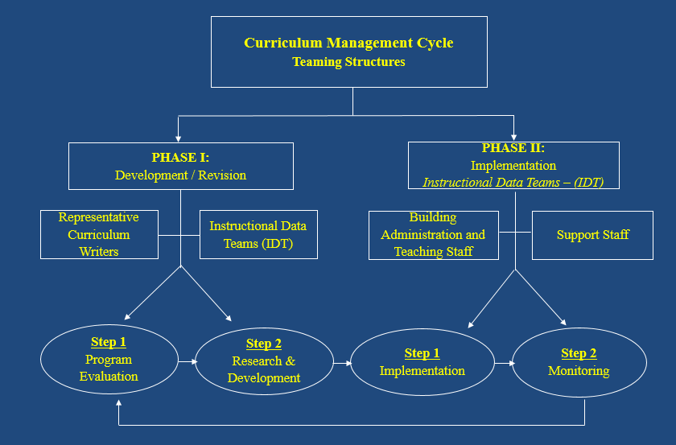

Slide 17
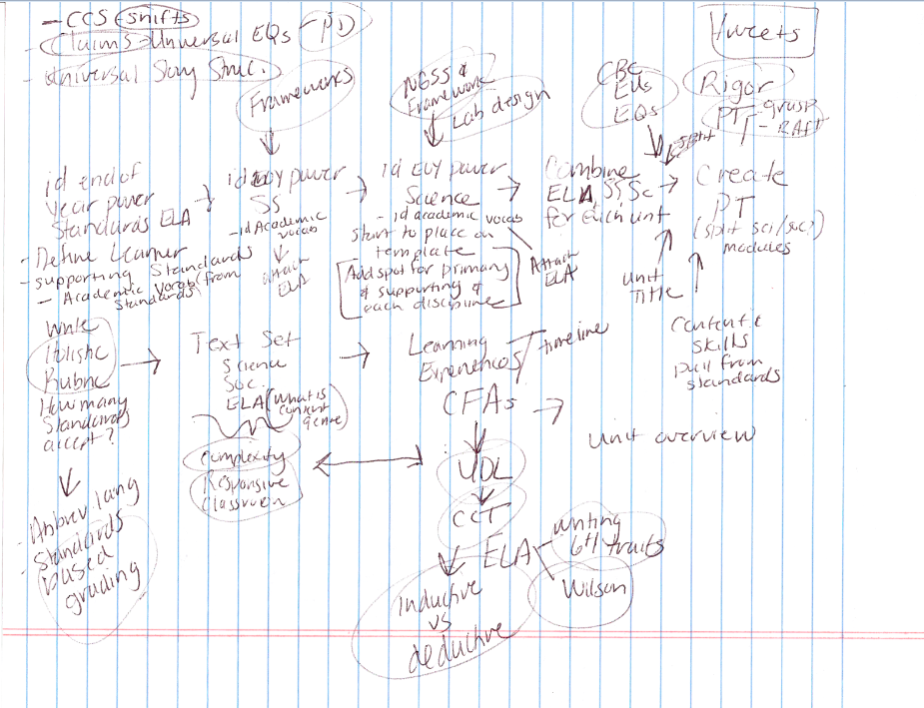
Interdisciplinary Curriculum Writing Process

Slide 18
CCS
CT SS Framework
NGSS
Lab/Engineering Design
CELP
K-3 SEI
Rigor/DOK
GRASPS/RAFT
AET, SB
Identify EOY ELA
Power Standards
-Define Learner
-Add supporting standards
-Pull Academic Vocab
from standards
-Write EUs/EQs
Identify EOY SS
Power Standards
-Define Learner
-Add supporting standards
-Pull Academic Vocab
from standards
-Write EUs/EQs
Identify NGSS Standards
-Pull Academic Vocab from
standards
-Write EUs/EQs
Embed Additional Standards
-Vocab for the ELL
-Academic behaviors
Create Performance Assessment and CFA(s)
-End of module PA
-Evaluate with AET
Abbreviated Language
Standards-based Grading
Text Complexity
Culturally Responsive
UDL
CCT
Text-dependent Questions
Inductive/Deductive
Implement
Monitor
Develop
Create Holistic Rubric
-Consistent template
Identify Text Set
-Science
-Social Studies
-ELA
Learning Experiences
-Timeline
-Resources
-Differentiation
-Targets/criteria
-Lesson Design
Unit Overview
6+1 Writing Traits
(Wilson Fundations
Science Kits

Slide 19
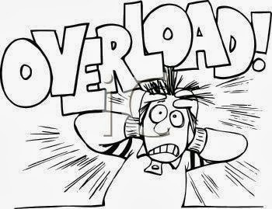


Slide 20
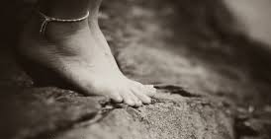
“If I had only focused on how far I had to go then I might have been overcome with doubt. In many ways that’s what we’re doing here at school too…unsure of where the road might lead us on the way to our goal, but at some point you just need to take that first step, and keep on going with a belief and a trust that you’ll get there.” -Connected Principals

Slide 21
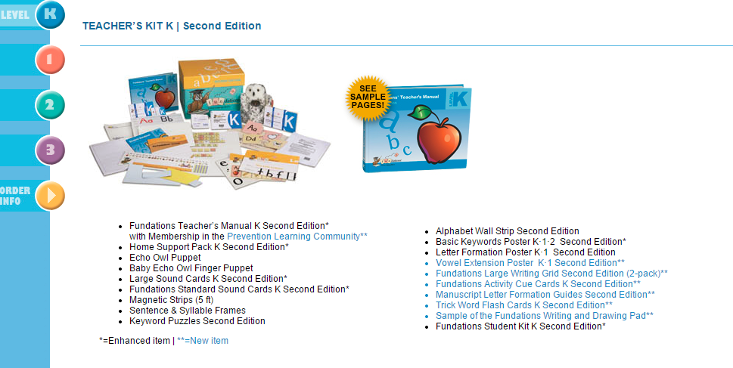
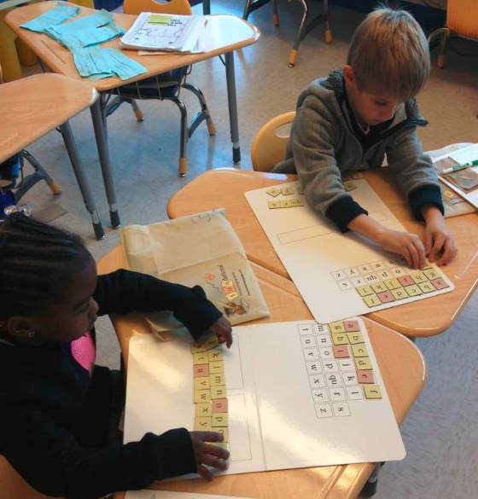
Fundations K-2 (replaces scope & sequence)
*Separate block from the Unit (lessons paced in unit timeline)

Slide 22
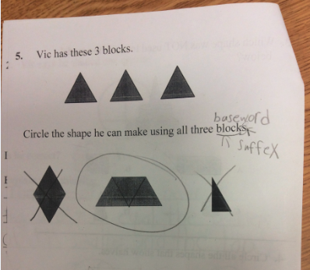
Grade 1 District Math Assessment

Slide 23
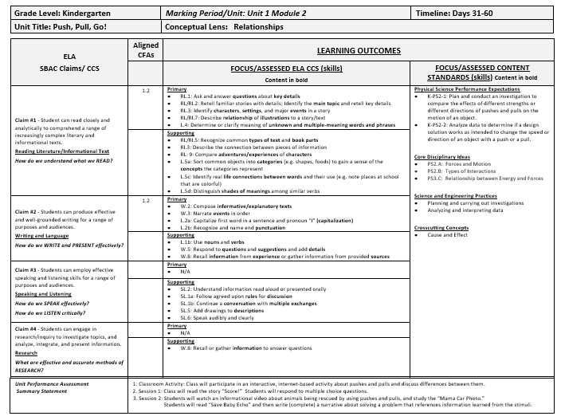
New Templates K-12
CCS ELA Primary &
Supporting
Standards/skills
SS or NGSS with CELP & K-3 SEI
Standards/skills
SBAC Claims
Web
Content in Bold

Slide 24
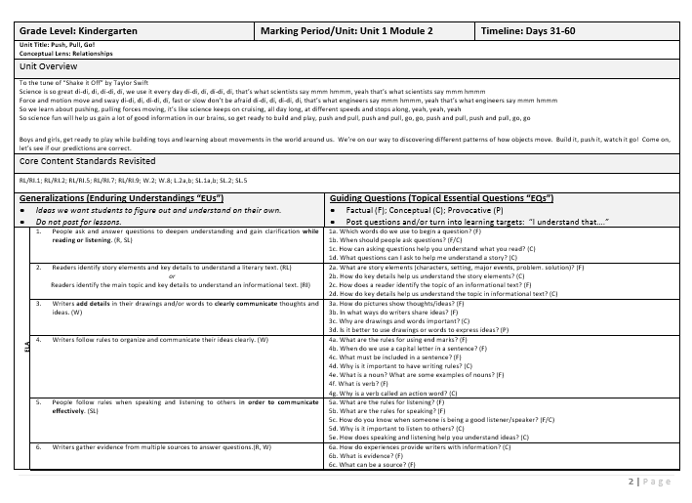
Enduring Understandings
Essential Questions

Slide 25
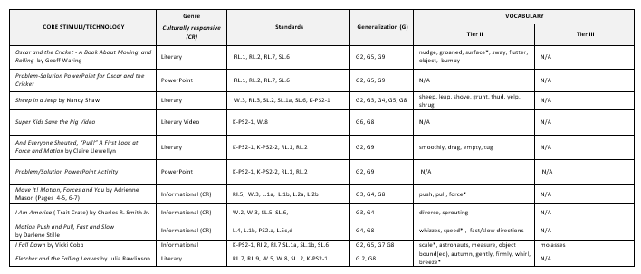
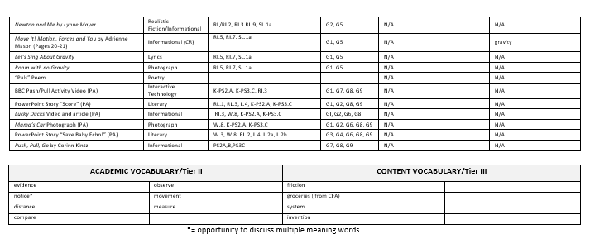
Core Stimuli/
Technology
Enduring Understandings
Vocabulary
Genre
(Culturally Responsive)
Standards
Additional Vocabulary

Slide 26
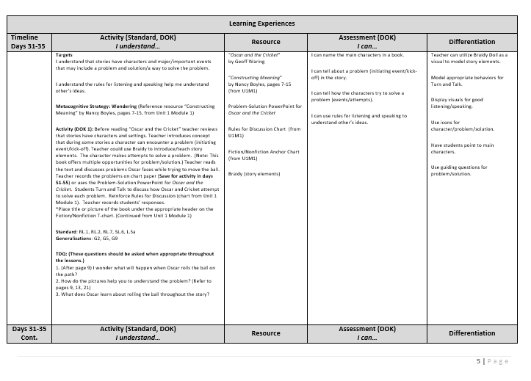
Learning Targets (CCT)
Resource
Assessment
(Criteria “I Can”, CCT)
Differentiation
Metacognitive Strategy
Activity & DOK
Standard/
Enduring Understanding
Text-Dependent Questions

Slide 27
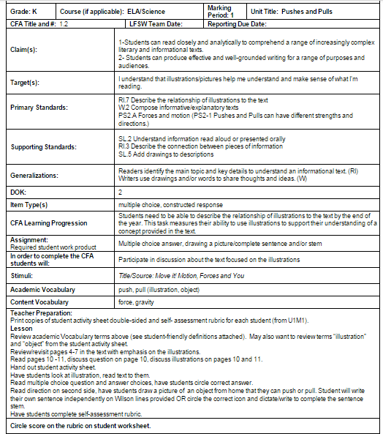
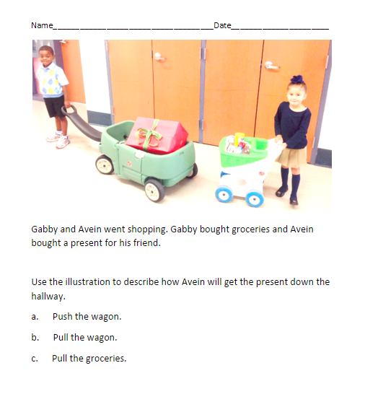
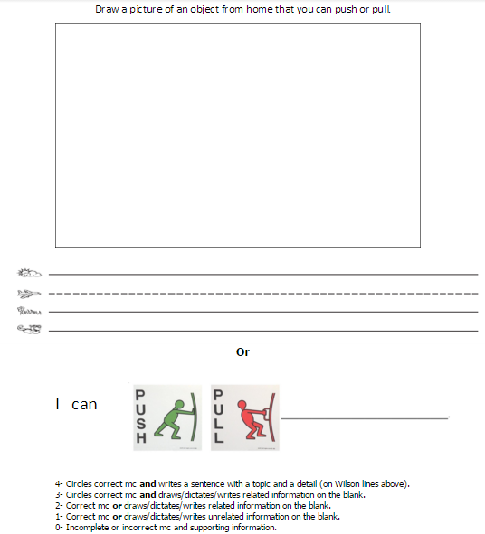
Common Formative Assessment

Slide 28
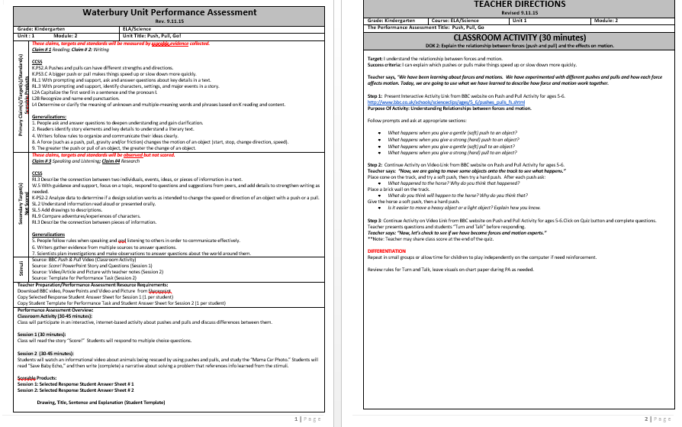
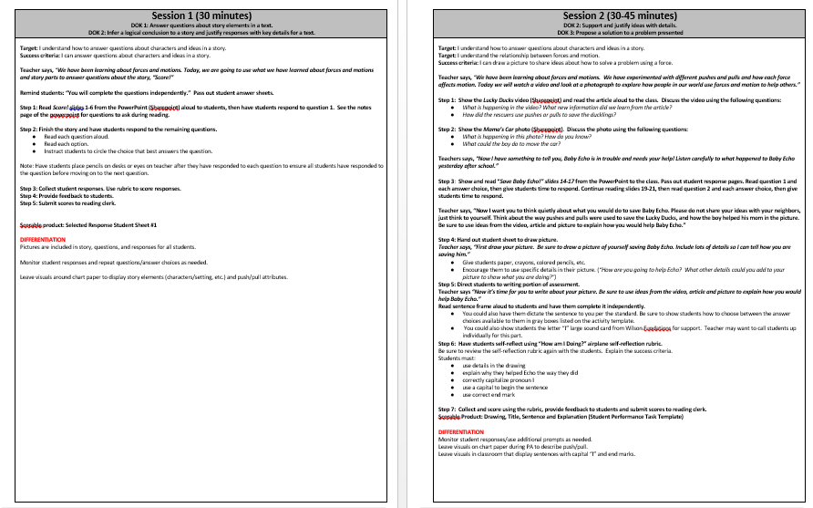
Performance Assessment

Slide 29
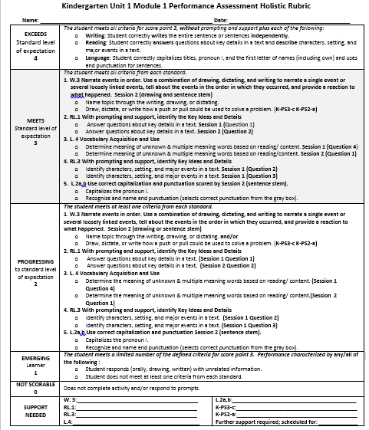
Performance Assessment Holistic Rubric

Slide 30
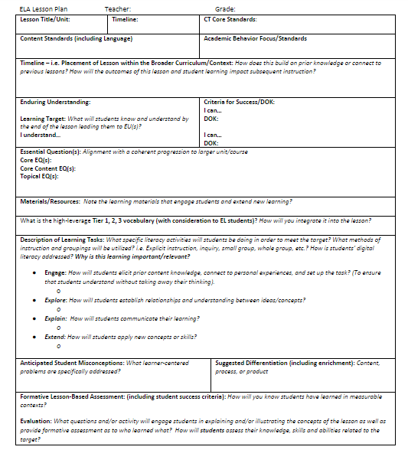
Lesson Design (CCT)

Slide 31
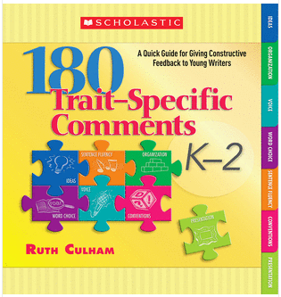
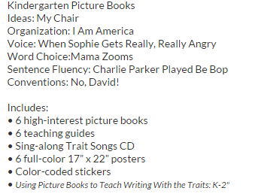



The Trait Crate (writing resource)

Slide 32

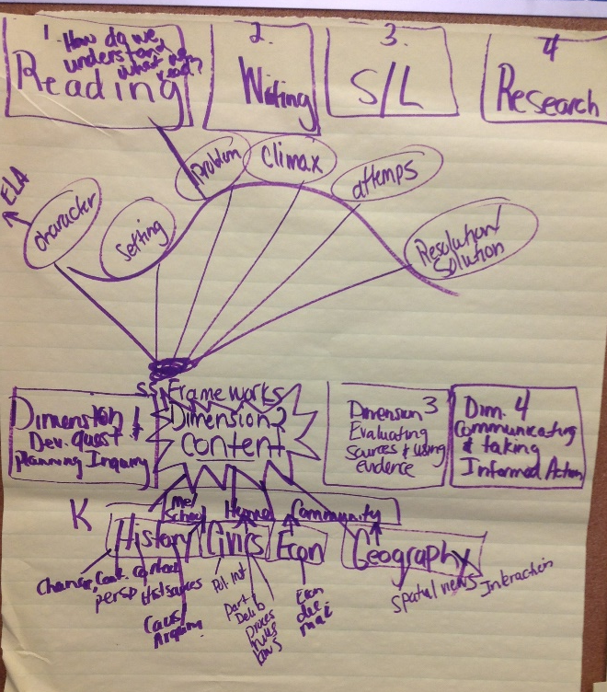
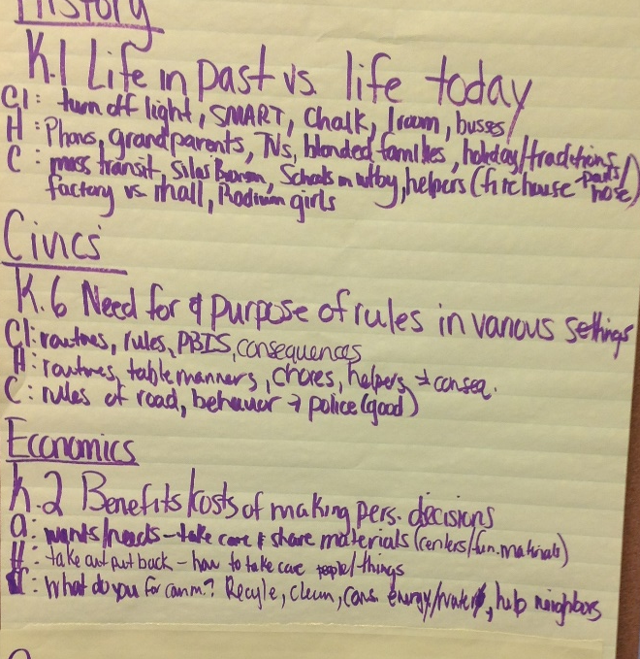

Slide 33

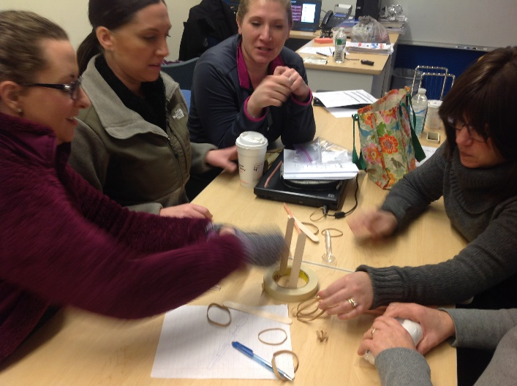
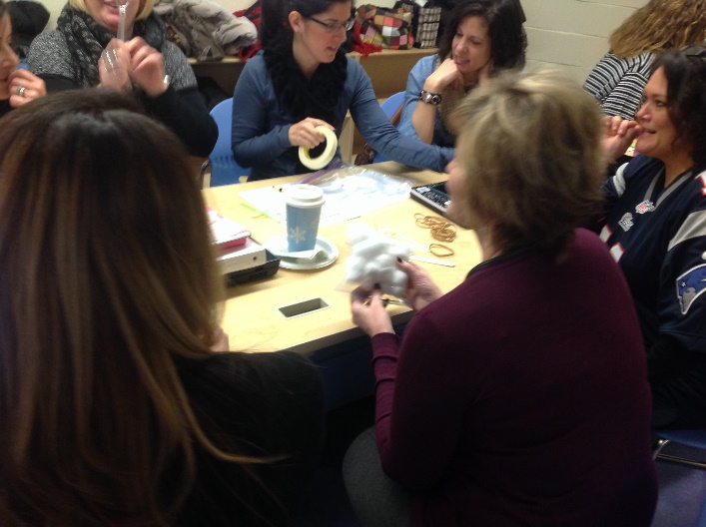
Next Generation
Science Standards

Slide 34

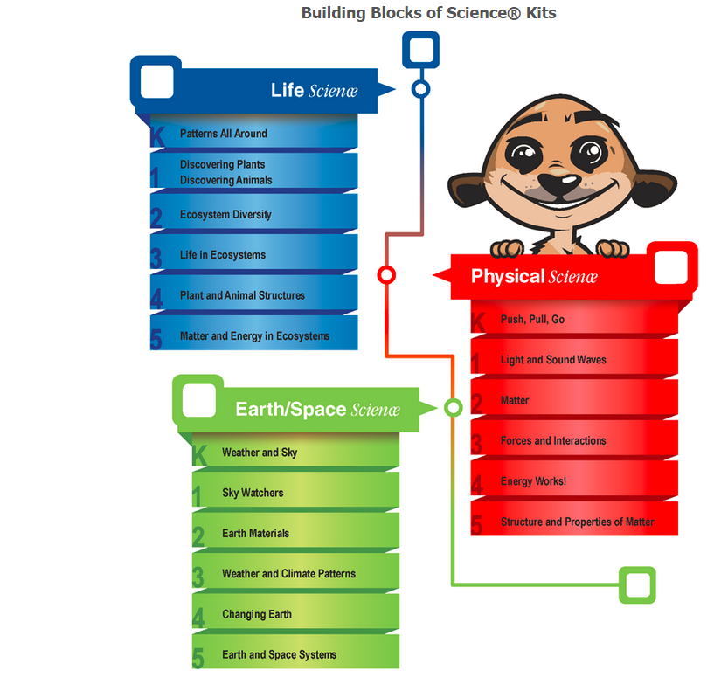
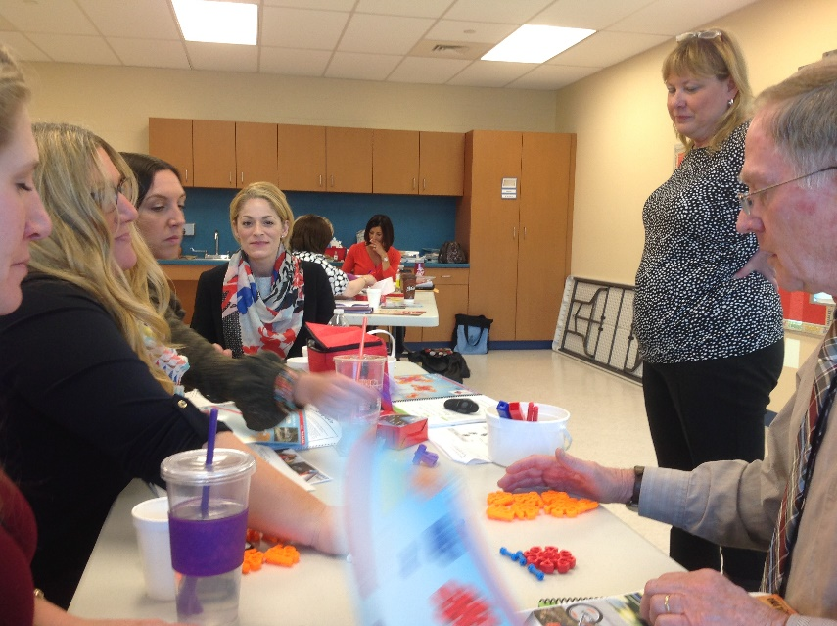

Slide 35
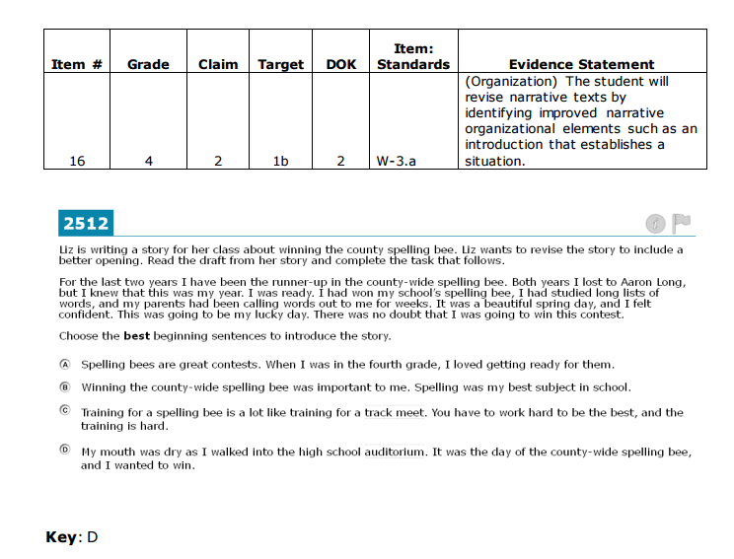
Grade 4 Practice Test Scoring Guides
Smarter Balanced Practice Tests and Info

Slide 36
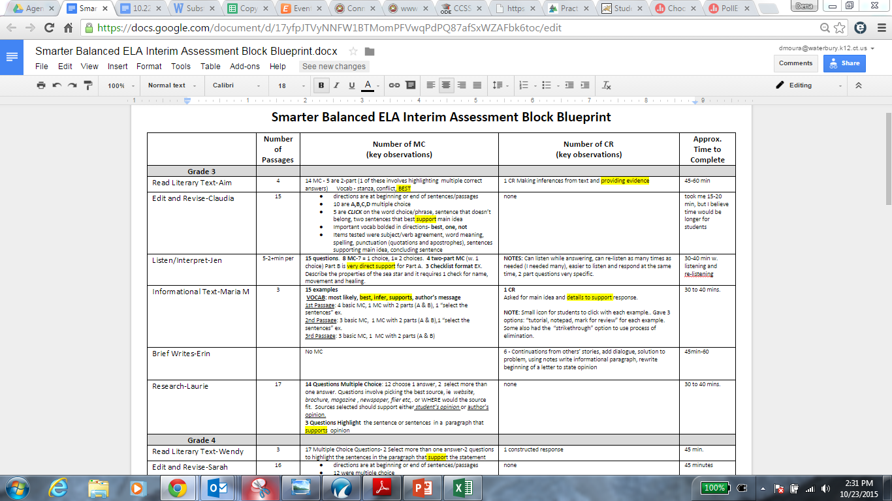
Google Drive!!

Slide 37
July 2010-Present
July 2010
CCSS Adopted by CSDE
August 2012
Shifts
Deconstructed Standards
DOK
January 2013
Concept-Based Curriculum Written
August 2013
Concept-Based Curriculum Implemented
September 2013-June 2014
CT Systems of Professional Learning
EQuIP
Text Complexity
Text Dependent Questions
Close Reading
September 2014
Used Equip
Curriculum Management Cycle
Revised Templates
New standards (multidisciplinary)
August 2015-
Present
Standards-Based, Concept-Based units developed, implemented, monitored
Google Drive
Implement
Monitor
Develop
PD

Slide 38
What is the data telling us?

Slide 39
SB ELA Baseline 2015

Slide 40
Unit Development Criteria Scores
EQuIP

Slide 41
mCLASS Composite Scores

Slide 42
Action Steps 2015-16
STANDARDS, STANDARDS, STANDARDS!!
Exposure: question types (SBAC, SAT) =
  class work; common formative assessment; performance tasks; SBAC interim assessment(s)
Units of Study: grounded by rigorous performance assessment
CCT-Centric Lesson Design
K-12 Curriculum Mapping
Standards-Based Scoring Tools (rubrics tied to Claims, targets, etc.)
Reflection-in-Action (coaching cycles, learning from student work protocols, etc.)

Slide 43
Resources
“The Common Core K-5: Teaching Students to Meet the Reading Standards” by Maureen McLaughlin and Brenda Overturf
“Countdown to Common Core Assessments” by CTB/McGraw Hill
Survey Monkey (Send anonymous surveys to collect info/data)
  https://www.surveymonkey.com
Eventbrite (send invitations for PD and collect data)
  https://www.eventbrite.com/
Google Drive (Share documents; edit documents in “real time”)
  https://www.google.com/drive/
Poll Everywhere (Live polls using text or web)
  https://www.polleverywhere.com/
Smarter Balanced Practice Test Scoring Guides (professional learning)
  http://www.smarterbalanced.org/practice-test-resources-and-documentation/#scoring
CT Core Standards Library of Professional Learning (professional learning)
  http://ctcorestandards.org/?page_id=3794

Slide 44
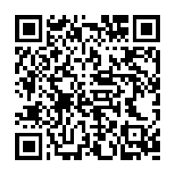
Questions?
Takeaways?
QR Reader for iPad – Free on App Store

Slide 45
Connecticut Core ELA: Waterbury’s Perspective
On Implementation Successes and Modifications
Dena Mortensen
Waterbury Public Schools
K-5 ELA Supervisor
dmoura@Waterbury.k12.ct.us

