Slide 1


Meeting the Challenge:
CT Core Standards Success for English Learners and Students with Disabilities
A Professional Learning Series for School Teams Dedicated to the Success of ALL Students
Module 4: Implementation and Sustainability

Slide 2
Essential Questions
What are the key areas that your team would like to address within your school?
How can you develop a clear vision that will be achieved through implementation of your action plan?
How can a better understanding of the change process ensure a more successful implementation?
Why will a communication plan be important to engaging all stakeholders in achieving your vision?
Notes:
These are the big questions that are the underpinning for today’s session. We are building upon our collective understanding of strategies to support all students including Students with Disabilities and English learners to create a vision and action plan that will ensure all students are successful within your school or district.

Slide 3

Module 4 Session Agenda
Implementation and Sustainability
  Sharing Successes and Challenges
  Creating the Vision for Supporting All Students
  Challenge of Change
  Communication Strategies
  Reflection, Next Steps, and Session Evaluation
Notes:
Presenter shares the points on the slide.

Slide 4
You are Here! Introductory Activity
Introductory Activity
Part 1:
Building a Shared Understanding
Part 2: Developing a Vision for Your Action Plan
Part 3: Addressing Change
Part 5:
Reflection, Next Steps, & Session Evaluation
Part 4: Communicating the Plan
Notes:
Point out to participants that this module is composed of 5 parts and an introduction.

Slide 5

Introductory Activity: Pair and Share
Find a participant that you have not met.
Introduce yourself by sharing:
  School or District
  Current Role
  Modules Attended
Share something that you thought was useful that you brought back to your school.
Share a question you may still have.
Page 2
Notes:
As an ice breaker, ask participants to find someone they have not worked with or met and introduce themselves through the bullets on the slide.

Slide 6
You are Here!
Part 1: Building a Shared Understanding
Introductory Activity
Part 1:
Building a Shared Understanding
Part 2: Developing a Vision for Your Action Plan
Part 3: Addressing Change
Part 5:
Reflection, Next Steps, & Session Evaluation
Part 4: Communicating the Plan
Notes:
Part 1: Building a Shared Understanding

Slide 7

Looking Back… Building a Shared Understanding
Building a shared understanding of the modules from the Meeting the Challenge series will help team members to:
  Develop a framework from which to build upon
  Foster an understanding of the concepts from the modules
  Create a common language to support communication for the entire staff
“Clarity precedes competence.”
–Mike Schmoker
Notes:
Building a shared understanding of each of the modules content will be important to complete teams’ action plans. This slide leads into a review of module 1.

Slide 8
Reflecting On Academic Optimism and
Growth Mindset
Key messages from Module 1:
There is a substantial body of research that shows a school’s culture and climate has a broad impact on students’ learning and growth.
New programs, initiatives, or changes that are implemented will struggle to be successful if the school staff do not have the mindset to support the change.
Notes:
The next few slides review the key messages from academic optimism and growth mindset.

Slide 9
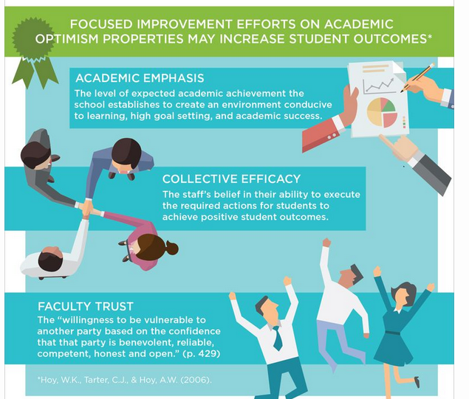
Revisiting Academic Optimism
Academic Optimism is a set of beliefs for building school success.
Based on three tenets:
  Academic Emphasis: Having high expectations for all students
  Collective Efficacy: Believing in each other as a faculty to achieve your goals
  Faculty Trust: Building a trusting relationship between teachers, parents, and students
Notes:
Academic Emphasis: Academic achievement is important
Faculty Trust: Students and parents can be trusted to cooperate with teachers
Collective Efficacy: A school-wide confidence that students will succeed academically
Note that the three areas are connected. They are all of equal importance.
Remind participants that the three important dimensions collectively produce a potent academic environment that positively influences school achievement.

Slide 10

Revisiting Growth Mindset
Leads to a desire to learn and therefore students and adults:
  Embrace challenge
  Persist during setbacks
  See effort as a path to success
  Learn from criticism
  Find inspiration in the success of others
Notes:
Remind participants of the components of a growth mindset including:
Learning goals have shown an increase in performance and enjoyment and a decrease in negative emotions.
Effort is connected to success, not a barrier for both students and adults.
By supporting new ways of thinking, you are building a culture of academic optimism in classrooms and throughout the school.

Slide 11
Activity 1: Building a Shared Knowledge and Understanding of the Meeting the Challenge Modules
Using a Jigsaw to Build Common Understanding
Team members will select a representative from each team to join the following groups: Module 2: EL; Module 2: SwD; Module 3: EL or Module 3 SwD. In your module groups, review the handout and list the key learnings and big ideas from the module. Include ways that your schools can incorporate the research, strategies, and suggestions into all classrooms. Share any successes or challenges that might have occurred already. Rejoin your school team and share with team members the information gained from each module. Come to a consensus on which ideas should be incorporated into your plan.
Page 4
Notes:
Review the activity. Provide 30 minutes to complete. Focus your discussion on the prompt: Based on the module series, what changes should be made to support ALL learners in our school or district? Ask participants to report out some of their discussions.

Slide 12

Putting the Pieces of the Puzzle Together
Think back on the plans you made for building a Culture of Academic Optimism.
Consider: How will the plans fit together with the content gained from the other two modules?
Mindset
TPR
Strategies
Learner
UDL
Engagement
Variability
Adapting
Academic Optimism
Modeling
Notes:
This slide reviews some of the components from all three modules. Ask the teams to think about aligning and focusing their plans as they build out their action plan that they began in module 1.

Slide 13
You are Here!
Part 2: Developing a Vision for Your Plan
Introductory Activity
Part 1:
Building a Shared Understanding
Part 2: Developing a Vision for Your Action Plan
Part 3: Addressing Change
Part 5:
Reflection, Next Steps, & Session Evaluation
Part 4: Communicating the Plan
Notes:
Part 2: Developing a Vision for Your Action Plan

Slide 14


The Need to Develop a Vision and a Plan
“Failure to plan will damage the effectiveness of the organization and can even lead to complete break-down.”
–Fred Silver
“Stuck on an Escalator”
Notes:
This slide reviews the need to have a vision and a plan to ensure teachers are empowered to know what to do when they get stuck, rather than calling for help.
The team leading this change who is serious about a new initiative’s success need to take charge to enact a well thought out and articulated plan. Otherwise staff members will not know the direction and will wait for “help to arrive.” Unfortunately, there are many who want or even expect the road to success to be effortless, simple, and smooth – like riding an escalator. When their escalator breaks down, they start stressing out and waiting for help instead of having a plan developed that can help them to continue moving forward. We’ve all seen new initiatives get “stuck,” not being fully realized as was planned. The difference between changes that are successful and those that are not is that successful changes have a plan to address roadblocks and speed bumps so success can be realized rather than “stuck.” Obstacles are going to happen along the way, but they can become opportunities as long as there is a plan in place.
After participants watch the video, which is around 2 minutes, ask for how the video resonates with the participants.
https://www.youtube.com/watch?v=YQUAs3syuJE

Slide 15

Developing a Vision for Implementing Your Action Plan
Developing strong vision statements will help all staff reach a common understanding.
A vision is your school's goal—where you hope to see it in the future.
Notes:
This slide introduces vision as an important component of the action plan. Thinking about designing a plan based on the backward design model is helpful to ensure everyone is on the same page.
Remember that all schools/districts have current goals, or improvement plans. It is important to ensure that they are all aligned and focused to achieve your vision.

Slide 16
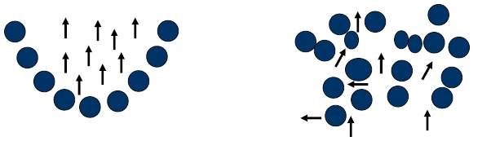
Why is it Important to Have a Vision?
Without a vision, your school or district lacks direction.
If you don't have a common, agreed-on destination, then everyone is left to do what they think is effective.
When staff’s efforts are unfocused or misaligned, everyone may be working hard, but results are not realized.
Working Towards Vision
Working in Different Directions
Notes:
A vision will define what your school will look like when achieving your goals. It will help the team to overcome obstacles and provide a direction when things get difficult. A vision that is well defined helps you focus and create a purpose that becomes your measurement for your success. Note that in the graphic, everyone is not in the same place, some are more ahead than others, but everyone is pointed in the same direction. Both scenarios take energy and effort, however, only one gets results.

Slide 17
Activity 2: Clarify a Vision for Your School’s Future
Creating a Shared Vision and Action Plan
Step 1: Desired Future: Discuss what high quality instruction should look like within your school. Project into the future (18 months, then 3 years) and describe what it looks like, sounds like, and feels like having accomplished your goals in your action plan. Step 2: Look “back” from your projected future and describe how it looked when you started (from today). Step 3: Connecting your Desired Future to the Beginning Past: Connect the Projected Future to the Beginning Past by explicitly answering “how” you moved your school from the past.
Pages
6-7
Notes:
Review directions for the activity. They will be developing a vision for 18 months and 3 years, and they will be incorporating their action plans into attaining their vision.
Allow 60 minutes for activity.

Slide 18
Clarify a Vision
Desired Future
18 months 3 years
Beginning Past December, 2015
How we got there

Slide 19

Let’s Take A Break…
…Be back in 10 minutes
Notes:
The break should be 10 minutes. Remind participants to try to be timely in their return.

Slide 20
You are Here!
Part 3: Addressing Change
Introductory Activity
Part 1:
Building a Shared Understanding
Part 2: Developing a Vision for Your Action Plan
Part 3: Addressing Change
Part 5:
Reflection, Next Steps, & Session Evaluation
Part 4: Communicating the Plan
Notes:
Part 3: Addressing Change

Slide 21

Addressing Change Within Your School
To achieve your vision, changes will be necessary
How your team addresses the change process is critical for success of the action plan
Notes:
After the break, discuss that a great vision and strong action plan will require changes for many staff members. In order to address change, the leadership team must begin to develop strategies to address the resistance that may become a barrier to achieving their goals.

Slide 22

Things to Know About Change
    Change is a process, not an event:
  Made by individuals first, then institutions
  Change is a highly personal experience:
  Entails developmental growth in feelings and emotions, as well as skills
  Personal concerns are legitimate:
  Normal to want to know how something new will affect you
  Successful innovations consider:
  People first and the innovation second; and
  Every person needs to be his or her own change agent
Notes:
Review slide. For a new program to succeed, it is critical to address the concerns of the people charged with implementing it. Staff may respond to change in many ways, from stress and anxiety to cynicism and burnout. The leadership team should identify staff concerns, understand they are legitimate and provide targeted support to help individuals cope and focus on the action steps outlined in the plan.

Slide 23
Frequent Responses to Change
“It takes a lot of time and new materials to teach this way.”
“I get very frustrated with the number of “new things” they expect us to do each year.”
“Sometimes I just sit back and listen since we all know this too shall pass.”
“Why should I
give up the activities and lessons that I’ve developed?”
“I’m more comfortable with what I’m used to doing.”
Notes:
Each quote comes on a click. Ask teams to discuss what they think will be some of the responses they may hear when they present the action plan.

Slide 24

Making the Vision a Reality – Addressing the Challenge of Change
Chip and Dan Heath’s Switch Framework Addressing Change:
  Direct the Rider
  Motivate the Elephant
  Shape the Path
Notes:
In Switch: How to Change Things When Change is Hard, Chip Heath and Dan Heath explain the change process in this way: “For individual behavior to change, you’ve got to influence not only their environment but their hearts and minds.” To explain their ideas, they offer the metaphor of an elephant with a rider, with the intellect represented by the rider and emotions by the elephant. The rider plans and directs; the elephant provides the energy. They extend the metaphor by including “the path,” the situation or environment in which the rider and elephant find themselves. The team’s role is to guide the changes needed while implementing the action plan through clarity of purpose and direction, motivate the elephant by engaging people’s emotions, and “shape the path” to enable the desired performance.

Slide 25
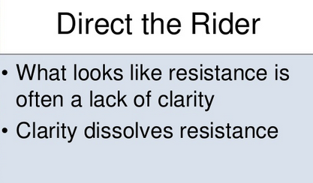

Direct the “Rider”
Follow the bright spots
Script the critical moves
Point to the destination
Notes:
Direct the Rider: Heath brothers say what looks like resistance is usually a lack of clarity. If the rider doesn’t know where to go, they spin the Elephant in circles. To direct the rider, create a crystal clear vision of the outcome. This includes when or how much, along with a specific set of actions and tactics to get there. Important actions should be clearly outlined or scripted to ensure the implementation, PD, or other actions meet your expectations.
Ask teams to discuss what areas of their action plan may need to have the critical moves scripted.

Slide 26
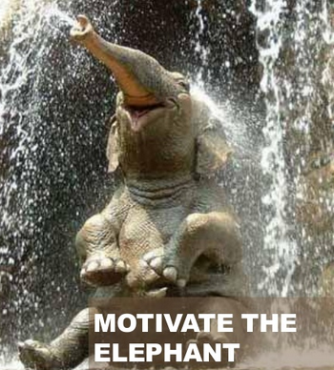

Motivate the Elephant
Find the feeling
Shrink the change
Grow your ‘people’
Notes:
Motivate the Elephant: What looks like laziness is often exhaustion. Help the staff feel the need for change; emotions or personalization is important. Analytical appeals don’t cut it. Knowing is not enough. Get beyond the knowing and make it possible for people to feel the impact. Win the heart and the mind follows.
What will motivate your staff?

Slide 27

Shape the Path
Tweak the environment
Build habits
Rally the herd
Notes:
Shape the Path. What looks like a people problem is often a situation or an environment problem. Make it easy to embrace the change. Make instructions simple with step-by-step guidance. Provide supports. Create quality professional development. Pair struggling staff members up with early adopters. Create positive peer pressure. Success breeds success.
What habits need to be built to reach your vision?

Slide 28
Activity 3: Addressing Change Within the
Action Plan
Identify the Strategies to Support the Vision
Review the Switch Framework on page 10 of the Participant Guide. Reflect on each of the three areas and determine what strategies should be in place that meet the intellectual, emotional, and environmental issues of all staff to ensure that the changes necessary to implement the action plan will be successful. Place the strategies into the Action Plan Template handout. Be ready to share out with the large group.
Pages
9-10
Notes:
Introduce the activity on the slide. Answer any questions. Provide 30 minutes for this activity.
Remind participants that they may not have the right people in their group to enact the changes that they may need. If teams do not have the capacity within their team, who at your school will drive the change. Getting the right people on board may need to be the initial focus of your plan. Be realistic in how you will address the needs.

Slide 29
You are Here!
Part 4: Communicating the Plan
Introductory Activity
Part 1:
Building a Shared Understanding
Part 2: Developing a Vision for Your Action Plan
Part 3: Addressing Change
Part 5:
Reflection, Next Steps, & Session Evaluation
Part 4: Communicating the Plan
Notes:
Part 4: Communicating the Plan

Slide 30

Making Communication a Priority Within
Your Plan
With all the new initiatives, communication does not have the priority status it needs
Paying attention to building relationships with our stakeholders will ensure support and trust that we are making good decisions in the best interest of the students and the community
Relationships built through strong communication provide long-term sustained support for our schools and districts
Notes:
It is important to understand the principles of implementing effective communication and its key role in the success of the action plan. When planning communication strategies, it is also important to dig deeper and consider specific details necessary to create the precise messages that will develop a shared understanding for all the stakeholder groups. Stakeholder groups for your school or district may include professional staff, support staff, students, parents, community groups, central office staff or other administrators, and school board members depending on the size of your district.

Slide 31
Principles of Effective Communication
Planned
Concise
Clear
Relevant
Constant
Notes:
Review each of the five principles of effective communication. The principles should be considered when designing a communication plan.
Planned: Plan out your communication strategy. Having an explicit plan leaves nothing to chance. All your stakeholders will understand the changes in process which will provide less opportunity for inaccuracies to become pervasive throughout your school.
Concise: Keep messages concise. Putting too much information in an email or notice increases the chances that the message being communicated will not be read in its entirety. Too much text lends itself to skimming and scanning, not reading for complete understanding.
Clear: Ensure messages are clear. Asking more than one staff member, both members and non-members of the leadership team, to read the message before it is disseminated to all stakeholders is critical. Sending messages that are not clear will not support the on-going changes, but rather hinder progress.
Relevant: Keep the messages relevant. Use the opportunity to adhere to the central tenets of the transition, rather than adding other non-essential information to the message. If stakeholders understand that the communications are purposeful, they will be more willing to dedicate the time to reading the communication each time it is disseminated to the stakeholders.
Constant: Plan a schedule to send out communication. Determine the different ways that information will be shared with various stakeholders. Keep communicating; with so many changes happening, it is impossible to over communicate. Stakeholders will appreciate being kept informed.

Slide 32
Communication Opportunities
Develop communication system through identified ambassadors
Provide staff updates through email or other tool
Build two-way communication into each meeting
Notes:
Make sure your people know what is going on. It's demoralizing to hear about what's happening where you work from someone outside the system.
Don't forget your support staff, research indicates that they are the most important communicators/public relations specialists you have in your district.
Keeping staff informed can be done through:
Staff Newsletter which includes ongoing updates regarding status
Recognition for those involved in a new initiative
Focus groups: building/staff/department meetings
Solicitation of input on mission, belief statements, vision
Feedback loop built into scheduled meetings

Slide 33
Considerations When Communicating New Initiatives
Anticipate
Anticipate how people will react, the questions they'll raise, and the issues that may result
Design the communication to address the concerns immediately
Key Communicators
Key communicators identified by the team should keep staff up to date regularly
Resistors
Resistors will be present. Expect the change or new initiative to have resistors or detractors, appreciate their point of view
Design
Notes:
These are important considerations as participants think about how they plan to message out their vision and action plan (steps) to get there.
Review the 8 indicators on this slide and the next.

Slide 34
Considerations When Communicating New Initiatives
Listen
Listen to what people have to say and encourage their participation
Solicit ideas and topics to communicate to ensure concerns are addressed immediately
Be Direct
Be direct in stating the change and explaining the rationale in relation to the overall goals you wish to achieve
Keep Communicating
Keep communicating about the change after it has been made – recognize and celebrate its successful implementation
Solicit Ideas
Notes:
Review slide.

Slide 35
Activity 4: Identifying Communication Strategies
Creating Communication Strategies for Your Plan
Using the Communication Plan Template handout, think about the major components that should be communicated throughout the school year regarding your vision and action plan. Decide on key messages, method of communication, and frequency of communication needed to gain support for the changes you propose. What questions or concerns do you have regarding your communication strategies? Who will need to be part of the plan? What will be their role?
Page 12
Notes:
Introduce the activity on the slide. Answer any questions. Provide 30 minutes for this activity.

Slide 36
You are Here!
Part 5: Next Steps
Introductory Activity
Part 1:
Building a Shared Understanding
Part 2: Developing a Vision for Your Action Plan
Part 3: Addressing Change
Part 5:
Reflection, Next Steps, & Closing Activity
Part 4: Communicating the Plan
Notes:
Part 5: Reflection, Next Steps, and Closing Activity

Slide 37

Activity 5: Next Steps
What are some of the Next Steps you will need to do to ensure the action plan is successfully implemented?
With whom in your school or district do you need to share your action plan?
What will you do as a team within the next few weeks to begin to meet your goals 18 months from now?
Page 14
Notes:
Ask each team to come up with Next Steps in the upcoming weeks to ensure success. After they discuss as a team, ask a spokesperson to share with the rest of the group.

Slide 38
Session Evaluation
Thank you for attending Module 4’s session, Implementation and Sustainability.
Your feedback is very important to us! Please fill out a short survey about today’s session.
The survey is located here: http://surveys.pcgus.com/s3/CT-Module-4
Notes:
Remind participants to complete the online Session Evaluation. The survey is located here: (add link)
Ask for further thoughts, questions.

Slide 39





Additional Resources
Center for Applied Specialized Technology
www.cast.org
Connecticut Core Standards
http://ctcorestandards.org/?page_id=7773
National Center for Universal Design for Learning
www.udlcenter.org
Maryland Learning Links
http://marylandlearninglinks.org/1021
Notes:
Share these resources with participants.

Slide 40
Thank you!

