Slide 1


Connecticut Core Standards for Mathematics
Systems of Professional Learning
Module 4 Grades 6‒12:
Focus on Designing Learning
Notes:
(Slides 1–5, including the Pre-Assessment, will take about 10 minutes total.)

Slide 2

Focus on Designing Learning
By the end of this session you will have:
  Strengthened your working relationship with peer Core Standards Coaches
  Explored the structure of the Standards and the Progressions documents on which the Standards were developed
  Created effective learning targets for use in planning lessons
  Described a process and strategies for conducting information needs assessments in order to identify student needs
Notes:
Review the outcomes for the day, sharing what you hope to accomplish throughout the full day session. There are seven outcomes for this session. These are presented to the participants over two slides.

Slide 3
Focus on Designing Learning (cont'd)
By the end of this session you will have:
  Identified elements that need to be considered when designing and implementing CCS-Math lessons
  Designed and/or modified CCS-Math lessons in order to meet the needs of all students
  Made plans for next steps in your CCS-Math implementation
Notes:
Review the outcomes for the day.

Slide 4

Today’s Agenda
Morning Session
Welcome and Introductions
Sharing Implementation Experiences
Creating Learning Targets
Identifying an Entry Point into the Mathematics
Afternoon Session
Designing CCS-Math Lessons
Reflecting on the Lesson Design
Supporting Teachers
Post-Assessment, Session Evaluation, & Wrap Up
Notes:
Review the agenda letting participants know that this is the pathway they will travel in order accomplish the seven outcomes discussed earlier. Note that in addition to the break for lunch, there will also be shorts breaks throughout the day, but participants should feel free to take a personal break as needed. Emphasize the importance of coming back from lunch and breaks on time to ensure enough time to complete all the work of the day.

Slide 5


Introductory Activity:
Pre-Assessment – CCS-Math
Please complete the Pre-Assessment
Page 4
Notes:
This will be a short self-assessment found in the Participant Guide on page 4. It will assess where the coaches are now with understanding UDL and the formative assessment process introduced in Module 3, and assess where they are in how to create learning targets and design CCS-Math lessons. The participants will complete the same assessment at the end of the session. Allow 3–4 minutes to complete.

Slide 6
Sharing Implementation Experiences
Section 1
Page 6
Notes:
Section 1: Sharing Implementation Experiences
Section 1 Time: 30 Minutes
Section 1 Training Objectives:
To review the key ideas developed in Modules 1‒3.
To share, discuss, and address experiences with, and common challenges of, supporting teachers in implementing the Standards for Mathematical Practice and Standards for Mathematical Content.
Section 1 Outline:
The facilitator will begin by quickly reviewing the key ideas developed in Modules 1‒3.
Then, in groups, participants will share and discuss ideas and goals for working with teachers around the CCS-Math. Participants identify positive highlights, generate questions, identify areas of teacher need, and share possible avenues for meeting those needs. All ideas and questions will be recorded on chart paper so that common themes and additional strategies can be discussed as a large group. Participants can record new ideas on the worksheet Moving Forward with the CCS-Math.
The facilitator will wrap up Section 1 by explaining that to build upon their knowledge and experience with the CCS-Math thus far and to provide additional strategies for working with teachers, participants will begin to explore key elements and methodologies for designing CCS-Math learning experiences and important strategies for working with and providing support for teachers.
Supporting Documents
Moving Forward with the CCS-Math
Materials
Chart paper
Markers

Slide 7
Module 3 Review
In Module 3 you:
  Articulated a common understanding of UDL.
  Identified the importance of incorporating UDL Principles into lessons.
  Described the alignment of instructional practices and learning expectations of the CCS-Math.
  Planned for implementing UDL strategies within classroom lessons.
Notes:
Review the first four objectives of Module 3. As you quickly go through slides 7‒9 you will support these outcomes with key slides from the Module 3 PowerPoint.

Slide 8


Universal Design for Learning (UDL)
UDL is a set of three principles developed for providing all individuals equal opportunities to learn.
Principle 1: Provide Multiple Means of Representation
Principle 2: Provide Multiple Means of Action and Expression
Principle 3: Provide Multiple Means of Engagement
CAST (2011)
Notes:
Universal Design for Learning
Begin the review by reminding participants that Universal Design for Learning (UDL) is a set of three principles that were developed by CAST with the goal of providing all individuals equal opportunities to learn. Quickly review each principle:
Principle 1 focuses on recognition tasks that include how students gather facts and categorize what they see, hear, and read.
Principle 2 focuses on planning and performing tasks that include how students organize and express ideas.
Principle 3 focuses on how learners get engaged, stay motivated, and includes how students are challenged, excited, or interested by learning. Each of these are effective dimensions and work to provide the “why” of learning. The teachers’ role here is to design learning that stimulates students’ interest and motivation for learning.

Slide 9
Key Points About UDL
Universal Design for Learning Principles include guidance on:
  Providing flexibility;
  Reducing barriers;
  Providing appropriate accommodations, supports, and challenges; and
  Setting expectations for all students.
AND…..
CAST (2011)
Notes:
Key Points About UDL
Summarize the information on the slide and remind participants that these key points help to provide the broader lens for each of the three UDL Principles.

Slide 10
Key Points for Getting Started with UDL
UDL can support teachers’ implementation of the CCS-Math Standards.
The strategies that have been discussed for implementing the CCS-Math Standards overlap with the strategies that can be used to meet the UDL Principles.
Think about, plan for, and implement the UDL Principles strategically.
Begin with those that will have the greatest impact on YOUR students.
Notes:
Key Points for Getting Started with UDL
Review the four points on the slide.
UDL can support teachers’ implementation of the CCS-Math Standards. They should see UDL as a way to teach the CCS-Math Standards to all students, not as something separate that needs to be implemented.
The strategies that have been discussed for implementing the CCS-Math Standards parallel the strategies that can be used to meet the UDL Principles. They will want to bring out, just as was done during the discussion of each of the UDL Principles, the connections to work that has already been covered on implementing the CCS-Math Standards as this will help to clarify the relationship between UDL and the CCS-Math implementation.
Think about, plan for, and implement the UDL Principles strategically. This idea is important in that teachers may feel overwhelmed at the idea that there are nine guidelines with thirty-one checkpoints. The goal is not for the checkpoints to become a list of “things” that a teacher does, but that they should be used to provide the flexibility and options as described in order to meet the needs of their students. Every lesson will not call for every checkpoint to be addressed.
Begin with those that will have the greatest impact on YOUR students. As they work with teachers on incorporating UDL Principles, participants will want to help teachers examine their lessons, learning targets, and the needs of their students to determine which checkpoints will be used as a guide for planning their mathematics instruction. Learning targets are important here because, participants will need to make sure that teachers understand that the strategies they choose to implement may differ depending on the learning target. They will also want to keep in mind teachers’ readiness levels and help them choose the checkpoints and associated strategies that will have the greatest impact on their students’ learning and those that teachers can easily manage. These beginning strategies can be used as a foundation for further strategy introduction later on as teachers get more comfortable with UDL and the CCS-Math Standards themselves.

Slide 11
Module 3 Review
In Module 3 you:
  Developed a shared understanding of the four attributes of the formative assessment process.
  Reflected on the role of students in the formative assessment process.
  Explored strategies for supporting teachers as they make changes to their classroom practices.
  Made plans for next steps in your CCS-Math implementation.
Notes:
Go over the four outcomes covered in the second half of Module 3.

Slide 12

What are your goals for assessment?
Assessment OF Learning
Assessment FOR Learning
Notes:
Remind participants that they reviewed the differences between assessment OF learning (summative) and assessment FOR learning (formative). Ask participants for examples of both before moving on.

Slide 13
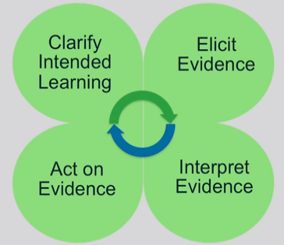
Formative Assessment: Four Attributes
(SBAC)
Notes:
Ask participants to give key points as an overview of the four attributes of the formative assessment process.
Key points to provide if not given by participants include:
Clarifying Intended Learning: The purpose of clarifying intended learning is to help students and teachers understand the expectations and goals for their work together through clear learning targets and success criteria.
Elicit Evidence: Evidence of learning can be elicited in a variety of ways. It can be planned for or done spontaneously and informal assessment activities can be conducted by the teacher, by peers, or may involve self-reflection by the student.
Interpret Evidence: Once evidence is elicited, it must be interpreted to determine where students are in relation to the learning target and success criteria. Gaps or misunderstandings in student’s prior knowledge may be discovered. Instructional plans may need to be adjusted. Interpreting evidence is not just the job of the teacher. Students and peer groups can engage in their own learning by having opportunities to interpret their own evidence.
Act on Evidence: Students and teachers act on the interpretation of the evidence. Teachers provide timely, descriptive feedback that is actionable. The best feedback helps students see where they are in relation to the learning target, and then provides hints or suggestions to act on. It puts “the ball back in the student’s court.” Teachers need to set aside the time for students to reflect on and act on the feedback.
The cycle continues as shown by the arrows in the center.

Slide 14
Key Strategies Focusing on Students’ Role in the Formative Assessment Process:
Activating students as learning resources for one another
Activating students as owners of their own learning
Wiliam. D. (2011)
Notes:
Finally, review the two strategies that were discussed for engaging students in the formative assessment process. Mention the connection between these strategies and Connecticut’s “Common Core of Teaching” (http://www.sde.ct.gov/sde/cwp/view.asp?a=2618&q=320862) in which student ownership of learning is clearly an expectation and has ties to teacher evaluation.

Slide 15

Sharing Implementation Experiences:
CSS-Math
Positive Highlights
Sharing Implementation Experiences
Each participant will discuss with their table group one positive highlight, one question that they have as coaches, and one ongoing need for teachers from their personal implementation of the CCS-Math thus far.
Each table group will then determine two positive highlights, two questions, and two ongoing needs that they will present to the larger group.
Participants will record notes and “New Ideas” generated from the discussion.
Questions
Ongoing Needs
Pages
6-7
Guide Pages 8-9
Notes:
Now that you have quickly reviewed the key points from Module 3, ask participants to now reflect on the work that they have done back at their school, in their role as a Core Standards Coach, with helping teachers learn more about and implement the CCS-Math. Have each participant discuss with their table group one positive highlight, one question that they have as coaches, and one ongoing need for teachers from their personal implementation of the CCS-Math thus far. Each table group will then determine two positive highlights, two questions, and two ongoing needs that they will present to the larger group. They can record notes from their discussion on page 6 in the Participant Guide.
As table groups present, record the participants’ responses on the chart paper titled Positive Highlights, Questions, and Ongoing Needs. After all groups have presented, summarize what has been charted and then ask the large group if anyone has an answer for any of the questions and/or a solution for meeting any of the ongoing needs. Encourage participants to record “New Ideas” on page 7 in the Participant Guide.
Wrap up the activity by explaining that the questions and ongoing needs will be revisited periodically throughout the day.
Transition to the next activity by explaining that participants will now begin to focus more deeply on designing CCS-Math lessons and that they will now look at the first step in that process, creating learning targets.

Slide 16
Creating Learning Targets
Section 2
Page 9
Notes:
Section 2: Creating Learning Targets
Section 2 Time: 120 minutes
Section 2 Training Objectives:
To understand the structure of the Standards.
To explore the information provided within the Progressions documents.
To examine the connection between the major work of the grade and lesson level learning targets.
To create learning targets from the mathematics of the Standards and the information provided in the Progressions documents.
To go deeper into the specific content and practice objectives that students should reach in their learning.
Section 2 Outline:
(40 minutes) Section 2 will begin with participants focusing on the understanding that teachers’ ideas about what is taught in lessons will change as they implement the CCS-Math. They will explore and discuss the overall organization of the Standards and why there is a difference in the organization between middle and high school. Participants will read page 1 of The Structure is the Standards, by Phil Daro, Bill McCallum, and Jason Zimba, to gain a context for the reason why the Standards were not written at the individual lesson level.
(20 minutes) Participants will gain a deeper understanding of the structure of the Standards by reading page 2 of The Structure is the Standards and by reviewing the Draft front matter of the Progressions document in order to see the connection between the structure and the coherent progressions upon which the Standards were developed.
(30 minutes) Participants will explore the CCS-Math in order to critically examine the information contained within the Progressions Documents and to understand how that information can be used to create learning targets. Participants will use this information as they practice constructing learning targets for the lessons that can be used as the general entry point into the mathematics of an identified grade level critical area. The hands-on practice segment of this section will involve participants working in small groups to:
Identify a grade level critical area and its supporting key ideas, cluster heading(s), and supporting standard(s);
Use the mathematics described within the Standards and the information within the corresponding Progressions document to create learning targets for the lessons. Targets will be constructed using a planning template that requires participants to think about the objectives in such a way as to ask themselves, ‘if I want my students to be able to ________________, then students will ___________________’. Each group will then prepare a poster of their work.
4. (25 minutes) Participants will engage in a gallery walk during which they will:
share their work;
review the work of others; and
post (by using sticky notes) questions and/or suggestions on the charts created by other groups as a form of peer support.
(5 minutes) Section 2 will wrap up with participants debriefing their work as a whole and identifying the amount and type of assistance the teachers with which they work will need as they design learning experiences for their students.
Supporting Documents
Internet access to the CCS-Math and the domain progressions
The Structure is the Standards by Phil Daro, Bill McCallum, and Jason Zimba
Notes on the Progressions Documents
Learning Target Planning Template
Materials
Chart paper
Markers
Sticky Notes
Highlighters
Notes: Throughout this section and the remainder of this module there are key vocabulary and phrases that you will need to pay close attention to so as to not confuse participants. These are:
‘the Standards’ – this refers to the CCS-Math as a whole and include the major work for a grade, critical areas, domains, clusters, and individual standard statements.
‘individual standards or individual standard statements’ – these are the statements found under each cluster heading within the Standards.
‘the Standards Document’ – this simply refers to the pdf document of the CCS-Math found on corestandards.org
‘the Progressions Document’ – this refers to the documents found on http://ime.math.arizona.edu/progressions/
‘progressions’ or ‘coherent progressions’ – this refers to the mathematical understanding that develops over time i.e. the progression of fractions
While this may seem confusing at first, we want to stay true to the language/titles used and referred to by the authors. We have attempted to differentiate the way in which the phrases differ and to better convey the underlying meaning by specifically attaching the work document and capitalizing key words whenever possible.

Slide 17
Key Ideas from Module 1
The CCS-Math embodies a core shift in teaching and learning.
  Three Shifts: Focus, Coherence, and Rigor
  Standards for Mathematical Practice
  Problem Types
  Accessibility
  Key Classroom Practices
  Formative Assessment Process
Notes:
Key Ideas from Module 1
Explain to participants that one of the first key ideas that was addressed in Module 1 was that implementing the CCS-Math embodies a core shift in teaching and learning and that this has been looked at through the shifts in the Standards of Focus, Coherence, and Rigor, through an examination of the Standards for Mathematical Practice, through the changes in the types of problems that students need to be asked to work with and how to make the mathematics accessible to all students; through looking at the classroom practices of questioning, discourse, use of multiple representations; and through an exploration of a formative assessment process. Through that work, the goal has been to give teachers the knowledge, skills, and understanding that they could start implementing immediately, no matter what the content focus, as they became more familiar with the CCS-Math. The focus now shifts towards how to bring all of that previous work together to design and implement lessons that embody the CCS-Math.

Slide 18
Key Idea for Module 4
In order to design learning experiences that align with the CCS-Math, teachers must develop a deep understanding of the structure of the Standards.
Notes:
Key Idea for Module 4
To make that shift, a key idea for Module 4 builds off of the key ideas in Module 1, expanding them to focus on the understandings that teachers will need when they sit down to plan and design the learning experiences that students engage in on a day to day basis.
Transition to the next slide by asking participants to notice the fact that the phrase ‘plan lessons’ is not used within this key idea. Instead the phrase ‘design learning’ is being used because one key role that coaches will play in helping teachers to implement the CCS-Math is to help them redefine their lessons. The next slides provide the beginning context for this statement.

Slide 19
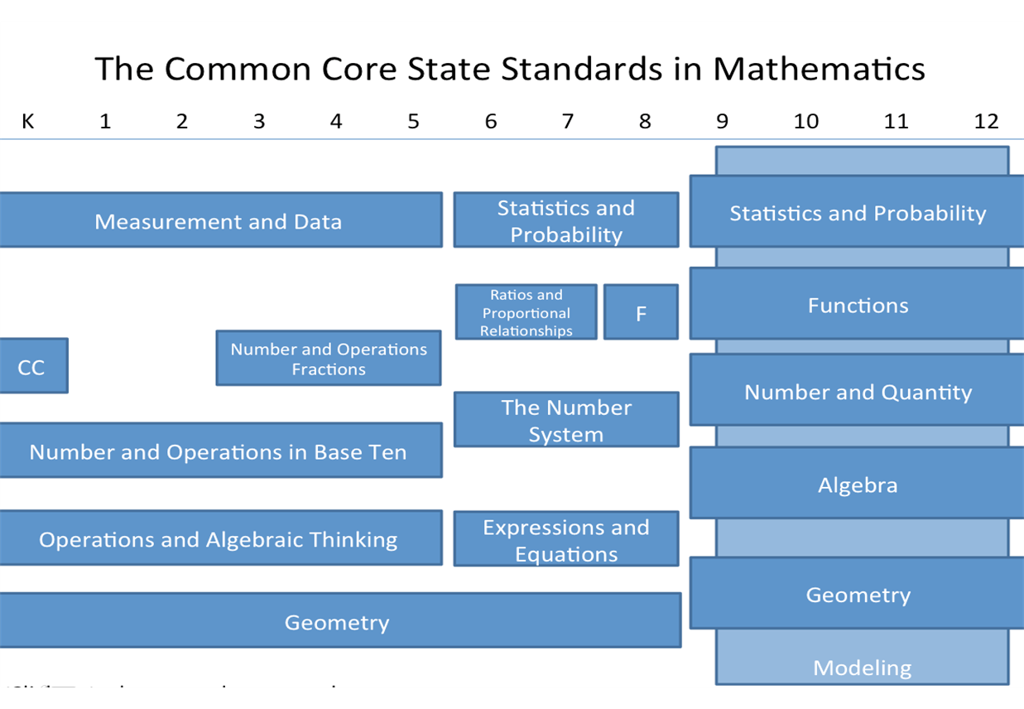
Functions
Notes:
Remind participants that in Modules 1 and 2, they looked at the coherence of the mathematics across grade levels and discussed the fact that this coherence is in place in order to help ensure that students receive instruction in mathematics that will lead to a deeper, more specialized investigation of mathematics in high school. Also, because of the key shift of coherence in the CCS-Math, when participants access the standards document for any grade level in K–8, all of the domains and clusters and individual standard statements are organized together in one grade level document. For example, the standards document for 6th grade will include information that covers all four domains. Transition to the next slide by noting that this organization changes somewhat as the focus shifts from grade level learning in middle school to course level learning in high school.

Slide 20
Transition from K–8 to 9–12:
Organization of the Standards
From a grade level organization of domains to an organization of domains by conceptual categories.
The conceptual category of Modeling is seen throughout each of the five other conceptual categories.
http://www.corestandards.org/Math
Notes:
Ask participants to access the overview of the Mathematics for High School on page 57 of the mathematics standards uploaded from http://www.corestandards.org/Math. Remind participants that at the high school level, the Standards are organized into conceptual categories. Note: Remember to focus only on the organization at this point as a deeper understanding of the rationale for this organization will develop as you progress through this section. The key point here is that the organization shifts from the grade level focus to the conceptual category focus.

Slide 21
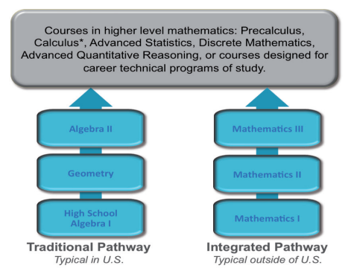
Organization of the Content
Appendix A http://www.corestandards.org/assets/CCSSI_Mathematics_Appendix_A.pdf
4 Pathways
  Traditional
    Typical (pg. 8)
    Compacted (pg. 82)
  Integrated
    Typical (pg. 44)
    Compacted (pg. 117)
Notes:
Explain to participants that the organization by conceptual category is just one of the levels of organization. The second level of organization is by course along a specific pathway. The information on this second level of organization can be found in Appendix A of the Standards. Ask participants to access Appendix A in a new window so that they have easy access to both the Standards document and Appendix A.
Once everyone has access to the information in Appendix A, continue to explain that the Standards are then further organized into course specific documents within one of four pathways.
Pathway 1: Traditional/Typical: consists of two algebra courses and a geometry course, with some data, probability, and statistics included in each course.
Pathway 2: Compacted version of the traditional/typical course in which students complete the content of 7th grade, 8th grade and Algebra 1 prior to entering high school.
Pathway 3: Integrated/Typical: sequence of 3 courses and each course includes number, algebra, functions, geometry, probability, and statistics.
Pathway 4: Compacted version of the integrated/typical pathway which accelerates the middle school organization to allow for students to work through Mathematics 1 prior to entering high school.
Ask participants to turn to the first page (listed on slide) of the pathway that their school follows.

Slide 22
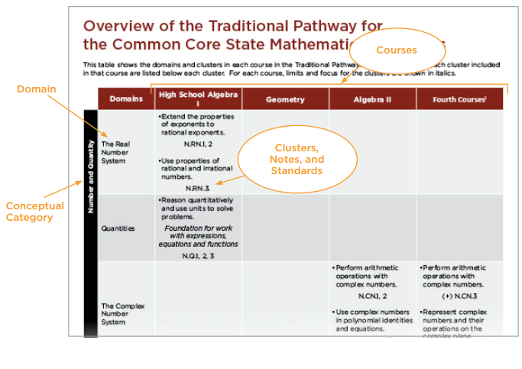
Notes:
Explain how to read the first chart in the pathway overview. Explain that each Pathway Overview provides the course titles that exist within the Pathway, and the breakdown of the conceptual category into domain, clusters, and notes by course. Note: Do not get into the second chart (on page 7) yet as this will be talked about in more detail as the structure of the standards is discussed. Again, the key point is simply to have participants understand the organization of the information. If participants want to discuss the rationale for the organization into conceptual categories, etc., at this point, let them know that the information that will answer their questions is forthcoming. The understanding of the organization, while it may seem tedious at first, is actual extremely important as this organization was not done arbitrarily as they will see.
Summarize key differences in the organization of the K–8 and 9–12 standards one more time. Then, transition to the next slide by explaining to participants that they will now focus on the structure of standards for grades K–12. Note: If necessary, explain that the difference between organization and structure is that both are based on coherence of the learning, but the organization tells at what grade something is taught and the structure tells why something is at a particular grade level.

Slide 23
The Grain-size of Mathematics
“Mathematics does not break down into lesson-sized pieces.”
- Phil Daro
Daro, P. (2013)
Notes:
The Grain-size of Mathematics
Ask participants to read the quote on the slide and for volunteers to give their first reaction. [Note: Be prepared for a range of responses from ‘that makes sense’ to ‘What does he mean because we have to teach a lesson a day?’. Some participants may feel uncomfortable with this statement because of past understandings and ideas of what daily lesson plans covered, but know that at this point that is okay, because the focus of this module is to help participants understand the structure of the CCS-Math and how they can help teachers redefine the idea of what lessons look like and cover so that they are designing learning that helps student to understand the key ideas within the Standards.] Explain to participants that when discussing the grain-size of the Standards and how learning should be designed around the Standards, Phil Daro talked about planning at what he called the ‘chapter level’ vs. ‘lesson level’ planning. He used the term ‘chapter level’ not to mean that teachers should literally plan around a specific chapter in a textbook, but that chapters typically encompass the bigger understanding that the Standards portray and that the Standards themselves are not broken down into succinct, fine-grain, lesson-sized pieces. Another way to think about this is that in the past, standards have been looked at as a checklist of items to be covered. Teachers were expected to plan a lesson or two that covered a specific standard and when that was done the standard was checked off the list and then the teacher moved on to the next standard. Those lessons usually involved a standard being posted somewhere that the teacher and students would talk about
‒ today we will ___________. This method isolated the standards into individual, small chunks of information. The CCS-Math were not designed in that fashion. As was discussed in Modules 1 and 2, the CCS-Math contain fewer topics that focus on the major work for each grade/conceptual category. They are designed around coherent progressions and conceptual connections. And, the major topics of each grade/conceptual category focus equally on conceptual understanding, procedural skill and fluency, and application of mathematics. In order to understand this further, explain to participants that they will now spend some time taking a more in-depth look into the structure of the Standards and the progressions that are embedded within.
Before moving to the next slide, ask participants to take a moment to read the first page of The Structure is the Standards by Phil Daro, Bill McCallum, and Jason Zimba on page 9 of their Participant Guide. As they read, ask participants to highlight or make notes on ideas that they feel are important for teachers to understand about the structure. After everyone has finished reading, transition to the next slide to begin to discuss the structure.

Slide 24
Understanding the Structure
“…individual statements of what students are expected to understand and be able to do are embedded within domain headings and cluster headings designed to convey the structure of the subject.”
“The Standards” refers to all elements of the design – the wording of domain headings, cluster headings, and individual statements; the text of the grade level introductions and high school category descriptions; the placement of the standards for mathematical practice at each grade level.”
Daro, McCallum, & Zimba (2012)
Notes:
Understanding the Structure
Begin discussing the structure of the Standards by asking participants to focus on the two quotes on the slide that make up the second paragraph. Have volunteers share what about these two statements they think is important.
“…individual statements of what students are expected to understand and be able to do are embedded within domain headings and cluster headings designed to convey the structure of the subject.”
“The Standards” refers to all elements of the design – the wording of domain headings, cluster headings, and individual statements; the text of the grade level introductions and high school category descriptions; the placement of the Standards for mathematical practice at each grade level.”
If it is not brought up by participants, explain that these two statements are important because it emphasizes the fact that what’s important about the CCS-Math is not just the individual statements it is also the structure and progression on which the Standards have been built. Go over the next several slides to explain this further by showing participants how all of the elements of the Standards work together to create a focused and coherent study of mathematics.

Slide 25
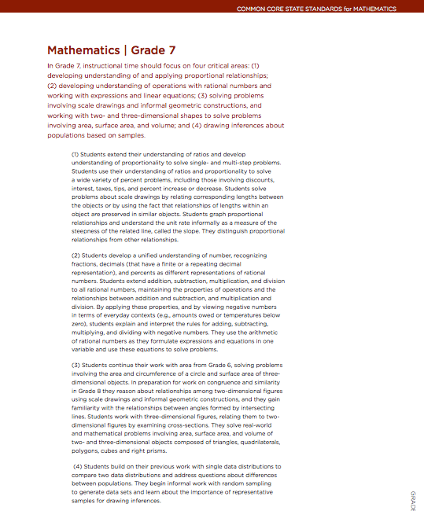
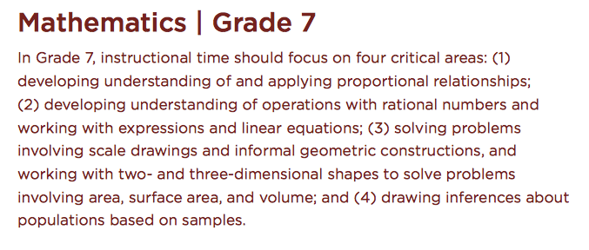
Focus
Fewer topics allow for focusing on the major work for each grade.
http://www.corestandards.org/
Notes:
Focus: Remind participants about the shift of Focus that was discussed in Module 1. The writers of the Standards worked very hard to reduce the number of expectations at each grade level. This work was not done arbitrarily. They focused on the different domains of mathematics such as Functions, Expressions and Equations, The Number System, Geometry, and Statistics and Probability, and determined what work was critical for students at each grade level to address in order to develop the concepts in each domain over time. This reduction in the number of topics allows teachers to shift their instruction to focus on the major work and critical areas of study at their grade in order for students to develop a deep understanding through investigation, inquiry, and problem solving.
Explain to participants that they will first look at how this work comes together at the middle school level. Ask participants to access the Standards online or in print if they have a copy with them, and to scroll/turn to the introduction for grade 7 and then transition to the next slide.

Slide 26
Provides the critical areas for the grade level.
Describes key ideas that students should learn in relation to each of the critical areas.
http://www.corestandards.org/
Notes:
Explain to participants that the introductory text for the grade level describes the major work for the grade level by providing the critical areas of focus in the top paragraph and then supports those critical areas with the corresponding paragraphs by describing the key ideas that students should learn in relation to each of the critical areas.

Slide 27
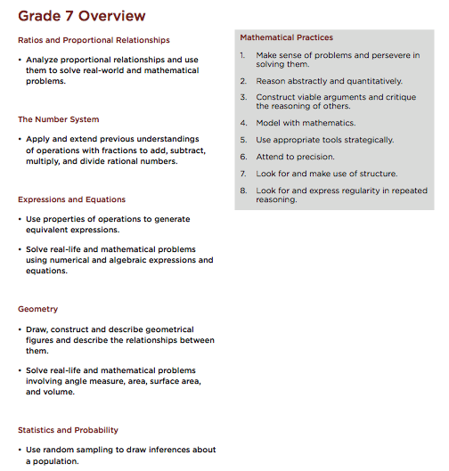
Domains
Cluster Headings
http://www.corestandards.org/
Notes:
The next page, the Grade Level Overview, displays the Domains (in red) covered within the major work for the grade level, and the more specific ideas, or Cluster Headings (bulleted in black under the Domains), that will be addressed. Also on this overview page is the Standards for Mathematical Practice, as these Standards are just as important as the ideas in the clusters and only through the development of both will the major work of the grade level be accomplished.

Slide 28
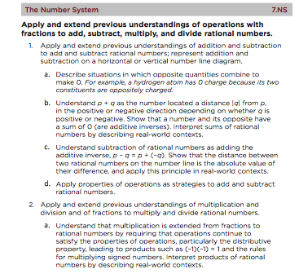
Domain

Standard
↵
Cluster
http://www.corestandards.org/
Notes:
On the pages following the Grade Level Overview, each of the Cluster Headings is further supported within the structure by the individual standard statements. Here we can begin to see how each individual element does not simply repeat information, but that each gives greater detail of what is to be learned in order for the critical areas of each grade level to be met.
Transition to examining the high school Standards by explaining to participants that the high school Standards provide for the same focus and coherence, but need to be looked at both across conceptual category and at the individual course level because, as was previously discussed, students are now deepening their understanding of mathematical concepts through the course focus.

Slide 29
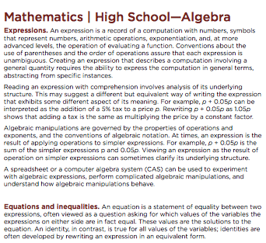
Notes:
Ask participants to scroll/turn to the conceptual category of Algebra (page 62) and explain that the introductory page provides information about the main ideas of the conceptual category of Algebra. Explain to participants that this is the high level overview of the understandings related to this conceptual category that students are expected to, and need to, understand over the course of their study of mathematics in high school.

Slide 30
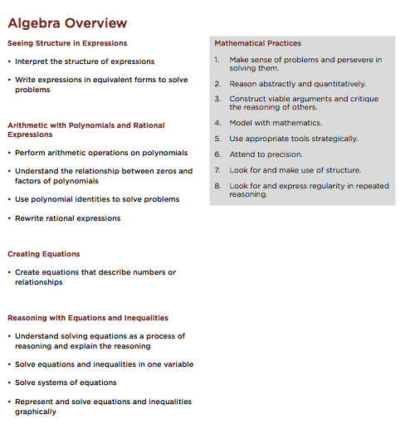
Domains
Cluster Headings
http://www.corestandards.org/
Notes:
The Conceptual Category Overview, just as was seen in the Grade Level Overview of 6–8, provides the domain and cluster headings addressed within the conceptual category and also attends to the dual importance of both the Content and Practice standards.

Slide 31
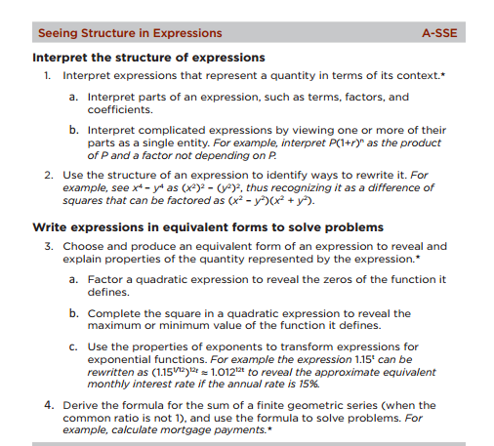
Domain

Standard
↵
Clusters
http://www.corestandards.org/
Notes:
On the pages following the Conceptual Category Overview, each of the Cluster Headings is further supported within the structure by the individual standard statements. This format is the same as you see in K–8. Again, we see how each individual element does not simply repeat information, but that each gives greater detail of what is to be learned in order for students to gain the deeper understanding of the conceptual category. The asterisk after standards 1, 2 and 3 indicates that these standards are also modeling standards providing students an opportunity to develop the 4th Standard of Mathematical Practice. Continue to reiterate to participants that it is important for teachers to gain this higher, but deeper, understanding of the conceptual category in order to better understand how these standards are addressed within their particular course focus as this is the ‘big picture’ that students are to understand throughout their study of mathematics in high school no matter what course they are in at a given time. For example, participants may have noticed when reviewing the Pathway chart in Appendix A that certain standards were repeated in multiple courses, such as A.SSE. 1a, 1b, & 2, which all fall under the cluster of Interpret the structure of expressions, were found in both Algebra I and Algebra II. This is because the deeper understanding within these standards is the same for both courses. The difference comes in when participants begin looking at the course specific lens that students will use to deepen their understanding. Another way to think about this is that the conceptual category gives the solid foundation of understanding that students must understand and each course provides students with different opportunities for understanding how to interpret the structure of expressions. In Algebra I, students learn to interpret the structure of expressions through work with linear, exponential, and quadratic expressions. And in Algebra II, they take this further by interpreting the structure of polynomial and rational expressions. Further explain that the specific course level lens can be found within Appendix A, so ask participants to now go to page 15 of Appendix A.

Slide 32
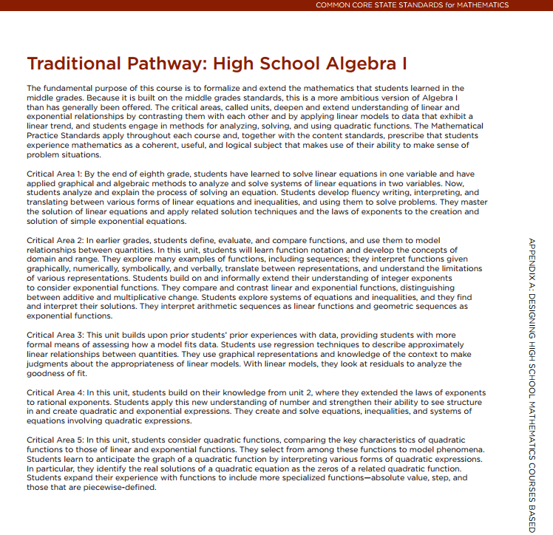
Course Overview
Critical Areas
Notes:
Explain to participants that the first page of each course provides, much like the first page in grade level standards for 6–8, an overview of the course which describes the major work of the course, and the critical areas that should be addressed. Explain to participants that the name ‘critical area’ is often interchanged with ‘unit’ throughout the document for high school only. They will see evidence of this as they begin exploring their course specific documents as this section progresses.

Slide 33
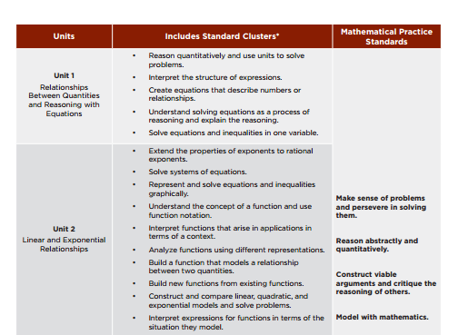
Notes:
As participants scroll to page 16 of Appendix A, explain that this page lists the units/critical areas for the course, the clusters from the conceptual categories that should be used to address the unit/critical area, and shows that the Practice Standards should be addressed within all five units/critical areas of the course.

Slide 34
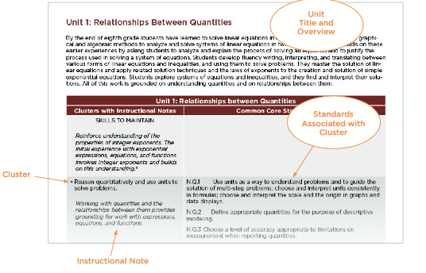
http://www.corestandards.org/assets/CCSSI_Mathematics_Appendix_A.pdf, p. 17
Notes:
As participants move to the next page, explain that this is where the specific course level focus of the Standards and the more specific details of each unit/critical area are uncovered. For each unit/critical area we are given the following:
The unit title and overview which provides a brief look at how students will build off of previous understandings from middle school and further outlines the course expectations (i.e. “Students develop fluency in writing, interpreting, and translating between various forms of linear equations and inequalities, and using them to solve problems.”).
The Clusters and the individual standard statements from the conceptual categories that are associated with the unit/critical area.
Instructional notes that provide the course specific lens for each cluster.

Slide 35
Important Points to Keep in Mind:
“The units (or critical areas) are intended to convey coherent groupings of content.”
The order of the clusters and standards within the units are not meant to be read as the order of instruction.
The instructional notes should not be overlooked as they convey constraints, extensions, and connections.
Notes:
The pathways and courses in this document are models, not mandates, but provide useful information regarding the appropriate progression and emphases for the CCS-Math. It’s important to note, however, that (CCSSM Appendix A, pg. 7):
“The units (or critical areas) are intended to convey coherent groupings of content.
“The clusters and standards within units are ordered as they are in the Common Core State Standards, and are not intended to convey an instructional order.” Note: The state has developed a model curriculum for Algebra 1 based on the CCS-Math. This curriculum is not mandated, but can serve as a resource and can be found here: http://sde-cthsmoodle.cthss.cen.ct.gov/moodle/course/view.php?id=526
This will be provided to participants as a resource when they begin to plan their lessons. You can mention this fact here, but do not provide the link yet as the purpose is still for participants to gain a deeper understanding of the structure of the standards and not the curriculum that is being used for its implementation.
Allow participants just a few minutes to explore their grade level or course specific information and then transition to the next slide.

Slide 36
Understanding the Structure
“…the Standards were crafted to reward study on multiple levels: from close inspection of details, to a coherent grasp of the whole.”
“Specific phrases in specific standards are worth study and can carry important meaning; yet this meaning is also importantly shaped by the cluster heading in which the standard is found. At higher levels, domain headings give structure to the subject matter of the discipline, and the practices’ yearly refrain communicates the varieties of expertise which study of the discipline develops in an educated person.”
Daro, McCallum, & Zimba (2012)
Notes:
Understanding the Structure
Continue the discussion of the reading, The Structure is the Standards, by pointing out that by understanding how all of the different pieces of information provided within the Standards for a grade level fit together, it is easier to understand how the design allows for close inspection of details and a coherent grasp of the whole. It is this part-whole relationship that brings about the connections within the mathematics that has often been missing from students’ understanding in the past.

Slide 37
The Grain-size of Mathematics
“Fragmenting the Standards into individual standards, or individual bits of standards, erases all these relationships and produces a sum of parts that is decidedly less than the whole.”
“Mathematics does not break down into lesson-sized pieces.”
Daro, P. (2013)
Notes:
The Grain-size of Mathematics [note: this slide has one animation. The bulleted quote will appear first, then you will need to click to bring back the Phil Daro quote that was used at the start of this discussion.]
Continue the discussion of the Standards by explaining that because the structure of support for the major work for each grade/course comes in the form of domain, clusters, and individual standard statements, it is understandable that fragmenting the Standards into individual pieces without that greater focus can cause a breakdown in the Focus, Coherence, and Rigor of the CCS-Math.
Click to bring up the Phil Daro quote. This deeper understanding also begins to provide a much clearer context for the statement that mathematics does not break down into lesson-sized pieces. [Note: The next discussion on the progression and then the example of how to make this structure work for designing learning will continue to build an understanding of the grain-size of the mathematics to be covered.]

Slide 38
A Progression of Understanding
Why is paying attention to the structure important?
Why not just focus on the individual standard statements?
How were the major work, critical areas, cluster headings, and individual standard statements determined?
Notes:
A Progression of Understanding
Acknowledge the fact that many participants may have questions about why the structure of the Standards is so important and why the Standards were not written at the grain size of individual pieces of learning that can be checked off as students accomplish whatever is stated within that standard. To answer those questions, participants will now look at the progressions upon which the Standards were developed. Ask participants to read page 2 of The Structure is the Standards and when the reading is complete, transition to the next slide.

Slide 39
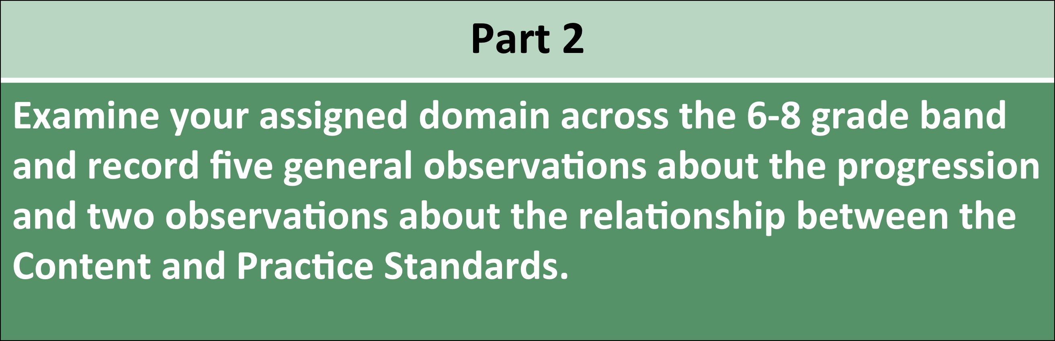
Exploring the Content Standards
8.NS.1
Know that numbers that are not rational are called irrational. Understand informally that every number has a decimal expansion; for rational numbers show that the decimal expansion repeat eventually…
7.NS.1
Apply and extend previous understandings of addition and subtraction to add and subtract rational numbers; represent addition and subtraction on a horizontal or vertical number line diagram.
6.NS.1
Interpret and compute quotients of fractions, and solve word problems involving division of fractions by fractions, e.g. by using visual fraction models and dquations to represent the problem.
Notes:
Exploring the Content Standards
Begin the discussion of the Progressions documents by reminding participants that in Module 2, when they explored the Content Standards with the cards, they began to get an understanding of the learning progressions as they looked at how the domains were developed across grade bands. Participants will now take a much deeper look into those progressions by reviewing the detailed Progression documents.

Slide 40
A Progression of Understanding
Access the CCS-Math Progressions here: http://ime.math.arizona.edu/progressions/.
Click on the first bulleted item under the Progressions heading: Draft Front Matter.
Within the Draft Front Matter, scroll to page 4 which begins the section titled: Preface for the Draft Progressions.
Notes:
A Progression of Understanding
Have participants access the CCS-Math Progressions documents online, pull up the Draft Front Matter document, and scroll to page 4 which begins the section titled: Preface for the Draft Progressions. Allow participants to read the material on page 4 (ending top of page 5) for 5 minutes on their own and then ask them to discuss what they read with their group. Each group should use the three questions on the next slide to guide their discussion. (Answers to the questions can be recorded on page 11 in the Participant Guide.)

Slide 41
A Progression of Understanding
What information do the Progressions documents provide?
Why is this information important?
How can this information be useful to teachers?
Page 11
Notes:
A Progression of Understanding
Debrief small group discussions and bring out the following key ideas if they are not brought up by participants:
The Progressions documents help us to better understand how topics may be sequenced and approached across grades/courses.
The Progressions documents point out cognitive difficulties and pedagogical solutions.
The Progressions documents allow us to fully examine what students were to learn in the previous grade level/course and to look ahead at how students will use and build upon their current learning.
Understanding the content progressions is important because:
When we understand what students were expected to know and understand from the previous grade level/course, it helps us to determine an entry point into the current mathematics.
When we understand what students are expected to know and understand in the next grade level/course, it helps us to ensure that current lessons will lead and prepare students to complete work at that level.
When we understand what students are expected to know and understand at the current grade level/course, it helps us to create reliable and accurate lesson level learning targets.

Slide 42

Let’s Take A Break…
…Be back in 10 minutes
Notes:
Note: Because Section 2 has been designed to last at least 120 minutes, participants will need to break during the section rather than between sections. This is a good place to have participants take that break. However, based on the individual sessions, this may need to be moved up or pushed back. The key thing is to be flexible and break when needed.

Slide 43
Designing Meaningful Learning
How do we use the structure of the Standards and the information in the Progressions documents to determine the learning targets of day-to-day lessons if the Standards themselves are not broken down into lesson-sized pieces?
Why do we need to focus on learning targets, why not just focus on the standards themselves?
Notes:
Designing Meaningful Learning
Shift participants’ focus now to the two questions on the slide. Explain that the answer to the second question can be had by looking back at Module 3.

Slide 44
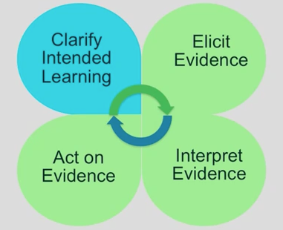
Formative Assessment: Four Attributes
Learning targets: Focus on what students will learn, not what they will do.
Success Criteria: Observable and measurable behaviors to be reached.
Notes:
Formative Assessment: Four Attributes
Remind participants again that in Module 3 they examined each of the four attributes of formative assessment and that the goal of the first attribute in the formative assessment process is to clarify the intended learning that is to take place within a lesson and that the purpose of clarifying intended learning is to help students and teachers understand the expectations and goals for their work together. To be able to clarify intended learning, each lesson must have learning targets and success criteria. So, while every lesson is designed and completed in such a way as to help students achieve the understanding of the ‘whole’ of the major work for the grade level/course, there must be targets in place that help teachers to measure students’ progress towards that achievement. It is important that these targets maintain that larger focus so as to attend to the important structure of the Standards.
Transition to the next slide by explaining that to answer the first question about using the structure and progressions to develop learning targets, participants will now go through an example and take time to work together to create learning targets at a grade level of their choosing. Pause now to put participants in grade level groups if they are not already in that arrangement.

Slide 45
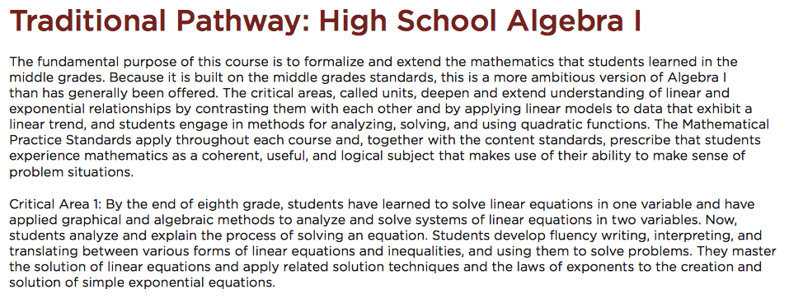
Focus on the Major Work:
Algebra Example
http://www.corestandards.org/assets/CCSSI_Mathematics_Appendix_A.pdf, p. 15
Notes:
Focus on the Major Work in Algebra
Ask participants to now go back to pg. 15 of Appendix A, the introductory material for High School Algebra I. The page shows the five critical areas (units) for Algebra I. In keeping with Phil Daro’s analogy of ‘chapter planning’ vs. ‘lesson planning’ we’ll look at an example of identifying a critical area and then gradually drilling down to the lesson target level. Ask everyone to read the first paragraph and then the text for Critical Area 1 (shown on the slide).

Slide 46
Critical Area 1:
By the end of eighth grade, students have learned to solve linear equations in one variable and have applied graphical and algebraic methods to analyze and solve systems of linear equations in two variables.
Analyze and solve linear equations and pairs of simultaneous linear equations.
8.EE.7: Solve linear equations in one variable.
  Give examples of linear equations in one variable …
  Solve linear equations with rational number coefficients…
8.EE.8: Analyze and solve pairs of simultaneous linear equations.
  a. Understand that solutions to a system of two linear equations in two variables…
  b. Solve systems of two linear equations in two variables…
  c. Solve real-world and mathematical problems leading to two linear equations…
Notes:
The first part of the text reveals the connection to work with linear equations in grade 8. (8.EE.7 & 8 – note that the full text of this cluster didn’t fit on the slide.)

Slide 47
Key Ideas of Critical Area 1:
Now, students analyze and explain the process of solving an equation.
Students develop fluency writing, interpreting, and translating between various forms of linear equations and inequalities, and using them to solve problems.
They master the solution of linear equations and apply related solution techniques and the laws of exponents to the creation and solution of simple exponential equations.
Notes:
[Note: This slide has three animations. The slide will start blank and then with each click a new, colored bit of text will appear.]
[Click for text] Building on that foundation, in Algebra I students develop the confidence to analyze and justify a solution process.
[Click for text] They develop fluency in working with linear equations and inequalities and use them to solve problems.
[Click for text]. The students becomes masters of solving linear equations as evidenced by their ability to apply strategies to simple exponential equations.
Once these high-level key ideas are identified and understood, teachers can begin to think about how individual lessons can be a part of this bigger picture.
Pause now and continue the discussion with participants, as a large group, in how thinking about designing learning in this manner is different from or similar to the way that teachers plan/design now. One key idea to bring out in the discussion if it is not raised by participants is that outlining the key ideas that support the critical areas helps teachers to bring deeper meaning and to create a sense of connectedness to the individual Standards and student learning. It also helps to keep the focus of the planning on the unit or chapter versus only thinking about what is going to happen in a particular lesson. This idea is developed further within the hands-on portion of the section.

Slide 48
Part 1: Critical Areas and Key Ideas
With your group, do the following:
Choose a grade level/course and critical area for which you will focus on designing learning throughout the remainder of this Module.
Identify the key ideas that support the critical area.
As you work, complete Part 1 of the Learning Target Planning Template.
Page 12
Notes:
Part 1: Critical Areas and Key Ideas
Before moving on, have participants work in their small groups to choose a grade level/course and critical area within that grade level and identify the key ideas that support the critical area. (High School participants should choose a different critical area than was in the example). Reiterate for middle grade level groups, they will use the grade level overviews in the CCSS to get a description of the critical area. High School level groups will use information provided in Appendix A of the Standards. As participants work, they should complete Part 1 of the Learning Target Planning Template on page 12. [Note: Not all critical areas will be as easy as the Algebra example to break down into the key ideas. This goes back to the crossover of ideas, and depending on the grade level and critical area chosen, some participants may need more assistance with completing this task.]

Slide 49
Making Connections to Clusters and the Individual Standards
Students analyze and explain the process of solving an equation.
“Mathematics does not break down into lesson-sized pieces.”
Daro, P. (2013)
Notes:
Making Connections to Clusters and the Individual Standards [Note: This slide has one animation. The bulleted information will come first, and then click to bring up the Phil Daro quote.]
Continuing with the Algebra example, explain to participants that now that they have the key ideas for the major work of their critical area outlined, it is time to begin to focus on designing the lessons that will allow students to reach those key ideas. For this example, the focus for the lesson will start with the first key understanding ‘Students analyze and explain the process of solving an equation’. Knowing that this is the key idea to be explored, individual lessons need to be designed that develop students’ ability to do this. To determine the more precise student understandings that need to be developed, teachers should identify the Content Standard(s) that support this key idea.
Click to bring the Phil Daro quote back on screen. Use the quote to transition to the next slide by explaining that while we need to identify the supporting Standards in order to get the details of the key idea, we must still keep Phil Daro’s quote in mind so that we do not lose the relationships that provide the structure of the Standards.

Slide 50
Making Connections to Clusters and the Individual Standards
“Fragmenting the Standards into individual standards, or individual bits of standards, erases all these relationships and produces a sum of parts that is decidedly less than the whole.” – Daro, P. (2013)
Critical Area
Key Idea
Key Idea
Key Idea
Key Idea
Lesson(s)
Lesson(s)
Lesson(s)
Lesson(s)
Notes:
Making Connections to Clusters and the Individual Standards
Explain to participants that while we are beginning to think about designing learning at the lessons level, we still need to avoid fragmenting the Standards. We can do this by continuing to focus on the critical area and the supporting key ideas, but we also need to find a general entry point into the mathematics. In the case of this critical area for Algebra I we can start with the first key idea and then, over time, use the lessons that are taught on a day-to-day basis to make connections between all of the key ideas that support the critical area. In this way, we are avoiding covering bits of information with the hope that students are making those connections. Instead we are purposefully connecting lessons for the goal of developing the deeper understanding. [Note: Participants may have questions about this visual. One may be whether or not every lesson has to start back at the first key idea addressed. The answer is explicitly, no. But, as new ideas are introduced, students should be able to connect what they are doing now to previous lessons. These connections may be made during a lesson introduction, they may, for example, come out within the questions that the teacher asks the students while they are working through tasks, or during discussions of work the teacher may ask students how what they are doing connects back to previous lessons. Another question may go back to the idea of one critical area being addressed within one unit. Again, the visual shows the connections to be made between ideas and lessons.]

Slide 51
Making Connections to Clusters and the Individual Standards
Students analyze and explain the process of solving an equation.
  Cluster: Understand solving equations as a process of reasoning and explain the reasoning.
  Associated Standard
      A.REI.1: Explain each step in solving a simple equation as following from the equality of numbers asserted at the previous step, starting from the assumption that the original equation has a solution. Construct a viable argument to justify a solution method.
Notes:
Making Connections to Clusters and the Individual Standards
For this example, while the key idea itself is a foundation for the other work with linear equations, this particular key idea is supported by standard A.REI.1. (The organization of the units in Appendix A may be helpful in finding this cluster and the associated standards.) Note: For a deeper look at this key idea, be sure to review the Progressions documents found here: http://ime.math.arizona.edu/progressions/. Click on the Draft High School Progression on Algebra and go to pg. 13.
Before moving to the next slide, ask participants why it is important to identify the Standards at this point. If it does not come up by participants, explain that the Standards give teachers the more formal and precise understandings that students need to develop, and the Standards can be used to develop the learning targets for each lesson.
Transition to the next slide by explaining that it just so happens that in this example there is only one cluster heading and one standard that explicitly supports this key idea. However, in other critical areas this may not be as clear. So to help understand the connection between the key ideas and the Standards, we can get more information from the Progressions documents.

Slide 52
Part 2: Connections to Clusters and Individual Standards
With your group, do the following:
Determine which key idea your group will use as the focus for your first lesson(s) within this critical area.
Identify the cluster heading(s) and individual standard(s) that support your selected key idea.
Complete Part 2 of the Learning Target Planning Template.
Page 13
Notes:
Part 2: Planning Learning Targets
Before moving on, have participants continue to work in small groups: (1) determine which key idea their group will use as the focus for their first lesson(s) within this critical area; and (2) identify the cluster headings and individual standard(s) that support their selected key idea.
As participants work, they should (3) complete Part 2 of the Learning Target Planning Template on page 13.
If participants are having trouble identifying their general entry point into the mathematics of the critical area, have them use the progressions in the Standards to identify the work that students were expected to complete in the previous grade level and then think about the next step that will set students on the path of building off of that information in the current grade level. Because of the coherent and progressive nature of the Standards, we want teachers to get into the habit of thinking through where students have been, where they are going now, and how does that help them to move forward in the future. After groups have identified their supporting clusters and individual standard statements, move on to the next part of the section, but have them keep the Progressions document open as they may find it helpful as they work to complete Part 3 of the Learning Target Planning Template.

Slide 53
Creating Learning Targets
Students analyze and explain the process of solving an equation.
  Cluster: Understand solving equations as a process of reasoning and explain the reasoning.
  Associated Standard
    A.REI.1: Explain each step in solving a simple equation as following from the equality of numbers asserted at the previous step, starting from the assumption that the original equation has a solution. Construct a viable argument to justify a solution method.
Access the CCS-Math Progressions here: ttp://ime.math.arizona.edu/progressions/
Notes:
Creating Lesson Level Learning Targets
Explain to participants that they can now take their standard(s) and determine the lesson level learning targets that they want their students to meet within a given lesson(s). Have participants access the High School Progression on Algebra document on the website provided on the slide. Provide participants time to review the information provided in the first paragraph on pg. 13 of that document and then ask small groups to explore the target stems on the next slide.

Slide 54
Creating Lesson Level Learning Targets
    If I want my students to be able to analyze and explain the process of solving an equation.
      Students will be able to write the if-then moves they used in solving an equation.
      Students will _______________________________.
      Students will _______________________________.
      Students will _______________________________.
Notes:
Creating Lesson Level Learning Targets
Explain to participants that what is shown on the slide is one way to think through the development of learning targets. This method uses the mathematics within the individual standard statement and the information in the Progressions document to engage teachers in thinking about if they want students to be able to do what is written in the standard, then students need to learn, do, understand, explain, describe, etc., very specific things. These very specific ‘things’ become the learning targets for lesson level work.
Ask participants to think about if students are expected to analyze and explain the process of solving an equation, what are some of the underlying targets that must be met. Provide an example of ‘If I want my students to analyze and explain the process of solving an equation, then: “Students will be able to write the if-then moves they used in solving an equation.” Chart participant responses as they are provided. Examples of additional responses might include:
Students will be able to explain why one step in the solution process follows from the previous step. Students will be able to explain why a step in the solution process maintains the equality from the previous step.
As participants provide examples, it is important to ensure that the learning targets directly support the mathematics within the individual standard statements so that there is the progression of understanding and so that we are not adding anything to the curriculum. Have participants think back to the Phil Daro video from Module 1 in which he talks about adding things to the curriculum such as the ‘butterfly method’ or FOIL. This is important because we do not want to add those things that will bring us back to the mile wide, inch deep curriculum of the past, because it is important for students to develop a conceptual understanding at each grade level. We want everything that students do to directly work towards developing the focused, coherent, and rigorous understandings of the CCS-Math. For this to happen, teachers have to think critically about why specific concepts are taught at a specific grade level and where the understandings that students will develop will lead down the road.
After several examples have been provided, move on to having participants complete Part 3 of the Learning Target Planning Template.

Slide 55
Part 3: Creating Learning Targets
With your group, do the following:
Create the lesson level learning targets for the general entry point lessons into the mathematics of your identified critical area.
Place your critical area, key idea, standard(s), and learning targets on chart paper.
Determine the Standard(s) for Mathematical Practice the students will be engaged in. Note these on your paper.
Page 14
Notes:
Part 3: Creating Learning Targets
Using their key ideas, Standards, and domain related progression, participants should now complete Part 3 of the Learning Target Planning Template on page 14 by creating lesson level learning targets for one of the Standards that support their identified key idea. As participants get ready to work, remind them to think also about the Practice Standards they want to address in their lesson, as these standards are equally as important as the content standards. Participants should determine which of the Practices they would focus on with this given set of learning targets. For example, in the Algebra example, Practice 7: Look for and make use of structure is one Practice Standard that should be further developed through students’ work.
Then, on chart paper, each group will list their key idea, standard(s), and learning target(s). When completed, participants should hang their chart paper in a designated spot within the room. Participants will use this chart paper in the final activity of this section and will expand their ideas through their work in Section 3.
[Note: If time is an issue, have groups that worked within the same grade level post their work next to each other so as to reduce the amount of time needed to find the work to be reviewed.]
[Note: You may mention to the 6-8 participants that the Standards for Mathematical Practice have now been annotated for the 6-8 classroom: http://commoncoretools.me/wp-content/uploads/2014/05/2014-05-06-Elaborations-6-8.pdf . This may be a helpful resource that can be used to determine which Practice Standard to address in a given lesson and how those Practices should be addressed at their grade level.]

Slide 56
Time to Share
With your group, review the work of others who worked at your same grade level/course.
Using sticky notes, provide your peers with questions to consider, suggestions on additional learning targets, and any general feedback that would be helpful in developing out their lesson design.
Notes:
Time to Share
Explain to participants that it is now time to share their work in order to give and receive peer feedback and support. Use the following process for sharing participant work with their peers:
1. With their group, review the work of others who worked at their same grade level.
2. Using sticky notes, participants will provide their peers with questions to consider, suggestions on additional learning targets, and any general feedback that would be helpful in developing their lesson design. Remind participants that they will use this chart paper and their ideas developed thus far throughout the module as they continue to build their lesson design.

Slide 57
Three Key Points to Communicate
The critical areas provide the supporting key concepts that students should explore in each grade level/course and provides the unit or chapter level view for designing learning.
Every lesson and resource should be designed and considered for the impact it will make on students understanding those key ideas.
The content progressions are an important part of the design process.
Notes:
Three Key Points to Communicate
Summarize the discussions thus far using the three points on the slide and explain to participants that while it may seem like a significant amount of time was spent creating learning targets, something that in the past may have only taken a few minutes, it is very important for teachers to take the time to understand the major work for the grade, how the Standards are connected and lead to the key ideas discussed, and how to use the coherent progression of the mathematics to develop those lesson level learning targets. When looking at the work completed in this section and considering the shifts of focus, coherence, and rigor, participants should be able to see how the shifts impact the work of both teachers and students in grade level planning and instruction. Because of this, and the deliberate design of the Standards, teachers should come to trust in the progression of the learning both within and across their grade level or course. End Section 2 here as participants will pick this work back up in Section 3.

Slide 58

Bon Appétit
Notes:
Remind participants of the need to be timely. Allow 45 minutes. State time to return.

Slide 59
Identifying an Entry Point into the Mathematics
Section 3
Page 16
Notes:
Section 3: Identifying an Entry Point into the Mathematics
Section 3 Time: 60 minutes
Section 3 Training Objectives:
To use the Progressions documents to identify student prior knowledge.
Explore strategies for assessing prior knowledge and for addressing gaps in prior knowledge.
Section 3 Outline:
(25 minutes) Section 3 begins with participants reviewing the Progressions documents in order to identify the prior knowledge that students should possess in order to begin to develop the key ideas identified in their work in Section 2. Participants will use that information to develop questions that they would ask as part of an assessment of that prior knowledge and then use this experience to make considerations on how they will help teachers to understand how to determine both content and practice prior knowledge.
(20 minutes) Participants move forward with their work by now determining how the assessment of prior knowledge will take place. This is related back to the formative assessment process reviewed in Module 3 and is discussed within the context of the depth and breadth of the prior knowledge. After thinking through the type of assessment that will be used (formal or informal) participants think about what teachers need to understand about assessing prior knowledge and how they will help teachers to gain this knowledge.
(15 minutes) Section 3 wraps up with participants brainstorming how gaps in understanding will be addressed as part of the progression of understanding using the structure of the Standards as the context. This activity transitions participants into their work on planning CCS-Math lessons in Section 4.
Supporting Documents
Internet access to the CCS-Math and the Progressions documents
Determining Prior Knowledge recording sheet
Assessing Prior Knowledge recording sheet
Addressing Gaps in Prior Knowledge recording sheet
Materials
Chart paper
Markers

Slide 60
What happens when….
…you find that your students have gaps in their content knowledge?
Notes:
What happens when…
Ask participants to think about the question on the slide within the context of what happens right now in their schools. Prepare for a variety of answers from “we modify the lessons,” “we do remedial activities first,” “we give extra homework,” “we provide tutoring,” and so forth. Further explain that none of these answers are wrong, however as they will see, the structure of the Standards approaches gaps in knowledge differently than the way we have thought about it in the past. Moving forward we think about these gaps in terms of providing multiple entry points into the mathematics.

Slide 61
Examples of Strategies for Differentiating Cognitively Rigorous Tasks
Scaffolding
Open Questions
Parallel Tasks
Notes:
Remind participants that in Module 2 they examined examples of strategies that can be used to provide multiple entry points into the mathematics of a unit or lesson. And, as they examined scaffolding, open questions, and parallel tasks the focus was on how to use these strategies within a lesson. Participants will now build off of that work and focus on determining when, and if, strategies such as these are needed within a given lesson or unit of study, and how those strategies will be used to address gaps in content knowledge.

Slide 62
Determining Prior Knowledge
Determining the prior knowledge:
  Use the learning target information that you created in Section 2 and the information from the Progressions documents to identify what students should already know and be able to do prior to the work at the current grade level.
  Be sure to identify prior knowledge based on both the Content and the Practice Standards.
Guide Page
X
Page 16
Notes:
Determining Prior Knowledge
Explain to participants that you want them to work with their same group from Section 2 and to use the Standards and the Progressions documents to determine the prior knowledge that students should possess for the work that they began to outline and that they created learning targets for in Section 2. Remind participants that they should identify prior knowledge for both the Content and the Practice Standards.
Before participants begin working, go over the example on the following two slides.

Slide 63
Determining Prior Knowledge
By the end of eighth grade, students have learned to solve linear equations in one variable and have applied graphical and algebraic methods to analyze and solve systems of linear equations in two variables.
Prior Knowledge:
Analyze and solve linear equations and pairs of simultaneous linear equations.
8.EE.7: Solve linear equations in one variable.
  Give examples of linear equations in one variable …
  Solve linear equations with rational number coefficients…
8.EE.8: Analyze and solve pairs of simultaneous linear equations.
  a. Understand that solutions to a system of two linear equations in two variables…
  b. Solve systems of two linear equations in two variables…
  c. Solve real-world and mathematical problems leading to two linear equations…
Notes:
Determining Prior Knowledge
Continuing with the Algebra example from Section 2, recall that the text defining the critical area gave information regarding prior knowledge. Students will build on this knowledge as they develop the ability to analyze and explain the process of solving a linear equation. (The instructional note in Appendix A, pg. 18, clarifies that students should focus on and master this for linear equations in Algebra I and be able to extend and apply their reasoning to other types of equations in future courses.)

Slide 64
Determining Prior Knowledge
What will be assessed:
  8.EE.7a – Can students give an example of a linear equation in one variable with one solution? Infinitely many solutions? No solutions?
  8.EE.7b – Can students solve linear equations with rational number coefficients, including those requiring use of the distributive property and collecting like terms?
Notes:
Determining Prior Knowledge
Knowing what was covered previously allows us to determine more specifically what would be assessed when determining if students have obtained this prior knowledge. On the slide are questions that we would look to have answered as part of that assessment. [Note: We are not talking about how these questions would be assessed yet, only developing the questions that we want to have answered through an assessment.]

Slide 65
Determining Prior Knowledge
What will be assessed:
  MP6 – Do students use the correct terminology when referring to the steps they use to solve an equation?
  MP7 – Can students discern the structure of equations that have just one solution? Infinite solutions? No solutions?
Notes:
Determining Prior Knowledge
In terms of the Practice Standards, what Practices will students need to be engaged in to address the targeted learning? There are definitely other Practice Standards at play here– the slide provides two examples.

Slide 66
Determining Prior Knowledge
Determining the prior knowledge:
  Use the learning target information that you created in Section 2, the Standards, and the information from the Progressions documents to identify what students should already know and be able to do prior to the work required by the learning target.
  Be sure to identify prior knowledge based on both the Content and the Practice standards.
Guide Page
X
Page 16
Notes:
Defining Prior Knowledge
Provide participants with approximately 20 minutes to determine what questions they would want to have answered through an assessment of students’ prior knowledge.
When time is called, begin to debrief the small group work by asking for volunteers to share their work.

Slide 67
Determining Prior Knowledge
Was there anything interesting or surprising about what you found?
How did you determine where students should be with their development of the Practice Standards?
Notes:
Defining Prior Knowledge
Continue to debrief the small group work by using the two questions on the slide to drive a large group discussion. Two things that should come out of this discussion are: 1) that teachers may not fully understand the prior knowledge that students should have developed according to the Standards and the Progressions documents and they will need guidance on how and where to find that information; and 2) because the Practice Standards are written for grades K-12, teachers within and across grade levels need to discuss how these Practices are and will be developed at each grade level so that there is continuity and coherence not just for students but for teachers as well. The Practice Standards will need to be discussed regularly so teachers can clarify, refine, and expand their grade level expectations through their work with students.

Slide 68
Assessing Prior Knowledge
(SBAC)
Notes:
Draw participants’ attention back to the formative assessment process. Participants have already clarified the intended learning by, in this case, identifying specifically the questions to be answered through an assessment of students’ prior knowledge. Next, they will need to determine how that assessment will be carried out.

Slide 69
Assessing Prior Knowledge
Decisions to be made:
  How will you elicit evidence?
    Formally: pre-tests, diagnostic assessment
    Informally: questions, tasks, student work
  When will you elicit evidence?
    Prior to planning the upcoming lessons
Algebra Example: As a class-opener within the previous unit, students are asked to create a linear equation having an infinite number of solutions.
Notes:
Assessing Prior Knowledge [Note: Each bullet on the slide is animated.]
[click for first level of text] Explain that in order to determine how an assessment of prior knowledge will be carried out, there are certain decisions that will need to be made. These decisions are dependent on both the depth and breadth of the prior knowledge being assessed.
[Click for text] The first decision to be made is how evidence of prior knowledge will be elicited.
[Click for text] This can be done formally through things such as pre-tests or diagnostic assessment. Ask participants when they think it would be beneficial to use a formal method of pre-assessment. Examples might include when students enter high school, coming in from various middle schools and there is no clear indication of prior knowledge, or when they need to obtain a baseline of understanding.
[Click for text] If the prior knowledge is less complex, assessment can take the form of key questions, a sample task, or specific aspects of students’ work.
[Click for text] The next decision to be made is when the evidence will be elicited. The answer as to when evidence will be elicited really depends on what students are doing now and the specifics of the prior knowledge being assessed. Is this something that can be captured based on a diagnostic or entry assessment? Or, is this knowledge an extension of the previous unit? So, while the ‘when to elicit evidence’ may vary from unit to unit, the one this to keep in mind is:
[Click for text] that participants will want to elicit the evidence prior to planning the upcoming lesson. This is important because participants will need time to interpret and act upon the information received.
[Click for text] For example, in the Algebra example, the assessment may take the form of one or more class-opening tasks within the previous unit (5 minutes each). In those tasks, students would solve a variety of carefully chosen linear equations and also create equations based on certain criteria, e.g., a linear equation with an infinite number of solutions.

Slide 70
Assessing Prior Knowledge
With your group, determine how you will assess students’ prior knowledge.
Be prepared to talk about your assessment decisions.
Page 17
Notes:
Assessing Prior Knowledge
Provide participants approximately 15 minutes to work with their group to determine how students’ prior knowledge will be assessed. Participants should complete their work using the space provided on page 17 in their Participant Guide. After time is called, have volunteers share how they made their decisions.

Slide 71
Addressing Gaps in Prior Knowledge
(SBAC)
Notes:
Addressing Gaps in Prior Knowledge
Begin to wrap up Section 3 by reminding participants that once they have elicited evidence of prior knowledge, they now need to interpret the evidence and determine how that information will influence upcoming lessons.

Slide 72
What happens when….
…you find that your students have gaps in their content knowledge?
Notes:
What happens when…
Draw participants’ attention back to the question that started this section. Explain that within the early implementation of the CCS-Math, teachers are going to find that larger numbers of students may have gaps in their content knowledge and in their development of the Practices, but that the structure of the Standards and the Progressions documents are designed to help teachers more effectively identify and remedy these gaps.

Slide 73
Addressing Gaps in Prior Knowledge
“The natural distribution of prior knowledge in classrooms should not prompt abandoning instruction in grade level content, but should prompt explicit attention to connecting grade level content to content from previous learning.”
“Much unfinished learning from earlier grades can be managed best inside grade level work when the progressions are used to understand student thinking.”
Daro, McCallum, & Zimba (2012)
Notes:
Back to the Structure
The two quotes on the slide are from the Section 2 reading of The Structure is the Standards. Ask participants to read the quotes and ask for volunteers to explain how they interpret this information. If it does not come out in the discussion, explain that what is being said is that just because gaps may exists, teachers should not stop the progression of learning, but make connections back to work that was previously completed, use that work to provide an entry point into the current mathematics, and to provide opportunities for gaps to be filled within the current work. For example, in the Algebra example, if it is found that students are able to solve a variety linear equations, but are not able to create equations satisfying certain criteria, activities and models within the current work can be used to develop that understanding. There may be times, however, when filling a gap may require more extensive work. In those cases knowing and understanding exactly how that gap will impact students’ current work becomes even more important so that planning can include appropriate modifications, thus allowing for the multiple entry points.

Slide 74
Addressing Gaps in Prior Knowledge
With your group, brainstorm ideas for addressing gaps in prior knowledge that you will work into your lesson plan in Section 4.
Mix, Mingle, and Share
  When prompted, find two other people with whom you will share your ideas.
  When time is called, return to your table group and share any new ideas gained from your one-on-one discussions.
Page 18
Notes:
Addressing Gaps in Prior Knowledge
[Note: Depending on time, this activity can be lengthened or shortened as needed because the work here is just the preliminary thinking that will be developed out into a lesson plan in Section 4.]
Provide the scenario that participants have completed their assessment of students’ prior knowledge and the evidence shows that only one-half of the students have fully developed the prior knowledge identified. Now they need to think about how they will address those gaps within the next unit of study. The work here wraps up Section 3 and is the transition into Section 4.

Slide 75
Designing CCS-Math Lessons
Section 4
Page 20
Notes:
Section 4: Designing CCS-Math Lessons
Total Time on Section 4: 80 minutes
Section 4 Training Objectives:
To explore the types of decisions that need to be made when planning a CCS-Math lesson.
To practice using the information and data gained from pre-assessments as a way to provide an entry point into the mathematics for all students.
To create a lesson or modify a lesson online for the learning targets identified in Section 2 that meets the needs of all students based on the pre-assessment data.
Section 4 Outline:
The facilitator charts responses to the question, “What are the ingredients of an effective CCS-Math lesson?” As participants share ideas, the facilitator will encourage participants to reflect back on the 3 UDL Principles and the shifts inherent in the CCS. (10 minutes)
The facilitator will refer participants to the sample CCS-Math Lesson Design Template provided, linking these elements to the ones the participants provided. (10 minutes)
Using this sample template, groups will design a lesson that will address one or more of their selected learning targets from Section 2 and that will meet the needs of all students based on the pre-assessment data from Section 3. The groups can choose to create their own lesson or modify a lesson that they find online (resources provided on page 24). (55 minutes)
The facilitator will wrap up Section 4 by debriefing with participants on the experience of using the template as a tool to ponder all aspects of the lesson. In the next section, participants will be evaluating their lesson design. (5 minutes)
Supporting Documents
Ingredients of an Effective CCS-Math Lesson recording sheet
CCS-Math Lesson Design Template
Resources for Planning Lessons
Reflect recording sheet
Materials
Chart paper
Markers

Slide 76

Effective CCS-Math Lessons
What are the ingredients?
Example: Formative assessment practices are used throughout the lesson.
Notes:
To begin this section, chart responses to the question “What are the ingredients of an effective CCS-Math lesson?” (10 minutes) This slide is animated and the example will appear on click. A recording sheet has been provided on page 20 in the Participant Guide. As participants share ideas, encourage participants to reflect back on the 3 UDL Principles, the formative assessment process, the Standards for Mathematical Practice, and the shifts inherent in the CCS (Modules 1‒3).
Other examples of ingredients of an effective CCS-Math Lesson:
The students are engaged in at least one of the Standards for Mathematical Practice.
The lesson includes high cognitive demand tasks.
Students are developing conceptual understanding as well as procedural understanding.
Students are making connections to prior learning and applying the learning to new situations.
Each student has access to the mathematics and is provided scaffolding/enrichment as appropriate.
The students are presented with options for expressing their ideas.
When charting of the ingredients is complete, ask the participants to turn to page 21 in their Participant Guide where a sample template for a CCS-Math Lesson Design has been provided. Note that this template is a sample template – this one is not mandated by Connecticut. Their school/district may use one with a different design, but the one they use should reflect the priorities and shifts inherent in the CCS. Draw participants’ attention to the questions within the template. Explain to participants that these questions are examples of things that they should ask themselves when thinking what to put in each section of the template. Also, explain that even though they may not use this exact template back at their school, these questions can still be used because they are not template specific, these are simply some of the questions that should be asked when designing any CCS-Math aligned lesson.

Slide 77
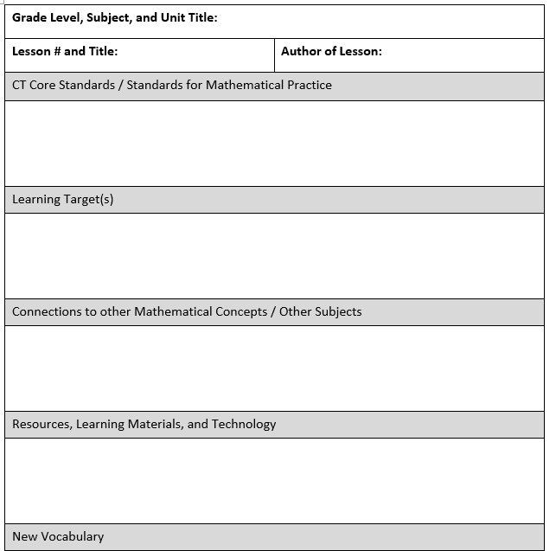
Sample CCS-Math Lesson Design Template:
Page 21
Notes:
Ask the participants to look over the elements on the Sample CCS-Math Lesson Design Template linking those to the list the group charted. Debrief with the whole group, asking for comments about the template, e.g. “Does the template include everything we charted so that a teacher will be thoughtful in their lesson planning and create a quality CCS-Math lesson?” (10 minutes)
Moving to the next slide, explain that table groups will now use the sample CCS-Math Lesson Design Template to design a lesson (page 21 in their Participant Guide). For the participants’ convenience in using the template, a Word version of the template is posted to the ctcorestandards.org website.

Slide 78
Designing a CCS-Math Lesson
Use the template to design a lesson that will address:
  The learning targets you identified in Section 2.
  The needs of all students through the pre-assessment data you created in Section 3.
Notes:
Explain to the participants that they will now work in their groups using the template to design a lesson that will address one or more of their selected learning targets from Section 2 and that will meet the needs of all students based on the pre-assessment data from Section 3. Each table group can choose to create their own lesson or modify a lesson that they find online. (Some resources for lessons are listed on page 24 in the Participant Guide.) (30 minutes)

Slide 79
Resources for Planning Lessons
CT Common Core Alg I Curriculum –
http://sde-cthsmoodle.cthss.cen.ct.gov/moodle/course/view.php?id=526
Illustrative Mathematics – http://www.illustrativemathematics.org
Achieve the Core – http://achievethecore.org
Smarter Balanced – http://smarterbalanced.org
Mathematics Assessment Project – http://map.mathshell.org/materials/index.php
Page 24
Notes:
These resources are also listed on page 24 in the Participant Guide.

Slide 80
Reflect on the use of the Sample
CCS-Math Lesson Design Template
Now that you have used it –
  How will the regular use of a template like this affect classroom instruction in your setting?
  Is there anything you would change about the template?
Page 24
Notes:
Using the questions on the slide, (also found on page 24 of the Participant Guide) ask the participants to briefly reflect on the use of the Lesson Design Template and share out as a large group. (5 minutes) If time permits, additional questions to ask and/or discuss include:
How is this template similar or different from what is regularly used?
Was there a part of the template that was more beneficial than another?
How well do the guiding questions provided in the template fit into current models of planning?
Are there questions that teachers may need more support with than others?

Slide 81
Let’s Take A Break…
…Be back in 10 minutes

Slide 82
Reflecting on the Lesson Design
Section 5
Page 26
Notes:
Section 5: Reflecting on the Lesson Design
Section 5 Time: 25 minutes
Section 5 Training Objectives:
To use the three UDL Principles, and the EQuIP rubric as tools to evaluate the quality of a lesson design.
Section 5 Outline:
Participants will do an assessment of their lesson design using the EQuIP rubric and the 3 UDL Principles. Grade level groups will make modifications and adjustments to the lesson design based on these results. (20 minutes)
The facilitator will wrap up this section by debriefing with the large group about any areas in their lesson design that needed to be changed as a result of their assessment. (5 minutes)
Section 5 Supporting Documents
UDL Design Principles
Lesson Design Evaluation recording sheet
Section 5 Materials
Copies of EQuIP rubric
Chart paper
Markers

Slide 83
Evaluating the Lesson Design
Use the following tools to evaluate the lesson you created/modified:
  EQuIP rubric (introduced in Module 1)
  UDL Principles (introduced in Module 3)
Record your observations and modifications on page 27.
Notes:
Ask the grade level groups to evaluate the lesson they created/modified using two tools: the EQuIP rubric introduced in Module 1 (distribute copies to each table) and the UDL Principles introduced in Module 3 (a copy is provided on page 26 in the Participant Guide).
As time permits, each table group should make modifications and adjustments to the lesson based on their observations. Participants can use the Lesson Design Evaluation recording sheet (page 27) to record any observations they made. (20 minutes)

Slide 84
Questions for Reflection
What were the strengths of your lesson design?
What areas of your lesson design were deficient?
Which of the evaluation tools did you find most helpful in finding these deficiencies?
Notes:
Wrap up this section by debriefing with the large group about any areas in their lesson design that needed to be changed as a result of their assessment. (5 minutes)

Slide 85
Supporting Teachers
Section 6
Page 29
Notes:
Section 6: Supporting Teachers
Section 6 Time: 30 Minutes
Section 6 Training Objectives:
To determine the questions to be answered as to teachers’ readiness, prior knowledge, and understanding of the structure of the Standards and how to design learning that is aligned to the CCS-Math.
Section 6 Outline:
1. Section 6 begins with participants determining what they want to know about teachers’ readiness, prior knowledge, and understanding of the structure of the Standards and how to design learning that is aligned to the CCS-Math. Based on what they want to know, participants will create questions that they want to have answered and determine how they will find the answers to those questions.
2. After participants create their questions, they will share their questions with their table group.
3. Section 6 will wrap up with a whole group debrief of the small group discussions and with the facilitator explaining that participants should bring the answers to their questions with them to the Module 5 session.
Supporting Documents
Determining an Entry Point into the Work
Materials
Chart paper
Markers

Slide 86
Determining an Entry Point
What do you want to know?
  Create the questions you want to answer around teachers’ readiness, prior knowledge, and understanding of the structure of the Standards and how to design learning that is aligned to the CCS-Math.
How will you find out?
  Conduct observations? Attend grade level meetings? Talk one-on-one?
What will you do with your findings?
Pages 29-30
Notes:
Where do we go from here? [sub-bullets are animated on this slide]
Now that participants have had the opportunity to explore the structure of the Standards and to plan and assess a CCS-Math lesson, it’s time to start thinking about what they should do now back in their school. Explain to participants that before they can bring today’s information back to their teachers, they will need to find out what teachers already know and are doing in terms of creating CCS-Math aligned lessons. They need to find this out in order to, just as we do with students, determine an entry point into the learning.
Explain to participants that you want them to first work alone to:
[click for text] Determine what they want to know and to create the questions that they want to answer around teachers’ readiness, prior knowledge, and understanding of the structure of the Standards and how to design learning that is aligned to the CCS-Math.
[click for text] Then, think about how they will find the answers to their questions. Will they conduct classroom observations? Sit in on grade level meetings? Schedule one-on-one time with each teacher?
After participants have answered these two questions on their own by completing the charts on pages 29-30 in their Participant Guide, have them discuss what they want to know and how they will find out with others at their table. Wrap up Section 6 by debriefing the small group discussions as a large group and by providing the answer to the third question on the slide. Explain to participants that between now and Module 5 they will need to work to complete the ‘Answer’ column in their participant guide and that they need to bring this work with them to the Module 5 session as the focus will specifically be on strategies for coaching teachers in their implementation of the CCS-Math.

Slide 87
Closing Activities
Page 32
Notes:
The goal of the Closing Activities is for participants to determine how they will take the key information back to their peers at their school so that everyone gains a shared understanding.
Total time on Closing Activities: 5 minutes
Closing Activities at a Glance:
1. Review the Module 4 Outcomes.
2. Have participants complete the Post-Assessment.
3. Have participants complete the online Session Evaluation located here: http://surveys.pcgus.com/s3/CT-Math-Module-4-6-12.

Slide 88
Focus on Designing Learning
By the end of this session you will have:
  Strengthened your working relationships with peer Core Standards Coaches
  Explored the structure of the Standards and the Progressions on which the Standards were developed
  Created effective learning targets for use in planning lessons
  Described a process and strategies for conducting informal needs assessment in order to identify student needs
Notes:
Review the outcomes for the day. There are seven outcomes for this session. These are presented to the participants over two slides.

Slide 89
Focus on Designing Learning (cont'd)
By the end of this session you will have:
  Identified elements that need to be considered when designing and implementing CCS-Math lessons
  Designed and/or modified CCS-Math lessons in order to meet the needs of all students
  Made plans for next steps in your CCS-Math implementation
Notes:
Continue to review the outcomes for the day.

Slide 90

Post Assessment and Session Evaluation
Where Are You Now?
Assessing Your Learning.
Please complete an online Session Evaluation. Your feedback is very important to us! The survey is located here:
http://surveys.pcgus.com/s3/CT-Math-Module-4-6-12
Notes:
This Post-Assessment is the same as the Pre-Assessment they took in the beginning of the session. This assessment is to gauge their learning based on the activities of the full day session. Remind the participants to fill out their online Session Evaluation as well: http://surveys.pcgus.com/s3/CT-Math-Module-4-6-12.

Slide 91

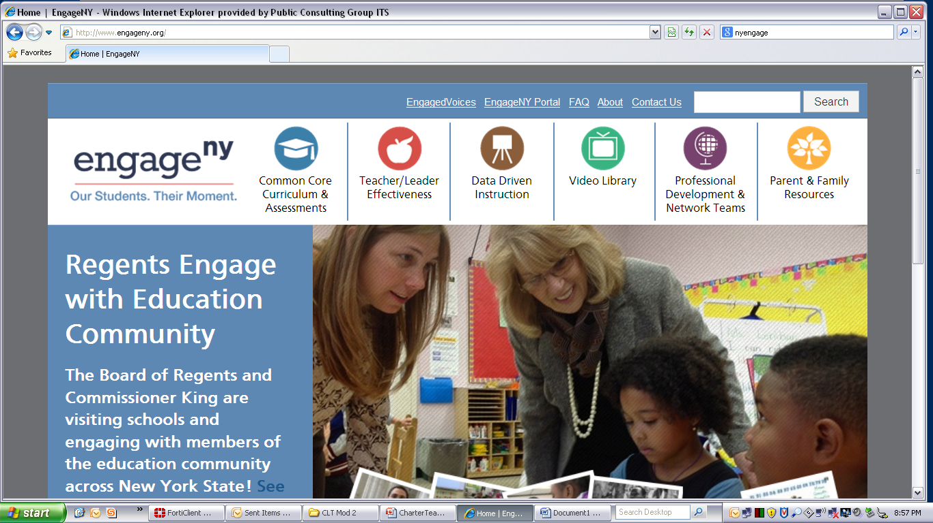

Some Key Resources
ctcorestandards.org
engageny.org
achievethecore.org
americaachieves.org

Slide 92
Thanks, and see you next time!

