Slide 1


Meeting the Challenge:
CT Core Standards Success for English Learners and Students with Disabilities
A Professional Learning Series for School Teams Dedicated to the Success of ALL Students
Module 3:
Designing Curriculum with Intention and Rigor

Slide 2
Essential Questions
How can I create a learning process that ensures each student connects to the learning in personal and meaningful ways?
What does it mean to “water-up” my curriculum? How do I do it?
How do I create an instructional process that connects objectives, goals, instruction, and assessment into a closed effective loop?
How can I naturally embed a UDL framework to “water-up” my curriculum so I create an environment where all students meet higher expectations with personal success?
Notes:
These are the big questions that are the underpinning for today’s UDL session. We are building upon our understanding of UDL and scaffolding our instructional design so we will create rigorous learning environments where all students may access high expectations.

Slide 3
Module 3 Session Agenda
Designing Curriculum with Intention and Rigor
  Introductory Activities
  Four Components of Curriculum Design in the UDL Classroom
  Attributes, Examples, and Applications of Formative Assessment
  Making Effective Instructional Decisions
  Reflection, Next Steps, and Session Evaluation
Notes:
Presenter shares the points on the slide.

Slide 4
You are Here! Introductory Activities
Introductory Activity
Part 1:
Four Components of Curriculum Design in the UDL Classroom
Part 2:
Attributes, Examples, and Applications of Formative Assessment
Part 3:
Making Effective Instructional Decisions
Part 4:
Reflection, Next Steps, & Session Evaluation
Notes:
Point out to participants that this module is composed of 4 parts and an introduction.

Slide 5



Introductory Activity: Code, Highlight, Focus
  After reading through today’s Essential Questions and Session Agenda, code each question accordingly:
+ I have sufficient background knowledge and experience.
I have an understanding, but I need to apply with
consistency.
! This is exciting! I want to learn more so I can apply it!
  Next, highlight the words in each Essential Question that will provide a focus and help you set your intention for today’s collaborations.
Page 4
Notes:
Introductory Activity—Allow 15-20 minutes for this activity.

Slide 6
You are Here! Four Components of Curriculum Design in the UDL Classroom
Introductory Activity
Part 1:
Four Components of Curriculum Design in the UDL Classroom
Part 2:
Attributes, Examples, and Applications of Formative Assessment
Part 3:
Making Effective Instructional Decisions
Part 4:
Reflection, Next Steps, & Session Evaluation
Notes:
Part 1: Four Components of Curriculum Design in the UDL Classroom

Slide 7
Universal Design for Learning
Universal: Everybody has the opportunity to develop and reach his personal best.
Design: UDL is “intentional, purposeful, and planned.” The variability of learners and their needs are considered right from the start.
Learning: All individuals are challenged and supported in meaningful ways to work toward making progress and mastering goals.
Notes:
Connect and review the UDL framework from modules 1 and 2 to provide the context of applying UDL Principles and Guidelines throughout today’s session. Encourage participants to make connections to previous module work. Ask them to consider how they have applied UDL so far since attending modules 1 and 2. Allow a few minutes to share connections and specific experiences to UDL and their classrooms.
Consider referencing the chart on page 10 of the Participant Guide.
Transition discussion to next slide—which will delve deeper into the comprehensive components of applying UDL.

Slide 8
Four Components of Curriculum
Assessment
Setting Goals
Materials
Methods
Learner
www.cast.org
Notes:
Emphasize that within a UDL framework, the curriculum is defined as rigorous or successful when it provides genuine learning opportunities for everyone. It is responsive and flexible to adjust to the needs and interests of all learners. This definition is broader than traditional definitions which treat curriculum as a sequence of content and materials that must be implemented in a certain way. Adopting an understanding of curriculum through the UDL lens places the learner at the center of the learning process rather than a text book or packaged set of materials and content elements.
In addition, emphasize the connection between this view of curriculum as student-centered with the process of formative assessment where again the students’ connections, performance, and understandings are at the center of the teaching and learning process.

Slide 9
Activity 1: Accessing Curriculum Jigsaw
Creating Accessible Learning
Number off at your table: 1, 2, 3, 4 (1=Goals, 2=Instructional Materials, 3=Teaching Methods, 4=Assessments). Individually read your corresponding curriculum component from the handout Universal Design for Learning and Meaningful Access to the Curriculum (Goals page 15; Instructional Materials pages 15-16, Teaching Materials page 16, and Assessments page 16). Your reading focus will be to: Explain the curriculum component. Gather examples of the contrast between traditional and UDL approaches to the specific curriculum component. Use post-its to record your thinking. Be prepared to share with your team. As your colleagues share, you may wish to continue recording notes.
Page 6
Notes:
Allow 30 minutes for this activity.
Following the activity, have participants share as a whole group to emphasize how a deeper understanding of curriculum places teachers in control of what happens in their classrooms. This activity should set the stage for teachers to begin to connect to the value and urgency of making meaningful instructional decisions each day.

Slide 10
Central Ideas for Watering-Up the Curriculum
Instruction facilitates deep understanding of core ideas and meaningful learning.
Instruction strives to support the learner in fundamental ways.
UDL is proactive and keeps variable learners in mind throughout the planning, instruction, and assessment process of learning.
UDL embeds student specific supports and scaffolds.
Enter UDL
Notes:
When you are in slide show presentation mode–review the first two bullets then click so “Enter UDL” will appear. This will take your explanation of watering-up the curriculum to another level as you guide participants to connect UDL with designing and delivering instruction that provides high expectations and rigor. This slide also connects to upcoming ideas on the importance of using UDL strategies to scaffold the learning process to allow all students to experience the rigor of a meaningful learning process.
Many practices associated with providing students with accommodations water down the curriculum and expectations of students with disabilities. The watering-down approach reflects an apparent belief that the role of special education is to enable students to acquire the necessary course credits that lead to graduation and to enable them to understand and remember the minimal amount of content-area information necessary to attain course credits. Such accommodations may initially seem like logical practice, but they are inherently limited in many ways.
The concept of watering up the curriculum was first proposed by Edwin Ellis in 1997.
In a watered-up classroom, the role of the teacher is to facilitate students' constructing (and reconstructing) of understandings so that their thinking becomes increasingly clear.
Goals of a Watered-up Curriculum
Knowledge dimension
More emphasis on students' constructing knowledge
More depth, less superficial coverage
More emphasis on archetype concepts, patterns, and strategies
More emphasis on developing relational understanding and knowledge connections to real-world contexts
More student elaboration
More emphasis on developing effective habits of the mind, higher order thinking and information processing skills, and learning strategies

Slide 11
CAST, Inc. 2011. Used with Permission. All Rights Reserved.
Notes:
Review this graphic organizer as participants connect to what they have learned about its application from module 1 and 2. This organizer will continue to be used by participants as a reference to complete activity 2—as well as throughout this module.

Slide 12
Activity 2: Milling to Music
Share Your Thinking
Independently read through Watering-Up the Curriculum starting on page 8 in your Participant Guide. For each goal, write down one UDL Principle that aligns with the goal. Jot down your responses on the Key Words Note-Catcher on page 11. When prompted, get ready to share your thoughts with two peers as we follow the Milling to Music protocol. As the music is playing, walk around the room. When the music stops, share your notes with the person closest to you. Remember to listen to your colleague’s thoughts as well. When the music begins, move around the room again. Feel free to dance! When the music stops, share your thinking and listen with the colleague closest to you. Be prepared to share your thoughts when you return to your table.
Pages
7-11
Notes:
Now that the idea of learner variability has been discussed and understood by participants, we move to the application of the idea of viewing all students in the classroom as variable—not students with disabilities, but rather all students are variable. So what can we proactively plan for when we adapt curriculum to meet the needs of variable learners? This activity, along with the next slide, will get participants to begin to apply the idea.
Allow 20-30 minutes for this activity.

Slide 13

Let’s Take A Break…
…Be back in 10 minutes
Notes:
The break should be 10 minutes. Remind participants to try to be timely in their return.

Slide 14
Promoting Independent Learning and
Self-Reliance
Keep expectations high by setting goals that align with CT Core Standards, skills, and strategies.
Use the UDL Principles and Guidelines to support effective, meaningful instruction and assessment of true learning.
Keep the Watering-Up goals in mind and within your teaching moves.
Notes:
Well intentioned teachers often accommodate in ways that enable or provide lower expectations for students with disabilities. Scaffolding in ways that support understanding of CT Core Standards will promote independence and encourage students to become more aware of their strengths and advocate for their needs to learn.

Slide 15
Activity 3: Goals and Strategies to Water-Up with UDL
Create Meaningful and Rigorous Learning Environments
Choose one of your lesson plans or one that is provided at your table. Use your UDL Principles and Guidelines on page 10 to identify three places in the lesson plan where a UDL Principle is evident. Place a post-it and label it with your identified principle. Use the goals from the Watering-Up Curriculum article and identify what aspects of the lesson plan align with these goals. Use your Watering-Up the Plan Note-Catcher to organize your thinking. Be prepared to share!
Pages
12-13
Notes:
Introduce the activity on the slide. Answer any questions. Provide 20-30 minutes for this activity.

Slide 16
Scaffolds, Scaffolds, Scaffolds!
UDL provides naturally embedded scaffolds that are good for all students.
Some students need further scaffolding—leading to the need for teachers to proactively differentiate the level of scaffolds.
Front-end Scaffolding and Back-end Scaffolding are two options to create access to the content during the moments of teaching for students with disabilities.
Notes:
About Scaffolds and Scaffolding:
Scaffolds create access to the rigor of the CT Core Standards. Providing scaffolds means providing tools, structures, or supports such as chunking text or pre-teaching vocabulary that allow more students to access the learning. The term scaffold, comes from Wood, Bruner, and Ross (1976), who define it as a process "that enables a child or novice to solve a task or achieve a goal that would be beyond his unassisted efforts" (p. 90). As they note, scaffolds require the adult's "controlling those elements of the task that are initially beyond the learner's capability, thus permitting him to concentrate upon and complete only those elements that are within his range of competence" (p. 90). For example, in teaching a child to ride a bike, the training wheels serve as one scaffold. The adult running alongside the bike serves as another. In other words, the adult handles the harder parts temporarily, while allowing the child to try out the easier parts.
Like scaffolds that hold a building in place as it's constructed, "scaffolding is actually a bridge used to build upon what students already know to arrive at something they do not know. If scaffolding is properly administered, it will act as an enabler, not as a disabler" (Benson, 1997, p. 12).
Designing instruction using the three principles of UDL naturally allows teachers to embed scaffolds. A true universal design looks at what students know and provides multiple means of enabling more students to access, engage in, and succeed in the work. SwD often need further scaffolds—which creates a need for teachers to be proactive in their decisions to make the content accessible to these students.
Resources: Wood, D. J., Bruner, J. S., & Ross, G. (1976). The role of tutoring in problem solving. Journal of Child Psychiatry and Psychology, 17(2), 89-100
Benson, B.K. Coming to Terms: Scaffolding, English Journal, Vol. 86, No. 7, November 1997

Slide 17
Effective Scaffolding Examples
Front-end scaffolding:
The actions teachers take to prepare students to better understand how to access complex text before they read it.
This scaffold builds a context for the reading and activates and creates a background knowledge base for students to begin to attach meaning to the text.
Traditional Front-end scaffolds include:, Previewing vocabulary, making predictions, and summarizing the text before it is read.
Meeting Students Needs Through Scaffolding, Expeditionary Learning. Retrieved from
https://www.engageny.org/sites/default/files/resource/attachments/scaffolding_student_needs.pdf
Notes:
Review the value of front-end scaffolding as one way of providing access to the high expectations and rigorous curriculum.
Source: https://www.engageny.org/sites/default/files/resource/attachments/scaffolding_student_needs.pdf
Meeting Students Needs Through Scaffolding, Expeditionary Learning

Slide 18
Effective Scaffolding Examples
Back-end scaffolding:
The actions teachers take following the reading of complex texts to help deepen students’ understanding of the text.
The implementation of this scaffold follows a “Release-Catch-Release” model, allowing students to grapple with hard text FIRST, and then providing supports as needed.
Meeting Students Needs Through Scaffolding, Expeditionary Learning. Retrieved from
https://www.engageny.org/sites/default/files/resource/attachments/scaffolding_student_needs.pdf
Notes:
Review back-end scaffolds as another scaffolding option for removing learning barriers, so all learners may access the same high standards.
Engage participants in a discussion about the value of applying scaffolds. For example, a variety of barriers exist—such as low skill levels in decoding, comprehension, writing, math fluency, speaking, and lack of confidence. Thoughtful scaffolds planned proactively through the UDL lens will provide access, so students will meet with personal success toward mastery. Scaffolds allow for all students to enter the lesson and increase their personal abilities from the point they’re at. Teachers must show students what is expected by sharing learning target and CT Core Standard (from module 2) and guide students to increase their personal ability levels. Allow time for participants to connect and share specific experiences.
Source: https://www.engageny.org/sites/default/files/resource/attachments/scaffolding_student_needs.pdf. Meeting Students Needs Through Scaffolding, Expeditionary Learning

Slide 19
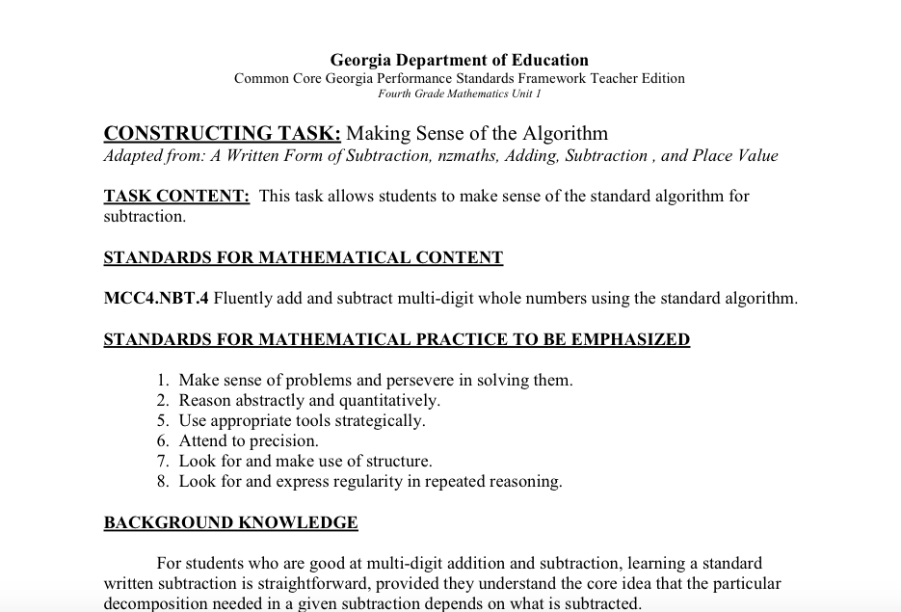
Example of Scaffold in Math
Learning target:
Writing standard multi-digit algorithm for subtraction
Front-end Scaffold:
Review how to decompose for accuracy and fluency
Back-end Scaffold:
Provide students with additional modeling and review following the lesson
Provide additional visual examples, graphic organizers, graph paper, and peer support, within the lesson as needed
Notes:
Review front-end and back-end scaffolds as they appear in this math lesson. Review the skills all students need to master this learning target: Namely, they need to be fluent with adding and subtracting whole numbers—and they need an understanding of place value as well as the need to be organized to add and subtract multi-digit whole numbers. Review the examples of some scaffolds that can take place—have participants share any other ideas they may have.
Source: http://ctcorestandards.org/?page_id=795
Discuss the value of applying scaffolds across content areas.

Slide 20

Example of Scaffolds for Writing
Learning Target:
Writing an argument to support a claim
Front-end Scaffold:
Model examples and strategies
Review the reading and main ideas through additional close reading and annotating
Review writing complete sentences and overall mechanics
Provide graphic organizer supports at the onset
Back-end Scaffold:
Review the reading and writing process following the student’s best attempts
Supply graphic organizer or study guide after the student’s best attempt
Notes:
Review this example of front-end and back-end scaffolds in action for English Language Arts. Identify the skills all students will need to accomplish this learning target: Namely, ability to identify themes and text-based evidence to support their theme. In addition, students will need to synthesize the text evidence to support their thinking. Also, students will need to apply appropriate mechanics of standard English and organization of their ideas into paragraphs.
Writing Evidence-Based Claims. Retrieved from http://odelleducation.com/wp-content/uploads/2012/08/Writing-EBC-Handout-Jobs.pdf
Overarching goal is to make learners as independent as possible.

Slide 21
Activity 4: Meeting Students’ Needs through Scaffolding Protocol
Applying Appropriate Scaffolds
Read through the text, “American Explorers” on page 15. Decide on the types of scaffolds that would work through a UDL lens. Use the UDL Principles and Guidelines to come up with two scaffolds that would work for your whole class of variable learners. Now read Meeting Students’ Needs Through Scaffolding and decide specific ways you would apply front-end and back-end scaffolding. Use the Scaffold For Success Note-Catcher to capture your thoughts. Share and brainstorm application ideas with your team. Be prepared to share with the whole group.
Pages
14-16
Notes:
Read instructions for Activity 4. Allow 30 minutes for this activity
Meeting Students’ Needs Through Scaffolding. Retrieved from https://www.engageny.org/sites/default/files/resource/attachments/scaffolding_student_needs.pdf

Slide 22

Bon Appétit
Notes:
Participants have 60 minutes for lunch. Remind them to be back on time as we will begin promptly.

Slide 23
You are Here! Attributes, Examples, and Applications of Formative Assessments
Introductory Activity
Part 1:
Four Components of Curriculum Design in the UDL Classroom
Part 2:
Attributes, Examples, and Applications of Formative Assessment
Part 3:
Making Effective Instructional Decisions
Part 4:
Reflection, Next Steps, & Session Evaluation
Notes:
Part 2: Attributes, Examples, and Applications of Formative Assessments

Slide 24
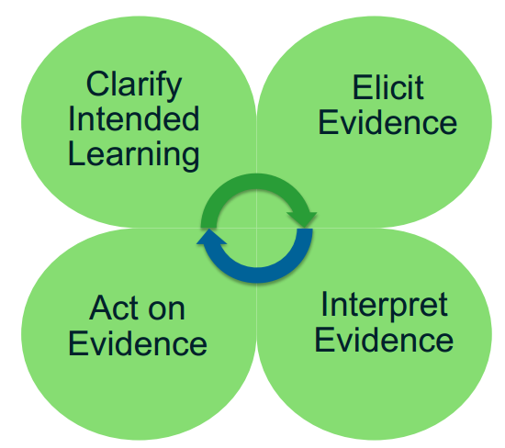
The Formative Assessment Process
http://www.smarterbalanced.org/
Notes:
Formative Assessment is a deliberate process used by teachers and students during instruction to provide actionable feedback. Teachers use the information gleaned from students’ performance to adjust ongoing teaching and learning strategies.
Four Attributes in a Formative Assessment cycle:
Clarify intended learning: stated learning goals-big ideas and concepts that are transferrable to the CT Core Standards.
Elicit Evidence: determines where students are along their progress and performance toward intended learning.
Interpret evidence: collect data/student samples in connection to learning goals to determine students’ progress. Teachers and students can analyze evidence of learning to inform future instruction and learning.
Emphasize that this Formative Assessment process provides actionable feedback to allow students to take an active role in their learning process—and allows teachers with the evidence they need to plan and structure meaningful learning experiences.
Have participants take a minute to connect this Formative Assessment process with the Four Components of a UDL Curriculum. Discuss in table groups and whole group.

Slide 25
Activity 5: Video Connections
Formative Assessment: Collaborative Discussions
View the video Formative Assessment: Collaborative Discussions. Think about what you noticed, what surprised you, and which ideas you may bring back to your classroom or school. Jot down your connections and ideas on post-its. Be ready to share!
Page 18
Video: Teaching Channel. Formative Assessment: Collaborative Discussions. Retrieved from https://www.teachingchannel.org/videos/formative-assessment-example-ela-sbac
Notes:
Formative assessment video: https://www.teachingchannel.org/videos/formative-assessment-example-ela-sbac
Allow 20-30 minutes for this activity

Slide 26
Activity 6: Highlight the Strategies
Formative Assessment Applications
Take a look at your Tools for Formative Assessment: Techniques to Check for Understanding—Processing Activities. Put a check next to all of the strategies you have used. Highlight 3‒5 strategies that you would like to use within the next few months. Identify the UDL Principle that aligns with this strategy. Be prepared to share at least one of your ideas for application with your team.
Page 19
Notes:
Tools for Formative Assessment: Techniques to Check for Understanding—Processing Activities. Retrieved from http://www.levy.k12.fl.us/instruction/Instructional_Tools/60FormativeAssessment.pdf
Allow Allow 20 minutes for this activity—engage participants in table group and whole group shares

Slide 27
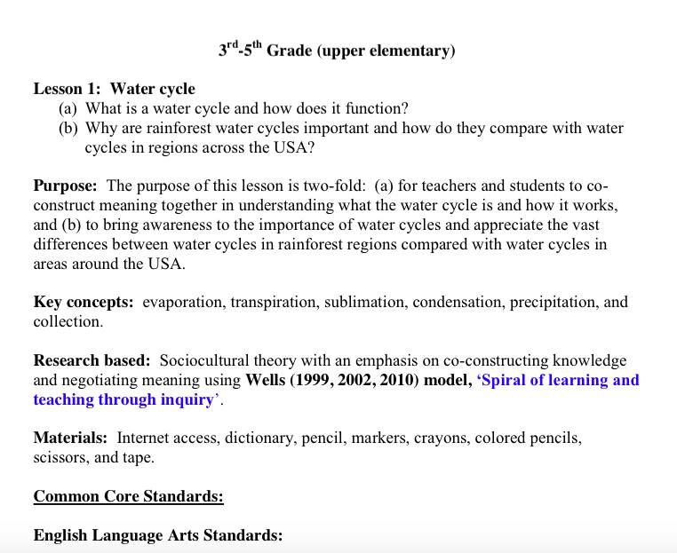
Lesson Plan Analysis
Effective instruction waters-up the curriculum through naturally embedded UDL Principles and Guidelines and opportunities for ongoing assessment.
Effective teachers proactively plan for the need to differentiate scaffolds ahead of time to meet the needs of students with disabilities.
Notes:
Participants will be provided with a variety of content area lesson plans to choose from.

Slide 28
Activity 7: Watering-Up the Curriculum
Tools for Formative Assessment
Read through one of the lesson plans at your table. Also refer to Tools for Formative Assessment: Techniques to Check for Understanding: Processing Activities (from Activity 6): How does this plan already incorporate effective formative assessment? What do you notice? How does this plan’s use of assessment inform the teacher’s instructional planning and goal setting for future lessons? What changes would you make? How could this plan influence a more effective use of formative assessment in one of your upcoming lessons? Use the Evidence of Watering-Up the Curriculum on page 28 to document your ideas and spark your thoughts for applications.
Pages 27-28
Notes:
Explain the instructions for Activity 7. Allow 20 minutes for this activity—Be sure to have participants make the connections between instructional decisions, scaffolding, and watering up the curriculum. Reference page 8 of the Participant Guide so participants can recall goals of watering up

Slide 29
You are Here! Making Effective Instructional Decisions
Introductory Activity
Part 1:
Four Components of Curriculum Design in the UDL Classroom
Part 2:
Attributes, Examples, and Applications of Formative Assessment
Part 3:
Making Effective Instructional Decisions
Part 4:
Reflection, Next Steps, & Session Evaluation
Notes:
Part 3: Making Effective Instructional Decisions

Slide 30
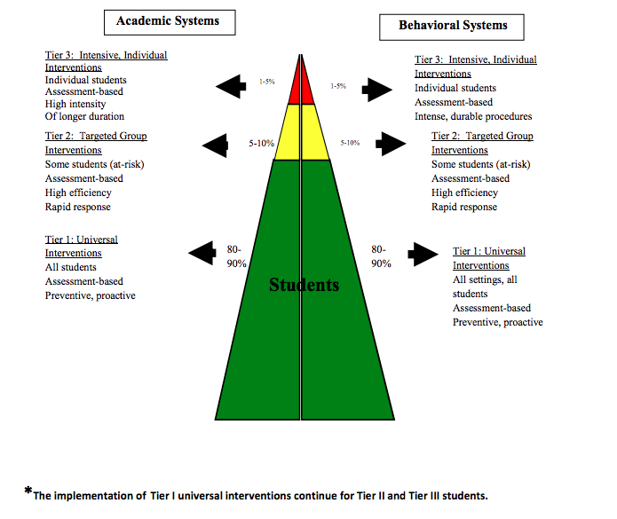
Tiered Instructional Decisions
Scientifically Research-Based Interventions (SRBI)
What drives the decision making?
*The implementation of Tier 1 universal interventions continues for Tier 2 and Tier 3 students.
Notes:
It must be emphasized that all three tiers are a part of a comprehensive educational system involving scientific, research-based, core, general education practices and interventions with supports from a wide range of support services personnel. In particular, the tiers should not be viewed as categorical placements or as “gates” to special education. When interventions are designed to meet specific students’ needs, implemented with fidelity and there are data demonstrating students’ progress, then most students should not require special education services. UDL and progress monitoring when implemented effectively provide a means for all students to access curriculum and for teachers to ensure student understanding.

Slide 31
The Power of Monitoring Student Learning
Know your Students
Plan Content with UDL in Mind
Implement Variety of Research-Based Strategies
Ongoing Assessments
Reflect
Notes:
Emphasize that the process of effective instruction begins with a deep knowledge of the needs of the variable learners and the content we are to teach.
Plan with intention, flexibility, and reflection to keep the cycle of learning connected to students and to meaningful learning experiences.
Make time for participants to analyze, connect, and share their thinking around this process—turn and talk and then whole-group share.
Know your students: For SwD, understand their present level of performance indicated on page 4 and 5 of the IEP.

Slide 32
Activity 8: Final Word Protocol
Distinguish Between Accommodations and Modifications
Review The Power of Monitoring Student Learning figure. Choose one person in your group to take the role of presenter. The presenter will get one minute to share his or her thinking. The presenter will be the only speaker. One person should be the designated timekeeper. The presenter will discuss how this cycle connects with what happens in your classrooms. How can this cycle meet the needs of variable learners? What would could be added to this cycle that would further depict effective learning? Rotate presenters in clockwise manner. Rotating presenters will re-emphasize important aspects to the first presenter while contributing his or her own thinking to push everyone’s thinking along. The original speaker gets the last word—sharing how his or her thinking has evolved after listening to other presenters.
Pages
30-31
Notes:
Allow 20 minutes for this activity. Read the instructions for Activity 8.

Slide 33
Let’s Take A Break…
…Be back in 10 minutes
Notes:
The break should be 10 minutes. Remind participants to try to be timely in their return.

Slide 34
Activity 9: Check For Understanding
Techniques You Can Apply in Your Classroom
Read the handout Checking for Understanding: Key Assessment for Learning Techniques. Check off the techniques as you read through to identify three techniques that you would like to apply in your classroom. Turn and talk to discuss your application plans. As you listen to your colleagues ideas, jot down your connections for application. Be prepared to share.
Page 32
Notes:
Checking for Understanding: Key Assessment for Learning Techniques handout. Retrieved from https://www.engageny.org/sites/default/files/resource/attachments/checking-for-understanding-techniques.pdf
Allow 15 minutes for this activity

Slide 35
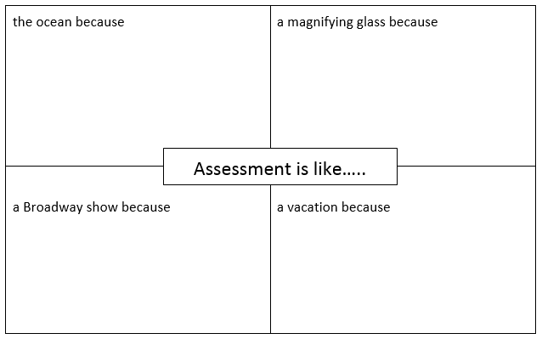
Activity 10: Thinking Deeply about Assessment
Turn to page 33 and complete your thinking about assessment. Be ready to share!
Notes:
Take 10 minutes to allow participants to connect to the value of assessment.

Slide 36
Summarize and Synthesize
UDL Components of Curriculum
Nine Goals of Watering-Up the Curriculum
Four Attributes of Formative Assessment
How does it all connect?
Notes:
Provide a 5 minute discussion on bringing it all together. Decide if you would like table groups to discuss or if you would like to share as a whole group.

Slide 37
You are Here! Reflection, Next Steps, & Session Evaluation
Introductory Activity
Part 1:
Four Components of Curriculum Design in the UDL Classroom
Part 2:
Attributes, Examples, and Applications of Formative Assessment
Part 3:
Making Effective Instructional Decisions
Part 4:
Reflection, Next Steps, & Session Evaluation
Notes:
Part 4: Reflection, Next Steps, & Session Evaluation

Slide 38
Collaborative Team Plan
WHY
WHAT
HOW
Collaborate
Topics/ Students
Process
Notes:
Emphasize the belief that beginning collaborations with “the why” sets the tone and intentions for creating a shared vision in creating meaningful learning environments. Sharing perspectives and knowledge of students and best practices as a combined effort creates powerful practice.

Slide 39
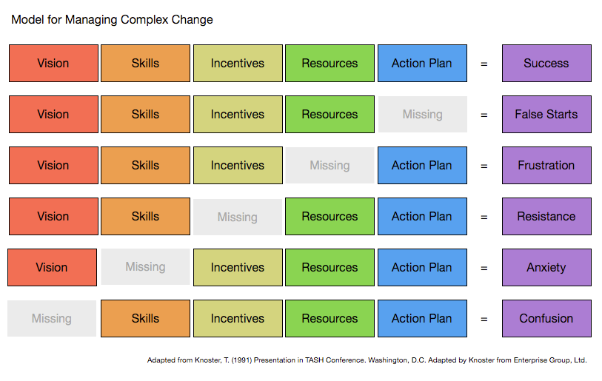
Notes:
Discuss the first line as the ideal way to collaborate and create positive efforts and experiences. Missing components will most likely lead to fragmented collaborations. Have participants turn and talk for one minute about their connections and thoughts on the value of this chart to spark effective collaborations in their schools.
RISConnections Newsletter. (2014, September 15). Model for managing complex change (from Knoster, T., 1991). RISConnections, 2(1), 3. Retrieved from http://www.reinventingschools.org/wp-content/uploads/2014/09/RISConnections-9-15-14.pdf

Slide 40
Activity 11: Creating a Collaborative Action Plan
Shared Vision
Use the Shared Vision Organizer on page 36 to begin team discussions for creating a collaborative team action plan in your schools. For each component of the process, outline what your team will need in order to lead to success.
Pages
35-36
Notes:
Allow 20 minutes for this activity. For Reflections and Next Steps, participants who came as teams must be seated with each other.

Slide 41
Shared Vision Organizer
Fill in the chart below to map your ideas to create positive change and increased
student achievement.
 | Who | What | Where | When | Why and How
Vision
Skills
Incentives
Resources
Action Plan Steps
Notes:
This is a visual of the Shared Vision Organizer in the Participant Guide.

Slide 42
Reflections and Next Steps
On page 37 of your Participant Guide, jot down your reflections for turning today’s ideas into actions within the near and far future.
What aspect of today’s learning can you bring back to your classroom or school tomorrow, three months from now, and one year from now?
Page 37

Slide 43





Additional Resources
Center for Applied Specialized Technology
www.cast.org
National Center for Universal Design for Learning
www.udlcenter.org
Connecticut Core Standards
http://ctcorestandards.org/?page_id=7773
Maryland Learning Links
http://marylandlearninglinks.org/1021
Maryland State Education Department
UDLinks app
Notes:
Share these resources with participants—Emphasize the tools provided at these sites all support the natural instructional and assessment process teachers need to address learner variability in all classrooms.

Slide 44
Session Evaluation
Thank you for attending Module 3’s session, Designing Curriculum with Intention and Rigor.
Your feedback is very important to us! Please fill out a short survey about this afternoon’s session.
The survey is located here: http://surveys.pcgus.com/s3/CT-Module-3-SwD
Notes:
Remind participants to complete the online Session Evaluation. The survey is located here: http://surveys.pcgus.com/s3/CT-Module-3-SwD
Ask for further thoughts, questions.

Slide 45
Thank you!

