Slide 1


Meeting the Challenge:
CT Core Standards Success for English Learners and Students with Disabilities
A Professional Learning Series for School Teams Dedicated to the Success of ALL Students
Module 3 ‒ EL
Accessing the Connecticut Core Standards in Mathematics
Notes:
Presenter:
Slide showing when participants enter.
This module supports participants as they continue to learn how to support EL students in the CCS by exploring the mathematics standards.

Slide 2

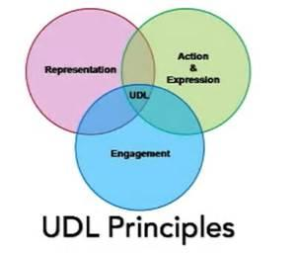
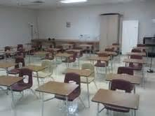


Think-Pair-Share: Your Learning and Applications from Modules 1 and 2
Beowulf
imagery
Notes:
Presenter:
Set the stage:
Acknowledge that some participants attended Modules 2 and have done this activity once already.
Some participants attended Module 1 and now Module 3.
We are repeating this exercise.
The review and repetition is beneficial. Plus, the outcomes may be different with different educators participating.
Think - don’t talk.
Reflect on previous learning from Modules 1 and 2.
an “aha” moment
a time you “designed to the edges” (term from Module 1 video)
something that affirmed your current practices
an application with your school or with your students
Pair - share your reflection with a table partner.
This should take about 3 minutes.
BENEFITS for ELs Think-Pair-Share:
Provides think time.
Suggestion: younger learners - “Put on your thinking caps.”
Promotes home language retention and development through homogeneous pairings.
Promotes English language development when a partner shares in English what his/her non-English speaking partner said: i.e., now that person is also hearing his/her idea expressed in English.
Opportunity to rehearse language with a partner in a lower-stress situation prior to sharing; such rehearsal opportunities can have a profound effect on language production.
Hearing an idea more than once promotes receptive language development.
Every student participates:
Students who most need language growth are not typically the ones with their hands up to volunteer.
It may also be culturally inappropriate to do so for students with collective cultural backgrounds; however, it is generally appropriate across cultures to share a group or partner idea.
Use differentiated sentence frames to support ELs and provide models for language growth of all learners.
Easier for students with less confidence/language to share if they have a starting point.
Structure younger learners’ partner talk further; e.g., ask “birds” to share then when done, tell “butterflies” to share.
Tell younger students who their partner is before the sharing begins; e.g., students come to rug in pairs; there would be no more than one triad; no one left out; no time wasted.

Slide 3
Sentence Frames
I learned that _________________________.
I was surprised to learn that _____________.
__________ was the most interesting to me.
Another important big idea was__________.
I felt that _______________ would have the greatest impact on my teaching.
The emphasis on _________________ seems particularly relevant for teaching students in multicultural, multi-level classes.
Notes:
Presenter:
Traditional Think-Pair-Share: volunteers share ideas with whole group.
Adaptation of “Stand and Share” (Kagan) engages more learners.
Read the sentence frames.
Think of how you might share your most important learning using one of these frames. Allow approximately 10 seconds to do this and mention that appropriate think time is being modeled.
Ask everyone to stand; assure audience this is a volunteer activity.
One person shares; others sit if they had the same/similar idea.
The person sharing calls on the next person to share.
Speakers need to speak to audience, not the presenter.
This should take about 5 minutes.
BENEFITS for ELs:
Sentence Frames
Gives a starting point as well as provides modeling for the range of learners.
Teacher hears all statements.
Recommend writing the sentences in the order of complexity: simplest on the top.
Sentence frames and oral language practice provide models that can later be applied to writing.
Promote additional sentence variety:
Use more than sentence starters.
Provide omissions at the beginning of a sentence.
Model varied syntax to promote development of complex language; transferable to writing.
Consider the audience when constructing sentence frames; i.e., with younger ELs use only 2 or 3.
Use color:
Separates frames.
Can indicate level of difficulty.
Note: When asking students to share learning, use “I learned that” rather than “I learned” so that students are forced to express a complete idea, either an important fact, or better yet, a statement of understanding. Otherwise students will say I learned “about” a topic or “how”. Neither require statement of important learning.
Adapted Stand and Share (Kagan)
Opportunity for rehearsal, repetition, building comprehension, and hearing other ideas.
Used at the beginning of class provides review of previous learning as well as an orientation for students who were absent the day before.
Used at the end of class, promotes summary statements; encapsulation of essential learning.
Productive use of class time:
Beginning of class: “bell ringer” activity; students not present do not miss essential new learning.
During class: encourages engagement and physical activity; reinforces new learning.
End of class period: for older students eliminates ‘packing up/checking out’ before the bell; for younger students utilizes every moment including just before lunch, recess or dismissal.
Tips:
Use when students need to move.
Use at the beginning of class to review previous learning.
Use at the end of class to reflect on essential learning.
Use to support language development but do not use them all the time.
Write to specifically support the content.
Observe to make sure most reserved students are ready.
Observe to seek out students who regularly sit before sharing and appoint them to share first.
Know that once students are comfortable with this form of sharing, many will try to think of another idea to remain standing.

Slide 4
Today’s Agenda
Warm-Up Activities
The Language of Math
Digging Deeper – Language Scaffolds
  SMP 1: Make sense of problems and persevere in solving them.
  SMP 6: Attend to precision.
Collaboration is Key
Reflection, Next Steps, and Session Evaluation
Notes:
Presenter:
Introduce self.
Make any acknowledgements; e.g., PCG representative(s) present; CSDE representative(s) present
Location of washrooms or other important info
Breaks midmorning and midafternoon and one-hour lunch
Review content highlights on slide.
Under “Digging Deeper”, these two particular SMPs were selected because they are considered overarching, foundational habits of mind for mathematical thinkers. Therefore, we will go into greater depth with SMP 1 and SMP 6.
Note that actual classroom instructional strategies will be used throughout the day to engage with the content.

Slide 5

Today’s Agenda con’t.
Instructional Strategies:
Think-Pair-Share
Sentence Frames
Stand and Share (adapted)
Cornell Notes
Closed Sort
Role Play and more
Stay and Stray
3-Column Graphic Organizer
Foldables
Left Margin-Right Margin
Notes:
Presenter:
Read, point out a few, or have participants read to themselves.
All of these will be done as adult learners to explore the workshop content.

Slide 6
Goal of Today’s
Professional Development:
Deepen participants’ understanding of the Connecticut Core Standards (CCS) for Mathematics and their impact on instruction in meeting the needs of ALL learners, with an emphasis on English learners.
Notes:
Presenter:
Read aloud, paraphrase, or have participants read to themselves.

Slide 7

Pre-Assessment of Today’s Activities
I know the difference between CCS Mathematical Standards and the Standards for Mathematical Practice.
I understand the shifts of Focus, Coherence, and Rigor.
I am fully aware of the practices and the associated language functions that English learner students need in order to engage with mathematics content.
I have a practical understanding of the full descriptions of the Standards for Mathematical Practice and am able to apply them to math tasks for my English learner students.
I am able to identify the changing roles of the TESOL professional and can make educated recommendations that benefit English learner students.
Page 6
Notes:
Presenter:
Participants should rate on a scale of 1-4 their comfort/knowledge for each of these four statements.
This will be repeated at the end of the training to provide a Post-Assessment as well.
Allow about 5 minutes.

Slide 8
You are Here!
The Language of Mathematics
Warm-Up Activities
Part 1:
The Language of Mathematics
Part 3: Collaboration is Key
Closing Activities
Part 2:
Digging Deeper – Language Scaffolds
Notes:
Presenter:
Graphic will be displayed throughout the day.
Now, Part 1: The Language of Mathematics

Slide 9
Activity 1: Viewing a Video – Beyond Right Answers
Cornell Note-Taking
View the video, Beyond Right Answers. Using the note-taking organizer on page 9 of your Participant Guide, take graphic or text notes in the right-hand column. Key words and ideas, Important information, Repeated/stressed information After the video, note the most important information in the left-hand column. Main idea(s), Key questions With your team, write a summary of the video in the space at the bottom.
Page 9
Notes:
Presenter:
Video is 10 minutes in length.
Cornell Note-taking
Generally thought of for college note-taking but applicable to middle/secondary school.
Note-taking is done in the right column during the video/lecture/instruction.
Following, key points/questions are noted in the left column.
Finally, a summary is written at the bottom in the student’s own words.
Link to video: Teaching Channel. Beyond Right Answers: Math and the CCSS. Retrieved from https://www.teachingchannel.org/videos/teaching-math-ccss
Cornell Note-taking Benefits for ELs:
Can be partially completed prior to instruction so new learning is focused.
Either left or right column could be completed prior to instruction to help differentiate for the English learning needs of the student.
For students with beginning English proficiency, teachers can supply the details in the right column and ask the student to complete the main ideas/key questions in left column.
For students with intermediate English proficiency, teachers can supply the main ideas/key questions in the left column and ask the students to complete the detailed note-taking in the right column.
Can record information in symbols, graphics, or similar representations.
Serves to activate higher-order thinking when synthesizing and applying information.
Working with another student(s) can provide opportunities to process information in the home language and/or hear the group’s thoughts in English.

Slide 10

Beyond Right Answers
Teaching Channel. Beyond Right Answers: Math and the CCSS. Retrieved from https://www.teachingchannel.org/videos/teaching-math-ccss

Slide 11

Two Kinds of Math Standards Working Together
Standards for Mathematical Content
K-8 by Grade Level
High School by Conceptual Category
Standards for Mathematical Practice
Standard Across All Grades
Notes:
Presenter:
Two kinds of standards in Mathematics.
Standards for Mathematical Content.
Grade level for K-8; high school is by conceptual category.
Content students need to know and skills they need to possess.
Standards for Mathematics Practice.
Same for K-12.
Processes and proficiencies educators need to develop in students.
Good metaphor is two gears working to get a job done.
Slides 9-21 should take about 15 minutes.

Slide 12
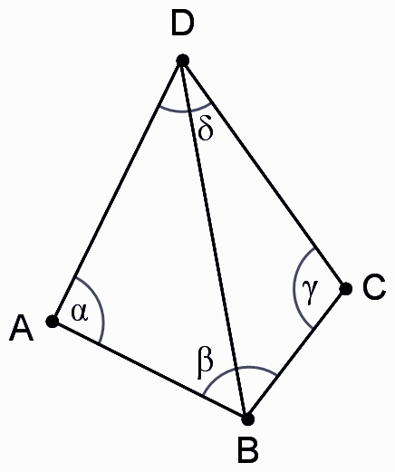
Kindergarten - 8th Grade Math Standards
Early Elementary
Upper Elementary
Counting & Cardinality: K
Operations & Algebraic Thinking: K-5
Number & Operations in Base 10: K-5
Measurement & Data: K-5
Number & Operations - Fractions: 3-5
Ratios & Proportional Relationships: 6-7
The Number System: 6-8
Expressions & Equations: 6-8
Statistics & Probability: 6-8
Functions: 8
Geometry: K-8
Is the only domain addressed
at all 9 levels
Notes:
Presenter:
Mathematics Standards are organized by grade level and domain in K-8.
Geometry is the only domain that is addressed at all 9 levels.
Domains organized in grade level clusters.
See additional resources: http://ctcorestandards.org/?page_id=2

Slide 13
High School Math Standards
Number and Quantity | Algebra | Functions
The Real Number System Quantities The Complex Number System Vector & Matrix Quantities | Seeing Structure in Expressions Arithmetic with Polynomials & Rational Expressions Creating Equations Reasoning with Equations & Inequalities | Interpreting Functions Building Functions Linear, Quadratic, & Exponential Models Trigonometric Functions
Modeling | Geometry | Statistics & Probability
Modeling is best interpreted not as a collection of isolated topics but rather in relation to other standards. Making mathematical models is a Standard for Mathematical Practice, and specific modeling standards appear throughout the high school standards indicated by a star symbol (*). | Congruence Similarity, Right Triangles & Trigonometry Circles Expressing Geometric Properties with Equations Geometric Measurement & Dimension Modeling with Geometry | Interpreting Categorical & Quantitative Making Inferences & Justifying Conclusions Conditional Probability & the Rules of Probability Using Probability to Make Decisions
Notes:
Presenter:
High school standards are organized by conceptual category.
See additional resources: http://ctcorestandards.org/?page_id=2
Our challenge today is learning how to implement the standards for ELs.

Slide 14

8 Standards for Mathematical Practice
Make sense of problems and persevere in solving them.
Reason abstractly and quantitatively.
Construct viable arguments and critique the reasoning of others.
Model with mathematics.
Use appropriate tools strategically.
Attend to precision.
Look for and make use of structure.
Look for and express regularity in repeated reasoning.
Notes:
Presenter:
Invite participants to review the SMPs independently.
Ask themselves this rhetorical question: Why is this important to my students’ expertise development?
Next 8 slides demonstrate SMPs in kid-friendly representations
Turn and talk to a partner
Elements (content, layout & language) of these posters that make SMPs comprehensible for ELs.
Implications for teachers.

Slide 15
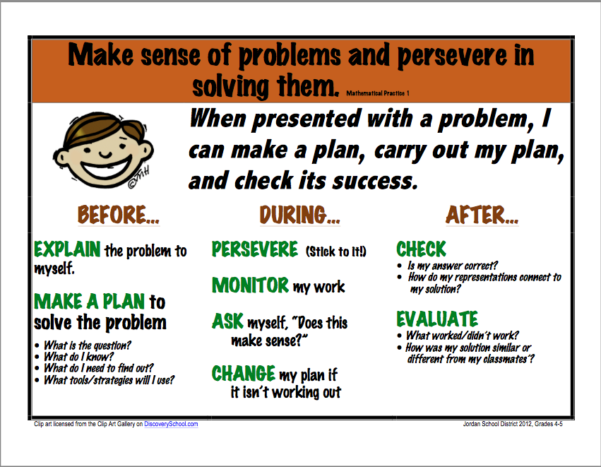
http://howtobeagreatteacher.com/
Notes:
Presenter:
Allow 2 minutes to review and discuss focusing on:
Elements (content, layout & language) of these posters that make SMPs comprehensible for ELs.
Implications for teachers.

Slide 16
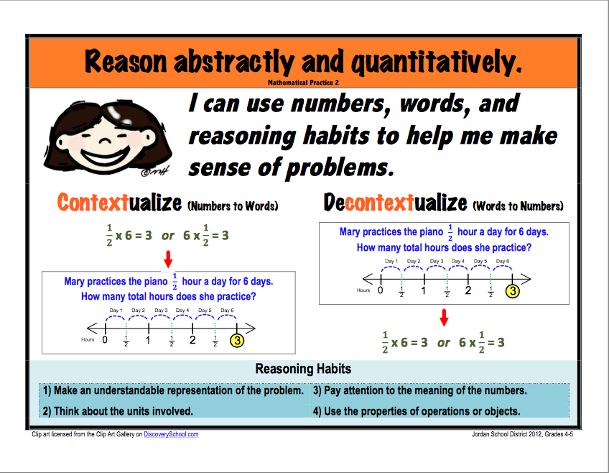
http://howtobeagreatteacher.com/
Notes:
Presenter:
Allow 2 minutes to review and discuss focusing on:
Elements (content, layout & language) of these posters that make SMPs comprehensible for ELs.
Implications for teachers.

Slide 17
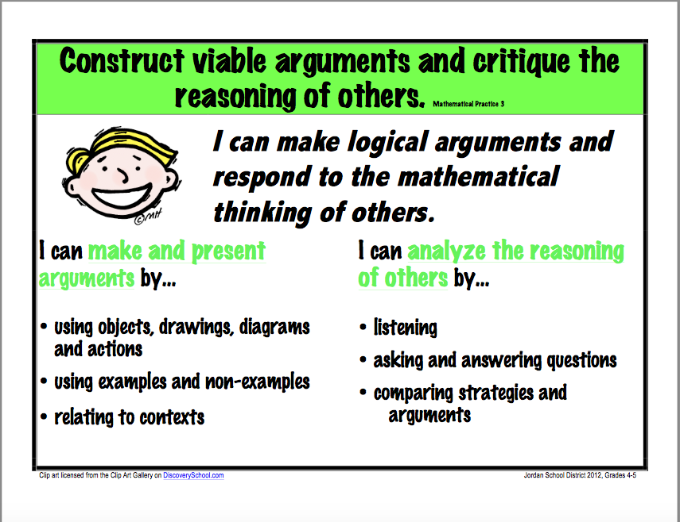
http://howtobeagreatteacher.com/
Notes:
Presenter:
Allow 2 minutes to review and discuss focusing on:
Elements (content, layout & language) of these posters that make SMPs comprehensible for ELs.
Implications for teachers.

Slide 18
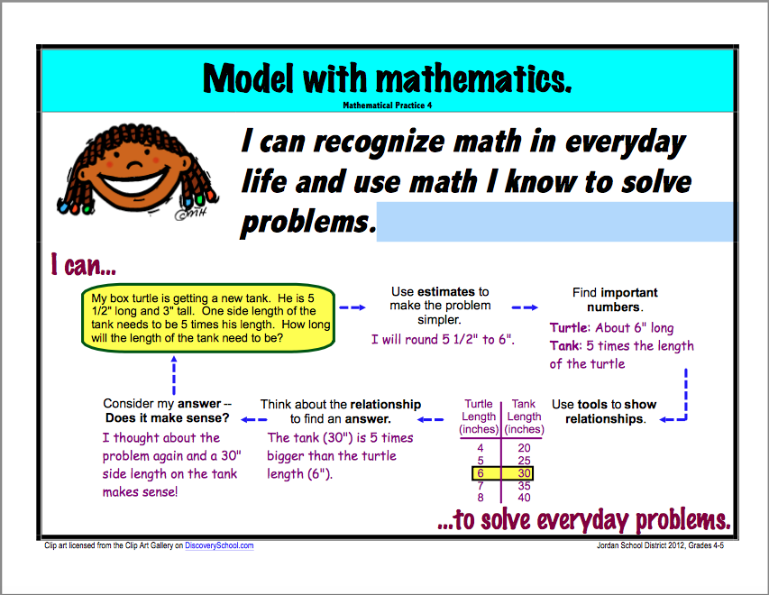
http://howtobeagreatteacher.com/
Notes:
Presenter:
Allow 2 minutes to review and discuss focusing on:
Elements (content, layout & language) of these posters that make SMPs comprehensible for ELs.
Implications for teachers.

Slide 19
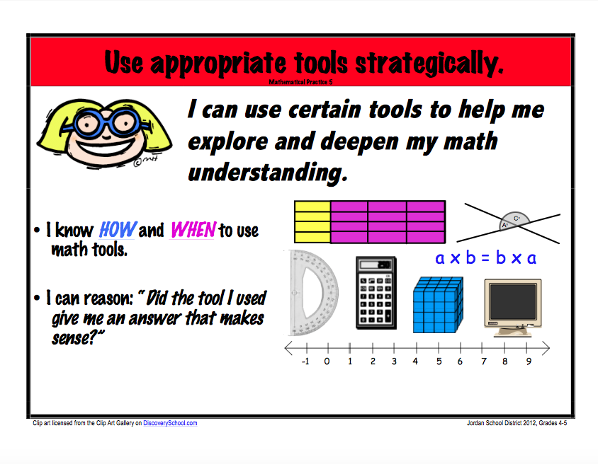
http://howtobeagreatteacher.com/
Notes:
Presenter:
Allow 2 minutes to review and discuss focusing on:
Elements (content, layout & language) of these posters that make SMPs comprehensible for ELs.
Implications for teachers.

Slide 20
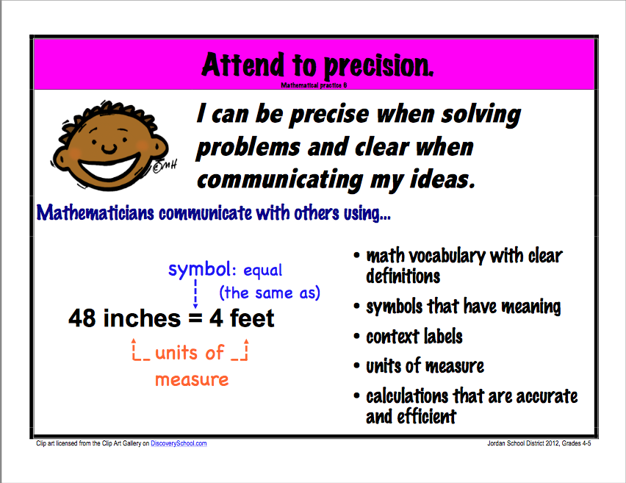
http://howtobeagreatteacher.com/
Notes:
Presenter:
Allow 2 minutes to review and discuss focusing on:
Elements (content, layout & language) of these posters that make SMPs comprehensible for ELs.
Implications for teachers.

Slide 21
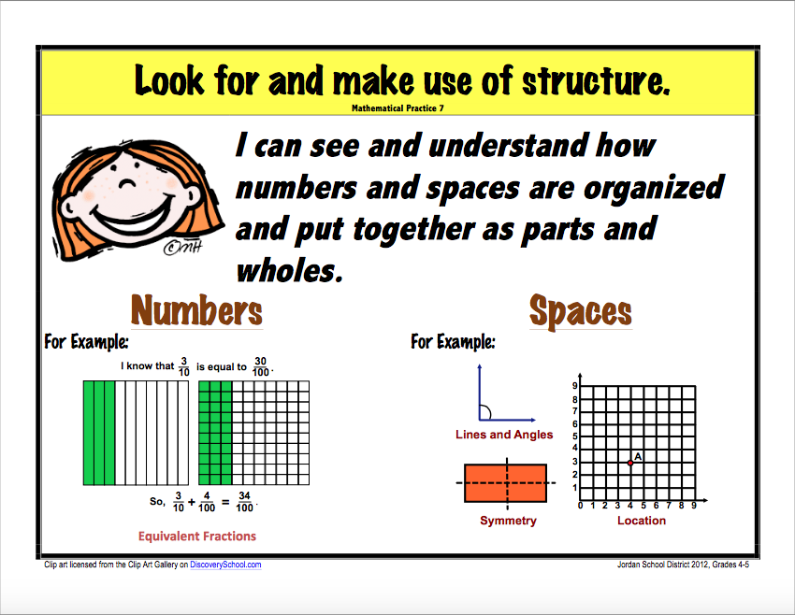
http://howtobeagreatteacher.com/
Notes:
Presenter:
Allow 2 minutes to review and discuss focusing on:
Elements (content, layout & language) of these posters that make SMPs comprehensible for ELs.
Implications for teachers.

Slide 22
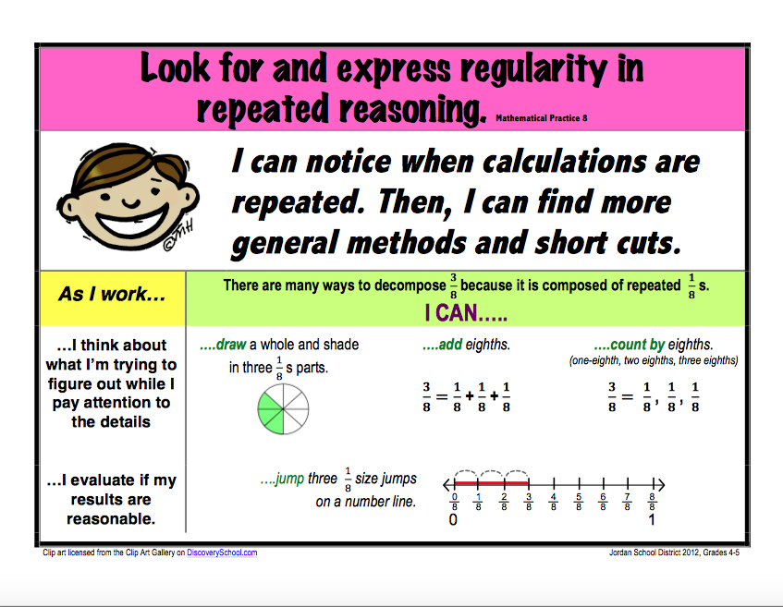
http://howtobeagreatteacher.com/
Notes:
Presenter:
Allow 2 minutes to review and discuss focusing on:
Elements (content, layout & language) of these posters that make SMPs comprehensible for ELs.
Implications for teachers.

Slide 23
Activity 2: The Core Shifts in Mathematics
Focus, Coherence, and Rigor
View the video on the Shifts in Mathematics from Achieve the Core. Pay particular attention to the discussion of Focus, Coherence, and Rigor. Consider these questions relative to English learner students and discuss with a table partner: What do Focus, Coherence, and Rigor look like for ELs? What challenges do you see to teaching the Connecticut Core Standards for Mathematics for ELs?
Page 12
Achieve the Core. The Common Core State Standards Shifts in Mathematics. Retrieved from http://achievethecore.org/shifts-mathematics
Notes:
Presenter:
Video is 5 minutes in length.
Participant’s Guide: take notes particularly on Focus, Coherence, and Rigor
Discussion Questions:
What do Focus, Coherence, and Rigor look like for ELs?
What challenges do you see to teaching the Connecticut Core Standards for Mathematics for ELs?
Link to Video: http://achievethecore.org/shifts-mathematics
This activity, including the video, should take roughly 10 minutes.

Slide 24
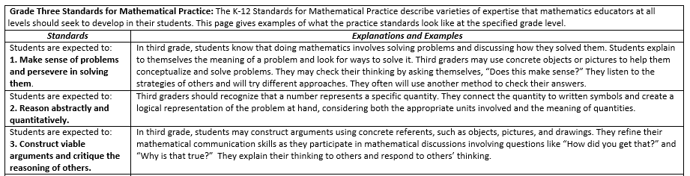
Illustrated Practices Charts from the CSDE
Connecticut State Department of Education. Grade 3: Illustrated Practices Charts. Retrieved from Math Units of Study http://www.sde.ct.gov/sde/cwp/view.asp?a=2618&q=322592
Notes:
Visual of Grade 3 Illustrated Practices Chart.
Connecticut State Department of Education. Grade 3: Illustrated Practices Charts. Retrieved from http://www.sde.ct.gov/sde/cwp/view.asp?a=2618&q=322592
Scroll to the bottom and find the heading “Mathematics”
Click on “K-12 Math Units of Study”
Open each grade level.
Then open “Illustrated Practices”

Slide 25
Activity 3: Illustrated Practices Charts from the CSDE
Compare and Contrast
With your team, compare the Grade 3 Illustrated Practices Chart with the Grade 7 Illustrated Practices Chart in your Participant Guide. Compare and contrast the elements of Focus, Coherence, and Rigor. Further, consider the two questions that were asked earlier with the video: What do Focus, Coherence, and Rigor look like for ELs? What challenges do you see to teaching the Connecticut Core Standards for Mathematics for ELs?
Pages 13-16
Notes:
Presenter:
Participants will be provided the Illustrated Practice Charts for Grades 3 & 7 in their Participant Guide.
Available at each grade level K-8 and High School.
Some are currently in draft form.
Compare the 2 charts
Discuss Focus
Discuss Coherence
Discuss Rigor
Large group share-out: wrap around and pose the questions that were posed for the previous video:
What do Focus, Coherence, and Rigor look like for ELs?
What challenges do you see to teaching the Connecticut Core Standards for Mathematics for ELs?
This activity should take about 25 minutes.

Slide 26

Let’s Take A Break…
…Be back in 10 minutes
Notes:
The break should be 10 minutes. Remind participants to try to be timely in their return.

Slide 27
Activity 4: Closed Sort – Analytical Tasks and
Receptive and Productive Language Functions
Closed Sort
With your team, locate the following headings within the set of cards you were given: Analytical Tasks, Receptive Language Functions, and Productive Language Functions Now, discuss and sort the illustration of the practice into the appropriate headings. Pair up with a team who did the other Closed Sort (e.g., one of you did SMP 1 and one of you did SMP 6). Share your Closed Sorts and discuss implications for teaching and learning.
Page 17
Notes:
Presenter:
Teams will be given Closed Sort Cards for either SMP 1 or SMP 6.
Headings are Analytical Tasks, Receptive Language Functions and Productive Language Functions.
Note to developer: Use the first 3 practices per heading for the sort
When completed, an SMP 1 groups should partner with an SMP 6 group to share and collectively review sort.
Discuss implications for ELs.
This chart is from the CCSSO ELPD Framework (2012) and can be found in its entirety at http://www.ccsso.org/Resources/Publications/The_Common_Core_and_English_Language_Learners.html
This activity (slides 25-29) should take about 25 minutes.
Benefits for ELs:
Oral English language is modeled by peers.
Students are provided the opportunity for structured talk.
Students use prior knowledge to organize and make sense of words and concepts.
Students may be required to defend their sorting by talking about the common features of the categories and how each specific term/phrase/indicator meets these criteria.
Students at all levels use higher order thinking skills.
Incorporates these best practices for ELs:
Activating prior knowledge.
Explicit vocabulary introduction/practice.
Preview of key concepts.

Slide 28
Discussion Starters
“I believe that this item belongs in _____ category because ….”
“These items are connected because…”
“I see your logic, but I disagree because….”
Notes:
Presenter:
Show this slide as participants are completing the closed sort to prompt academic discussion while completing the activity.

Slide 29
SMP 1: Make sense of problems and persevere in solving them.
Analytical Tasks | Explain to self a problem’s meaning, look for entry points to solution, and plan solution pathway Analyze givens, constraints, relationships, and goals Make conjectures about form and meaning of solution
Receptive Language Functions | Comprehend the meaning of a problem as presented in multiple representations such as spoken language, written texts, diagrams, drawings, tables, graphs, and mathematical expressions or equations Comprehend other’s talk about math problems, solutions, approaches and reasoning Coordinate texts and multiple representations
Productive Language Functions | Communicate (orally, in writing, and through other representations) about concepts, procedures, strategies, claims, arguments, and other information related to problem solving Create, label, describe, and use in presenting solutions to a math problem multiple written representations of a problem Present information, description of solutions, explanations, and arguments to others
Notes:
Presenter:
Groups that did SMP 1 should check their accuracy, make changes (if needed), and discuss their results.

Slide 30
SMP 6: Attend to precision.
Analytical Tasks | When appropriate, communicate precisely with others about mathematical reasoning and objects (e.g., use clear definitions of terms, state meaning of symbols used, specify units of measure, label visual representations, and make claims that apply to a precise set of situations) Refine communication about mathematical reasoning and objects so that it increasingly becomes more mathematically precise (e.g., uses clearer definitions of terms, explicitly states the meaning of symbols used, specifies units of measure) Calculate, compute, and use arithmetic procedures appropriately, accurately, and efficiently
Receptive Language Functions | Comprehend others’ spoken language regarding definitions, meaning of symbols, arithmetic procedures, strategies, solutions, claims, evidence, etc. Comprehend others’ spoken language regarding definitions, meaning of symbols meanings, units of measure, and visual representations as presented in multiple representations (e.g., texts, diagrams, and visual media)
Productive Language Functions | Define key terms and concepts Explain meaning of symbols Specify units of measure
Notes:
Presenter:
Groups that did SMP 6 should check their accuracy, make changes (if needed), and discuss their results.
Note: The full table will be a separate handout for participants.
Share out in large groups the implications for ELs discussed.

Slide 31
Discussion Starters
“I see a pattern of challenges for ELs in that…”
“_____ will be a linguistic challenge for English earners because…”
“There is opportunity for collaboration and support between TESOL instructors and general education teachers here…”
Notes:
Presenter:
Show this slide to facilitate the discussion of linguistic challenges and opportunities for collaboration to support ELs in the math classroom.
Sentence Frames Benefits to ELs:
Gives a starting point as well as provides modeling for the range of learners at various levels of English proficiency.
Teacher hears all statements.
Sentence frames and oral language practice provide models that can be later be applied to writing.

Slide 32
You are Here! Digging Deeper – Language Scaffolds
Warm-Up
Activities
Part 1:
The Language of Math
Part 3: Collaboration is Key
Closing Activities
Part 2:
Digging Deeper - Language Scaffolds
Notes:
Presenter:
Graphic will be displayed throughout the day at each transition.
Now: Digging Deeper - Language Scaffolds

Slide 33
Activity 5a: Standards for Mathematical Practice #6 Attend to Precision
Viewing a Video
View the video, Standards for Mathematical Practice #6. Note the following: How SMP 6 is defined. How SMP 6 is broken down into various components. How the video is organized. Elements of repetition, color, sound, etc.
Page 19
Video: YouTube. Standards for Mathematical Practice #6. Retrieved from https://www.youtube.com/watch?v=4whGbDxCorA
Notes:
Presenter:
Video is 3 minutes in length.
Prompt viewers to pay particular attention to:
How SMP 6 is defined
How SMP 6 is broken down into various components
How the video is organized
Repetition, color, sound, etc.
Link to Video: https://www.youtube.com/watch?v=4whGbDxCorA

Slide 34
Activity 5b: Your Turn – SMP1
Working with your team, create a “performance” to demonstrate SMP 1.
Role Play
Skit
Chant
Rap
Page 20
Simulation
Notes:
Presenter:
Teams to create a “performance” to explain SMP 1 to others
Consider those things in the video that were effective (e.g., sequencing, repetition, etc.)
Volunteers to share with large group
This activity should take about 25 minutes.
Benefits for ELs:
Authentic, contextualized acquisition of new vocabulary and structure.
Practice and use of English: speaking, listening, and understanding.
Acquisition of meaningful, fluent interactions in English.
Opportunities to practice communicating in different social contexts and in different social roles.
Improved sense of confidence in learning a new language.

Slide 35
Let’s Do Some Deconstructing
SMP 4: Model with Mathematics
Mathematically proficient students can apply the mathematics they know to solve problems arising in everyday life, society and the workplace. In early grades, this might be as simple as writing an addition equation to describe a situation. In middle grades, a student might apply reasoning to plan a school event or analyze a problem in the community. By high school, a student might use geometry to solve a design problem or use a function to describe how one quantity of interest depends on another...
Notes:
Presenter:
Note that this is a lot of language to read and understand.
Without changing the meaning or simplifying the language of mathematics, think about a way to say this making it more comprehensible.
Share with a partner.
Move on to next slide to share developer’s example.
Showing the example of “deconstructing” the Standards for Mathematical Practice should take about 8 minutes.

Slide 36
Let’s Do Some Deconstructing
SMP 4: Model with Mathematics
Mathematically proficient students can apply the mathematics they know to solve problems arising in everyday life, society and the workplace. In early grades, this might be as simple as writing an addition equation to describe a situation. In middle grades, a student might apply reasoning to plan a school event or analyze a problem in the community. By high school, a student might use geometry to solve a design problem or use a function to describe how one quantity of interest depends on another...
In other words,
Solve problems by applying math to everyday, real world situations.
Notes:
Presenter:
Lead a short discussion about how the right column is related to the left.

Slide 37
Let’s Do Some Deconstructing
SMP 4: Model with Mathematics
(continuing) Mathematically proficient students who can apply what they know are comfortable making assumptions and approximations to simplify a complicated situation, realizing that these may need revision later...
Notes:
Presenter:
Continue the text of SMP 4.
Invite participants to restate in the same manner as was done prior.

Slide 38
Let’s Do Some Deconstructing
SMP 4: Model with Mathematics
(continuing) Mathematically proficient students who can apply what they know are comfortable making assumptions and approximations to simplify a complicated situation, realizing that these may need revision later...
In other words,
Simplify complex problems by making estimates and assumptions - knowing that later they will be revised.
Notes:
Presenter:
Share developer’s example.
Debrief on how this is like/different those that volunteer’s shared.

Slide 39
Let’s Do Some Deconstructing
SMP 4: Model with Mathematics
(continuing) They are able to identify relationships using such tools as diagrams, two-way tables, graphs, flowcharts and formulas. They can analyze those relationships mathematically to draw conclusions...
Notes:
Presenter:
Continue the text of SMP 4.
Invite participants to restate in the same manner as was done prior.

Slide 40
Let’s Do Some Deconstructing
SMP 4: Model with Mathematics
(continuing) They are able to identify relationships using such tools as diagrams, two-way tables, graphs, flowcharts and formulas. They can analyze those relationships mathematically to draw conclusions…
In other words,
Identify relationships by using tools. Analyze the relationship to get an answer.
Notes:
Presenter:
Share developer’s example.
Debrief on how this is like/different those that volunteer’s shared.

Slide 41
Let’s Do Some Deconstructing
SMP 4: Model with Mathematics
(continuing) They routinely interpret their mathematical results in the context of the situation and reflect on whether the results make sense, possibly improving the model if it has not served its purpose.
Notes:
Presenter:
Continue the text of SMP 4.
Invite participants to restate in the same manner as was done prior.

Slide 42
Let’s Do Some Deconstructing
SMP 4: Model with Mathematics
(continuing) They routinely interpret their mathematical results in the context of the situation and reflect on whether the results make sense, possibly improving the model if it has not served its purpose.
In other words,
Interpret their results and reflect on whether or not it makes sense and adjusting if needed.
Notes:
Presenter:
Share developer’s example.
Debrief on how this is like/different those that volunteer’s shared.

Slide 43
Activity 6a: Your Turn – Deconstructing SMP 1 and SMP 6
Simplified Statements
Working with your team, break down the statement(s) of your assigned SMP (1 or 6) into simplified and student-centered language; i.e., What does this language mean?; What will students know and be able to do? Write your simplified statements in the right-hand side of the tables provided on pages 21 and 22 of your Participant Guide. Now, use your simplified statements to create a poster that makes your SMP comprehensible to others.
Pages
21-22
Notes:
Presenter:
Note: make sure that posters are displayed alternately: 1, 6, 1, 6, 1, 6, etc.
Allow about 20 minutes for small groups to create their posters.
Note: Connecticut English Language Proficiency Standards (CELP). The standards have now been officially adopted by the State Board of Education. The link to the standards is:
http://www.sde.ct.gov/sde/lib/sde/pdf/curriculum/bilingual/celp_standards.pdf. The CELP standards and supporting documents contain correspondences to the mathematics practices (with the majority of correspondences being to SMP 1 and 6).

Slide 44
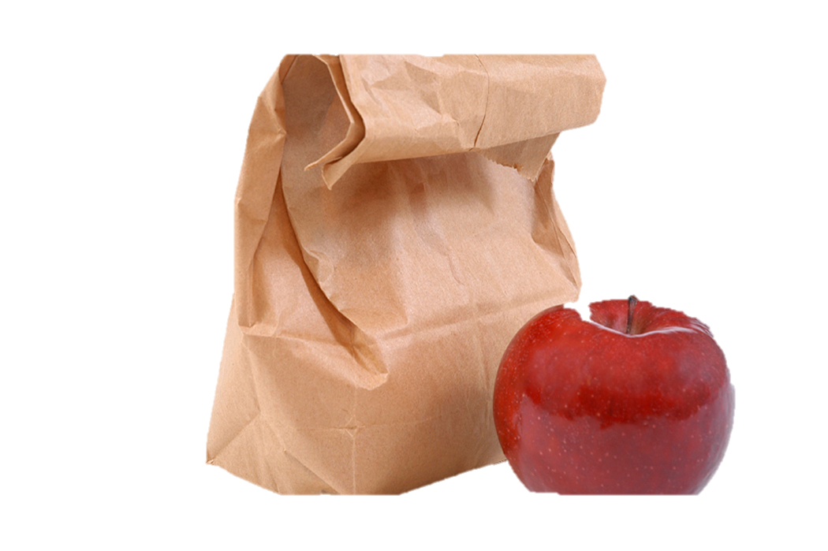
Bon Appétit
Notes:
Participants have 60 minutes for lunch. Remind them to be back on time as we will begin promptly.

Slide 45
Activity 6b: Stay and Stray
Explain Your Poster
With your team, gather around your poster. Discuss and make sure that each member can explain the poster and its contents to others. When prompted, one person will stay with the poster and the others will move clockwise to the next poster. The person remaining with the poster will explain it to the arriving group. Listen to the presenter for the next set of instructions.
Page 23
Notes:
Presenter:
Direct participants to stand by their poster.
They should discuss making sure that everyone understands the work created.
One person should stay with the poster; remaining people rotate clockwise to next poster.
Person staying with the poster explains it to the visiting group.
Surprise! One of the visitors now stays with the poster and everyone else moved on.
The visitor explains the poster to the next group.
Continue for pre-determined time with a new person staying with each poster on each rotation.
Benefits for ELs:
Group thinking, discussion, collaboration, and product reduce stress and build confidence.
Everyone contributes.
English is modeled and practiced.
Repetition of concepts and language throughout the process.
Promotes accountability since any group member could be selected to stay and teach the content to the next group; all are responsible for listening and understanding.
Since participants act as a teacher, they are able to demonstrate that they understand the concepts.
Tip
Have everyone in each group number off. The presenter can call a number and have that person from each group stay with their poster. For the next round, call a different number, and so on until everyone has a chance to “stay” and teach a small group the content of a poster.
Allow about 15 minutes for Stay and Stray.

Slide 46
Sum It Up! (Pun intended)
SMP 1 and SMP 6 are considered overarching, foundational habits of mind for mathematical thinkers, no matter what age. What are the challenges and benefits these may bring for EL students?
Notes:
Presenter:
In groups, participants should discuss this question.
Whole group share-out, if desired and time permits.
Summarizing Benefits to ELs:
Summarizing promotes higher-order thinking by forcing students to evaluate and choose only the most important information.
Collaborating with a partner or small group to summarize provides structured oral language practice, in which students are able to clarify and confirm comprehension with other group members as needed.
While summarizing, material is repeated as it is evaluated. The built-in repetition is beneficial to comprehension for ELs.

Slide 47
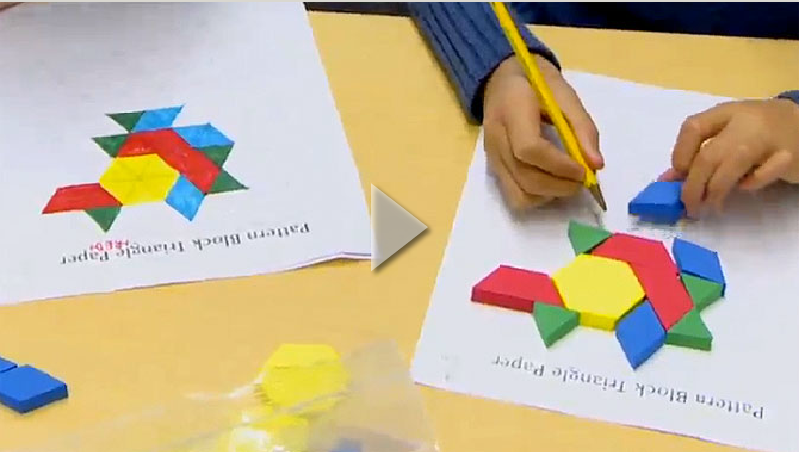
Activity 7: What Fraction of this Shape is Red?
View the video, What Fraction of this Shape is Red?
Complete the 3-Column Graphic Organizer on 25 page.
Pages
24- 25
Teaching Channel. What Fraction of this Shape is Red? Retrieved from https://www.teachingchannel.org/videos/teaching-fractions
Notes:
Presenter:
Video is 5 minutes long.
Participant’s Guide includes a 3-Column Graphic Organizer for viewing.
Evidence of SMP 1 and SMP 6
Evidence of Other SMPs
Missed Opportunities for SMPs (note what they are and how they might have been addressed)
Turn to a table partner and share.
If time permits, ask for a large group share-out.
Link to the Video: https://www.teachingchannel.org/videos/teaching-fractions
Viewing the video and completing the graphic organizer should take about 8 minutes.
Benefits for ELs:
Organizers help students to understand text structure and promote organized note-taking.
Students don’t have room to just copy the text; they need to paraphrase and summarize.
Students need to use some of their own words to retell.
All students can have assignments to complete a common graphic organizer but could use different readings or media to do so.
Whenever students share their graphic organizers with others, the information is organized and easier to process.
Organizers prepared by more advanced students one year can provide a “preview read” to an EL in subsequent years.
Ways to organize information may differ across cultures.

Slide 48
Teaching Mathematics to English Language Learners
“Mathematics teachers must attend to all students, including those who speak a first language other than English or have related cultural differences, and ensure that all have access and opportunities to learn mathematics and to reveal what they know. Every student’s cultural and linguistic heritage should be respected and celebrated for the diversity that it contributes to the learning environment. Expanded learning opportunities and instructional accommodations should be available to English language learners (ELLs) who need them to develop mathematical understanding and proficiency.”
National Council of Teachers of Mathematics. Position Statement, 2013. Retrieved from http://www.nctm.org/Standards-and-Positions/Position-Statements/ Teaching-Mathematics-to-English-Language-Learners/
Page 26
Notes:
Presenter:
Invite participants to read this for themselves.
Allow about 10 minutes to present this position statement from the National Council of Teachers of Mathematics (slides 49-53).

Slide 49
Multiple Dimensions of Instruction #1
“Establish learning environments and classroom norms that support the active engagement of all students, including ELLs. Such classrooms honor the diverse ways in which students approach mathematics, communicate their mathematical thinking (e.g., code-switching) and record their strategies and solutions to exercises and problems. For example, in some countries, one billion is written as 10¹² rather than 10⁹.”
National Council of Teachers of Mathematics. Retrieved from http://www.nctm.org/ELLMathematics/
Notes:
Presenter:
Invite participants to read this for themselves.
Show cultural math processes/notations such as:
Long division
Factoring
Period/comma differences

Slide 50
Multiple Dimensions of Instruction #2
“Identify and use instructional strategies that make content more accessible, and consider how to implement culturally relevant pedagogy in mathematics classrooms.”
National Council of Teachers of Mathematics. Retrieved from http://www.nctm.org/ELLMathematics/
Notes:
Presenter:
Invite participants to read this for themselves.

Slide 51
Multiple Dimensions of Instruction #3
“Orchestrate classroom discussions in ways that support acquisition of mathematics concepts and language development. It is important for all students, but especially critical for ELLs, to have opportunities to speak, write, read and listen in mathematics classes, with teachers providing appropriate linguistic support and encouragement.”
National Council of Teachers of Mathematics. Retrieved from http://www.nctm.org/ELLMathematics/
Notes:
Presenter:
Invite participants to read this for themselves.

Slide 52
Multiple Dimensions of Instruction #4
“Assess ELLs in ways that permit them to show what they know and are able to do. This requires providing test accommodations that lessen the language complexity without reducing the rigor of mathematics under investigation.”
National Council of Teachers of Mathematics. Retrieved from http://www.nctm.org/ELLMathematics/
Notes:
Presenter:
Invite participants to read this for themselves.

Slide 53
Foldables
Student-created 3-dimensional graphic organizers
Usable at any grade level or in any discipline
Tool for self-checking, study guides, assessment and more!
Researched-based (Marzano, Classroom Strategies that Work)
Notes:
Presenter:
Explain what a foldable is.
If possible, have some samples to show (ask colleagues for real student samples?)
Allow about 25 minutes for this activity.
Benefits for ELs:
A foldable is an interactive graphic organizer; all the benefits of graphic organizers apply here.
Teacher can determine initial understandings through the product.
ELs build factual knowledge through schema.
Encourages metacognition through active learning.

Slide 54
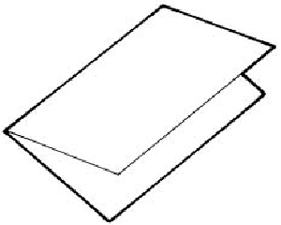
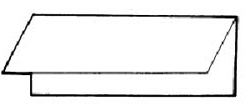
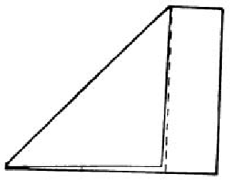
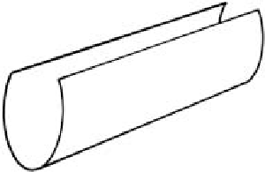
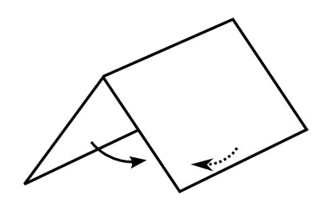
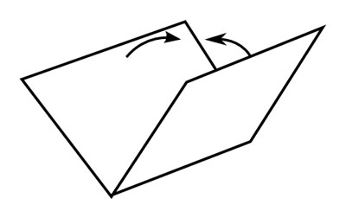
Foldables
Diagrams retrieved from www.averyschools.net
Notes:
Presenter:
Reading across:
Top: horizontal, vertical, diagonal (cut off at dotted line).
Bottom: rolled, like a name plate, inverted.
There are many more; see resources for accessing more information (i.e., www.dinah.com).
Mention that, for example, the vertical foldable could have the top cut upward into quarters to reveal one things at a time.
Diagrams retrieved from www.averyschools.net

Slide 55
Activity 8: Foldables
Work with the same group from the poster activity (SMP 1 or SMP 6/Stay and Stray). Construct a “foldable” to explain how that SMP looks in each of the four Dimensions of Instruction as defined by the National Council of Teachers of Mathematics: Learning Environments and Class Norms Instructional Strategies Classroom Discussions Assessment Place your foldable on display as directed by the presenter.
Page 27
Notes:
Presenter:
Direct the participants to paper/markers.
Provide time parameters, allowing about 15 minutes or what the agenda can provide given the time of day.
Tell them where to display their foldable.
When completed and on display, can move into afternoon break.
Upon returning, look at the foldables display.

Slide 56
Let’s Take A Break…
…Be back in 10 minutes
Notes:
The break should be 10 minutes. Remind participants to try to be timely in their return.

Slide 57
Should language of math tasks be adapted for ELs?
Changing the language of the task can change the mathematical sense of the task.
It is not yet clear which adaptations are best to make for which students, for which purposes, or at which time.
Instruction should support students in understanding complex mathematical texts because they are likely to appear in curriculum and assessment materials.
Experiences that allow ELs to engage (with support) with authentic language used in mathematics can provide opportunities for their continued language development.
Statements retrieved from Supporting ELLs in CCSS / Understanding Language: http://ell.stanford.edu/sites/default/files/math_learnmore_files/1.Introduction%20to%20the%20Materials%208-14-13.pdf
Notes:
Presenter:
After reviewing these citings, the participants should understand that the answer is “no.”
Statements retrieved from Supporting ELLs in CCSS / Understanding Language: http://ell.stanford.edu/sites/default/files/math_learnmore_files/1.Introduction%20to%20the%20Materials%208-14-13.pdf

Slide 58
Activity 9: Annotated Math Task
Making Matchsticks
Review the math task, “Making Matchsticks.” Look for evidence of and opportunities for ELA scaffolds Look for evidence of and opportunities for math scaffolds.
Page 28
Understanding Language Project, Stanford Graduate School of Education. Making Matchsticks. Retrieved from: http://ell.stanford.edu/sites/default/files/math_pdf/8.MS-Matchsticks%207-2-13%20copy.pdf
Notes:
Presenter:
Direct to auxiliary handout.
“Making Matchsticks” is a math task developed by Stanford / Understanding Language.
Demonstrates “language of math tasks.”
Students learn to read and understand word problems.
Students communicate about mathematics.
Students build disciplinary and academic vocabulary.
Students develop practices in mathematics.
Attend to these points (also included in description in Participant’s Guide) plus look for scaffolds.
Advance to the next slide to show appropriate scaffolding and have available for the exercise.
At the end, have a whole-group share.
Allow about 20 minutes for this activity and for presenting the list of scaffolds for ELs on slide 60.
http://ell.stanford.edu/teaching_resources/math

Slide 59
Sample Scaffolding for ELs
ELA:
Teaching academic vocabulary.
Integrating oral and written language instruction into content area teaching.
Providing regular, structured opportunities to write.
Capitalizing on students’ home language and knowledge.
Math:
Providing concrete and visual models.
Providing graphic organizers and foldables.
Using multimedia to enhance ELs’ comprehension of mathematical concepts
Retrieved from engageny.org
Notes:
Presenter:
Because of the nature of CCS, scaffolds need to reflect both ELA and math.
Important to note that a lesson will include one or more of these but not all of them at one time.

Slide 60
Activity 10: Your Turn – Annotate a Math Task
“Digging Dinosaurs”
Work with your team to annotate the math task “Digging Dinosaurs.” Employ ELA scaffolds. Employ math scaffolds. Share as directed by the presenter.
Page
Page 29
“Digging Dinosaurs.” Inside Mathematics. Retrieved from http://www.insidemathematics.org/assets/problems-of-the-month/digging%20dinosaurs.pdf
Notes:
Presenter:
Direct participants to “Digging Dinosaurs” supplemental handout.
http://www.insidemathematics.org/assets/problems-of-the-month/digging%20dinosaurs.pdf
In pairs or teams, participants will annotate the task with scaffolds for ELs.
(These directions will be repeated in the next slide as well for easy reference) Modified Jigsaw:
All members of each group will read the same text (the Math Task).
Each member of the group will use a different lens to read. Each team member will look for scaffolds of one (or two depending on team size) of the following types:
Teaching academic vocabulary
integrating oral and written language instruction into content area teaching
providing regular structured opportunities to write
capitalizing on students’ home language and knowledge
providing concrete and visual models
providing graphic organizers and foldables
using multimedia to enhance ELs’ comprehension of mathematical concepts
When finished reading, team members will share the scaffolds that they found.
The last slide is repeated next to guide their discussion.
Whole group share-out
Allow about 20 minutes for this activity.

Slide 61
Sample Scaffolding for ELs
ELA:
Teaching academic vocabulary.
Integrating oral and written language instruction into content area teaching.
Providing regular, structured opportunities to write.
Capitalizing on students’ home language and knowledge.
Math:
Providing concrete and visual models.
Providing graphic organizers and foldables.
Using multimedia to enhance ELs’ comprehension of mathematical concepts
Retrieved from engageny.org
Notes:
Presenter:
This slide is being repeated to guide participants in annotating their math task.
Modified Jigsaw:
All members of each group will read the same text (the Math Task).
Each member of the group will use a different lens to read. Each team member will look for scaffolds of one (or two depending on team size) of the following types:
Teaching academic vocabulary
integrating oral and written language instruction into content area teaching
providing regular structured opportunities to write
capitalizing on students’ home language and knowledge
providing concrete and visual models
providing graphic organizers and foldables
using multimedia to enhance ELs’ comprehension of mathematical concepts
When finished reading, team members will share the scaffolds that they found.
From previous slide, directions are on page 29 of the Participant Guide.

Slide 62
You are Here!
Collaboration is Key
Warm-Up Activities
Part 1:
The Language of Math
Part 3: Collaboration is Key
Closing Activities
Part 2:
Digging Deeper – Language Scaffolds
Notes:
Presenter:
Graphic will be displayed throughout the day.
Now: Collaboration is Key

Slide 63
Activity 11: Collaborating to Plan a Lesson
Viewing a Video
View the video from the Teaching Channel on collaborating to plan a math lesson. Consider and be ready to respond to these questions: What interactions do you see between these teachers? How do these two teachers engage in reflection? Brainstorm how these interactions/reflections would be different if it was a math and TESOL teacher collaborating?
Page 31
Teaching Channel. Collaborating to Plan a Common Core Math Lesson. Retrieved from https://www.teachingchannel.org/videos/teacher-collaboration-on-common-core-nea#
Notes:
Presenter:
Show the video on Collaborating to Plan a math lesson.
Emphasize that this video shows two general education math teachers collaborating. Ask participants to look for ways that these two teachers interact (are they fulfilling different roles?), and how they engage in reflection.
After participants watch the video, ask participants to turn and talk to neighbor/small group: How would this collaboration look different if this was a math teacher and a TESOL teacher? What does ideal collaboration between math and TESOL Teachers look like?
Link to Video: https://www.teachingchannel.org/videos/teacher-collaboration-on-common-core-nea#
Allow about 20 minutes for participants to view the video and answer the discussion questions.

Slide 64
Activity 12: Multiple Representations
Multiple Representations
Collaborate with your team to come up with at least two representations to illustrate the ideal collaboration between math and TESOL teachers (drawing, number sentence, words, symbols, equation, etc.). Create your multiple representations on chart paper. As teams, share your poster with the whole group.
Page 32
Notes:
Presenter:
In mathematics, students need to learn to examine/create multiple representations. Collaborate with your team to create at least 2 representations to illustrate the ideal collaboration between math and TESOL teachers. Teams should share their representations with the whole group. The posters can be brought back to share with districts if wanted.

Slide 65
Our Team’s Next Steps
In teams, discuss the following:
What is the role of the TESOL professionals in your school and has it changed in recent years?
How can TESOL professionals continue to serve the general education teachers in your school by acting as experts, advocates, or consultants on language development in addition to serving students directly.
What school structures would make it easier for TESOL teachers to fulfill this role?
Page 34

Slide 66
Post-Assessment and Session Evaluation
Thank you for attending Module 3’s session, Accessing the Connecticut Core Standards in Mathematics.
Your feedback is very important to us! Please fill out a short survey about today’s session.
The survey is located here: http://surveys.pcgus.com/s3/CT-Module-3-EL
Page 35
Notes:
Prompt participants to complete the post-evaluation in the participant guide to measure own learning.
Remind participants to complete the online Session Evaluation. The survey is located here: http://surveys.pcgus.com/s3/CT-Module-3-EL
Ask for further thoughts, questions.

Slide 67
Thank you!

