Slide 1


Meeting the Challenge:
CT Core Standards Success for English Learners and Students with Disabilities
A Professional Learning Opportunity for School Teams Dedicated to the Success of ALL Students
Module 2 - SwD
Adapting the Curriculum in UDL Style
Notes:
This module deepens participants’ understanding of Universal Design for Learning. This module builds upon Module 1 as we begin to apply how to incorporate a UDL philosophy. Participants will have the opportunity to expand their ability to support all learners by applying UDL Principles and Guidelines.

Slide 2
Essential Questions
How can I create a positive, rigorous learning environment while meeting the needs of variable learners?
How can I use the UDL Principles and Guidelines to address learner variability in any learning environment?
What are some effective scaffolds I can apply so my students become successful, independent learners?
How can I create lesson plans that honor a meaningful learning process that aligns with the CT Core Standards for each and every student?
Notes:
These are the big questions that are the underpinning for today’s UDL session.

Slide 3
Module 2 ‒ SwD Session Agenda
Adapting the Curriculum in UDL Style
  Introductory Activities
  Understanding Learner Variability
  Aligning IEP (Individualized Education Program) Goals and Learning Targets to CT Core Standards Using UDL
  Maintaining High Expectations for All Learners Through Meaningful Adaption
  Reflection, Next Steps, and Session Evaluation
Notes:
Presenter, shares the points on the slide.

Slide 4
You are Here! Introductory Activities
Introductory Activities
Part 1:
Understanding Learner Variability
Part 2:
Aligning Standards, IEP Goals, Learning Targets, and UDL
Part 3:
Maintaining High Expectations for All Learners
Part 4:
Reflection, Next Steps, & Session Evaluation
Notes:
Point out to participants that this module is composed of 4 parts and an introduction.
In the introduction we will explore how all learners have varied capabilities they bring to each learning environment.
We will move on to discussing the value of viewing learners who are variable and SwDs are part of that variability.
We will dig a bit deeper into how to adapt the curriculum to meet the needs of variable learners in any classroom.
Discuss the value of focusing on adapting the curriculum to meet the diverse abilities of each and every student in each learning environment.

Slide 5

Introductory Activities
Quick Write: Setting Intentions
After reading through today’s Essential Questions and Session Agenda, please engage in a Quick Write to express your goals and intention for today’s workshop. What do you hope to achieve today?
You may choose to write sentences, a short paragraph, a sketch, a poem, or jot down key words to express your goals and create a sense of purpose for our time together today.
Use the Quick Write section on page 5 of the Participant Guide to express your thoughts.
Today will be successful when…..
Page 5

Slide 6
Activity 1: List-Group-Label
What Does Skillful Teaching Look Like?
If you were to walk into a classroom, what might you see or hear (from the students as well as the teacher) that would cause you to think that you were in the presence of a master teacher? What would you see and hear that would make you think: Wow, this is amazing! If I had a child this age I would want my child in this class! Using one index card per idea, jot down 3 or 4 things you might see or hear in the classroom of a highly effective teacher. As a team, categorize all ideas into groups and label each group by writing the common theme for each group on an index card. Using the UDL Guidelines on page 7 of the Participant Guide, write which UDL Principle connects to your common theme cards. Be ready to share with the whole group.
Pages
6-7
Notes:
Following the activity, explain the List-Group-Label protocol. Have table groups discuss how they may be able to use the strategy in their classrooms. Emphasize how the UDL Principles connect to this activity.

Slide 7
You are Here! Understanding Learner Variability
Introductory Activities
Part 1:
Understanding Learner Variability
Part 2:
Aligning Standards, IEP Goals, Learning Targets, and UDL
Part 3:
Maintaining High Expectations for All Learners
Part 4:
Reflection, Next Steps, & Session Evaluation
Notes:
From here, in Part 1, we will look at the foundation for UDL, its definition, and how the UDL Principles each support the total construct of UDL.
In Part 2, we will examine UDL in practice—how do we move from the conceptual framework to real classroom application. In other words, what does it look like and how do each of the UDL Principles support and inform our classroom practices?
In Part 3, we’ll look at how we can infuse UDL into our lesson planning to strengthen our plans to reach our learners.
Finally, in Part 4, we’ll reflect on what we learned and think through what UDL means for us individually and as teams and how we develop next steps for starting to incorporate UDL into our daily practices and routines.
At each transition to the next part of the presentation, participants will be reminded where we are in the module.

Slide 8
Activity 2: UDL Video Clip
UDL: Reducing Barriers
View a brief video clip, UDL: Reducing Barriers, and take notes using the 3-2-1 Note-Taking organizer. After viewing, re-read your notes and complete the Summary/Reflection section at the bottom of the note-taking organizer. Be prepared to share your reflections.
Pages 9-10
Notes:
Introduce the activity on the slide. Explain the video’s focus will provide an opportunity for viewers to connect with how UDL can be a bridge to meeting the needs of variable learners. Answer any questions. Provide 15 minutes for this activity.

Slide 9

UDL: Reducing Barriers
Retrieved from https://www.youtube.com/watch?v=xTShQyw3m80

Slide 10
Learner variability is the norm!
Learners vary in the ways they take in information
Learners vary in their abilities and approaches
Learning changes by situation and context
Learners vary across their development
National Center On Universal Design for Learning, at CAST http://udlseries.udlcenter.org/presentations/learner_variability.html?plist=explore
Notes:
Allow participants a few minutes to sum up their understanding of learner variability. This is the foundation for adopting a philosophy that allows for meaningful curriculum adaptations. All learners are variable learners. This includes general education students, students with disabilities, English learners and gifted students. Each learner in each learning environment has unique capabilities that should be proactively considered when curriculum is planned. Emphasize that the context of learning is critical for meaningful learning to take place. For example, Daniel may be a visual learner for a social studies lesson on geography, but he is an auditory learner in English class when they are reviewing vocabulary words for a piece of literature the class is about to read. Context of learning matters!

Slide 11
Activity 3: Addressing Learner Variability
Connections and Ideas
On page 12 of your Participant Guide, read through the Examples of addressing learner variability. Connect your thinking from our Introductory Activity and your 3-2-1 Reflections. Think about the connections you make to your own practice. What examples can you add as you think about learners in your classrooms? Share your connections with your team. On chart paper, write the heading Addressing Learner Variability, and jot down your ideas and connections.
Pages 11-12
Notes:
Now that we have established all students are variable or unique learners, we move to proactively adapting the curriculum to meet their needs. The activity, and the next slide, will help participants apply this process.

Slide 12
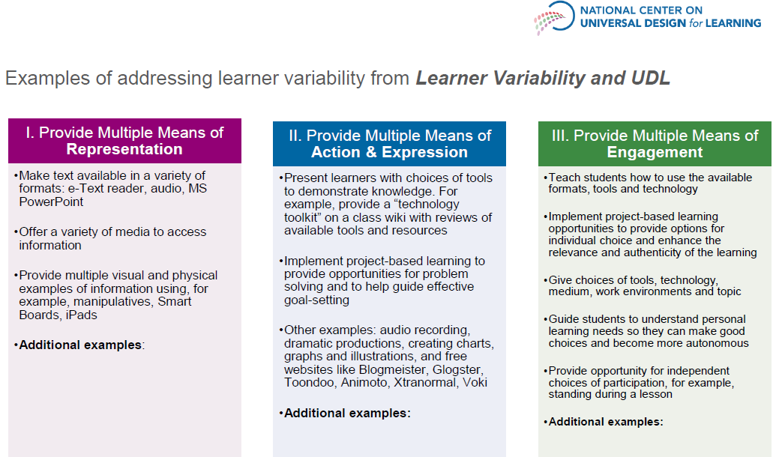
Learner Variability and UDL from the National Center on UDL (www.udlcenter.org)
Copyright 2015. CAST, Inc. Used with permission. All rights reserved.
Notes:
Review the examples of using the UDL Principles and Guidelines to address learner variability. Make sure to get participants to think about what they are already doing in their classrooms that connect with these examples. Guide participants to add any other examples. Note: The CAST website updated some of their graphics and the principles have been reordered so participants my see a different order, depending on the graphic, but the major categories have not changed.

Slide 13
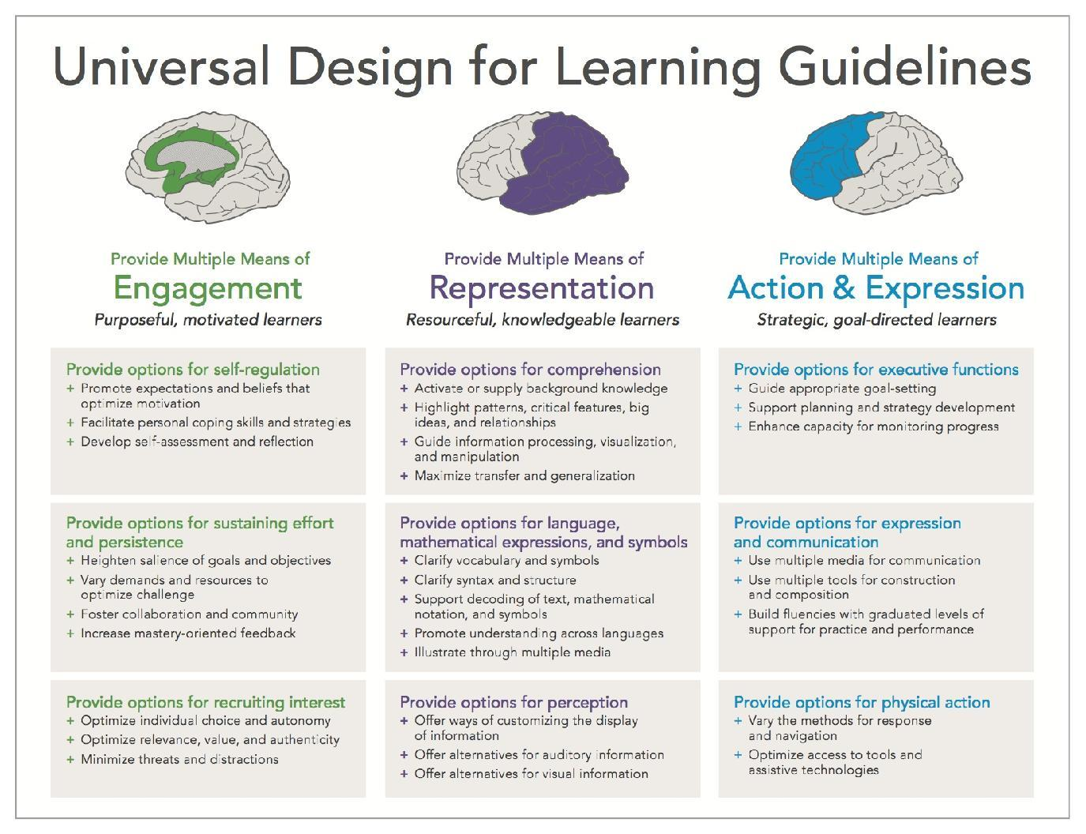
How to Meet the Standards
www.cast.org
UDL is included in the section of the Core Standards called Application to Students with Disabilities. However, UDL not only applies to students with disabilities, it applies to all other learners as well. All students can benefit from the types of instruction used to reach learners “in the margins,” as the learning needs of all individuals vary a great deal.
Notes:
Remind and review the natural connection between UDL and the CT Core Standards. Emphasize that over time, participants will notice the ways UDL is naturally embedded in their daily practice, and how it will become more consistent in time. Also mention that UDL benefits all learners.
Application to Students with Disabilities is located here: http://www.corestandards.org/assets/application-to-students-with-disabilities.pdf

Slide 14

Let’s Take A Break…
…Be back in 10 minutes
Notes:
The break should be 10 minutes. Remind participants to try to be timely in their return.

Slide 15
You are Here! Aligning CT Core Standards, IEP Goals, Learning Targets, and UDL
Introductory Activities
Part 1:
Understanding Learner Variability
Part 2:
Aligning Standards, IEP Goals, Learning Targets, and UDL
Part 3:
Maintaining High Expectations for All Learners
Part 4:
Reflection, Next Steps, & Session Evaluation
Notes:
Part 2: Aligning Standards, IEP Goals, Learning Targets, and UDL

Slide 16
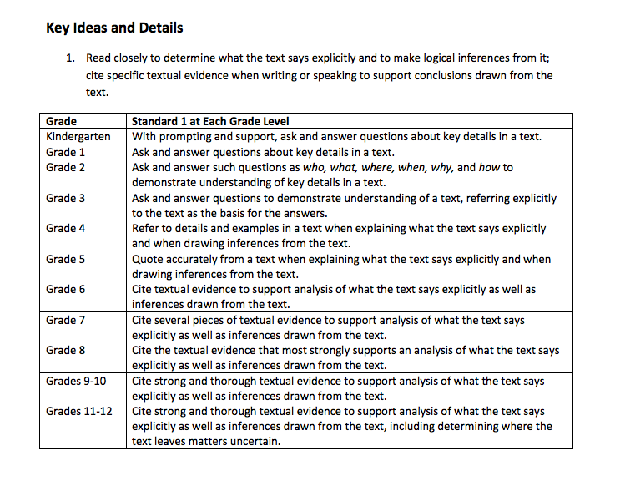

Anchor Standards through the Vertical Lens
Notes:
Introduce the value of reading each standard through a vertical lens. This activity will demonstrate how reading the standards vertically will help educators to focus on the key skills and strategies that learners must master. Emphasize the value for educators to guide a student who is reading below grade level to stay with the integrity of grade level expectations through a focus on the skills and strategies across the grade levels.

Slide 17
Activity 4: Reading the Standards through a Vertical Lens
Standards Progression
Each team will read through one of the standards progression handouts. As a team, choose one anchor standard to read, highlight key skills, and analyze vertically across the grade levels. Share your thinking around how reading the standards vertically can help in applying high expectations for students. As a team, write about your greatest “a-ha” during the process of viewing and discussing one standard across the grade levels. Be prepared to share.
Page 14
Notes:
Reading the standards through a vertical progression allows for educators to deconstruct the standards in a manner that guides meaningful connections to student learning in order to reach diverse learners.

Slide 18
Deconstructing the Anchor Core Standards to Guide Meaningful Scaffolding and Instructional Focus
Know each student’s present level of academic achievement and functional performance.
Identify the appropriate enrolled grade level skills needed in order to maintain grade level expectations.
Deconstruct the standard and find what each student needs to know and be able to do in the simplest terms possible. Keep wording simple and focused.
Notes:
Note: This information can be found on pages 4 and 5 of the IEP for students with disabilities and within the Section 504 plan for students identified as 504.
Once the standards are seen through a vertical lens, educators are more aware of skills needed to guide students toward success. The next step is selecting a standard that relates to a given lesson and then deconstructing the standard to make the learning process and targets clear to students. Deconstructing the standards also creates a clear focus so teachers will maintain and create a meaningful learning environment. Making the standards transparent is a powerful motivation tool to guide students to self-regulate and empower learning—naturally aligned with the UDL Principles.

Slide 19
Example: Writing Standard 9: Draw evidence from literary or informational texts to support analysis, reflection, and research.
Deconstructing provides a focus for creating the learning process:
-underline text-based evidence
-include the text evidence in their writing
Possible scaffolds needed to maintain high expectations:
-metacognition, assistive technology (high and low), graphic organizers - paper, software program
Notes:
Note: This is not an all-inclusive list.
Deconstructing the standards creates a focus for teachers to match the skill and strategies with the needs of the students to create a meaningful learning process. Teacher thinks: What do I have to teach? How will I teach it to guide student engagement? How will I know when I have taught it?

Slide 20
Example of Deconstructing a Standard
Break the standard into its component parts:
Quote accurately
Explain what happened
Draw Inferences
Analyze the subskills
  Decide on a focus. For example, focus on
  explaining what happened in the text to improve
  the student’s comprehension.
Determine adaptations needed for student to successfully reach standard to his full potential
Determine a plan to monitor student’s progress
Standard
Quote accurately from a text when explaining what the text says explicitly and when drawing inferences from the text. (RL.5.1)
Notes:
Review the example of deconstructing a standard to demonstrate the possibilities and realities of creating high expectations.

Slide 21
Activity 5: Deconstructing the Anchor Standards
Applying Understanding
Read through the information from, Deconstructing Standards: Clarifying Learning Targets. Choose an anchor standard. Take a few minutes to follow the questions for deconstructing a standard. Write a learning target to include the essence of your deconstructed standard. Think about the value of this process and how you can apply this process to your thinking and your daily practice as you guide students to achieve their personal best. What UDL Principle connects with your work? Be prepared to share with your team.
Pages
15-17
Notes:
Introduce this next activity where participants will dig deeper in their understanding of the process of deconstructing a standard. The takeaway for participants should be that deconstructing creates a focus for creating a meaningful process of learning. It begins by aligning the skills and strategies to formulate a clear learning target.

Slide 22
Fewer, Clearer, Higher
CT Core Standards are meant to bring focus and clarity to the intention and outcomes of learning.
The standards alone do not create rigor in the classroom.
Aligning the materials and the instructional methodologies creates the rigor.
Notes:
Explain that CT Core Standards were created to be fewer, clearer, and higher to create less standards with more consistency in preparing students for their future in school and career. In addition, the CCS are meant to create focused learning that guides students to think more deeply about concepts and topics. However, it is not the standards that create this rigorous learning process—it’s in the materials and methods we choose. Norman Webb’s Depths of Knowledge (DOK) is one effective teaching tool that can bring students’ thinking to higher levels—sequence to next slide.

Slide 23
Depths of Knowledge (DOK) Levels
Level 1: Recall and Reproduction
*Locate, define, list, label, match, copy, state, tell
Level 2: Skills and Concepts
*Infer, categorize, interpret, summarize, translate, predict
Level 3: Strategic Thinking and Reasoning
*Critique, cite evidence, conclude, argue, hypothesize
Level 4: Extended Thinking
*Initiate, design, synthesize, self-monitor, critique, conduct
A Guide for Using Webb’s Depth of Knowledge with Common Core State Standards by Karin Hess, Ed.D. Retrieved from http://www.crecnow.info/blendedsolutions/docs/docs/Webbs_Depth_of_Knowledge.pdf
Notes:
Review the levels and the verbs that coincide with each level.
Emphasize that DOK:
-is not a hierarchy.
-is a fluid learning process—all levels are important.
-DOK represents four different ways that students can interact with the content.

Slide 24
DOK Goes Way Beyond the Verb
Same Verb—Different DOK Levels:
DOK 1 - Describe the different moon phases.
(Requires basic recall.)
DOK 2 - Describe the difference between waning gibbous and waxing gibbous as seen in the northern hemisphere. (Requires cognitive processing to determine the differences in the two phases of the moon.)
DOK 3 - Describe the relationship between the positioning of the earth, moon, and sun during a full moon. (Requires deep understanding of the cause of the various moon phases.)
Notes:
Emphasize that the verb does not depict the level—it is the task that defines the rigor of the students’ thinking. Review the example of the verb “describe.” In this example the verb is the same, but the DOK level changes. The other variable to consider is defining the task itself.

Slide 25
Activity 6: Depths of Knowledge
Creating Opportunities for Higher Order Thinking
You are asked by your principal to create four questions to guide a discussion with colleagues with the aim of deepening their understanding and application of the Depths of Knowledge process. View the video, Depths of Knowledge, by Karin Hess. Retrieved from: https://www.youtube.com/watch?v=Cu8SfdLfbm8 Review the information on page 19 in your Participant Guide and through your internet access, feel free to explore A Guide for Using Webb’s Depth of Knowledge with Common Core State Standards by Karin Hess, Ed.D. Retrieved from: http://www.crecnow.info/blendedsolutions/docs/docs/Webbs_Depth_of_Knowledge.pdf
Pages
18-20
Notes:
Emphasize that the standards alone will not bring rigor to the learning process. Aligning the standards, IEP goals, and practical tools will create a meaningful learning process. Give participants time to explore the possibilities of applying Webb’s tool to their instruction. This activity is continued on the next slide.
Depths of Knowledge. Retrieved from: https://www.youtube.com/watch?v=Cu8SfdLfbm8
Note: A transcript is provided for this video.
A Guide for Using Webb’s Depth of Knowledge with Common Core State Standards.
Retrieved from: http://www.crecnow.info/blendedsolutions/docs/docs/Webbs_Depth_of_Knowledge.pdf
Note: A transcript is provided for this video (closed captioning should not be used because it is not a good match to what is being said).

Slide 26
Activity 6: Depths of Knowledge – continued
Creating Opportunities for Higher Order Thinking
Fill in the Depths of Knowledge (DOK) Discussion Starter Notes on page 20 in your Participant Guide to shape your discussion for guiding your colleagues’ understanding of using the DOK tool in the classroom. Also, write down one specific way you could incorporate Webb’s DOK tool into one of your upcoming lessons. Discuss with your team. Be sure to add to your notes additional ways to apply in the near future. Be prepared to share.
Pages
18-20
Notes:
Activity 6 continued.

Slide 27
Connecting Standards and Curriculum with UDL
So how do we UDL-ify our lessons and units?
  Content:
  1. Flexible ways of presenting content.
  2. Flexible options for student engagement.
  3. Flexible methods of expression and assessment.
Performance and Skills:
  1. Flexible ways of presenting content.
  2. Flexible ways for students to represent their understanding.
  3. Scaffold, Scaffold, Scaffold!
The UDL Principles and Guidelines effective scaffolding.
Notes:
Connect the information in this slide to deconstructing the standards and identifying learning targets. Focus is on student learning. What is it that you really want students to learn and how can you create a barrier-free learning experience for them?
Emphasize that scaffolding is the key. Some examples include: 1. Showing student work samples to guide understanding of the steps of a lesson, and 2. Using graphic organizers, rubrics, and opportunities to provide performance and mastery oriented feedback (specific feedback).
“Presentation” goes both ways–how students give and receive information. Provided at least one example of each.

Slide 28

Bon Appétit
Notes:
Participants have 60 minutes for lunch. Remind them to be back on time as we will begin promptly.

Slide 29
You are Here! Maintaining High Expectations for All Learners Through Meaningful Adaptions
Introductory Activities
Part 1:
Understanding Learner Variability
Part 2:
Aligning Standards, IEP Goals, Learning Targets, and UDL
Part 3:
Maintaining High Expectations for All Learners
Part 4:
Reflection, Next Steps, & Session Evaluation
Notes:
Part 3: Maintaining High Expectations for All Learners Through Meaningful Adaptions

Slide 30
Natural Connections between Standards, UDL, and IEP Goals
Reading Standards through Vertical Lens
Deconstructing the Standards
Linking Skills and Strategies to IEP Goals and UDL
Notes:
Bring it all together. Emphasize that the process of connecting CT Core Standards, IEP goals, learning targets, and UDL is a natural process that in time can become second nature when applied slowly and deliberately. Ask participants to connect their deconstructed standard to an IEP goal for one of their students. Emphasize the ease in connecting and the natural links between the process and focus. Emphasize that once standards are presented in meaningful ways, scaffolding is the key to guiding students toward success and independence.

Slide 31
Activity 7: Scaffolding for Success
Viewing a Video
After viewing the video, Hint Cards, identify which UDL Principle and/or Guideline connects with each strategy shown. What does this strategy remind you of? How does it spark your thinking about your future lessons? Write your thoughts on a post-it note and place on your UDL Guidelines on page 7. Be ready to share. Video: Hint Cards (2014). Retrieved from https://www.teachingchannel.org/videos/hint-cards. We encourage you to view these additional videos at your leisure. Literary Analysis through Literary Stations Break it Down
Page 22
Notes:
View Hint Cards video clip to guide participants to analyze the power of scaffolding and how it is naturally linked to UDL and guiding students to meet high expectations. If time, view Literary Analysis through Literary Stations as well. Whatever clips are not shown may serve as a resource for participants to view and share with colleagues at a later date. Note: A transcript is provided for this video.
The videos can be found here:
The Teaching Channel. Hint Cards (2014). Retrieved from https://www.teachingchannel.org/videos/hint-cards
The Teaching Channel. Too Hard? Break it Down (2014). Retrieved from https://www.teachingchannel.org/videos/teaching-difficult-lessons
The Teaching Channel. Literary Analysis through Literary Stations (2014). Retrieved from https://www.teachingchannel.org/videos/increase-engagement-and-understanding

Slide 32
UDL is Naturally Embedded in the CCS
www.cast.org
Notes:
Have participants spend some time connecting their deconstructed standard and learning target to the UDL Principles and Guidelines. How do they connect?

Slide 33
What is the Goal of Adapting the Curriculum?
To remove barriers to learning, so all students may demonstrate mastery to the best of their abilities.
Accommodations maintain the same standards for all learners, allowing for varied performance and ability levels. Accommodations are procedures and practices that ensure educators, parents, and students have a valid measure of what students know and can do while not reducing expectations for learning and providing access to the curriculum.
Scaffold students’ learning to encourage motivation and independence.
Expectations remain HIGH for all students!
Notes:
Once participants have had time to review ways to apply the standards with a UDL philosophy in mind, they are ready to discuss ways to apply this knowledge into designing their curriculum. Emphasize the goal of adapting the curriculum is to maintain high expectations for all learners.

Slide 34
Accommodation
Changes in how a student accesses information and demonstrates learning
Does not change the instructional level, content, or standard
Changes made in order to provide a student with equal access to learning and equal opportunity to show what he or she knows and can do
Notes:
Accommodation is one way we adapt the curriculum. It is a natural part of creating curriculum for all learners. Accommodation honors learner variability, creating a meaningful learning for everyone. (Page 8 of the IEP.) Accommodation maintains the same standards for all learners, allowing for varied performance and ability levels and access to the content.

Slide 35
Types of Accommodations
Presentation (e.g., repeat directions, read aloud, adjust format of text)
Response (e.g., mark answers in book, use reference aids, point)
Setting (e.g., study carrel, special lighting, separate room)
Timing/scheduling (e.g., extended time, frequent breaks)
Page 23
Notes:
Review the types of accommodation and refer the group to page 23 in Participant Guide to deepen the connection to everyday accommodations and UDL. UDL is a structured framework providing a means to meet the needs of all learners including a focus on accommodations. Emphasize that UDL is not considered an accommodation—it is highly effective teaching and is good for all learners!
Note: For SwD these are found on page 8 of the IEP and for students with a Section 504 plan these are defined in the 504 plan.

Slide 36
Modifications
Change what a child learns
Are different from scaffolds and accommodations
Are implemented after accommodations alone do not address the needs of the student
May be minimal or very complex depending on the student’s performance (Performance levels are found on the Present Levels of Performance, page 4 and 5 of the IEP. The information on these two pages actually drive the IEP and learning for the student with disabilities with an IEP.)
Must be clearly acknowledged in the IEP or 504 plan
Significantly change “what” is taught and learned, therefore changing the content, grade level, and curriculum expectations
Can increase the gap between the achievement of students with disabilities and the expectations for proficiency at a particular grade level
May result in less opportunity for the student to practice and ultimately master grade-level skills
Notes:
Only students who have IEPs or 504 plans are allowed modifications. Modifications are implemented to change:
How things are graded: Some teachers use pass/not pass instead of letter grades.
How tests are handled: A practice test might help the student prepare for the real deal. Or there may be two rather than four answer choices on a multiple-choice test.
How things are taught: The teacher might use more prompting and cueing to help the student determine the right answers. Class material may be written at an easier level of understanding.
Homework and classwork: Sometimes students who work at a slower pace will be given fewer or shorter class assignments and less homework.

Slide 37
Activity 8: Adaptation Sort
Accommodations and Modifications
With your team, read the student adaptation cards that are in an envelope on your table. Sort each as either, Maintains alignment with Core Standards, Negatively impacts alignment with Core Standards, and Unsure if this impacts alignment with Core Standards. Use the UDL Guidelines to identify Principle(s) and Guideline(s) that connect to each adaptation card. Think of a student who is presently in your class and create another adaptation that would apply to your classroom experience. Fill your adaptation on a blank adaptation card. Identify the UDL Principle(s) and Guideline(s). Be prepared to share as a whole group.
Page 24
Notes:
Review the steps in Activity 8 and guide participants through the process. Allow 5 minutes to introduce and review and 5 minutes for teams to sort.
Emphasize the importance for instructional decisions to align with the essence of the standards. Remind participants that deconstructing the grade level standards guides the process for us to stay focused on using effective materials and creating a deep meaningful learning process to guide students to personally connect to the learning.
Be sure to focus on the positive impact our instructional decisions make on embedding higher and deeper thinking processes in our classrooms.

Slide 38
Let’s Take A Break…
…Be back in 10 minutes
Notes:
The break should be 10 minutes. Remind participants to try to be timely in their return.

Slide 39
UDL Principles: Multiple Means of Engagement (The “Why” of Learning”)
Examples
  Opportunities for choice
  Grade appropriate activities
  Culturally relevant activities
  Charts/schedules/visible timers
  Display of goals, learning targets
  Group work/collaboration
  Personal journal—opportunities for self-reflections
Notes:
Using UDL supports or scaffolds are effective best practices Review these scaffolds that connect to the multiple means of engagement. Have participants share any other ideas or connections.

Slide 40
UDL Principles: Multiple Means of Representation (The “What” of Learning)
Examples
  Underlining/highlighting/Circling things such as:
  Big Ideas, Relationships, Pronouns, etc.
  Vertical lines/asterisks/doodles/numbers to organize information
  Provide multiple media/formats
  “Chunking” information
  Graphic Organizers
  Provide multiple examples
  Support background knowledge and context for learning
Notes:
Review these scaffolds that connect to the multiple means of representation. Have participants share any other ideas or connections. Emphasize that highlighting is not just for ELA but rather a strategy that supports recognition networks across content areas.

Slide 41
UDL Principles: Multiple Means of Action and Expression (The “How” of Learning)
Examples
  Multi-media for student expression (video, audio, text, drawing)
  Concept mapping tools
  Scaffolds and prompts
  Checklists, Step by Step Guidelines
  Embedded peer tutors
  Assessment rubrics for students
Notes:
In a UDL classroom, these are not considered accommodations, but rather effective teaching. Review these scaffolds that connect to the multiple means of action and expression. Have participants share any other ideas or connections.

Slide 42
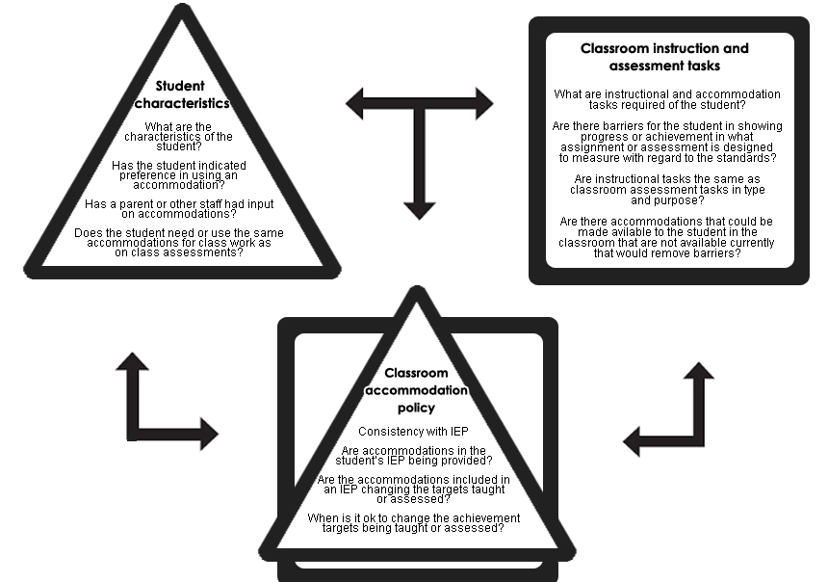
How might accommodations change over time?
Source: Accommodations Manual: How to Select, Administer, and Evaluate Use of Accommodations for Instruction and Assessment of Students with Disabilities, Third Edition: http://www.ccsso.org/Resources/Programs/Assessing_Special_Education_Students_(ASES).html
Notes:
This graphic is from the Accommodations Manual: How to Select, Administer, and Evaluate Use of Accommodations for Instruction and Assessment of Students with Disabilities, Third Edition: http://www.ccsso.org/Resources/Programs/Assessing_Special_Education_Students_(ASES).html.
Review each of its sections with participants.
Note that accommodations that a student uses may change over time. The student characteristics, classroom instruction, and assessment and the accommodation policy may be impetuses for these changes. Different kinds of accommodations may be needed as the child gets older, and the way decisions are made about accommodations change over time with the student self-advocating and taking more responsibilities for knowing what is needed in order to prepare them through high school to transition into post-secondary settings. Accommodations also make testing and instruction accessible for SwDs throughout K-12 and provide the necessary supports and scaffolds. As the student gets older, educators and parents must encourage independence and self-advocacy to support a successful transition to post-secondary settings. Source: Testing Students with Disabilities, Elliott, Turlow & Ysseldyke, 2nd Edition, Corwin Press 2003.

Slide 43
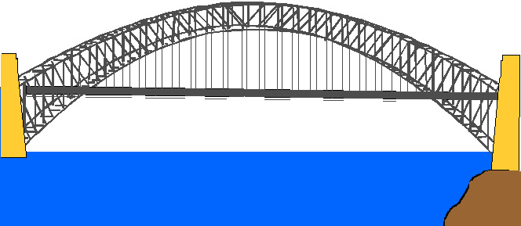
UDL and Accommodations Provide the Supports and Scaffolds to Successfully Bridge the Standards
UDL
Standards
Accommodations
Standards
Scaffolds
Notes:
Emphasize the natural bridge that UDL creates when implemented within the adaptation process. The next few slides will emphasize UDL strategies that are often viewed as accommodations, yet UDL is really a natural process for what master teachers do.

Slide 44
Three Minute Pause
Summarize Key Points
Add Your Own Thinking (Make a Connection)
Pose a Clarifying Question
The Reading Quest: http://www.readingquest.org/pdf/3mp.pdf
Notes:
Allow participants to process the information shared about adapting the curriculum through accommodations and modifications. Share out as whole group.

Slide 45
Activity 9: Lesson Plan Analysis
Making Connections
With your team, choose one of the lesson plans provided, or use one of your own lesson plan ideas to identify the natural UDL components. Use the UDL Principles and Guidelines on page 7 to identify one UDL Principle and Guideline. Think of a sample student with a potential IEP goal that would align with your chosen lesson. How well does this IEP goal connect with the standards and UDL components? On a scale of 1‒5 (with 5 being the greatest of ease), how naturally do you think UDL Principles and Guidelines, IEP goals, and standards connect? 6. Be prepared to share.
Page 25
Notes:
Review the steps in Activity 9 and guide participants through the process.

Slide 46
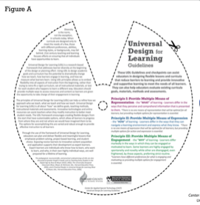
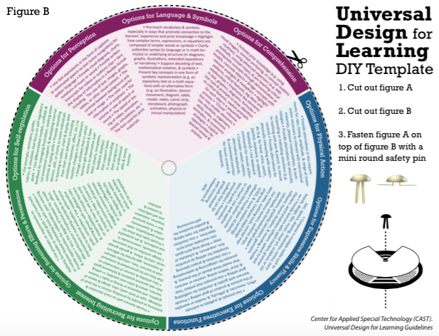
UDL Planning Tools
Notes:
This tool builds upon the first UDL planning tool found in the UDL Principles and Guidelines graphic organizer. Provide the option for teams to create their own UDL DIY Template. Summarize the value that this tool provides of applying the UDL Guidelines at a glance for increased application and consistency. Encourage teams to connect and express the value of this tool for future use in their classrooms. Specifically, ask participants how this tool can support effective, proactive planning. What value does this tool add to the usefulness of the UDL Principles and Guidelines graphic organizer? Give time for teams to put this tool together.

Slide 47
You are Here! Reflection, Next Steps, & Session Evaluation
Introductory Activities
Part 1:
Understanding Learner Variability
Part 2:
Aligning Standards, IEP Goals, Learning Targets, and UDL
Part 3:
Maintaining High Expectations for All Learners
Part 4:
Reflection, Next Steps, & Session Evaluation
Notes:
Part 4: Reflection, Next Steps, & Session Evaluation

Slide 48
What can I do TOMORROW to be better prepared to implement the CT Core Standards with all students?
Learn more about or solidify knowledge of differentiation and Universal Design for Learning (UDL).
Be more aware of the types of accommodations, while staying true to the integrity of what the CT Core standards are asking my students to know and do.
Gather and respond to data gathered from formative and summative assessments. (We will delve into this during Module 3.)
Practice gradual release of responsibility. (We will discuss and apply knowledge of scaffolding in Module 3.)
Notes:
Allow time for participants to think about the immediate and long term goals they can create and apply starting tomorrow!

Slide 49
Sneak Peek into Module 3
UDL Lesson Planning
Embedding Formative and Summative Assessments
Progress Monitoring
Making Instructional Decisions
Embedding Technology
Notes:
Sneak peek into Module 3.

Slide 50
Activity 10: Blanket the Table
Reflection and Next Steps
Think about the key words, phrases, and ideas you consider important to remember from today’s session. Take a blank sheet of paper and fold it into eight sections. Write one word or idea per section of paper. Tear off your idea and put it on the table. Continue writing words in the sections, tearing off each section after you write your idea. Continue to cover the table with your ideas. Be prepared to share
Page 27
Notes:
For Reflections and Next Steps, participants who came as teams must be seated with each other.

Slide 51
Meeting the Challenge, Modules 3 and 4
Module | Title | Dates
Module 3 – Students with Disabilities | Designing Curriculum with Intention and Rigor | November 2, 3, 12, 13
Module 3 – English Learners | Accessing the Connecticut Core Standards in Mathematics | November 2, 3, 12, 13
Module 4 – All | Implementation and Sustainability | December 10, 16, 17
Notes:
Remind participants of upcoming modules and dates. Remind them to register if they have not done so already.

Slide 52
Session Evaluation
Thank you for attending today’s session, Adapting the Curriculum in UDL Style.
Your feedback is very important to us! Please fill out a short survey about this session.
The survey is located here: http://surveys.pcgus.com/s3/CT-Module-2-SwD-UDL
Notes:
Remind participants to complete the online Session Evaluation. The survey is located here: http://surveys.pcgus.com/s3/CT-Module-2-SwD-UDL
Ask for further thoughts, questions.

Slide 53
Thank you!

