Slide 1


Meeting the Challenge:
CT Core Standards Success for English Learners and Students with Disabilities
A Professional Learning Opportunity for School Teams Dedicated to the Success of ALL Students
Module 2 ‒ EL
Accessing the Connecticut Core Standards in English Language Arts
Notes:
Presenter:
Slide showing when participants enter.

Slide 2

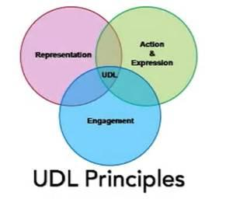
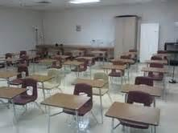


Think-Pair-Share: Your Learning and Applications from Module 1
Beowulf
imagery
Notes:
Presenter:
Think - don’t talk.
Reflect on previous learning from Module 1.
“aha” moment
a time you “designed to the edges” (term from Module 1 video)
something that affirmed your current practices
an application with your school or with your students“
Pair - share your reflection with a table partner.
This should take about 3 minutes.
BENEFITS for ELs:
Provides think time.
Suggestion: younger learners - “Put on your thinking caps.”
Promotes home language retention and development through homogeneous pairings.
Promotes English language development when a partner shares in English what his/her non-English speaking partner said: i.e., now that person is also hearing his/her idea expressed in English.
Opportunity to rehearse language with a partner in a lower-stress situation prior to sharing; such rehearsal opportunities can have a profound effect on language production.
Hearing an idea more than once promotes receptive language development.
Every student participates:
Students who most need language growth are not typically the ones with their hands up to volunteer.
It may also be culturally inappropriate to do so for students with collective cultural backgrounds; however, it is generally appropriate across cultures to share a group or partner idea.
Use differentiated sentence frames to support ELs and provide models for language growth of all learners.
Easier for students with less confidence/language to share if they have a starting point.
Structure younger learners’ partner talk further; e.g., ask “birds” to share then when done, tell “bees” to share.
Tell younger students who their partner is before the sharing begins; e.g., students come to rug in pairs; there would be no more than one triad; no one left out; no time wasted.

Slide 3
Sentence Frames
I learned that _________________________.
I was surprised to learn that _____________.
__________ was the most interesting to me.
Another important big idea was__________.
I felt that _______________ would have the greatest impact on my teaching.
The emphasis on _________________ seems particularly relevant for teaching students in multicultural, multi-level classes.
Notes:
Presenter:
Traditional Think-Pair-Share: volunteers share ideas with whole group.
Adaptation of “Stand and Share” (Kagan) engages more learners.
Read the sentence frames.
Think of how you might share your most important learning using one of these frames. Allow approximately 10 seconds to do this and mention that appropriate think time is being modeled.
Ask everyone to stand; assure audience this is a volunteer activity.
One person shares; others sit if they had the same/similar idea.
The person sharing calls on the next person to share.
Speakers need to speak to audience, not the presenter.
This should take about 5 minutes.
BENEFITS for ELs:
Sentence Frames
Gives a starting point as well as provides modeling for the range of learners.
Teacher hears all statements.
Recommend writing the sentences in the order of complexity: simplest on the top.
Sentence frames and oral language practice provide models that can be later be applied to writing.
Promote additional sentence variety:
Use more than sentence starters.
Provide omissions at the beginning of a sentence.
Model varied syntax to promote development of complex language; transferable to writing.
Consider the audience when constructing sentence frames; i.e., with younger ELs use only 2 or 3.
Use color:
Separates frames.
Can indicate level of difficulty.
Note: When asking students to share learning, use “I learned that” rather than “I learned” so that students are forced to express a complete idea, either an important fact, or better yet, a statement of understanding. Otherwise students will say I learned “about” a topic or “how”. Neither require statement of important learning.
Adapted Stand and Share (Kagan)
Opportunity for rehearsal, repetition, building comprehension, and hearing other ideas.
Used at the beginning of class provides review of previous learning as well as an orientation for students who were absent the day before.
Used at the end of class, promotes summary statements; encapsulation of essential learning.
Productive use of class time:
Beginning of class: “bell ringer” activity; students not present do not miss essential new learning.
During class: encourages engagement and physical activity; reinforces new learning.
End of class: for older students, eliminates ‘packing up/checking out’ before the bell; for younger students, utilizes every moment including just before lunch, recess or dismissal.
Tips:
Use when students need to move.
Use at the beginning of class to review previous learning.
Use at the end of class to reflect on essential learning.
Use to support language development but do not use them all the time.
Write to specifically support the content.
Observe to make sure most reserved students are ready.
Observe to seek out students who regularly sit before sharing and appoint them to share first.
Know that once students are comfortable with this form of sharing, many will try to think of another idea to remain standing.

Slide 4
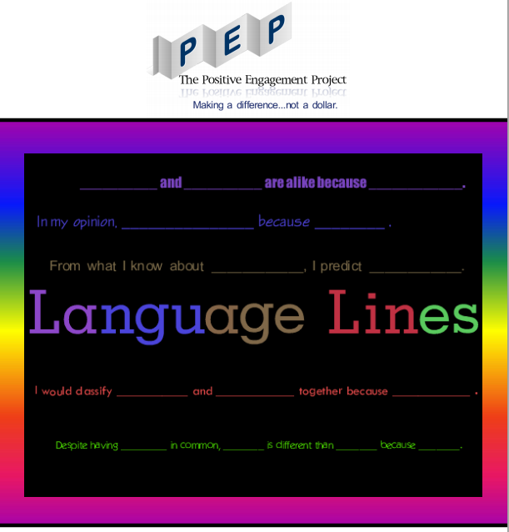
Sample Sentence Frame Resource
The Positive Engagement Project: http://pepnonprofit.org/uploads/2/7/7/2/2772238/pep_language_lines_sentence_frames.pdf
Notes:
Presenter:
Resource
Sentence frames differentiated by color for various proficiency levels
Older students responsible for keeping sentence frames in binders
Organizational patterns: cause/effect, compare/contrast, etc.
Strategies: drawing inferences, making predictions, etc.
Use frames to meet the language function of the assignment

Slide 5
Today’s Agenda
Content:
Opportunities for English Learners (EL) using Connecticut Core Standards (CCS)
Speaking and Listening to Work Collaboratively
Reading Engagment with Complex Texts
Using Evidence in Writing and Research
Notes:
Presenter:
Review content highlights on slide.
Note that actual classroom instructional strategies will be used throughout the day to engage with the content.

Slide 6

Today’s Agenda con’t.
Instructional Strategies:
Think-Pair-Share
Sentence Frames
Stand and Share (adapted)
Chalk Talk
Closed Sort
Sentence Frames
TPR
Strike a Pose!
Visual Representation
Line Up
Reading Closely for Text Evidence
Within-Team-Jigsaw
LEA
Graphic Organizers
R.A.F.T.
Notes:
Presenter:
Read, point out a few, or have participants read to themselves.
Some will be demonstrated/explained to them.
Some they will actually do.

Slide 7
Goal of Today’s
Professional Development
Deepen participants’ understanding of the Connecticut Core Standards (CCS) for English Language Arts and Literacy in History/Social Studies, Science, and Technical Subjects and their impact on instruction in meeting the needs of ALL learners, with an emphasis on English learners.
Notes:
Presenter:
Read aloud, paraphrase, or have participants read to themselves.

Slide 8

Pre-Assessment of Today’s Activities
I feel equipped to differentiate for the language development needs of my EL students in the Connecticut Core Standards.
I understand key principles of instruction for ELs and how they apply to my own lesson planning and instruction.
I know strategies to scaffold skill development for ELs.
I know what resources are available to me to support my instruction for EL students.
Page 6
Notes:
Participants should rate on a scale of 1-4 their comfort/knowledge for each of these four statements. This could be repeated at the end of the training to provide a Post-Assessment as well.
Allow about 5 minutes.

Slide 9
You are Here!
Opportunities for ELs Using CCS
Warm Up Activity
Part 1: Opportunities for ELs Using CCS
Part 2: Speaking and Listening to Work Collaboratively
Part 3: Reading Engagement with Complex Texts
Part 4:
Using Evidence in Writing and Research
Notes:
Presenter:
Graphic will be displayed throughout the day.
Now, Part 1: Opportunities for ELs using CCS

Slide 10
Objectives for Focus Area:
Opportunities for ELs using CCS
Content Objective:
Participants share their professional reactions and insights to Understanding Language’s Key Principles for EL Instruction, reflect on the example shared/past instructional experiences, and begin to shift their pedagogy in implementing the CCS.
Language Objective:
When provided with the ‘Principles’ and a classroom example, participants will read and respond through drawing or writing that includes technical language to convey their ideas.
Notes:
Presenter:
Acknowledge that many already use Content and Language Objectives for planning lessons with ELs; effective instructional planning for ELs.
Content objective reflects what the student (participant) should know and be able to do at the end of instruction/experience.
Language objective reflects what English language processes the student (participant) will use to engage with the content.
Will model this best practice and initiate each workshop component with a content objective and a language objective.
Integrating content and language objectives for ELs is a crucial part of implementing the CCS.
Presenter reads aloud, paraphrases, participants read silently, etc.
Define technical language as the language teacher’s use in their appointed profession.
E.g.: “scaffold” is technical language in the education profession. We use this word in a distinct way that applies only to our profession (and indeed, most dictionaries do not recognize the use of “scaffold” as a verb, but educators use it as such all the time).
Another example: “differentiate.”

Slide 11

Assignment in a 6th grade classroom: Give a speech on an endangered animal.
Chinese
age-appropriate schooling
6 months in U.S.
beginning
Notes:
Presenter: Today we want to focus on how ESL and general education teachers can collaborate in serving ELs. Let’s consider one option for an assignment and then a revision based on UDL.
ESL teacher in pull-out program:
General education teacher asks ESL teacher to help an EL on an assignment.
Assignment: speech to class on an endangered animal.
EL student has a resource - a book about a panda bear.
Book is written at a lexile level appropriate for average 6th grade readers.
The first thing an ESL teacher needs to do is consider characteristics of the student.
From China.
Has background knowledge on panda bears; topic is appropriate.
Had age-appropriate schooling in China.
Has been in US for only 6 months.
Beginning level of English Language Development.
ESL teacher feels conflicted because assignment is not developmentally appropriate.
Talking through this example, slides 11–30 should take about 20 minutes.

Slide 12
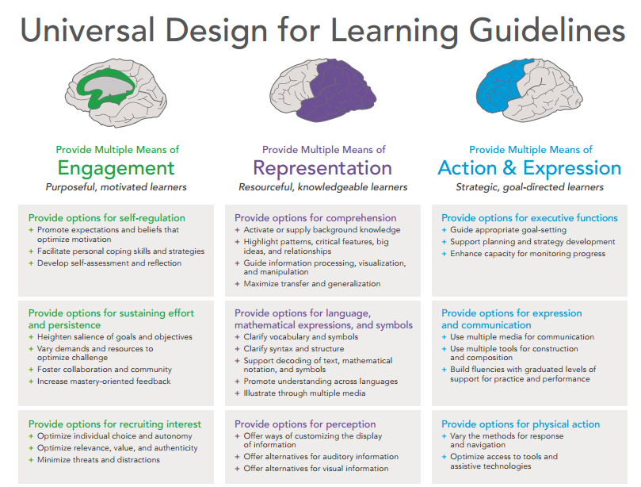
Assignment Revision to Reflect UDL
© 2014 CAST. Used with Permission. All Rights Reserved.
Notes:
Presenter:
Let’s think about following UDL Guidelines from Module 1 to revise this assignment.
How this could be done will be explained in the following slides.
Look over the guidelines. As the slides are presented look for evidence of Engagement, Representation, and Action and Expression and check off some you see exemplified.
Source: http://castprofessionallearning.org/wp-content/uploads/2014/05/UDL-Guidelines-2014.pdf

Slide 13
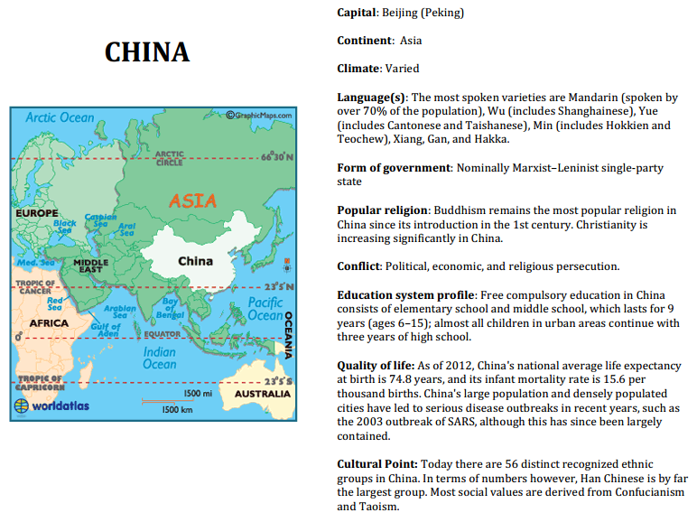
Chinese Culture Card
Notes:
One of the most important ways to serve ELs is to consider their background knowledge. Given the girls background, Panda bear was a good choice.
Note: It is helpful for educators to know as much as possible about the countries, languages, and cultures of their ELs. This Chinese culture card is part of the Country Culture Cards document at Southern Connecticut State University. This is just one of the resources available to CT teachers working with ELs. These resources provide ready access to some basic facts. Teachers would also want to continually seek to expand their cultural awareness in ways that go beyond the facts. Make cultural connections when possible.

Slide 14
UDL: What are my goals?
ELA Connecticut Core Standards
CSS.ELA-Literacy.CCRA.SL.4
Present information, findings, and supporting evidence such that listeners can follow the line of reasoning and the organization, development, and style are appropriate to task, purpose, and audience.
Notes:
Presenter:
UDL asks us to define our goals.
Teach Core Standards to all learners.
Modified assignment will address developmentally appropriate learning for the range of learners.
In this case, focus is on College and Career Readiness Anchor Standard for Speaking and Listening #4.
Educators identify themes to teach the standards.

Slide 15
UDL: What do I want students to know?
Animals have common survival needs that they meet in similar and different ways. | When the survival needs of an entire species aren’t met, they become extinct.
Many animals are in danger of extinction because of human behaviors. | Conflicts arise when environmentalists try to protect endangered species.
Broader Understandings
There are typically multiple perspectives for solving complicated problems.
Many proposed resolutions have both positive and negative consequences.
Notes:
Presenter:
The next decision to be made is to identify the important knowledge and understandings for the unit.
Skim examples.
Each is important but more important are the Broader Understandings.
UDL directs us to:
Highlight patterns, critical features, big ideas, and relationships
Maximize transfer and generalization

Slide 16
UDL: What will students do?
Each team will give a speech on an endangered animal that includes:
How the animal meets common needs
The causes of extinction
Solution attempts and results
Suggestions for problem resolution and predictions of results
Challenge: Present a controversy between those who seek to protect a species and those who oppose the proposed actions.
Notes:
Presenter:
Think about student engagement. How interesting would it be to listen to 30 students give a speech on an endangered animal?
The assignment is too difficult for some and not challenging for others.
Speeches may focus on low-level sharing of basic information, not controversial issues related to resolving complex problems.
Consider how modifying the assignment to distribute the presentation among team members addresses developmentally appropriate instruction and student work.

Slide 17
CCS Vocabulary Tiers
Tier 1
Everyday words familiar to most students
Primarily learned through conversation
Tier 2
High utility academic vocabulary found in many content texts
Cross-curricular terms
Tier 3
Domain-specific academic vocabulary
Notes:
Presenter: Model of Tiered Vocabulary.
Once the big ideas/understandings of a lesson have been identified, it is important to determine the most essential vocabulary. This model is helpful.
Implications for ELs:
Tier 1: ELs know concept in home language but not the label in English.
e.g., know what a bird is but does not know the English word “bird”; easily taught by pointing to a graphic of a bird during reading/instruction.
Tier 2: Words appear in grade level text.
require different teaching strategies:
#1 - Demonstration: TRUNK - trunk of an elephant, trunk of the human body, trunk of a car.
#2 - Cognates; e.g., fortunate/afortunado (Spanish).
#3 - Pre-teach words that cannot be demonstrated or are not cognates.
Tier 3: Low-frequency found in content books in upper grade.
Translate.
Briefly explain either in English or in the EL’s home language.
Advisable for all classrooms to have bilingual dictionaries.

Slide 18
What is “Academic Language”?
The language we use to:
correctly and appropriately learn, teach, and communicate about academic content.
assess and evaluate content learning and academic achievement.
The language used in:
books and other academic, professional, or technical texts.
standards and standardized tests.
schooling and academic discourse communities.
Rebecca Freeman Field, Ph.D.
Notes:
Presenter:
Academic vocabulary development is directly correlated to student achievement.
Read for yourself this definition of “academic language.”
Many ELs can manipulate English language to extent of providing a correct answer, yet they still do not understand content.
ELs need explicit instruction on academic content language.

Slide 19
Identify Vocabulary
Tier 3: Content Specific Vocabulary
Tier 2: Cross-disciplinary Academic Vocabulary
Tier 1: Words of everyday language
species | extinct | environmentalist | endangered
needs (n) | perspective | consequences | cause
effect | affect | controversy | reproduce
conflict | solution | prediction
animal | food | water | temperature
space | die/dead | danger | problem
Notes:
Presenter:
This slide reflects the Tier 1, Tier 2, and Tier 3 vocabulary that would be needed to support the unit on Endangered Animals.
UDL asks us to clarify vocabulary. Focus vocabulary instruction on:
Any unknown concepts/terms in the big ideas or understandings.
The most essential content-specific vocabulary.
Emphasis is on Tier 2 words, those that are used across the disciplines, many with multiple meanings.
Teach for maximum transfer, “food” is more important than “bamboo.”
ELs will know the Tier 1 words in their own language, so they don’t need to be “taught” the word, rather learn to recognize the concept in a different language.
Don’t rely on dictionary definitions to teach unknown concepts.
When teachers identify which vocabulary is most essential, instruction can provide focused support rather than overload.
If teachers recognize the Tier 1 vocabulary needed by ELs at earlier levels of language development, that vocabulary won’t be overlooked.

Slide 20
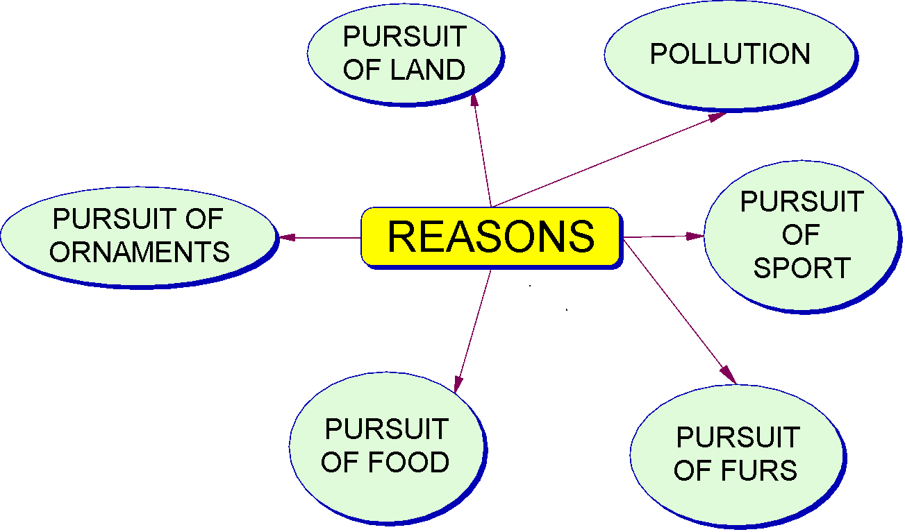
UDL: What do I want learners to care about?
Notes:
Presenter:
UDL asks educators to incorporate into their lesson what students care about:
Global problems.
Risk to endangered animals.
Multiple ways human behaviors have endangered many species.
Problem resolution attempts and related controversies.
Team jigsaw
Assignment: Present animal based on one of the reasons animals are endangered.
Team choice of animal supports student engagement.
Benefits:
Provides time for more in-depth exploration of a topic.
Teacher can hear all information as it is shared.
Note: Provide structure and scaffolding needed for effective participation of all members.
Older learners can decide group structure if they have had experience with the process and equitable division of labor.
BENEFITS for ELs:
Support opportunities from team members.
Teachers or aides can give guidance to teams and individuals as needed without disrupting others.
Fewer topics for each learner to read about and process, so comprehension is enhanced.
The ELs can be given responsibility for a developmentally appropriate task.

Slide 21
Team Member 1: Animals have common survival needs.
Habitat and Space
Food and Water
China’s mountains, coniferous forest. Bamboo is at lower elevation. Males range 1.5 to 2.5 sq. miles, females 75-100 acres. (less than other bears)
99% of diet is bamboo leaves, stems and shoots. Ineffective digestive system. Must eat 12-16 hours a day.
NEEDS: Panda Bear
Protection
Air & Livable Temperature
Ability to Reproduce
Protective fur. Oily protective coating. Large size, camouflage. Cubs vulnerable.
Only 10% males & 30% females fertile. Usually 1 cub, if 2 often abandon. Cubs 3-4 ½ oz.
Cold, damp, misty area
No problems with this need.
Notes:
Presenter:
Effective use of Team Jigsaw, individuals need to be accountable for specific tasks.
In this example, each team member will teach one of the important understandings related to their animal.
Team number 1: Develop a web that represents how his/her team’s animal will meet common needs
This would be an appropriate assignment for our EL student: she will present how the Panda bear meets common survival needs.
To support comprehension for all learners, a graphic organizer will be used by each presenter.
BENEFITS for ELs:
Many of the benefits are for all learners.
It is helpful to include the understanding that matches an organizer on the same page, so students retain focus on the broader context.
Organizers help students understand text structure and promote organized note-taking.
Students don’t have room to just copy the text. They need to use some of their own words to retell.
All students can have the assignment to complete a common organizer related to a topic, but they can use different readings to do so.
Whenever students share their graphic organizers with others, the information is organized and easier to process.
Organizers prepared by more advance students one year can provide a “preview read” to an EL.
Ways to organize information may differ across cultures.

Slide 22

Language modeling for “our” EL student
Pandas are large black and white bears.
They have protective fur and large claws.
Pandas live in the mountains in China.
They eat bamboo leaves stems and shoots.
The bears need a lot of food.
They eat 12 to 16 hours a day.
Pandas don’t have many cubs.
Notes:
Presenter:
Use of sentence frames that support each graphic organizer promote variety in sentence structure.
Note: simple key words were provided that would be appropriate for the EL student as well as some special needs learners.
This part of the assignment would be done by students needing the most support (team number 1).
BENEFITS for ELs:
Overall benefits previously explained; additionally,
Additional language support for the oral presentation.
Practice of basic language structures.

Slide 23



Seek developmentally appropriate readings, but include multiple and multilevel resources.
Search for resources at diverse Lexile levels. After reading a “just right” book, students read a more complex one.
Encourage use of resources in the native language.
Outstanding real pictures of bears in the wild.
Notes:
Presenter:
More than one source of information is needed.
Important to have text the student can read, but the goal is to also raise their reading levels.
Giving students the opportunities to use multi-level text related to a common topic can dramatically increase their reading level related to that topic.
The skills and confidence transfer to other reading tasks.
BENEFITS for ELs:
Reading about the same topic from multiple resources:
Provides practice with key content vocabulary.
Exposure to different ways of expressing common ideas.
Quickly raises the reading level of literate EL learners by providing the context and vocabulary support from one source to access a more complex reading.
Use of native language resources:
Promotes development of reading skills at the student’s reading level, and many of those skills will transfer to English.
Conveys respect for the native language and the importance of maintaining and developing it.
Provides background knowledge that supports reading in English.

Slide 24



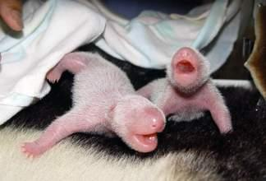
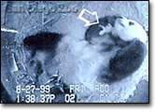
Use visuals to support comprehension.
Notes:
Presenter:
Core standards ask learners to make multi-media presentations.
Students learn the use of technology as they integrate visuals into their presentations.
Engagement in the assignment as well as in the audience is enhanced.
BENEFITS for ELs:
Visuals are needed to support comprehension for ELs with beginning and developing levels of English language proficiency.
Use of multi-media during presentations lowers anxiety because the listeners are not focused exclusively on the speaker.
An accent and error in English are not as confusing to the listeners because the spoken English is supported by visuals.

Slide 25

Seek out videos online.
Image from a video at nationalgeographic.com
Notes:
Presenter:
A video could be a source of information for students as they prepare their presentations.
Even a student with almost no English skills could share a video with the class.
BENEFITS for ELs:
Being accountable for a portion of multipart team project provides a sense of accomplishment to the student.

Slide 26
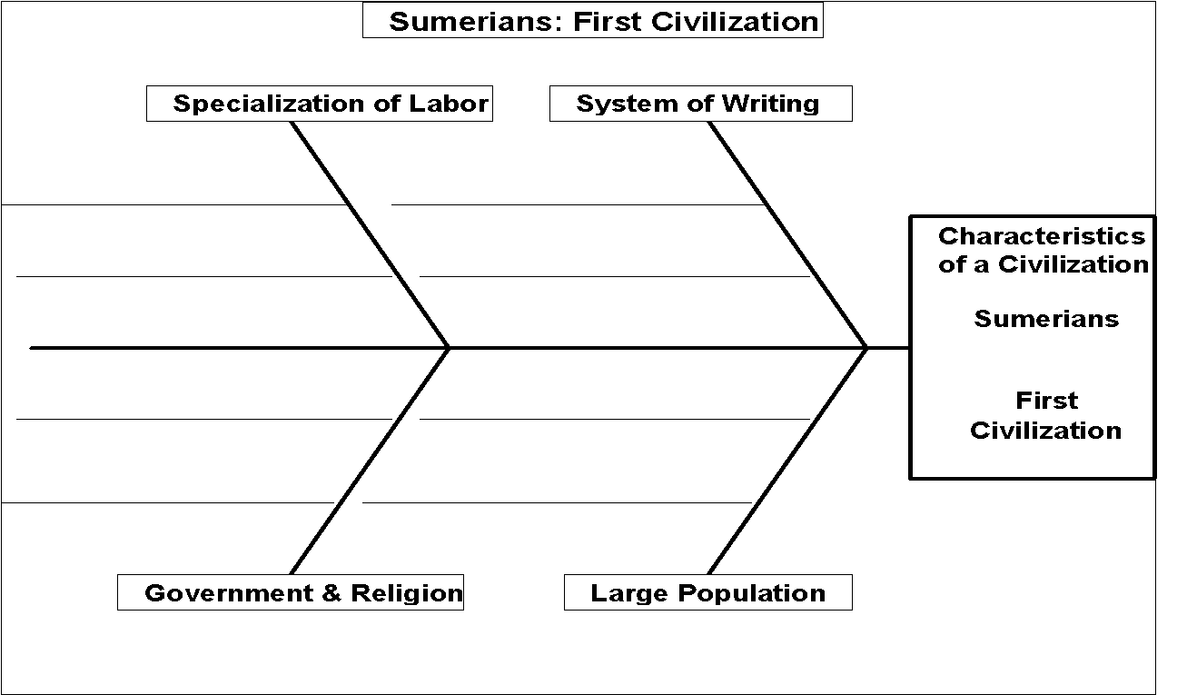
Team member 2: Teach the causes of extinction.
When the survival needs of an entire species aren’t met, they become extinct.
Lack of space
Farming
Pandas in danger of extinction
Poaching
Few Offspring
Notes:
Presenter:
Just looked at developmentally appropriate possibilities for the ESL student.
Quickly take a look at similar, but more complex tasks, for other team members.

Slide 27
Sentence Variety to Express Cause and Effect
_________________________, so____________________________.
__________________________because_________________________.
Because ________________________, _________________________.
Since____________________________, _________________________.
__________________________ since ___________________________.
_______________________; consequently, ________________________.
________________________; therefore, ___________________________.
________________________; hence, ____________________________.
__________________causing, which causes (caused) ______________________.
____________________ resulting in _______________________________.
_______________ which results (resulted) in ____________________.
___________________affects (affected) __________________________.
Now that ____________, ______________________________________.
Notes:
Presenter:
Use of differentiated cause-effect sentence frame supports sentence variety for all learners.
Students who are ready to write cause-effect paragraphs and essays will typically incorporate more variety if they write the sentences first or use them when doing a more complex writing assignment.
BENEFITS for ELs:
Sentence frames are the most beneficial if introduced at a pace and level appropriate for the grade and ELP level.
Older learners can use the frames for each language function as a reference in their binders after use in class.

Slide 28


Modeling for intermediate level ELs
Because farmers want bamboo, Pandas are running out of food.
Pandas don’t have many cubs because so many adult pandas are infertile.
Notes:
Presenter:
This is just a sample for intermediate ELs of those sentence frames.

Slide 29
Farmers used DDT pesticides
1.
DDT absorbed by plants.
2.
Insects ate the plants.
3.
Sequence of Events
is more appropriate
for some endangered animals.
For example:
Peregrine falcons were in danger of extinction.
Small birds ate the insects.
4.
Peregrine falcons ate the small birds.
5.
DDT damaged the egg shells.
6.
Environmentalists saved the falcons by changing nests to skyscrapers away from pesticides.
8.
Few falcons were born
7.
Notes:
Presenter:
Students need to use the types of organizers that best match the organizational format.
Some animals are endangered for multiple reasons.
For others, a Sequence of Events would be a better organizer.

Slide 30
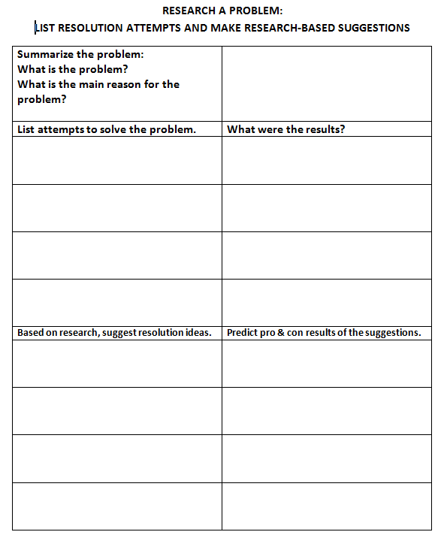
Team members 3 and 4: Teach solutions attempted and the results as well as student suggestions and predictions.
Top: basically review.
Center: requires more in-depth research.
Bottom: challenges students to suggest solutions and predict results based on their research.
Notes:
Presenter:
More advanced students would be challenged by completing this organizer for their presentations.
E.g., solutions already attempted to save Panda bears and the results.
Based on research, suggest ways to protect Panda bears and predict results.
This organizer promotes higher-order thinking and has 3 levels of difficulty.
Consider use with younger learners: for example, solution attempts by the Little Red Hen.
How do students think the hen should have gotten help?
What would their parents do to ask for help with chores?
Look back at your UDL Guidelines and share for a moment with a partner how the guidelines were reflected in this revised assignment. How would all students benefit from the revision?
Benefits for ELs:
Graphic organizers were previously explained in this presentation.

Slide 31
Opportunities for ELs Using CCS
Activity #1: Chalk Talk
Page 9
A silent conversation in writing that allows students
an equal opportunity to participate.
Chalk Talk adapted from the National School Reform Faculty
Notes:
Presenter:
Introduce the Six Key Principles for EL Instruction as being a document from the Understanding Language Project, Stanford Graduate School of Education. Retrieved from http://ell.stanford.edu/content/six-key-principles-ell-instruction
Outline steps for Instructional Strategy #1: Chalk Talk:
Maintain total silence.
Respond to prompts and build upon others’ responses.
Responses can be words, symbols, images, questions, statements, or observations (stress the non-print options for response).
Revisit posters as (silent) Chalk Talk discussion unfolds.
Stand back and ponder as others are adding to Chalk Talk.
Instruct participants to make two rounds to all of the Chalk Talk posters: once for initial response, and then again to build off of others ideas and to see how the discussion is unfolding.
Presenter may want to participate in Chalk Talk to model.
The Chalk Talk activity should take about 15 minutes. Then allow about 10 minutes for debriefing each Chalk Talk poster using slides 32-37.

Slide 32
Six Key Principles for EL Instruction
Instruction focuses on providing ELs with opportunities to engage in discipline-specific practices which are designed to build conceptual understanding and language competence in tandem.
Stanford University: Understanding Language
Notes:
Presenter:
Mini-lecture Key Points:
Learning is a social process.
Listening, speaking, reading, and writing opportunities and instruction must be integrated into each content area.
Teachers must identify and explicitly teach academic language for each discipline.
Reference previous discussion on this.
Note: to be timely, integrate summary of Chalk Talk poster discussion with the mini-lectures for each Principle for EL instruction.

Slide 33
Six Key Principles for EL Instruction
2. Instruction leverages ELs’ home language(s), cultural assets, and prior knowledge.
Stanford University: Understanding Language
Notes:
Presenter:
Mini-lecture Key Points:
Home language and culture are assets to student learning.
Teachers must be familiar with individual students’ home language and cultural practices and possess an authentic understanding of communities that exist in their schools.
This information must be used to:
activate prior knowledge.
connect to new learning.
make language and learning comprehensible and accessible to all.
create meaning and new learning.

Slide 34
Six Key Principles for EL Instruction
3. Standards-aligned instruction for ELs is rigorous, grade-level appropriate, and provides deliberate and appropriate scaffolds.
Stanford University: Understanding Language
Notes:
Presenter:
Mini-lecture Key Points:
Consider shift in your instruction necessitated by the implementation of CCS.
Provide opportunities for students to describe their reasoning.
Provide opportunities for students to share explanations.
Provide opportunities for students to make conjectures such as guesses, estimations, assumptions, inferences, and speculations.
Provide opportunities to justify conclusions.
Provide opportunities to argue from evidence.
Provide opportunities to negotiate meaning from complex texts.
Provide supports or scaffolds.
Understand and learn English language.
Understand and learn grade-level and age-appropriate academic vocabulary.

Slide 35
Six Key Principles for EL Instruction
4. Instruction moves ELs forward by taking into account their English proficiency level(s) and prior schooling experiences.
Stanford University: Understanding Language
Notes:
Presenter:
Mini-lecture Key Points:
Teachers must be attentive to:
Home language proficiencies.
English language proficiencies.
Literacy levels in home language.
Literacy levels in English.
Previous experiences in schools, perhaps in another country as well as in the US.
Time spent in the US.
All of the above must be taken into consideration when planning instruction.
Another resource for CT teachers are the CT EL Strategies Desk Cards: http://www.ctlearning.net/ell/DeskCardsSeptember3,2009.pdf

Slide 36
Six Key Principles for EL Instruction
5. Instruction fosters ELs’ autonomy by equipping them with strategies necessary to comprehend and use language in a variety of academic settings.
Stanford University: Understanding Language
Notes:
Presenter:
Mini-lecture Key Points:
Strategy instruction needs to be explicit.
ELs must be taught and practice a broad repertoire of strategies to construct meaning from academic talk and complex text.
ELs must be taught and practice how to participate in academic discussions.
ELs must be taught and practice how to write for a variety of reasons, primarily academic situations.
Teachers must gradually release responsibility for learning so that ELs move toward becoming completely independent.

Slide 37
Six Key Principles for EL Instruction
6. Diagnostic tools and formative assessment practices are employed to measure students’ content knowledge, academic language competence, and participation in disciplinary practices.
Stanford University: Understanding Language
Notes:
Presenter:
Mini-lecture Key Points:
Teachers must continuously monitor student learning.
Teachers must use data to adjust instruction accordingly.
Teachers must provide students with timely and meaningful feedback.
Students must be encouraged to reflect on their own thinking and learning.

Slide 38

Why is Chalk Talk
an effective instructional strategy for English learners?
Notes:
Presenter:
This debriefing may best be done by the presenter so points are accurately made and the timeframe is adhered to.
Benefits for ELs:
Students in the “silent period” or early stages of language development have as much opportunity to offer their thoughts as students who are more proficient.
Use of pictures and symbols is encouraged allowing students of all levels of English language development to participate equally to share their ideas; more articulate students do not dominate the learning environment.
Dissenting viewpoints can often be more easily “heard” and responded to in a thoughtful fashion.
A method for assessing prior knowledge/assessing what was learned.
A way to discuss difficult issues (e.g., if someone said something culturally inappropriate without realizing it)
A format for ELs to have a representational model of what is being discussed.

Slide 39

Let’s Take A Break…
…be back in 10 minutes
Notes:
Presenter:
The break should be 10 minutes.
Remind participants to try to be timely in their return.

Slide 40
You are Here!
Speaking and Listening to Work Collaboratively
Warm Up Activities
Part 1: Opportunities for ELs Using CCS
Part 2: Speaking and Listening to Work Collaboratively
Part 3: Reading Engagement with Complex Texts
Part 4:
Using Evidence in Writing and Research
Notes:
Part 2: Speaking and Listening to Work Collaboratively

Slide 41
Objectives for Focus Area:
Speaking & Listening to Work Collaboratively
Content Objective:
Participants will rate the Grade Band 4–5 descriptors for ELPA 21 Standards 1 and 3 in order of language complexity level.
Language Objective:
Participants will orally discuss organization and ratings of language descriptors using appropriate language to compare and contrast.
Notes:
Presenter:
Note that we are now moving into the Speaking and Listening area of ELA.
We are presented with a new Content Objective and a new Language Objective.
Read aloud, paraphrase, or allow participants to read silently.

Slide 42
Speaking and Listening to Work Collaboratively
Activity #2: Closed Sort
Page 14
Students employ critical thinking to examine words, phrases, or sentences. The teacher determines the process for categorization.
adapted from Vacca and Vacca, 1996
Notes:
Presenter:
Using Closed Sort to familiarize ourselves with the language complexity levels of the ELPA21 Standards. Note: CT is in the process of adopting new English Language Proficiency Standards, which will hopefully be adopted by the SBOE in early fall. The CELP (CT ELP) Standards have been adapted from the ELPA21 standards, which are closely aligned to CT Core Standards. The standards and a number of supporting documents can be viewed on the CSDE's Bilingual/ESL page, the CSDE's Teaching and Learning page and the CT Core Standards page (http://ctcorestandards.org/wp-content/uploads/2015/06/CELP_Standards_DRAFT_Rev_June_15_2015.pdf )
Introduce the steps in doing a Closed Sort:
Closed Sort: Teacher determines what is to be sorted and the categories.
Twelve cards provided:
2 headings: ELPA21 Standards 1 and 3
5 levels of language complexity for each standard
Decide which descriptors apply to each standard and then organize in order of language complexity
When completed, the group should check their own sort against the KEY.

Slide 43
Closed Sort Discussion
_____ is (easier/more difficult) than _____.
_____ requires (less/more) complex use of language than _____.
_____ is the (easiest/most difficult) task.
Add “because” to any frame to support your opinion.
Notes:
Presenter:
You can use these sentence frames as you do the sentence sort.
Be sure to use sentence frames that match the function of the task.
In this example, you will need to compare and contrast, so the frames are comparative.
Allow about 10 minutes for the closed sort activity.
BENEFITS for ELs: Explained previously

Slide 44
Why is a Closed Sort
an effective instructional strategy for English learners?
Notes:
Presenter:
This debriefing may best be done by the presenter so points are accurately made and the timeframe is adhered to.
BENEFITS for ELs:
Oral English language is modeled by peers.
Students are provided the opportunity for structured talk.
Students use prior knowledge to organize and make sense of words and concepts.
Students may be required to defend their sorting by talking about the common features of the categories and how each specific term/phrase/indicator meets these criteria.
Students at all levels use higher order thinking skills.
Incorporates these best practices for ELs:
Activating prior knowledge
Explicit vocabulary introduction/practice
Preview of lesson’s key concepts
Presenter:
This was a general closed sort.
Closed Word Sort: Single words determined by teacher as well as pre-determined headings.
Open Word Sort: Single words determined by the teacher but no pre-determined headings.
Students construct their own meaning based on how they categorize words.
Whether to use an Open or a Closed Word Sort depends on the desired processes and outcomes for the lesson.

Slide 45
Where do you start with beginning ELs?
Total Physical Response
Introduce Vocabulary
Model Actions with Commands
Students Follow Commands
Constantly Review
Notes:
Presenter:
The easiest thing to learn in any language is a command.
E.g., “Look at Mama. Touch your nose, etc.”
TPR builds on this universal way of teaching children language by identifying key nouns, giving related commands, and demonstrating the commands.
Avoid the tone many use for teaching babies.
However, even for older learners it is very helpful to be playful with the language.
One modification is to say different key words with a unique rhythm or tone.
Learners can not only follow the command more quickly, but retention is much greater. It is also more fun!
Apply Total Physical Response to:
teach entering and beginning ELs.
incorporate TPR (giving directions) into multilevel classes.
progress to EL-friendly literacy tasks.
teach the strategy to mainstream students, so they can use it to assist ELs.

Slide 46

Use whenever directions can be incorporated.
Notes:
Presenter:
In general education classes, teachers may identify ways to incorporate commands into many lessons.
An ESL teacher may use it to help preview course content.
It is very helpful to teach students how to do TPR, so they can teach their EL classmates.
E.g., they could write the command on a card, and the EL student draws a picture on the back.
“Dribble the ball. Pick up your lunch tray, and so forth.”
Note: The presenter will now demonstrate use of TPR. The participants will simply participate in the activity in a language other than English to experience the progression of activities.
Demonstration of TPR, including slides 47–71, should take about 20 minutes.

Slide 47



Example of TPR
Notes:
Presenter:
Script for example done in Spanish.
The teacher points to each: martillo (hammer), clavos (nails)
Teacher models the action: Clava el clavo con el martillo. (Pound the nail with the hammer.)
The teacher can change the tone for the sentence. (Strong staccato sound for pounding.)

Slide 48




Introduce nouns with action.
Notes:
Presenter:
Point to each: serrucho (saw) madera y serrucho (wood and saw).
Say: Corta la madera con el serrucho. (Cut the wood with the saw.).
Seek to match the intonation and stress with the action.
Note: This is not specified for the strategy, but it helps students be successful more quickly, is more fun, and promotes retention.
Say: Carpintero corta la madero con el serrucho. (Carpenter, cut the wood with the saw.)
Note: because teachers will recognize the cognate, it is not necessary to point to the carpenter first.
However, many students do not automatically notice cognates.
Periodically repeat the simple commands: Clava con el martillo. Corta con el serrucho.
Even before students understand the words, they will be able to do the correct commands just from the intonation and stress.

Slide 49




Students all do actions.
Notes:
Presenter:
Say: Clava el clavo en la madera con el martillo. (Pound the nail in the wood with the hammer.)
Note: Longer sentences are being use with the adult participants.
Say: Tablas de madera. (lengths of wood) Point to the stack of wood.
Say: Madera Point to plywood.
Say: Tablas de madera. Indicate length with hand motions.
Say: Carpintero corta la tabla de madera. (Carpenter, cut the length of wood.)
Say: Clava con el martillo. (Pound with the hammer).
Remember to periodically repeat the commands previously introduced.
Say: casa (house)
Remember to review related vocabulary previously taught.

Slide 50





Introduce no more than 7 new words. Others are review.
Notes:
Presenter:
Say: brocha (brush - review word)
Say: Pinta con la brocha. (Paint with the brush.)
Review from painting pictures in class.
Say: pintor (painter - action is paint with a brush.)
Review from class activity.
Say: Pintor mezcla la pintura. (Painter, mix the paint.)
Review from class activity.
Say: Paredes (walls)
Say: Pintor, pinta las paredes de la casa. (Paint the walls of the house.)
Note: More language is being introduced during this activity than is recommended for newcomer ELs.
However during the activity, there is an attempt to have participants get a sense of the progression of activities.

Slide 51
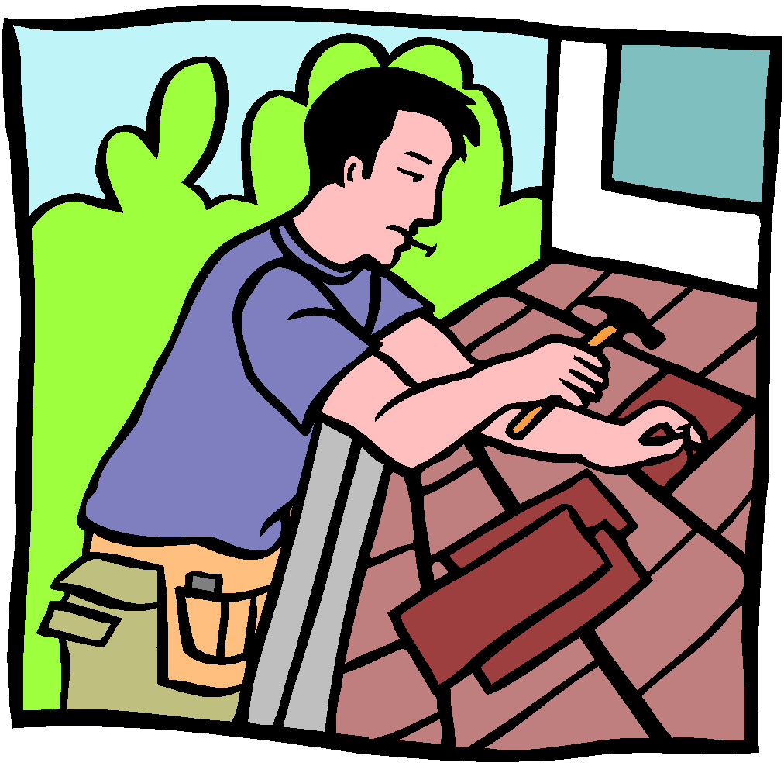

Review as you introduce and practice new words.
Notes:
Presenter:
Say: Techo (roof) Point to the roof.
Say: Carpintero, clava los clavos en el techo. (Carpenter pound the nails in the roof.)
Say: Ponga el techo en la casa. (Put [review word] the roof on the house.)

Slide 52

Easiest Reading: TPR Commands
martillo
Clava con el martillo.
clavos
Clavo el clavo con el martillo.
Notes:
Presenter:
The easiest reading is a repeat of a TPR command.
Read the slide.
English translation of the slide.
Hammer.
Pound with the hammer.
Nails.
Pound the nail with the hammer.

Slide 53

Clava el clavo en la madera con el martillo.
Carpintero clava los clavos en la madera.
No ponga los clavos en la boca.
Notes:
Presenter:
Read the slide.
Translation:
Pound the nail in the wood with the hammer.
Carpenter, pound the nails in the wood.
Don’t put the nails in your mouth. (Point to mouth.) boca (mouth [review]), pongas (put [review])

Slide 54
Corta la madera con el serrucho.
serrucho
madera y serrucho
Carpintero corta la madera con el serrucho.
Notes:
Presenter:
Read the slide.
Translation:
Cut the wood with the saw.
Wood and saw.
Carpenter, cut the wood with the saw.

Slide 55

Pinta con la brocha.
Pinta la casa con la brocha.
brocha
El pintor está pintando las paredes en la casa.
Progress to simple descriptions. This is not TPR.
Notes:
Presenter:
Read the slide.
Translation:
Brush.
Paint the house with the brush.
con (with [review])
The painter is painting the walls in the house.
Gradually progress to simple descriptions of what someone is doing while they are doing it.

Slide 56




Construye una casa.
Notes:
Presenter:
Translation: Build a house.
Say: construye (construct [review])
The images also convey the meaning of the word.

Slide 57


Teach skills in context.
El carpintero está clavando el clavo.
La carpintera está clavando el clavo.
Simple descriptive sentences, not TPR.
Notes:
Presenter:
Seek to always teach grammar skills in a familiar context with words students know.
Read the sentences.
Translation: The carpenter is pounding the nail.
Read the first sentence with a very low voice and the second sentence in a high voice.
Point to the man, “el” and the “o” ending.
At this point the teacher would not explain that “the” in Spanish has a masculine and feminine form.
The noun ending also reflects gender.
“La” and the “a” ending are feminine.
Students would just be exposed to the examples.
Note: English learners would not be exposed to the number of words, nor the grammar focus in one day.
However, the goal is for educators to have a feeling for the progression.

Slide 58

Prepare for related literacy.
After reading TPR commands, students listen to a read-aloud that uses some of the same phrases.
They gradually read and/or role play.
Notes:
Presenter:
Reading a story can be:
an extension of TPR as it was initially used.
incorporates more than just reading simple commands.
promotes practice of known vocabulary and comprehension of new words in an engaging context.
builds on the fact that literacy is an extension of oral language.
teaches language in a more cognitively challenging way.
BENEFITS for ELs:
Use of the book builds literacy skills, as well as grammar skills, in a familiar context with language that can be made comprehensible.
Hearing and seeing the words in a meaningful context enhances learning.
Stories can be very engaging. ELs can often participate in related literacy tasks.
ELs tend to get excited about how much English they are learning.
An EL with very limited comprehension, can understand a story.

Slide 59

Notes:
Presenter:
If students can read a book first in the home language, they may read the same text in English.
Appropriate for this type of story that incorporates content.
For literature, it is preferable for students to read authentic literature in the home language.
This book is a translation of the book in English: Harry’s House by Angela Shelf Medearis, illustrated by Susan Keeter.

Slide 60
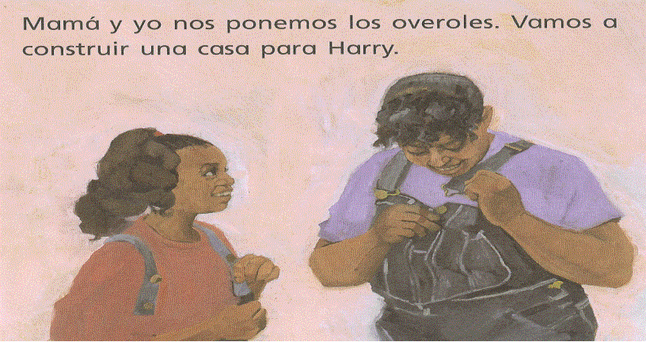
Notes:
Presenter:
Use the same intonation used in the TPR when saying the TPR commands on the first reading.
Use hand motions and point to images as needed to help clarify language.

Slide 61
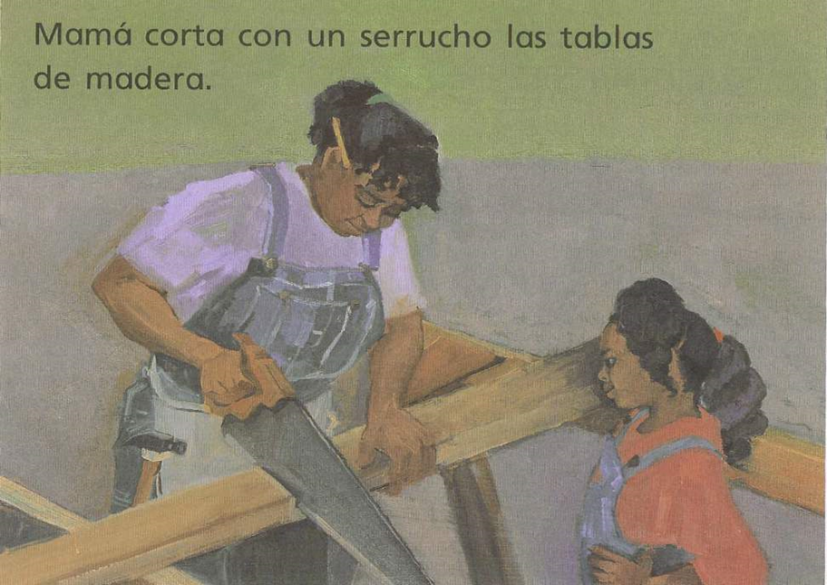
Notes:
Presenter:
Continue reading until the end using notations from previous slide.

Slide 62
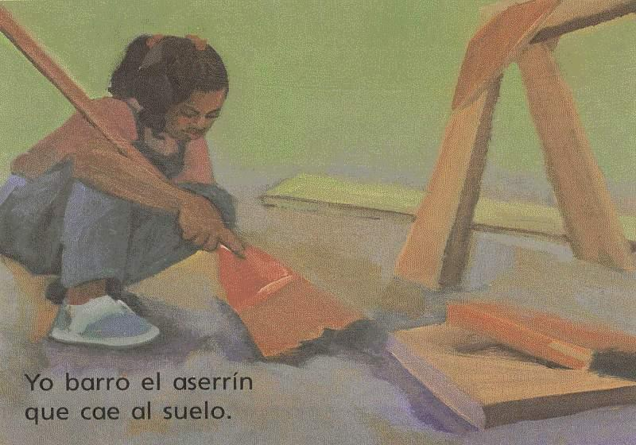
Notes:
Presenter:
Continue reading until the end using notations from previous slide.

Slide 63
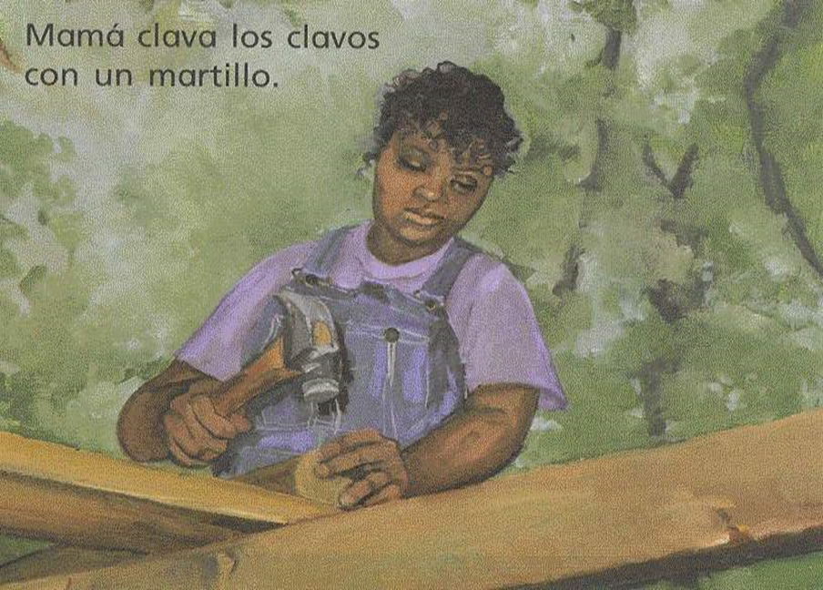
Notes:
Presenter:
Continue reading until the end using notations from previous slide.

Slide 64
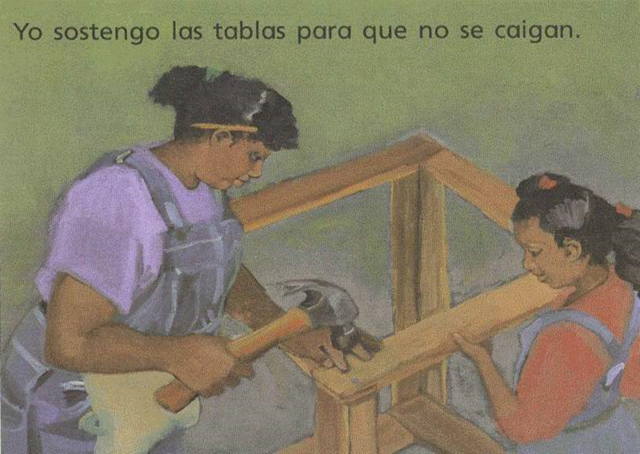
Notes:
Presenter:
Continue reading until the end using notations from previous slide.

Slide 65

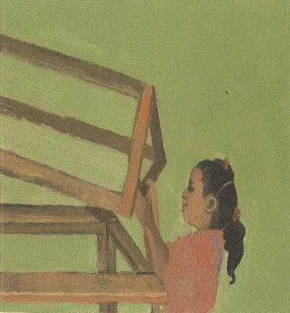
Notes:
Presenter:
Continue reading until the end using notations from previous slide.

Slide 66
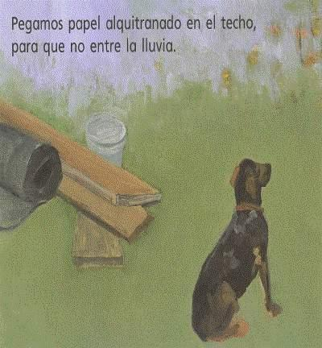
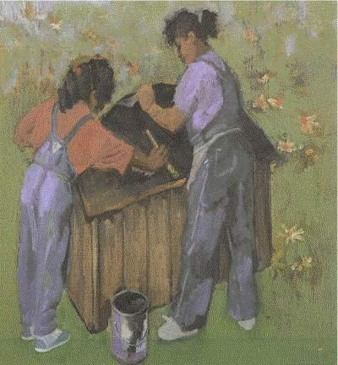
Notes:
Presenter:
Continue reading until the end using notations from previous slide.

Slide 67
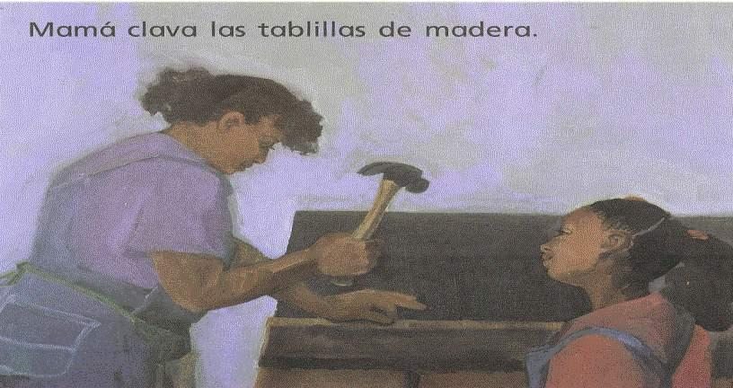
Notes:
Presenter:
Continue reading until the end using notations from previous slide.

Slide 68

Notes:
Presenter:
Continue reading until the end using notations from previous slide.

Slide 69
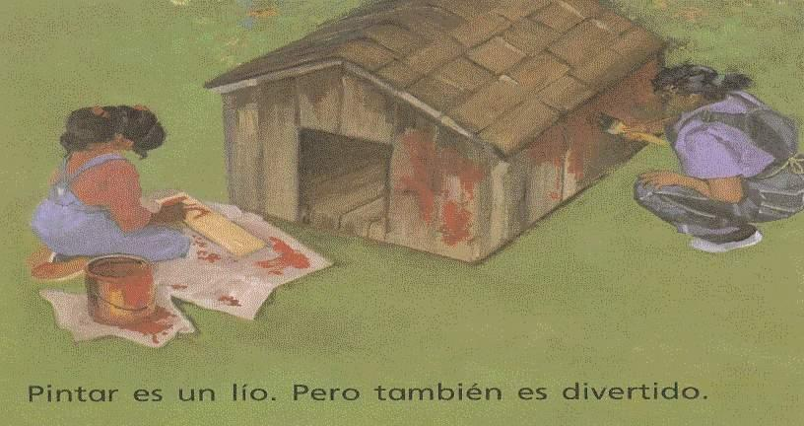
Notes:
Presenter:
Continue reading until the end using notations from previous slide.

Slide 70
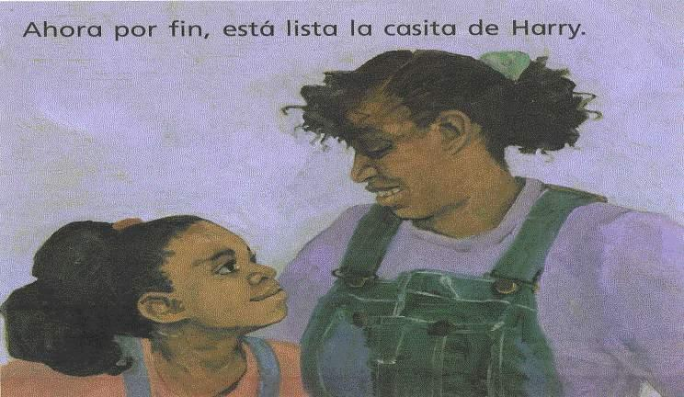
Notes:
Presenter:
Continue reading until the end using notations from previous slide.

Slide 71
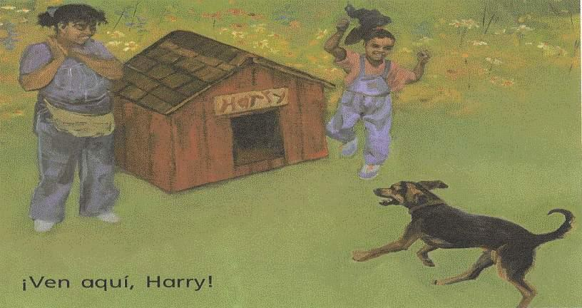
Notes:
Presenter:
Continue reading until the end using notations from previous slide.

Slide 72
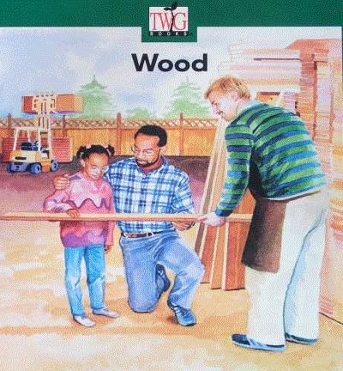
Teach thematically with related readings for review and expansion of vocabulary.
By Rebel Williams, Illustrated by Celeste Enriquez
Notes:
Presenter:
Thematic interdisciplinary instruction is powerful for ELs:
BENEFITS for ELs
Enhanced opportunities for comprehension.
Review and practice of vocabulary.
Connections across the disciplines.

Slide 73
Interdisciplinary Units
Big Ideas/Understandings
People need plans, measurements, the right materials and tools to make shelters.
A specific process is used to measure a unit length.
Consumers make decisions about quality and price when making purchases.
Notes:
Presenter:
Incorporate cross-disciplinary instruction.
Focus on broader big ideas/understandings promotes transfer of learning beyond the specific topic of investigation.
Sample Unit Activities:
Book shared: girl and her mother built a doghouse. Book noted on previous slide: girl and her father.
Compare and contrast the stories.
Discuss how cultures differ in the pets they have, how they feel about them, and how they care for them.
Students make plans for building a doghouse: size needed, measurements, type and quality of materials needed, best prices, and so forth.
Students perform measurements, math calculations, and related consumer dialogues.
BENEFITS for ELs:
Active participate in classroom activities in all disciplines.
Language learning opportunities in a meaningful context.
Tasks requiring higher-order thinking that meet CCS.

Slide 74
What do you want students to know and be able to do?
KNOW
Linear measurements
Money units
Addition and subtraction facts
Strategies for comparing and contrasting
DO
Measure length accurately
Match currency and coins with cost
Add costs of building supplies
Subtract costs to compare prices
Notes:
Presenter:
UDL encourages educators to identify what students will “know” and “do.”
The above example is related to the math activities that would follow the two books, each about a child building a doghouse. They would include:
Determine how big the doghouse would need to be based on the size of the adult dog.
Measure to determine how many materials would be needed.
From online resources and/or advertisements, decide what materials need to be purchased if they have the tools.
Discuss the quality of the wood needed, the type and quality of paint, and so forth.
Subtract to compare and contrast product prices.
Use a calculator to add total costs.
Role-play buying the supplies.
BENEFITS for ELs: Specified in the previous slide.

Slide 75
Tier 2 Vocabulary
CONTENT CATEGORY Vocabulary
shelters
materials
tools
linear
consumers
purchase
ACADEMIC TOOLKIT Vocabulary
plan
process, steps
characteristics
compare, contrast
measure
estimate
Notes:
Presenter:
In early grades:
The content specific vocabulary may not be Tier 3 level of technicality.
The content instructional focus is on category words like “tools.”
Classification activities with the examples both visual and written (hammer, house, inch, foot, etc.) can be placed under the category headings.
Essential vocabulary instruction should focus on the words with the most transfer, the academic toolkit vocabulary.
BENEFITS for ELs:
Focus on category words and toolkit words promote the greatest transfer.
ELs can easily understand sample nouns (hammer) and even some of the verbs (buy, sell) more readily than category words and academic toolkit vocabulary.
Multiple meanings need to be taught.

Slide 76

Bon Appétit
Notes:
Presenter:
Participants have 60 minutes for lunch.
May offer suggestion for lunch, if appropriate. (E.g., there is a cafeteria onsite.)
Remind them to be back on time as we will begin promptly.

Slide 77
Welcome Back … Strike a Pose!
Work with your team to create a frozen scene that will illustrate your Key Principle for Teaching ELs.
The other groups will guess which principle you are illustrating.
Notes:
Presenter:
Assign each team a principle at random.
Announce that teams should keep their principle a secret.
Groups must create a frozen scene that reflects their assigned principle. Consider, “How can I use my face and body to show my understanding of this text/principle?”
After sufficient time to plan the scene, call groups individually to the front of the room to “strike their pose.”
Facilitate other groups to try to guess the principle being illustrated.
Prompt participants to justify their guesses:
“Why do you believe that this group is illustrating Principle #__?”
“What is your evidence for this conclusion?”
“What evidence are you using to argue that this pose illustrates Principle #___?”
Depending on time, presenter can call all groups to the front or only a few.
Allow about 10 minutes for teams to plan their pose. Then allow another 10-15 minutes for groups to take turns posing and the audience to guess the key principle. Not all groups need to pose – it is okay to ask for volunteers and then end the activity after the time allotted.

Slide 78
Engaging with Complex Texts
Page 17
Activity #3: Strike a Pose!
Students use frozen scenes
to bring to life key concepts from text.
Notes:
Presenter:
Because of the nature of the re-engagement activity, just note the contents of this slide.
It was not displayed prior to the activity as with all other instructional strategies.
Quickly move on to debrief in the following slide.

Slide 79
Why is Strike a Pose
an effective instructional strategy for English learners?
Notes:
Presenter:
This debriefing may best be done by the presenter so points are accurately made and the timeframe is adhered to.
BENEFITS for ELs:
Close Reading skills can be taught through non-print text first (strike a pose, photographs, visuals, etc), then ELs can read multi-level/differentiated reading based on ELD level.
Physical actions can demonstrate understanding with or without reliance on text.
Sharpens observation skills.
Discussion starter.
Encourages students to dig deeper into understanding of history, literature, or visual arts.
A way to present diverse perspectives in a comprehensible manner.
Students can participate equally regardless of language proficiency.

Slide 80
You are Here!
Reading Engagement with Complex Texts
Warm Up Activities
Part 1: Opportunities for ELs Using CCS
Part 2: Speaking and Listening to Work Collaboratively
Part 3: Reading Engagement with Complex Texts
Part 4:
Using Evidence in Writing and Research
Notes:
Part 3: Reading Engagement with Complex Texts

Slide 81
Objectives for Focus Area:
Reading Engagement with Complex Texts
Content Objective:
Provided a non-print and print text, participants will cite evidence of strategies that are effective for ELs.
Language Objective:
While engaged in diverse modality texts, participants will record textual evidence in a graphic organizer and orally share.
Notes:
Presenter:
Note that we are now moving into the Reading area of ELA.
New Content Objective and a new Language Objective.
Read aloud, paraphrase, or allow participants to read silently.

Slide 82
Core Shifts
Regular practice with complex text and its academic language
Reading, writing and speaking grounded in evidence from text, both literary and informational
Building knowledge through content-rich nonfiction
Notes:
Presenter:
Knowing the shifts in CCS ELA is important in implementation.
Presenter reads or participants read silently.

Slide 83
Reading Engagement with Complex Texts
Page 19
Activity #4: Visual Representation
A non-linguistic representation of information using pictures, symbols, or graphics to communicate information or demonstrate understanding.
Notes:
Presenter:
Direct participants to the Visual Representation space on page 19 of the Participant Guide.
“Think about the diverse learners in your classes. Draw how you might organize your class for a task using 3 levels of reading with the goal that the students read and share with others what they read.”
Allow about 2 minutes for participants to create their drawing in the participant guide.

Slide 84

Interacting with Complex Text: Scaffolding Reading
https://www.teachingchannel.org/videos/middle-school-ela-unit-persuasion
Notes:
Presenter:
This video clip is one segment in a series of 6 videos. It provides an exemplar unit that focuses on ELA instruction for middle school learners. It showcases a 5-week lesson plan on persuasion and includes scaffolding use of complex texts.
In this clip, Katie Langlois builds background knowledge for the readings and is using the reading task to help prepare students for writing their own persuasive speeches.
As you watch the video, think about how the teacher organized the differentiated tasks as well as how the content and questions reflect CCS shifts. The video is located here: https://www.teachingchannel.org/videos/middle-school-ela-unit-persuasion
BENEFITS for ELs: This video was developed specifically to support English Leaners. However, it is evident that the strategies will be helpful for all students. The full unit is available online with 6 video clips, with the resources for teachers and students.
Link to video: https://www.teachingchannel.org/videos/middle-school-ela-unit-persuasion

Slide 85
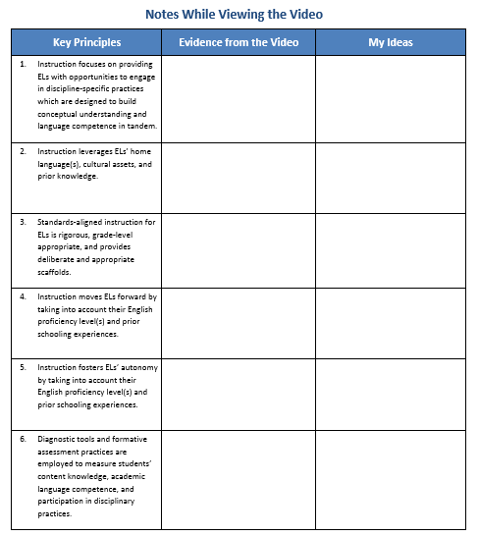
Take notes on the video clip using Within-team Jigsaw.
Each team member is responsible for sharing one principle, but try to see evidence of each. You can make suggestions to further reflect the principles.
Revisit your Visual Representation and add or discuss new ideas.
Page 20
Notes:
Presenter: Because the participants did the Chalk Talk and Strike a Pose related to the six Principles, they should now be able to identify how they were reflected in the video clip and share within their groups.
The presenter may need to provide additional information about the group strategies:
The teacher uses Within-team Jigsaw; each student teaches his/her “piece” of information to teammates.
To insure access and successful accountability:
Provide differentiated tasks to the team members:
In cases where the tasks may still be difficult, or support and discussion with other members is needed:
Team members with the same piece meet in homogeneous teams to prepare together. These are known as Expert Teams.
The teacher scaffolds the task to promote higher-order thinking, discourse, and teaching focus.
The teacher checks with the team to insure all members are prepared to share.
Each student returns to their heterogeneous group and teaches his/her “piece” to the team.
The teacher also needs to scaffold the discussion after each person shares his/her information to promote connections, recognition of patterns, similarities and differences across the information.

Slide 86







Sample Immigration Titles
Notes:
Presenter: Another option to differentiate readings in heterogeneous classes:
Students work in homogeneous Literature Circles to read a “just right” book with developmentally appropriate readings.
Having students read different literature related to a common theme is one way to develop literacy skills in comprehensible ways.
Seek literature where students at all literacy levels would be interested in the stories.
Some students are capable of reading above what is typically used in their grade levels and are provided with more challenging readings.
BENEFITS for ELs:
All students need comprehensible quality literature that promotes literacy development and exposure to common themes they can discuss with classmates.
When focusing on CCS goals to wrestle with complex text, the student needs to be able to benefit from the process with a text that can be accessible with effort and multiple readings.
After students share readings with each other, another student may be able to access a more complex reading.

Slide 87
Immigration Stories Comparison Matrix
Main characters | Immigrate from __ to __ Reason for immigration | Major conflict during the trip or in the new home | Coping strategies | Story ending
Notes:
Presenter:
Either Team Jigsaw or Within-team jigsaw could be used for students to share their stories.
Use of a matrix is a helpful way for students to share and take notes on multiple aspects of comparisons related to 3 or more similar groups, in this case immigration stories.
BENEFITS for ELs:
A matrix helps ELs focus on key characteristics of a story/topic/group, recognizing similarities and differences.
The structure supports reading, sharing, and listening.

Slide 88




Multi-level and Native Language Resources
Seek multi-level readings in science and social studies.
Narrow readings related to the same topic to raise reading levels.
Native language resources provide context and skill development.
Notes:
Presenter:
Use multi-level readings in heterogeneous groups and with individuals.
Quickly progress in reading levels related to a topic.
Promote confidence in students who see rapid progress in their ability to read text.
Can promote interest and engagement when students have the opportunity to check predictions.
Supports writing: students pay more attention to how the text is written, not just the content.
Makes academic content more comprehensible.
Helps develop the language and literacy skills needed to process complex text.
BENEFITS for ELs:
Many ELs have the ability to read more complex text but lack the vocabulary to do so, a lower book provides the vocabulary support needed.
Multi-level readings gives them access to comprehensible content.
The reading skills developed in the multi-level resources transfer to more complex text in other contexts.
Of course native language text, including from online resources, gives ELs:
opportunities to learn content while learning English.
the chance to develop literacy skills with more challenging text.
the chance to practice close reading strategies with grade level materials.
development of literacy skills that transfer from the home language to English.
pride that comes when the language is respected, developed, and viewed as an asset.

Slide 89
Reading Engagement with Complex Texts
Activity #5: Line Up
Page 22
A configuration for structuring the sharing of information and response(s).
Notes:
Instructions:
Assist participants in forming two lines facing each other.
Partners share one piece of evidence-ideas-themes from graphic organizer from Activity 4 and respond to ideas.
Three rotations:
Round 1: Partner A shares first. Partner B responds with affirmation, question, or extension of ideas.
Line A moves 2 people to the left.
Round 2: Repeat process with Partner B sharing first.
Repeat line movement
Round 3: Partners reflect on use of differentiated/multi-level readings.
Presenter:
There are a variety of names and variations including Inside-Outside Circles as identified by Spencer Kagan.
Use when students need to get up and move.
Students have the opportunity to share with different students.
No one is left out.
Can be used to review facts if students have 1 or 2 cards with questions and answers. Trade when rotating.
Try to pair a non-English speaker with a bilingual partner. The two rotate as one.
Allow about 10 minutes for this activity.

Slide 90
Why is Line Up
an effective instructional strategy for English learners?
Notes:
Presenter:
This debriefing may best be done by the presenter so points are accurately made and the timeframe is adhered to.
BENEFITS for ELs:
Opportunities for oral language development; practice in a fun activity.
Exposure to different views and summaries of learning.
Interactions with all classmates.
Promotes active listening.
Provides a forum for the modeling and rehearsal of English oral language.
Encourages oral summarization.
Gets students up and moving.
Exposes students to different points of view and ideas.
Can partner beginning ELs with same-language partners (these native language buddies can move together throughout the activity).

Slide 91
Reading Engagement with Complex Texts
Activity #6: Reading Closely for Text Evidence
Page 23
A 3-step method to encourage students to extract textual evidence from complex text.
Adapted from Lehman & Roberts (2013) Falling in Love with Close Reading
Notes:
Presenter:
Will be using article, “Realizing Opportunities for English Learners in the Common Core English Language Arts and Disciplinary Literacy Standards” by Bunch, Kibler, & Pimentel.
Since this is a 3-part process, directions will be on following slides.
Reading Closely for Text Evidence has many practical uses:
Reading complex texts.
Gathering text-based evidence.
Using text-based evidence to expand conceptual understandings.
Activating prior knowledge and motivating new learning.
Addressing multiple intelligences.
BENEFITS for ELs:
Encourages multiple readings.
Sets a purpose for reading/previewing text.
Encourages active, not passive, learning.
Has built-in repetition.
Note: the reading must be accessible for the ELP level and literacy level of the learner.

Slide 92
Part 1: Read Through Lenses
  Identify one section of the article per team member.
  Highlight the things that the authors are telling teachers to do and students to do.
  Document this text evidence in a T-chart.
Teachers Do: | Students Do:
Notes:
Presenter:
Part 1 is described in slide.
Allow about 7-10 minutes for participants to read and complete the T-chart.

Slide 93
Part 2: Find Patterns
Identify patterns (make connections) that rise to the surface based on the text evidence.
  Which details fit together in your section?
  How do these details fit together?
Notes:
Presenter Notes:
Instruct each individual to look critically at his/her T-chart.
Identify patterns that rise to the surface.
Which details fit together?
How do these details fit together?

Slide 94
Within-Team-Jigsaw
Each member shares his/her T-chart to teach team.
The title of my section is______________.
The authors suggest that teachers _________.
______________ is/are also recommended.
Students should be taught to ___________.
Another suggestion is that students ______.
I think _____ fit together because _____.
_______ seems to be another pattern_____.
Notes:
Presenter:
Benefits of sentence frames for ELs were highlighted previously.
Be sure the sentence frames are selected or formulated to match the language function, in this case, summarizing and identifying patterns.
Allow about 10 minutes for the Within-Team-Jigsaw discussion.
BENEFITS for ELs of Within-Team-Jigsaw:
Opportunity to develop oral language skills.
Simpler explanations in student language of text material.
Accountability for teaching others.
The increased learning that comes from teaching others.

Slide 95
Part 3: Develop New Understanding of the Text
How do these patterns help you
to expand your own understanding of teaching ELs with the CCS?
Collaborate with your team members to write a broad statement of understanding to share with the entire group.
“We understand that…”
Notes:
Presenter:
Instruct teams to discuss the question “How do these patterns help you to expand your own understanding of teaching ELs with the CCS?”
State your shared learning in a broad generalizing statement of deeper understanding.
Write your answer as a complete statement that could begin with the words, “We understand that…”
When ready, a member of the team will be called upon to share the team’s understanding.
This will take about 5 minutes.
BENEFITS for ELs:
It is helpful for all students to summarize broader understandings in this way.
For ELs, having a team collaborate to state the most important understanding from the details in a reading or topic of investigation can place the focus on what is most essential.
As mentioned previously, focus on broader understandings promotes transfer of learning.

Slide 96
How can Reading Closely for Text Evidence, and Within-Team-Jigsaw be effectively differentiated for English learners at various development levels?
Notes:
Presenter:
Discuss together as a group some ways to differentiate both Reading Closely for Text Evidence and use of Within-Team Jigsaw in diverse classes with ELs.
Use gradual release of responsibility to scaffold the close reading process.
ELs must be able to understand and teach his/her jigsaw piece.
Give a simpler reading task.
Provide additional scaffolding: a related pre-reading at a lower level, focus questions, a frame for sharing.
A teacher aide, or other student can help with the reading and practice the teaching.
Listening to others share the information in the team gives them access to other “pieces” they may not be able to access through reading.

Slide 97
Let’s Take A Break…
…be back in 10 minutes
Notes:
Presenter:
The break should be 10 minutes.
Remind participants to try to be timely in their return.

Slide 98
You are Here! Using Evidence in Writing and Research
Part 1: Opportunities for ELs Using CCS
Part 2: Speaking and Listening to Work Collaboratively
Part 3: Reading Engagement with Complex Texts
Part 4:
Using Evidence in Writing and Research
Warm Up Activities
Notes:
Part 4: Using Evidence in Writing and Research

Slide 99
Objectives for Focus Area:
Using Evidence in Writing and Research
Content Objective:
Participants will synthesize their prior knowledge and their new understandings from this session to gather evidence for the benefits of collaborating with colleagues to implement the CCS with ELs.
Language Objective:
Participants will write and evaluate pieces of evidence.
Participants will orally discuss differentiated writing scaffolds for English learners.
Notes:
Presenter’s Instructions:
Note that we are now moving into the Writing area of ELA.
We are presented with a new Content Objective and a new Language Objective.
Read aloud, paraphrase, or allow participants to read silently.

Slide 100
Evidence and Valuation
Consider the benefits of working collaboratively to ensure that EL students have full access to curriculum and the CCS.
On note cards, write as many reasons as you can for why this collaboration is beneficial (one reason per notecard).
Notes:
Presenter’s:
Use the background knowledge you brought plus what you learned today.
Forward to the next frame; it offers springboards for evidence.
Allow about 5 minutes for this activity.

Slide 101
Core Shifts
Regular practice with complex text and its academic language
Reading, writing, and speaking grounded in evidence from text, both literary and informational
Building knowledge through content-rich nonfiction
Notes:
Presenter:
Repeat of slide shown at beginning of the “Reading Engagement with Complex Texts.”
Again, knowing the shifts in CCS ELA is important in implementation.
Presenter reads or participants read silently.

Slide 102
Evidence and Valuation
Rate each notecard on the continuum from Weak to Strong Evidence.
Page 27
Weaker Evidence
Stronger Evidence
1 2 3 4 5
Notes:
Presenter:
Instruct individuals to rate the evidence cards they have created on the continuum from weaker pieces of evidence to stronger pieces of evidence.
Allow about 5 minutes for this.

Slide 103
Composing
Differentiating Writing Tasks:
LEA (Language Experience Approach)
Word Bank
Graphic Organizers
Sentence Frames
Paragraph Frames
RAFT (Role-Audience-Format-Topic)
Notes:
Presenter:
Due to time constraints, we will not actually compose.
Important take-away: choose writing tasks that can be differentiated.
Explore these examples on next slides as a springboard for your planning.
Sharing the differentiated writing tasks, including the LEA video (slide 105), should take about 20 minutes.

Slide 104
Language Experience Approach
Shared experience
Generate vocabulary
Record dictation
Teacher reads aloud
Student reads aloud
Teach for skills
Use as springboard to writing
What I can say,
I can write.
What I can write, I can read.
I can read
what I write
and what other people can write for me
to read.
Roach Van Allen
LEA Advocate
ca 1960’s
Notes:
Presenter:
Steps:
Focus on an experience that is either common to all students (e.g., family going to the grocery store) or an experience that is the result of a class trip, class lesson, or class activity.
Generate vocabulary that authors would most likely use if they were writing about the topic or idea.
Record student’s/students’ dictation making sure student(s) can clearly see what you write.
Try not to rephrase student’s/students’ sentences.
Grammar can be taught later.
Teacher reads the text aloud modeling fluency and making connections between speech and print by pointing to each word.
Invite student/students to read and reread the text orally and silently to promote fluency.
Once the complete text is known by the student or group, begin to focus on the smaller components of the text such as sentences, words, and letters.
Fosters word recognition skills.
Can use sentence strips so students can manipulate the text.
BENEFITS for ELs:
LEA provides bridge between spoken and written language.
Utilizes what student already “owns:” existing language and experiences/knowledge.
Used to develop listening, writing, and reading skills.

Slide 105

LEA Video
  The Language Experience Approach for ESL Reading: Part 2 http://youtu.be/lH7qoXvZ-6M
Notes:
Presenter:
Short video to demonstrate LEA with teacher and older English learners.
Process easily transferrable to ELs of all ages.
Watch for the steps outlined:
Shared experience.
Generate vocabulary.
Record dictation.
Teacher reads.
Students read.
The video is 7 minutes long. The Language Experience Approach for ESL Reading: Part 2 http://youtu.be/lH7qoXvZ-6M

Slide 106
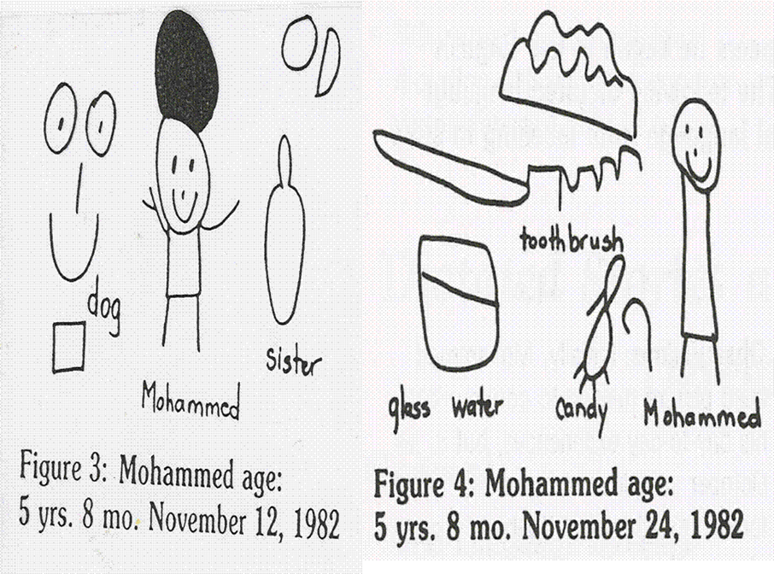
LEA Example
Notes:
Presenter:
Series of examples of LEA with young EL having almost no English skills.
Remembering that students say whatever they can and teacher scribes the words. In these examples Mohammed could only provide labels.
In next slide, notice growth over the course of a year.
Source: Whole Language Strategies for ELS Students (1991) Gail Heald-Taylor. Dominie Press.

Slide 107
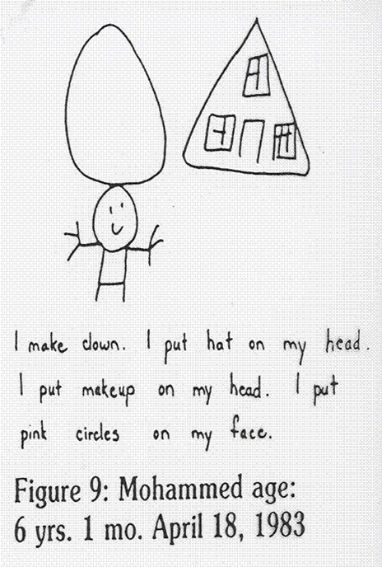
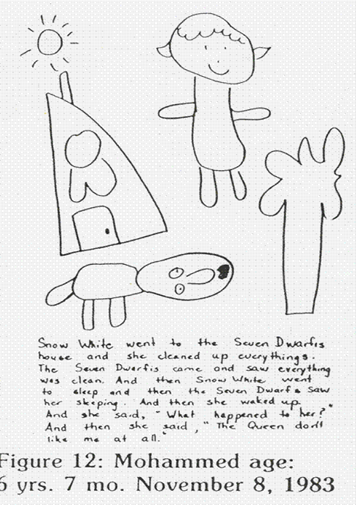
Notes:
Presenter:
As the child gains language, he can relate personal experiences in simple sentences.
Retelling quality children’s literature is a great way to help learn story structure.
Note that Snow White has multiple versions, written at different reading levels, so a student can progress to more complex versions.
When with an individual, record the exact words the student uses. This supports literacy development for pre-literate students and provides a record of oral language growth.
In addition to developing oral language reading skills, oral language is a powerful way to model writing.
Resources are available that provide:
Ways to engage all learners during a class or small group retelling.
Various options for dealing with errors during the dictation depending on the purpose.
Explicit guidance in writing.
Strategies for students to use LEA variations during team collaboration on a writing project.
Examples of elementary, intermediate and JH ELs that gave permission to share their LEA dictations.

Slide 108
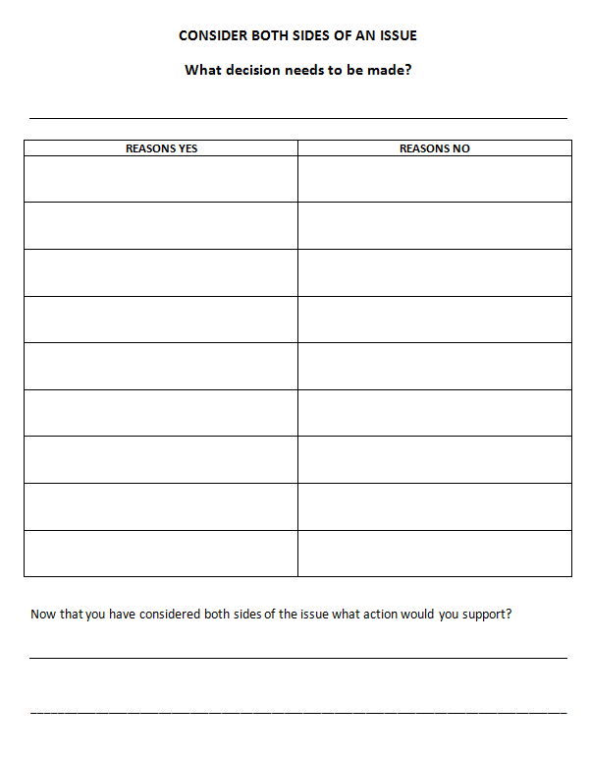
Graphic Organizers for Argument and Evidence
Notes:
Presenter:
Benefits of organizers were shared in previous slides.
Additional suggestions for Argument and Evidence:
Use an organizer where students must consider both pros and cons.
Provide differentiated support resources: readability levels, diverse viewpoints, those that include needed background information, resources with organizational support for discussing complex controversial issues.
In cooperative groups or with partners, the opposing viewpoint is encouraged.
BENEFITS for ELs:
Students from other cultures often have a different viewpoint but may be shy about expressing it.
ELs benefit greatly from resources that provide some background information, particularly to current controversies in the U.S. that may be very unfamiliar to them.

Slide 109
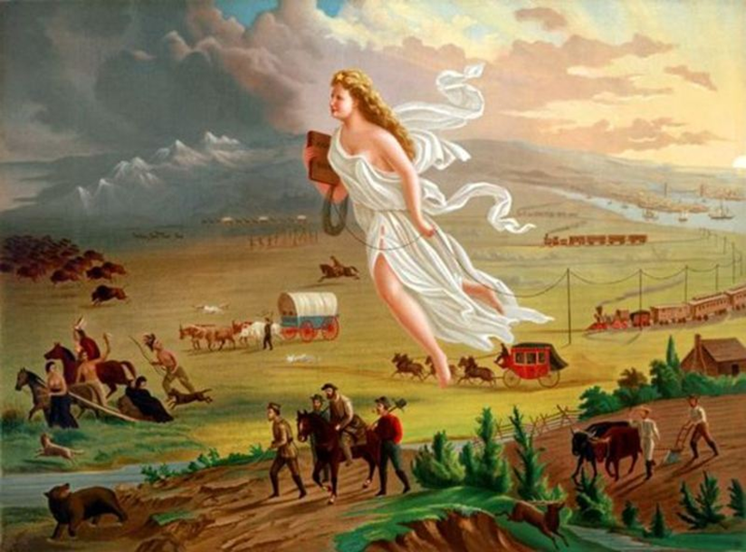
Sentence Frames
Manifest Destiny
An Allegorical Painting by John Gast 1872
Notes:
Presenter:
Look at the image.
Think about the message conveyed through the art.
Why do you think this was painted?
Presenter’s background information . Does not need to be shared with participants:
“This painting shows "Manifest Destiny" (the religious belief that the United States should expand from the Atlantic Ocean to the Pacific Ocean in the name of God). In 1872 artist John Gast painted a popular scene of people moving west that captured the view of Americans at the time. Called "Spirit of the Frontier" and widely distributed as an engraving portrayed settlers moving west, guided and protected by a goddess-like figure of Columbia and aided by technology (railways, telegraphs), driving Native Americans and bison into obscurity. It is also important to note that angel is bringing the "light" as witnessed on the eastern side of the painting as she travels towards the "darkened" west.”
http://www.dailykos.com/story/2011/07/03/991041/-George-Orwell-and-Howard-Zinn-on-Patriotism-and-Nationalism
Resource for participant handout. Teachers’ Domain has multi-dimensional resources. The following link provides interactive exploration of Manifest Destiny in ways that reflect diverse perspectives with diverse modality resources beneficial for ELs: a video, this image, simplified text, interactive activities with self assessments and a writing project. http://www.teachersdomain.org/resource/midlit10.soc.splland/

Slide 110
Sentence Frames: provide oral practice for citing evidence from a source.
The image suggests that _______.
From this picture, one can infer that ______.
Another inference someone could draw is that ____.
The use of ______would indicate that ___.
Because the picture ______, it seems that _____.
One assumption that could be made is that _____.
______ is another possible assumption.
This depiction of ____ leads one to believe that___.
Notes:
Presenter:
Use the sentence frame and cite evidence from the picture source to support your thinking.
BENEFITS for ELs:
Using pictures to preview CCS skills has many advantages for ELs:
The opportunity to learn the skills in ways that are not dependent on literacy.
A chance to understand a skill and think analytically at a lower language level than needed to process in text.
Many concepts can be taught with visuals: main idea and supporting details, predictions, drawing inferences, diverse perspectives, citing evidence from a source and so forth.
The use of sentence frames with pictures supports:
Oral language for discussions during close readings.
Related writing tasks.

Slide 111
Scaffold Writing For ELs
Students read quality examples.
Use graphic organizers to teach the structure.
Model using Language Experience Approach.
Provide sentence frames.
Use rubrics for guidance and assessment.
Give assignments and feedback for each step of major assignments.
Use self and peer feedback as appropriate.
Notes:
Presenter:
Provide scaffolding for all phases of the process.
BENEFITS for ELs:
Discourse patterns and ways of organizing information differ across cultures.
Organizers provide explicit guidance in ways to structure different genre in this culture.
The combination of both organizers and sentence or paragraph frames provide effective scaffolding for ELs.
Not all cultures organize information in the same way, so explicit guidance is particularly important for ELs.
Giving feedback during different phases of the writing process provides ELs the option to make revisions prior to completion of the project.
When teachers differentiate the level of scaffolding, ELs can be involved in tasks above their current level.
Don’t ask ELs to peer assess for errors they cannot identify, rather focus on the conventions and skills taught.
If gradual release of responsibility progresses from high levels to lower levels, ELs get the support needed while moving toward individual accountability.

Slide 112
Differentiated R.A.F.T.
Role-Audience-Format-Topic
Sample Formats:
Directions for taking needed actions
Pro or Con posters to support a point of view
Dialogues between people on two sides of an issue
Response to point of view in an online article or blog
Letters to persuade or persuasive essays
Debates
Research paper
Consider options for Role and Audience related to workshop topics or your own class.
Notes:
Presenter:
Role, Audience, and Topic is situational based on content.
Will discuss only Format with this slide.
R.A.F.T. is an effective strategy for writing assignments in diverse classes:
All students can do assignments related to the same topic and, if desired, a common function.
In this instance the goal is to persuade.
Students can incorporate voice and creativity.
It is easy to construct R.A.F.T.s across the disciplines and to incorporate real-world problems.
Think about the workshop topics:
endangered animals
caring for pets
consumer purchases
immigration
Manifest Destiny
BENEFITS for ELs:
The assignments can easily be differentiated for language proficiency level by adjusting the format.
R.A.F.T.s provide opportunities to be engaged in authentic tasks that require creativity.
Assuming different roles and audiences promotes interest and flexibility.
Some cultures do not place emphasis on arguing with a text, seeking alternative points of view, such varied assignment types, and so forth.

Slide 113
Our Team’s Next Steps
Reflect on today’s session:
Jot down key words and phrases to summarize, synthesize, and create future steps to apply ideas shared during today’s session.
Examine the educational models in your schools:
Consider EL programs: pull-out, push-in, co-teaching, etc.
Discuss applications:
How might you take your learning back and apply the strategies in your particular setting?
Page 28
Notes:
Presenter:
Teams create next steps.
Allow about 5 minutes for this.

Slide 114
Meeting the Challenge, Modules 3 and 4
Module | Title | Dates
Module 3 – Students with Disabilities | Designing Curriculum with Intention and Rigor | November 2, 3, 12, 13
Module 3 – English Learners | Accessing the Connecticut Core Standards in Mathematics | November 2, 3, 12, 13
Module 4 – All | Implementation and Sustainability | December 10, 16, 17
Notes:
Remind participants of upcoming modules and dates. Remind them to register if they have not done so already.

Slide 115
Post-Assessment and Session Evaluation
Thank you for attending today’s session, Accessing the Connecticut Core Standards in English Language Arts.
Your feedback is very important to us! Please fill out a short survey about this session.
The survey is located here: http://surveys.pcgus.com/s3/CT-Module-2-EL
Notes:
Presenter:
Remind participants to complete the online Session Evaluation.
The survey is located here: http://surveys.pcgus.com/s3/CT-Module-2-EL
Ask for further thoughts, questions.
If time permits, ask participants to complete the Post-Assessment (same as the Pre-Assessment).

Slide 116
Thank you!

