Slide 1


Connecticut Core Standards for Mathematics
Systems of Professional Learning
Module 5 Grades 6–12:
Focus on Sustaining Change

Slide 2


Closing Activities
Post-Assessment–CCS-Math
Session Evaluation
Page 40

Slide 3


Post Assessment and Session Evaluation
Where Are You Now?
Assessing Your Learning.
Please complete an online Session Evaluation. Your feedback is very important to us! The survey is located here:
http://surveys.pcgus.com/s3/CT-Math-Module-5-6-12
Page 40
Notes:
This Post-Assessment will be the same as the Pre-Assessment they took in the beginning of the session. This assessment is to gauge their learning based on the activities of the full day session. Remind the participants to fill out an online Session Evaluation located here http://surveys.pcgus.com/s3/CT-Math-Module-5-6-12.

Slide 4
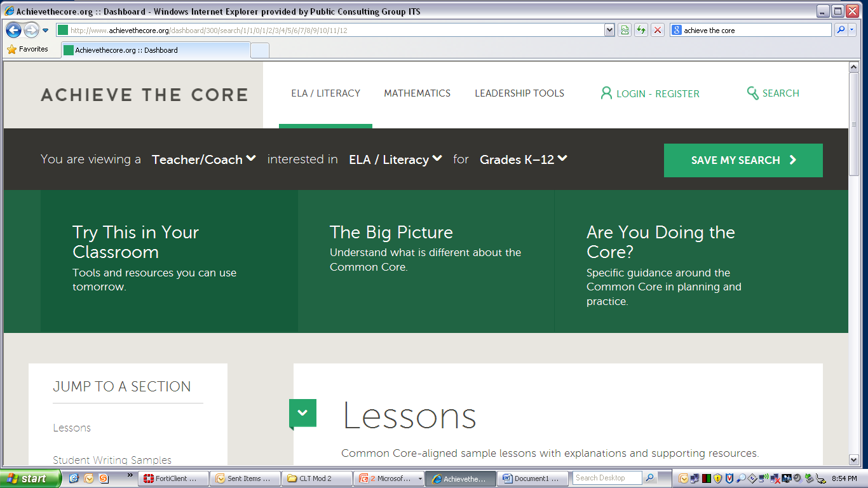
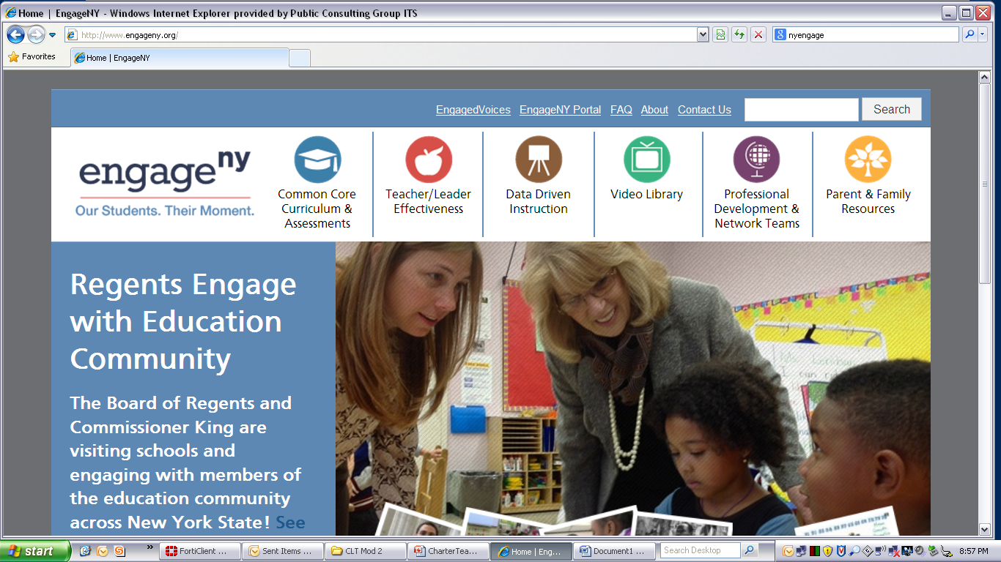
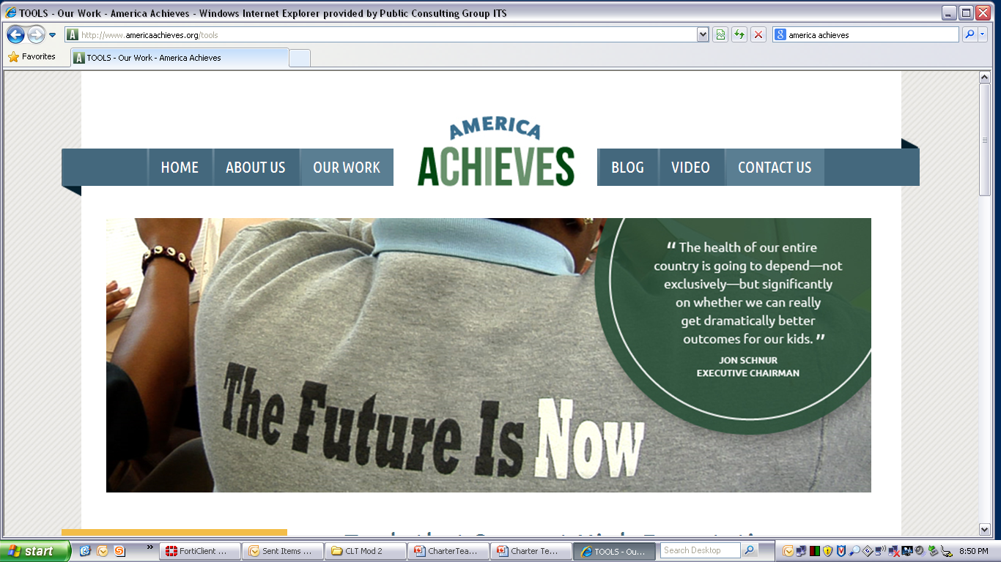


Key Resources
ctcorestandards.org
engageny.org
achievethecore.org
americaachieves.org
Notes:
Some Key Resources
Remind participants of some of the key resources that they have available to them as they continue to provide support for the CCS-Math implementation at their school.

Slide 5





Additional Key Resources
Smarter Balanced Digital Library: http://www.sde.ct.gov/sde/cwp/view.asp?a=2748&q=335358
insidemathematics.org
teachingchannel.org
mathedleadership.org
aft.org
nctm.org
Notes:
Some Key Resources
Remind participants of some of the key resources that they have available to them as they continue to provide support for the CCS-Math implementation at their school.
http://www.sde.ct.gov/sde/cwp/view.asp?a=2748&q=335358

Slide 6
Thank you!

