Slide 1
Connecticut Core Standards for English Language Arts & Literacy
Systems of Professional Learning
Module 5 Grades K–5:
Focus on Deepening Implementation

Slide 2
Today’s Session
CCS-ELA & Literacy
Successes and Challenges
Supporting Teachers in the Change Process
Collaborative Examination of Student Work
EQuIP Quality Review Rubric
Reflection and Planning
Classroom “Look Fors”
Notes:
40 minutes

Slide 3
Part 3
Assessing Written Curriculum with the EQuIP Rubric
Page 17
Notes:
Starts at 10:15
Part 3: 60 minutes total, including introduction.

Slide 4
Ensuring Alignment with the EQuIP Rubric
How well does the unit or lesson align with the Connecticut Core Standards for ELA & Literacy?
4 Dimensions of Alignment - EQuIP Rubric
Alignment to the Rigor
Alignment to the Shifts
Alignment to Instructional Supports
Alignment to Assessment
Notes:
In Activity 2, participants will become familiar with the EQuIP Rubric to determine if a lesson is aligned to the CCS for ELA & Literacy. Participants will be involved with several activities to help understand its purpose and value. They will discuss how this tool can be used by teachers and teacher leaders to ensure quality design of CCS-aligned units and lessons.
Educators Evaluating Quality Instructional Products (EQuIP) is a collaborative of states working to increase the supply of quality instructional materials that align with the Connecticut Core Standards for use in elementary, middle, and high schools. This rubric was developed by Massachusetts, Rhode Island, and New York as the Tri-State Rubric, with the assistance of Achieve. The rubric is now available for use by all states.
The rubric helps educators examine the following dimensions:
Alignment to the rigor of the Connecticut Core Standards for ELA & Literacy: For example, are the standards identified and addressed? Is the purpose of instruction clear? Are appropriately complex texts used?
Key areas of focus: 1) content-rich text; 2) reading closely; 3) purposeful writing; 4) academic language
Instructional supports: engagement; variety of opportunities to engage with challenging text; scaffolding for all learners
Assessment: observable evidence that students are working towards proficiency on specified standards; use of aligned rubrics to assess writing

Slide 5
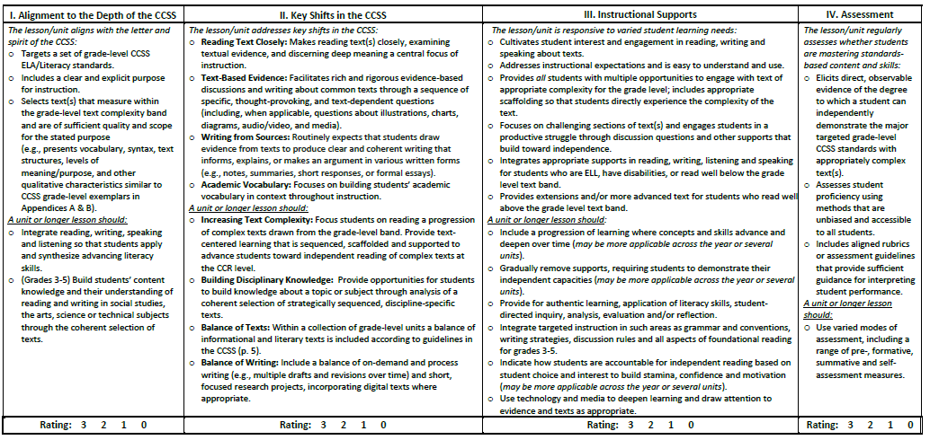
The Rubric Organizes Criteria That Describe Quality Lessons/Units
Criteria that define the rubric are organized to describe quality in four dimensions.
**The most critical criteria are considered to be “must have’s” for a quality CCS lesson/unit.
EQuIP Training Materials from Achieve.org

Slide 6
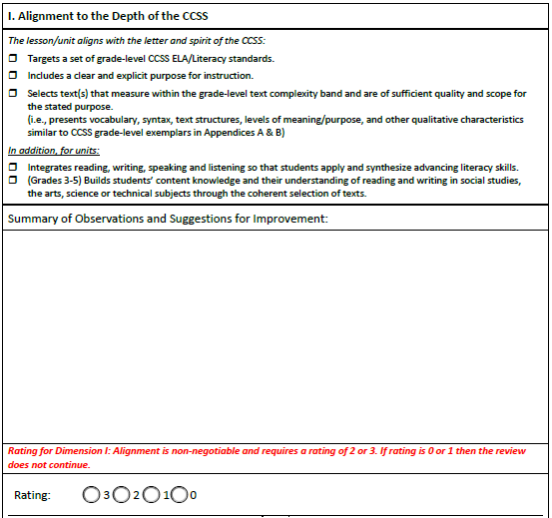
Using the EQuIP Rubric
For each dimension:
Select the checkbox for each criterion for which clear and substantial evidence is found.
Make observations and suggestions related to criteria and evidence.
Determine a rating for each dimension based on checked criteria and observations.
Use alignment rating to determine whether to proceed with review.
EQuIP Training Materials from Achieve.org
Notes:
This slide illustrates how quality review rating teams use the rubric. Explain to participants that if the unit/lesson is not well aligned in Dimension 1, the review doesn’t continue. Have them read the criteria in Dimension 1, then show the feedback example on the next slide.

Slide 7
Activity 3: Using the EQuIP Rubric
Activity 3a: Building Expertise with the EQuIP Rubric
Each table will be assigned a dimension of the EQuIP Rubric: Table 1 – Depth and Rigor of CCS Table 2 – Key Shifts in the CCS Table 3 – Instructional Support Table 4 – Assessment Read and discuss your Dimension of the EQuIP Rubric. When completed, place the number of the section you read on a sticky note. Find 3 other people to form a group of 4 that contains an ‘expert’ from each section of the rubric. Share key information about your section.
Page 17
Notes:
15 minutes
Using a jigsaw protocol, table groups will read, discuss, and build expertise on one section of the EQuIP Rubric. Participants will then remix with “experts” from other sections to share key information about their section of the rubric. With the full group, participants will briefly discuss how closely the current units and lessons they use might fare when evaluated with the EQuIP Rubric. Point out that the EQuIP Rubric is not used to evaluate teaching performance, it is solely used to evaluate units and lessons.

