Slide 1


Connecticut Core Standards for English Language Arts & Literacy
Systems of Professional Learning
Module 3 Grades K–5:
Supporting All Students in Writing and Research

Slide 2


Activity 8b: Scaffolding a Writing Task
Activity 8b: Scaffolding a Writing Task
Return to the text you used for your close reading lesson in Module 2. Using the scaffolded writing task you’ve just reviewed, create a prompt with a focusing question. If time allows, write a few examples on the evidence chart. Share your prompt and focusing question with a neighbor who is not your writing partner. Discuss: To what extent will a scaffolded writing assignment be effective with your chosen text and grade level?
Notes:
For this activity, explain that participants will be using the story or text for which they wrote a series of text-dependent questions in Module 2. If both partners are attending this session today, it would be good for them to work together on 8a and 8b.
If a participant did not attend Module 2, or does not have a text, he or she may work with a text from the box of books at the location, or with an Appendix B exemplar. However, he or she will need to choose quickly after 8a in order to have enough time to complete 8b.
Allow 20 minutes for 8b: 15 to create a prompt and 5 to debrief.

Slide 3
Resource: Literacy Design Collaborative (LDC)
Instructional system for developing literacy skills.
Builds students’ literacy skills and understanding of content through reading and writing assignments aligned to the CCS.
Basic building block is a module, two to four weeks of instruction comprising a “teaching task,” standards, “mini-tasks,” and other instructional elements.
Working with LDC’s framework and tools, teachers develop a literacy-rich task and design instruction to help students complete that task.
http://ldc.org/
Notes:
The purpose of this slide is to briefly introduce a powerful resource.
LDC is a national community of educators providing a teacher-designed and research-proven framework, online tools, and resources for creating literacy-rich assignments and courses across content areas. They have developed an entire system of templates to create instruction leading to literacy performance tasks in every discipline. These templates and tasks have recently been extended to lower grades.

Slide 4
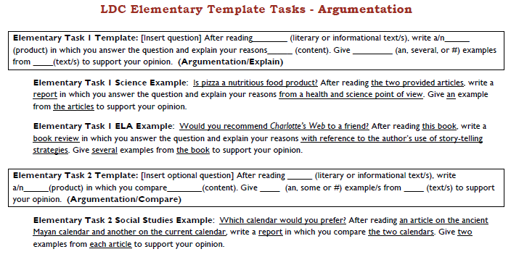
LDC Template Task
http://ldc.org/sites/default/files/LDC-Elementary-Template-Tasks-v1.pdf
Notes:
Facilitator, read a few examples to show the versatility of these templates. Encourage participants to explore this website if they have not done so. There are examples of full units of study leading to these types of performance tasks.

