Slide 1
Connecticut Core Standards for English Language Arts & Literacy
Systems of Professional Learning
Module 3 Grades K–5:
Supporting All Students in Writing and Research

Slide 2
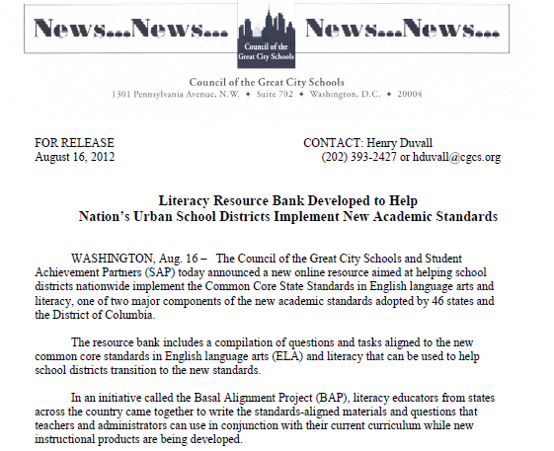
Resource: Basal Alignment Project
http://www.cgcs.org/Page/323
Notes:
The purpose of this slide is to introduce the Basal Alignment project. This project is led by Student Achievement Partners, but is carried out by teacher volunteers. The goal is to rewrite lessons from basal reading programs to align with the Common Core. It is an Edmodo site, which can be joined free of charge.

Slide 3
Introduction to Writing to Sources: Guided Instruction
Written by Student Achievement Partners and Council for Great City Schools
Framework for scaffolding writing after closely reading a text
Helps students build deeper meaning
Intended to accompany the Basal Alignment project lessons
Adaptable for any elementary literature writing task
Notes:
A recent addition to the Basal Alignment Project are Writing to Sources lessons, aligned with the BAP reading lessons.

Slide 4
Activity 8a: Examining a Framework
Activity 8a: Examining a Framework
Individually, review the framework, Writing to Sources: Guided Instruction. Working with a partner, choose one of the two sample lessons provided in your participant guide. As you read and discuss the sample lesson, annotate the parts of the lesson, using words from the Teachers’ Guide. Turn and talk to your partner: What are the benefits of using a framework like this to scaffold a writing task? Are there disadvantages as well?
Page 31
Notes:
Allow 20 minutes for this activity, about 8 to review the framework, and 10 to annotate the sample lesson, then another 2 for the turn and talk prompt.
The Writing to Sources framework is available on Edmodo, in the Basal Alignment Project https://www.edmodo.com/home#/group?id=1121902&sub_view=folders

