Slide 1


Connecticut Core Standards for English Language Arts & Literacy
Systems of Professional Learning
Module 3 Grades 6–12:
Supporting all Students in Writing and Research

Slide 2

Closing Activity
Post-Assessment
Page 48
Notes:
Adjusting for time, you may want to ask groups to share some of their ideas from Activity 10.

Slide 3

Post-Assessment
Where Are You
Now?
Assessing Your
Learning
Notes:
The Post-Assessment will be the same as the Pre-Assessment they took in the beginning of the session. This assessment is to gauge their learning based on the activities of the morning. They will find the Post-Assessment in the Participant Guide (3-4 minutes).
Ask for further thoughts, questions.

Slide 4

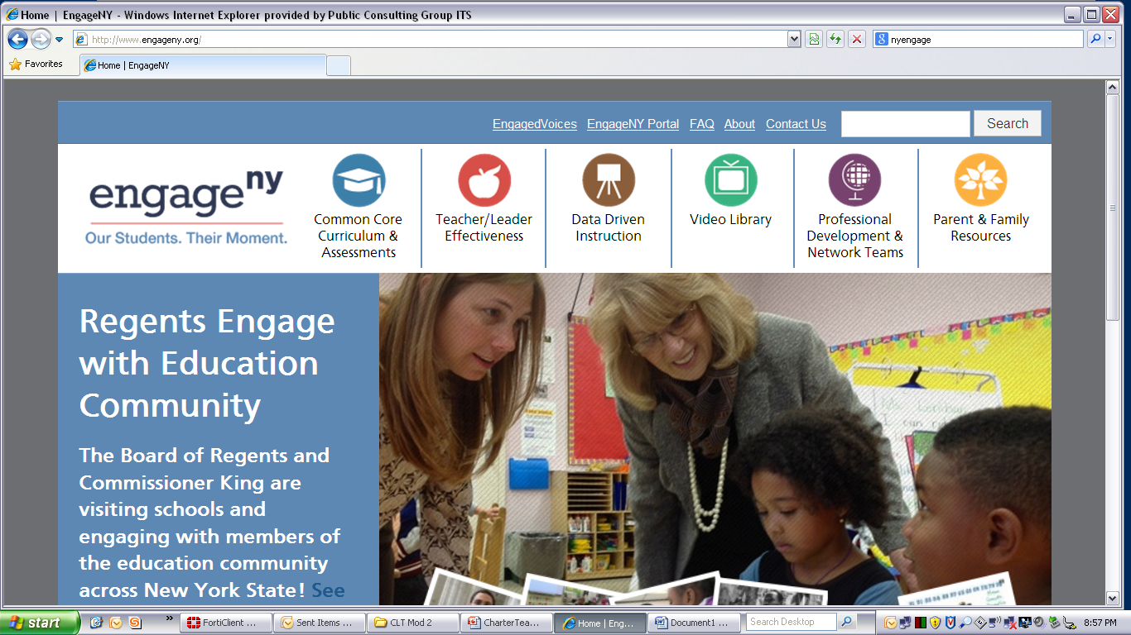



Some Key Resources
ctcorestandards.org
engageny.org
achievethecore.org
americaachieves.org

Slide 5
Thank you!

