Slide 1


Connecticut Core Standards for English Language Arts & Literacy
Systems of Professional Learning
Module 3 Grades 6–12:
Supporting all Students in Writing and Research

Slide 2
Today’s Session
CCS Writing and Research
Successes and Challenges
Close Look at the Writing Standards
Inquiry and Research in CCS ELA & Literacy
Creating Claims and Writing Grounded in Evidence from Text
Routine and Daily Writing
Supporting Students in Writing
Notes:
In Module 2, we considered ways to support students in reading closely and drawing evidence from text. Because of the integrated nature of the CCS, many of those supports address writing as well as reading.

Slide 3

Part 6
Supporting Students in Writing
Page 44
Notes:
Part 6 will take about 10 minutes.

Slide 4
Supporting Students
Determine what students need to know and be able to do
Find examples and models to show the skill
Talk through the findings
Give students chances to practice in low-risk situations
Have discussion before writing
Have students organize or draw before writing
Apply the new skill to writing currently being completed

Slide 5


Activity 8: Viewing a Video
Activity 8: Viewing a Video
View this segment of a video lesson where a secondary classroom writes and presents persuasive speeches. As you view, jot notes in your Notepad: What do you see and hear in this class? How are students being supported in writing, speaking, and listening? Be sure to be looking around the classroom as well as listening to and looking at the immediate activity on camera. Discuss with your table, using the prompts in your Participant Guide and on the next slide. Video: Teaching Channel Writing and Delivering Persuasive Speeches. https://www.teachingchannel.org/videos/teaching-persuasive-speeches
Page 51
Notes:
Tell participants that they will be viewing a class writing and delivering persuasive speeches. Ask them to look for supports in reading, speaking, writing, and even listening.

Slide 6

Discussion Prompts for Activity 8
What were some of the strategies and supports you saw and heard the teacher use?
What did you notice about student engagement and participation?
To what extent did this teacher and the lesson sequence prepare students to be competent and confident in their writing?
What do teachers need to know and be able to do in order to be able to effectively prepare students to write?
Notes:
After discussion, be sure to elicit responses from volunteers. Or, let tables know that you will be calling on someone to answer each question. The last question is particularly important for coaches.

Slide 7
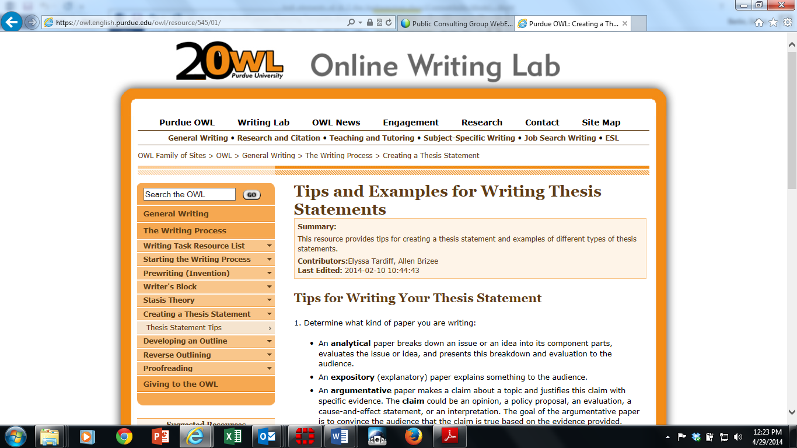
PURDUE OWL – Guides to Writing Thesis Statements and Research
Notes:
The Online Writing Lab (OWL) at Purdue University houses writing resources and instructional material, provides a free service
e-learning from the Writing Lab at Purdue (https://owl.english.purdue.edu/owl/resource/545/01/). Students, members of the community, and users worldwide can find information to assist with many writing projects. Teachers and trainers can use this material for in-class and out-of-class instruction.

Slide 8
Anthology Alignment Project
Sign up - Edmodo account at www.edmodo.com and log-in to your home page
Homepage, underneath your name, click the link that says Groups Join or Create Click Join and enter the group code: pkx4sp
“You have successfully joined the group Anthology Alignment Project.”
Click on Anthology Alignment Project on your left-hand side under Groups to enter the group.
Click on The Folders. Here are the completed lessons to date. They are listed on your left-hand side of the page.
Page

Slide 9
Resource: Literacy Design Collaborative (LDC)
Instructional system for developing literacy skills
Builds students’ literacy skills and understanding of content through reading and writing assignments aligned to the CCS.
Basic building block is a module, two to four weeks of instruction comprising a “teaching task,” standards, “mini-tasks,” and other instructional elements.
Working with LDC’s framework and tools, teachers develop a literacy-rich task and design instruction to help students complete that task.
http://ldc.org/
Notes:
The purpose of this slide is to briefly introduce a powerful resource.
LDC is a national community of educators providing a teacher-designed and research-proven framework, online tools, and resources for creating literacy-rich assignments and courses across content areas. They have developed an entire system of templates to create instruction leading to literacy performance tasks in every discipline. These templates and tasks have recently been extended to lower grades.

Slide 10
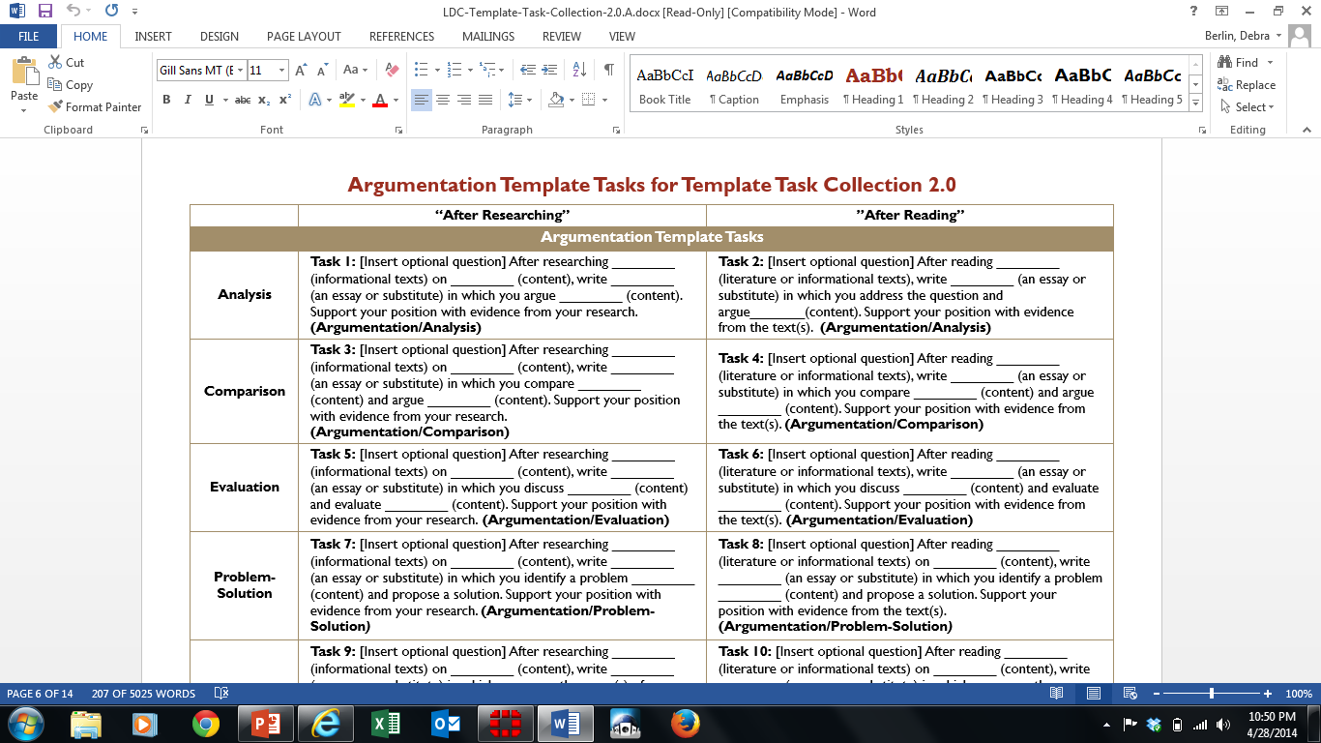
LDC Template Task Collection 2.0
Assisting teachers to create aligned performance tasks
http://ldc.org/how-ldc-works/modules
Notes:
Encourage participants to explore this website if they have not done so. There are examples of full units of study leading to these types of performance tasks. The Literacy Design Collaborative is committed to equipping middle and high school students with the literacy skills they need to succeed in their later education, their careers, and their communities, working through many different partnerships to meet that literacy challenge. Teachers should choose from these collections the templates that work best for them for any given task.
This collection aims to help teachers craft tasks that engage students in writing in response to reading. It provides template tasks for implementing the Literacy Design Collaborative (LDC) strategy by drawing directly from the language and skills articulated in each Common Core Anchor Standards. When filled in, a template task becomes a teaching task that sets up a context for teaching the specific skills and demands embedded in the standard.
All LDC template tasks are designed for tasks that involve students in writing in response to reading or research. They are clustered by the writing modes described in the CCSS: argumentative, informative/explanatory, and narrative. Teachers should choose the mode and template that best suits their instructional purpose.

