Slide 1


Connecticut Core Standards for English Language Arts & Literacy
Systems of Professional Learning
Module 3 Grades 6–12:
Supporting all Students in Writing and Research

Slide 2
Today’s Session
CCS Writing and Research
Successes and Challenges
Close Look at the Writing Standards
Inquiry and Research in CCS ELA & Literacy
Creating Claims and Writing Grounded in Evidence from Text
Routine and Daily Writing
Supporting Students in Writing
Notes:
One group of writing standards is focused on research skills. However the CCS are explicit in pointing out that research is integrated throughout the standards

Slide 3

Part 4
Inquiry and Research in CCS-ELA & Literacy
Page 36
Notes:
Part 4 is allotted 60 minutes.
In this section, we’ll look at the standards related to research and technology, and think about the demands of these standards. One of the best ways to do this is to look at units that have been developed by teachers and writers who have worked closely with the authors of the CCS.

Slide 4
Research to Build and Present Knowledge in the CSS
Read W.9-10.7, W.9-10.8 and W.9-10.9.
Discuss: What are the skills and expectations embedded in these standards?
W.9-10.7. Conduct short research projects to answer a question, drawing on several sources and refocusing the inquiry when appropriate.
W.9-10.8. Gather relevant information from multiple print and digital sources; assess the credibility of each source; and quote or paraphrase the data and conclusions of others while avoiding plagiarism and providing basic bibliographic information for sources.
W.9-10.9. Draw evidence from literary or informational texts to support analysis, reflection, and research.
Notes:
The purpose of this slide is to show the writing standards that focus on research skills.

Slide 5
Research: Key Design Features
Research is an inquiry-driven process designed to deepen students’ understanding
Process is iterative and cyclical in nature
Students are encouraged to pursue topics of interest
Process is designed to build students’ independent research skills and use inquiry to refine/hone research
Notes:
Review the design features of research.

Slide 6

Conducting and Composing Research
Think about your content area:
What type of research will students be conducting?
What skills will they to conduct research?
What skills will they need to write a research paper?
Notes:
Use this as a whole group discussion. You may choose to have 2 recorders from the audience stand at chart paper (one chart paper for Conduct and one for Writing).
Generate lists of ideas on the skills students will need to both conduct and write research.

Slide 7
What will students will need to know?
Research relevant information from multiple sources
Introduce ideas and form conclusions
Make connections and transition between ideas
Introduce other’s ideas with student’s own commentary
Paraphrase and NOT plagiarize
Properly use quotes
Determine reliability and credibility
Notes:
Compare this list of possible skills with the one generated from the participants. Skills like these can best be developed over time; however, how well students are taught a research process and how often they produce research with feedback will help students to master the research process. Models of well-written research and collaboration can assist this process.

Slide 8
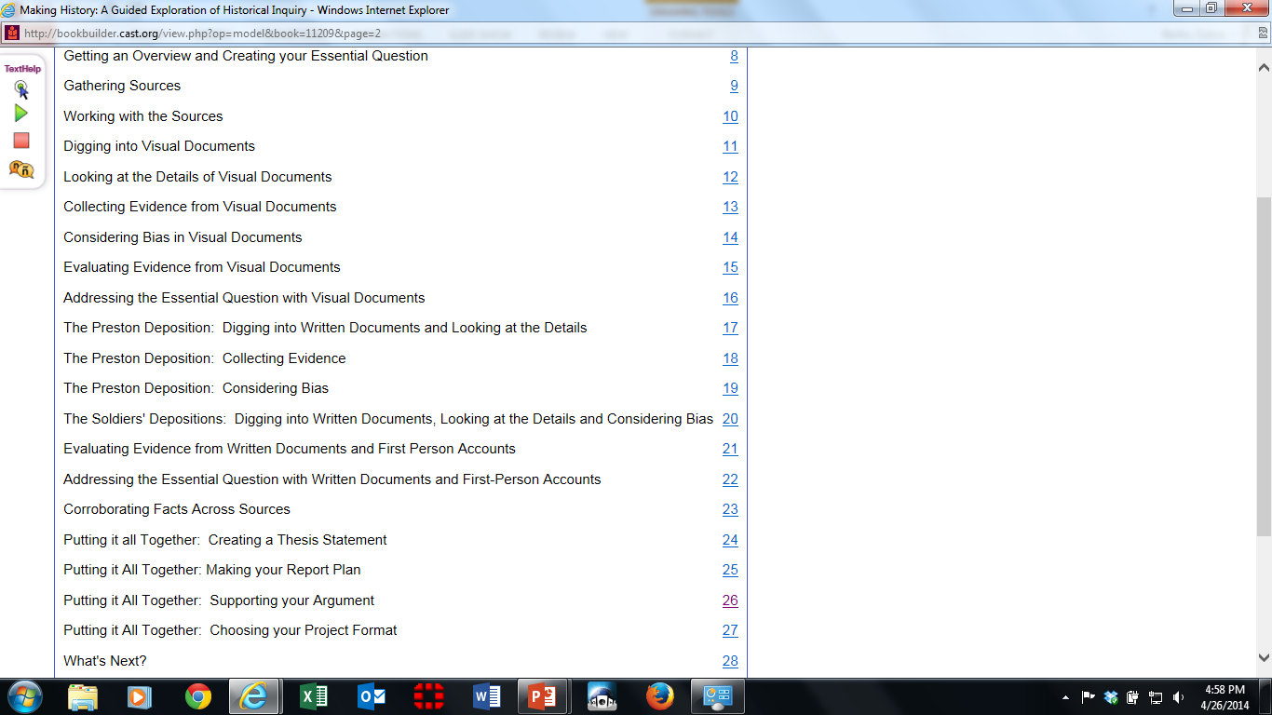
Making History: A Guided Exploration of Historical Inquiry - CAST Book Builder
An Online Guided Exploration of Historical Inquiry
Notes:
This online book models the process of historical inquiry by stepping students through a sample inquiry. Students find the model inquiry and coaching support for creating their own inquiry. Teachers find tips, techniques, and resources.
Found on CAST Book Builder, the hyperlink is embedded in the slide.
If there is time to explore this source, the pages can be forwarded at the very bottom of the right side of the screen.
This book has text-to-speech functions as well as modeling and coaching of the inquiry process.

Slide 9

Activity 6a: Reviewing a Research Framework
Activity 6a: Reviewing a Research Framework
1. First, with a partner, review the Teacher Research Unit Guide: Part 1: Initiating Inquiry Part 2: Gathering Information Part 3: Deepening Understanding Part 4: Finalizing Inquiry Part 5: Developing an Evidence-Based Perspective 2. The entire unit can be found at EngageNY.org. 3. As we look at research in CCS-aligned Units and Lessons, in the next activity, look for the above parts of a framework for conducting research.
Page 36
Notes:
Participants review the Teacher Research Unit Guide from EngageNY.org.

