Slide 1


Connecticut Core Standards for Mathematics
Systems of Professional Learning
Module 2 Grades K-5:
Focus on Content Standards
Notes:
(Slides 1-5, including the pre-assessment, will take about 10 minutes total.)

Slide 2

Supporting Change
Section 5
Page 25
Notes:
Section 5: Supporting Change
Section 5 Time: 85 minutes
Section Training Objectives:
To help participants identify elements of lessons that work to develop conceptual understanding, procedural skill and fluency, and application of mathematics.
To provide participants with instructional strategies for teaching the content standards through problem solving, for helping students to develop procedural skill and fluency, and to provide students with opportunities to apply their mathematical understandings.
To have participants create a plan for disseminating big ideas from the session with teachers at their school
To have participants anticipate specific teacher questions and challenges around implementing lessons that incorporate the Standards for Mathematical Content
Section 5 Outline:
Participants will begin by watching the videos Skip Counting with Counting Collections and What Fraction of the Shape is Red. During each video, participants will take notes on the corresponding Video Observation worksheet. After each video, discuss the strategies that were seen and the evidence provided as a large group and chart strategies to use as a master resource.
Participants will then begin to think about areas of instructional practice that will need to be addressed with the teachers with whom they work. Participants will be asked to consider this through the lens of approaching teachers with the idea of rather than learning to teach in a completely new way, working towards enhancing the instructional strategies in place now so that they help students to meet the expectations of the CCS-Math. To experience this, participants will explore ways that current strategies, such as concept cards/maps, journals, group work, decision making and so forth, can be restructured to meet the new expectations. Participants will Jigsaw each of the instructional strategy areas during which they will examine instructional strategies and/or examples, discuss how the examples can be implemented, and generate at least one new idea to share with others.
Participants will return to their ‘home’ group and discuss their strategy and new idea and as a group will wrap-up the activity by working together to make a plan for helping the teachers they work with understand and implement the key ideas and strategies presented in the module.
Section 5 Supporting Documents
Video Observation Sheets
A New Spin on Old Strategies
Group 1: Math Journals
Group 2: Mathematical Language
Group 3: Fluency
Group 4: Group Work and Decision Making
Next Steps
Section 5 Materials
Chart paper
Markers and tape
Notes: If time is a factor at this point in the day, you may opt to only play one video giving participants enough time to review each of the strategies in the Jigsaw activity.

Slide 3

Watch Video
Notes:
Counting Collections: Kindergarten
To begin the activity explain to participants that they will watch two videos; one showing parts of a primary lesson and one showing parts of an intermediate lesson. While watching the videos, participants should makes notes on the Video Observation sheet provided in the Participant Guide on pages 25-26. After each video, pause for a short discussion centered around participants’ observation notes and chart instructional strategies used and discussed as a large group. The goal of watching the videos is to get participants looking for examples of the important aspects of teaching the Content Standards that have been discussed throughout this session, and to also look at additional teaching strategies that they want to bring back to teachers at their school.
Begin by watching the first video, Skip Counting with Counting Collections, that shows part of a Kindergarten lesson. Click on “Watch Video” to play the video from here: https://www.teachingchannel.org/videos/skip-counting-with-kindergarteners. The video is 12 minutes long.

Slide 4
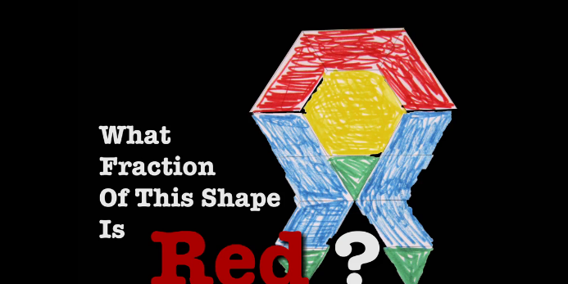
Watch Video
Notes:
What Fraction of This Shape is Red?
Following the discussion of the Kindergarten lesson, watch the video What Fraction of This Shape is Red that takes place in a fifth grade classroom. Click on “Watch Video” to play the video from here: https://www.teachingchannel.org/videos/teaching-fractions. The video is 5 minutes long. Again discuss and chart the instructional strategies used by the teacher.
(Note: In this video, What Fraction of this Shape is Red, the standards being addressed are 3rd grade standards and this lesson is being delivered in a 5th grade classroom setting. So, while the lesson is worth watching because of the strategies being used, participants should be able to point out that it is not grade level appropriate for 5th grade.)
After the discussion on the second video, explain to participants that they will now have an opportunity to explore some additional strategies and resources for teaching the CCS-Math Content Standards.

Slide 5
A New Spin on Old Strategies
Group 1: Journals
Group 2: Mathematical Language
Group 3: Fluency
Group 4: Group Work & Decision Making
How can this strategy/resource support the CCS-Math content and practice standards?
Generate at least one new idea for the use of the strategy/resource with students.
Pages
27-28
Notes:
A New Spin on Old Strategies
Participants will work in small groups to examine four different Math strategies and/or resources. The group that participant sat in to watch the video will become their home group. Have participants number off at each table until everyone has a number representing 1, 2, 3, or 4. Then, participants will move into their Jigsaw groups (1’s will become Group 1 and discuss Journals, 2’s will become Group 2 and discuss Mathematical Language, etc.). On the notes page in the Participant Guide, each participant should note key points that come out of the discussion and the group should develop at least one new way to implement the strategy being discussed. (Allow 15 minutes for the Jigsaw discussions)
When time is called, participants will move back to their ‘home’ group and each person will have 5 minutes to discuss their strategy/resource.
Notes about setting up and managing movement to tables:
• In cases where you are working with a large number of participants, create multiple jigsaw groups (e.g., two to three groups labeled as Group 1, two to three groups labeled as Group 2, etc.) so that there are no more than six participants at any one table at any one time.
•Make sure that each table is clearly labeled (use the cardstock that has been provided with the supplies to label tables) so that groups are not trying to figure out where they are going as they move.
•Give participants a 1 minute wrap-up warning at each table so that they can conclude their conversations and prepare to move to the next table.
“Set up” this activity to participants by explaining that they might explore strategies they already know. However, a new spin has been put on each strategy in order to meet the challenges presented by the CCS-Math. Also, explain that at there is space within the Participant Guide on pages 27-28 on which they can make notes about the important points they want to bring back to their ‘home’ group and to teachers at their school.
After the ‘home’ group discussion is complete, debrief the strategies/resources as a large group and highlight and chart some new ideas generated.
Transition to the last part of this section by asking participants how they will now share this information back at their school site and allow participants to make notes on the Next Steps worksheet on page 39 in the Participant Guide.

