Slide 1


Connecticut Core Standards for Mathematics
Systems of Professional Learning
Module 2 Grades K-5:
Focus on Content Standards
Notes:
(Slides 1-5, including the pre-assessment, will take about 10 minutes total.)

Slide 2

The Language of the Content Standards
Section 2
Page 8
Notes:
Section 2: The Language of the Content Standards
Section 2 Time: 45 minutes
Section 2 Training Objectives:
To define conceptual understanding, procedural skill and fluency, and application of mathematics.
To understand the differences between conceptual understanding, procedural skill and fluency, and application of mathematics.
To begin to understand how developing conceptual understanding can lead to the development of procedural skill and fluency.
To demonstrate how application of mathematics can support students’ development of conceptual understanding.
Section 2 Outline:
In groups, participants will complete the first part of the Who Knows Math exercise during which they will examine short examples of student work and make observations about what the student knows based on the answers given.
After a brief large group discussion, small groups will watch the video Mathematics Fluency: A Balanced Approach and develop working definitions of “conceptual understanding,” “fluency,” and “application” as addressed in the content standards.
Groups will then work through short, basic examples on how students can demonstrate conceptual understanding, and then discuss current strategies used now to develop procedural skill and fluency. The discussions will continue with how those strategies will benefit from students first developing a conceptual understanding of the mathematics.
The wrap-up of the session takes place as participants complete the second part of the Who Knows Math exercise in which they revise their first round of answers given their new understandings.
Supporting Documents
Who Knows Math
Materials
Chart paper, markers
Individual copy of the mathematics standards that participants bring or access online
Video
Mathematics Fluency: A Balanced Approach

Slide 3
What Do These Students Understand? – Part 1
What Do These Students Understand? – Part 1
Read and analyze the “Who Knows Math” handout on page 9 in the Participant Guide. Record your observations on what these students know and what they can do on page 10 in the Participant Guide.
Would you be comfortable with his/her understanding if s/he continued to approach division in his/her particular way? Explain your reasoning.
2 412
1
2
X 412
Pages 9-11
Notes:
What do these students understand?
Ask table groups to read and analyze the “Who Knows Math” handout on pages 9-11 in the Participant Guide. Ask them to think about what each student on the sheet knows and doesn’t know. Also have them think about what is unknown about what the students know. Participants can record their observations on the handout. Briefly discuss participants’ observations and explain that they will return to the this after exploring the language of the content standards in more detail.
Note: If time is an issue at the start of this activity, you may choose to have groups focus on only one student. If you have five groups, assign each group a different student.

Slide 4
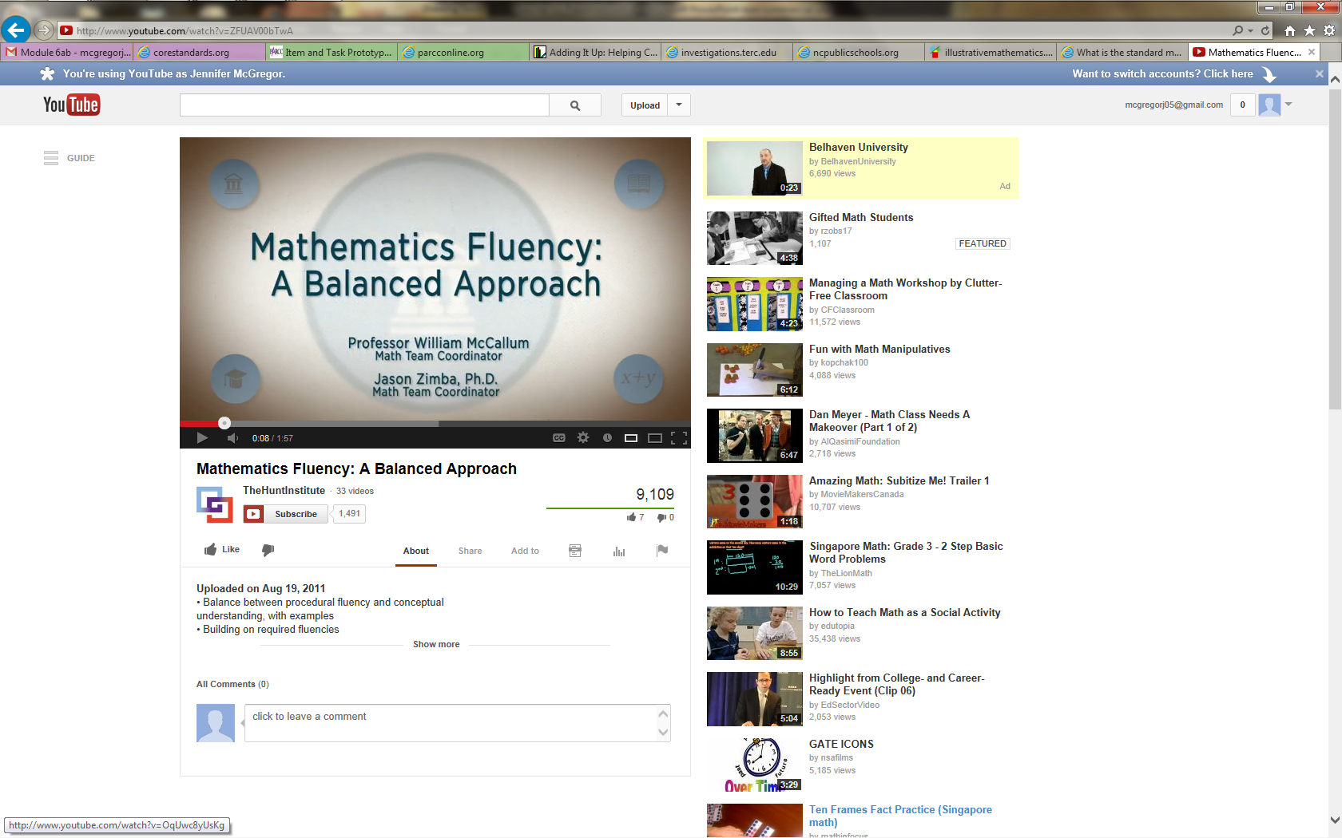
From the CCSS-M Authors
Watch Video
Notes:
From the Authors
Click on “Watch Video” to play the video Mathematics Fluency: A Balanced Approach from here: http://www.youtube.com/watch?v=ZFUAV00bTwA. The video is 1:57 long.
After the video has played, ask participants for their thoughts.
Transition to the next part of this section by explaining to participants that they will now look more closely at conceptual understanding, procedural skills and fluency, and application of mathematics in more depth.

Slide 5
Rigor
The major topics at each grade level focus on:
CONCEPTUAL UNDERSTANDING
More than getting answers
Not just procedures
Accessing concepts to solve problems
PROCEDURAL SKILL
AND FLUENCY
Speed and accuracy
Used in solving more complex problems
Built on conceptual understanding
APPLICATION OF MATHEMATICS
Using math in real-world scenarios
Choosing concepts without prompting
Notes:
Rigor: Remind participants that one of the big shifts in the content standards is that at all ages, students are to be taught with rigor as defined on the slide. Review the three aspects of rigor: conceptual understanding, procedural skill and fluency, and application of mathematics. Repeat that rigor means learning based in the deep understanding of ideas AND fluency with computational procedures AND the capacity to use both to solve a variety of real-world and mathematical problems. Explain to participants that you will now go over each aspect of rigor in more depth.

Slide 6
Conceptual Understanding
“Conceptual understanding refers to an integrated and functional grasp of mathematical ideas.”
(Adding it Up: Helping Children Learn Mathematics. 2001)
Notes:
Ask participants to turn to pages 12-13 in the Participant Guide where space is provided for them to take notes on Conceptual Understanding, Procedural Skill and Fluency, and Application of Mathematics.
Conceptual Understanding
As participants read the quote on the slide, explain that conceptual understanding can be difficult to define. Ask participants to read the description on page 12 in the Participant Guide that is an overlap of the National Research Council and NCTM definitions of conceptual understanding:
“Students demonstrate conceptual understanding in mathematics when they provide evidence that they can recognize, label, and generate examples of concepts; use and interrelate models, diagrams, manipulatives, and varied representations of concepts; identify and apply principles; know and apply facts and definitions; compare, contrast, and integrate related concepts and principles; recognize, interpret, and apply the signs, symbols, and terms used to represent concepts. Conceptual understanding reflects a student’s ability to reason in settings involving the careful application of concept of definitions, relations, or representations of either.” (Balka, Hull, & Harbin Miles, n.d.)
Just as they looked at “I Can” statements with each of the Practices, use the next slides to show examples of student responses that demonstrate conceptual understanding.

Slide 7
Conceptual Understanding
Example
CCSS.Math.Content.1.NBT.C.4
Add within 100, including adding a two-digit number and a one-digit number, and adding a two-digit number and a multiple of 10, using concrete models or drawings and strategies based on place value, properties of operations, and/or the relationship between addition and subtraction; relate the strategy to a written method and explain the reasoning used. Understand that in adding two-digit numbers, one adds tens and tens, ones and ones; and sometimes it is necessary to compose a ten.
Question: What is 20 + 70?
Notes:
Conceptual Understanding
Ask participants to look at the example on the slide and discuss with their group how a student might demonstrate conceptual understanding if asked the question What is 20 + 70. Allow participants to discuss this briefly, 2-3 minutes, and then transition to the next slide.

Slide 8
Conceptual Understanding
Question: What is 20 + 70?
Student Response: 20 is 2 tens and 70 is 7 tens. So, 2 tens and 7 tens is 9 tens. 9 tens is the same as 90.
Notes:
Ask participants to now consider the student response to the question and have them determine if this student has developed a conceptual understanding. A standard that may be used to support this students response is CCSS.Math.Content.1.NBT.B.2.c
The numbers 10, 20, 30, 40, 50, 60, 70, 80, 90 refer to one, two, three, four, five, six, seven, eight, or nine tens (and 0 ones).

Slide 9
Conceptual Understanding
Example
Standard 2.OA.3: Determine whether a group of objects (up to 20) has an odd or even number of members, e.g., by pairing objects or counting them by 2s write an equation to express an even number as a sum of two equal addends.
Question: Is 7 an even or odd number? Explain how you know.
Student Response: 7 is odd because I cannot make pairs with all of the cubes like I can with 8 cubes. When I can make pairs with all of the cubes it is an even number.
Notes:
Conceptual Understanding
Go over example on the slide and ask participants how the student’s response relates to Standard 2.OA.3. Here we want participants to see that a student is demonstrating a conceptual understanding of determining if a number is even or odd. They may need to see multiple responses of this students’ work to make a final determination of this, so ask what else, if anything, might they ask or look for from this student. And, to support the idea that there is no one right way for a student to demonstrate conceptual understanding, what other ways might they expect to see students answer this question.
Transition to the next slide by explaining that, as they have seen, not all standards explicitly focus on conceptual understanding so they will now look at procedural skill and fluency.

Slide 10
Procedural Skill and Fluency
“Procedural skill and fluency is demonstrated when students can perform calculations with speed and accuracy.”
(Achieve the Core)
“Fluency promotes automaticity, a critical capacity that allows students to reserve their cognitive resources for higher-level thinking.”
(Engage NY)
Notes:
Procedural Skill and Fluency
Focus on the two key points on the slide. Ask participants for their thoughts on Bill McCallum’s statements in the video (shown on slide 16) in which he talks about the design of the standards being such that there is a build up to procedural skill and fluency. Ask why they think this is the case. If it does not come out in the conversation, have participants think back to the video of CCSS-Math co-author, Phil Daro’s, video that was viewed in Module 1 about teaching students to get answers. Ask participants what connections might be made between Bill McCallum’s and Phil Daro’s videos.
Then, transition to the next slide by explaining that teaching students procedures and how to use an algorithm or any type of short cut or trick without developing some level of conceptual understanding for why those things work mathematically is akin to teaching answer getting vs. problem solving.
Note: For a deeper look at Phil Daro’s discussion on answer getting, review the video of his longer discussion here: http://vimeo.com/79916037

Slide 11
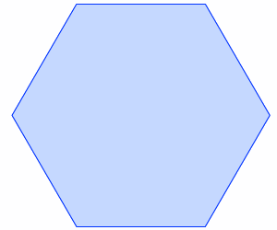
Procedural Skill and Fluency
Check all the equations that are true
8 x 9 = 81
54 ÷ 9 = 24 ÷ 6
7 x 5 = 25
8 x 3 = 4 x 6
49 ÷ 7 = 56 ÷ 8
Mariana is learning about fractions. Show how she can divide this hexagon into 6 equal pieces. Write a fraction that shows how much of the hexagon each piece represents.
Adding / subtracting with tens
[Ask orally]
(a) Add 10 to 17
(b) Add 10 to 367
(c) Take 10 away from 75
(d) Take 10 away from 654
Notes:
Procedural Skill and Fluency
Go over the examples on the slide. Each of the these is a variation on the traditional activities that teachers have used to determine if students have developed mathematical fluency. Ask if there is anything more that they would want to see to determine if students’ fluency is based in conceptual understanding.

Slide 12
Procedural Skill and Fluency
Standard 1.OA.6: Add and subtract within 20, demonstrating fluency for addition and subtraction within 10, use strategies such as counting on; making ten; decomposing a number leading to a ten; using the relationship between addition and subtraction; and creating equivalent but easier or known sums.
Example
Question: What is 5 + 6?
Student Response: I know that 5 + 5 = 10; since 6 is 1 more than 5, then 5 + 6 must be 1 more than 10. 1 more than 10 is 11.
Notes:
Have participants think about the example on the slide and ask them to explain how the student’s response relates to Standard 1.OA.6 and why, at this grade level, they may want students to provide their strategy rather than just the answer.
After the discussion of the standard, transition to the next slide by explaining to participants that some of the standards ask students to apply their mathematical understanding and skills within a given context.

Slide 13
Application of Mathematics
The Standards call for students to use math flexibly for applications.
Teachers provide opportunities for students to apply math in authentic contexts.
Teachers in content areas outside of math, particularly science, ensure that students are using math to make meaning of and access content.
Frieda & Parker, 2012
Achieve the Core. 2012
Notes:
Application of Mathematics
Go through points on the slide. Ask participants how they have had students apply mathematics. Get two or three examples. Ask participants why this is important.
Application of mathematics is important because without this step or expectation students are learning math as a set of rules, procedures, etc. that have no real meaning in the world outside of the classroom. Students need to learn how math works and how it is used. Note here that when the conversation of application of mathematics typically comes up the phrase ‘real-world problems’ is usually somewhere in the conversation. As teachers think about the types of problems that students will solve in order to apply their mathematical understanding, have them think about problems that would be ‘real world’ to their students. This means that the problems should be contextually relevant and easily understood by the students at their particular grade level. Also note that, just as we saw with the fluency standard, not all standards focus on application. But, when the standard does point to solving problems through an application of mathematics, we really want to see how students can flexibly use what they know and understand. Finally, ask participants to briefly discuss how they can engage students in authentic problem-solving scenarios.
Before moving to the next slide that has examples of contextually relevant problems, focus participants on the third bullet on the slide and ask for one or two volunteers to give examples of how the CCS-Math standards can be supported and connected to the standards from other content areas in order for students to see and apply mathematics outside of their typical math lesson time.

Slide 14
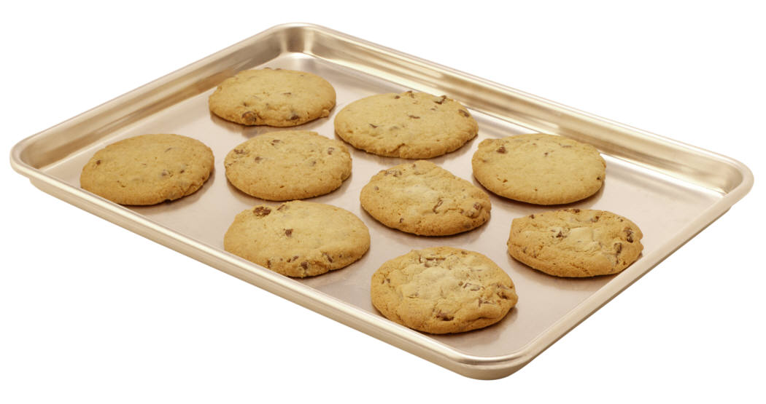
Application of Mathematics
Example
There are 9 cookies left in the pan. Five students want to share the cookies equally. How many cookies will each student get?
Notes:
Application of Mathematics
Have participants examine the example on the slide and discuss ways that conceptual understanding and procedural skill and fluency can be applied when solving this problem. Then, have participants look at their standards to determine which standard is being addressed in this problem.
Standards addressed by the problem
CCSS.Math.Content.5.NF.B.3
Interpret a fraction as division of the numerator by the denominator (a/b = a ÷ b). Solve word problems involving division of whole numbers leading to answers in the form of fractions or mixed numbers, e.g., by using visual fraction models or equations to represent the problem.
Example of Participant Response:
Students should see this as a division problem even though the word divide, nor the division symbols are present. Some students may draw ‘cookies’ and show the division by partitioning the ‘cookies’. Students then write 9÷5 = 1 4/5 Students can then be prompted to write 1 4/5 as the fraction 9/5 as this is the number of 1/5 sized pieces that each student will receive of the cookie. And then discuss how their fraction 9/5 relates to the original division problem of 9 ÷ 5. If they wrote this out they would see that 9 ÷ 5 = 9/5. Students could then be prompted to try this out with other division problems and then make a generalization about interpreting fractions as a division of the numerator by the denominator.
Other students may simply perform the calculation of 9÷5 to get the answer of 1 4/5 and be able to explain that each student gets 1 whole cookie and then the remaining four cookies can be divided into 1/5s with each student receiving four of the 1/5 sized pieces. When asked to write their answer in fraction form, not as a mixed number, and make an observation of their answer 9/5 and its meaning within the problem context, they are able to see and explain that 9÷5 = 9/5 and further make a generalization about interpreting fractions as a division of the numerator by the denominator. Depending on where students are with their personal understanding more or less prompting through questioning may be needed to get at the intended deeper understanding of the generalization.

Slide 15
What Do These Students Understand? – Part 2
2 412
What Do These Students Understand? – Part 2
Return to the “Who Knows Math” handout on pages 9-11 in the Participant Guide. Which students have shown conceptual understanding, which have shown procedural skill and fluency, which have shown both, and which pieces of work would you need to know more to make the determination?
1
2
X 412
Pages 9-11
Notes:
Have participants look back at the “Who Knows Math” student work and ask them to make assumptions about which students have shown conceptual understanding, which have shown procedural skill and fluency, which have shown both, and which pieces of work they would need to know more about in order to make the determination. Have volunteers share their thinking.
Things to note about each student’s piece of work:
Effie: Is able to make the conceptual connections, but does not have a way to get an answer.
Abie: Produced two correct answers, but lacks the conceptual understanding of the operations and that would allow the connection to be made between division and multiplication of fractions.
Ceedee: Is able to make the conceptual connections, but did not perform the calculations in a way that produced the correct answer. Also, as she performed the calculations she was not paying attention to the precision of her answer and asking herself, ‘does my answer make sense?’
Gigi: More information on Gigi’s thinking and understanding would be needed to determine if there was conceptual understanding.
Hi: Seems to have an efficient way for finding the answer, but more information is needed to determine what ‘it’ is.
An important point to bring up here is that we are asking participants to make assumptions only because the student is not present to find out more. However, teachers should try not to make a determination of what students know and understand based on an assumption. They need to probe deeper to really determine where students are with their understanding.

Slide 16


Think About It…
How does the approach of the CCS-Math content differ from previous approaches to mathematics teaching and learning?
How might you help teachers to understand these differences?
Notes:
Think About It
Finally, wrap up this section by asking participants to reflect on the questions on the slide. Allow 5 minutes for discussion. You can also use this question to transition to the next activity after the break by linking the discussion on the CCS-Math approach to rigor and now looking specifically at the standards to see how conceptual understanding, procedural skill and fluency, and application of mathematics is developed over and within grade levels.
As time permits, ask for volunteers to share their responses to the question.

