Slide 1
CONNECTICUT STATE DEPARTMENT OF EDUCATION
Deepening Relationship Building & Engagement
Community of Practice
November 18, 2021
Developed by the CSDE in collaboration with Attendance Works & SERC
Notes:
Amanda

Slide 2
WELCOME & INTRODUCTIONS
Notes:
Prompt to put name/district/role in chat

Slide 3
Introductions
Please share in chat:
name, position, district
something that keeps you hopeful during these challenging times.

Slide 4
Attendance & Engagement Work Group
Jay Brown Education Consultant Special Education, CSDE
Judy Carson, Education Consultant Family Engagement, CSDE
Kari Sullivan Custer, Education Consultant Attendance & Engagement, CSDE
Megan Alubicki Flick, Education Consultant English Learners, CSDE
Lauren D. Johns, Project Specialist SERC
Dr. Gladys Labas, Director Language and Equity, CSDE
Amanda Pickett, Education Consultant School Climate, CSDE
Stephen Proffitt, Director for Special Education Programs and Instructional Design, SERC
Louis Tallarita, Education Consultant Homeless Education and McKinney-Vento, CSDE
Notes:
Link to email

Slide 5
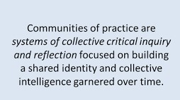
Student Attendance and Engagement
Community of Practice

Slide 6
Today’s Agenda
Welcome & Introductions (5-10 min) Kari Sullivan Custer, Education Consultant, Attendance & Engagement, CSDE
Updates from CSDE (5 min)
Kari Sullivan Custer, Education Consultant, Attendance & Engagement, CSDE
Why Tier 1 Relationship Building Continues to Matter (10 min)
Hedy Chang, Attendance Works
Characteristics of High Impact Engagement and Relationship Building (10 min)
Judy Carson, Education Consultant, Family Engagement, CSDE
Break Out: What are promising and proven Tier 1 activities taking place in your schools and districts? (20 minutes + 15 min for report out)
Hedy Chang, Attendance Works
6 . Discussion: How can Districts Build School Capacity for Relationship-Building and Engagement? (20 Min)
Hedy Chang & Judy Carson facilitate

Slide 7
WHAT’S NEW AT CSDE AND PARTNERS
CONNECTICUT STATE DEPARTMENT OF EDUCATION

Slide 8
What’s New at CSDE
2021 Performance Matters Forum – December 8 – Registration Open
Screen and Stay (Press Release) - DPH/CSDE Screen and Stay Guidance - Screen and Stay Supplementary PowerPoint slides
Remote Learning FAQ
CONNECTICUT STATE DEPARTMENT OF EDUCATION

Slide 9
Track Data Early and Often…
New on EdSight
2020-21 Chronic Absence Rates
State
District
School
Student groups (Els, SWDs, Grade, F/R Meals)
September 2021 Attendance Data
Attendance by Student Group and District, 2021-2022 (.csv)
Attendance by School, 2021-2022 (.csv)
District Attendance Rates by High Needs category and by grade (.xlsx)
District Attendance Rates for English learners and students with disabilities by grade band (.xlsx)
Chronic Absence by District (.xlsx)
District Chronic Absence and Attendance Rates for students wth disabilities by primary disability (.xlsx)
CONNECTICUT STATE DEPARTMENT OF EDUCATION

Slide 10
WHY TIER 1 RELATIONSHIP BUILDING MATTERS
CONNECTICUT STATE DEPARTMENT OF EDUCATION

Slide 11
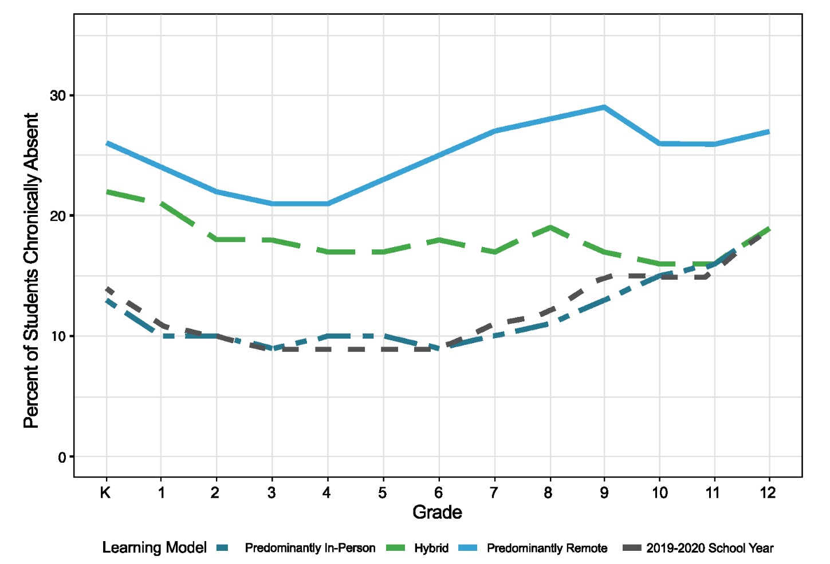
Chronic absence grew last year. Patterns and grades most affected by absenteeism differed by learning model.
https://www.attendanceworks.org/wp-content/uploads/2019/06/Chronic_Absence_in_CT_062421.pdf
Notes:
While chronic absence for mostly in-person was similar to prior years (the bottom two lines), it was much higher for younger students in hybrid (green line) and highest for all students who attended predominantly remote (top blue line).
The spike in 9th grade remote learning is particularly frightening since we know 9th grade chronic absence is a major predictor of students dropping out.

Slide 12
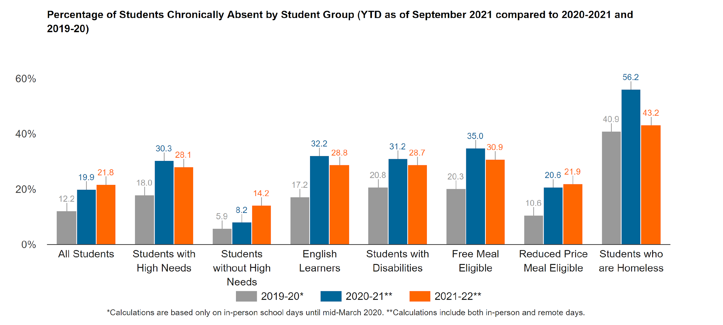
Tier 1 Relationships are Key To Addressing the Growing Levels of Chronic Absence
Find your district’s data at Supporting Student Participation (ct.gov)
Notes:
Chronic absence is increasing slightly from last year– which already represents a significant increase from before the pandemic. Interestingly – it is increasing fastest for students without high needs while it seems to be decreasing slightly amongs most other high need groups. It suggests universal relationship building strategies are essential.

Slide 13
Attendance is Even More Challenging in Fall 2021-22
The surge in Covid-19 cases is increasing the number of students who are absent.
Returning to in-person school is difficult after so many months of remote learning.
Many older students are struggling to balance school with family and work responsibilities especially in communities hard hit by the pandemic.
Chronic absence in the first months of school is especially problematic for learning, relationships and routines.
Notes:
Student are missing school because they are sick and they are quarantined and they are concerned about the health and safety of schools.
The return to school is harder than ever. Students are out of the routine of going to school, inform and formal support systems for getting to school are still being assembled and have been disrupted by Covid ( e.g. the bus driver shortage), and school climate is tough with students unaccustomed to being around other kids for many months. Bullying is on the rise.
Older students are still balancing with family and work responsibilities.
When schools first shut down due to Covid in March 2020, it was very different. That was at the end of the year. But we are now seeing chronic absence early in the year. This means kids are missing out on core concepts that are essential to continuing to learn later in the school year, they are also not forging connections to students or to teachers. Left unaddressed chronic absence early in the year, predicts chronic absence in the spring.

Slide 14
Key Success and Risk Indicators are the ABC’s: Attendance, Behavior, Course Performance
 | Attendance | Behavior | Course Performance
Off-Track | Less than 90% | 1+ suspension and/or mild sustained misbehavior | Failing 1 or more year long or 2 semester course
On-Track | Greater than 90% | Solid academic behaviors | Passing Courses
Post-Secondary Ready | Greater than 95% |  | B- or Better GPA
 |  | Agency and Hope

Slide 15
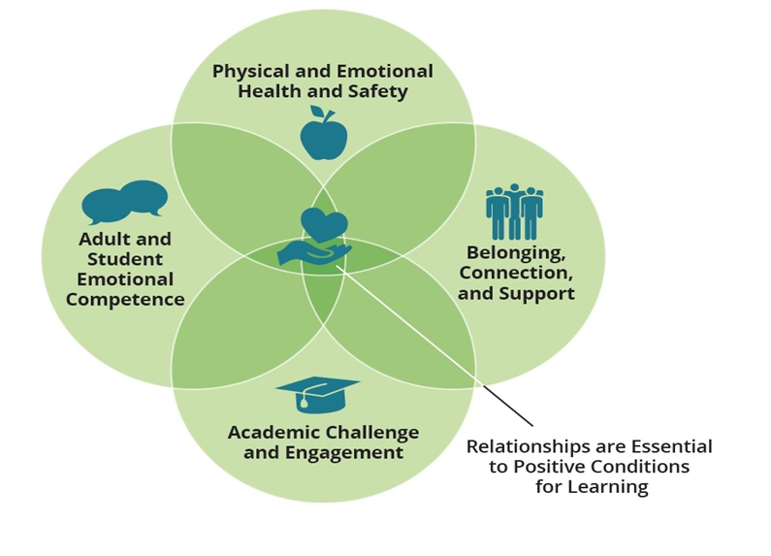
Chronic Absence is an Early Warning that Positive Conditions for Learning are Missing Whether Classes are In Person, Distance or Blended
Notes:
High Levels of Chronic Chronic absence

Slide 16
Take a Tiered Approach to Engagement
Tier 3
Intensive Intervention
Tier 2
Early Intervention
Tier 1
Universal Prevention
Foundational “Whole School” Supports
https://www.attendanceworks.org/chronic-absence/addressing-chronic-absence/3-tiers-of-intervention/
Notes:
A strong team is needed to ensure we can take a tiered approach. And, as many of you know, we added in whole school supports to this pyramid.
Tier 1 represents universal strategies to encourage good attendance for all students.
Tier 2 provides early intervention for students who need more support to avoid chronic absence.
Tier 3 offers intensive support for students facing the greatest challenges to getting to school.
Foundational Supports. The pyramid graphic shows how the 3 Tiers of Intervention sit on top of foundational supports. We believe that these foundational supports are the building blocks of good schools that promote attendance.
Keep in mind that these tiers are additive. A student needing tier 3 supports, still needs tier 1 and tier 2 and the foundational supports.

Slide 17
Foundational Supports are Building Blocks of Schools that Promote Engagement
Healthy learning environments
Enrichment
activities and clubs
Positive relationships
Active family and student engagement
Access to tech equipment and connectivity
Challenging and Engaging Curriculum
Traditions and celebrations
Support for families to facilitate learning
at home
Welcoming, safe school climate
Learning Supports
Access to Food and Other Basic Needs
Advisories or Morning Meetings to Build Community
Foundational “Whole School” Supports
Notes:
1. Say: Foundational whole school supports are the building blocks of schools that promote engagement and build a sense of community.
These are supports that don't explicitly address attendance but when they are present, they lead to better attendance and engagement.
2. Write in Chat: Which supports do you need to strengthen this year?

Slide 18
Going to School Reflects When Families Have…
Hope
for a better future
Faith
that school will help your child succeed
Voice
in decisions that affect them and their children
Access
to needed support and services
Relationships instill hope, nurture faith, allow voice and ensure understanding of needed supports. They also help children and adults recover from traumatic experiences.
Notes:
Going to school reflects when families have…
Hope for a better future
Faith that school will help their child to succeed
Voice in decisions that affect the and their children
Access to needed support and services
Each of these elements helps to promote a positive school environment that encourages daily attendance.

Slide 19
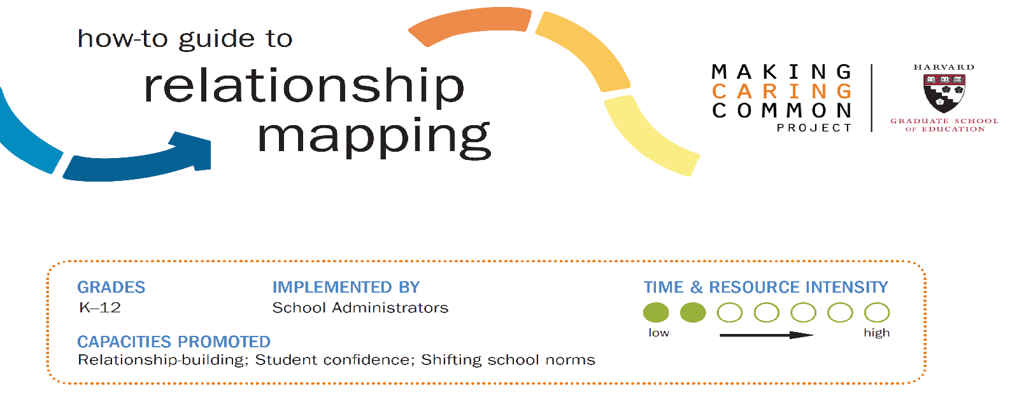
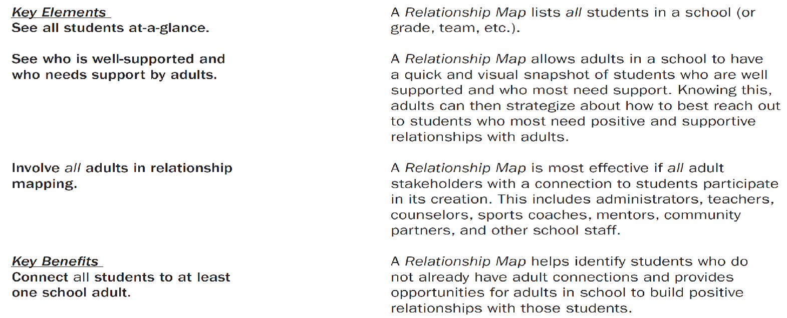
Title
Download in-person and virtual versions of this guide at
https://mcc.gse.harvard.edu/resources-for-educators/relationship-mapping-strategy
Notes:
When we met in October, I shared a process for having a caring conversation with students and families that creates dialogue. Start by listening and learning, sharing positives. Then informing, discussing and problem solving to address barriers to attendance. Reminder not to skip steps which is our tendency when we get tired.
This is the step-by-step framework for Caring Conversations. Learn about the family or student’s hope for their/their child’s future. Share positive things you observed about their child and their contribution to the school and the difference it makes when they are there. Inform the family of their child’s attendance and participation level, tailor the conversation to the student’s level of attendance. If the student is missing a lot of school discuss what challenges are contributing to the student’s absences. Arrive at a plan including offering support on behalf of the school as needed. If a student is struggling with absences agree to meet again in 2 weeks

Slide 20
WHAT ARE HIGH IMPACT RELATIONSHIP BUILDING AND ENGAGEMENT STRATEGIES?
CONNECTICUT STATE DEPARTMENT OF EDUCATION

Slide 21
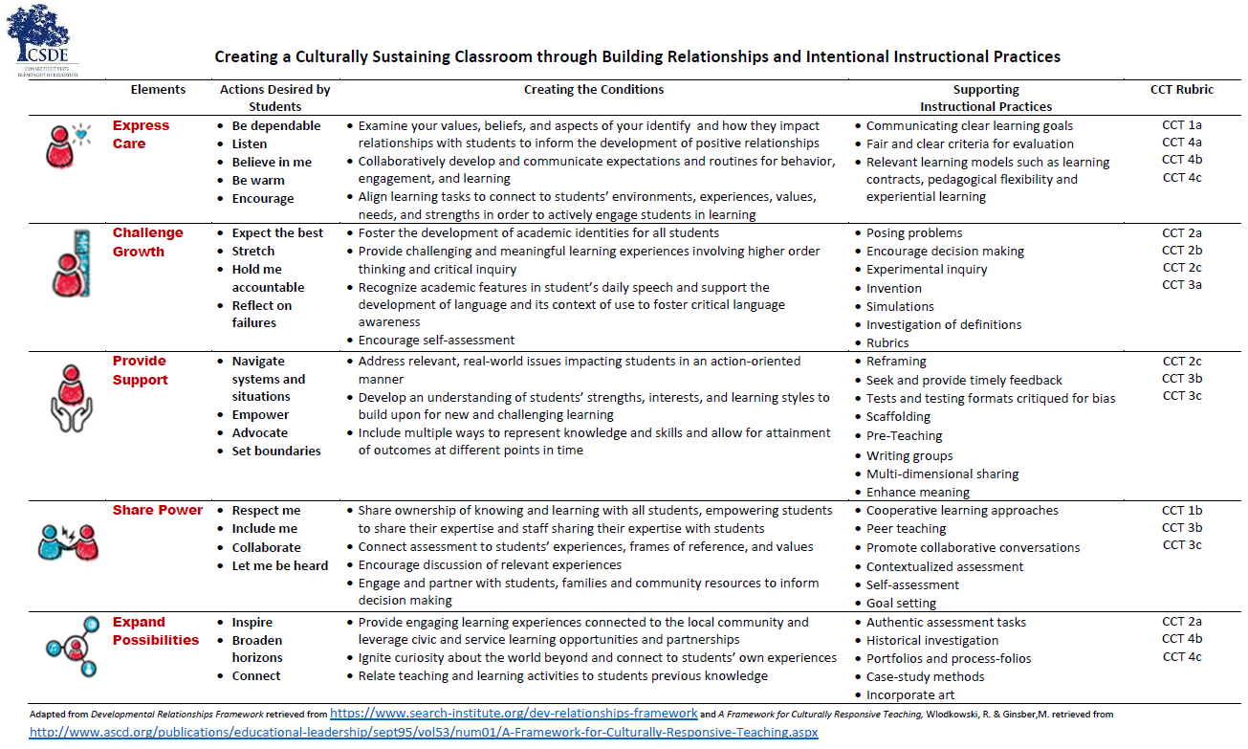
CSDE - Creating A Culturally Sustaining Classroom through Building Relationships and Instruction
Notes:
X Amanda could present this slide.

Slide 22
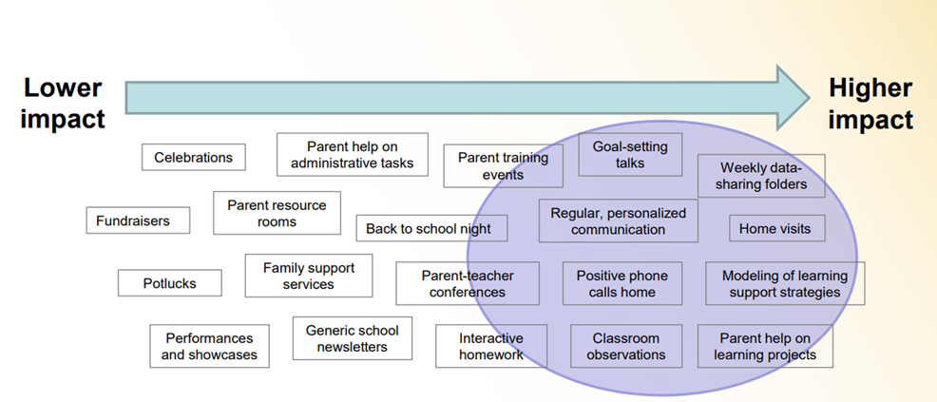
High-Impact Family Engagement
Courtesy of Flamboyan Foundation
CONNECTICUT STATE DEPARTMENT OF EDUCATION

Slide 23
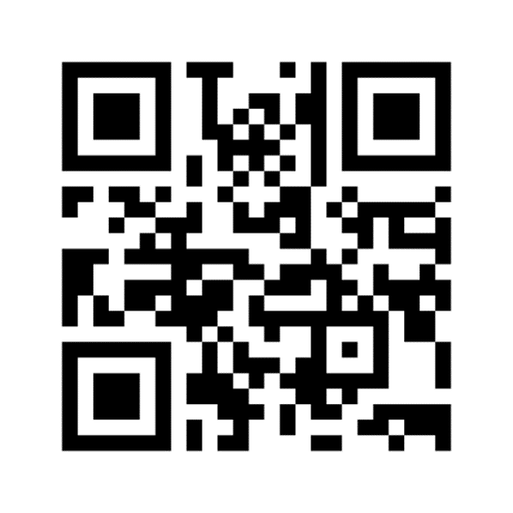
Think back…
CONNECTICUT STATE DEPARTMENT OF EDUCATION
Notes:
Judy

Slide 24
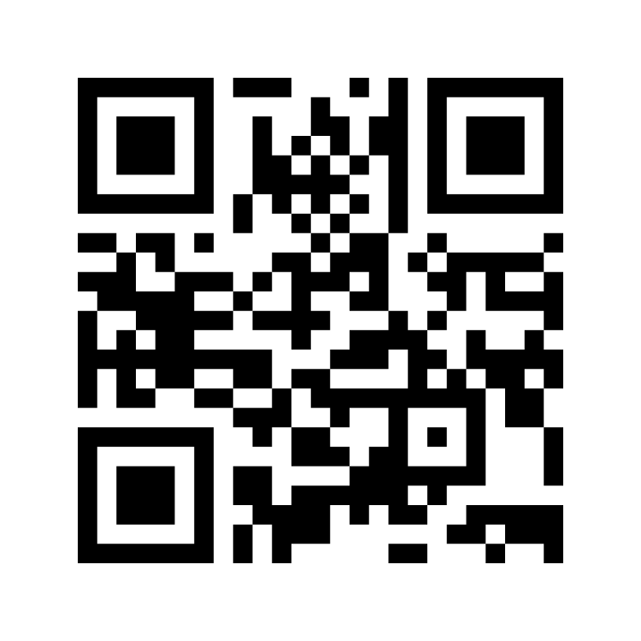
What Would It Take?
Under what conditions would you tell your secret?
Think about a person you would be comfortable sharing your secret with. What are the characteristics of that person and your relationship?
What words would you use to describe them? that relationship?
https://www.menti.com/hx2kdf8ara
CONNECTICUT STATE DEPARTMENT OF EDUCATION
Notes:
(GREG) At this time, we are going to ask you to open your phone to be directed to our first interactive piece around engagement. Iris will also place a link in the chat if you do not have a mobile option. Once you’re directed to menti.com, what word or words come to mind when you think of the characteristics of the person you would share your secret with and your relationship with them. You will be able to put multiple options in but only one word at a time. Lets take 2-3 minutes to input your thoughts.
Transition to Judy- explanation of word cloud

Slide 25
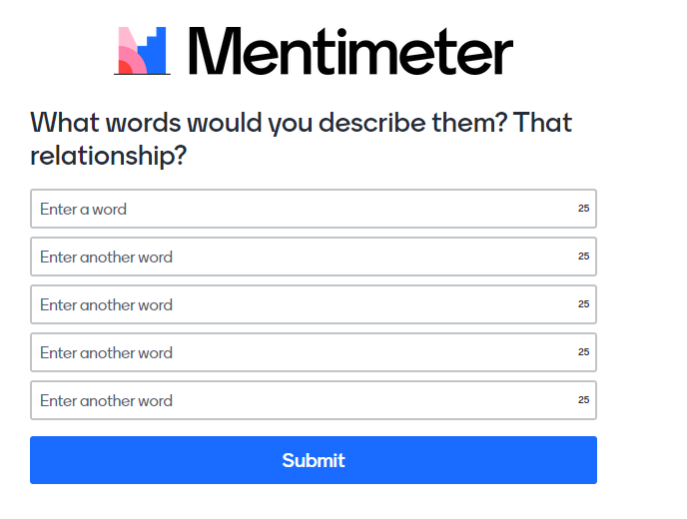

Slide 26
Four Characteristics of TRUSTWORTHINESS
Respect (Fundamental to trust) | Acknowledge another's dignity Genuinely listening and valuing the opinions of others
Integrity | Keep their word Consistency between what is said and done.
Competency | Capable Ability to fulfil an obligation
Personal Regard | Compassionate Benevolent Non-judgmental Go the extra mile
CONNECTICUT STATE DEPARTMENT OF EDUCATION
Notes:
(JUDY)

Slide 27
Why Relational Trust Matters
The development of relational trust between home and school is key for any other partnership work to actually take place.
The level of trust between families and schools is an underlying predictor of student performance.
Dr. Karen Mapp, Harvard University
Effective Family Engagement Starts with Trus
Questions for Trust Building Conversations with Families - Relationship Building Toolkit. Flamboyan
CSDE Playlist for Building Trust & Two-way Communication with Families
CT Definition and Framework for Family Engagement
What Works – Strategies for Building Trust
Welcoming: Actively welcome families and create a safe space.
Reflection Question: What might make a family feel unwelcome at our school?
Two-way Conversations: Focus on the strengths and highlight the positives.
Truly listen to families and affirm their value.
Student-Centered: Build families’ capacity to support their children’s learning and development. *
Be Trustworthy.

Slide 28
TIER 1 STUDENT AND FAMILY ENGAGEMENT / RELATIONSHIP BUILDING ACTIVITIES TAKING PLACE IN YOUR SCHOOLS AND DISTRICTS
CONNECTICUT STATE DEPARTMENT OF EDUCATION

Slide 29
Break Outs
Break Out Session
Questions:
What are promising and proven Tier 1 activities taking place in your schools and districts? What impact are you seeing?
Small Group Options:
Preschool
Elementary School
Middle School
High School
Link on Jamboard and find your page (preschool/Elem/MS/HS)
Ground Rules
Turn on your video camera
Briefly introduce yourself
Raise your hand to speak
Ask clarifying questions
Explore differences of opinion
Create space for everyone to speak (and use the chat to express ideas)
Use Jamboard to collect your ideas
Person whose last name is closest to A helps facilitates.
Person whose last name is closest to Z reports out!
https://jamboard.google.com/d/1DFDlyRPyjaY74HJbQyclQE4eGKjSSrfK0a4g_IxWoPg/viewer?f=0
Time: 20 minutes
Notes:
Preschool
Elementary School (Kari)
Middle School
High School

Slide 30
Report Out
Report out by Group
We will show the jam board
Share key strategies or insights from your group

Slide 31
Peer Sharing and Discussion
How can Districts Build School Capacity for Relationship-Building and Engagement?
(Raise your hand so we can call on you to speak)

Slide 32
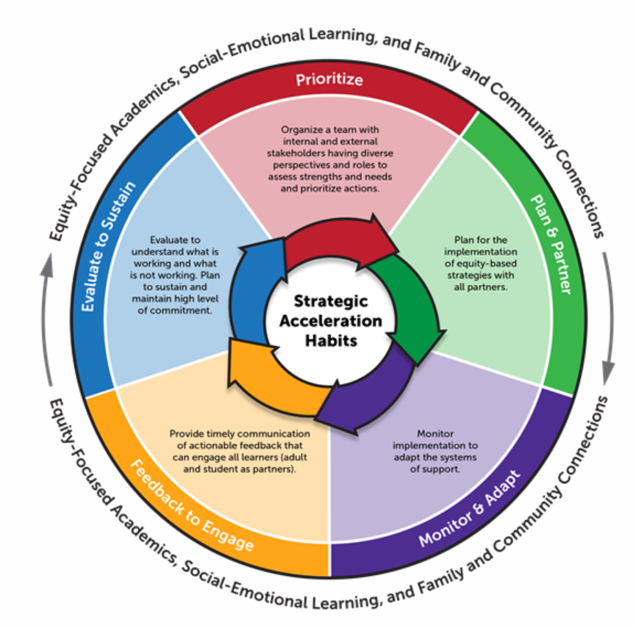
Consider drawing upon resources from Aug COP
PLAN & PARTNER:
What practice/strategy will you implement?
How are you engaging stakeholders?
Who will implement this practice – when and where?
Are there resources and professional development related to the practice/strategy readily available?
Resource to support:
CSDE - Full, Equal and Equitable Partnerships with Families
Flamboyan Foundation Resources:
Strategy Guide for Educators
School Leader Tool
Attendance Works Implementation Guide
Notes:
Moving from this step to the next into today’s CoP
Importance of understanding student/family needs when selecting strategies. Carefully select strategies based on fit, need, and capacity.
Questions to consider:
What practice/strategy will you implement? How is it matched to the needs you identified in step 1?
How are you engaging stakeholders? ESPECIALLY families and students. Multiple perspectives, more than a survey.
Who will implement this practice – when and where? Explicit expectations, communication strategy.
Are there resources and professional development related to the practice/strategy readily available? How will you support the learning?
JUDY RESOURCES – mention talk Tuesday and Flamboyan Resources

Slide 33
Support: Describe the practice in your context | Description: Describe who implements this practice and where | What Triggers this Practice: Describe when this practice is employed (i.e. under what circumstances) | How do we know/Fidelity: Describe what data we collect to determine that our staff is using the practice as indicated | How do we know it is working for Student/Outcomes: Describe what data we collect to determine that students are benefiting from the use of the practice
Welcome Phone Calls:
Quick (5 min) communication (through phone call or zoom/google meet) to welcome families in, share excitement, and positive quality/skill of student that you have noticed.
Who Implements: Certified Teaching Staff
Where: Phone or virtual platform
When: within the first 2 weeks of school
Log phone contact into powerschool (date, who conversation was with, and platform used).
School Attendance team will review powerschool log entries on Sept 30th
Staff Feedback Survey
Baseline attendance data from 2020-2021 school year:
SMARTIE Goal: 100% of students will receive a phone call prior to Sept 30.
*include targeted data
Action Steps: | By Whom? | By When?
Update Family Contact Info Sample script developed Inform Staff and train on how to log into powerschool Review Powershool entries and summarize data Gather staff feedback – develop brief survey, administer, and summarize results | Secretary Attendance Team PDAC Attendance Lead Attendance Team | Sept 2, 2021 Aug 22, 2021 Aug 24, 2021 Sept 30, 2021 Oct 7, 2021
Notes:
Here is a tool you may consider using when defining your strategies/practices. This can be use for defining all tiers of intervention strategies – academic and behavioral. I have seen SRBI teams complete this for ALL tiered interventions and strategies.
I am going to walk us through a sample/example family engagement strategy to demo how you may use this tool.
Click
Support – clearly defining the practice (link to resource shared in TT) Be mindful that for this example we may want to consider that we define the practice in a way that includes what happens before , during, and after the call.
Click
Description – who implements, how have they been engaged and informed. How will they be supported?
Click
Triggers – what’s the decision rule? Who will receive this intervention?
Click
Fidelity – How will you ensure the strategy is being implemented with integrity and as designed?
Click
Outcomes – what’s your goal you identified in step 1 of the acceleration cycle?
Click
Action Steps – all those considerations can assist in developing an action plan for your attendance team. For example for this strategy - I'd suggest that the school leader have a conversation with teachers to get buy in and set the tone that this is a relational practice - review and discuss the script, make modifications, practice, etc. Talk about implicit bias. Though implementation is important, the purpose is not just to make contact (for the sake of compliance) but to develop a foundation of trust on which to build a relationship.
Careful consideration to be intentional about choosing a strategy that meets YOUR need – go back to step 1 and ensure your strategy meets your identified root causes and needs.
Ensuring that family partnership is part of this planning – they should be at the table designing these strategies and providing feedback! This is also an opportunity to demonstrate 2 way communication – how will families be empowered and seen as assets
-Tools from Talk Tuesday – Planning tool as a fidelity check, reflection tool to progress monitor

Slide 34
Attendance & Engagement Work Group
Jay Brown Education Consultant Special Education, CSDE
Judy Carson, Education Consultant Family Engagement, CSDE
Kari Sullivan Custer, Education Consultant Attendance & Engagement, CSDE
Megan Alubicki Flick, Education Consultant English Learners, CSDE
Lauren D. Johns, Project Specialist SERC
Dr. Gladys Labas, Director Language and Equity, CSDE
Amanda Pickett, Education Consultant School Climate, CSDE
Stephen Proffitt, Director for Special Education Programs and Instructional Design, SERC
Louis Tallarita, Education Consultant Homeless Education and McKinney-Vento, CSDE
Notes:
Link to email

Slide 35
Attendance & Engagement Community of Practice Schedule
Upcoming 2021-22 Meeting Dates
12/16/2021 **Canceled
1/20/2022
2/17/2022
3/17/2022
4/21/2022
5/19/2022
6/16/2022
All CoPs will be held on the 3rd Thursday of the month from 10 to 11:30 a.m.

Slide 36
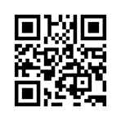
Exit Slip--Mentimeter
“What will be your next steps?
https://www.menti.com/vfb9kwv2fj

