Slide 1

Connecticut State Department of Education
Connecticut Certification Overview for Human Resources
2023
Bureau of Educator Standards and Certification
Material provided is subject to change.
Please check for updates by visiting the State Department of Education website
and/or contacting our department.

Slide 2
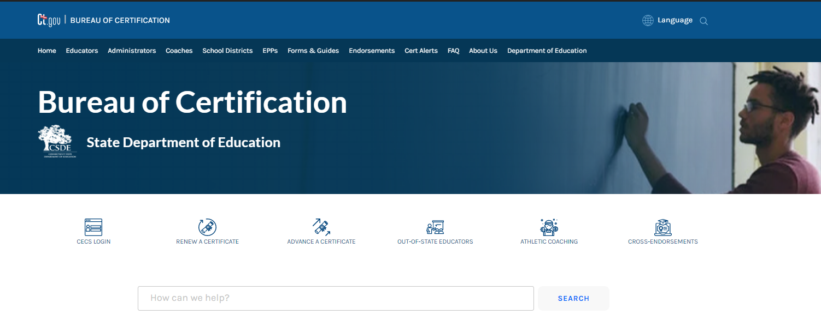
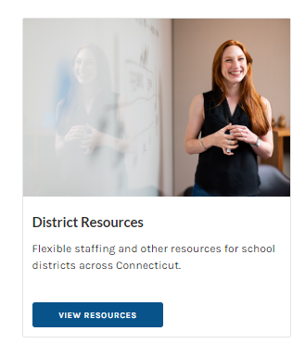
Bureau of Educator Standards & Certification www.ct.gov/sde/cert
Notes:
New Home Page

Slide 3
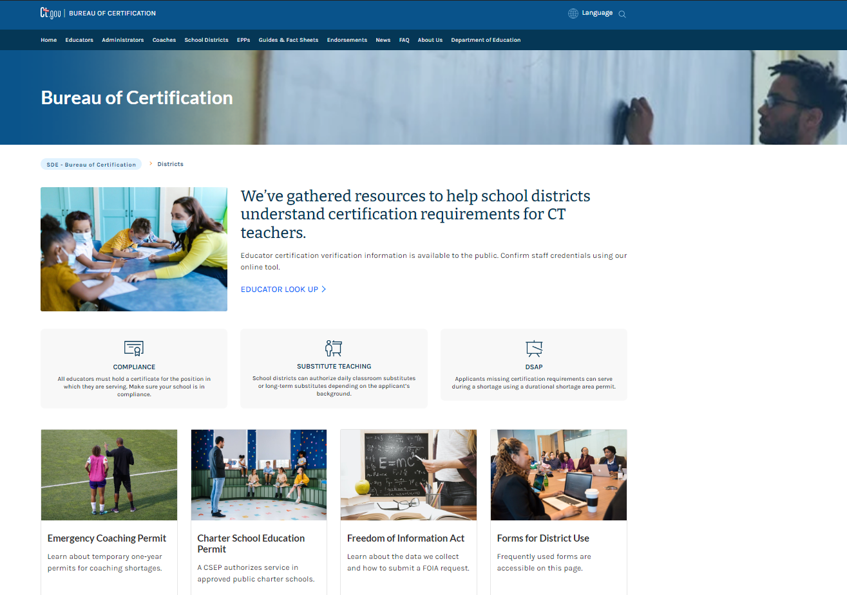
Certification Resources for Districts
Notes:
Introduce New District Resources page

Slide 4
Statutory Requirements
Connecticut General Statutes state:
“No teacher, supervisor, administrator, special service staff member or school superintendent shall be employed in any of the schools of any local or regional board of education unless such person possesses an appropriate state certificate [CONNECTICUT] nor shall any such person be entitled to any salary unless such person can produce such certificate dated previous to or on the first day of employment.” (Sec. 10-145(a))
Appropriate authorization is required prior to signing a formal employment contract.
Notes:
District may choose to start candidate as a short-term substitute…but this is only acceptable for 40 days.

Slide 5
Statutory Requirements
(Continued)
Connecticut General Statutes state:
“If the State Board of Education determines that a local or regional board of education is not in compliance with any provisions of sections 10-144o to 10-149, inclusive, and section 10-220a, the State Board of Education may require the local or regional board of education to forfeit of the total sum which is paid to such a board of education from the State Treasury an amount to be determined by the State Board of Education...” (Sec. 10-145(b))
Service without an active, grade/subject appropriate certificate places the teacher out-of-compliance and jeopardizes any potential Teacher Retirement Credit (TRB) as directed in Connecticut General Statutes, Section 10-183b(26).

Slide 6
Mandated Background Checks
CRIMINAL HISTORY
A criminal history records check is conducted by the State Police on ALL applicants seeking certification. The Bureau has no control over the timeline for routine background checks
DEPARTMENT OF CHILDREN AND FAMILIES (DCF)
C.G.S. 10-221d(g) requires a records check for ALL applicants seeking certification. If notification is received that the applicant is listed on the DCF child abuse and neglect registry, the application for the certificate, authorization or permit must be denied.
DISTRICT RESPONSIBILITY
Required to fingerprint each person hired within 30 days of employment.
If the district receives notice of a conviction of a crime by a person holding a certificate, authorization or permit issued by the State Board of Education, the district must notify the Bureau of Investigations and Professional Practices.
Note: Educators on DCF registry may work directly with DCF to be removed from registry.
Notes:
**Keep this in mind when district applies for authorizations (DSAP, coaching permits, LTS)

Slide 7
Types of Certificates
Initial Educator Certificate
Valid for three years
To advance: 10 months of appropriate service under the Initial Certificate & completion of TEAM; or 20 months of appropriate service in another state; or 30 months of appropriate service in an approved Connecticut nonpublic school
May be renewed if educator has not served under the certificate
Provisional Educator Certificate
Valid for eight years
To advance: 30 school months of successful service under the Provisional Certificate in Connecticut and advanced coursework
May be renewed if educator has not met requirements to advance.
Note: to advance an #092 certificate to professional requires 30 credits beyond master’s degree
Professional Educator Certificate
Valid for ten years
Notes:
An application must be submitted PRIOR TO EXPIRATION of existing certificate to prevent lapse.

Slide 8
Types of Certificates
(Continued)
Temporary Certificates/Permits/Authorizations
Nonrenewable Interim Educator Certificate
Temporary 90-Day Certificate
Resident Educator Certificate
Durational Shortage Area Permit (DSAP)
Visiting International Teacher Permit (VITP)
Long-Term Substitute Authorization
Temporary Authorization for Minor Assignment
Charter School Educator Permit (CSEP)
Military Spouse Teacher Permit
Notes:
Details on each of these certificates to follow – forms for these authorization are on District Resources page

Slide 9
Assessment Deferral
Nonrenewable Interim Certificate
Issued at the Initial or Provisional level
Must meet all certification requirements other than assessments
Valid for three years
Must pass all deferred assessments prior to the expiration date to prevent lapse in certification
If all deferred assessments are met prior to the expiration date of the interim certificate, deficiencies are removed, and a new certificate is issued. If certificate expires prior to testing being met, a new application must be submitted.
*Applicable to candidates who do not qualify for testing waiver*
Notes:
If interim certificate expires before test requirements have been met, a new application will be required.
Districts should monitor educators holding nonrenewable certificates.

Slide 10
Transitional Certification
Temporary 90-Day Permit
Issued to candidates who have completed an approved Connecticut alternate route to certification program:
Requires district request (ED 172); candidate must be entered in EDS
90-Day period can start no earlier than date the application is submitted to CSDE
When calculating 90-day period, do not include holidays or weekends
Position should ideally be one expected to extend beyond the 90-day period
All assessment requirements must be met; no testing deferrals
Following the successful 90-day period, candidate applies for Initial Educator Certificate (ED 172A); district attestation to successful service under 90-Day Certificate should be signed no earlier than two weeks prior to the expiration of the 90-Day Certificate
Notes:
- If position is part-time (less than 0.5 FTE), two consecutive 90-Day Certificates will be required.
- Currently applicable to OHE ARC and Charter Oak (some older Relay graduates)

Slide 11
Transitional Certification
Resident Educator Certificate
Available to candidates enrolled in an approved program with an established residency model:
Valid for two years; may be extended for one additional year
Requires district submission of form ED 199 and program submission of ED 199 Attachment
Requires at least one of the following:
Passing scores on all assessments required for endorsement; or
Major or 30 credits in endorsement area; or
Completion of at least one year in the residency program
Following at least one year of successful service as teacher of record under Resident Educator Certificate, candidate then applies for Initial Educator Certificate with form ED 170A
Notes:
Candidates may start as teacher of record or in other position but must serve as teacher for at least one year to transition to Initial.
Currently: Relay and CREC Residency (available to all EPPs who have established a residency format)

Slide 12
Durational Shortage Area Permits
Required Qualifications
Bachelor’s degree from an accredited institution
12 semester hours of credit in the subject/endorsement area sought
Enrollment in approved certification program, if required (many cross endorsements do not require enrollment in a program)
District must apply for the DSAP
Application ED 177
ED 177 Attachment (evidence of enrollment) requires signature of both the district and the certification officer
Option for first issuance without support of institution
Not ideal; be very thoughtful in considering
In lieu of ED 177 Attachment, candidate must confirm enrollment and provide a full plan of study toward program completion
Only valid for service in the requesting district
May be renewed twice if:
District submits new ED 177 requesting reissuance
Candidate has made progress in program (completed an additional nine credits during previous DSAP period)
Note: Renewal of DSAP for Special Education (#165) requires passing score on the Praxis II Special Education test
Notes:
PLEASE confirm required qualifications have been met before requesting DSAP.
* 062 DSAP, the 12 credits must be at the graduate level unless candidate is enrolled in ARCLMS (ACES).
* 102, 112 and 113 endorsements require enrollment in planned program even though they are cross-endorsements.
* Administrative DSAPs (092, 097) requires enrollment in approved planned program – admin endorsements are issued separately; they are not cross-endorsements.
* DSAP may be issued for out-of-state programs
* May be requested in any subject area

Slide 13
Visiting International Teacher Permit (VITP)
Issued for one year – renewable up to four times, as long as the candidate holds the J-1 visa
Teachers come from Spain, China and other countries via approved US Dept of State exchange programs under J-1 Visas
Issued only in academic content areas designated as shortage areas, and in bilingual education
Candidates are fully certified in their home country, most have master’s degrees and at least 2 years of teaching experience
Passing scores on ACTFL OPI in English or approved equivalent required
District Responsibility: work with sponsoring agency, provide salary and benefits, provide mentoring, support and professional development
For additional information, email Wendy.Harwin@ct.gov
Notes:
For the teacher to stay beyond the 4 years allowed, they must meet all requirements for full teacher certification.
Cannot be issued for SpEd
PROCESS:
Submit an ED 170 with “Visiting International Teacher Permit” written at the top. No fee required. Must be accompanied by a letter signed by the superintendent, requesting the VITP for the specific individual. Letter must include Specific dates of service; Description of the position and specifically what the educator will be teaching at which grade levels; Statement that district support will be provided to the visiting teacher.

Slide 14
Substitute Authorizations
Daily Substitutes w/Bachelors Degree
Hired at the local level; require no authorization from CSDE
Cannot exceed 40 days in the same assignment during the school year*
*Can only serve as “Ms. Smith, grade 4” for 40 days in the academic year
Daily Substitutes w/out a Bachelors Degree
Minimum requirements: At least 18 years old, high school diploma or equivalent, and experience with school-age children
Cannot exceed 40 days in the same assignment
Districts apply directly through website (Qualtrics Survey)
Long-Term Substitute Teacher Authorization
For service in the same assignment for 40+ days in a given school year
You cannot remove someone after 39 days and then place them back in the same position for another 40 days
Requires bachelor’s degree and 12 credits in the subject area
Cannot be issued for special service or administrative endorsements
Form ED 175
Notes:
PLEASE confirm required qualifications have been met before requesting LTS.

Slide 15
Special Authorizations
Emergency Endorsements (2023-24 will only be available to Provisional & Professional cert holders)
Available only to educators who hold a valid Initial, Provisional, or Professional teaching certificate
District must provide rationale and supports that will be made available to the teacher
Service under an Emergency Endorsement is applicable for TRB credit
Types:
Emergency Generalist, PK-8 (#201) – extends EC, elem, or middle school endorsement to cover all content in grades PreK-8
Emergency Generalist, 7-12 (#202) – extends middle school or secondary endorsement to cover all subject areas (grades 5-12)
Emergency Teacher of English Language Learner (#204) – allows TESOL, World Language, or Bilingual certified educators to teach bilingual education and/or TESOL
Emergency PreK Authorization for Comprehensive Special Education (#205) – extends K-12 Special Ed endorsement to PreK
Temporary Authorization for Minor Assignment (TAMA)
Candidate must have a primary assignment in the district in an area for which they hold a valid certificate
Authorizes educator to teach up to 2 periods per day in separate subject area
Requires 12 credits (6 with good cause) in subject area for which the minor assignment is requested
Educators who hold only elementary certification are not eligible
Notes:
TAMA used primarily in middle and secondary schools where subjects are departmentalized.

Slide 16
Additional Authorizations
Charter School Educator Permit (CSEP)
Only authorizes service in a specific charter school – noted on permit
Requires a bachelor’s degree and passing scores on all tests corresponding to the endorsement sought
Length of permit aligns with the school’s charter dates
Experience under a CSEP cannot be accepted to waive recommendation for regular certificate
Educators serving under CSEP cannot contribute to TRB
No more than 30% of staff in a charter school may serve under a CSEP
Military Spouse Teacher Permit
Available to educators whose spouses have military orders directing them to Connecticut
Educator must document at least two years of successful teaching experience in another state, under a valid certificate
Valid for a period of three years
Does not require Connecticut assessments to be met
May be renewed, as long as educator documents completion of the 36 clock-hour course of study in special education

Slide 17
Certification Flexibility
Kindergarten Authorization and Birth to Three Authorization
Educators who hold an Elementary, 1-6 (#305) certificate can request approval from Commissioner to serve in kindergarten for one school year
Educators who hold a comprehensive special education, integrated early childhood and special education, partially sighted, blind, or hard of hearing endorsement can request approval from Commissioner to serve in a Connecticut Birth-to-Three program
Online application is available on District Resources page (Qualtrics Survey)
Science Crosswalk – Explains which science endorsements authorize the teaching of various science classes

Slide 18
ParaEducator Equivalency
Paraeducator Equivalency for Temporary Special Education Authorizations
A district may pursue a Temporary Authorization (Long Term Substitute or Durational Shortage Area Permit) in special education for someone who has served successfully for at least 20 months as a special education paraeducator.
Candidate must meet all other requirements for corresponding temporary authorization (e.g., hold a bachelor’s degree, enrolled in an approved program)
Para experience can be accepted in lieu of the 12 credits normally required for issuance of a DSAP or LTS
Recommending institution does not accept experience toward requirements for full certificate
Notes:
20 months under a #165 CSEP is also applicable.

Slide 19
Out-of-State Applicants
RECIPROCITY AGREEMENT
Applicable to Delaware, District of Columbia, Maine, Maryland, Massachusetts, New Hampshire, New Jersey, New York, Pennsylvania, Puerto Rico, Rhode Island, Vermont, and Virginia
Candidate must hold valid certificate in other state that is equivalent to at least our Initial Certificate
Allows for issuance of closest equivalent endorsement (e.g., Elem, PK-6 in other state = Elem, 1-6 in CT)
Exempts educator from Connecticut testing
Administration and special service candidates must verify applicable graduate degree
Experience in other state required to determine level of Connecticut certificate
Notes:
Applicants will receive closest comparable CT endorsement – some states offer endorsements for which CT does not have a comparable endorsement
Examples :
Elementary 1-8 program may result in issuance of our Elementary 1-6 endorsement.
PK-3 program may result in Elementary, 1-6 (not necessarily #113)

Slide 20
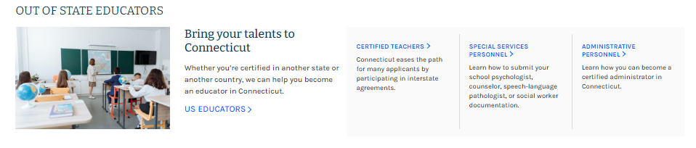
Out-of-State Applicants
(Continued)
INTERSTATE AGREEMENT
Facilitates certification of teachers and special service educators from other states
Applicable to all 50 states, D.C. and Puerto Rico
Does not waive degree, experience, or assessment requirements, although some out-of-state tests may be accepted as equivalent and/or assessments may be deferred for three years
Agreement does not apply to administrative certificates
You may direct candidates to the “Out of State Educators” section of the website
Notes:
Applicants will receive closest comparable CT endorsement, based on their out-of-state program.
Programs must be reviewed by our consultants on a case-by-case basis.
Examples : Elementary 1-8 program may result in issuance of our Elementary 1-6 endorsement.
PK-3 program may result in Elementary, 1-6 (not necessarily #113)

Slide 21
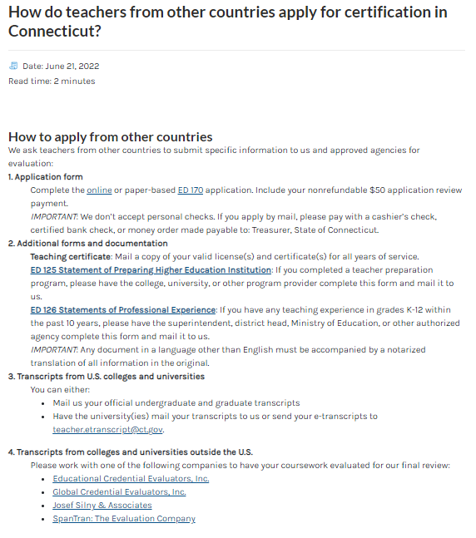
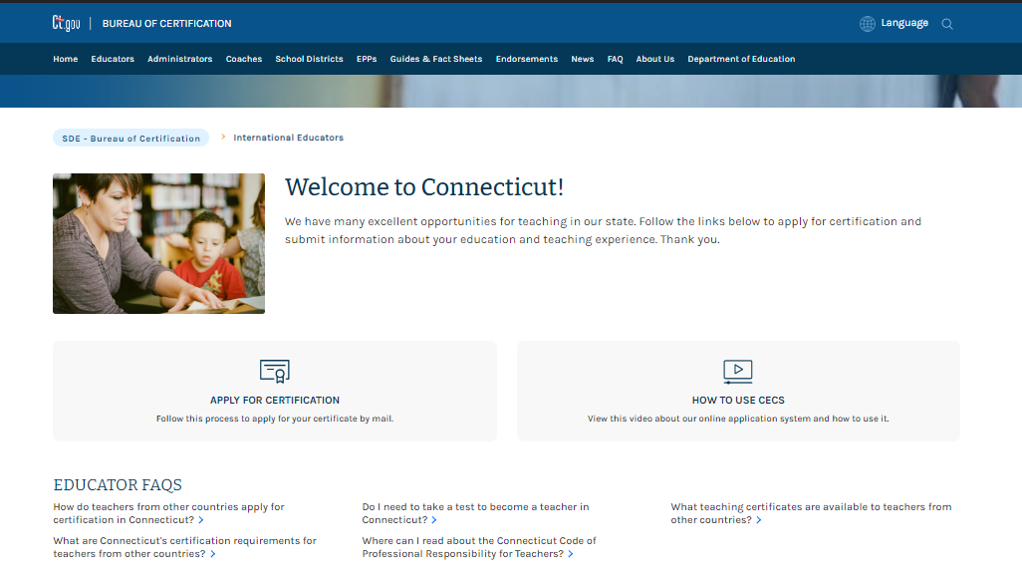
International Applicants
Information is available under the “Educators” tab on the main page of our website
Foreign credential analysis is mandatory for review
Be aware that processing will take longer
Notes:
Transcript analysis is required for ALL permits, including those that only need a HS diploma

Slide 22
Assessment Exemption
For out-of-state applicants who do not qualify for certification via enhanced reciprocity
Educator must hold a valid certificate in another state (equivalent to at least a CT Initial Educator Certificate); and have one of the following:
Three years of successful, full-time, appropriately licensed teaching experience in the endorsement area sought, within the past 10 years; or
A master’s degree in the academic subject area for which certification is sought. Note: Pedagogical degrees (elementary education, special education, etc.) are not applicable.

Slide 23
Cross-Endorsements
Designated Subject Shortage Areas* only require passing Praxis II/ACTFL scores to be eligible for the cross-endorsement:
Mathematics (middle and secondary)
Science (middles and secondary)
World Languages (secondary)
Technology Education (PK-12)
Computer Science (P.A. 19-128)
History & Social Studies (middle and secondary as of July 1, 2023)
*Not applicable to: Special Education, TESOL, School Library Media, Bilingual or Special Service areas
Requirements to add other endorsement areas include both coursework and testing
To add one of the integrated early childhood endorsements or the remedial reading endorsement, completion of an approved program (leading to institutional recommendation) is required
Special service and administrative certificates are issued separately and cannot be added as a cross-endorsement

Slide 24
Validity of Certificates
Integrated Early Childhood/Special Education:
#112 authorizes regular and/or special education in Birth to K settings
#113 authorizes regular education in PreK – grade 3 and special education only in grades PreK/K
Elementary and Middle Grades endorsements:
May teach only grades and subject area(s) covered by the certificate
May not teach up or down a grade level
Elementary (#013) authorizes K-6 only
Elementary (#305) authorizes 1-6 only
Elementary Bilingual (#902):
Authorizes teaching in grades K-9
Secondary Subjects, Grades 7-12:
May teach subject down to grade 5 in a departmentalized setting
World language endorsements authorize teaching of the language down to grade 4
Notes:
Strict guidelines – for an educator to serve outside their area(s) of certification – even for one period – they must hold an appropriate authorization.

Slide 25
Obsolete Endorsements
PK-8 (001)
PK-6 (002)
PK-3 (003)
Grades 1-8 (004)
Elementary K-6 (013)
Middle Grades 4-8 (006)
Although no longer issued to new educators, these endorsements still authorize the teaching of all academic subject areas in grades listed
Bilingual, PreK-12 (009)
Although no longer issued to new educators, this endorsement still authorizes the teaching of all academic subject areas to bilingual students
Notes:
Current middle school endorsements are subject-specific
Former endorsements authorize the teaching of all academic subjects.

Slide 26
Coaching Permits
Any athletic coach of intramural or interscholastic athletics in elementary, middle or high schools, must hold a valid coaching permit, regardless of coaching assignment or compensation.
Five-Year Renewable Coaching Permit
Requested by candidate (ED 185)
Requires a valid CT Educator Certificate or completion of approved 45-clock hour coaching course
Valid First Aid and CPR (online only not acceptable)
Renewal requires 15 clock hours in workshops, seminars or coursework
Temporary Emergency Coaching Permit
Requested by district (ED 186)
Valid for service in requesting district only
May be reissued one time with proof of enrollment in a coaching course
First Aid and CPR completed within one year of application (online only is not acceptable)
All coaching permits require concussion and head injury training (module 15) from CIAC.
Concussion refresher module required every five years.
Notes:
APPLY EARLY – do not wait until right before season starts! Background checks often take at least 4 weeks to clear.
NOTE: Current CPR/First Aid is required to obtain the five year permit; however, most CPR/First Aid must be renewed every two years. Be certain your coaches are keeping these up-to-date as well.

Slide 27
Lapsed Certificates
Encourage all certified staff to monitor their certificates to avoid a lapse
Encourage all certified staff to regularly confirm contact information is correct in the CECS
Lapse in certification may result in:
Testing to regain endorsement
A change in endorsement (may lose authorization to teach certain grades)
An impact on teacher retirement contributions
Compliance issues for the district
Educators are responsible for maintaining their certificates (renewing and/or advancing the certificate)
Districts are encouraged to monitor certification status by running report for “expiring certificates”

Slide 28
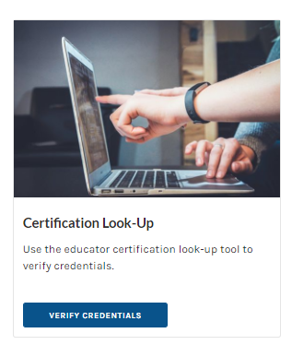
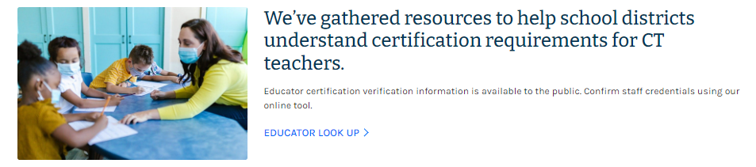
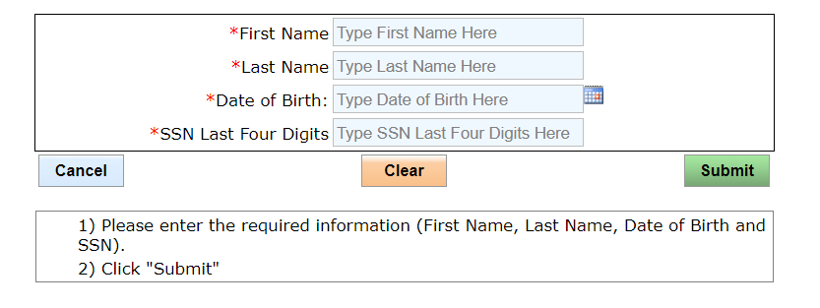
Educator Certification Look-Up
Public Look-Up is located at the bottom of the Certification Main Page
District Look-Up is located at the top of the District Resources page and allows you to print a copy of the certificate

Slide 29
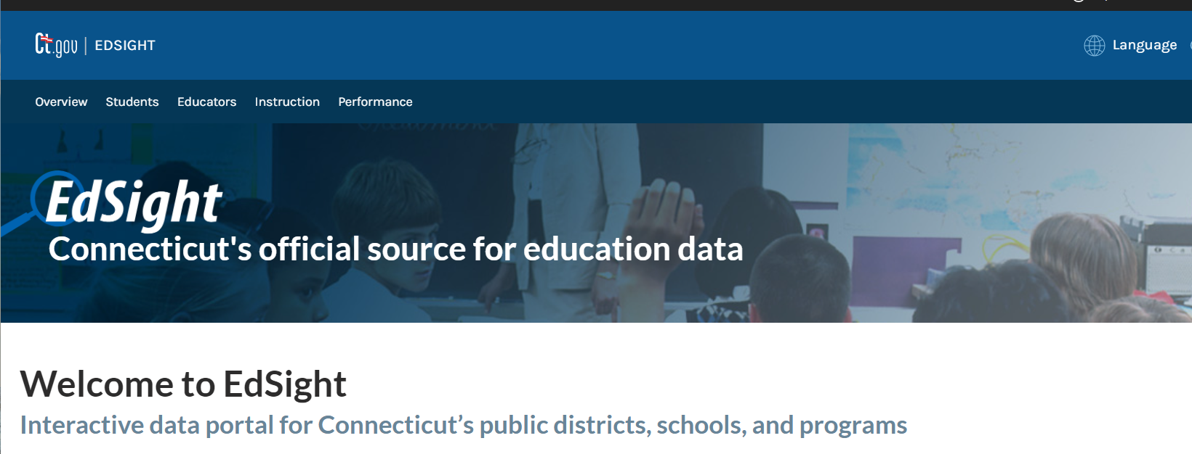
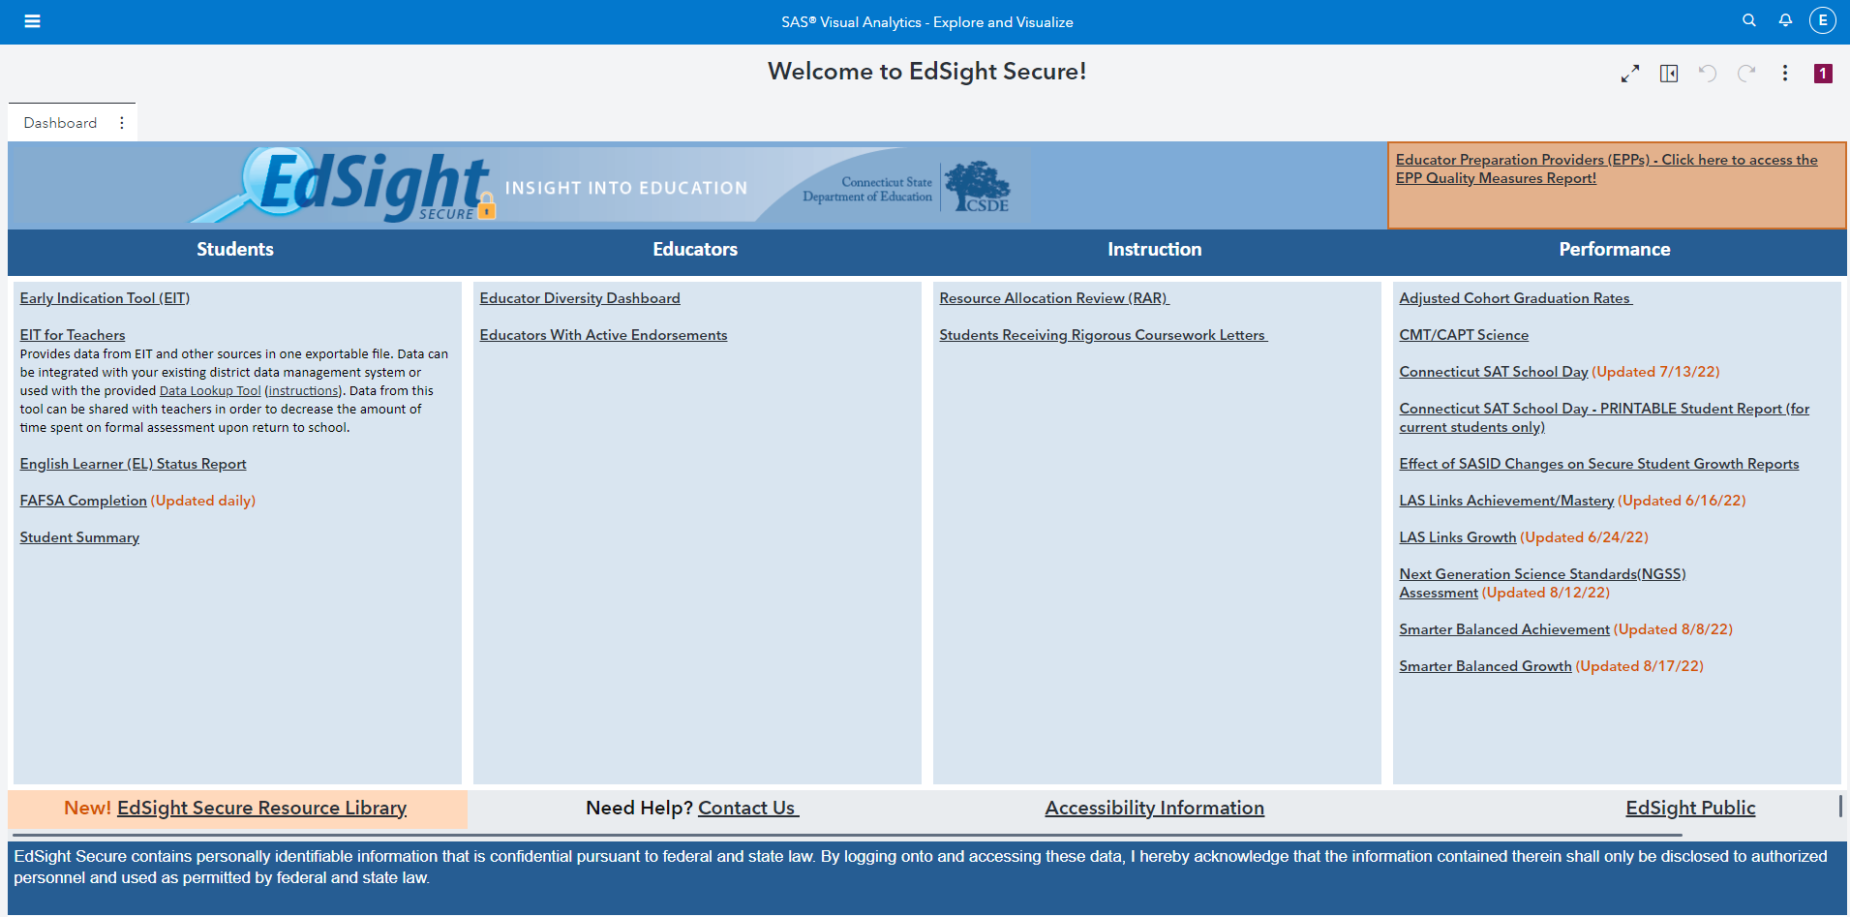

EdSight Secure – Active Certificate Search
To create a list of certified educators for the purpose of recruitment, start on the main EdSight page.
The login for EdSight Secure is at the bottom of the page.

Slide 30
Annual Compliance Review
Annual Certified Staff File Information (EDS)
+
Annual Certification Database Information (CECS)
=
Annual Compliance Report
(Certification Verification Survey)
Educators must hold an appropriate certificate for the position(s) in which they are serving.
The CSDE no longer sends a fall report to districts, as compliance status is continuously available in the EDS.
Use the appropriate assignment code to reflect educator’s position.
Districts with educators serving in “unlisted teaching” or “unlisted non-teaching” positions are listed under separate 90990/90995 report. Use of these assignment codes requires prior authorization from the CSDE.
Districts are expected to regularly monitor compliance status throughout the entire school year.
Educators who remain out of compliance will be notified in the spring, in writing. If compliance is not resolved, both the district and TRB will be formally notified of this noncompliance at the end of the school year.
Notes:
Accuracy is vital, as it impacts educators’ certification and retirement contributions.

Slide 31
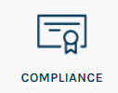
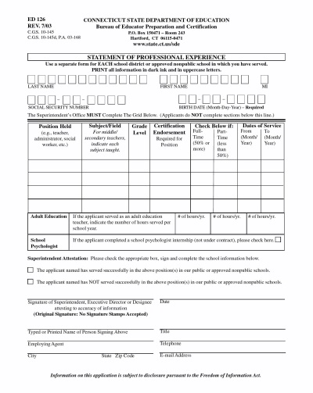
Assignment Codes
Each certified staff member should be entered into the EDS with the assignment code(s) that best represents their particular position(s).
Please refer to assignment code descriptions list for guidance (located under “Compliance” link on District Resources page of the website).
Review the assignment codes each year, as additional categories are often added.
If unsure of correct code, email full job description to juliannefrost@ct.gov for review.
Information in the EDS must align with information provided to the Bureau of Educator Standards and Certification on ED 126 forms.
The CSDE relies on accurate entries in the EDS to determine both educator compliance and their eligibility to obtain, maintain, and advance certificates.
A written explanation will be required from the district if there are inconsistencies between the assignment in the EDS and the position listed on ED 126.
Notes:
Accuracy is vital, as it impacts educators’ certification and retirement contributions.

Slide 32
Statement of Professional Experience (ED 126)
List only endorsement(s) under which the educator has served; educator will not lose an endorsement because they haven’t worked under it.
If educator served in multiple assignments, each should be reflected in the EDS, and district should list experience on a separate line of the ED 126 form (e.g., classroom teacher and department chair).
Include percentage of time for each assignment (FT = 0.5 FTE or greater / PT = less than 0.5 FTE)
List leave of absence on a separate line of the ED 126 form.
ED 126 grid should not be completed by the educator; central office must provide all information
Must include signature of Superintendent unless a letter authorizing another designee is on file with the CSDE
Remember to indicate successful/unsuccessful service
May be submitted by district to SDEdistricts.cert@ct.gov
Successful vs. Unsuccessful Service:
District determines whether service was successful or unsuccessful
Examples of unsuccessful service: misconduct; failure to meet district expectations
Unsuccessful service will require written district explanation
Unsuccessful service is not counted for advancement but will not necessarily result in loss of certificate
Notes:
Requested less often now that successful service is verified in the EDS

Slide 33
Common Compliance Errors
Check that the assignment code and grade levels are in agreement (e.g. “elementary” assignment code cannot be used for
kindergarten or grade 7 position)
Pay attention to the endorsement that authorizes the position (e.g. an elementary certified educator teaching math in
grade six should be entered with “elementary” assignment code, while a middle or secondary math certified educator
teaching math in grade six should be entered with the “mathematics” assignment code)
Use of “S” for grade level indicates a systemwide administrative position. If educator is providing service across all
grades levels, list all of the grades
Educators serving in multiple roles will likely have more than one assignment listed (e.g. teaching 0.8 FTE and
department chair 0.2 FTE)
Intervention/Academic Support is authorized under grade or subject-appropriate endorsement
Administrative endorsements do not authorize teaching
Take note of “remedial reading” vs. “non-remedial reading” assignment codes (remedial reading requires #102)
Curriculum/Program Director (#092) vs. Reading Consultant (#097)
Occupational Subjects (#098) vs. Technology Education (#047)
Notes:
Accuracy is vital, as it impacts educators’ certification and retirement contributions.

Slide 34
Approved Designees
District-based forms can only be accepted if signed by the Superintendent/Executive Director or someone who has been appointed as a designee
CSDE maintains a list of approved designees for each district; notify us of any changes (i.e. authorized staff no longer serving in the district should be removed/newly appointed designees should be added)
The Superintendent or Executive Director should submit any designee changes in writing, to the designated district email address

Slide 35
Formal Appointment of a Superintendent
Districts must notify the Connecticut State Department of Education and receive approval for any person serving as Superintendent or Interim Superintendent.
Process of appointing new superintendent:
District Board Chair submits letter to the Commissioner of Education
Letter of approval is then sent to the Board Chair

Slide 36
Human Resource Best Practices
Designate time during the August and January professional development meetings for certified staff members to log into the CECS account to check certification status and update their contact information.
Note: The CSDE no longer sends notification letters to educators regarding their certification’s expiration date.
Contact our office to inquire about specific applicants for temporary authorizations, and the appropriate authorization to cover the assignment (e.g., LTS vs. DSAP).
Once certification alerts are sent to superintendents, the CSDE also sends them directly to our district HR partners. Please ensure that we have the appropriate contact email to ensure these HR alerts are being received.
Notes:
Second bullet: ED 177 first, then ED 175. we will use the original submission date.

Slide 37
Contact Information for the Public
Website: www.ct.gov/sde/cert Email: teacher.cert@ct.gov Telephone: 860-713-6969 (Monday & Thursday, Noon – 2:00 p.m.)
Submission of Documents
Electronic Transcripts: teacher.etranscript@ct.gov
Paper Transcripts, Signed Forms, and All Other Documents:
Mailing Address: Street Address:
Bureau of Educator Certification Bureau of Educator Certification
P.O. Box 150471 450 Columbus Boulevard
Hartford, CT 06115 Hartford, CT 06103
(Lobby Hours for leaving materials in SDE Drop Box:
Monday-Friday, 8:30 a.m.-4:30 p.m.)

Slide 38
Contact Information for District Personnel
Website (District Resources):
https://portal.ct.gov/sdecertification/Districts?language=en_US
Email: SDEDistricts.Cert@ct.gov
Designated Superintendents’ Telephone Lines
NOTE: Please DO NOT share the designated district email address or designated phone numbers with the public
Notes:
Superintendents are given designated numbers to then share with whom they choose.

Slide 39

Questions?

