Slide 1


Slide 2
Connecticut Behavioral Health Partnership (CT BHP)
A contract structure that is unique in the country, allowing for a multi-agency approach to problem solving and to address seemingly intractable system concerns, resulting in significant positive outcomes. Examples include:
The Department of Children and Families (DCF), the Department of Mental Health and Addiction Services (DMHAS), and the Department of Social Services (DSS), contracting with Beacon Health Options as the Administrative Services Organization (ASO)
Behavioral Health Oversight Council and subcommittees created in statute as an advisory body
True provider partnerships developed over the years
Alignment of contract and contract incentives designed to increase access and improve member outcomes

Slide 3
CT BHP – At A Glance
Features:
Innovative analytic capacity with deep quality and reporting resources
No claim payment
Foreign Network that we “co-manage”
Covered Lives: 800,000+
Contract Type: Administrative Services Only
Cost Plus
Withholds and Performance Standards
Year Started: Effective 2006; renewed and expanded in April 2011, just extended through 2020
Covered Services: Management of core services covered under Medicaid and grant-funded community services, including management of:
For Youth: DCF residential care, intensive home-based services, PRTF, child state inpatient care, autism services
For Adults: Outpatient, Inpatient, IOP/PHP, Detox
Geography: Statewide
CT

Slide 4
Beacon Recovery Model
As CT BHP administrator, Beacon ascribes to a recovery and resiliency model in developing and delivering its programs, services, member and family engagement, provider relations, and performance goals. These standards are based on the Substance Abuse and Mental Health Services Administration (SAMHSA) Eight Dimensions of Wellness to maintain recovery and support growth in resiliency over time:
Engagement-focused | Recovery-oriented
Person-centered | Relationship-focused
Trauma-informed | Strength-based
Solution-focused | Whole-person focused
Culturally competent | Affiliation/community focused

Slide 5
Medicaid Covered Behavioral Health (BH) Services for Youth
Psychiatric hospitalization
Observation
Partial Hospitalization Program (PHP)
Crisis Stabilization Bed (CARES unit)
Psychiatric Residential Treatment Facility (PRTF)
Residential Treatment Center for Children through DCF
Child Group Homes through DCF
Home-Based Services for Ages 21 and under
Children in Congregate Care for DCF
Case Management for Ages19 and under
Outpatient Services
Intensive Outpatient Services (IOP)
Autism Spectrum Disorder Services
Psychological Testing, and
Home Health Services for Behavioral Health Issues

Slide 6
Specialty Youth Programs Administered by Beacon

Slide 7
Specialty Youth Programs
Ensure a person/family-centered, strength-based approach, focused on member success and recovery, prominently factoring social determinants of health
Consistent use of evidence-based recovery, clinical and operational protocols
Experienced clinicians, care coordinators, peers, and administrative staff with expertise in behavioral health
Access to specialty Behavioral Health providers and facilities
Integrated care coordination with primary care and social supports, inclusive of regular clinical dialogue with Community Health Network (CHN) nurses and physicians
Outcomes monitoring, comprehensive reporting, and informed data analytics to support and improve individual outcomes

Slide 8
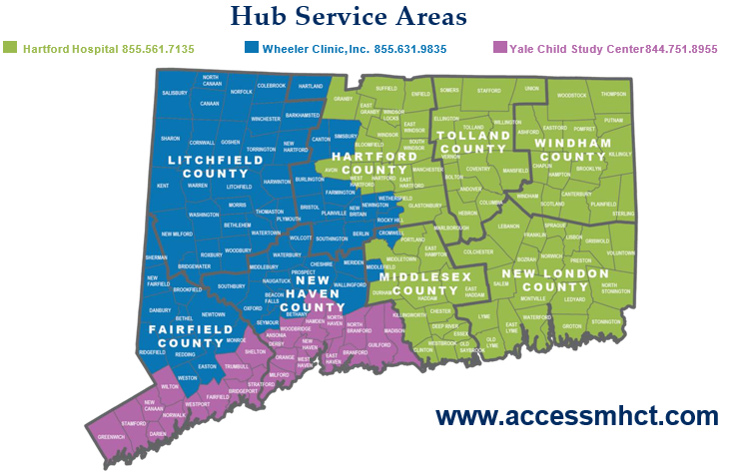
ACCESS Mental Health: Celebrating Four Years!
ACCESS Mental Health CT provides free, telephonic consultation to PCPs treating children with BH concerns, regardless of insurance status. Our psychiatrists, clinicians, and care coordinators provide valuable PCP education on mental health assessment, treatment, and access to community resources, while our peer specialists help members and their families navigate the BH delivery system.
Program increases
PCPs’ BH knowledge
base so they can
identify and treat
mental health more
effectively and
expand their aware-
ness of local BH
resources and
supports.

Slide 9
Intensive Care Coordination (ICC) Services
ICC’s goal is to support families in keeping children with complex behavioral and mental health challenges in their natural and community settings. Intensive Care Coordinators and Peers provide direct community-based, non-clinical support to youth through age 17 who:
    Have serious BH needs returning to the community from congregate care or other treatment setting (ED, Inpt, PRTF) and need discharge planning support
    Are at risk of out of home placement
    Frequently utilize EDs and/or psychiatric inpatient care
    Are in need of community-based, family-driven plan of care to maintain within their home/community
Using the evidence-based Wraparound Practice Model, ICC assists and supports families to develop a sustainable team and effective plan to meet their vision and address the needs of the whole family

Slide 10
ICC Services (Con.)
ICC staff meet with families weekly at the their home or in the community
Identify their needs through screening and assessment
Enhance connections with community supports
Provide education on navigating the mental health system and self advocacy
With lived experience, the Family Peer Specialist promotes engagement, education, and empowerment with the family by providing the necessary tools for recovery and resiliency
Network Managers assist with regional based service system development

Slide 11
Autism Spectrum Disorder (ASD) Services
Beacon has been managing ASD since Jan 2015
Members with HUSKY A, C, and D under age 21 are eligible for evaluation, behavioral assessment, and treatment services
Clinical Care Managers are Licensed Clinicians who authorize in-home Applied Behavioral Health Analysis (ABA) services
Care Coordinators and Peers provide individual/family supports connecting them to community providers for in-home ABA services and resources
They also help families gather documentation necessary to confirm eligibility for ASD services
They help address barriers to coordination of care specific to ABA services
NOTE: Any HUSKY member can receive support from an ASD Care Coordinator or Peer

Slide 12
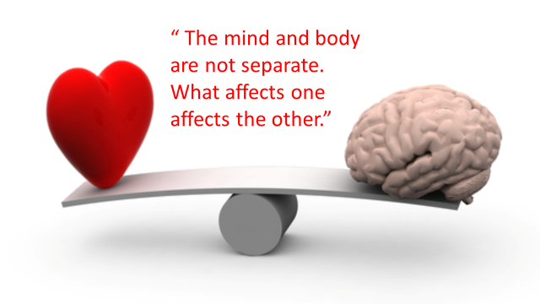
Medical/Behavioral Health Co-Management

Slide 13
Co-Management with CHN-CT
Since January 2018, Beacon collaborated with the Community Health Network of CT, the medical ASO, on over 3,000 co-managed medical/behavioral health cases
We have been co-managing cases since contract inception in 2006, with approximately 3,000 referrals per year. Enhanced tracking of such cases was implemented in 2011
Beacon participates in Complex Care Rounds which have representatives from all ASOs participating to ensure a holistic approach to care coordination
We also participate in Complex Member Collaboratives attended by CT BHP, CHN, and the Department of Social Services (DSS)
Although the vast majority of medically involved behavioral health cases are adult, we manage a significant number of youth, especially in the areas of eating disorders, diabetes, and sickle cell anemia

Slide 14
Co–Management Case Study
Sam is a 17 year old male with an eating disorder. He was adopted at age seven and in treatment for both medical and behavioral health issues, as well as significant educational problems. In early January of 2018, his case was referred to the co-management team by CHN as Mom was not able to locate a PCP to address his eating disorder issues. After consulting with Mom, CHN and the office of the healthcare advocate (who also communicated with the school system), Sam was connected with the Eating Disorder program at Rockville General for a full evaluation and inpatient admission; he has since been connected with their IOP and PHP. Originally, Mom was seeking out-of-district placement from the Board of Ed but this youth has been able to remain at home and in his community thanks to the work of all the providers involved in care coordination

Slide 15
First Episode Psychosis (FEP)
Background
  Evidence supports effectiveness of early intervention for FEP
  The Substance Abuse and Mental Health Services Administration (SAMHSA) directive to set aside 10% of Mental Health Block Grant for Serious Mental Illness (SMI)
  CT DCF contracted with Beacon to identify, refer, & follow-up
Connecticut FEP Program
  Utilize claims data to identify potential FEP Medicaid members
  Produce a monthly ‘triage report’ that is used internally
  Utilize internal identification methods (e.g., real-time referrals)
  FEP ICM (1) outreach to identified members, offer referrals and support
  Refer to evidence-based programs, when possible, or to other appropriate treatment and services
  Utilize predictive modeling to better identify members
  Assess readiness of provider network to adopt best and evidence-based FEP practices

Slide 16
Resources to Link Services and Supports

Slide 17
Intensive Care Management
For members with more complex, higher risk, and/or persistent disorders, who have been unable to stabilize with standard care management strategies, Beacon utilizes Intensive Care Management. ICM is a short-term program, in recognition of community providers’ ability to best deliver the ongoing support necessary to maintain long-term recovery.
Our ICM intervention involves a team of licensed Intensive Care Managers and Peer Support Specialists with lived experience who work together to provide a person-centered, strength-based, holistic approach to recovery.
Eligibility for ICM Services include but are not limited to:
Members with high rates of acute care services (four or more admissions to acute care within six months or three admissions within 90 days)
Increased use of emergency department (ED) and inpatient admission
Delay in discharge due to a barrier in treatment or placement
Pregnancy and dual and/or substance use diagnoses
History of difficultly engaging with the treatment system
Multi-state agency involvement
Individuals requiring behavioral and medical intervention

Slide 18
The Intensive Care Manager
The Intensive Care Manager (ICM) is a licensed behavioral health care clinician who may have specific training in areas, such as developmental and intellectual disabilities, substance use disorder (SUD), and/or First Episode Psychosis (FEP). ICMs assigned to adult members are trained in motivational interviewing, wellness and recovery action planning (WRAP) and recovery coaching. ICMs:
Work with members, families and/or providers to identify barriers to recovery, interventions and available resources
Collaborate with the member and/or family, and providers and supports to develop a care plan in a positive, person-centered, and recovery–oriented manner
Partner with Beacon Peers to enhance care management and to provide direct support
Work with ED staff on disposition planning to help ensure the member receives the appropriate treatment intervention. ICMs also support any Medicaid youth stuck in the ED.
Attend/participate in facility based rounds
Participate in provider meetings to discuss treatment history, current needs, and supports/available resources. Attend treatment and discharge planning meetings.
Outreach to engage high-cost/high-need individuals to connect them with treatment
Provide face-to-face support with members in the community

Slide 19
The Peer Support Specialist
A Peer, whether a family peer or individual peer, has “lived experience” with either a mental health and/or substance use disorder, or they have cared for a family member who has. Because of this, the peer can teach, offer support, and help members work with the health care system.
Peers help and don’t judge. They provide hope that recovery is possible.
They can provide assistance in various areas of the member’s life:
Connect with community resources
Find traditional and non-traditional services
Work with providers to develop treatment and discharge plans
Gain education, tools, and feedback to support members’ recoveries
Advocate for members 'care
Transition from a hospital stay to home
Take part in aftercare following other programs, such as a Partial Hospitalization Program (PHP), residential care, or detox

Slide 20
If Families Have Questions or Concerns
Call the Customer Service Department toll free at 877-552-8247
Hearing impaired, call TTY/TDD 866-218-0525 or dial 711
The Call Center is open Monday through Friday from 9 am to 7 pm
Clinical Care Managers are available 24 hours a day, 365 days a year
If you don’t speak English, a Customer Service Representative will connect you to a person who is able to speak your language.

Slide 21
Additional Collaboration Opportunities
Interested in participating in regional meetings to hear more specifics regarding challenges/opportunities
Use of Regional Network Management staff to support collaboration
  Provider Introductions
  Support Community connections and collaboration
Other

Slide 22
Questions

