Slide 1
Resources for Building Trauma Informed Schools
Jason Lang, Ph.D.
Child Health and Development Institute

Slide 2

Child Health and Development Institute
(CHDI)
Our Vision
All children have a strong start in life with ongoing supports to ensure their optimal health and well-being.
Our Mission
To ensure healthy outcomes for all children in Connecticut by advancing effective policies, stronger systems, and innovative practices.
Our Strategy
Identify, demonstrate, support and promote effective health & mental health care innovations & improvements, working closely with providers, policymakers, academic institutions and state agencies.
State Systems & Policy
Schools & ECE
Researchers
CHDI
Community-Based Providers
Consumers & Family Advocates

Slide 3

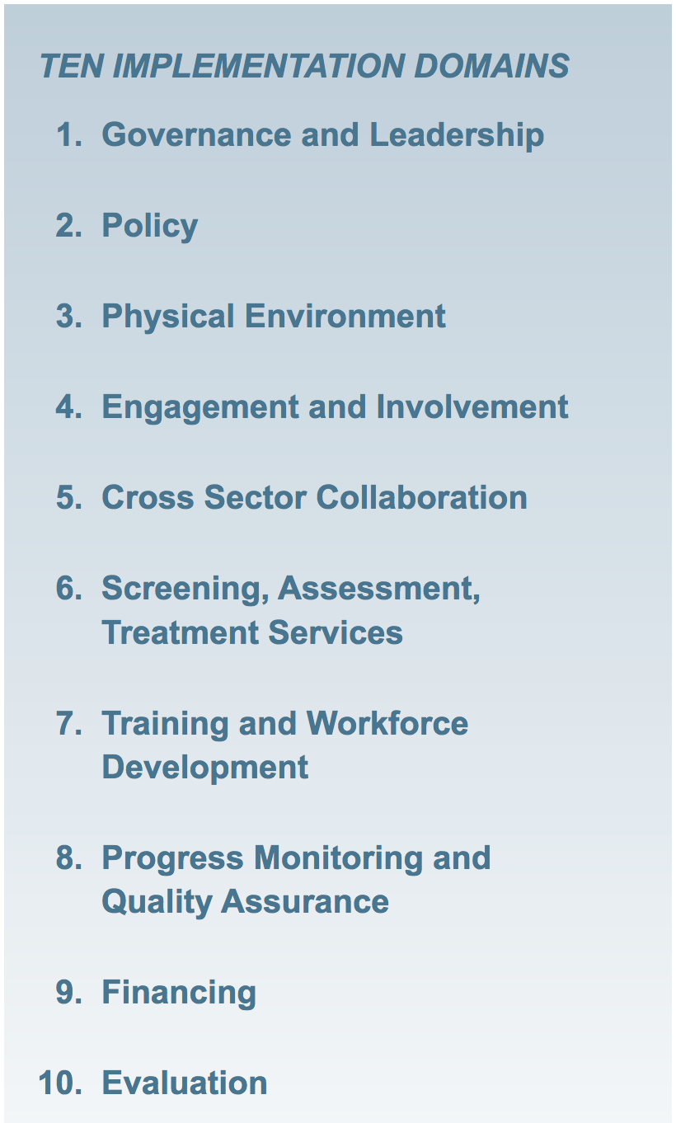
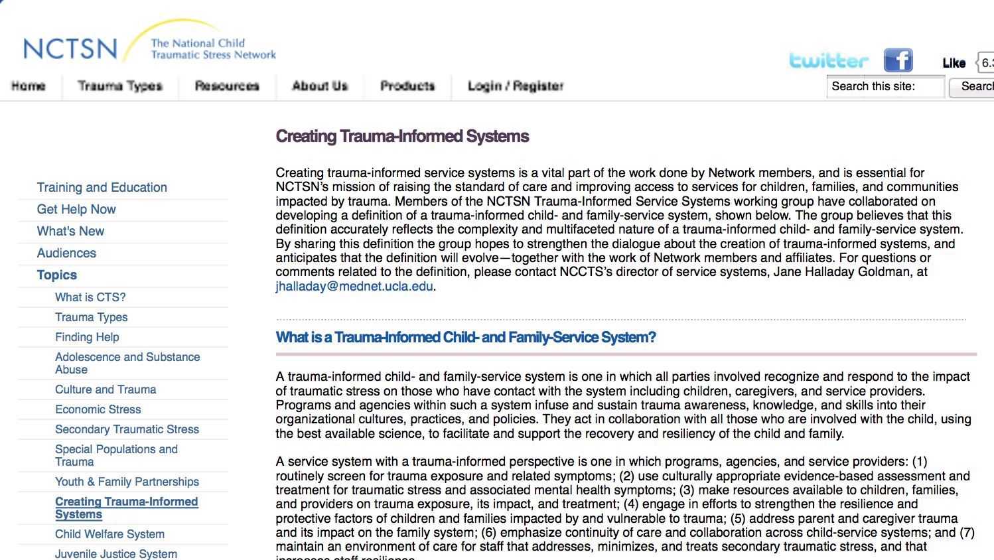
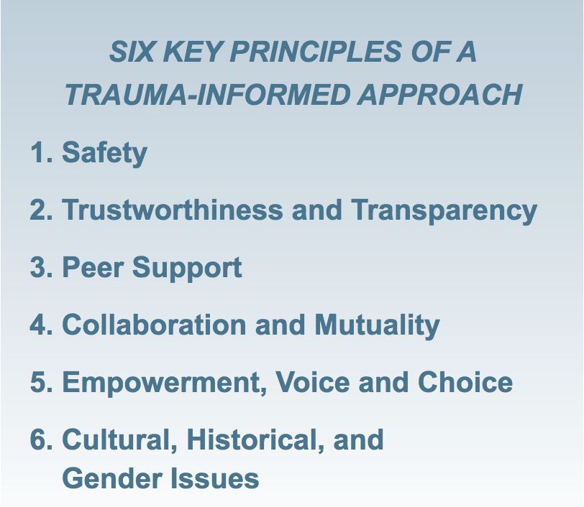

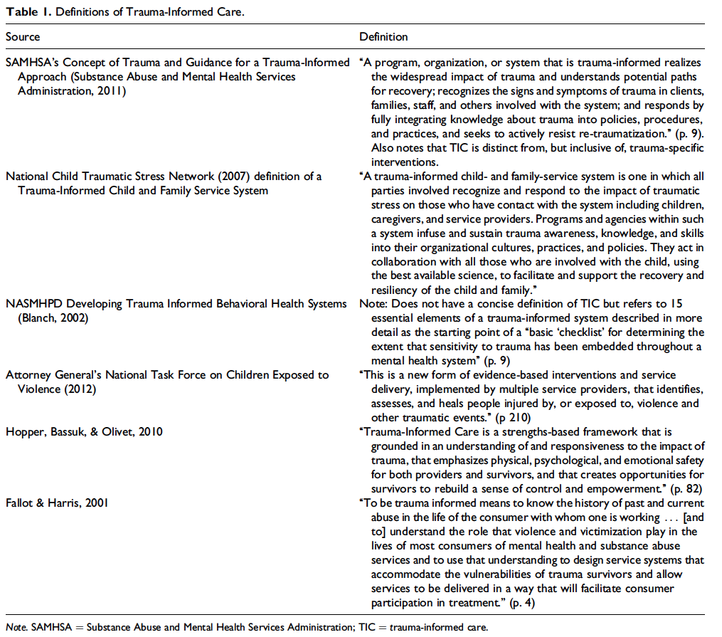
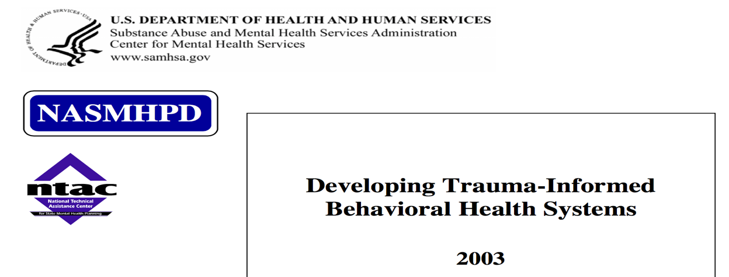
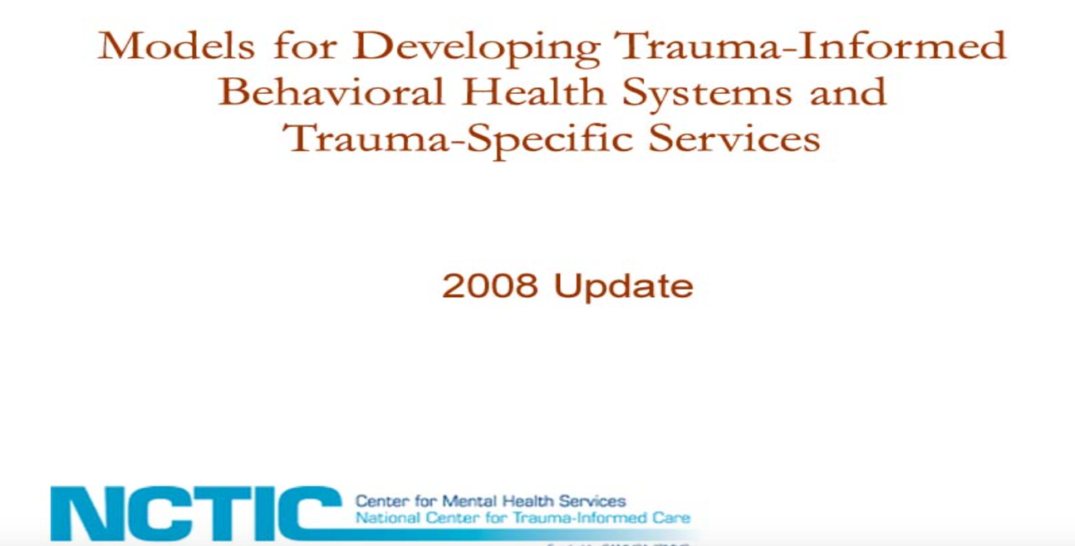


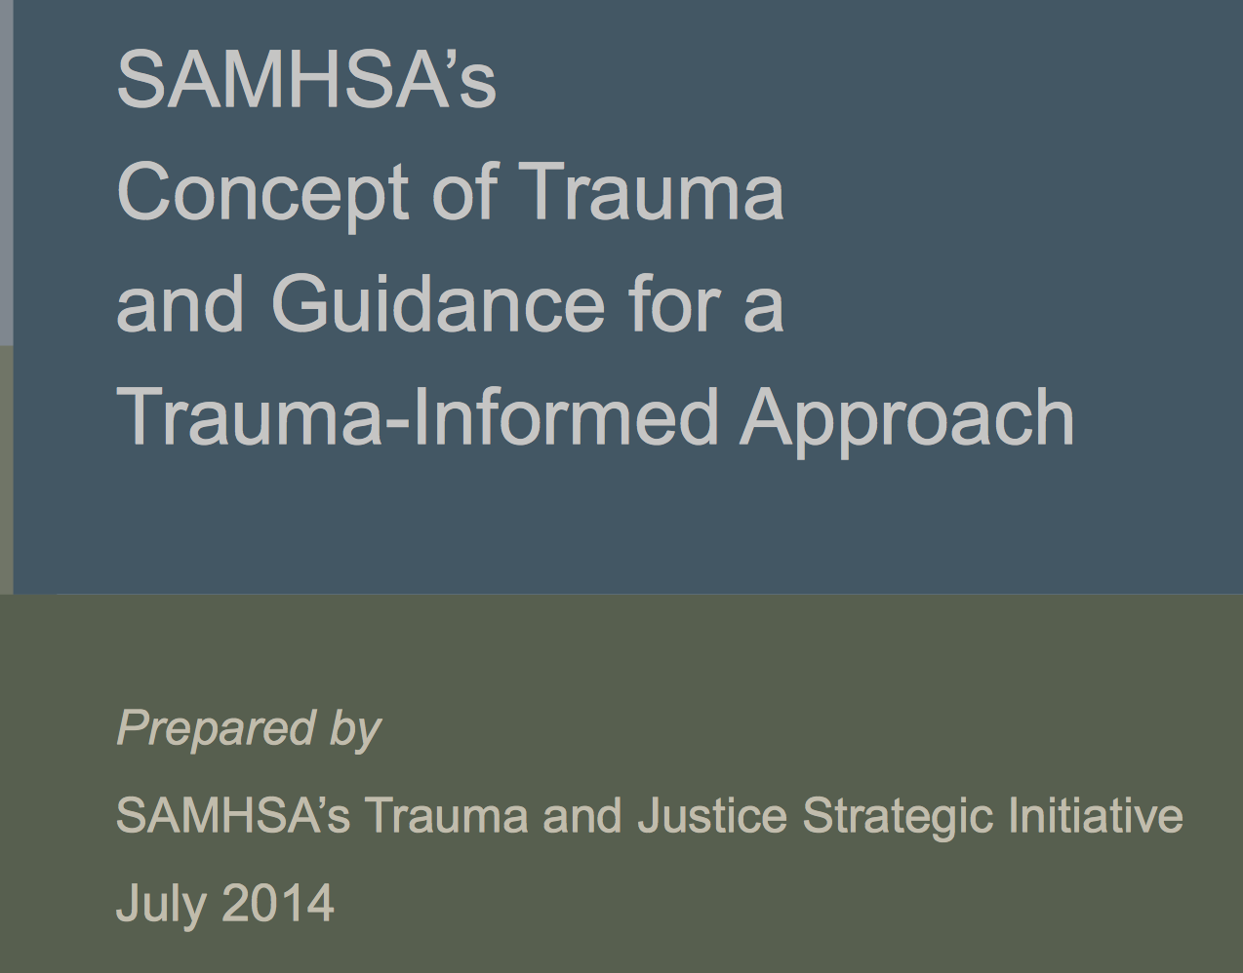
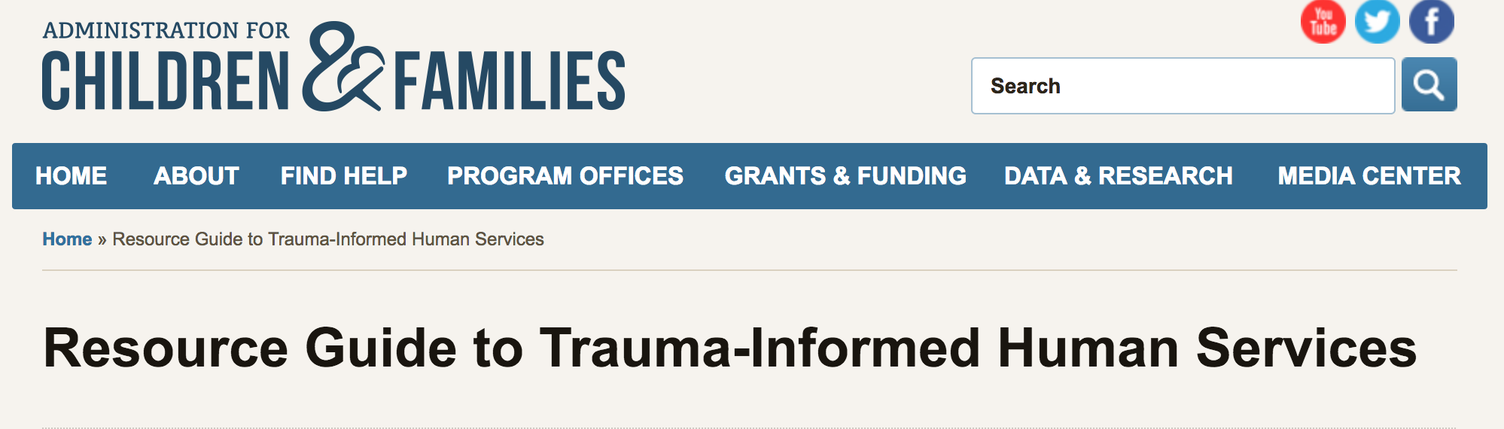


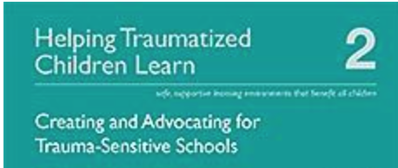
Trauma-Informed School
Trauma-Informed Care
Trauma-Informed System
Trauma-Informed Approach
Notes:
TI Schools Package:
Schools that embody these core principles:
a) have staff who understand trauma and its impact;
b) believe that healing happens in relationships;
c) ensure emotional and physical safety for all;
d) view students holistically;
e) support choice, control, and empowerment for students, staff, and families;
f) strive for cultural competence;
g) use a collaborative approach

Slide 5
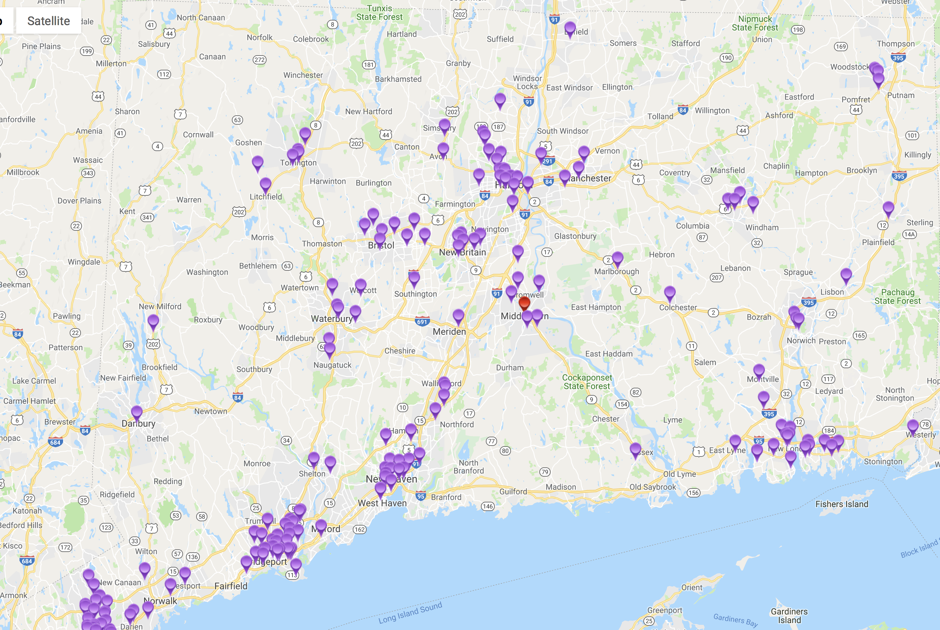
CT Has Many Child Trauma Resources

Slide 6
A few cautions
Trauma informed is not a single program or person
Trauma training does not equal “trauma-informed”
Trauma informed doesn’t mean changing everything
Trauma informed is not a substitute for “school mental health”
Avoidance is a hallmark of trauma, including in schools/systems

Slide 7

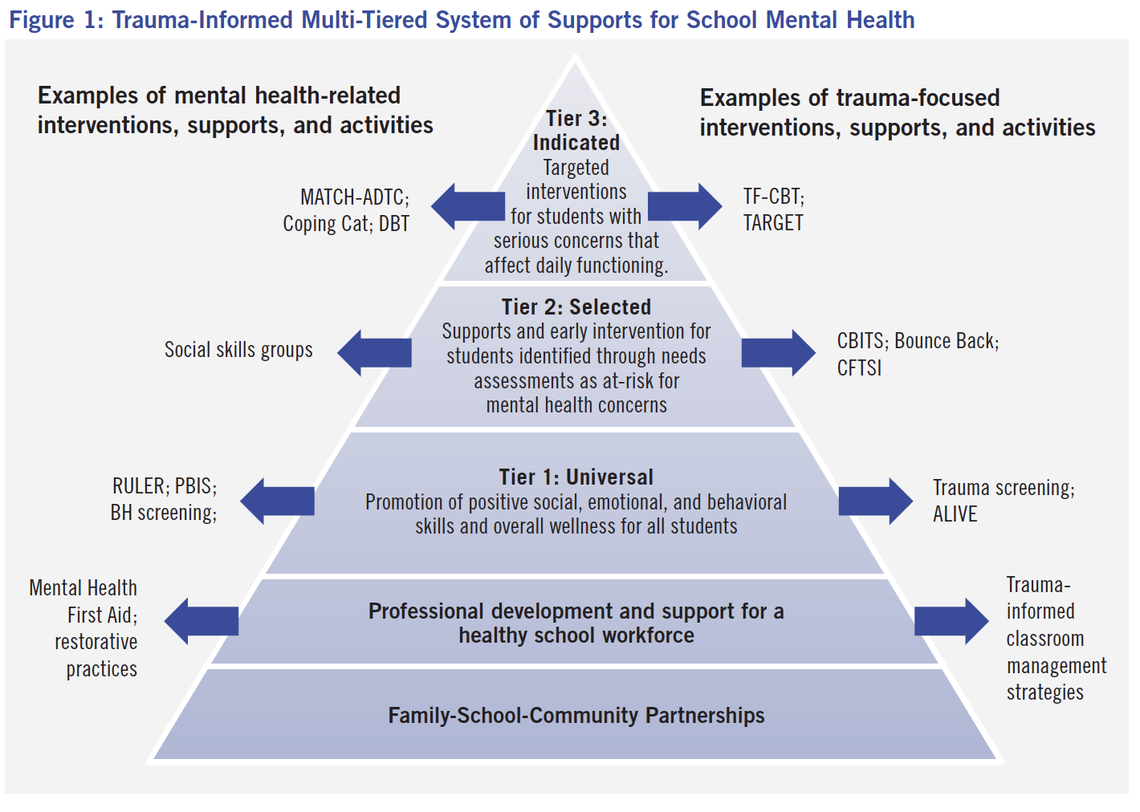

Slide 8


SHAPE your School Mental Health System!
The School Health Assessment and Performance Evaluation (SHAPE) System is a free, interactive system designed to improve school mental health accountability, excellence, and sustainability
SHAPE is the web-based portal to access the National School Mental Health Census and Performance Measures
SHAPE is hosted by the Center for School Mental Health and funded in part by the US Dept. of Health and Human Services.
CHDI offers free technical assistance and support
www.theshapesystem.com

Slide 9
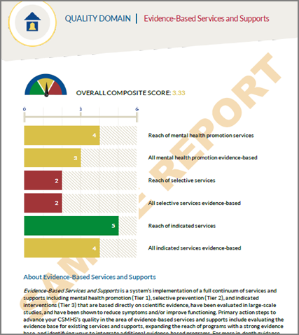
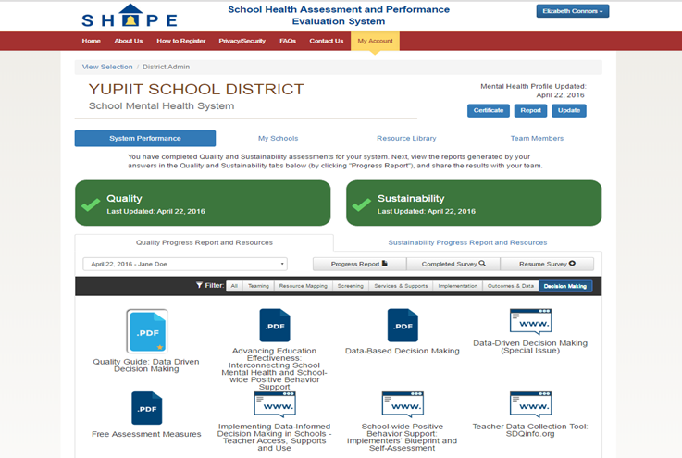

Schools and School Districts Can Use SHAPE To:
Document your service array and multi-tiered services and supports
Advance a data-driven mental health team process for the school or district
Access targeted resources to advance quality and sustainability
Achieve SHAPE Recognition to increase opportunities for federal, state and local grant funding
www.theshapesystem.com
Notes:
The National School Mental Health Census is an opportunity for our field to capture the landscape of school mental health systems in the US at school and district levels. For the first time in over 10 years (since the Foster et al 2005 study funded by SAMHSA) we can locate and describe the structure of school mental health systems in a way that will help identify our collective needs and strengths, and ultimately drive growth of comprehensive school mental health systems.
Most importantly, this census is actually designed as a “School Mental Health Profile” that lets your team document your service array and multi-tiered services and supports. This slide shows sample pages from the custom report generated for your team after you complete the SMH Profile, which you can use to share information about your school mental health system and advocate for improvements as needed.

Slide 10
Cognitive Behavioral Intervention for Trauma in Schools (CBITS) & Bounce Back
Strong research support
For children from K-12 suffering from exposure to trauma
Group intervention (3-8 students)
Delivered in schools
10 group sessions (plus 1-3 individual/parent sessions)
CBITS (5th-12 grade) and Bounce Back (K – 5th grade)

Slide 11
CBITS in Connecticut - Opportunity
State funded dissemination of CBITS since 2014
Growing network of 15+ districts and 50+ schools
All training, consultation, data reporting, and QA is provided at no cost to districts
Sustainability funding provided (performance-based)
Train-the-trainer option available
Clinician certification

Slide 12
CBITS in Connecticut – It Works!
110+ clinicians have been trained
More than 950 children have successfully completed treatment
Children show significant improvements in PTSD symptoms (CBITS: 42% reduction; BB 39% reduction)
90% of children successfully complete the group
94% of caregivers reported satisfaction with their child’s treatment

Slide 13
CBITS Resources
www.cbitsprogram.org
www.bouncebackprogram.org
https://www.chdi.org/our-work/mental-health/evidence-based-practices/ebp-provider-resources/
For more information about CBITS in CT please contact:
Diana Perry, PsyD
Project Coordinator
dperry@uchc.edu
860.679.3327

Slide 14
Trauma Screening
  Child Trauma Screen (CTS)
  One of briefest measures with empirical support
10 items
  4 exposure items
  6 reaction/PTSD symptom items
Age 7-17 (Version for age 3-6 is being piloted)
Child-report and parent-report versions
English & Spanish
Facilitates discussion of adversity/trauma
Cut scores identify students at risk of PTSD
No cost; available at www.chdi.org/cts
Notes:
Mention pediatric study

Slide 15
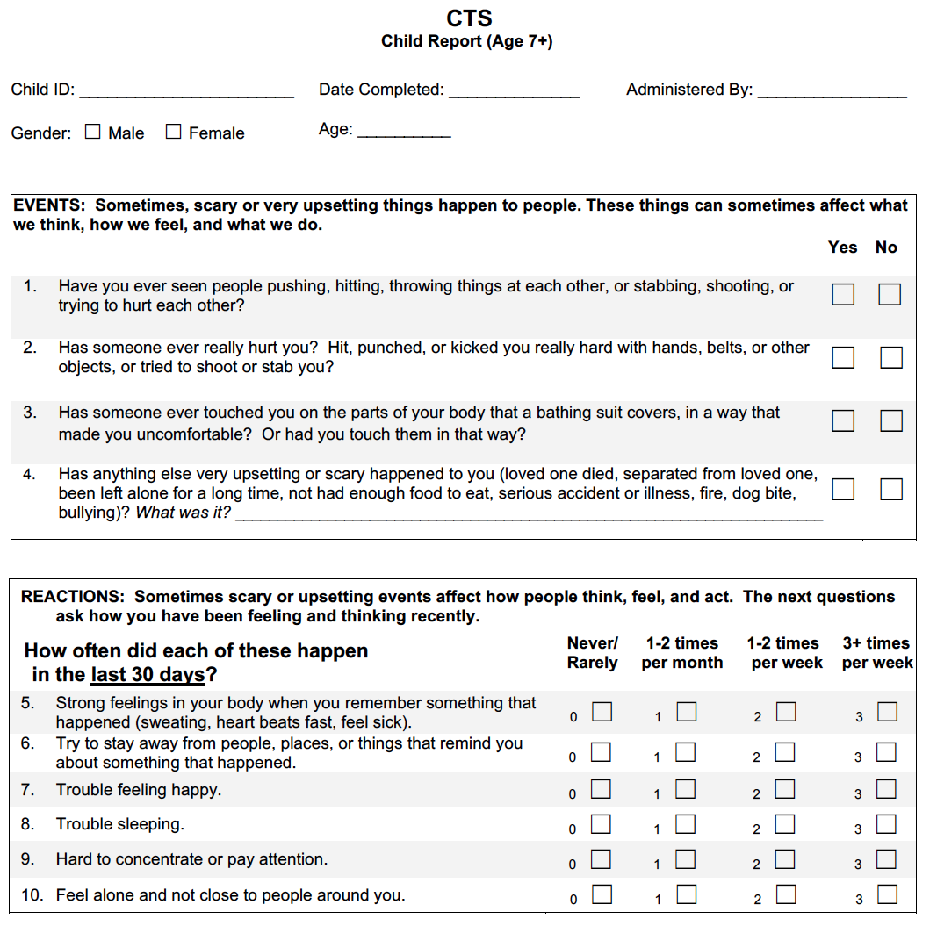

Slide 16

Finding Local Trauma-Focused Providers
Most therapists are not trained in specialty trauma treatment
  Trauma-focused Cognitive Behavioral Therapy (TF-CBT) is available at 30+ agencies in CT
  Other models available (TARGET, MATCH, CBITS)
www.kidsmentalhealthinfo.com
Notes:
Children report:
43% decrease in PTSD symptoms
55% decrease in depression symptoms
High caregiver satisfaction
Fewer no-show appointments
Shorter length of stay in treatment

Slide 17
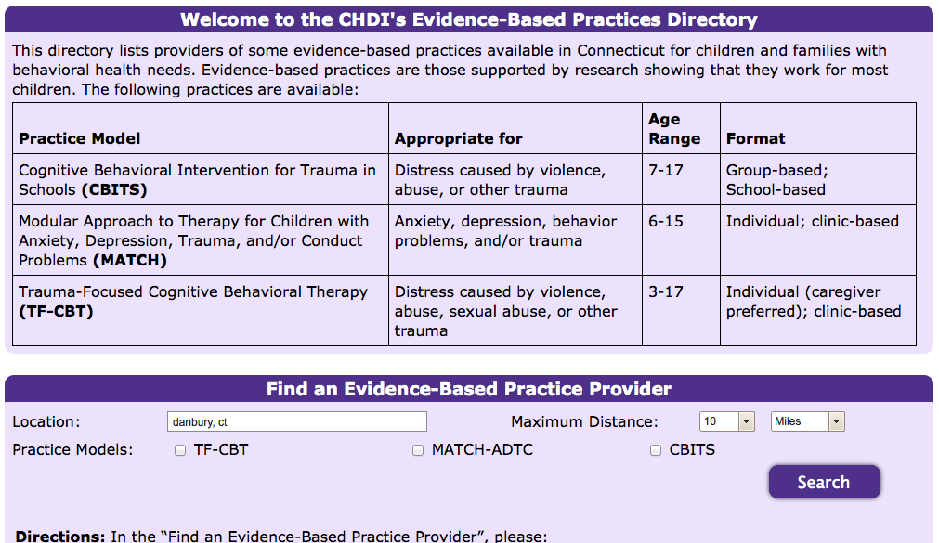
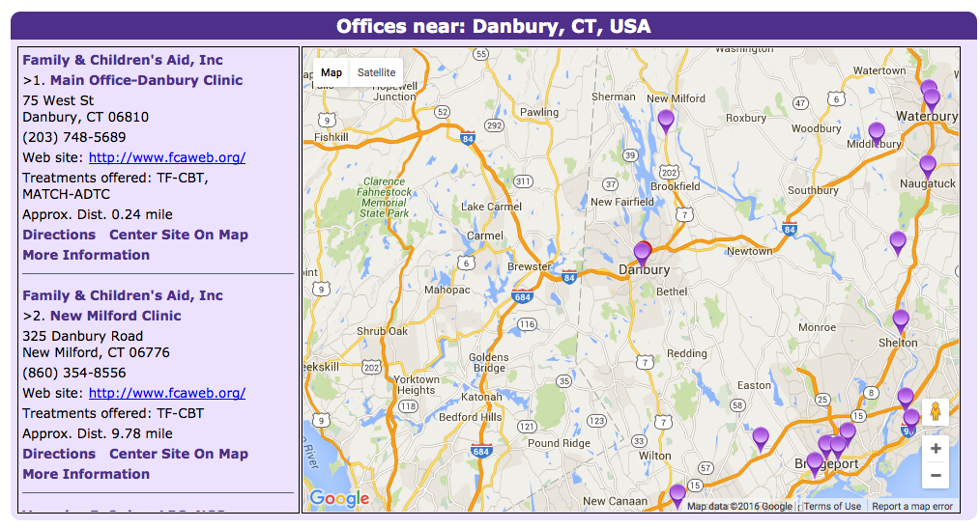

Slide 18
School-Based Diversion Initiative (SBDI) Goals
  Reduce the number of discretionary arrests in school; reduce expulsions and out-of-school suspensions
  Build knowledge and skills among teachers, school staff, and school resource officers to recognize and manage behavioral health crises in the school, and access needed community resources
  Link youth who are at-risk of arrest to appropriate school and community-based services and supports

Slide 19





SBDI Core Components
Professional Development
  Training and Workgroups
Referral and Service Coordination
  Mobile Crisis Intervention Services
  Community Engagement (YSBs, SOC)
  Family Engagement
Discipline Policy Consultation
  Graduated Response Model
  Law Enforcement Engagement
  Restorative Practices
Implementation Guided by SBDI Toolkit
Notes:
YSB=Youth Services Bureaus (positive youth development, juvenile justice diversion)
SOC=local Systems of Care (community-based behavioral health services)

Slide 20

Mobile Crisis Intervention Services (formerly EMPS)
Component of CT’s behavioral health system
  Funded and managed by DCF
  Available FREE to all CT children
  MOAs with schools
Access: Dial 2-1-1
  Phone support 24/7, 365
  Mobile hours M-F 6am-10pm;
  Weekends/holidays 1pm-10pm
Rapid response to behavioral crises
  90%+ mobility rate
  On site in 45 min. or less
Crisis stabilization, assessment, brief treatment, linkage to ongoing care www.empsct.org
Notes:
PA 13-178 legislated MOAs between all Mobile Crisis providers and the schools they serve—updated list and links to completed MOAs are on the website
CHDI serves as Performance Improvement Center for all QI data—monthly, quarterly, and annual reports are available online

Slide 21
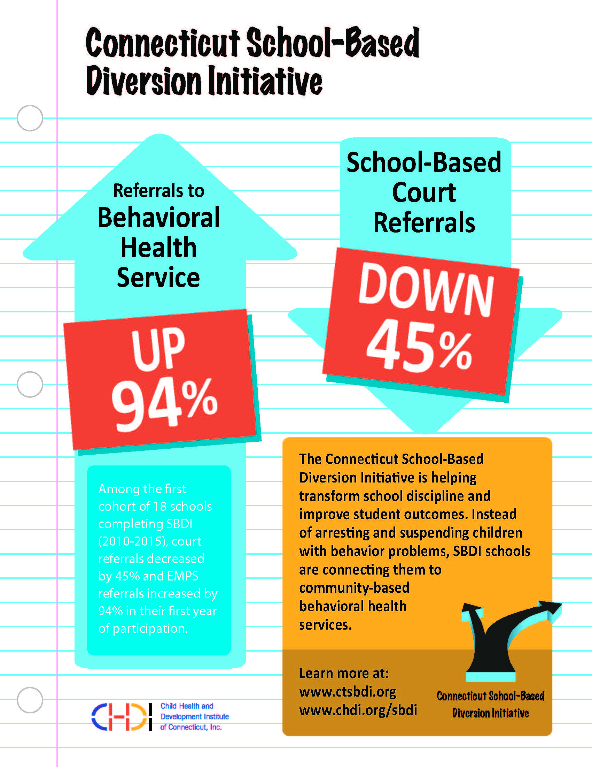
SBDI Outcomes

Slide 22


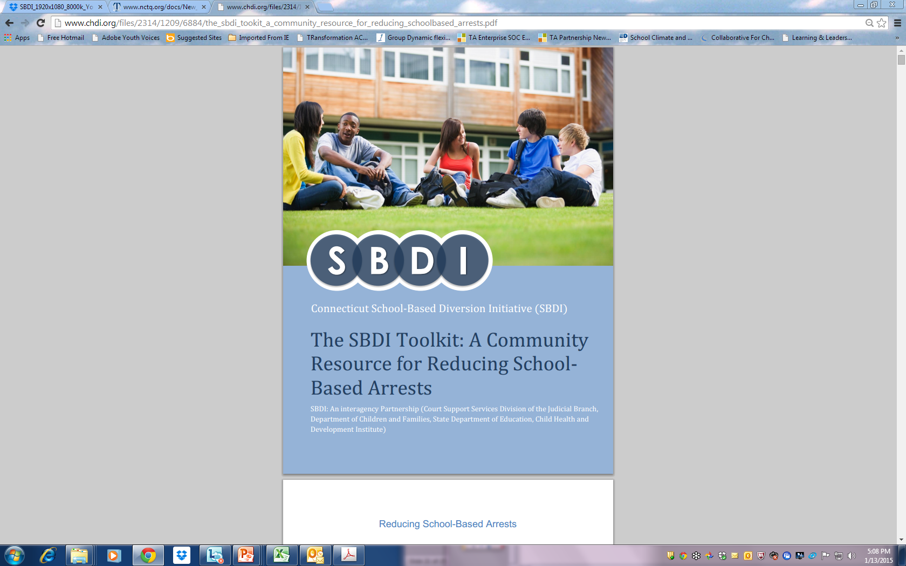
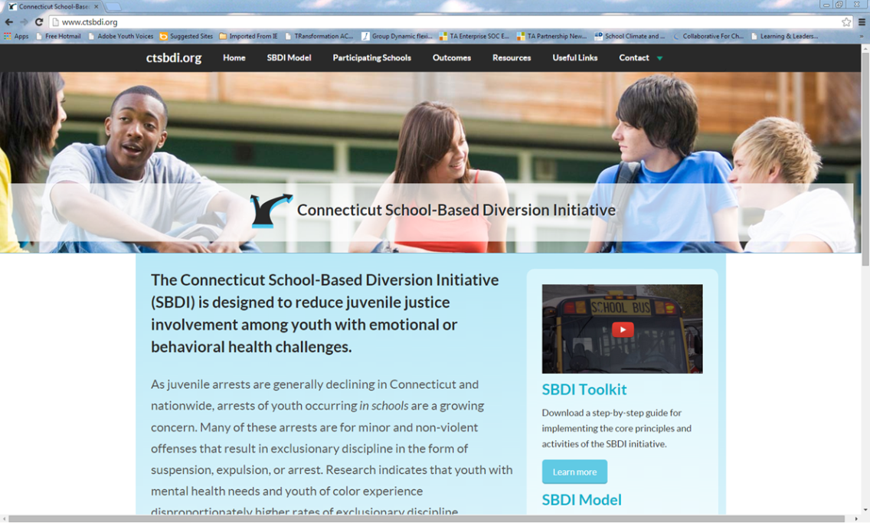
SBDI Resources
Toolkit available for free download http://www.chdi.org/SchoolToolkit
Additional resources available at http://www.ctsbdi.org and http://www.chdi.org

Slide 23
Contact Information
Jason Lang, Ph.D.
Vice President for Mental Health Initiatives
Child Health and Development Institute
860-679-1550
jalang@uchc.edu
www.chdi.org

