Slide 1
Building Capacity for Trauma-Sensitive Districts
October 19, 2018

Slide 2

The Department of Children and Families
Children’s Behavioral Health Plan
Schools
State agency partners
Providers
Families
To allow for a holistic and family centered approach

Slide 3
CONCEPT Grant 2011
To improve trauma-focused care for children in child welfare system
  Workforce Development
  Institutionalize Trauma Screening and Referral Procedures
  Support Implementation of Evidence-based Interventions
  Evaluation

Slide 4
Trauma Informed and Responsive Service Array
Child Trauma Screen (CTS)
Mobile Crisis (EMPS)
Trauma Focused Cognitive Behavioral Therapy (TF-CBT)
Child and Family Traumatic Stress Intervention (CFTSI)
Modular Approach to Therapy for Children: Anxiety, Depression, Trauma, Conduct Disorder (MATCH-ADTC)
Cognitive Behavioral Intervention for Trauma in Schools (CBITS)
https://www.chdi.org/our-work/mental-health/trauma-informed-initiatives/

Slide 5
The growth of a trauma responsive system
Since 2007
  More than 8,600 child serving professionals trained
  More than 50,000 children screened for trauma exposure
  More than 8,700 children have received trauma focused evidence based practices
  Broad dissemination of TF-CBT and other trauma focused EBP’s

Slide 6
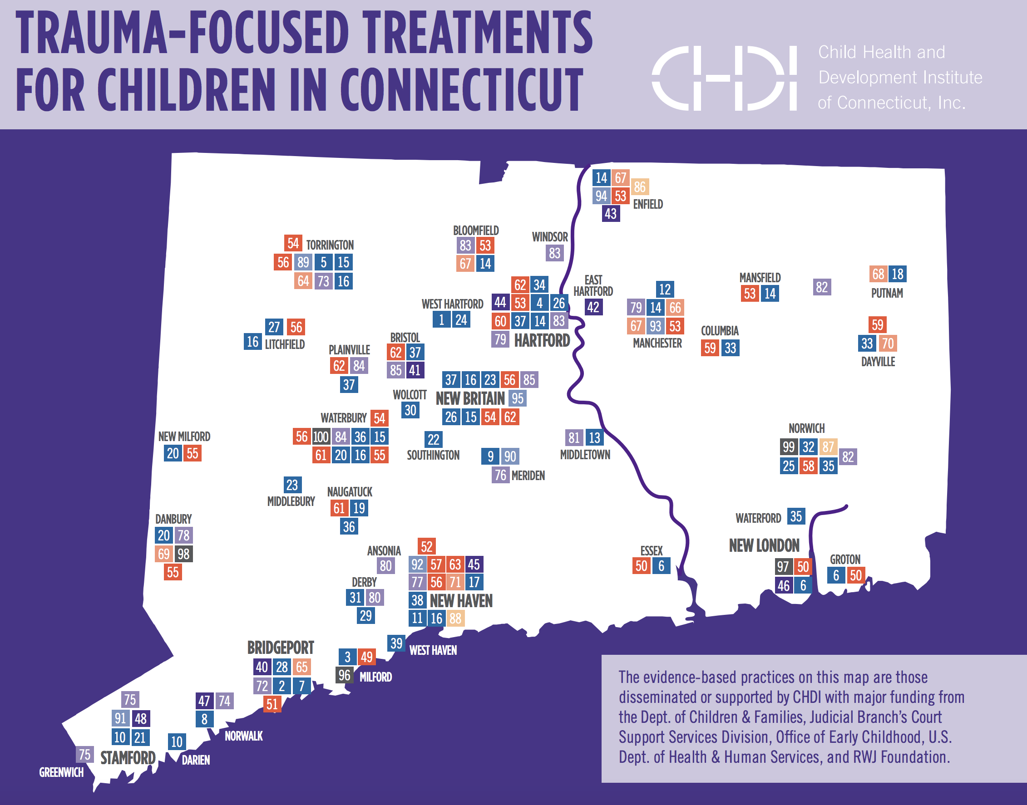

Slide 7
Where to start?
Who are your partners?
What resources exist in your community?
How can partners outside of the school be helpful?

Slide 8
Thank You!
Kristina Stevens, Deputy Commissioner
860.550.6657
Kristina.stevens@ct.gov

