Slide 1
CONNECTICUT STATE DEPARTMENT OF EDUCATION
Early Childhood
Landscape Analysis Tool
and
Transitioning to Kindergarten Guidance
May 18, 2018

Slide 2
Our ESSA plan includes provisions to:
promote coordination in early learning among local communities;
align preschool with early elementary school;
and build the capacity of teachers, leaders and others serving young children to provide high-quality early learning opportunities.

Slide 3
Early Childhood in Connecticut
Early Childhood Landscape Analysis Tool
Transitioning to Kindergarten Guidance
Early Learning Evidence-Based Practice Guides

Slide 4
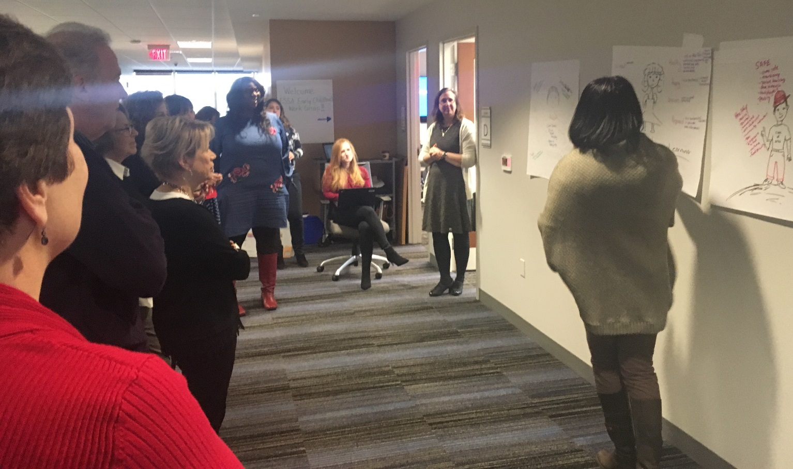
How did we get here?
Stakeholders included:
LEAs (superintendents, directors, principals, teachers, attendance officers), OEC, SDE, CAS, Head Start, School Readiness Councils, Mayor’s Office, Higher-Education, and philanthropy.

Slide 5
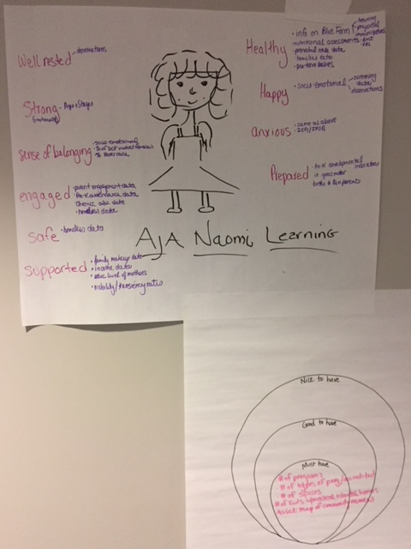
How did we get here?

Slide 6
http://portal.ct.gov/SDE/ESSA-Student-Transition-Resources-PreK-to-Kindergarten

Slide 7
http://portal.ct.gov/SDE/ESSA-Student-Transition-Resources-PreK-to-Kindergarten

Slide 8
Contact Information
Lisa Lamenzo
Turnaround Office, CSDE
Lisa.lamenzo@ct.gov
Andrea Brinnel
Bureau of Special Education, CSDE
Andrea.Brinnel@ct.gov
Danielle Ewen
Senior Policy Advisor, EducationCounsel
Danielle.ewen@educationcounsel.com
Erica M. Forti
Superintendent, East Haven Public Schools
eforti@east-haven.k12.ct.us
Miguel Cardona
Assistant Superintendent for Teaching and Learning, Meriden Public Schools
miguel.cardona@meridenk12.org

