Slide 1
Head Start programs prepare America’s most vulnerable young children to succeed in school and in life beyond school. To achieve this, Head Start programs deliver services to children and families in core areas of: early learning, health, and family well-being while engaging parents as partners every step of the way.
Head Start’s Mission
Notes:
Head Start encompasses Head Start preschool programs, which primarily serve 3- and 4-year-old children, and Early Head Start programs for infants, toddlers, and pregnant women.

Slide 2
Delivered through 1,700 agencies in local communities
Each agency tailors the federal program to the local needs of families in the service area
Head Start and Early Head Start provide services to over 1 million children every year, in every U.S. state and territory, in farmworker camps, and in over 155 tribal communities
Head Start programming is responsive to the ethnic, cultural, and linguistic heritage of each child and family

Slide 3
Early learning: Children’s readiness for school and beyond is fostered through individualized learning experiences. Through relationships with adults, play, and planned and spontaneous instruction, children grow in all aspects of development. Children progress in social skills and emotional well-being, along with language and literacy learning, and concept development. All children are assessed at least 3 times per year against established school readiness goals.

Slide 4
Health: Each child’s perceptual, motor, and physical development is supported to permit them to fully explore and function in their environment. All children receive health and development screenings, nutritious meals, oral health and mental health support. Programs connect families with medical, dental, and mental health services to ensure that children are receiving the services they need.

Slide 5
Family well-being: Parents and families are supported in achieving their own goals, such as housing stability, continued education, and financial security. Programs support and strengthen parent-child relationships and engage families around children’s learning and development.

Slide 6
Head Start - Nationally
Notes:
90% of our children are served in center-based classrooms;
about 60% of this is a 5-day/week, 6 or more hours per day model;
also have 5-day/week with fewer than 6 hours, and also have 4-day/week model;
Almost 8% are served through our home-visiting model;
1% in family child care.

Slide 7
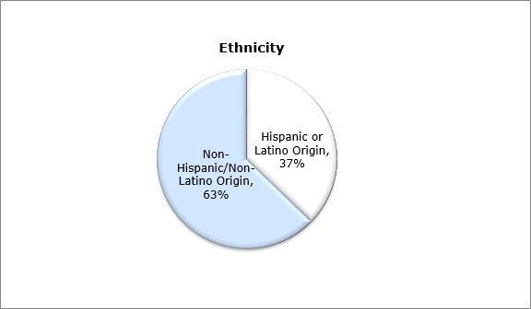
Head Start - Nationally
Notes:
Head Start served a diverse group of children, families, and pregnant women. Thirty-seven percent identified themselves as Hispanic/Latino, and 29 percent were Black/African-American.
Families were asked to self-identify both an ethnicity and a race category based on U.S. Census Bureau measures. For example, a family that identifies their child as Black and Cuban was counted in the "Black or African-American" race category for the race question and counted in the "Hispanic or Latino" category for the separate question on ethnicity.
Twenty-nine percent of participants were from families that primarily spoke a language other than English at home. Approximately 23 percent of participants were from families that primarily spoke Spanish at home.

Slide 8
In Fiscal Year 2017:
90 percent of children were enrolled in Medicaid, the Children's Health Insurance Program (CHIP), or a state-funded child health insurance program.
By end of program year, 97% of children had established a medical home
90% had established a dental home
13% of enrolled children had disabilities, defined as children having special plans under the Individuals with Disabilities Education Act (IDEA).
Notes:
Dental: these numbers are much more dramatic, up from 80% at start of year; challenges with finding dental care in our rural areas as well as finding providers who will accept government-funded insurance.
Disabilities: In comparison, nationally, about three percent of infants and toddlers and six percent of preschool-age children have identified disabilities. Head Start serves a greater percentage of children with disabilities than found in the overall population.

Slide 9
87 percent of enrolled pregnant women received prenatal education on fetal development and 21 percent had medically high risk pregnancies.
Approximately 49,000 families served during the enrollment year experienced homelessness.
Of these, 34 percent found housing during the program year.
Approximately 71,000 Head Start families received housing assistance, such as subsidies, utilities, and repairs.
More than one million adults volunteered in their local Head Start program. Of these, 769,000 were parents of Head Start children.
Notes:
Homelessness: at rate of 5% of children enrolled nationally; in CT, 6.6% of children enrolled experienced homelessness, and 38% of families acquired housing during the year.
Foster Care: 2.9% of enrolled children in foster care at some point during the year; 5% of children served in HS/EHS are referred by the child welfare agency.

Slide 10
Connecticut FY2017 Data:
19 Grantees
7,396 children served (EHS 1,449 HS: 5,947)
Grantees operated 376 classrooms
181 LEAs are located in the service areas served by Head Start/Early Head Start
CT grantees have agreements with 138 LEAs to coordinate services for children with disabilities
CT grantees have agreements with 136 LEAs to coordinate transition services
CT grantees had 99 formal agreements for collaboration and resource sharing with public school prekindergarten programs
Notes:
19 includes the state collaboration grant

