Slide 1
Implicit Bias in Preschool
Walter S. Gilliam, PhD
Edward Zigler Center in Child Development & Social Policy
Yale University Child Study Center
Early Childhood PreK-3 Alliance District Symposium
Middletown, Connecticut
May 18, 2018

Slide 2
Expulsion Rates (per 1,000)
a. Gilliam, WS (2005). Prekindergarteners left behind: Expulsion Rates in state prekindergarten programs. FCD Policy Brief, Series No. 3. Available: www.ziglercenter.yale.edu/publications/briefs.html
b. Gilliam, WS & Shahar, G (2006). Preschool and child care expulsion and suspension: Rates and predictors in one state. Infants and Young Children, 19, 228-245.

Slide 3

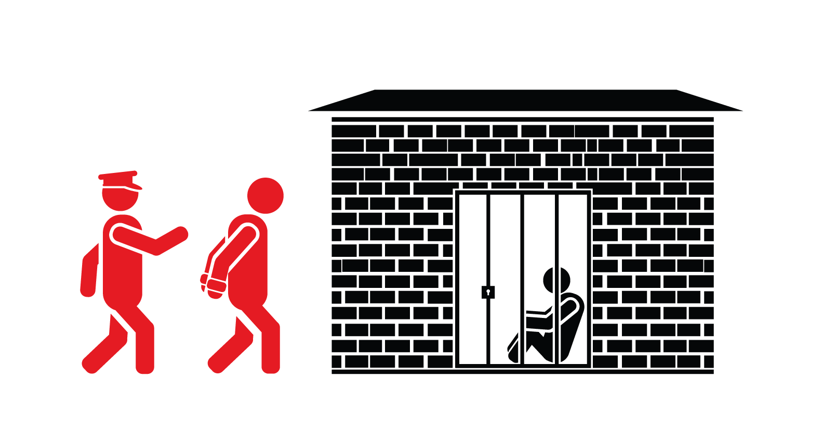

The Preschool to Prison Pipeline
Gilliam, WS (2005). Prekindergarteners left behind: Expulsion Rates in state prekindergarten programs. FCD Policy Brief, Series No. 3. Available: www.ziglercenter.yale.edu/publications/briefs.html
Walmsley, R. (2013). World prison population list (10th ed). London, UK: International Centre for Prison Studies.
Notes:
Let’s put this into perspective: how does preschool expulsion compare to K-12 expulsion?
3 times greater than the K-12 rate! (This rate hasn’t really changed much.)
When you think about preschool expulsion, it’s a form of social exclusion—It’s what we do to children who “behave badly”.
Here’s something of interest: What does society do to adults who behave badly?
We incarcerate them.
PreK expulsion rate is 6.7 (or approx. 7) per 1,000 preschoolers
US incarceration rate, deemed as highest in the world, is 7.16 (or approx 7) per 1,000 of the national population
---
Additional:
CHILD CARE expulsion rates
Child Rates
Detroit, MI (Grannan et al., 1999; n=127; 28%)
Rate = 28/1,000
Massachusetts (Gilliam & Shahar, 2006; n=119; 64%)
Rate = 27/1,000 (39% Classes)
Massachusetts (MA DOE, 2003; n=764; ?%)
Rate = 2% expelled; 1% “suggested,” 1% transferred
Colorado (Hoover, 2006; n=1,075; 17%)
Rate = 10/1,000

Slide 4
Child Care Expulsion Rates
Child Rates
  Detroit, MI (Grannan et al., 1999; n=127; 28%)
    Rate = 28/1,000
  Massachusetts (Gilliam & Shahar, 2006; n=119; 64%)
    Rate = 27/1,000 (39% Classes)
  Massachusetts (MA DOE, 2003; n=764; ?%)
    Rate = 2% expelled; 1% “suggested,” 1% transferred
  Colorado (Hoover, 2006; n=1,075; 17%)
    Rate = 10/1,000
Center/Classroom Rates
  Illinois (Cutler & Gilkerson, 2002; n=195 I/T; 38%)
    Rate = 42% of Centers
  Alaska (Alaska CCPO, 2005; n=493; 71%)
    Rate = 35% Centers

Slide 5
Many Factors Predict Preschool Expulsion
Child-Teacher Ratio
Program Length of Day
Teacher Job Stress
Access to Behavioral Supports

Slide 6
Preschool Expulsion
Is NOT
a Child Behavior.
It is an Adult Decision.

Slide 7
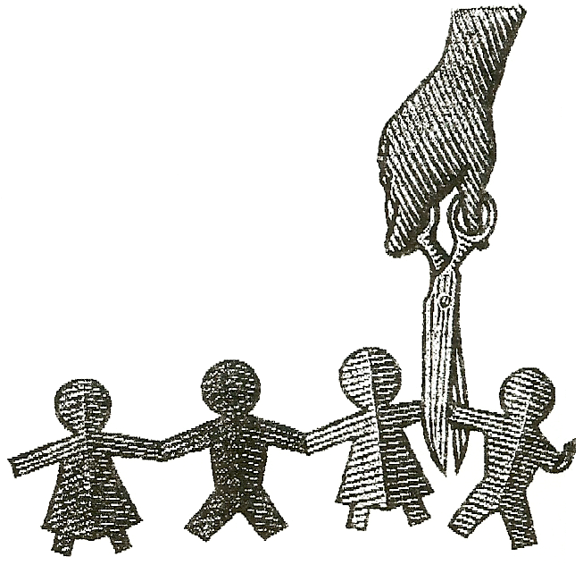
Who Gets Expelled?
4-year-olds 50% more likely than 3’s
Black preschoolers more than 2 times as likely as white preschoolers
Boys more than 4 times as likely as girls

Slide 8
The 3 B’s of Expulsion Risk
BIG
BLACK
BOY

Slide 9
So, Why Are Our Boys and Our Black Children Most At Risk?
Potential Reasons:
  Boys are more susceptible to stressors (Autor et al, 2015).
  Children of color often have more stressors.
  Children of color often attend programs of poorer quality and fewer resources (Barnett et al, 2013).
Yet, these alone don’t seem to account for all of the disparities in early suspensions and expulsions.

Slide 10
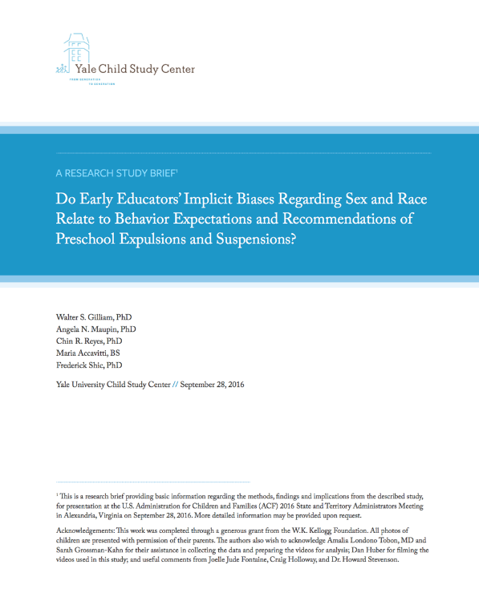
Finally,
A Study of Implicit Bias in ECE
Jan 2015 – Funding (Thanks, W.K. Kellogg Foundation!)
Nov 2015 – Collected Data
Sep 2016 – Released Report of Findings

Slide 11
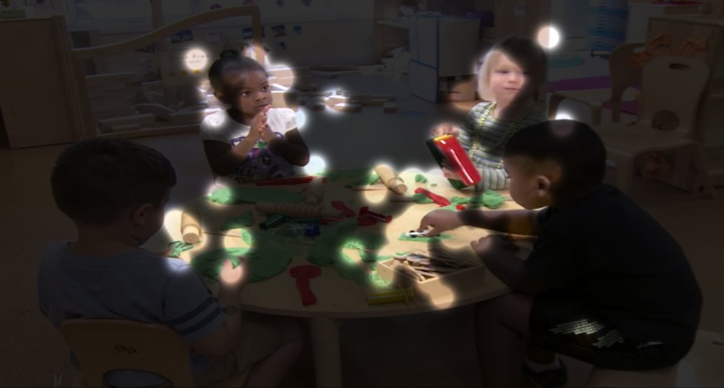
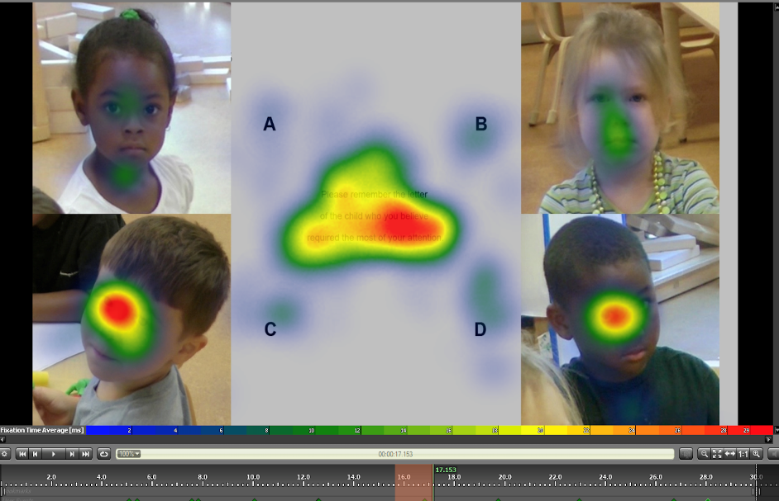
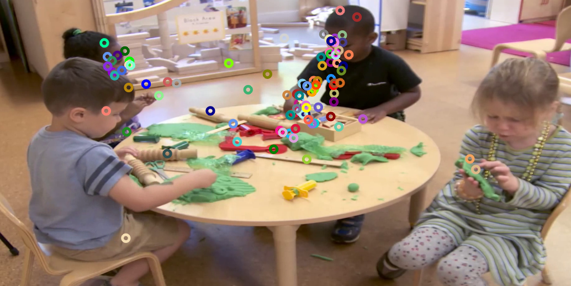
Eye Tracking Results
Main: ∧=.693, F=50.87, p<.001, d=1.33.
Interaction: ∧=.925, F=9.36, p<.01, d=.57.
10%
13%
x²=39.09, p<.001
34%
42%
Notes:
Results revealed a main effect for race such that participants spent more time gazing at Black children, Wilks’ Λ=.693, F(1, 115)=50.87, p<.001, d=1.33. No significant main effect was found for sex, Wilks’ Λ=.987, F(1, 115)=1.57, p=.213. We also found a significant sex × race interaction effect such that teachers spent more time gazing at Black boys

Slide 12
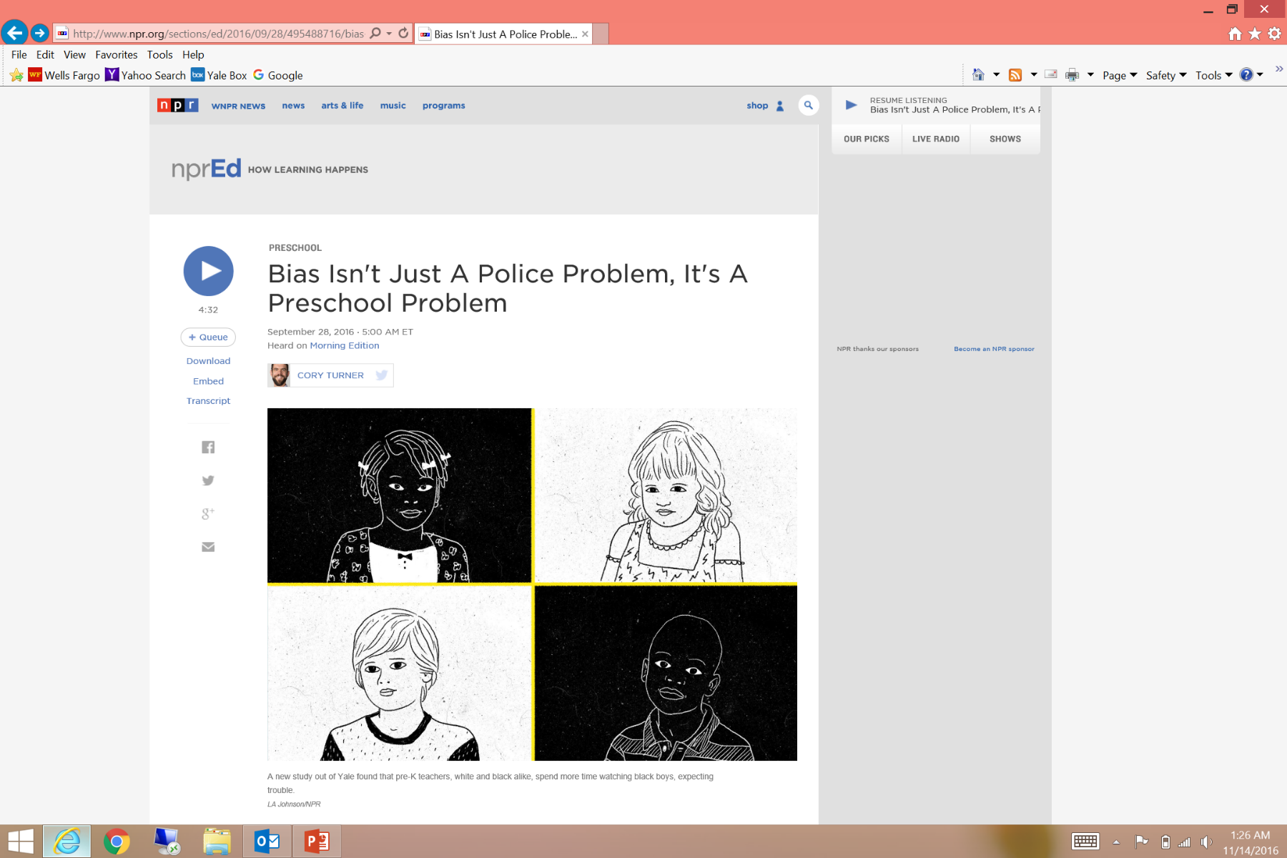


Slide 13
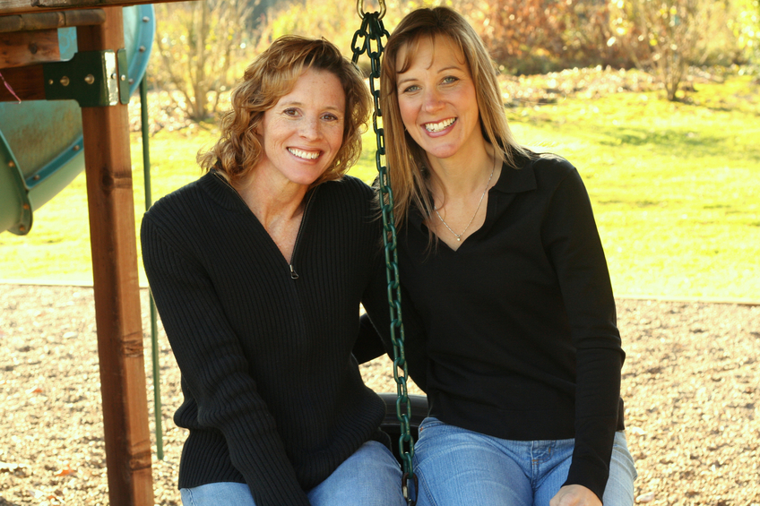
Are social biases contagious?
Skinner, A, Meltzoff, AN, Olson, KR (2017). “Catching” social bias: Exposure to biased nonverbal signals in preschool children. Psychological Science, 28, 216-224.

Slide 14
The Hopeful News
In the past 3 years:
23 states have made significant progress on preschool expulsions/suspensions
15 states and Head Start now ban preschool expulsions/suspensions
Over 1.6 Million preschoolers are now protected from preschool expulsion/suspension

Slide 15
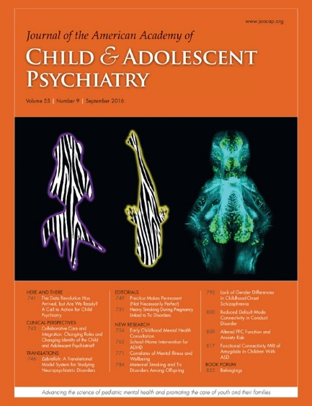
Early Childhood
Mental Health Consultation

Slide 16
Climate of Healthy Interactions for Learning & Development (CHILD)
A new observational measure of the relationships and “mental health climate” of early childhood settings.
Measures all interactions.
  Staff-Child
  Child-Child
  Staff-Staff
Measures staff attunement to overt and subtle cues, verbal and nonverbal behaviors.
Addresses equity and inclusion.

Slide 17
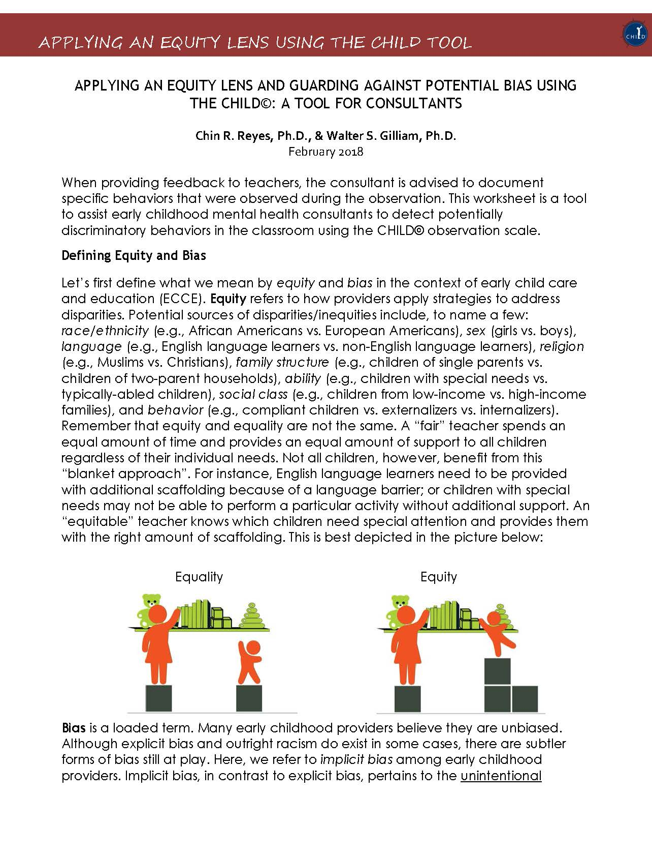
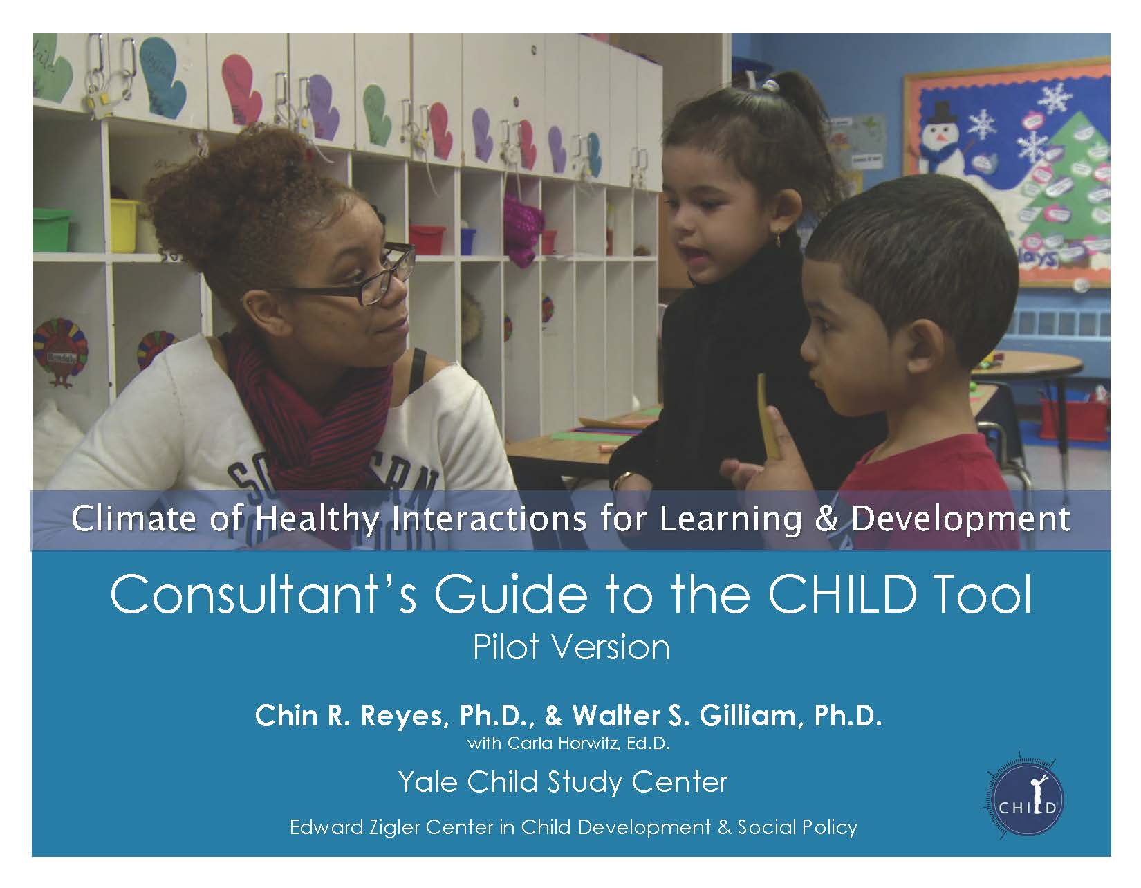
The CHILD & Equity

Slide 18

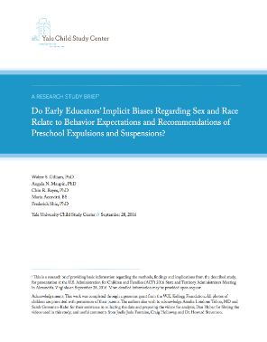
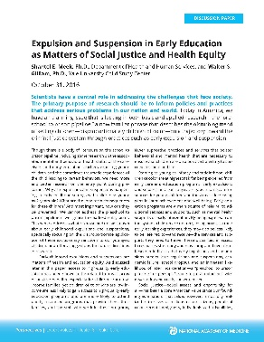

Thank You! To Read More…
Robert Wood Johnson Report (Aug 2016)
rwjf.ws/2erCYjN
Random-Controlled Evaluation of ECMHC (Sep 2016)
bit.ly/2kwRnja; bit.ly/2kwP8MS
Yale Preschool Implicit Bias Study (Sep 2016)
bit.ly/2erxzsP
National Academy of Sciences (Oct 2016)
bit.ly/2ff5G5t
Preschool Suspension & Expulsion Timeline
bit.ly/2erztd8
Follow me on Twitter: @WalterGilliam

Slide 19
Thank You! To Read More…
Robert Wood Johnson Report (Aug 2016)
rwjf.ws/2erCYjN
Random-Controlled Evaluation of ECMHC (Sep 2016)
bit.ly/2kwRnja; bit.ly/2kwP8MS
Yale Preschool Implicit Bias Study (Sep 2016)
bit.ly/2erxzsP
National Academy of Sciences (Oct 2016)
bit.ly/2ff5G5t
Preschool Suspension & Expulsion Timeline
bit.ly/2erztd8
Follow me on Twitter: @WalterGilliam

