Slide 1

Hartford and firstschool

Slide 2

Why firstschool?

Slide 3

The current reality

Slide 4
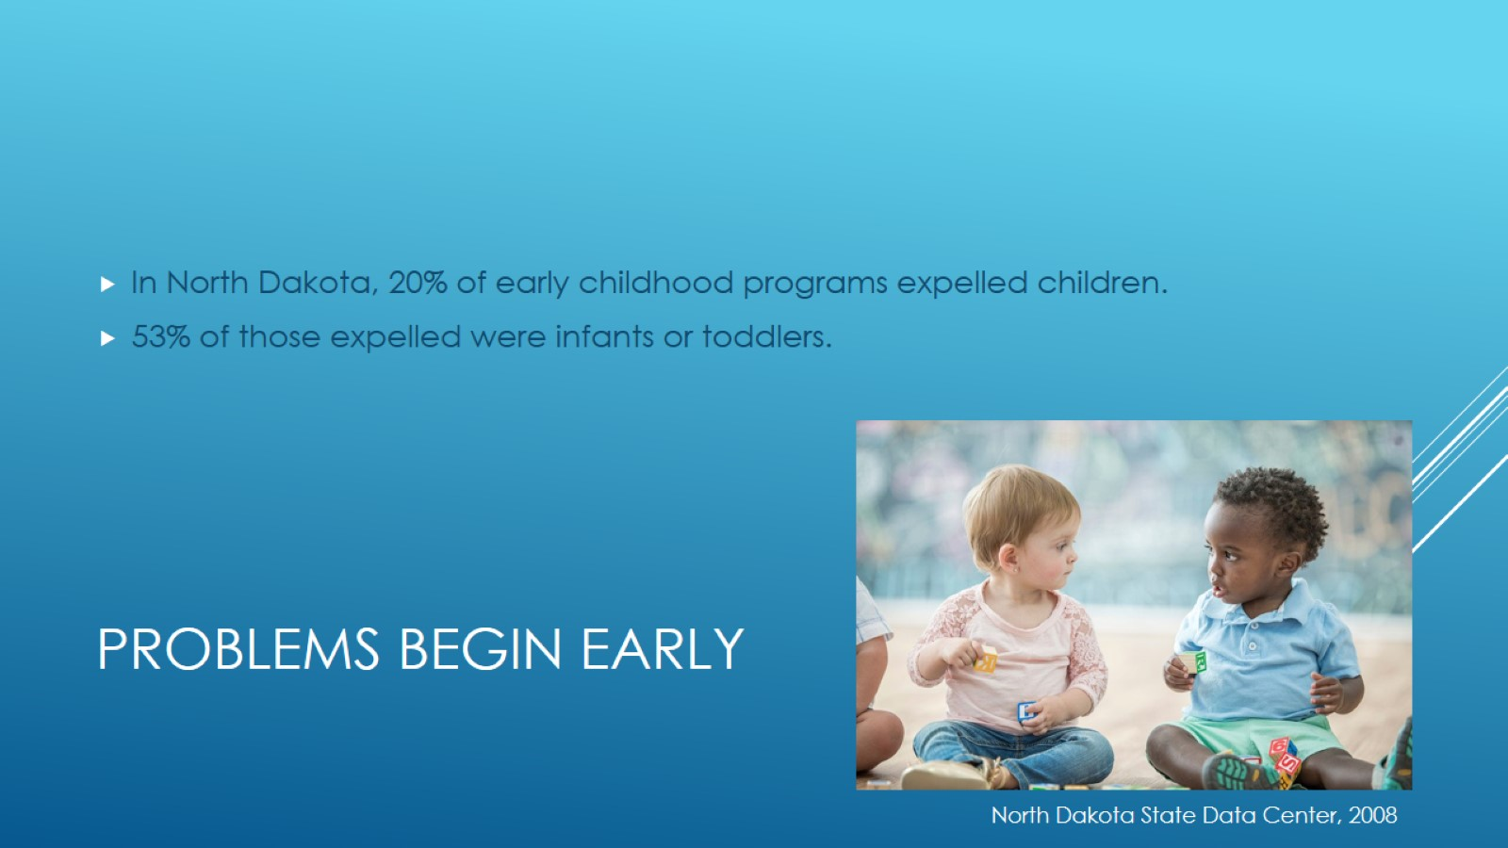
Problems begin early

Slide 5

disproportionality

Slide 6

Tip of the iceberg

Slide 7
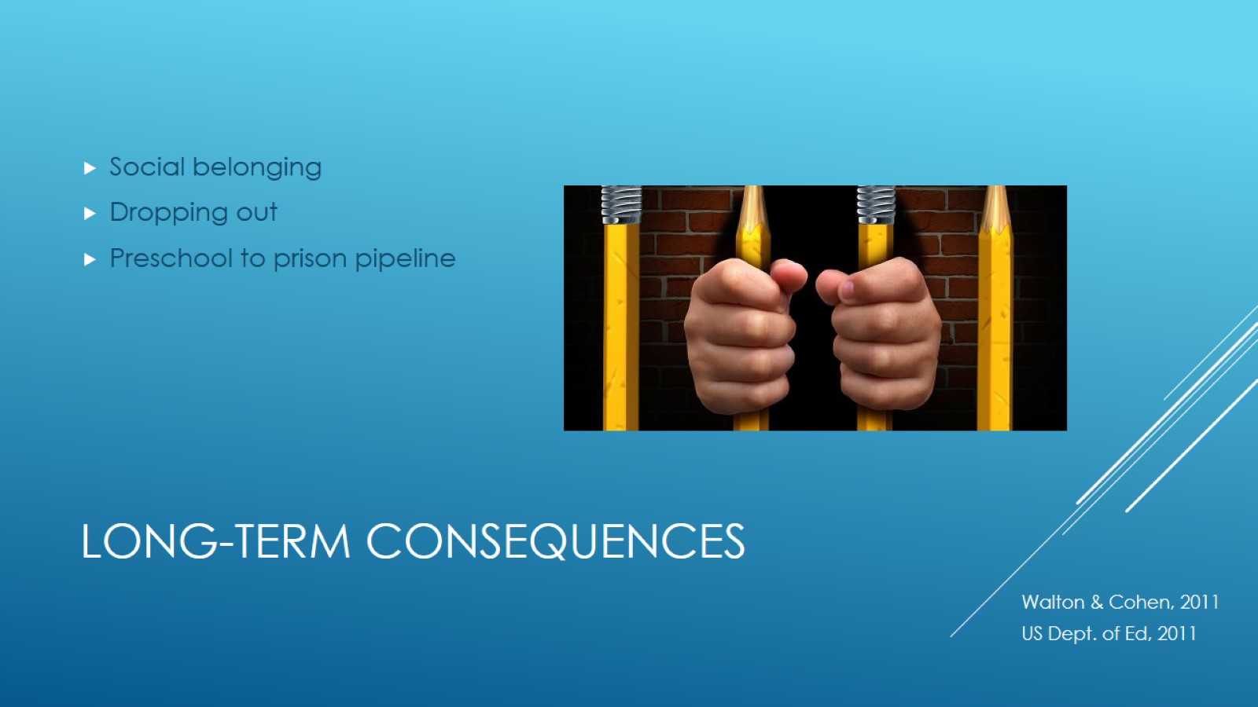
Long-term consequences

Slide 8
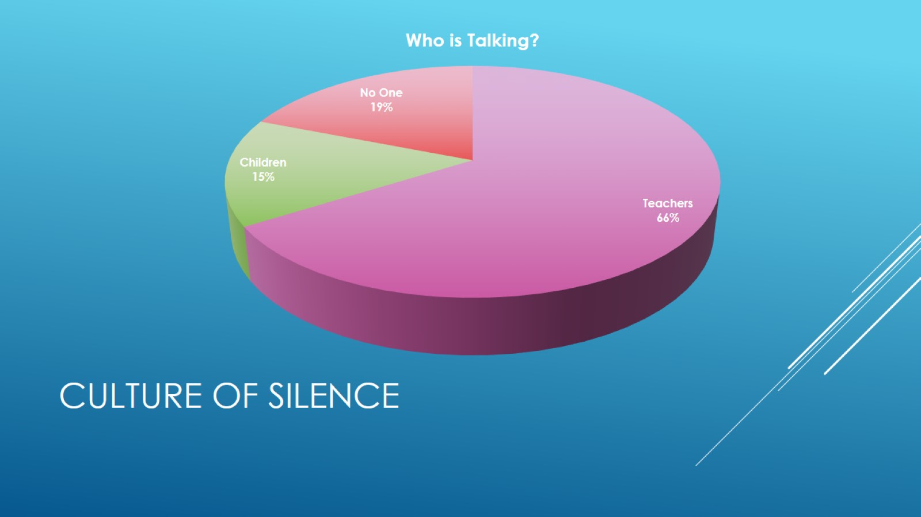
Culture of silence

Slide 9
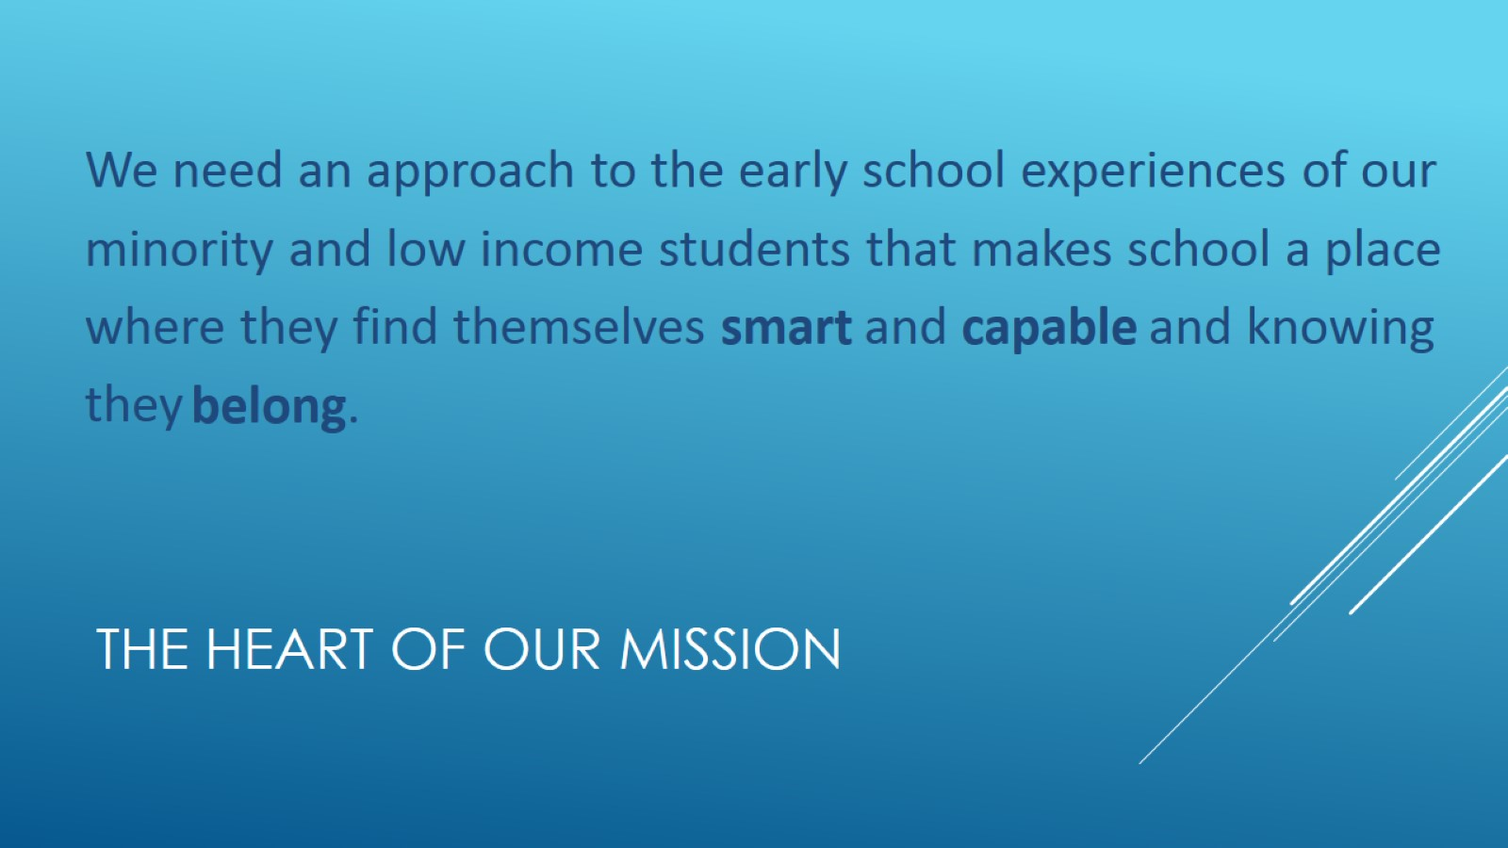
The heart of our mission

Slide 10
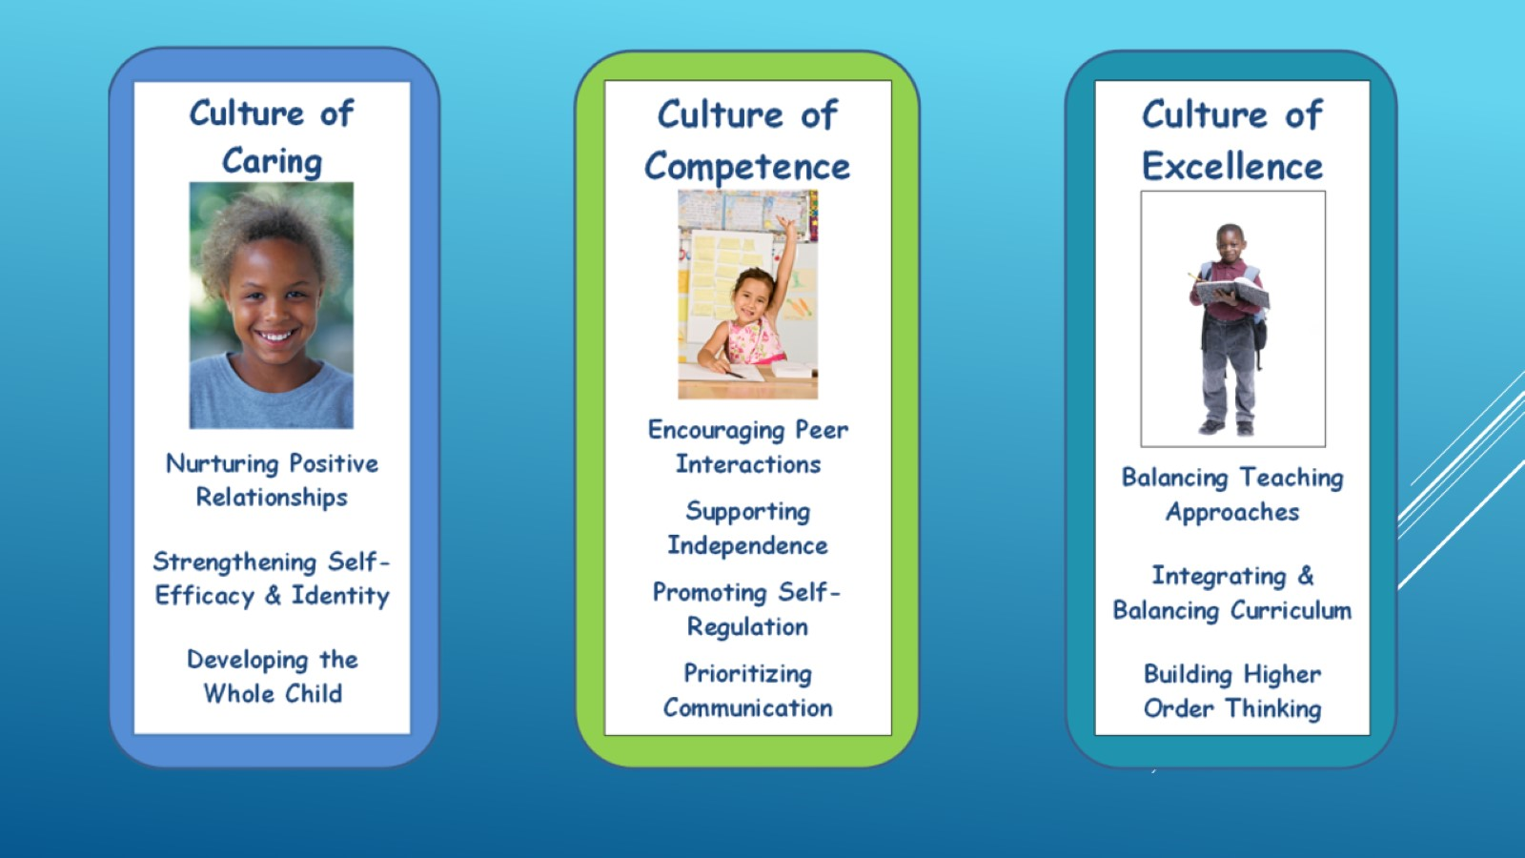

Slide 11
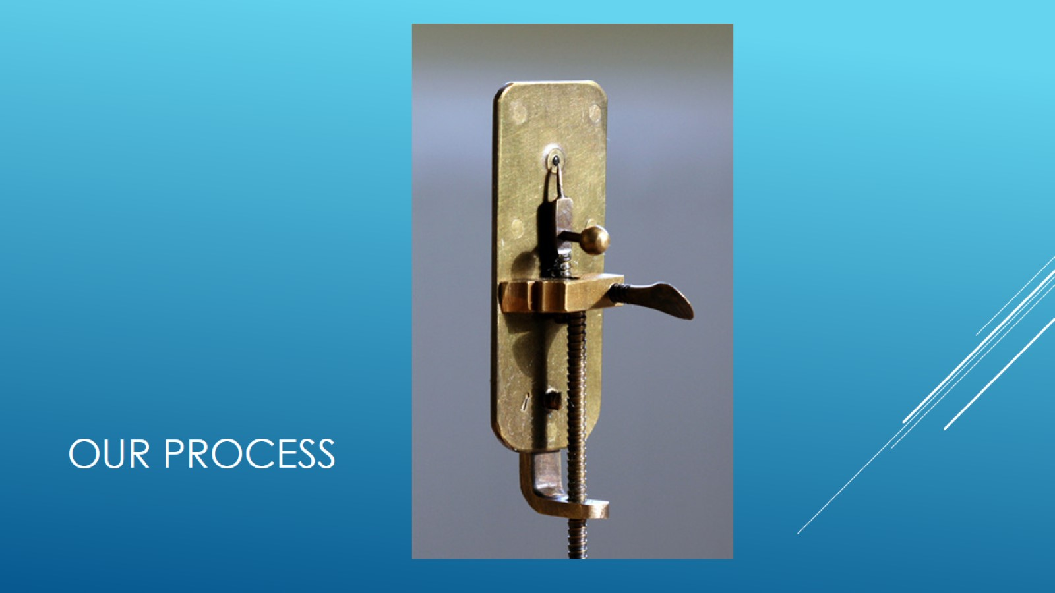
Our process

Slide 12


Slide 13
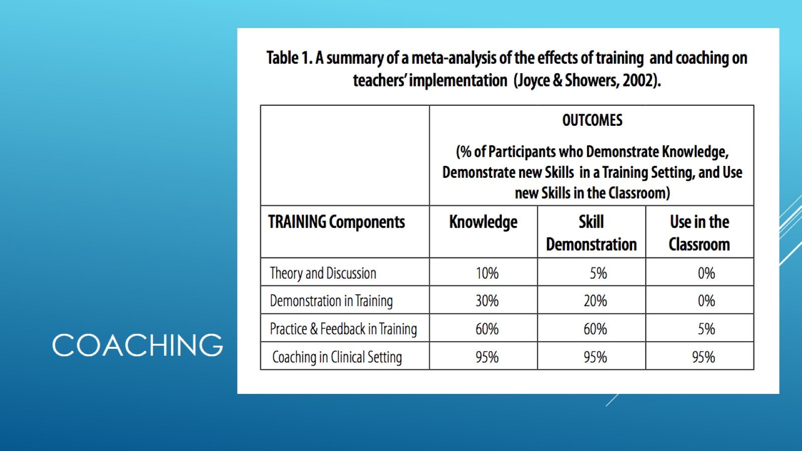
coaching

Slide 14

Coaching in hartford

Slide 15
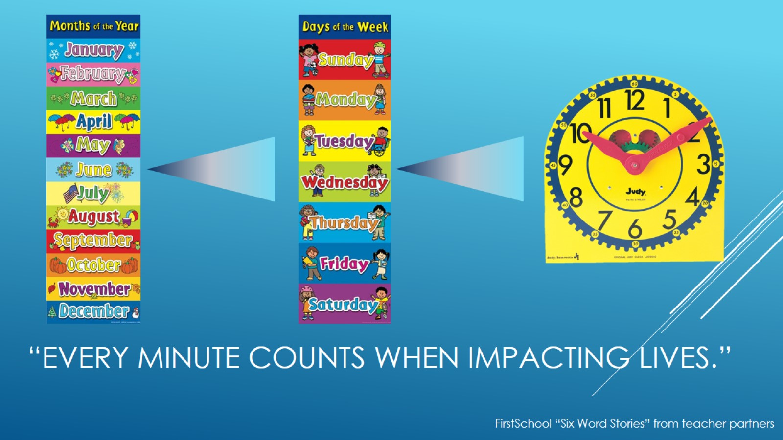
“Every minute counts when impacting lives.”

Slide 16

A culture of caring

Slide 17
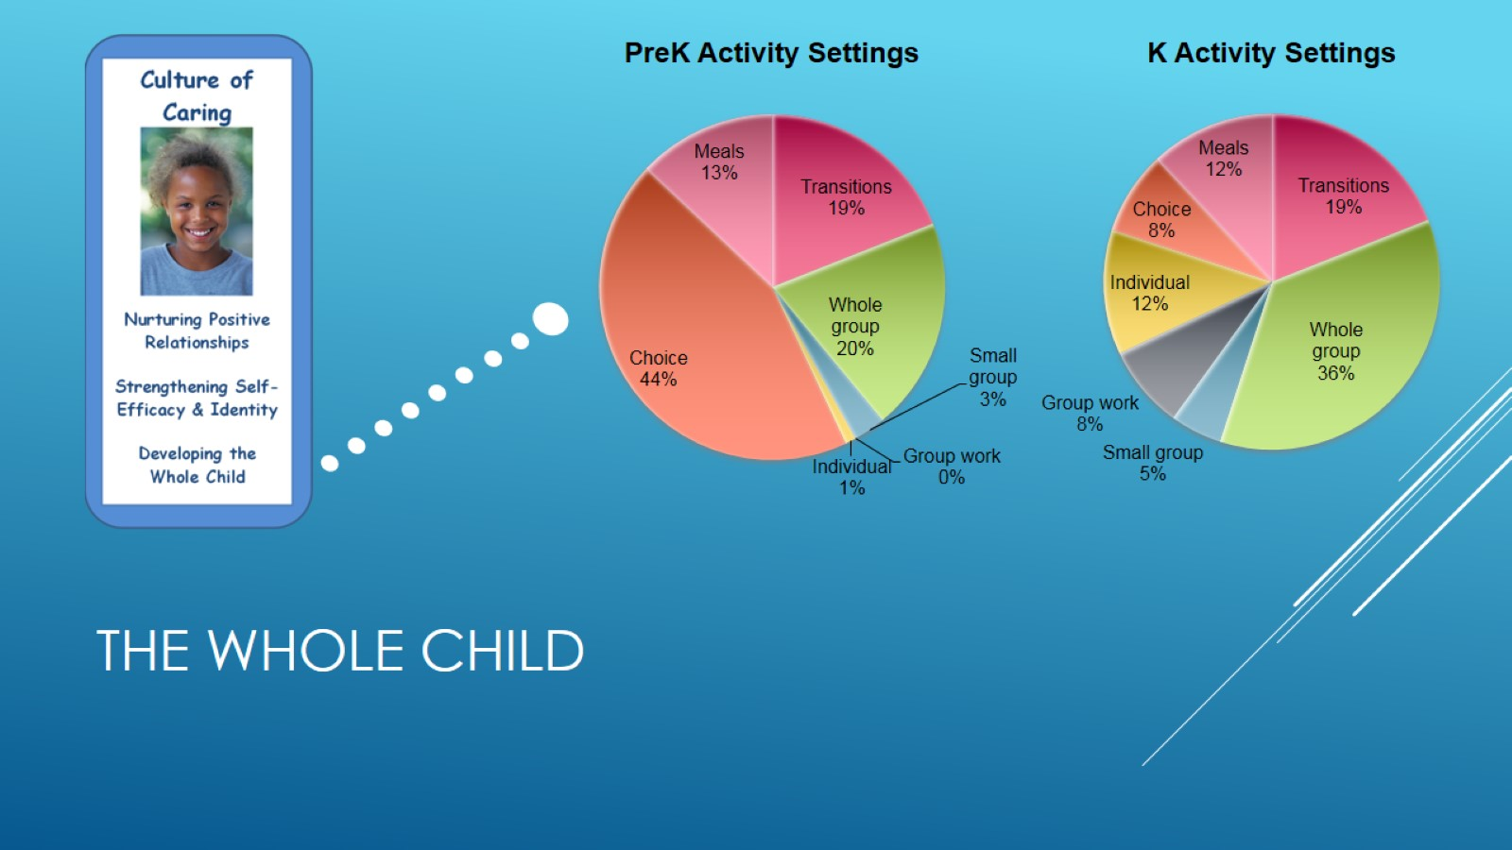
The whole child

Slide 18
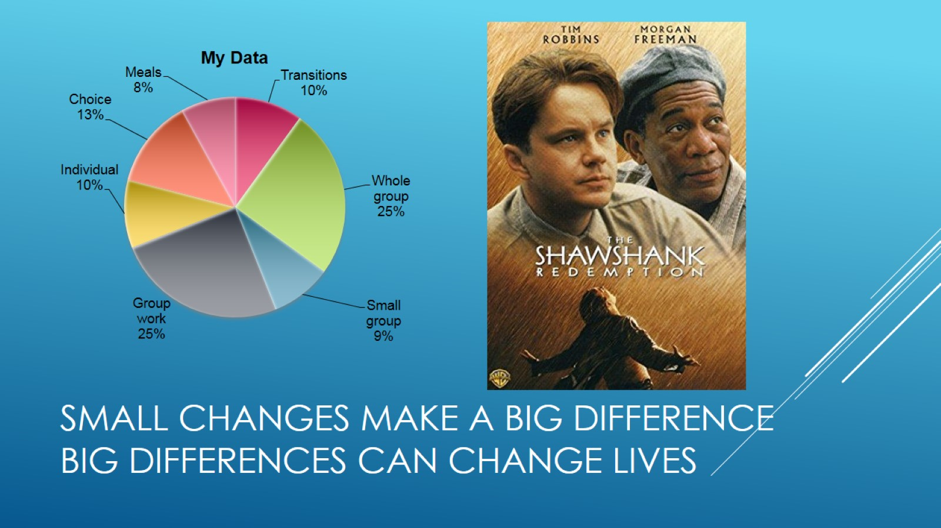
Small changes make a big difference
Big differences can change lives

Slide 19
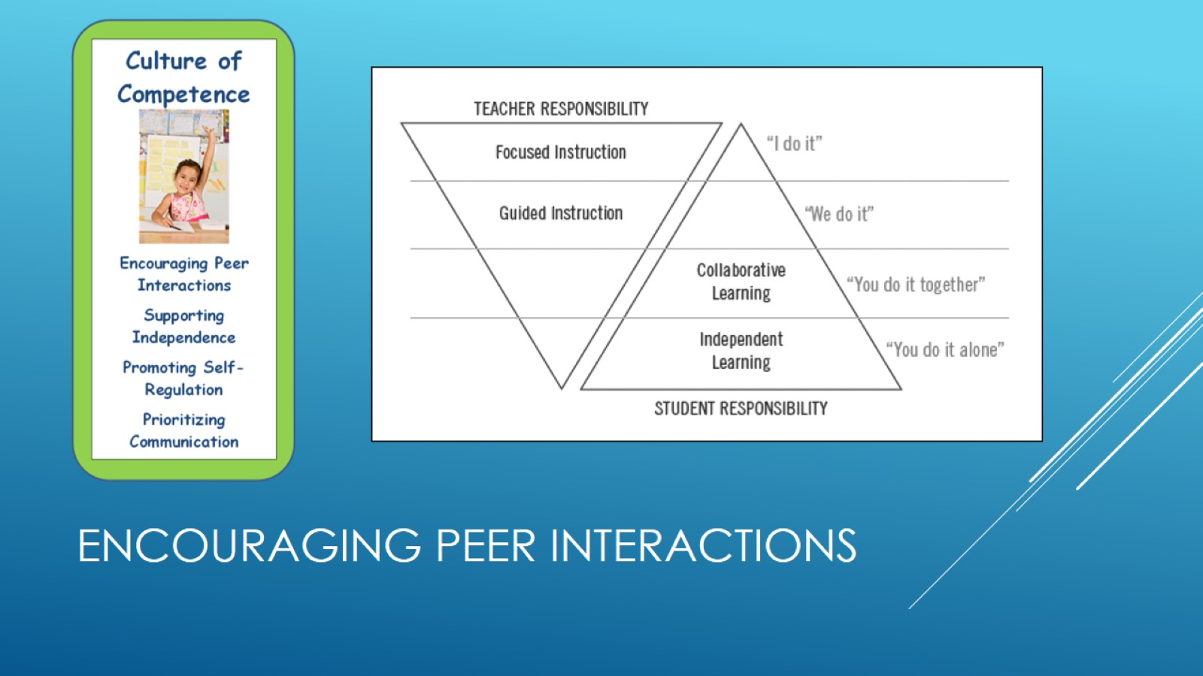
Encouraging peer interactions

Slide 20
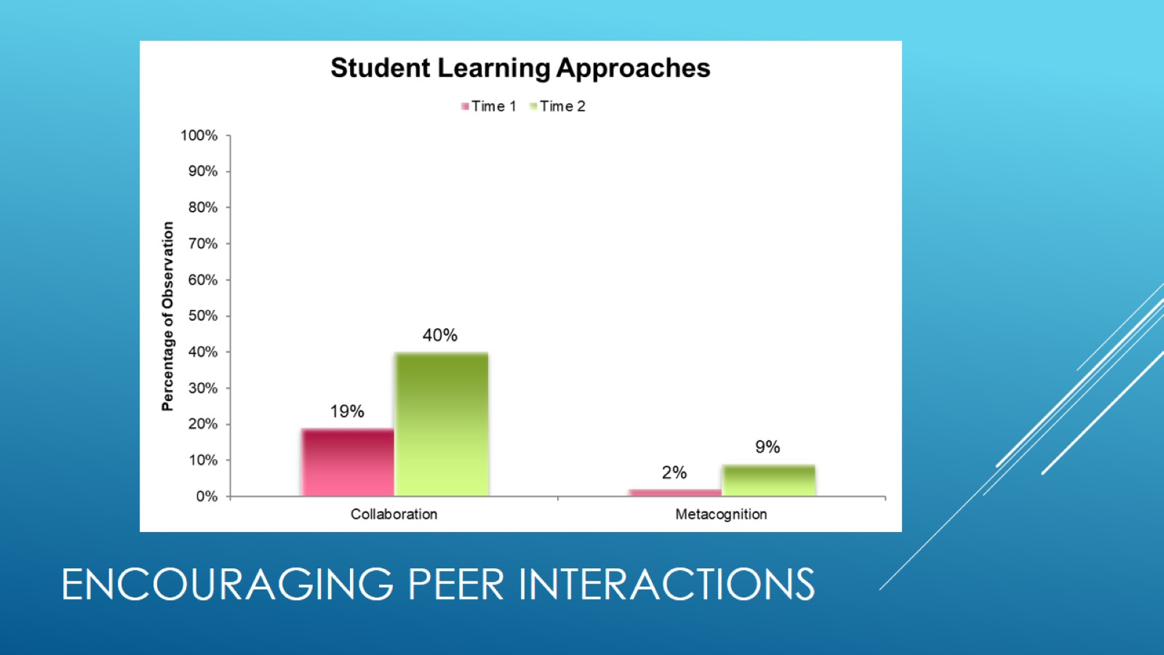
Encouraging peer interactions

Slide 21
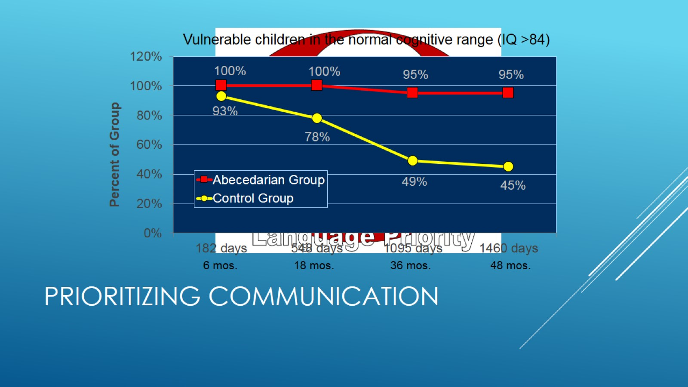
Prioritizing communication

Slide 22
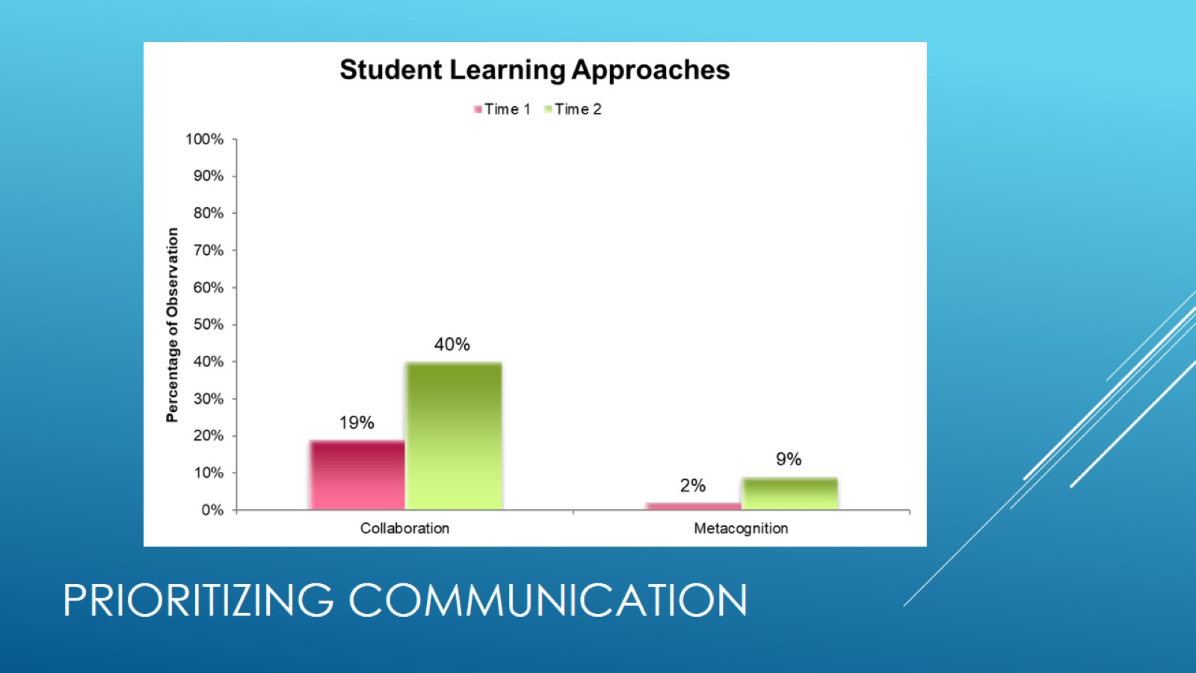
Prioritizing Communication

Slide 23
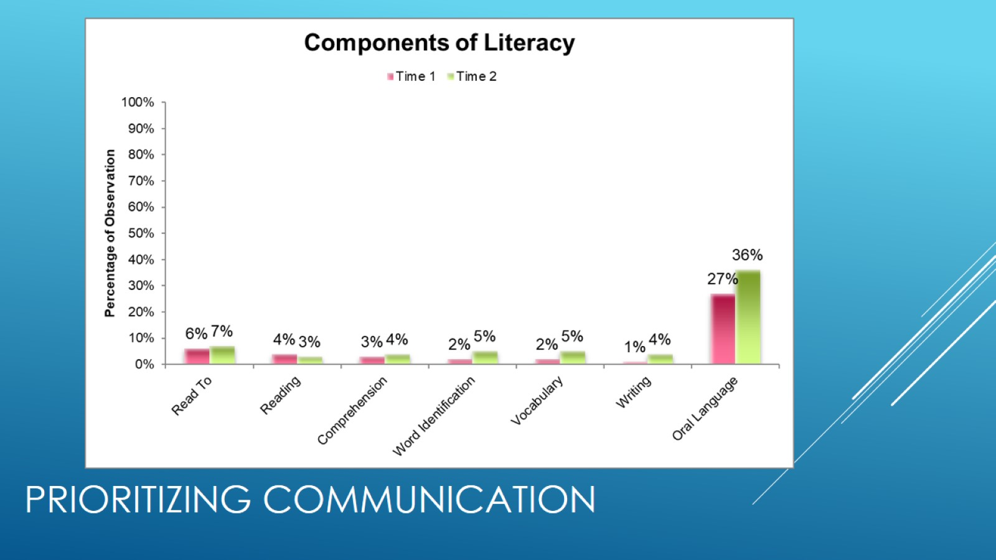
Prioritizing communication

Slide 24
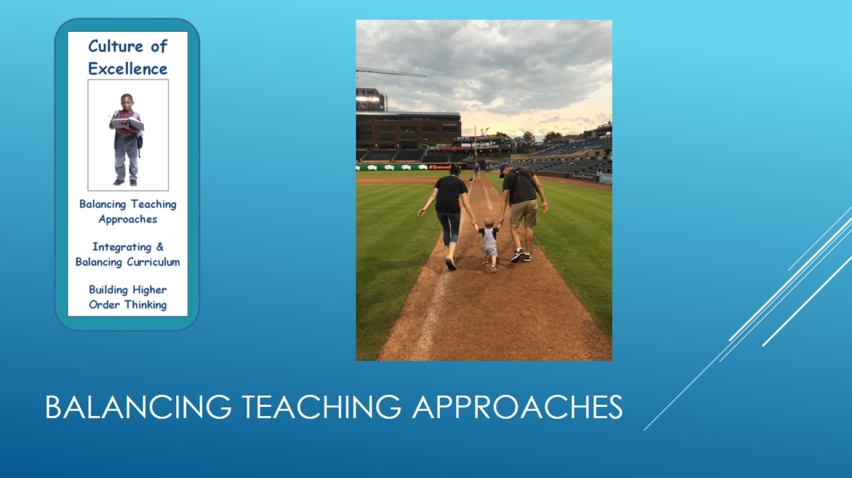
Balancing teaching approaches

Slide 25
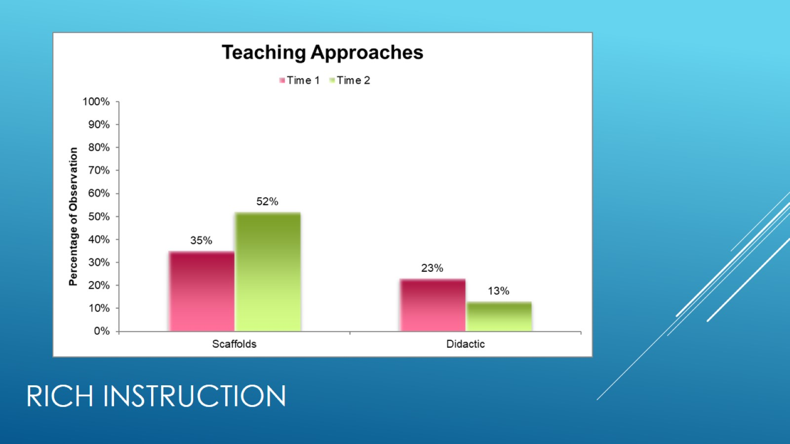
Rich instruction

Slide 26
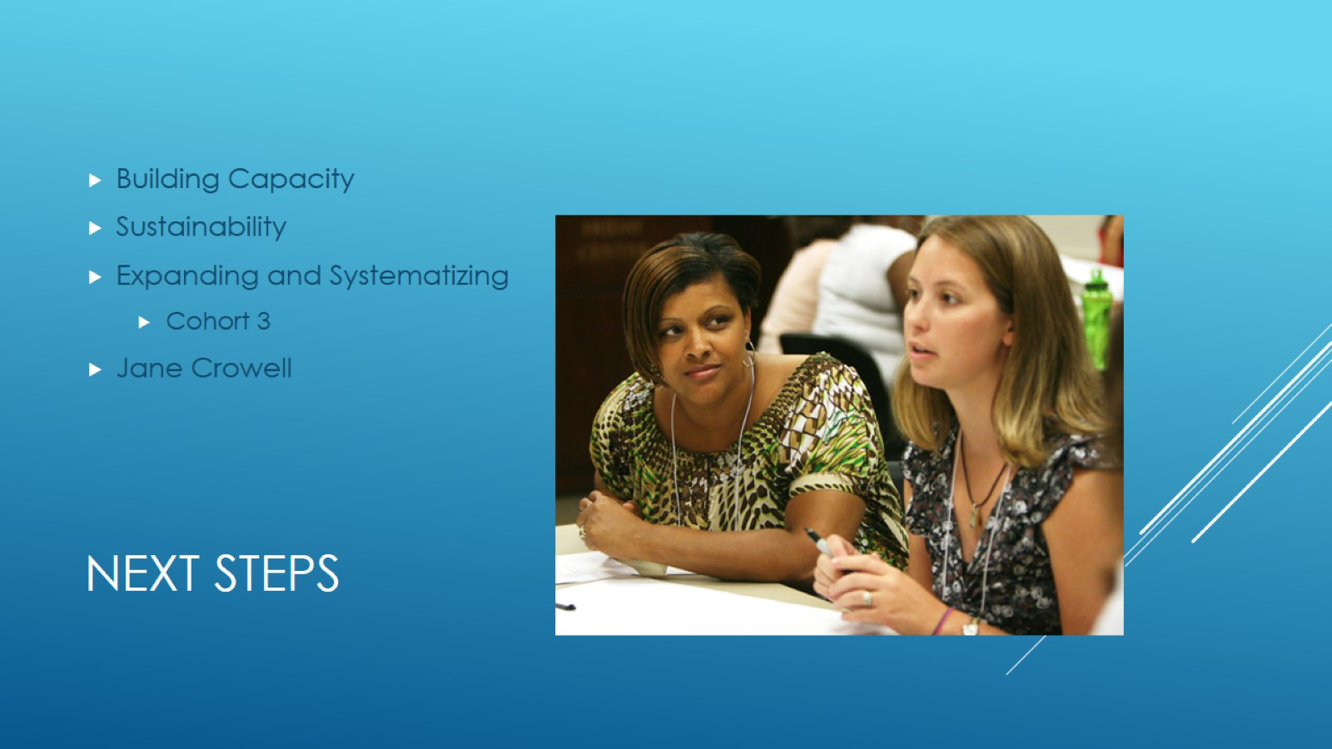
Next steps

Slide 27

Join us!

