Slide 1
Early Childhood Endowment Advisory Meeting
Friday, September 11, 2026

Slide 2
Quality and Workforce Initiative Updates
Systems
Supports
Initiatives

Slide 3
Early Childhood Education Endowment funding in QI Division
Funding from the Endowment is supporting these activities:
Quality Building Activity | SFY27 Budgeted | SFY26 Expended
Quality Improvement | $4,609,077 | $571,588
Workforce | $18,677,200 (incl. $5,327,200 SFY26 carryforward) | $6,372,800

Slide 4
Scholarship and Workforce Engagement
Scholarship
  Increased scholarship funding by $1 mil to $2 mil total
    FY 25: award $1.6 mil; for 490 individuals
    FY 26: award $2.8 mil; for 820 individuals
  Updated Registry functions improving the pathway to scholarships
    Scholarship SMART application
  Registry accounts: 52,339; FY27 new accounts: 5,167

Slide 5
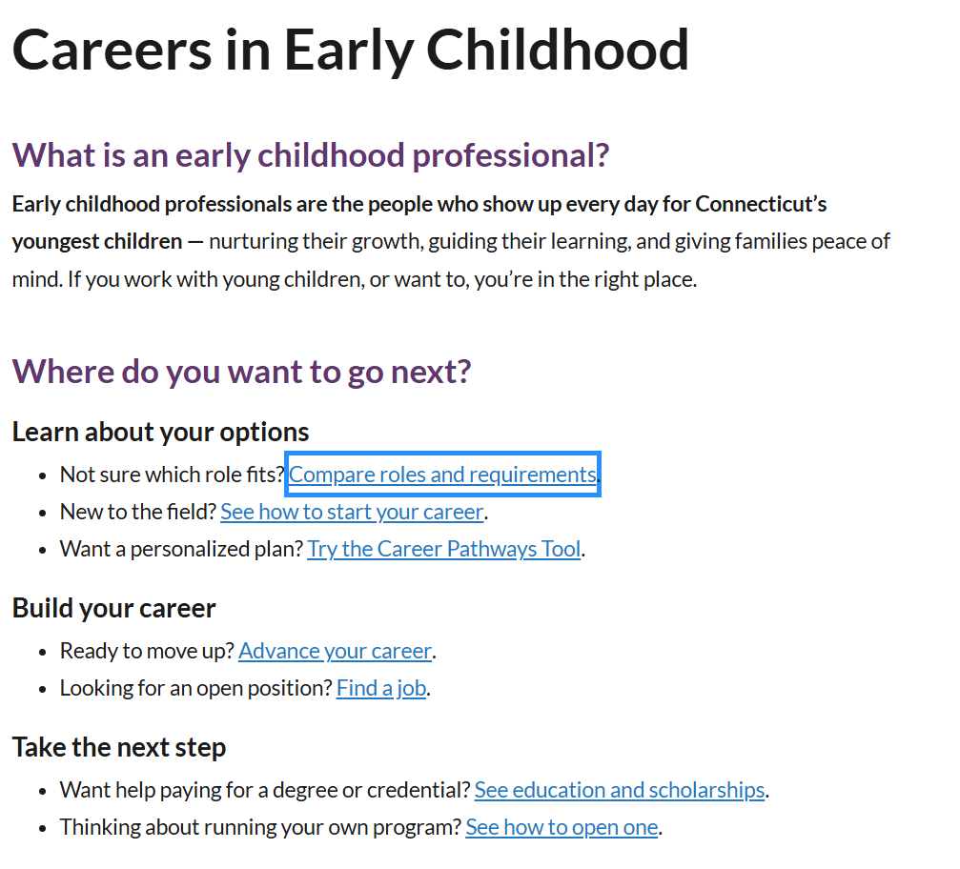
Career Development Materials Coming soon!
Notes:
Developed new Career Development Materials to support the existing and recruit new members of the workforce.
Materials will be housed on this Career Development section of the OEC webpage

Slide 6
Career Development Materials - QSM
New communications guides to support QSM planning and compliance :
Director Registry Guide: Step by Step Guide for Directors and Administrators
Teacher Registry Guide
12 foundational credits: what they are, who needs them, how to get them

Slide 7
Support for high-quality through NAEYC Accreditation
Accreditation Support
  AQIS service delivery
    150% increase in applicants over last 2 rounds from providers preparing for or already in Early Start CT
    232 active sites engaged in the NAEYC accreditation process
    Applications available again Fall 2026
    Developing a cohort model for multi-site organizations to help manage capacity
Notes:
NAEYC Accreditation supports are funded through Endowment funding
Accreditation support is the most rapidly growing of all of our quality initiatives. “canary in the coal mine” for how programs are managing their efforts toward quality.

Slide 8
Apprenticeship
The Office of Early Childhood (OEC) is implementing a statewide Early Childhood Education (ECE) Registered Apprenticeship initiative to recruit and strengthen the early childhood workforce, support credential attainment, and improve wage opportunities.
  Includes Family Child Care (FCC – 100 participants) and center- based apprenticeship (98 participants)
  Working toward implementing the Unifying Framework with clear levels — ECE I, ECE II
  Includes planned expansion from CDA into stackable Associate’s ECE II pathways
  Thank you to CT DOL, SEIU Education and Support Fund and partners
Includes On the Job Training, mentorship, related instruction and college credit, and stipends
Notes:
Thank you to the Dept of Labor for their partnership and SEIU Education and Support Fund for their work with Family Child Care
ECE ll level starting Jan 2027. New contracts will support ~180 new apprentices. Add support for employers??

Slide 9
Results
Increased retention
Increased professional growth
Increased knowledge of child development & quality
Increased wages
Increased college credit
Increased FCC C4K rates for NAFCC
Participation in the apprenticeship program has positively impacted retention. Apprentices show higher commitment, stronger engagement, and a greater probability of remaining with the organization compared to what is typically observed in standard entry-level ECE positions, largely due to structured support, mentoring, and clear career pathways.
Notes:
Yellow arrow, helping staff to work towards meeting QSM, (for funded programs). Green arrow: Increased student confidence.

Slide 10
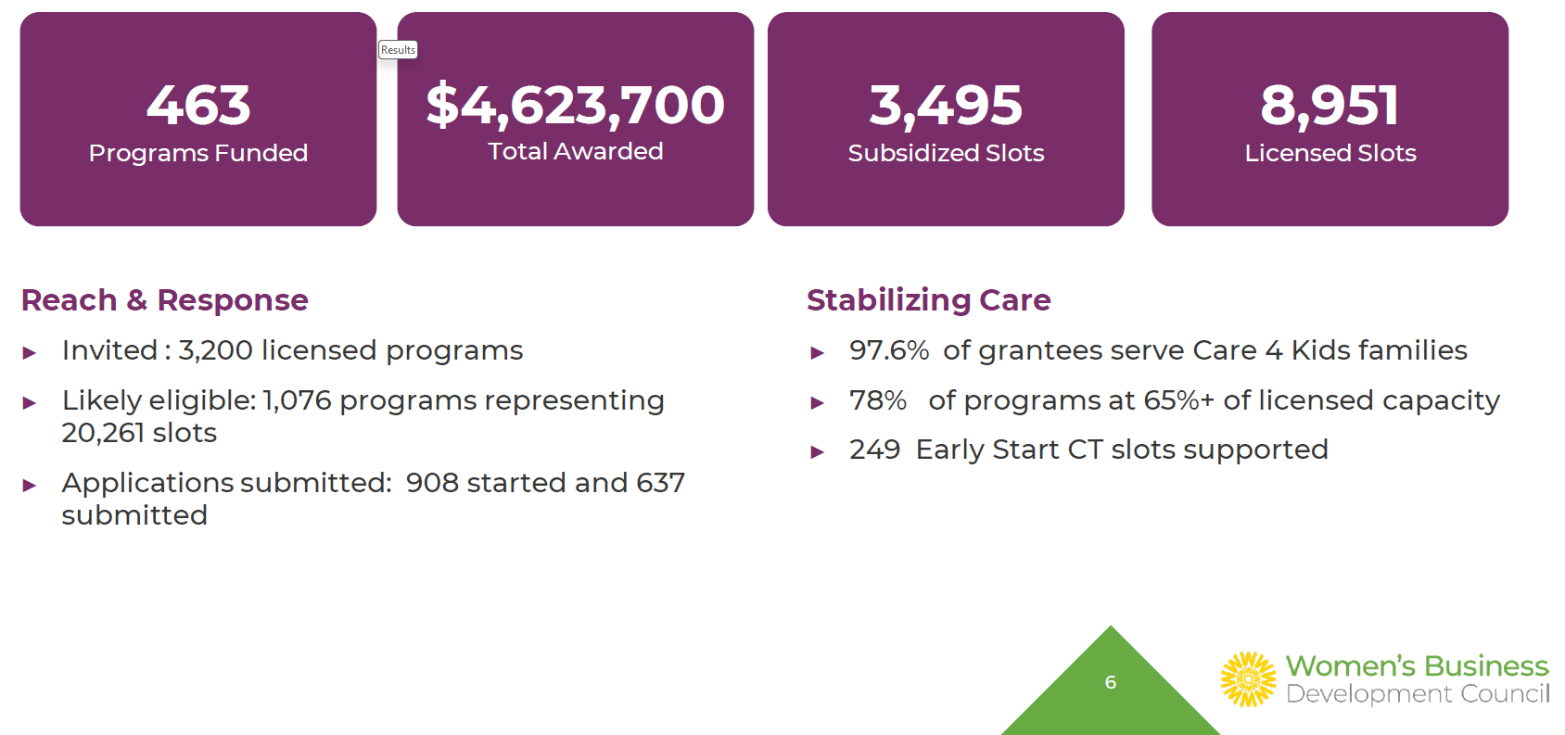
Program Operations Grant Summary
Notes:
Key eligibility at a glance:
Licensed by OEC prior to November 1, 2025
Currently operating full-time with enrolled children – minimum thresholds apply
Operating in a high-medium needs area as defined by OEC (COI/Child Care Access)
Next Round:
Expanded eligibility, longer application time
Applications to be released after January, 2027

Slide 11
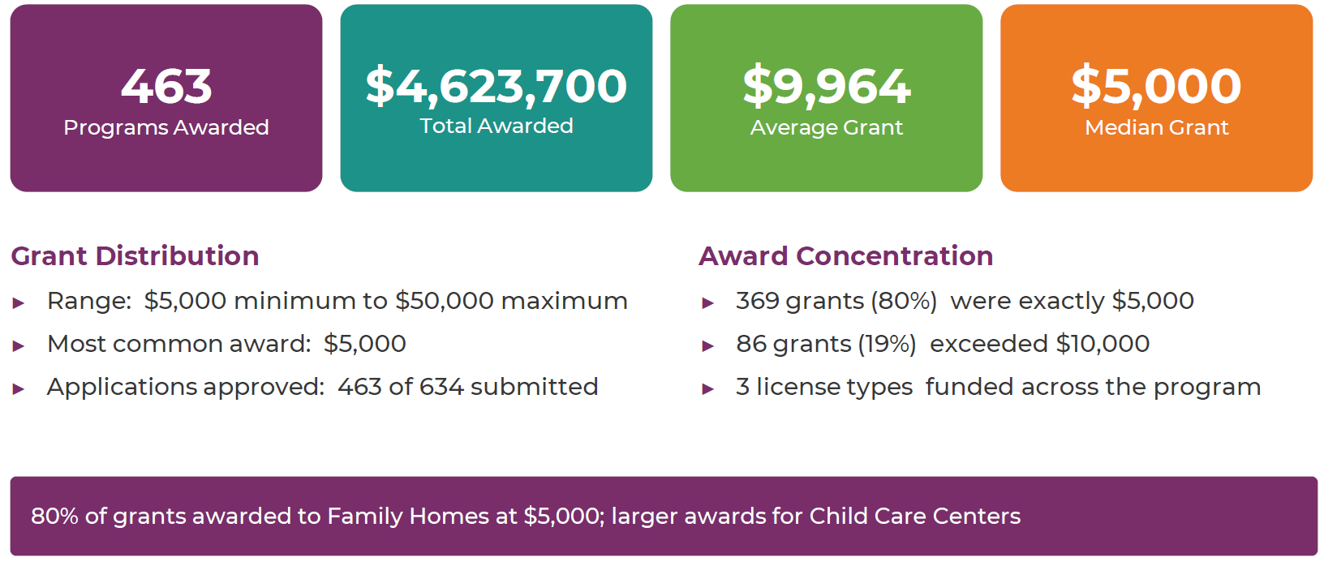
Program Operations Grant Summary
Notes:
Key eligibility at a glance:
Licensed by OEC prior to November 1, 2025
Currently operating full-time with enrolled children – minimum thresholds apply
Operating in a high-medium needs area as defined by OEC (COI/Child Care Access)
Next Round:
Expanded eligibility, longer application time
Applications to be released after January, 2027

Slide 12
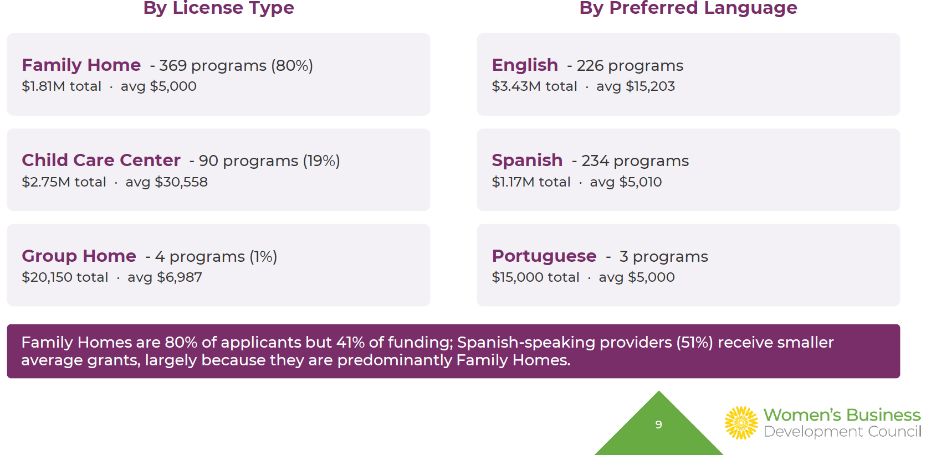
Awards by License Type and Language
Notes:
Key eligibility at a glance:
Licensed by OEC prior to November 1, 2025
Currently operating full-time with enrolled children – minimum thresholds apply
Operating in a high-medium needs area as defined by OEC (COI/Child Care Access)
Next Round:
Expanded eligibility, longer application time
Applications to be released after January, 2027

Slide 13
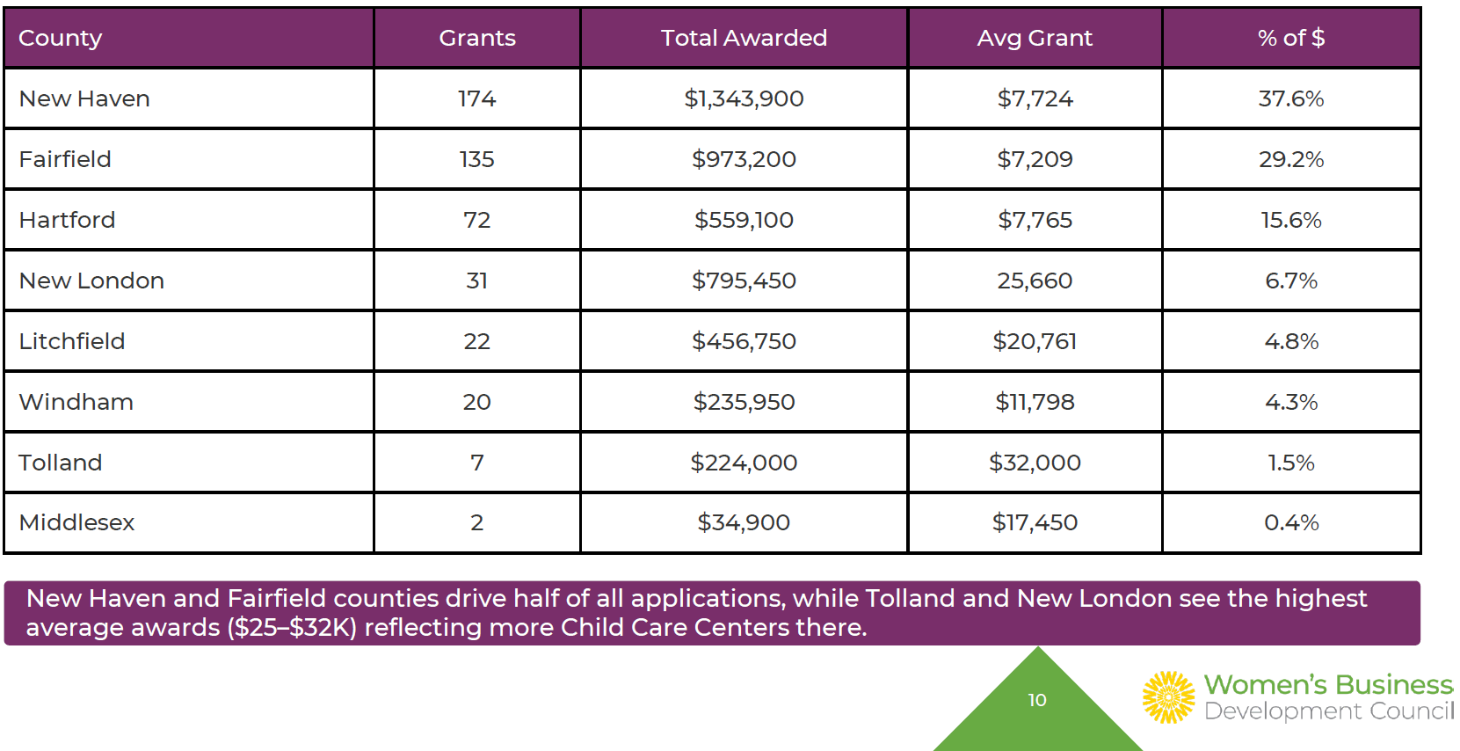
Awards by County
Notes:
Key eligibility at a glance:
Licensed by OEC prior to November 1, 2025
Currently operating full-time with enrolled children – minimum thresholds apply
Operating in a high-medium needs area as defined by OEC (COI/Child Care Access)
Next Round:
Expanded eligibility, longer application time
Applications to be released after January, 2027

Slide 14
Stories from the Field

Slide 15
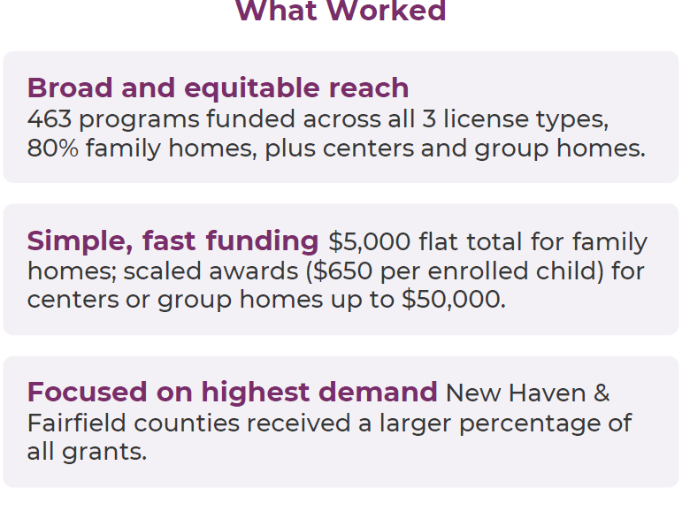
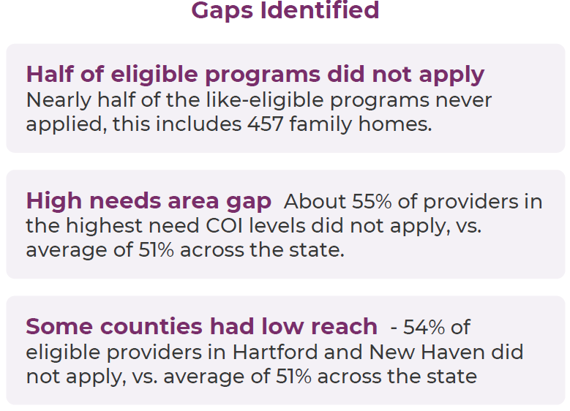
Lessons Learned
Notes:
Elena:
Next Round:
Expanded eligibility, longer application time
Applications to be released after January, 2027
More comprehensive marketing campaign (targeted outreach)

Slide 16
OEC Upcoming Sessions and Events

Slide 17
OEC Upcoming Sessions & Events
Family Child Care (FCC) Community Engagement Sessions – October 2026
Systems (SFCCNs, community networks, etc.) sessions
    Two sessions – one in person and one virtual
  Educator sessions
    Four sessions – 2 in person and 2 virtual with Spanish interpretation available
Early Start Provider Meetings
Tuesday, October 13, 9:30-12:00pm New London
Saturday, October 17, 9:30 – 12:00pm Bridgeport
Tuesday, October 20, 9:30 – 12:00pm Hartford
Local Governance Partner Focus Groups – September & October
Town Hall for Providers and Families – November
Notes:
Elena

