Slide 1

Executive Summary
The current state of child care access in Connecticut is a significant challenge. It is a fragmented and confusing "patchwork system" that forces parents and caregivers to navigate multiple disconnected sources for basic information, program availability, and financial assistance.
The proposed solution, the One Entry Portal, will unify this patchwork by bringing all essential information and application processes into a single, comprehensive location.
This initiative is expected to yield substantial financial and practical benefits, reducing cost of subsidy implementation by digitizing the application process and helping families find affordable care more quickly.

Slide 2
Connecticut's Commitment to Early Childhood Access
"Access to child care and early education programs is massively important to the success of our state, not only because these programs provide valuable tools for children that will lead them to success in the future, but also because being able to enroll your child in care right now means that parents themselves can have an opportunity to obtain employment and earn an income that supports their family.”
Governor Ned Lamont
This project directly aligns with the mission of the Office of Early Childhood by resolving the complexity for families and providers, ensuring a more equitable and comprehensive system for accessing and affording child care, and addressing the systemic inefficiencies that currently impact families and the state.

Slide 3
HB 5003 Requirements
Include but not limited to:
Assisting families in locating child care
Allow providers to promote child care space availability
The ability for the agency to manage child care payments to programs
Have mobile Access
Allow parents to apply for subsidy.

Slide 4
Current State
Several Routes to Obtain Basic Information
What child care options do I have?
Where can I find location, hours, and other information?
Is it a quality program?
Looking for child care in Connecticut means navigating a patchwork system of formal and informal networks, no, matter the entry point.
Family Child Care
Child Care Centers
Care.com
Local Governance Partners (LGP)
Licensing Violations
Accreditation
School District PK
Head Start
211
Word of Mouth
OEC Elevate
Disconnected Systems for Financial Assistance
Does the program offer financial assistance?
Am I eligible?
How do I apply?
Care4Kids
Early Start
Locally Funded
State Guidelines
Care4Kids Screener
Local Governance Partners (LGP)
Care4Kids App
Smart Start
Head Start
Independent Scholarships
Federal Guidelines
Word of Mouth
Direct with Provider
Opaque Program Availability
Does the program have space?
Does the program have subsidized spots?
Can the program accommodate
special needs?
Calling
Emailing
Word of Mouth
Calling
Emailing
Word of Mouth
Local Governance Partners (LGP)
Calling
Emailing
Word of Mouth
Compounded by Each Young Child in Your Family

Slide 5
Proposed Solution
Understand the child care landscape
Learn how to find affordable child care & apply for subsidy
The One Entry Portal will bring information together in one place, ensuring families and the organizations supporting them are receiving the same, comprehensive information about how to access and afford child care in Connecticut.
Search for programs that meet unique your needs
Access support in your language when you need it

Slide 6

Listening to Learn…
Portal Advisory Group :
Owners and directors of Head Start, state-funded, and family child care centers
Representatives from Local Governance Partners (LGPs)
Representatives from nonprofits and advocacy organizations
Parents
Listening Sessions
Connecticut Early Childhood Cabinet
OEC Parent Cabinet
OEC External Steering Committee
Child Care for Connecticut
Connecticut Early Childhood Alliance
Family Child Care Union
LGP Liaisons in January

Slide 7
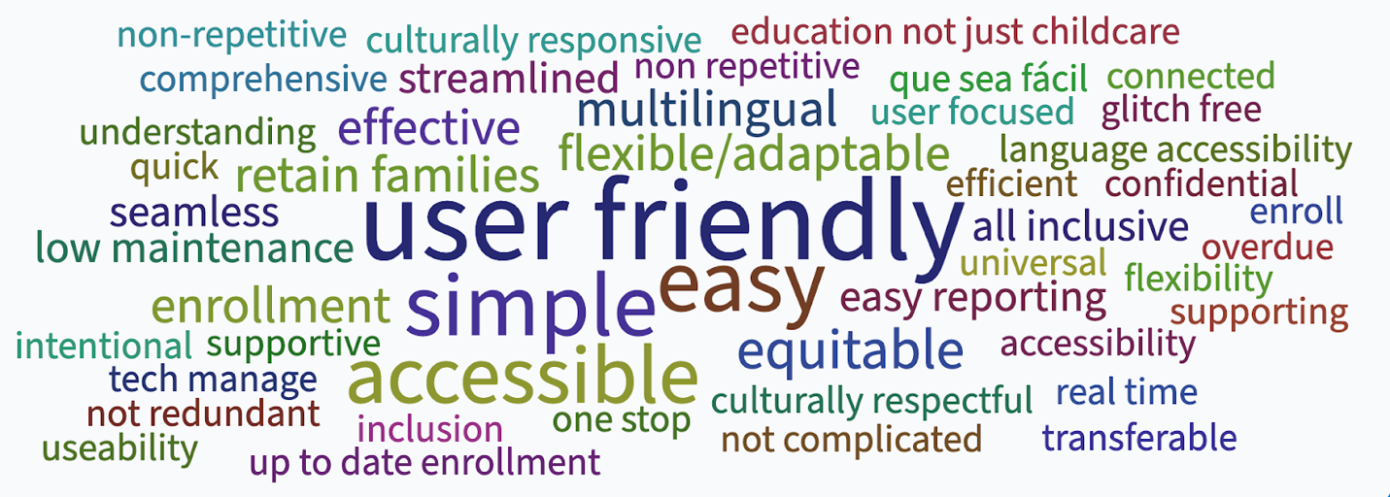
Hopes

Slide 8
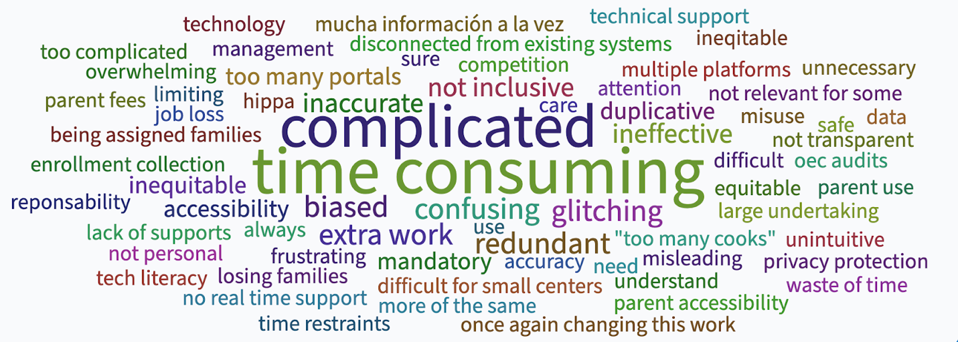
Fears

Slide 9





Critical to the Success of Implementation
Continuous Feedback Loops
Intentional Rolls Outs
Small Pilots
Learning Aides and Training
Responsive Customer Service

Slide 10
Project Goals
Project Goals | Target FY for Goal | Current Condition | Success Criteria
Successfully implement One Entry Portal | FY28 | Parents access child care and means to pay for child care (subsidy, state funded spaces) in a disjointed. | A single-entry point, ONE place that allows them to make an informed decision.
Successfully expand OEC’s existing Provider 360 portal to integrate with the One Entry. | FY28 | The current system is disjointed and difficult to manage. | Create a single-entry point .
Successfully expand OEC’s existing Provider 360 portal to integrate with the One Entry. | FY28 | Providers often do not have the human or time capital to effectively maintain their programs. | Create a single-entry point that allows providers to market their programs free of charge effectively.
Create a single point of entry that will provide OEC with accurate information on the child care needs of specific geographical locations | FY28 | Currently OEC has no data on the types of child care services that families are seeking | A single-entry point will capture the locations, hours, and types of care families are searching for.
Simply the system for parents and providers. | FY28 | Providers and families currently manage different systems within the early childhood infrastructure. | Create a simplified access point for families and providers to manage.

Slide 11
Primary Beneficiates
Beneficiary Describe the primary beneficiaries of this project | Expected Benefit Describe the nature of the benefits and the metrics that will be used to demonstrate benefit realization
Parents / Guardians | A one stop shop to learn about providers, determine eligibility for free- or reduced-cost care, and enroll in an available seat.
Early Child Care Providers | A powerful tool to market to families, collect and manage enrollment paperwork, and access tools for day-to-day business operations.
Office of Early Childhood | Access to real time data and information will increase efficiency, strengthen the workforce, and lead to more children accessing care.
Broader Public, Advocates, Legislators, etc. | Insight into system level supply / demand data to inform advocacy efforts and to support sector sustainability.

Slide 12
Next Steps
The current state of child care access in Connecticut is a significant challenge for Connecticut’s families and its child care business owners, and these challenges result in lost opportunities for working families and child care providers and over a billion dollars in lost productivity and tax revenue at the state level.
In 2025, the State Legislature mandated a change, passing HB 5003 and calling for a Single Point of Entry Portal to make finding affordable child care easier.
To meet that mandate, OEC must move forward on the following next steps:
Begin phased build
Procure new vendor
Training & onboarding plan
Use Federal PDG dollars to begin enhancements to provider-facing Provider 360.
Procure and on-board a new vendor to build parent- and community-facing modules and ensure integration with Provider 360.
Develop comprehensive training and onboarding plan to ensure that child care providers are prepared to use new functionality in advance of public launch.

