Slide 1
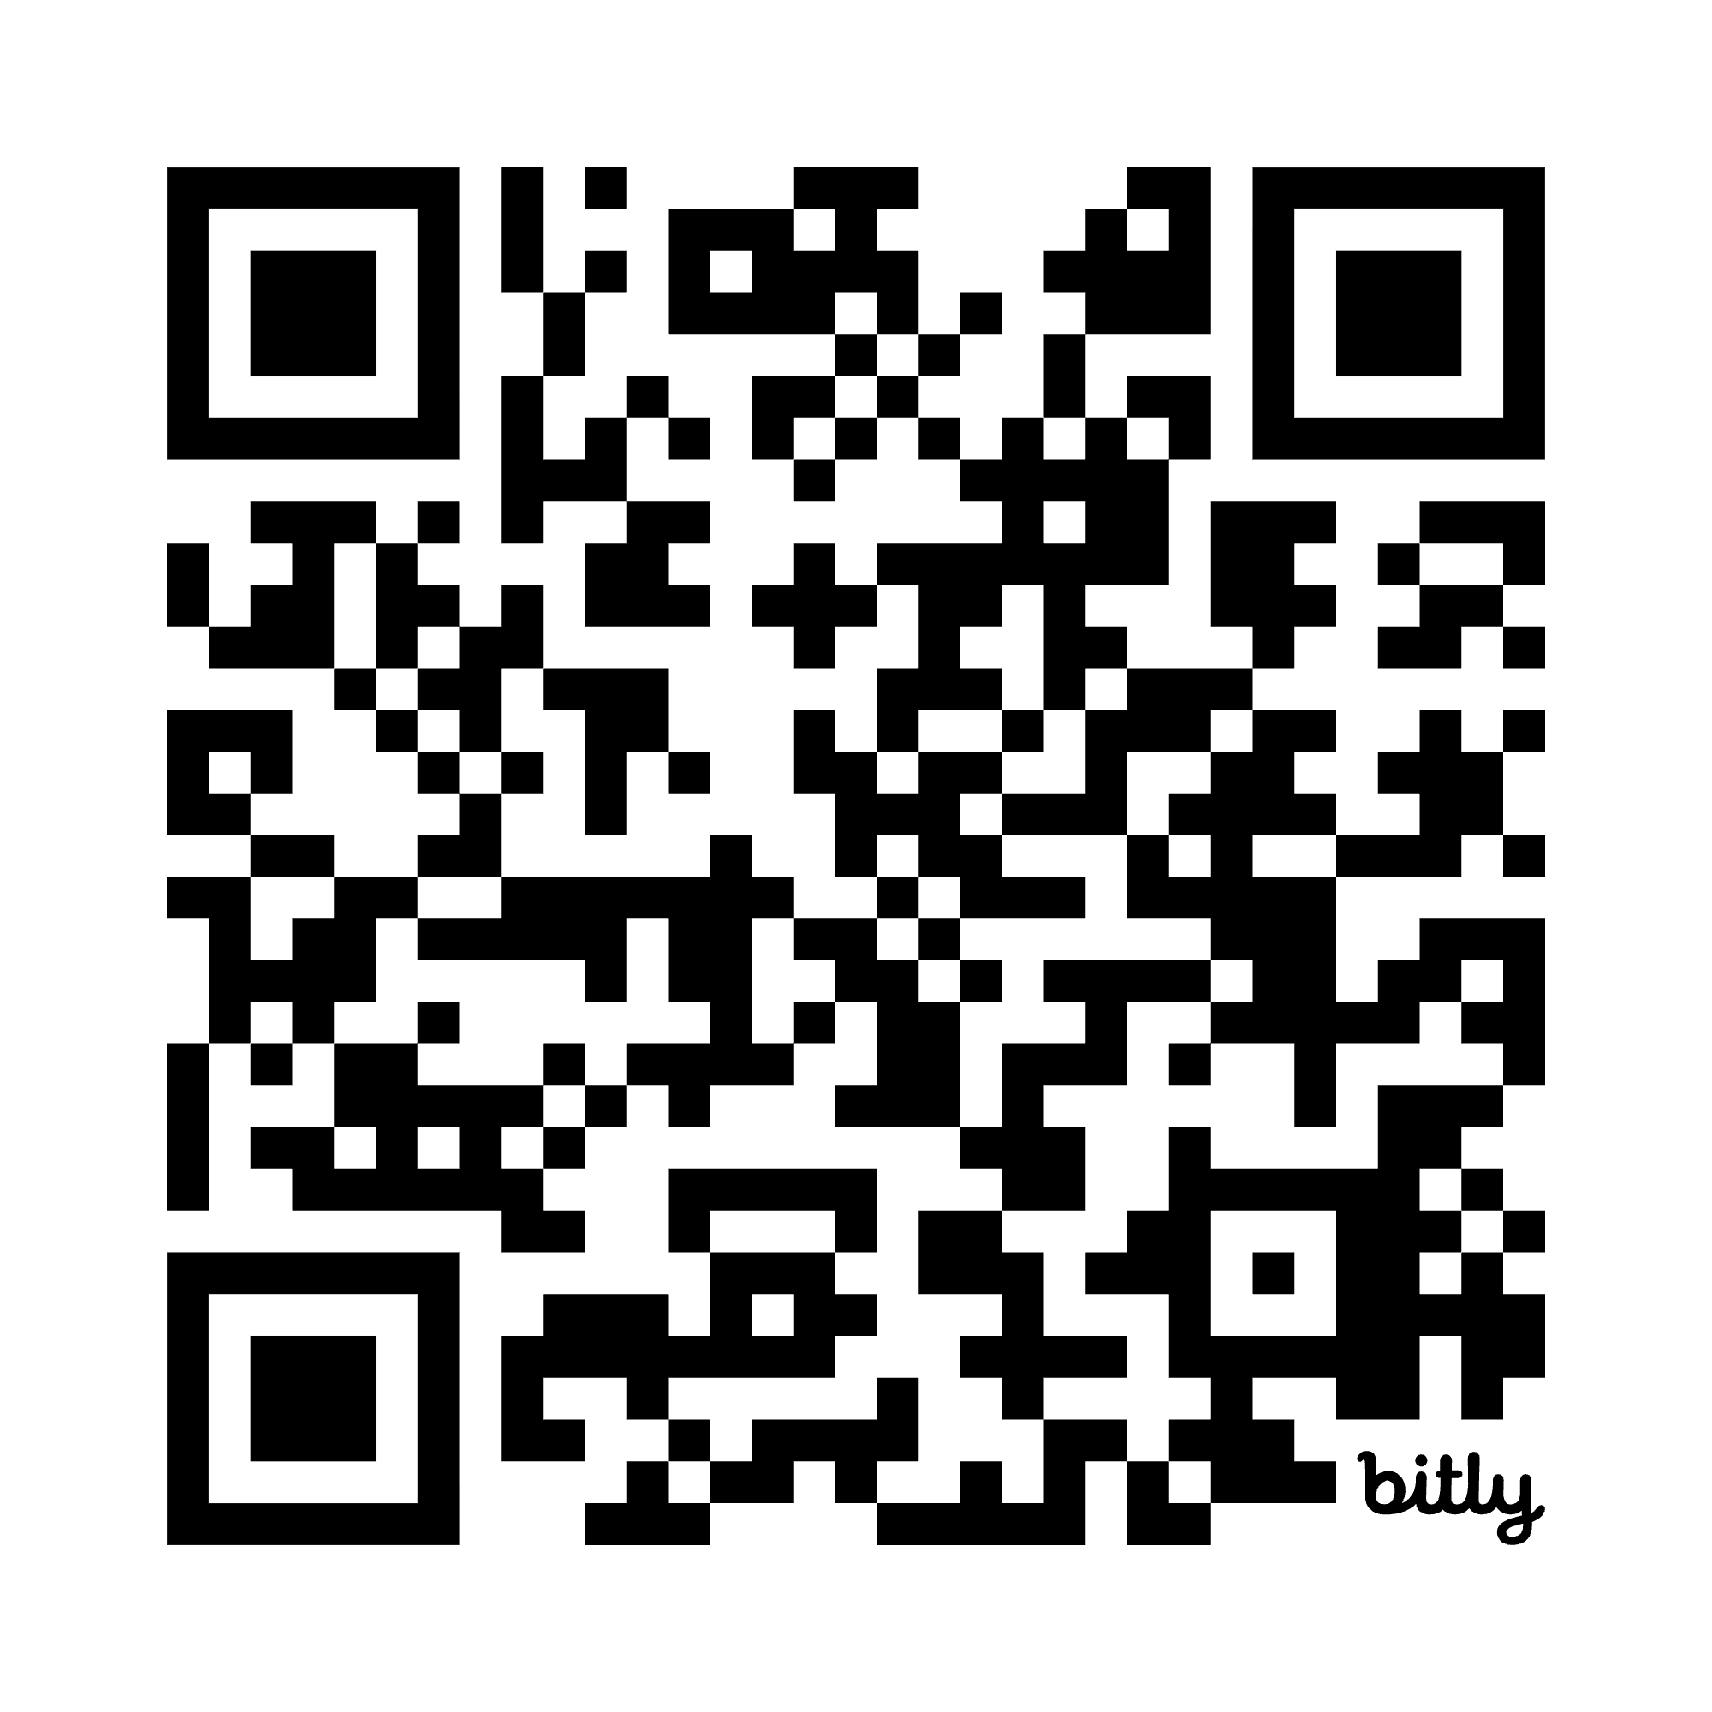
What are Local Governance Partners (LGPs)
PRELIMINARY DRAFT
LGPs are located in cities and towns that receive Early Start CT funding, or they are regional across multiple communities. They bring together parents, early childhood providers, and community organizations to strengthen services for children birth to age five. The LGPs empower the community's voice to shape how services are delivered locally.
LGPs are a key part of the Early Start CT system, and they are intended to engage and support all early care and education programs in the community, including those that do not receive state funding.
Check out the LGP Fact Sheet at:

Slide 2
What LGPs Do
PRELIMINARY DRAFT
All LGPs across Connecticut operate within the same framework, while adapting to local needs.
Every LGP must:
EMPLOY Liaisons and Parent Ambassadors
Regularly CONVENE a Community Table
CONDUCT a data-driven needs assessment and create a community plan
SUPPORT all early childhood providers in their area
STRENGTHEN partnerships with families and community organizations

Slide 3
PRELIMINARY DRAFT
Local Needs Assessment (LNA) Overview
  Each LGP is required by legislation to complete a local needs assessment (LNA) to build a holistic understanding of the early childhood landscape in their community.
  An LNA Toolkit was developed by the OEC, including shared data and a customizable framework to guide LGPs through the process.
  The LNA features a section on the Availability and Affordability of Early Care and Education, including specific questions on Early Start expansion.
  The OEC has contracted with the CTData Collaborative and the RESCs to provide training and technical assistance to LGPs on the LNA process, along with their ongoing support from Shine.
Notes:
Karen

Slide 4
PRELIMINARY DRAFT
Local Needs Assessment (LNA) Overview
  LGPs will have until the end of June 2026 to complete the initial LNAs.
  LNA findings will serve as the foundation for each LGP's Community Plan, which LGPs will draft in Summer - Fall 2026.
  The OEC will summarize and share LNA findings with the state's ECE community.
  LNA findings will inform Early Start CT planning and applications over the coming years.
  The LNA and Community Plan will be part of an iterative process, allowing LGPs to update their priorities and plans as local/regional needs change.
Notes:
Karen

