Slide 1
Early Childhood Education
Endowment Advisory Board
April 10, 2026

Slide 2
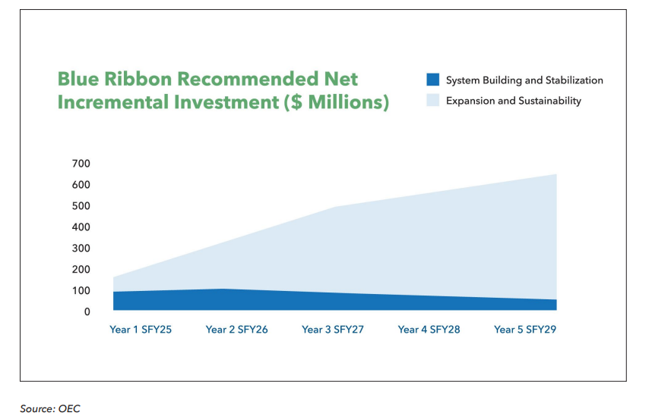
Blue Ribbon Plan Recommendations
Years 1–3 focus on stabilization and system-building due to urgent workforce shortages impacting both access and quality of ECE.
Stabilize the current workforce and build a future pipeline before pursuing significant system expansion.
Strengthen core infrastructure—including data, information, and management systems—to enable effective use of funds.
Expand OEC capacity to support planning and implementation at scale.
Invest in facilities and capital expansion to support future growth of the system.
Blue Ribbon Panel on Child Care - Connecticut Office of Early Childhood

Slide 3
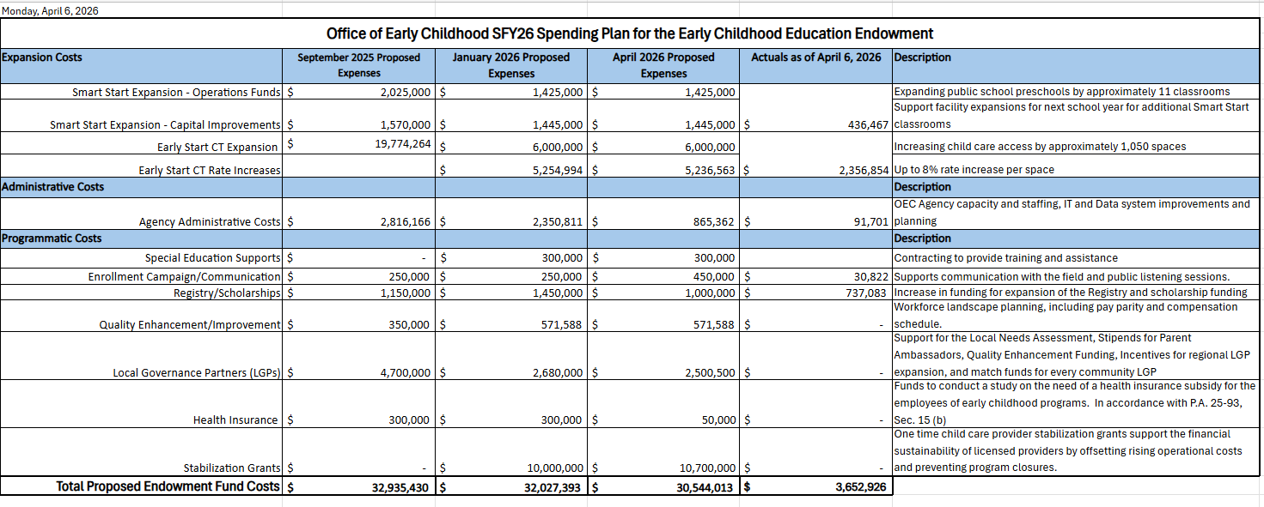
Endowment Funding Spend Plan Update

Slide 4
Review – Endowment Statute
Endowment Deposit Timeline
June 2026
SFY27 Endowment deposit known
June 2027
SFY28 Endowment deposit known
Programmatic requirements per statute Timeline
July 2026
Health care subsidy
July 2027
Family fee changes
By June 30th of each fiscal year, any unappropriated surplus will be transferred to the Endowment, with up to $300 million being transferred in FY 2025 and the full unappropriated surplus amount being transferred to the Endowment in FY 2026 and beyond. (Sec. 2)
Public Act 25-93
4
Notes:
Reminder about timing and way the endowment deposits work
Too early to know exactly what is going to happen with surplus
Agency standing ready to take steps once amount is known
As such, scenarios are being developed to get an idea for how we can stand ready
Thie advisory board is critical to helping guide and advise

Slide 5
Endowment scenario planning – FY27
PRELMINARY DRAFT
 | FY 2026 | FY 2027 - No Deposit | FY 2027 – Breakeven* | FY 2027 - $300M
Prior Year Fund Balance | 300,000,000 | 288,048,450 | 288,048,450 | 288,048,450
Est. Deposit EOY FY 26 | - | - | 95,000,000 | 300,000,000
Fund Balance | 300,000,000 | 288,048,450 | 383,048,450 | 588,048,450
Statutory Spending Limit - % | 12% | 12% | 12% | 12%
Available for Expenditure | 36,000,000 | 34,449,208 | 45,965,814 | 70,565,814
*Breakeven means the amount needed as a deposit into the endowment at the end of SFY26 to cover the current proposed SFY27 budget
5
Notes:
Remind the board that this is a small amount compared to the GF and $184M that goes toward ESCT spaces now and will continue.

Slide 6
Estimated Systems Costs
PRELMINARY DRAFT
Each year, there are ongoing commitments that need to be sustained and grow as system expands. From FY26, these commitments include:
Expansion costs:
  1,000 new spaces, rate increase, and Smart Start Expansion of 10 classrooms. (~21M)
Administrative costs:
  IT, Data, and OEC and SDE staffing (at least 4M)
Programmatic costs:
  Workforce, Quality, LGPs, and Health insurance (at least 18M)
  Family Fees are in statute for SFY28 (35M)
Cost to add an additional 1,000 slots: ~ $11M
Cost to raise rates 8% without expansion: ~ $15M
Cost to raise rates 8% with expansion: ~ $26M
Disclaimer: These are rough estimates meant to provide high-level direction. They incorporate many assumptions.
6
Notes:
An annual operating budget should reflect the goals of an organization for the upcoming year.
The $60 Million in the projections assumes the total costs in the SFY27 budget. As Early Start CT expands, our system continues to grow and requires additional investments into quality, workforce, infrastructure, etc. Many of the line items in our SFY 26 budget are ongoing commitments made this year that will continue year over year as the system expands. Costs in the SFY budget contain the following:
Ongoing costs do not reflect 1x stabilization grants.

Slide 7
Discussion & Questions

