Slide 1
Technical Skill Development for Agency Transformation Committees
September 19, 2014

Slide 2
Good Morning!
Who’s in the Room?
Notes:
Patrice
Name, agency and what you want to get out of today

Slide 3
Charge to Pilot Agencies
Vision Statement: State agency staff at all levels are working collaboratively to improve service to Connecticut residents.
Mission Statement: To develop and sustain a workplace culture that encourages input from all employees resulting in innovations, continuous improvement, and efficiencies in state government through positive and productive labor management relationships.
Notes:
Karen and Dan – Patrice to introduce
Discussion of the Labor Management Steering Committee – it’s role and how it can help agency Transformation Committees.
HAND OUTS – CHARGE and Transformation section of SEBAC agreement

Slide 4
Charge to Pilot Agencies: Part I
Review of the Transformation Agreement
Notes:
Karen and Dan
Harness the creativity and experience of front-line bargaining and non-bargaining unit state employees to improve the efficiency and effectiveness of state government;
Streamline and flatten organizational structures to concentrate on service delivery;
Examine and redress barriers to the most efficient use of in-house resources to address agency and cross-agency needs; and
Discourage the use of outside contractors and consultants when internal capacity exists or can reasonably be developed.

Slide 5
Charge to Pilot Agencies: Part II
Transformation Committees
Membership
Committee and Meeting Structure
Notes:
Karen and Dan
Identify Membership
Co-chaired by one manager (HR Director/Deputy Commissioner/Bureau Chief) and one labor rep (must be an employee of the agency – can be a leader but does not have to be)
Membership should be representative of all operational/programmatic areas in the agency
Include Representatives of all Identified Unions
Include agency Lean Coordinator as a member the Committee
No hierarchy on the committee
Committee co-chairs must be approved by the agency Commissioner, OPM and SEBAC
Committee and Meeting Structure
Create one Committee for the entire agency, if possible
Where necessary, create separate Committees for each facility/primary function
All members should be encouraged to participate at each meeting they attend
Meetings should occur regularly and as agreed to by the committee.
One member responsible for facilitation
One member responsible for taking minutes and reporting with follow-up tasks after the meeting
Identify Areas of Mutual Interest and Focus and Attempt to reach consensus
Develop ground rules that define how the committee will run

Slide 6
Today’s Agenda
Review of vision, mission and charge to pilots (parts 1 and 2)
Review of charge to pilots (parts 3, 4 and 5)
Exercise to reinforce Lean tools
Lean and Transformation – state agency example
Exercise to reinforce Lean tools
Lunch – 1 hour
Technical Skill Development
Simulation and discussion
Q&A and wrap-up
Notes:
Alison
Review of vision, mission and charge to pilots (parts 1 and 2)
Review of charge to pilots (parts 3, 4 and 5)
Exercise to reinforce Lean tools
Lean and Transformation – examples from DDS and DOT
Exercise to reinforce Lean tools
Lunch – 1 hour
Technical Skill Development (more in depth review of project selection, tracking and accountability)
Simulation and discussion
Q&A and wrap-up
There will be 2 breaks, each for 15 minutes
The event will conclude at 4:00pm

Slide 7
Charge to Pilot Agencies: Part III
Soliciting Ideas
Selecting a Project
Tracking Results
Accountability
Notes:
Alison
Part 3 is highly technical and will be discussed in detail later this afternoon

Slide 8
Charge to Pilot Agencies: Part IV
Roles of Agency Committees
Process Transformation
Ideas for Substantive Improvements in Quality of Efficiency
Notes:
Patrice
Part 4 will be discussed in theory – practical experience comes at your next Committee meeting!

Slide 9
“Numbers Exercise”
Strike out numbers 1-49 in the correct sequence
You will have 20 seconds to complete the task
You will get 3 tries to improve your time
Notes:
Alison
Give the sheets out face down and have someone keep time.
Ask each person to call out their individual scores (how many numbers they struck out) and mark them on a flipchart. Circle the lowest and therefore team score.
Ask if they are happy with the score
HAND OUT – EXERCISE – SHEET 1

Slide 10
48
30
87
33
45
72
3
69
27
51
21
57
24
18
75
9
6
78
54
60
63
36
12
15
42
81
39
66
84
90
2
68
77
80
53
74
86
62
29
65
5
20
41
23
56
32
44
35
89
83
8
50
47
11
26
17
38
14
59
71
64
49
31
61
34
28
54
40
16
7
52
10
58
76
22
88
73
1
85
4
43
37
82
13
25
19
67
79
46
70
Notes:
Alison
This sheet represents our current work place.
Our job during a 20 second shift, is to strike out the numbers 1 to 49 in correct sequence.
The team score will be represented by the lowest individual score achieved.
HAND OUT – EXERCISE – SHEET 2

Slide 11
48
30
33
45
3
27
21
24
18
9
6
36
12
15
39
42
2
29
5
20
41
23
32
44
35
8
47
11
26
17
38
14
49
31
34
28
40
16
7
10
22
1
4
43
25
19
37
13
46
Notes:
Alison
For our first action, we are going to implement 5S in this area.
The first step of this is “Sort” and so we have removed from the area all the numbers from 50 to 90 which are not needed.
Same rules apply. Strike out numbers 1 to 49 in sequence during a 20 second shift.
What do you think would be helpful now?
HAND OUT – EXERCISE – SHEET 3

Slide 12
2
4
7
8
10
1
3
5
6
9
16
20
11
15
17
18
19
12
13
14
21
22
23
24
25
26
27
28
30
29
32
31
33
36
37
34
35
38
39
40
41
47
42
43
44
45
48
49
46
Notes:
Alison
Having now made a significant step forward, we must “Standardize”.
Since we are dealing with numbers 1 to 49 in sequence, it seems logical to re-organize them in a standard way that makes the completion of the work task as easy as possible.
This should ensure that everyone is able to complete the task (and therefore produce a team score of 49)

Slide 13
“Numbers Exercise”
What did you learn?
5S : Sort – Straighten – Shine – Standardize - Sustain
How does this relate to our work in state government?
Notes:
Patrice

Slide 14
BREAK

Slide 15
Lean and Transformation
Transformation Agreement
C.G.S. 4-68z
How does this all fit together?
Notes:
Alison
Where are the opportunities for overlap?
How can we ensure we’re not duplicating effort?
How can each effort make the other stronger, and not detract from it?
All of the requirements on us – including these, RBA, Open Data, etc. are all part of the same effort to use data and information to make better decisions, together. They are all linked by their interest in using collaborative problem solving to improve services to our customers. That’s it.
HAND OUT – CGS 4-68z

Slide 16
Lean and Transformation: DOT Case Study

Slide 17
Lean and Transformation: DDS Case Study
Notes:
Patrice - Josh

Slide 18
Lean Exercise: Build Three (3) Peanut/Sunflower Seed Butter and Jelly Cracker Sandwiches
Build 3 cracker sandwiches, using the provided supplies, as quickly as you can
You will get 2 tries to perfect your technique
Have fun!
Notes:
Alison
15 MINUTES
Mark Stankiewicz (DOL) to facilitate this exercise.

Slide 19
Lean Exercise: Build Three (3) Peanut/Sunflower Seed Butter and Jelly Cracker Sandwiches
What did you learn?
Plan – Do – Check - Act
What does this have to do our work in state government?
Notes:
5 MINUTES
Deming Cycle – developed in the 1950s as a methodology to determine why a product would be different from the customer’s expectations.
That is the analysis we need to focus on in order to improve service.
That is the process we cannot do without full engagement and participation from all staff.
As we saw in this exercise, it allows us to isolate the “issue” or “problem” or “opportunity for improvement” and make adjustments to test a new approach. This assumes we are ok with experimentation and we can tolerate failure because we have a systematic way of correcting it.

Slide 21
Soliciting Ideas
Solicit ideas from all staff
Learn from other agencies
Notes:
Patrice
Solicit ideas for improvement projects from all staff – any level, any position
Learn from other agencies about strategies that they’ve found to be useful/successful. This is your network. Develop and maintain these connections.

Slide 22
Soliciting Ideas: Small Group Discussion
Talk with your co-workers and discuss the following points:
What has your agency tried that worked/has not worked?
What other methods would you like to try?
Develop a strategy of next steps
Notes:
Patrice

Slide 23
Selecting a Project
Collect and prioritize staff ideas
Resource assessment
Add and re-prioritize as you go
Notes:
Alison
Collect and prioritize staff ideas (based on agency solicitation process and criteria for prioritization – should reflect agency mission and goals)
Decide which resources (staff, time, funding) are needed for each project – what do we mean by “resources”?
Add ideas and re-prioritize the list as you complete each project/as resources allow
HAND OUT – HOW TO SELECT A PROJECT

Slide 24
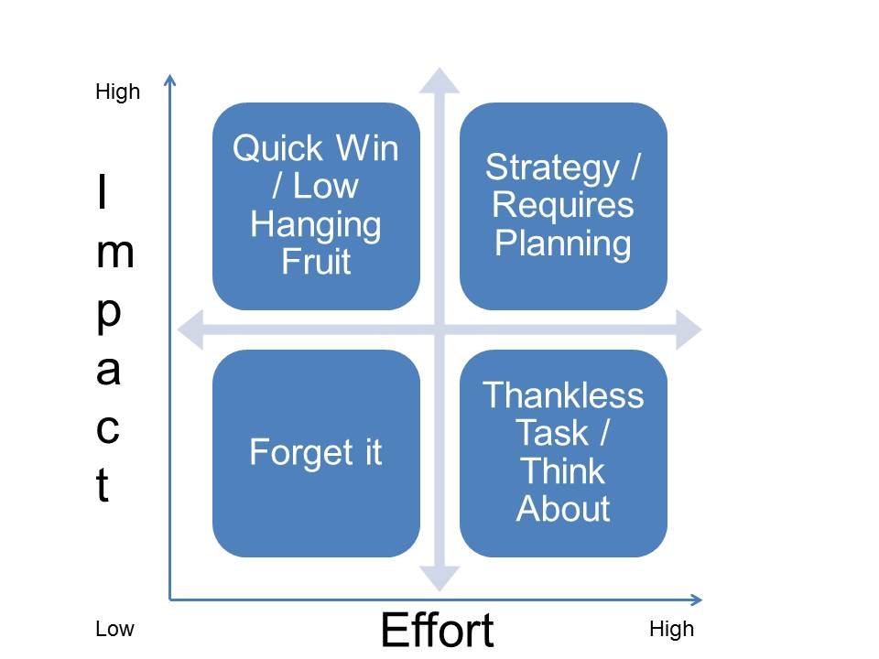
Selecting a Project
Start with projects that will yield a high outcome (impact) for a low resource investment (effort)
Notes:
Alison
This is what’s known as a “grid analysis” or a matrix. It is a type of method to help groups make decisions.
Focus on high impact/low effort - AKA ‘Low Hanging Fruit”
If a project will not yield a significant outcome, there is no reason to prioritize it and expend resources on it.
What does High Effort/Low Impact mean? What does “Thankless Task” mean? Should you do it?

Slide 25
What is a “Lean” project?
If you need additional resources to complete a project, such as:
Professional or additional facilitation
Help or input from other state agencies
Significant changes to available technology, policy or procedure
Additional funding
Input from many key stakeholders
Notes:
Alison
HAND OUT – WHAT IS A LEAN PROJECT?

Slide 26
Who is responsible?
The responsibility is with all members of the Transformation Committee and includes activities such as selection, monitoring and reporting.
Notes:
Patrice

Slide 27
How can we make sure that we are doing the right projects?
Notes:
Patrice
Your projects should always align closely with the strategic goals of the agency and have outcomes that are measurable and attainable.
Take time out of one of your Committee meetings to review your agency’s mission, overall goals and the expectations you have as a group. Revisit this information as needed.

Slide 28
Notes:
Patrice
Basic model for project selection which follows the plan-do-check-act Deming cycle we learned about earlier.
A theme you will notice is that is very important to track your work and your progress. Without that check, how else will you know if you’ve succeeded?
It doesn’t matter which model you use, as long as it has these components.

Slide 29
Tracking Results
Developing performance measures
Follow-up meetings
Accountability
Templates/tools/hints
Notes:
Alison
Key elements of tracking results that each Committee should have. It doesn’t need to be very complicated as you will see in the handout.
HAND OUT – TRACKING TEMPLATE

Slide 30
Measuring Results
Baseline data
Benchmarking
Measurement categories
Regular discussion: “what gets measured, gets managed”
Templates/tools/hints
What type/amount of data does your agency collect?
Notes:
Alison
Talk to your Open Data Officer
HAND OUT – METRICS GUIDE

Slide 31
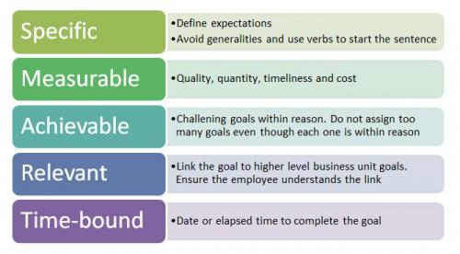
What is a Measureable Objective?
- an action verb (increase/decrease)
-measureable output
(count, %, rate)
quantity improvement
(by x %)
- time frame (by xx/xx/xx)
As presented by the State of Maine
Notes:
Patrice
What happens when the customer experiences this service?
How can we manage this process?
Who is better off?
How do we know?
**We must develop tolerance for experimentation and unpredictability – it is inherent in data and in process improvement!

Slide 32
Accountability
Report Template
Reporting Schedule
Adjust as Necessary
Notes:
Alison
Develop a reporting mechanism to share results with executive leadership at your agency and the Statewide Transformation Steering Committee
Report on a regular basis (monthly, quarterly, annually, etc.) to ensure effective communication and transparency
Make changes to goals or outcomes as necessary
HAND OUT – PROJECT SUMMARY and RESULTS TEMPLATE

Slide 33
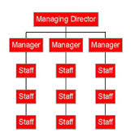
We Must Be Accountable to Each Other!
Notes:
Alison

Slide 34
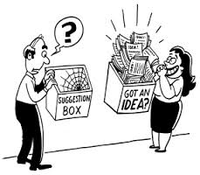
Transformation Exercise: 30 Minutes
Please identify:
Tools/templates you can use
Resources (people, time, data, etc.) you will need
Next steps
Notes:
Patrice
Evaluate and prioritize the projects.
Explain why you chose your first priority, identify the resources you need to get started, and what your next steps are.
HAND OUT – ALL 3 EXAMPLES: Website, Eligibility and Hiring

Slide 35
www.ct.gov/LeanCT
Notes:
Wrap –up
Q&A

