Slide 1

Continuous Improvement in
Connecticut State Government
2014 Lean Systems Summit
August 8, 2014
Notes:
2 MINUTES
Introduce ourselves, our roles in CT state government and our roles in the workshop : Alison, Steve, Mark
What do we have planned for this morning?
Activity
Overview of CT’s Lean Journey

Slide 2

Good Morning!
Who’s in the Room?
Notes:
1 MINUTE
Show of hands by industry

Slide 3

Lean Exercise: Build Three (3)
Peanut/Sunflower Seed Butter and Jelly
Cracker Sandwiches
Build 3 cracker sandwiches, using the provided supplies, as quickly as you can
You will get 2 tries to perfect your technique
Have fun!
Notes:
15 MINUTES

Slide 4
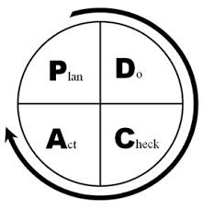
Lean Exercise: Build Three (3)
Peanut/Sunflower Seed Butter and Jelly
Cracker Sandwiches
What did you learn?
Plan – Do – Check - Act
What does this have to do with Lean Government?
Notes:
5 MINUTES

Slide 5

Continuous Improvement in
Connecticut State Government
Government is a Constrained Growth Industry and Must:
  Adapt
  Respond
  Serve
Notes:
5 MINUTES
“constrained growth industry” – as long as the population continues to grow, there will be increased expectations of the public service delivery system. As our economy changes over time, our revenue streams will also change – at times becoming more and more strained. This is why government (and the services it provides) is a growth industry that is often constrained by the funds it can use to support necessary expenses.
In the state of CT, the majority of our revenue comes from personal income tax and sales tax. These revenue sources are almost entirely dependent upon the strength of the economy. (if needed - when people make less money from salary, assets or investments, the amount of revenue collected from taxes is less) The demand on public services continues to increase. State government services alone are often not enough to meet the needs of 100% of our customers 100% of the time.
Because of this, state government must continuously adapt to the ever-changing needs of our customers, respond as efficiently and effectively as possible, and serve to the best of its ability.

Slide 6
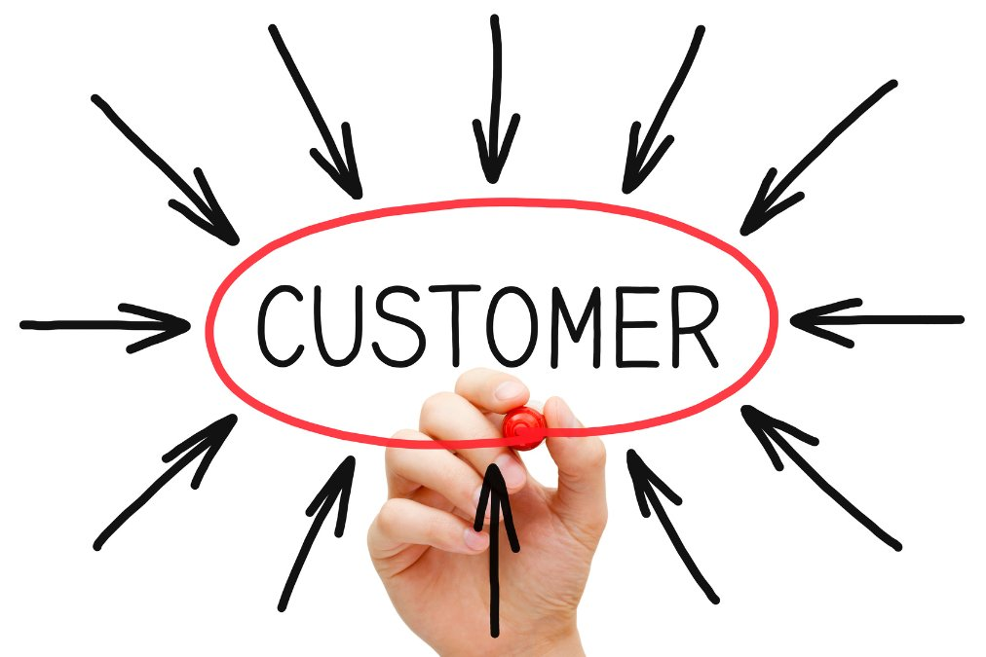
Continuous Improvement in
Connecticut State Government
Vision
Serving the individuals, families, businesses and communities of Connecticut in the most efficient and responsive way.
“Lean is one of the best ways we can continue to improve service delivery even in the face of a tough budget and a challenging economy. By getting routine activities to function smoothly and consistently, staff time is freed up to focus on higher value tasks that are more directly linked to meeting customer needs.” – Governor Malloy, March 2013
Notes:
7 MINUTES
Although the concept of Lean originated in private industry, the fundamental purpose for it is a universal concept that can be applied to anything, even the way you cook a meal or organize your closet.
However, in a service industry such as state government, the pillars of process improvement may be applied a little bit differently. In CT, we use an approach that can be easily communicated, trained and understood. We do not require certificates, belts or sophisticated data analysis. Our #1 priority is to improve service to the customer. In order to achieve this goal, we must engage 100% of our staff in adopting Lean thinking. Some of our staff do not have advanced degrees. Some can not read. It is important for us to develop a cultural shift that everyone can get involved in, regardless of their level in the organization or their academic aptitude.
We find that staff engagement is relatively easy, because in our state, we have had to cut back significantly on training over the years. This is one of the only statewide, holistic opportunities for staff development and people are embracing it. We value each employee and recognize that change can only be successful when input is received from the people who actually do the work related to the process we’re trying to improve. Although we have executive support, which is very important, this not just an executive staff initiative. It is a grassroots, empowering, creative process that engages all staff at all levels.

Slide 7
Making Government Work: Lean is a key enabler for our transformation efforts
Faster
  Investing in information technology solutions to achieve efficiencies
  Identify statutory and regulatory obstacles to change
  Pursue interagency initiatives or opportunities to continuously improve
  Developing core metrics with measurable data
More effective
More efficient
More responsive
More predictable
More transparent
Notes:
3 MINUTES
Outcomes from our focus on process improvement (left) allows us to focus and invest in the activities our state government values (right)
We can use Lean Tools to Develop and Inform:
Budget Requests
Resource Allocation
Business Requirements for IT solutions
Succession Planning
Professional Development
Our stakeholders and customers

Slide 8
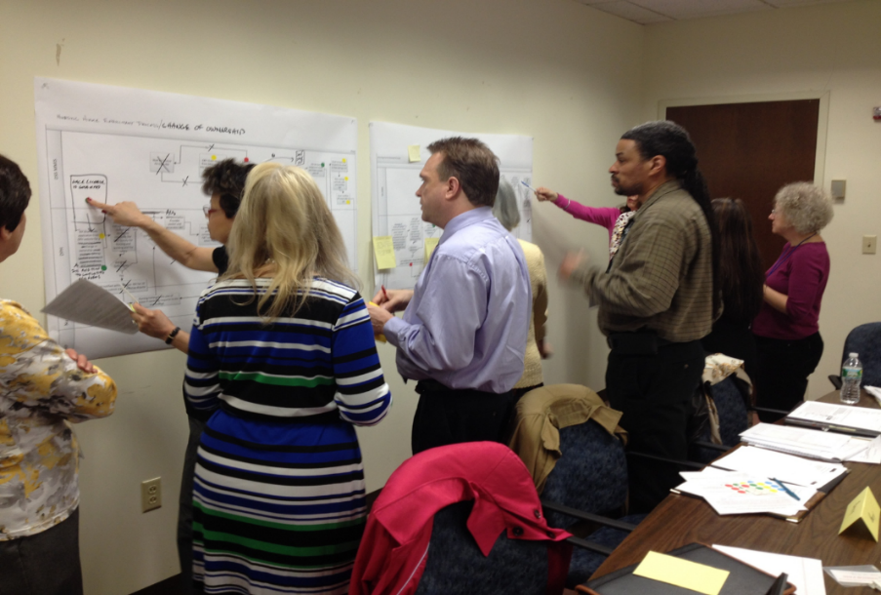
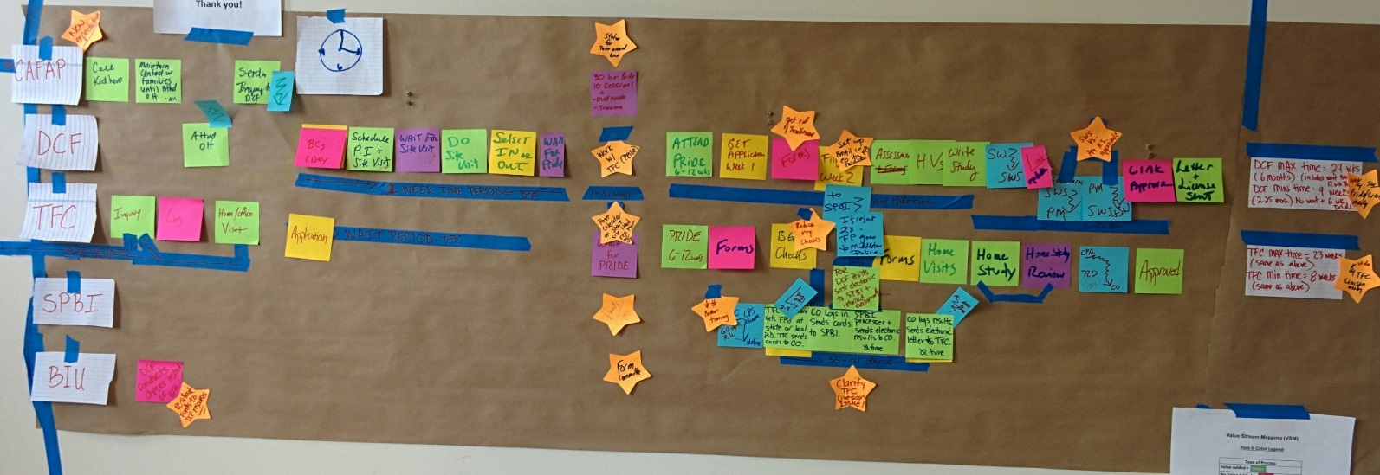
“Lean” in Connecticut State Government is:
A set of tools and templates
A term for the improvements we make
A philosophy
Notes:
5 MINUTES
A set of tools and templates used to make a particular process more efficient
A term for the improvements that state employees make every day
A philosophy/ way of thinking that promotes creativity, collaboration, and improved customer service with a specific focus on the customer – what do they value?
CT is undergoing a cultural shift and is working toward embedding Lean thinking and process improvement into the way we complete our daily activities. Agencies are doing this using tools such as identifying their agency’s lean philosophy (mission and vision) and communicating it with all staff, linking Lean projects and outcomes to manager performance evaluations, developing agency teams to identify improvement projects and measure results, and provide regular updates and reports to executive leadership to ensure accountability and ongoing support.
Lean is simple to understand. In many cases, employees are using these tools already without realizing the “Lean jargon” that is associated with them. This is common sense approach to make our work a little less frustrating and lot more productive.

Slide 9
Statewide Continuous Improvement Timeline
State of CT Jobs Bill passes
Statewide Process Improvement Steering Committee
- Increased activity
- Accountability
- Continued investment
- Governor’s Directive
- LeanCT Program
Limited Statewide Lean Activity
Before 2011
2011
2012
2013
2014 +
Notes:
5 MINUTES
Before 2011:
Beginning in 2000, the CT Department of Labor (DOL) begins its Lean journey, serving as the statewide champion of continuous improvement in CT state government
Between 2000 and 2010, DOL provides training and support to agency staff across the state in Lean tools and critical thinking and introduces other state agencies to the Lean process (CT Departments of Energy and Environmental Protection (DEEP), Transportation (DOT), Motor Vehicles (DMV) and Social Services (DSS))
November 2011: Jobs Bill passes and requires the use of Lean in areas such as permitting, licensing, and enforcement
January 2012: Statewide Steering Committee forms to oversee implementation of Lean statute
September 2012: Report to the Governor on “Changing How Connecticut State Government Does Business”
March 2013: Governor Malloy directs state agencies to utilize Lean tools
November 2013: Report to the Governor on “Continuous Improvement in Connecticut State Government”
November 2013: Development of LeanCT program at CT Office of Policy and Management
February 2014: Statewide Steering Committee expands to include all functions of government
April 2014: CT holds its first Statewide Process Improvement Showcase at the State Capitol
May 2014: CT joins National Community of Practice
July 2014: Report to the Governor on “Continuous Improvement in Connecticut State Government: A Focus on Lean”
Remainder of 2014 and Beyond: Continued investment in our commitment to Lean practices & continuous improvement

Slide 10
LeanCT Program
CT Office of Policy and Management
Developed in November 2013
Promotes, coordinates, and manages daily tasks to create a statewide culture of continuous improvement
Centralized program to bring standardization and strategic guidance to the overall effort
Supports state agencies in becoming more data-driven, transparent, responsive and accountable
Encourages state agency staff at all levels to participate in improvement activities
Notes:
3 MINUTES
Situated at OPM –the Governor’s Budget Office. Secretary of OPM oversees the program and it’s developments on behalf of the Governor.
Currently a staff of one with a relatively limited program budget. Most of what we do is through meetings, marketing, promotion and trainings at a very low cost.
Provides guidance and direction for statewide effort but would not be successful without the help of the Statewide Steering Committee.
CT relies heavily on partnerships and in-kind support to move this effort forward.

Slide 11

Statewide Process Improvement Steering Committee: Member Agencies by Function of Government
General Government
Office of Policy and Management/LeanCT (Chair)
Department of Administrative Services
Department of Revenue Services
Regulation and Protection
Department of Emergency Services and Public Protection
Department of Motor Vehicles
Department of Consumer Protection
Department of Labor
Corrections
Department of Correction
Conservation and Development
Department of Energy and Environmental Protection
Department of Economic and Community Development
Health and Hospitals
Department of Developmental Services
Human Services
Department of Social Services
Transportation
Department of Transportation
Education
Office of Early Childhood
Notes:
3 MINUTES
Work together to support each other and those not on the Steering Committee
Set policy for the statewide effort
Determine how to support and promote Lean and other process improvement tools (scorecards, strategic plans, etc.) throughout the state
Engages state staff to work on Kaizen projects and receive training through statewide contract for Lean services. 5 vendors on current contract who provide an array of services ranging from
executive coaching to Kaizen facilitation to Lean leadership certification.

Slide 12
An Overview of Connecticut’s Lean Journey
The Jobs Bill has sparked State Government to embrace Lean process improvement techniques, with customer service as its focus
Assignment of Agency Lean Coordinators
Training of state employees and non-profit providers
Process improvement activities using Lean tools
Focus is on ALL areas of government
Collaboration across agency lines
Notes:
3 MINUTES
Over 40 state agency heads (the 15 on the Steering Committee and another 25) have assigned “Lean Coordinators” to coordinate process improvement efforts and promote a new way of thinking
Over 2,000 state employees (and over 100 non-profit provider staff members) have been trained to use Lean tools and principles
Hundreds of processes have been improved using Lean tools, generating savings and improving service to CT residents
Agencies that have participated in Lean events or project implementation span all functions of government, including regulation and protection, health and human services, corrections, conservation and development, education, enforcement and compliance, housing, transportation, and general oversight.
These events have improved business processes by eliminating waste, removing redundant steps and adding automation.

Slide 13

Measuring Success and Ensuring Accountability Through:
Establishment of Specific Goals and Key Performance Indicators, such as:
  Customer Response Time
  Customer Satisfaction Surveys
  Staff Development/Training
Agency Lean Coordinators and Agency Lean Workgroups
LeanCT program
Suggestions for Innovation from Staff at all Levels
Benchmarking
Notes:
6 MINUTES
Primary focus is on the customer – we need to reduce or eliminate process/service that our customers do not want/need, so that we can redirect our resources toward what our customers do want/need.
“This is really efficient now that we know no one wants it”
SEBAC (State Employee Bargaining Agreement Coalition) union agreement of 2011 – transformation teams/”suggestions for innovation” from all employees
PARS – link Lean projects to manager performance

Slide 14

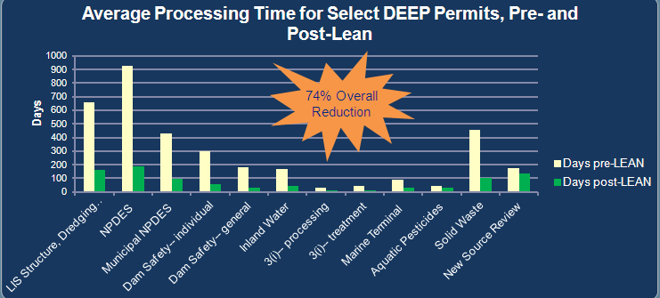
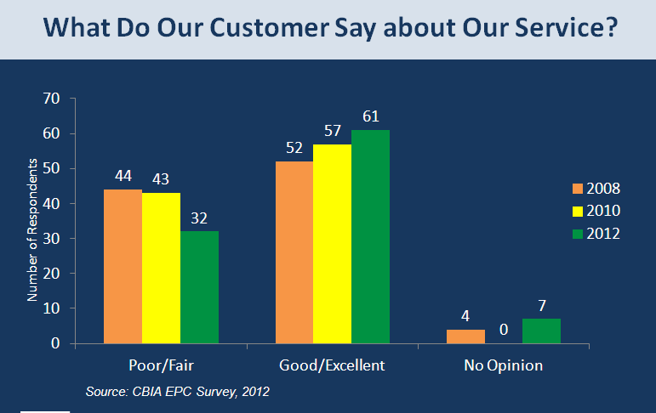
Department of Energy and Environmental
Protection: Summary of Results
  Goal
  Moving toward Electronic Permitting (Storm water Registrations are now available online)
  Result
  74% reduction in average processing time for Select DEEP permits
  Staff Development
  65 projects / kaizen events have been undertaken since June of 2008
  50% (over 500 FTEs) of DEEP staff trained in Lean
Notes:
2 MINUTES
What is important here is not specifically what the processes or metrics are, but to highlight a sample of process improvement work that has taken place over the past few years in CT state government. You will notice that the highlighted results span across operational areas and agency missions. Regardless of the service an agency provides, Lean tools can be applied to increase efficiency and reduce waste in an industry that has varying and complex demands put upon it.

Slide 15
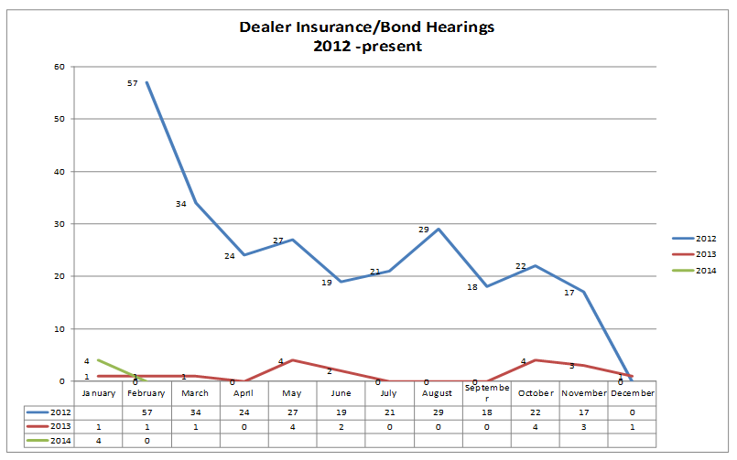
Department of Motor Vehicles:
Dealer Insurance/Bond Hearings (June 2012)
Goal
To reduce the number of hearings being held for Insurance and Bond Cancellation for Dealers
Results
128 step process to 60 steps – 53% reduction!
Eliminated the need to withdraw hearings
Reduced the number of forms and eliminated hearing calendar
Reduced number of hearings –eliminated the need to schedule a hearing officer all day
Reduced the amount of office supplies utilized (e.g., paper, files, mailing labels, etc.)
Notes:
1 MINUTE

Slide 16

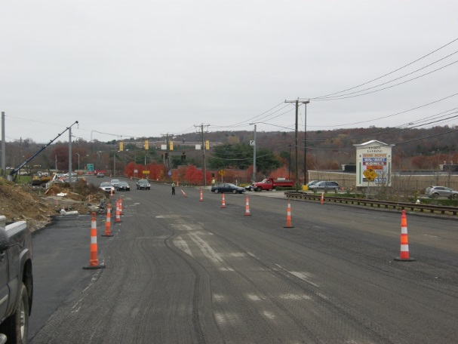
Department of Transportation:
Highway Encroachment Permits (April 2013)
Goal
Expedite and improve statewide permitting process for better customer service
Results
Reduced from 52 steps to 35 = 33% efficiency
Revise Encroachment Permit Manual
Building new central database
Developing of checklist, new streamlined application & permit form
Improving website
Notes:
1 MINUTE

Slide 17

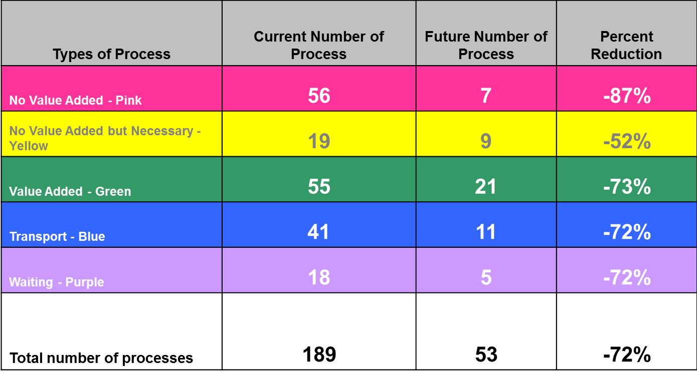
Department of Children and Families:
Foster and Adoptive Family Licensing Process (March 2014)
Goal:
Streamline the current process to improve timeliness of licensing families and standardize work across all regions.
Result
Reduced the average length of time from initial inquiry by a family to licensure to approval from over 6 months to 3 months!
Lean reduced total steps by over 70% and reduced time by over 50%
Notes:
1 MINUTE

Slide 18
What’s Next on Connecticut’s Lean Journey?
Continue our commitment to continuous improvement
Annual progress reports
Connecticut Lean Consortium
Promote the regular use of state data
National Community of Practice
State of Connecticut Lean University
Notes:
3 MINUTES
Aside from continuing to do everything we are already doing (training, support, development, reporting, statewide steering committee, Lean teams at agencies, etc.), we will:
Continue our commitment to continuous improvement through:
Training and other development opportunities
Supporting agency Lean efforts
Encouraging agency staff to begin tracking new ideas, initiating projects and reporting on results
Promoting collaboration across agency lines
Complete Annual progress reports detailing success using Lean tools
Develop a Lean Consortium with membership from other industries
Promote the use of state data regularly to make informed decisions
Participate as a member of National Community of Practice – one of 15 participating states – collaborating to benchmark and share best practices for statewide Lean government implementation
Develop a Lean University – train the trainer model with “Lean experts” who can facilitate events, provide targeted trainings and support state agencies on their individual Lean journeys.

Slide 19
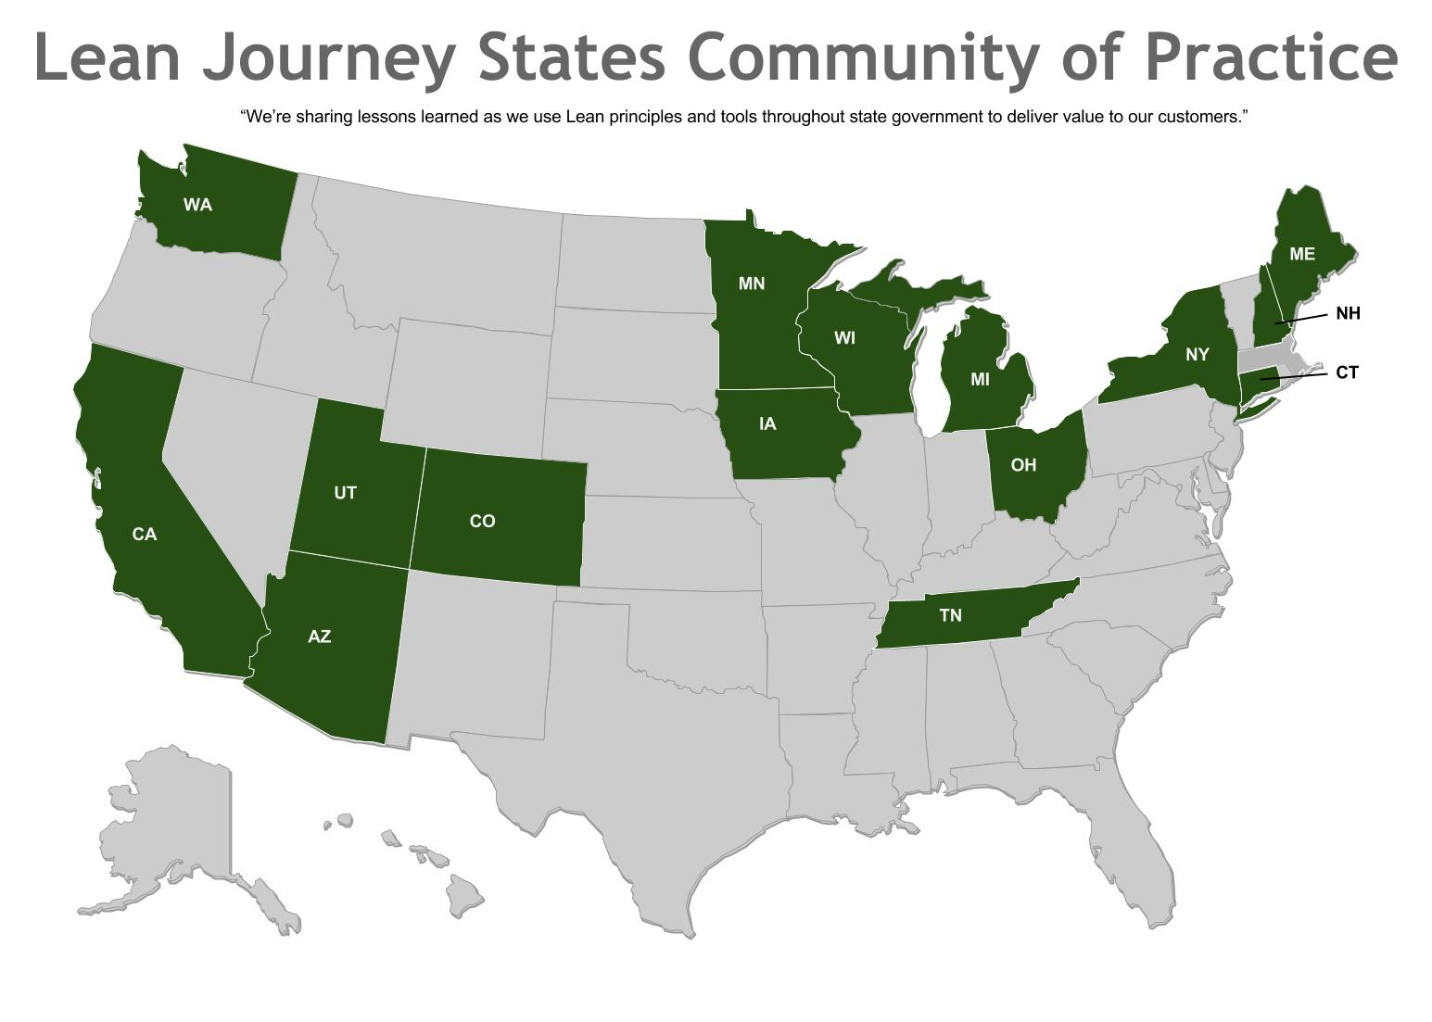
National Lean Community of Practice: Participating States
As Presented by the State of Washington
Notes:
1 MINUTE
One of 15 states in a mutually-beneficial workgroup, led by the State of WA. We have just begun our work to share best practices, learn from one another and build upon each other’s successes.
Continuous improvement efforts in state government mirror those of the Delivering Results initiative, the 2014-2015 initiative of that newly appointed Chair of the National Governors Association, Colorado Governor John Hickenlooper.
Delivering Results specifically will focus on:
· Changing recruitment and retention processes to ensure that the who of state government remain the best and the brightest
· Changing the how of delivering services to people by adopting lean processes and using new technologies; and
· Changing the what of policies and programs by better using research to inform policymakers about what works.
These goals are precisely what LeanCT’s future efforts will focus on – employees, customers, data and continuous improvement. We are proud that our Governor, Dan Malloy, is a member of the NGA Executive Committee that will oversee the implementation of the Delivering Results initiative, and we are proud to be a part of this national effort. All of the states who participate in the National Community of Practice are behind the NGA’s efforts and will continue to work together to improve the public services that our country provides.

Slide 20
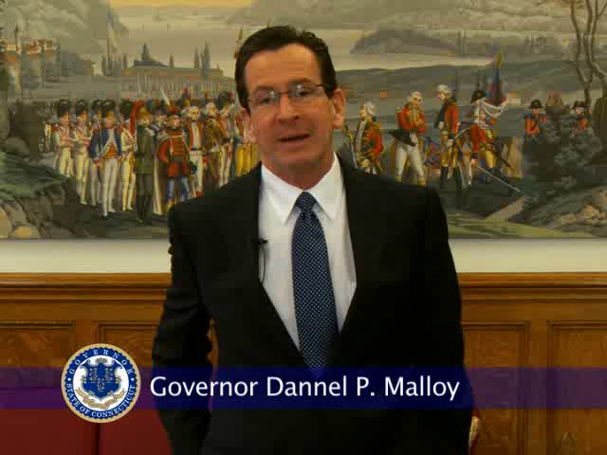
A Message about Lean Training from Governor Malloy
Notes:
2 MINUTES

Slide 21
For more information on
Continuous Improvement in
Connecticut State Government please visit: www.ct.gov/LeanCT
Notes:
1 MINUTE
This morning’s workshop has highlighted just a sample of what we’ve accomplished in the state of CT and I invite you to please review our first annual Lean results report to see more of our work. The report, and other information including tools, helpful hints, event information, and our contact information can be found on the LeanCT website.
Thank you so much for your interest in process improvement and your interest in our state’s efforts. Please stay tuned and keep in touch with us to see what’s next!

