Slide 1
Lean Coordinator Workshop
August 14, 2014
DOT Training Center
Presented by Members of the Statewide Process Improvement Steering Committee

Slide 2

Notes:
Intro – Alison, Laurie Ann, Cheryl and Cindy
Review of the workshop and intended outcome, mention Steering Committee and that we are all here to help
Overview of Agenda
Housekeeping (restrooms, exits, breaks, etc) – Lisa

Slide 3

Good Morning!
Who’s in the Room?
Notes:
Introduce yourself
Name, Agency, Title, Lean Coordinator?

Slide 4


Vision
Serving the individuals, families, businesses and communities of Connecticut in the most efficient and responsive way.

Slide 5
What do you want to get out of today’s workshop?
How can we help you?
What are the issues you are facing?

Slide 6
Employee Engagement
Soliciting ideas
Tracking ideas
Prioritizing projects
Reporting
P-D-C-A
Notes:
Alison
Handouts: project selection, what is a “Lean” project, sample project tracking form, sample reporting template
This may look different for your agency, based on internal culture, values and org structure. Take what you can and adapt it as you see fit.

Slide 7
OPM Case Study :
Agency Lean Workgroup
Leadership/chair role held by Lean Coordinator
Lean Coordinator has direct line to Secretary
One member from each division
Solicit ideas – “Suggestions for Innovation”
Track ideas and outcomes
Select projects
Internally facilitate projects when necessary
Monthly meetings
Internal SharePoint site
Notes:
Alison

Slide 8







OPM Case Study :
Agency Lean Workgroup
“If I could change one thing about this process it would be...”
“What if…”
YOU fill in the blanks*!
(*complimentary blanks provided on the attached)
Notes:
Alison

Slide 9
Accountability and
Follow-Up
Structure – internal (agency-level) and external (statewide)
Roles – Lean event and beyond
“Managers as messengers”
Team and agency committee meetings
PARS
Notes:
Cheryl
Handouts – Roles, Lean Structure

Slide 10
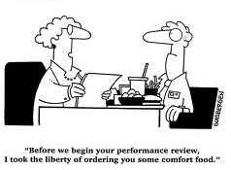
DOT Case Study : PARS
Notes:
Cheryl

Slide 11

BREAK
Notes:
Review: what do you want to get out of today’s workshop?
How can we help you put these tools into motion?

Slide 12
Measuring Success : Key Elements and Questions
Use data to help make decisions
Project specific measurement and roll-up – relate to overall goals
P-D-C-A
What can we collect and who should be responsible?
How can we make reporting on our data easier?
Notes:
Alison

Slide 13
Measuring Success: How it All Fits Together
Results Based Accountability
Balanced Score Cards
Lean
Notes:
Laurie Ann

Slide 14
Measuring Success : Technical Help
Baseline data
Benchmarking
Measurement categories
Regular discussion – “what gets measured, gets managed”
Templates/tools/hints
What data does your agency collect? Talk to your Open Data Officer
Notes:
Alison
LeanCT website
Handout – LeanCT metrics guide

Slide 15
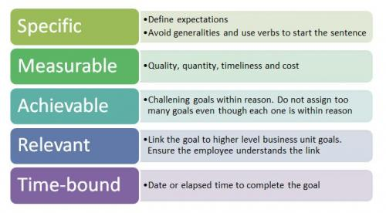
Measureable Objectives
- an action verb (increase/decrease)
-measureable output (count, %, rate)
- quantity improvement (by x %)
- time frame (by xx/xx/xx)
As presented by the State of Maine
Notes:
Alison
What happens when the customer experiences this service?
How can we manage this process?
Who is better off?
How do we know?
**We must develop tolerance for failure and unpredictability – it is inherent in data and in process improvement!

Slide 16
DMV Case Study: KPIs
Notes:
Cindy

Slide 17
DMV Case Study: KPIs
Notes:
Cindy

Slide 18
DMV Case Study: KPIs
Notes:
Cindy

Slide 19
DMV Case Study: KPIs
Notes:
Cindy

Slide 20
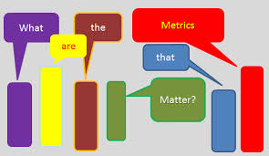
DSS Case Study : Connecting Metrics with Outcomes
Notes:
Laurie Ann

Slide 21
Review: What do you want to get out of today’s workshop?
Review of items identified at beginning
What can we focus the next workshop on?
Notes:
Alison

Slide 22
Thank You!
www.ct.gov/LeanCT
Notes:
Alison

