Slide 1

Continuous Improvement in
Connecticut State Government
Lean Overview for State Managers
October 22, 2014
Notes:
Welcome message – Cheryl Cepelak
Cheryl to transition
Cheryl Malerba, Nicole Lugli, and Alison Fisher
Introduce ourselves, our roles in CT state government, our roles in statewide Lean, and our roles in the workshop

Slide 2
Today’s Agenda
Why Lean?
CT’s Lean Journey
LeanCT and the Statewide Process Improvement Steering Committee
Lean Strategies and Tools
How you can get started with Lean
Lean at work: examples from state agencies
Notes:
Alison Fisher
There are copies of various documents/templates/tips/guides available for you in the back of the room. Please feel free to take them before you leave today. These documents are also available electronically on the LeanCT website: www.ct.gov/LeanCT

Slide 3

Continuous Improvement in
Connecticut State Government
Government is a Constrained Growth Industry and Must:
  Adapt
  Respond
  Serve
Notes:
Alison Fisher
“constrained growth industry” – as long as the population continues to grow, there will be increased expectations of the public service delivery system. As our economy changes over time, we may experience periodic shortages of resources, just as we have now. This is why government (and the services it provides) is a growth industry that is often constrained by the funds it can use to support necessary expenses.
However, the demand on public services continues to increase. State government services alone are often not enough to meet the needs of 100% of our customers 100% of the time.
Because of this, state government must continuously adapt to the ever-changing needs of our customers, respond as efficiently and effectively as possible, and serve to the best of its ability through innovation and partnerships.

Slide 4

Continuous Improvement in
Connecticut State Government
Vision
Serving the individuals, families, businesses and communities of Connecticut in the most efficient and responsive way.
“Lean is one of the best ways we can continue to improve service delivery even in the face of a tough budget and a challenging economy. By getting routine activities to function smoothly and consistently, staff time is freed up to focus on higher value tasks that are more directly linked to meeting customer needs.” – Governor Malloy, March 2013
Notes:
Alison Fisher
We are lucky here in CT because our Governor supports Lean and has made significant investments, both with funding and in our law, to ensure that process improvement is something we all have the flexibility to focus on. But this isn’t just an executive level initiative.
In a service industry such as state government, process improvement activity may be applied a little bit differently than the traditional model, as it was originally designed for manufacturing. We have some statutory and regulatory restrictions, we have a legislative process to contend with, we have budgetary constraints. However, our #1 priority is simply to provide the best possible service to our customer – just as it is for any organization. How can we do this in CT state government? By: engaging 100% of our staff in adopting Lean thinking and focusing our efforts on activities/work that provides value to those we serve. It is important for us to develop a cultural shift where everyone can get involved within our organization – those who do the job are the best ones to improve it! There are immediate changes everyone can make that are within their own control (low hanging fruit), and there are other changes that may take some time (may inform a long-term plan). No matter what the change, if it can positively impact a customer’s experience, it is worth our time to figure it out.

Slide 5
Making Government Work: Lean is a key ingredient for our transformation efforts
Faster
  Investing in information technology solutions to achieve efficiencies
  Identify statutory and regulatory obstacles to change
  Pursue interagency initiatives or opportunities to continuously improve
  Developing core metrics with measurable data
More effective
More efficient
More responsive
More predictable
More transparent
Notes:
Nicole Lugli
Outcomes from our focus on process improvement (left) allows us to focus and invest in the activities our state government values (right)
We can use Lean Tools to Develop and Inform:
Budget Requests
Resource Allocation
Business Requirements for IT solutions
Succession Planning
Professional Development
Our stakeholders and customers

Slide 6
Why is this Important for State Managers?
More to do with less or the same amount of resources
Directive from Governor Malloy/Expectations from Commissioners
Agency staff needs your support
You know your business and how it can be improved
Collaboration is key
Notes:
Nicole Lugli
Do you feel frustrated? Do you think that somehow your job could be easier if you could make a few changes? Lean could be the answer for you and your agency.
Pressure from above and below to do the best job possible
Collaboration – within your agency (IT, Finance, Data Officer, program staff, executive staff, etc.) and with all stakeholders (other agencies, external partners, etc.)

Slide 7
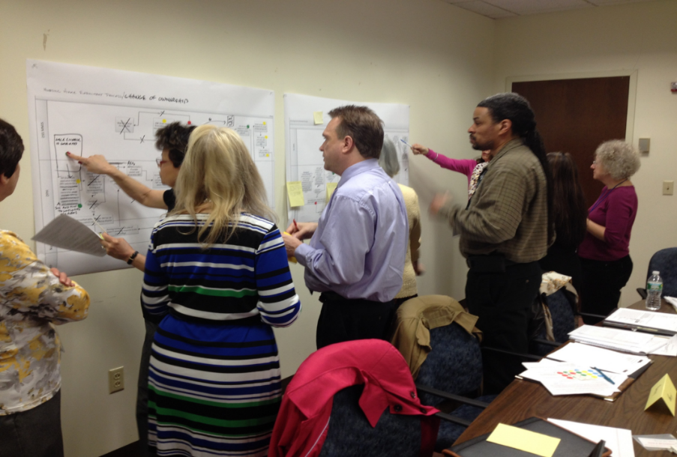
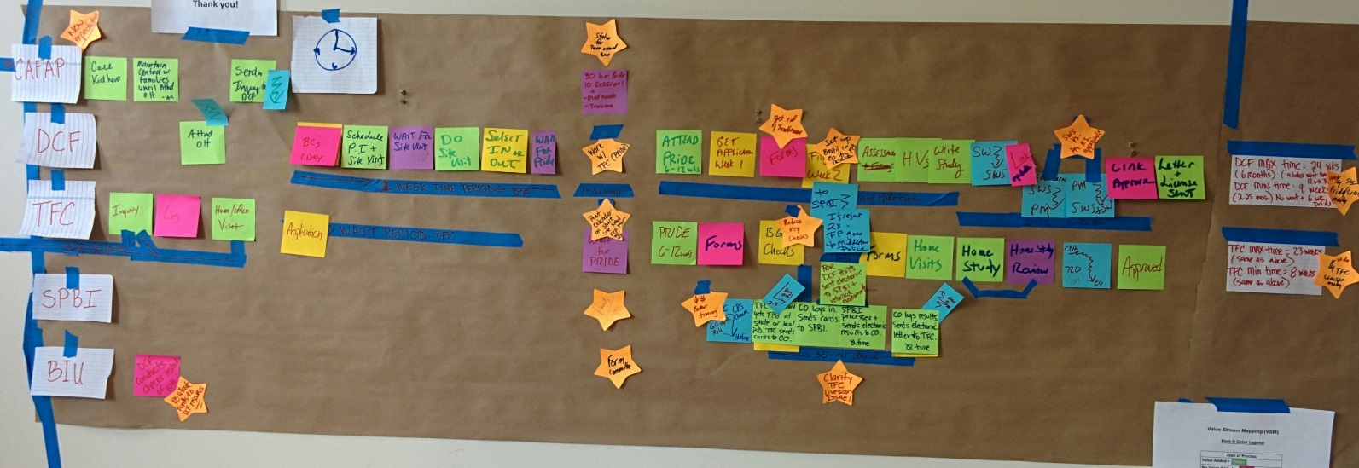
“Lean” in Connecticut State Government is:
A set of tools and templates
A term for the improvements we make
A philosophy
Notes:
Nicole Lugli
A set of tools and templates used to make a particular process more efficient.
Tools: The most common tool we use is value stream mapping. This is mapping out a process that you do – this helps with really seeing what is involved and where, specifically, improvements can be made. It also helps with documenting and standardizing and succession planning.
Templates: The most common template we use is the project implementation plan. This enables a team, or an individual, to set goals, identify tasks and keep track. It’s very similar to project management and can be done using Excel, Project or a piece of paper, if that’s what you like to use.
A term for the improvements that state employees make every day.
A philosophy/ way of thinking that promotes creativity, collaboration, and improved customer service with a specific focus on the customer – what do they value?
Lean is simple to understand. In many cases, employees are using these tools already without realizing the “Lean jargon” that is associated with them. This is common sense approach to make our work a little less frustrating and lot more productive. We are simply trying to “do a better job with the resources we have” because we don’t have the time to do anything different.

Slide 8
Statewide Continuous Improvement Timeline
State of CT Jobs Bill passes
Statewide Process Improvement Steering Committee
- Increased activity
- Accountability
- Continued investment
- Governor’s Directive
- LeanCT Program
Limited Statewide Lean Activity
Before 2011
2011
2012
2013
2014 +
Notes:
Alison Fisher
Before 2011:
Beginning in 2000, the CT Department of Labor (DOL) begins its Lean journey, serving as the statewide champion of continuous improvement in CT state government
Between 2000 and 2010, DOL provides training and support to agency staff across the state in Lean tools and critical thinking and introduces other state agencies to the Lean process (CT Departments of Energy and Environmental Protection (DEEP), Transportation (DOT), Motor Vehicles (DMV) and Social Services (DSS))
November 2011: Jobs Bill passes – section 10 requires the use of Lean in areas such as permitting, licensing, and enforcement (CGS 4-68z)
January 2012: Statewide Steering Committee forms to oversee implementation of Lean statute
September 2012: Report to the Governor on “Changing How Connecticut State Government Does Business”
March 2013: Governor Malloy directs state agencies to utilize Lean tools
November 2013: Report to the Governor on “Continuous Improvement in Connecticut State Government”
November 2013: Development of LeanCT program at CT Office of Policy and Management and a full-time position at OPM to spearhead the effort
February 2014: Statewide Steering Committee expands to include all functions of government
April 2014: CT holds its first Statewide Process Improvement Showcase at the State Capitol
May 2014: CT joins National Community of Practice of state who have a statewide “Lean” effort
Remainder of 2014 and Beyond: Continued investment in our commitment to Lean practices & continuous improvement

Slide 9
LeanCT Program
CT Office of Policy and Management
Developed in November 2013
Promotes, coordinates, and manages daily tasks to create a statewide culture of continuous improvement
Centralized program to bring standardization and strategic guidance to the overall effort
Supports state agencies in becoming more data-driven, transparent, responsive and accountable
Encourages state agency staff at all levels to participate in improvement activities
Notes:
Alison Fisher
OPM was so committed to promoting the proven benefits of continuous improvement with programs like Lean, that it identified a position to lead the program for the Statewide effort. This position has taken the helm of the statewide steering committee, providing guidance and direction to support and coach agencies on their continuous improvement journeys.
Situated at OPM –the Governor’s Budget Office. Secretary of OPM oversees the program and it’s developments on behalf of the Governor.
Currently a staff of one with a relatively limited program budget. Most of what we do is through meetings, marketing, promotion and trainings at a very low cost.
Would not and could not be successful without the help of the Statewide Steering Committee.
The CT model relies heavily on partnerships and in-kind support to move this effort forward, which is similar in many other states, including the state of WA – the national leader in Lean government.

Slide 10

Statewide Process Improvement Steering Committee: Member Agencies by Function of Government
General Government
Office of Policy and Management/LeanCT (Chair)
Department of Administrative Services
Department of Revenue Services
Regulation and Protection
Department of Emergency Services and Public Protection
Department of Motor Vehicles
Department of Consumer Protection
Department of Labor
Corrections
Department of Correction
Conservation and Development
Department of Energy and Environmental Protection
Department of Economic and Community Development
Health and Hospitals
Department of Developmental Services
Human Services
Department of Social Services
Transportation
Department of Transportation
Education
Office of Early Childhood
Notes:
Alison Fisher
Work together to support each other and those not on the Steering Committee
Set policy for the statewide effort– making important linkages on common issues and shared goals across agencies.
Determine how to support and promote Lean and other process improvement tools (scorecards, strategic plans, etc.) throughout the state
Engages state staff to work on Kaizen projects and receive training through statewide contract for Lean services. 5 vendors on current contract who provide an array of services ranging from executive coaching to Kaizen facilitation to Lean leadership certification.

Slide 11
An Overview of Connecticut’s Lean Journey
The Jobs Bill has sparked State Government to embrace Lean process improvement techniques, with customer service as its focus
Assignment of Agency Lean Coordinators
Training of state employees and non-profit providers
Process improvement activities using Lean tools
Focus is on ALL areas of government
Collaboration across agency lines
Notes:
Alison Fisher
Over 40 state agency heads (the 14 on the Steering Committee and another 30) have assigned “Lean Coordinators” to coordinate process improvement efforts and promote a new way of thinking
Over 2,000 state employees (and over 100 non-profit provider staff members) have been trained to use Lean tools and principles
Hundreds of processes have been improved using Lean tools, generating savings and improving service to CT residents
Agencies that have participated in Lean events or project implementation span all functions of government, including regulation and protection, health and human services, corrections, conservation and development, education, enforcement and compliance, housing, transportation, and general oversight.
These events have improved business processes by eliminating waste, removing redundant steps and adding automation across programmatic, functional and agency lines.

Slide 12
Role of Agency Lean Coordinator
Champion of Lean within the agency
Chairperson of Agency Lean Advisory Committee/ participates on Agency Transformation Committee
  Develops agency strategy for Lean implementation
Develops standard work for deployment of Lean events (before, during and after)
    Project solicitation and selection
    Supports Lean teams
    Assists in tracking and reporting results
    Communication and training
Coordinates with agency IT and Finance staff
Communicates with LeanCT about needs for support/coaching
Notes:
Alison Fisher
How many people here know who their agency’s Lean Coordinator is?
How many people here are their agency’s Lean Coordinator?
A list of all agency Lean Coordinators can be found on the LeanCT website. If your agency does not have a Lean Coordinator, please contact me so we can determine next steps together.

Slide 13

Lean Strategies
Lean has the flexibility to be as little or as big as you want it to be…
Notes:
Cheryl Malerba
Lean can occur within one small area or across a large organization or beyond breaking down silos and barriers for success. For example DOT and DEEP leaned the permitting process for projects together. It helped us understand each others work better while vastly improving the way we work together.

Slide 14

Measuring Success and Ensuring Accountability Through:
Establishment of Specific Goals and Key Performance Indicators, such as:
  Customer Response Time
  Customer Satisfaction Surveys
  Staff Development/Training
Agency Lean Coordinators and Agency Lean Workgroups
LeanCT program
Suggestions for Innovation from Staff at all Levels
Linking project outcomes to overall agency performance
Notes:
Cheryl Malerba
Primary focus is on the customer – we need to reduce or eliminate process/service that our customers do not want/need, so that we can redirect our resources toward what our customers do want/need.
“This is really efficient now that we know no one wants it”
SEBAC (State Employee Bargaining Agreement Coalition) union agreement of 2011 – transformation teams/”suggestions for innovation” from all employees
PARS –how can we link Lean projects to manager performance?

Slide 15
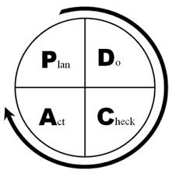
Aiding Accountability through Reporting
    Report Templates
    Reporting Schedule
    Adjust as Necessary
Notes:
Cheryl Malerba
Develop a reporting mechanism to share results with executive leadership at your agency and the Statewide Transformation Steering Committee
Report on a regular basis (monthly, quarterly, annually, etc.) to ensure effective communication and transparency
Make changes to goals or outcomes as necessary

Slide 16
More Than Just Good Business
Asset Management & Performance Measures
Help inform IT & Budget decisions
Results Based Accountability (RBA)
More can get done well
Helps capture institutional knowledge
Helps answer questions for the legislature and your agency’s Executive leadership team
Notes:
Cheryl Malerba
The biggest thrill is how quickly one week can transform a process and a team. The biggest benefit is being able to go in front of the legislature and be able to say with high confidence we know the state taxpayers dollar is being used wisely here and why.

Slide 17
How it Works
OPM may fund your Lean event if it
    Includes any process which touches two or more agencies
    Impacts internal or external customer service
    Is a project directed by OPM or the Governor’s Office
DAS state-wide contract for Lean professional services through June 30, 2015
Notes:
Cheryl Malerba
DAS contract available for all to pull off of for in-house Leans. OPM contract for use until funds end and is especially suited , but not limited to interagency opportunities
We must rely on professional services for Lean facilitation and related trainings/coaching until we have the internal State capacity to move this initiative forward on our own. The Statewide Process Improvement Steering Committee is actively identifying ways in which we can build internal capacity at the lowest cost possible.

Slide 18
How it Works
Applications for OPM funding to support your Kaizen event
  LeanCT website
2014-2015 Statewide Kaizen Calendar
  Role of Host Agency
  Responsibility of Lean team
Notes:
Cheryl Malerba
Let us know how we can support your agency. We will come out and meet with your management team, we will facilitate project scope discussions, we will let you place a team at one of our events. We will let you sit in on our events to learn about them. We will coordinate training with you.
A ‘Host Agency’ books an event at their facility and coordinates resources for the events
The host agency has first pick at filling the Kaizen events, however, if the agency does not have available teams that space will be made available to other agencies
Teams should be selected and fully committed at least a month in advance of booking date

Slide 19

How it Works
However…
  Lean tools can be used in a one-hour meeting
  “Mini” Lean events that take a few hours or a couple of days can be just as effective as 5-day Kaizen
  Lean is simply a common sense approach to problem-solving
  There is no “one-size fits all” method
Notes:
Cheryl Malerba
As long as your staff is supported to think differently/think critically about their work, change will occur.

Slide 20
Challenges
Gaining and maintaining commitment
  Lean basic training sessions will engage employees, set expectations and foster success in Lean Kaizen events
  Ensuring buy-in from all levels: from the bottom-up and from the top-down
Sustaining Lean over “generations”
  Not “flavor of the month”
Notes:
Alison Fisher
HOW you address these challenges will differ depending on your agency’s available resources and culture. Please do what you can to ensure long-lasting interest in positive change.
If you need support in doing so, please partner with your agency’s Lean Coordinator and reach out to any member of the Statewide Steering Committee for ideas.

Slide 21
Observations
Management support is critical
Select projects that will result in “quick wins”
Be fully engaged and allow change
Encourage experimentation as much as resources allow
Coordinate efforts with others : other programs, other staff, other agencies
Involve staff at all levels
Acknowledge and support the work of the team members, team leader, stakeholders, and staff
Focus on what you can change
Notes:
Alison Fisher
Transition to agency presentations : DECD, DOC, DCF, DEEP and DOT – in that order – 10 minutes each

Slide 22

DECD: Enterprise Zones
November 2013
Objective/Charter:
Document the complete process and streamline it. Identify opportunity for training.
Opportunity Statement:
The process is cumbersome, has many handoffs and it does not a have a uniformed workload during the year.
New participants have not been trained, towns not sure where to get information.
Connecticut Department of Economic and Community Development
Notes:
Ed Bona-Malwal – 10 minutes

Slide 23
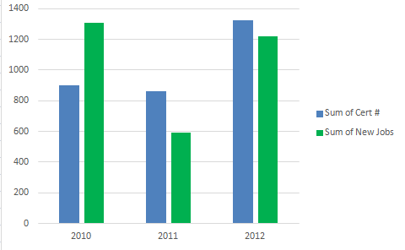
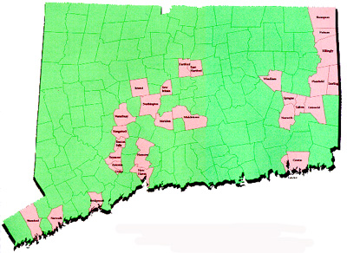
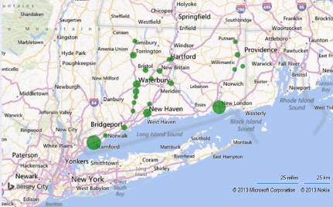
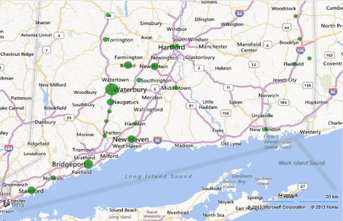
DECD: Enterprise Zones
November 2013
Visual Stream Mapping – Number of Steps
Metrics/KPIs
CT E/Z and Corridors
Type of Process | Pre-event | Post-Event
Value Added | 5 | 4
No value but Necessary | 7 | 4
No value | 4 | 0
Waiting | 12 | 2
Transport | 7 | 1
Totals | 35 | 11
Job Location
Certification Location
Connecticut Department of Economic and Community Development
Notes:
Ed Bona-Malwal

Slide 24
DECD: Enterprise Zones
November 2013
Major findings:
Pre-application and application serve same purpose, therefore, can be combined.
Assessors use different forms. During next Town Assessors Survey, the goal is to evaluate the forms and eliminate any forms that create waste.
The plan:
3 Months
Combine apps
Quarterly Meetings
6 Months
Town assessor survey
12 Months
Reduce the processing time by three weeks
Connecticut Department of Economic and Community Development
Notes:
Ed Bona-Malwal

Slide 25
DECD: Enterprise Zones
November 2013
Results:
Team consisting of towns, OPM and DECD mapped process and streamlined it. Identified follow-up items to be completed.
Pre-application eliminated, wait time reduced from 12 days to 2 days, database of EZ information competed and uploaded onto DECD website, quarterly training meetings started March 2014.
Connecticut Department of Economic and Community Development
Notes:
Ed Bona-Malwal

Slide 26


Employee Engagement
Connecticut Department of Correction
Notes:
Cheryl Cepelak – 10 minutes
How has Lean “taken off”?
Present on DOC’s Lean journey
How did it start?
Where is it now?
How did you get from A to B?

Slide 27


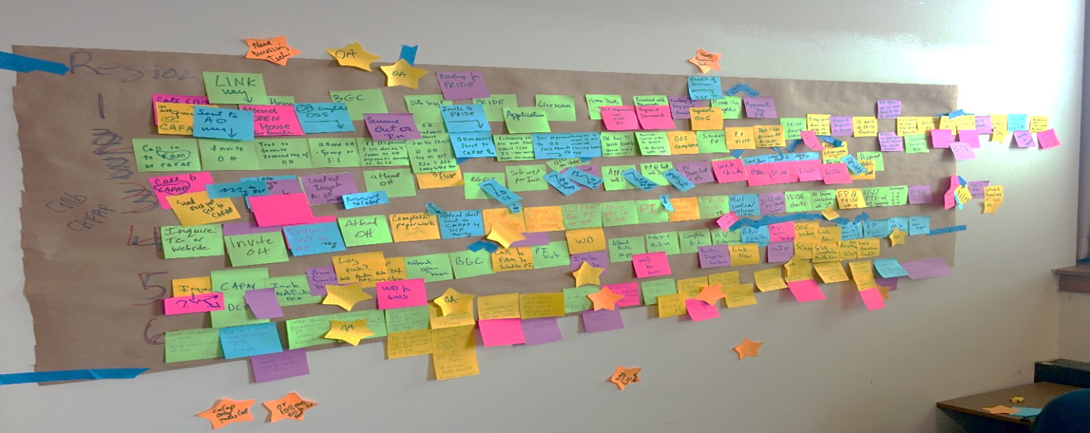
Current Stream Mapping by Region
Regions vary in their licensure process
  2 of the 6 regions do not utilize CAFAP for inquiries
  Staffing utilization discrepancies
  Documentation/Forms varies between regions
  Target populations vary
  Availability of PRIDE (wait time up to 3 months)
  Supervisory and Managerial approval process
Notes:
Pam Kelley – 10 minutes
Started our mapping and realized that everyone was doing different. So we started with our regional mapping (6 regions, 14 area offices, 17 Partner Agencies)

Slide 28
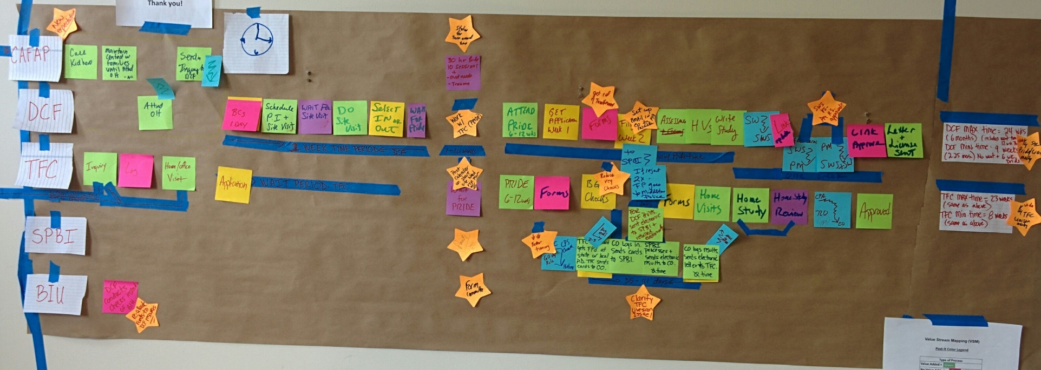
Future Stream Mapping
6 Regions will have standardized process from inquiry to licensure
  All 6 Regions will utilize CAFAP services as contracted from inquiry phone call to attendance at Open House
Family will not wait more than 2 weeks to be offered a PRIDE class to attend OR Schedule Pride classes every 2 weeks
  Offer a consolidated PRIDE (ie: 2 times per week or all day Saturday)
Standardize and reduce number of forms
Reduce the wait time for background checks
Full of use of enhanced technology
Expedite the approval process for final licensure
Notes:
Pam Kelley
Then we decide how to standardize and work together to benefit the families.

Slide 29

Current Stream Mapping
Department of Emergency Services and Public Protection
  Two divisions perform criminal background checks
    SPBI (up to 35 days to return)
      State and Federal fingerprint supported criminal history checks
    BIU (2 to 5 months to return)
      Local PD
      State Criminal History
      State Police Activity
      Sex Offender
      DMV
      Weapons Permit
      Department of Corrections
Notes:
Pam Kelley
Biggest barrier was eliminated by bringing all the stakeholders together and realizing we were all doing same thing! We had same access to BGC and the memo was written 25 years ago (pre-internet)
29

Slide 30

Future State
LICENSURE PROCESS REDUCED FROM
6 - 9 MONTHS TO 3 - 4 MONTHS
  Standardize and oversight of licensing process
  Standardize and oversight of forms and any proposed changes
  Shorter wait times for families starting PRIDE
  Shorter wait time for criminal checks up to 80%
  Money saved by elimination of BIU MOU
  Positive recruitment and retention outcomes
  Increase satisfaction for foster parents, children and staff
Notes:
Pam Kelley
If we do all LEAN recommendations then we get this!
Team dynamic were interesting as every one had own way and it took a day or so to be reminded that the consumer isn't us but the families. What adds value to them not us! But we got there and as the week went on the nay sayers were believers and champions for change.
A-Ha moments were the back ground checks and that we do them from our computer and the memo that out them in place was signed pre internet!
I would have changed that managers of the staff involved had to come to stakeholders day and the end to see the plan and to see the work their staff did.

Slide 31
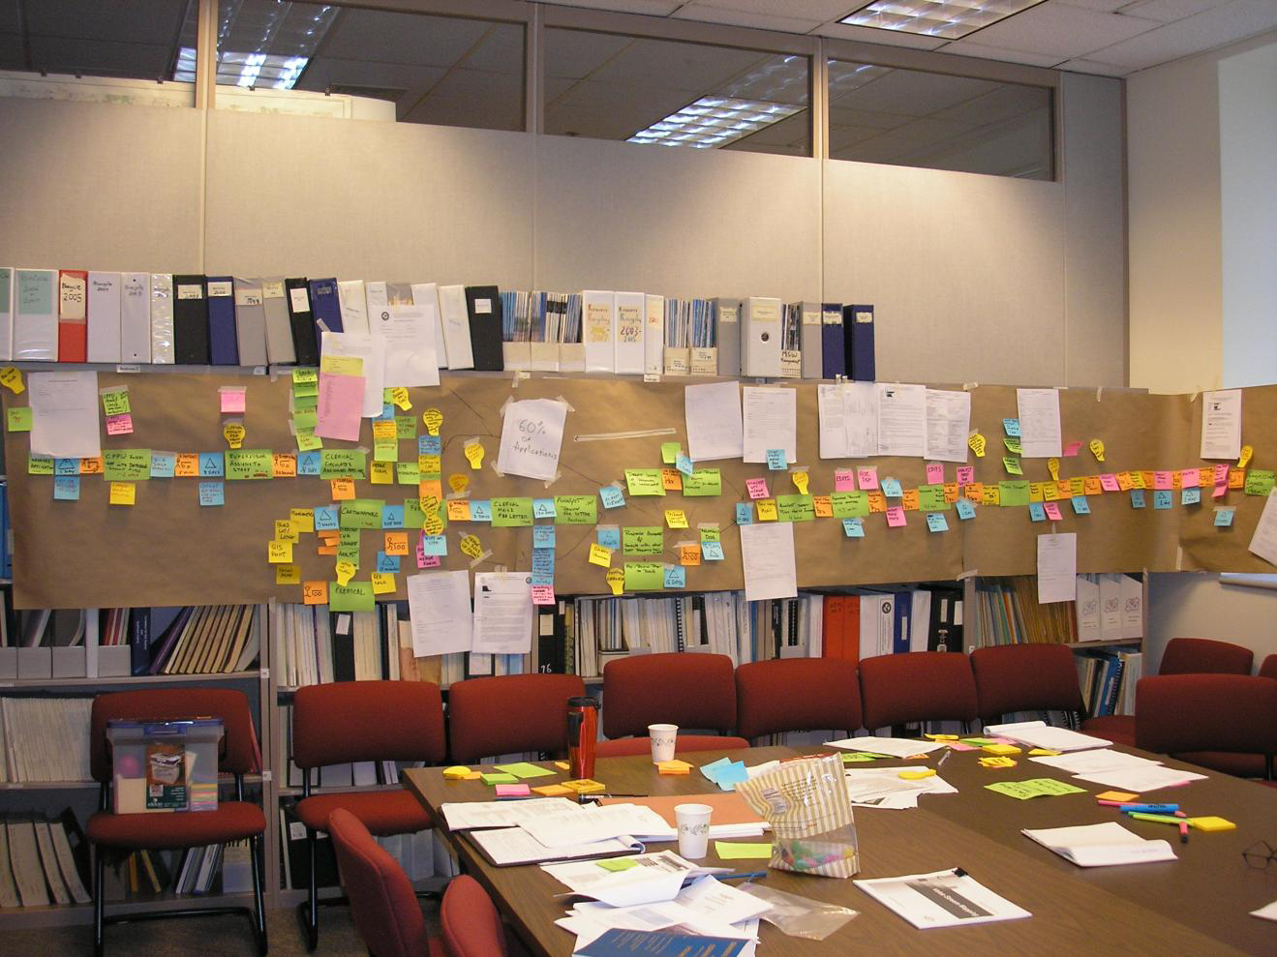

Current State – Endless Rework
Connecticut Department of Energy and Environmental Protection
Notes:
Jeff Caiola – 10 minutes

Slide 32
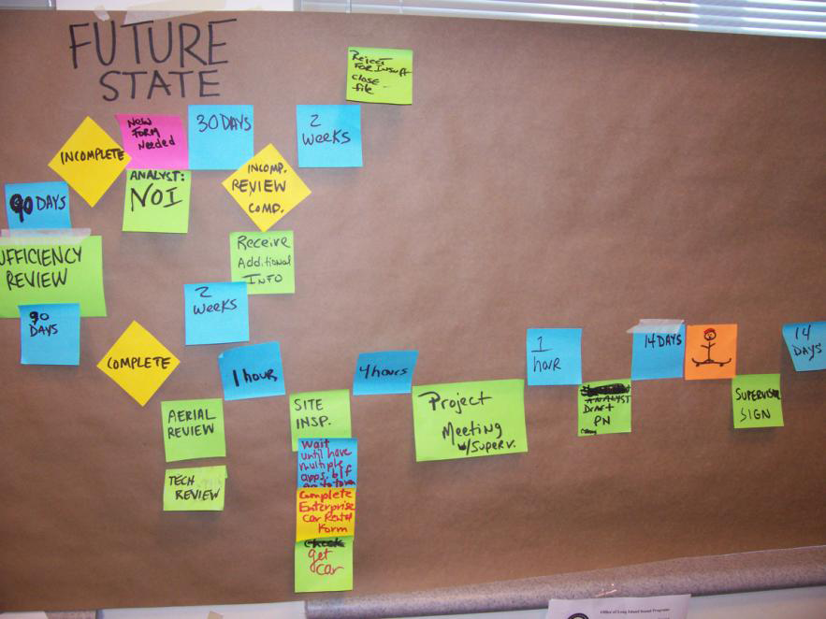
Future State – Eliminate Re-work
Connecticut Department of Energy and Environmental Protection
Notes:
Jeff Caiola

Slide 33
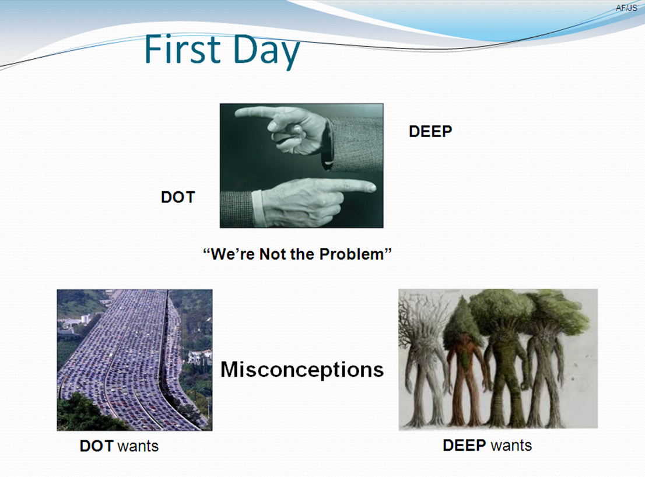
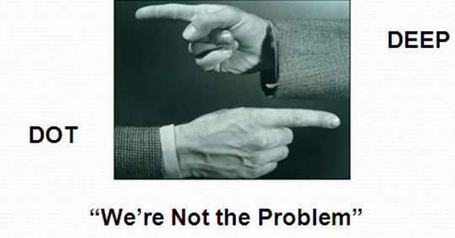
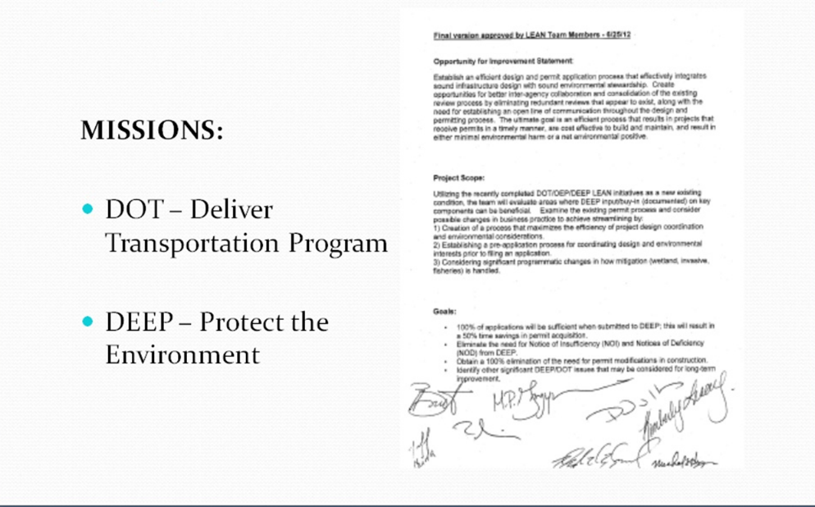
Interagency - Communication
Connecticut Department of Energy and Environmental Protection
Notes:
Jeff Caiola

Slide 34
Permit Processing Times Have Been Reduced
Connecticut Department of Energy and Environmental Protection
Notes:
Jeff Caiola
KPIs permitting – standardized: % backlog reduced; quality of permit applications – % complete applications; reduces processing times

Slide 35


Role of a Manager
Connecticut Department of Transportation
Notes:
Scott Hill
Why is Lean important?
For the agency
For staff (can focus on what they were hired to do)
For the manager (can finally work ON the business)
For the state
What is the manager’s responsibility?
Carry-out directive from Commissioners/Governor
Support staff to be successful
Move the agency forward
Use available resources as efficiently as possible

Slide 36
For more information on
Continuous Improvement in
Connecticut State Government please visit: www.ct.gov/LeanCT
Notes:
Alison Fisher
Additional information including tools, helpful hints, event information, and our contact information can be found on the LeanCT website.
Thank you so much for your interest in promoting Lean within your agency and in improving service to CT residents. If you haven’t yet started your agency’s Lean journey, we hope you will! If you’re already managing your agency’s Lean efforts, thank you so much for all you’ve done and we are so honored to continue to work with you!
Questions?

