Slide 1
COUNCIL ON ENVIRONMENTAL QUALITY
Using Templates to Develop Notices for the Environmental Monitor
November 18, 2019

Slide 2
COUNCIL ON ENVIRONMENTAL QUALITY
Why Publish in the Environmental Monitor? CEPA + RCSA
Sec. 22a-1a-5. | (b) Adoption and amendment of agency-specific environmental classification documents.
Sec. 22a-1a-6. | (e) Public scoping notice, or (f) Public scoping meeting.
Sec. 22a-1a-7. | (a) Post-scoping notice: 1) the agency intends to prepare an environmental impact evaluation (EIE), or 2) Needs more time (six months), or 3) the agency will not prepare an EIE, or the agency has cancelled the project/action.
Sec. 22a-1a-9. | The sponsoring agency shall publish notice of the availability of an EIE.
 | (c) A separate notice of public hearing regarding an EIE.
Sec. 22a-1a-10. | (d) The sponsoring agency shall provide a notice of the record of decision. (e) The Office of Policy and Management (OPM) shall publish its determination of adequacy.

Slide 3
COUNCIL ON ENVIRONMENTAL QUALITY
List of Available Templates:
Scoping Notice
Scoping/Post Scoping - Need More Time
Post-Scoping Notice
EIE - Notice of NEW Public Hearing
EIE Notice
Agency's Record of Decision
(Just OPM) OPM Review of the Record of Decision
Land Transfer Notice (Steps I-V)

Slide 4
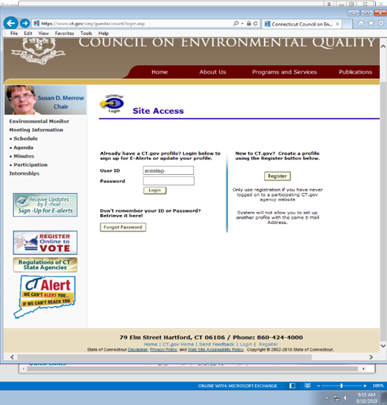
COUNCIL ON ENVIRONMENTAL QUALITY
1) Go to the CEQ website at www.ct.gov/ceq/. In the future, this will change to http://portal.ct.gov/ceq/
2) Go to bottom of CEQ home page and select “Login”. If you don’t have a user name and password, click “Register” to get credentials.
3) Enter credentials (user name and password).
4) Scroll to bottom of CEQ home page and select “Admin”

Slide 5
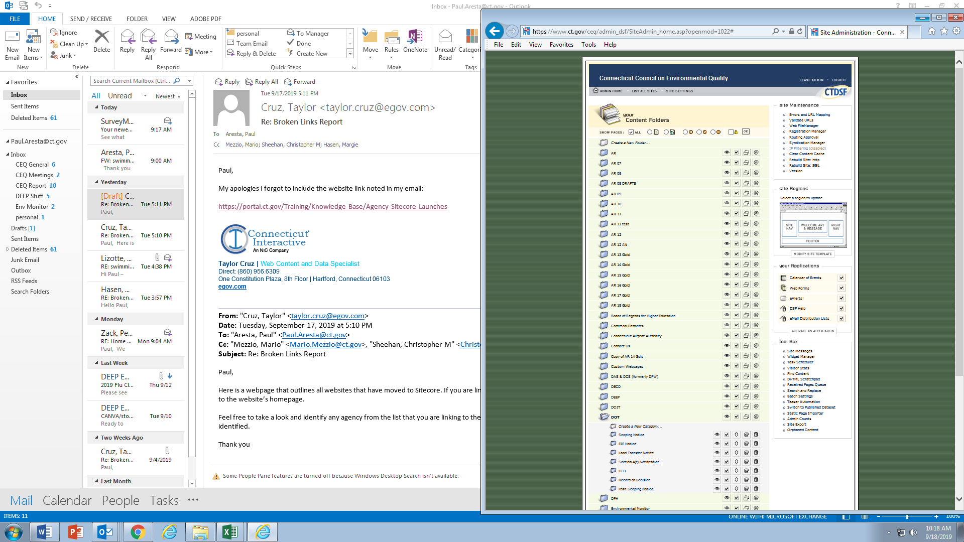
COUNCIL ON ENVIRONMENTAL QUALITY
5) On the “Admin” page under “Content Folders” , select the folder for your respective agency (example. – “DOT”) to see the content.
6) Select the appropriate folder for the type of notice you want to develop (example. – “Scoping Notice”).

Slide 6
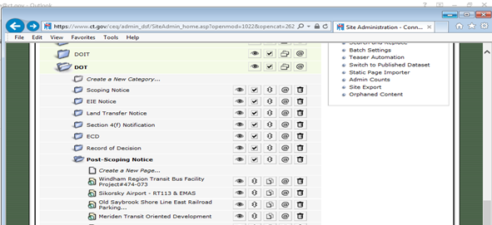
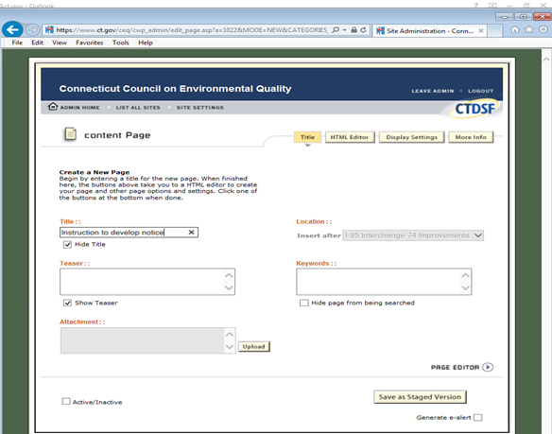
COUNCIL ON ENVIRONMENTAL QUALITY
7) Select “Create a New Page” from directly underneath the folder/category name. It’s the same procedure for any type of notice you want to create.
8) The “content Page” will open. Make sure your in the “Title” tab, then enter the title for the notice in the “Title” field and check “Hide Title”.

Slide 7
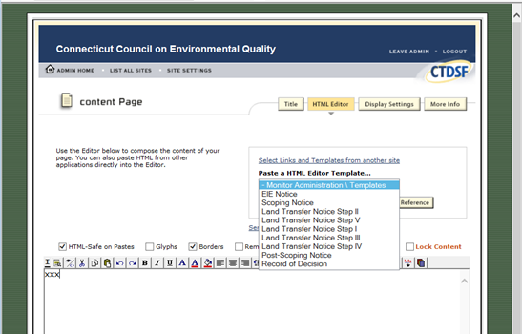

COUNCIL ON ENVIRONMENTAL QUALITY
9) On the same “content Page”, select the “HTML Editor“ tab.
10) Put your cursor in the body of the content page (see “xxx” on page).
11) Click on the drop down list under “Paste a HTML Editor Template” to see the list of possible templates by clicking on “Monitor Administration\Templates”

Slide 8
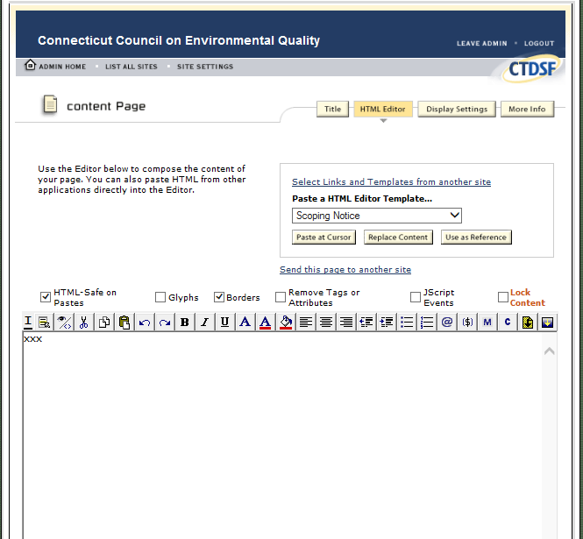
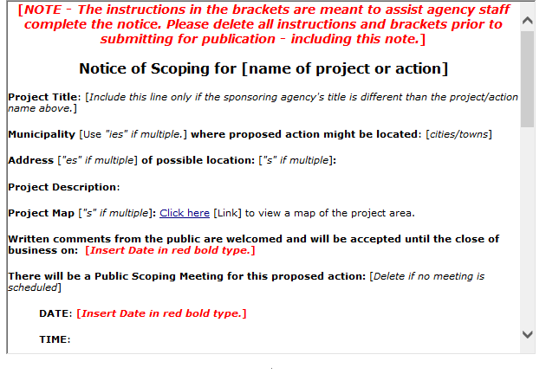
COUNCIL ON ENVIRONMENTAL QUALITY
12) Select the notice template from the drop down list (In this example, it is a Scoping Notice) and then select “Paste at Cursor” tab
13) The text from the template will be inserted into the body of the content page where you has placed the cursor

Slide 9
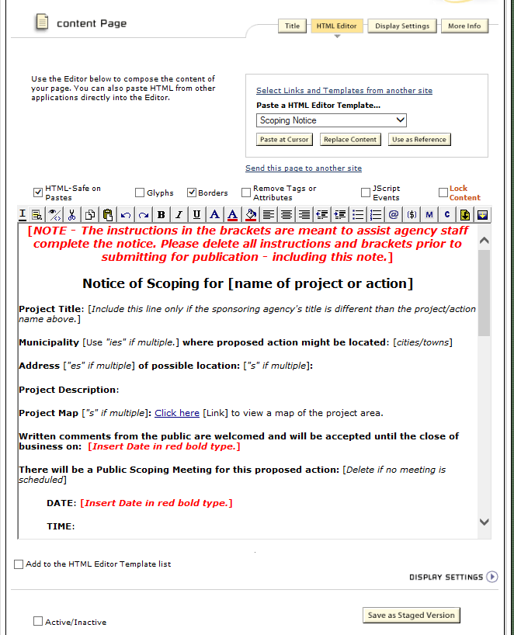
COUNCIL ON ENVIRONMENTAL QUALITY
14) Select “Save as Staged Version” and it will save this new notice as a draft in the folder/category you selected.
15) Use the editor functions to modify the text in the draft “Scoping Notice” for your specific project/action.
It works very similar to MS Word in that you can change or add to the content, make it bold, insert hyperlinks, etc.
The text in [brackets] are a guide. Delete all brackets before publishing.

Slide 10
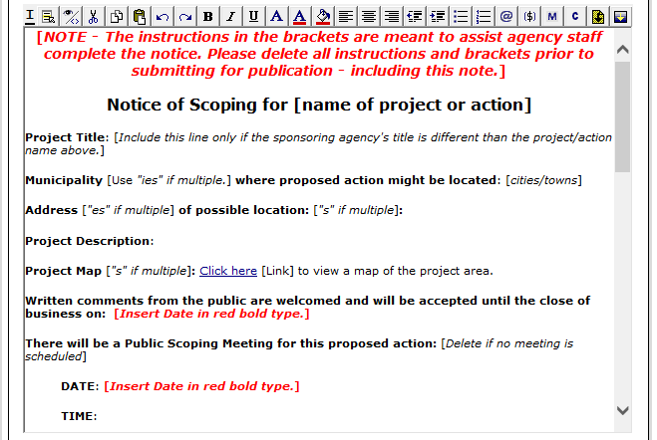
COUNCIL ON ENVIRONMENTAL QUALITY

Slide 11
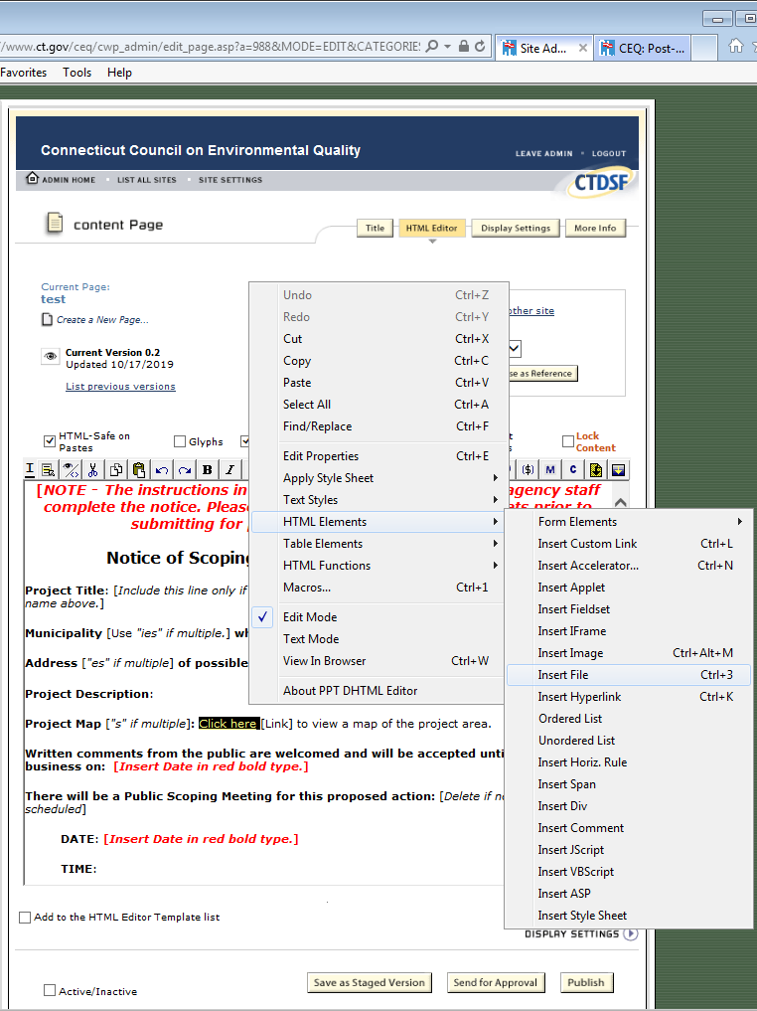
COUNCIL ON ENVIRONMENTAL QUALITY
16) To insert one or more files, it’s a two step process (example – “Click Here”), select the text that will serve as the hyperlink text.
17) Select the “Insert File” button from the editing menu (looks like a yellow piece of paper with a down arrow on it) or you can select the text, right mouse click, select “HTML Elements” then select “Insert File”.

Slide 12
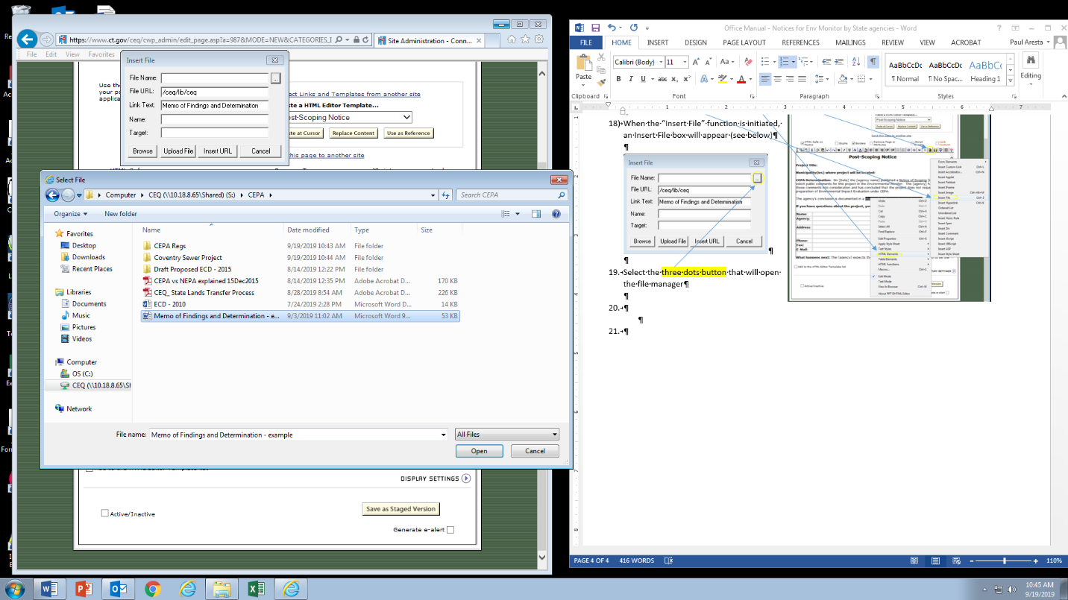
COUNCIL ON ENVIRONMENTAL QUALITY
18) When the “Insert File” function is initiated, an Insert File box will appear (see right).
19) Select the three dots button that will open the file manager.
20) Navigate in file manager (aka “Windows Explorer” if you use Windows), to the appropriate folder where the file exists, select the file, and select “Open”.

Slide 13
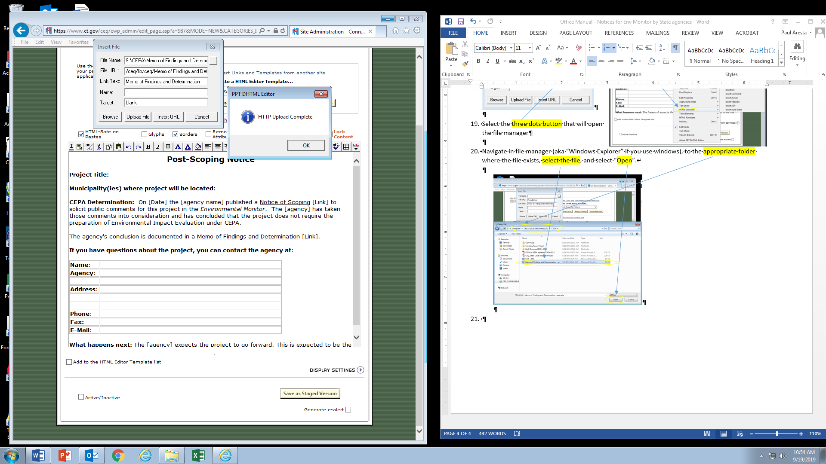
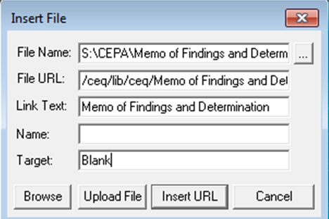
COUNCIL ON ENVIRONMENTAL QUALITY
21) The file name and path will be inserted into the “File Name” field. Select “Upload File” and the file will be uploaded from the local/network file storage to storage on the internet.
22) If the upload is successful, a PPT DHTML Editor window will open and indicate “HTTP Upload Complete”.
23) Type the word “Blank” in the “Target” field and then select “Insert URL” and the selected text will be hyperlinked to the file on the internet.

Slide 14
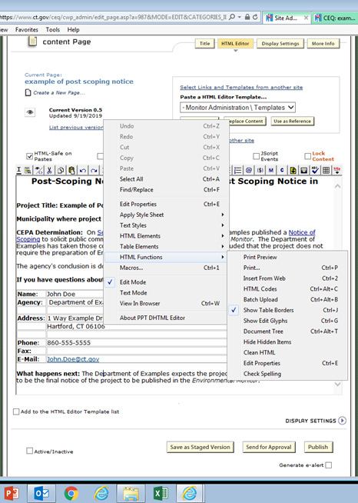
COUNCIL ON ENVIRONMENTAL QUALITY
24) Once all the edits are compete, you can run spell check by selecting the button that has the “ABC” with the check symbol under the letters. Alternatively, right mouse click on the page, select “HTML Functions” and then select “Check Spelling”.
25) To save changes/corrections, select “Save as Staged Version” again to save the most recent changes.

Slide 15
COUNCIL ON ENVIRONMENTAL QUALITY
26) To view how the page will look with an internet browser, select the preview button (looks like an eye) to the left of the “Current Version x”.
Go to the browser tab for the file and double check that all the links work by clicking on them. You can also copy the URL and paste it into another browser like Chrome, Firefox, etc. to see how the page will look to visitors using different internet browsers.

Slide 16
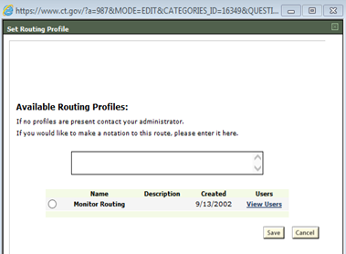
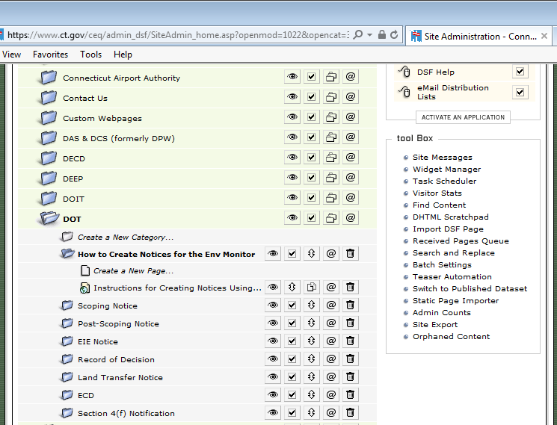
COUNCIL ON ENVIRONMENTAL QUALITY
27) Once the document is ready for publication, select “Send for Approval”. The routing dialog box will open. Complete the required fields and click save.
If you have any questions or issues, refer to the user guide in your agency’s folder “How to Create Notices for the Env. Monitor”, and select file “Instructions for Creating Notices Using Templates”

Slide 17
COUNCIL ON ENVIRONMENTAL QUALITY
Questions?

Slide 18
COUNCIL ON ENVIRONMENTAL QUALITY
Contacts:
Peter Hearn, Executive Director
Peter.hearn@ct.gov
860-424-4000
Paul Aresta, Environmental Analyst II
Paul.Aresta@ct.gov
860-424-4000
Thank You

